Slide 1
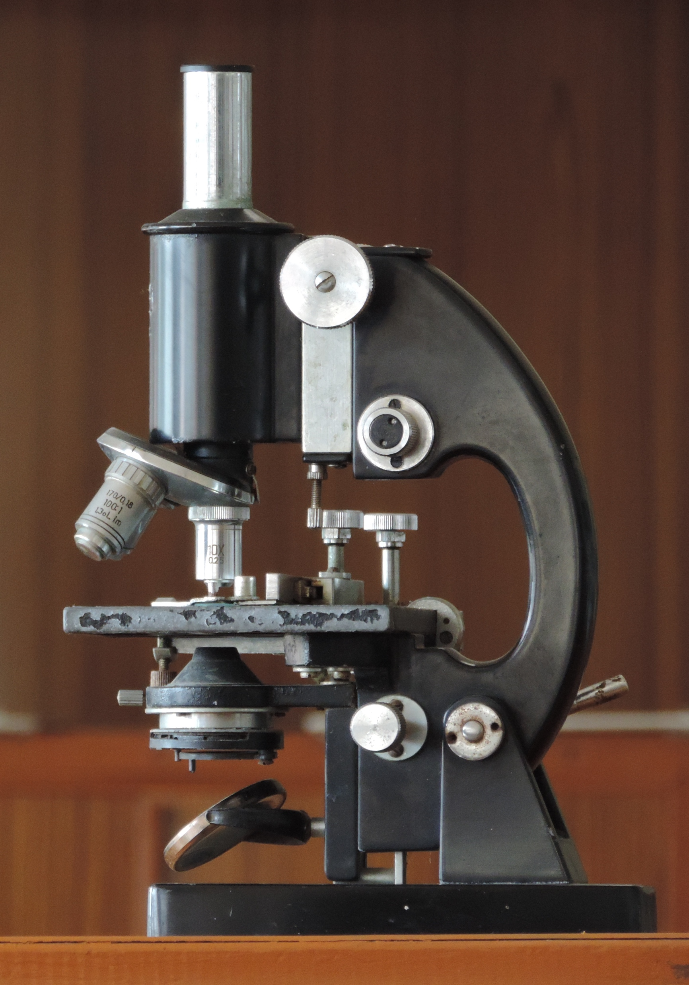
GERM THEORY
By Acagastya (Own work) [CC BY-SA 4.0 (http://creativecommons.org/licenses/by-sa/4.0)], via Wikimedia Commons
Notes:
Hello. Can you hear me OK? Let me jump right in for a moment.
Pause a moment
A great deal of our healthcare knowledge was built up from tools such as the microscope, the petri dish, and germ theory.
Ignore following:
For microscopes see https://en.wikipedia.org/wiki/Microscope --early 1600s
The germ theory of disease states that many diseases are caused by microorganisms. These small organisms, too small to see without magnification, invade humans, animals, and other living hosts. Their growth and reproduction within their hosts can cause a disease.
From wikipedia:
The germ theory was proposed by Girolamo Fracastoro in 1546, and expanded upon by Marcus von Plenciz in 1762. Such views were held in disdain, however, and Galen's miasma theory remained dominant among scientists and doctors. The nature of this doctrine prevented them from understanding how diseases actually progressed, with predictable consequences. By the early nineteenth century, smallpox vaccination was commonplace in Europe, though doctors were unaware of how it worked or how to extend the principle to other diseases. Similar treatments had been prevalent in India from just before 1000 A.D.^{[2]} ^{[N 1]} A transitional period began in the late 1850s as the work of Louis Pasteur and Robert Koch provided convincing evidence; by 1880, miasma theory was struggling to compete with the germ theory of disease. Eventually, a "golden era" of bacteriology ensued, in which the theory quickly led to the identification of the actual organisms that cause many diseases.^{[3][4]} Viruses were discovered in the 1890s.

Slide 2
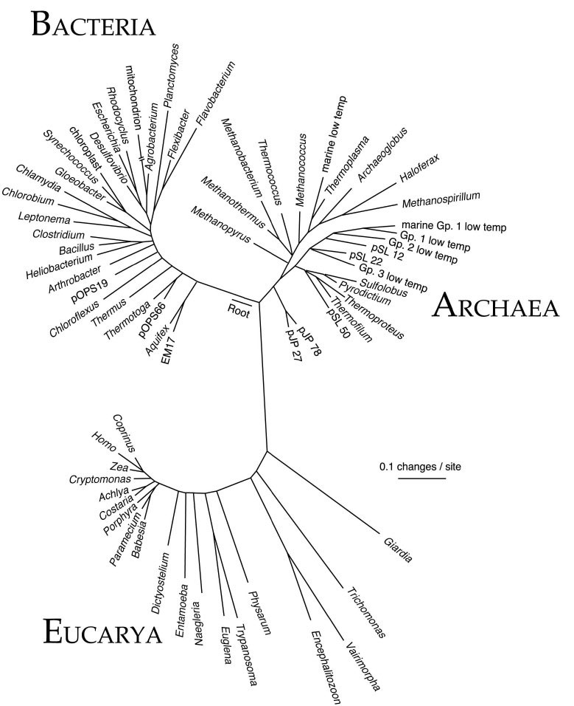
Green 2014
Notes:
A] These tools are still invaluable but we have another set of tools available to us now: high-throughput NGS, bio-informatics and lots of computing power.
B] These let us build an understanding of microbial ecology

Slide 3
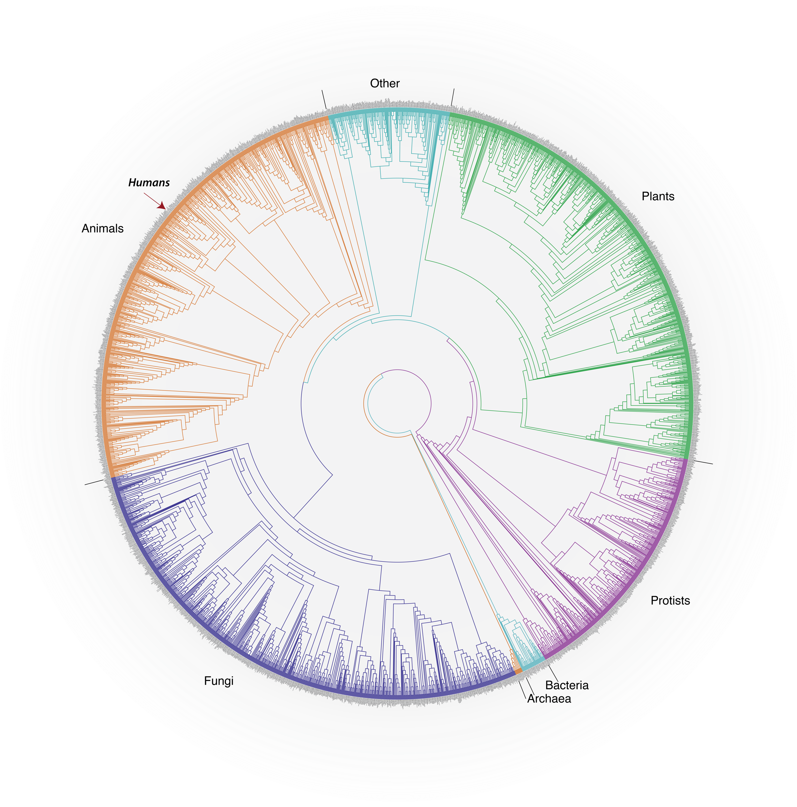
33%
GHG
90% inside
https://www.epa.gov/ghgemissions/sources-greenhouse-gas-emissions
Klepeis, N. E., et al. (2001). The National Human Activity Pattern Survey (NHAPS): a resource for assessing exposure to environmental pollutants. Journal of Exposure Analysis and Environmental Epidemiology, 11(3), 231–52. http://doi.org/10.1038/sj.jea.7500165
Notes:
A] These tools have helped expose the importance of the human microbiome, the community of microbes in and on us, to our personal health and well-being. Pathogenic, commensal, or mutualistic, microbes have been linked to immune function, behavior, cancer, obesity, autism and others.
B] What about the built environment microbiome?
C] We spend > 90% of our time in buildings or vehicles. We know very little about microbial ecology though. (this is a representation of the tree of life I’ll come back to later)
D] At the same time, those buildings, at least in the US, consume about 40% of our energy and produce about 33% of GHG emissions that are altering our climate systems.

Slide 4
33%
90%
Energy Design
Health Design
Natural ventilation
Daylighting
Other load reduction strategies
Pathogens and allergens
Antibiotic resistance
Probiotic ecologies
Notes:
4A] The effects of climate change on the health of the planet and individuals is and will be increasingly be tremendous. These include increased heat stress events, extreme weather events, wildfires, and increased duration and severity of pollen seasons. Food and other agricultural crops will be impacted as well, creating secondary downstream impacts on our lives.
4B] So, we know little, microbially-speaking, about the buildings that we spend so much time in and the design and operation of those buildings share a substantial responsibility for many health impacts we are facing due to climate change. With the potential for insights into individual health, perhaps microbial ecology can also provide impetus for buildings that have a lighter impact on planetary health.
Ignore; from the National Climate Assessment “ Americans are noticing changes all around them. Summers are longer and hotter, and extended periods of unusual heat last longer than any living American has ever experienced. Winters are generally shorter and warmer. Rain comes in heavier downpours. People are seeing changes in the length and severity of seasonal allergies, the plant varieties that thrive in their gardens, and the kinds of birds they see in any particular month in their neighborhoods.
Other changes are even more dramatic. Residents of some coastal cities see their streets flood more regularly during storms and high tides. Inland cities near large rivers also experience more flooding, especially in the Midwest and Northeast. Insurance rates are rising in some vulnerable locations, and insurance is no longer available in others. Hotter and drier weather and earlier snow melt mean that wildfires in the West start earlier in the spring, last later into the fall, and burn more acreage. In Arctic Alaska, the summer sea ice that once protected the coasts has receded, and autumn storms now cause more erosion, threatening many communities with relocation. “

Slide 5
Microbiology of the Built Environment: New Interfaces
Harvard Healthcare Symposium 2017
May 31, 2017
Jeff Kline, University of Oregon
The Biology and the Built Environment Center
Microbiologists, Evolutionary Ecologists, Bioinformaticians
Architects, Building Scientists, Mechanical Engineers
Notes:
I'm here from the Biology and the Built Environment Center at the University of Oregon. Founded with support from the Alfred P. Sloan Foundation, we have vision is to develop a hypothesis-driven, evidence-based approach to better understand the microbiome of the built environment (MoBE) and to use this knowledge to optimize the design and operation of the built environment to promote both human health and environmental sustainability.
My background is on this side of the center.
We’ll take a high-level look at several past projects to give you a flavor for what we do and how they might eventually address this dual vision of human health at the microbial and planetary scales. If time allows we’ll also look at a couple ongoing projects.

Slide 6
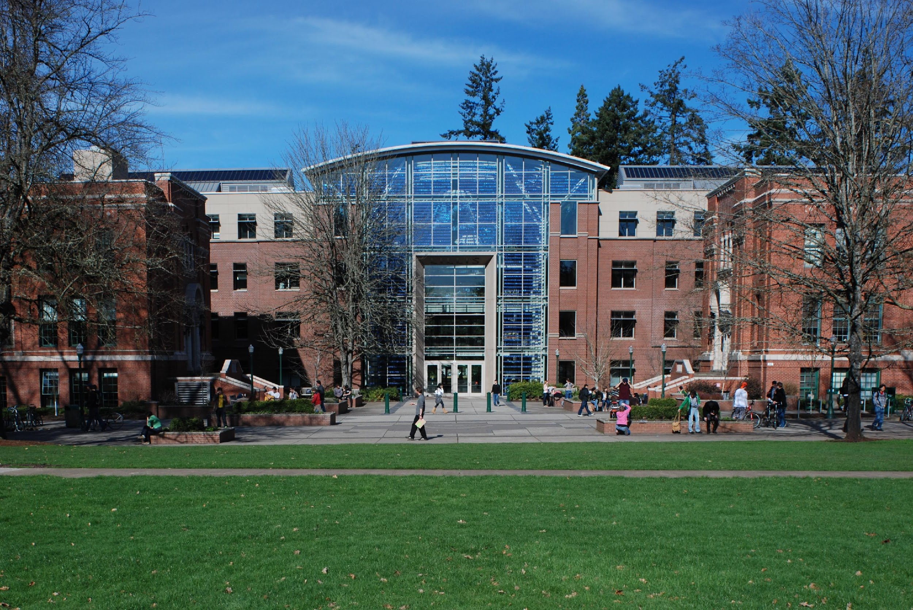
45% better energy performance than code at time of construction
Notes:
A] I have a story that illustrates how a building can act as a link between sustainability and MB research.
B] Some years ago the Energy Studies in Buildings Lab (the architecture side of BIOBE) was a member of the design team for this building at the University of Oregon. The was for the School of Business and they were very interested in a building that embodied the school’s focus on sustainability. Named Lillis Hall, it was completed about 12 years ago.
This is the south façade, Lillis in the middle and 2 flanking buildings on the sides. There is a central atrium and wings to either side.

Slide 7
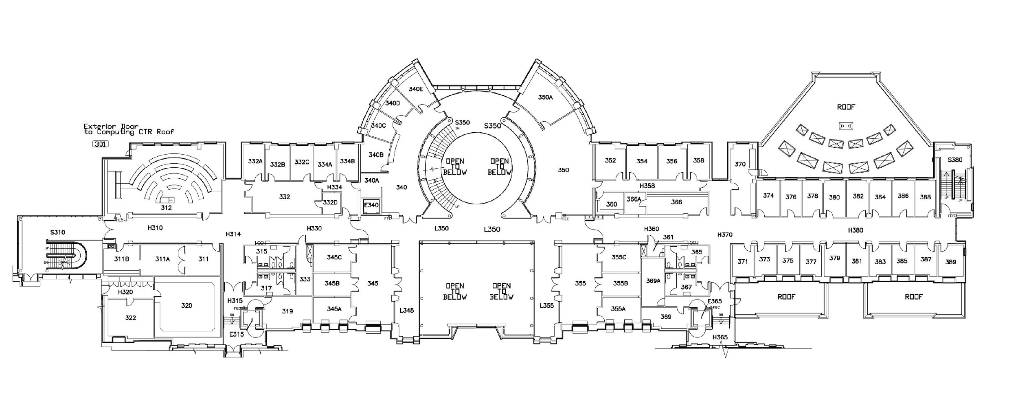
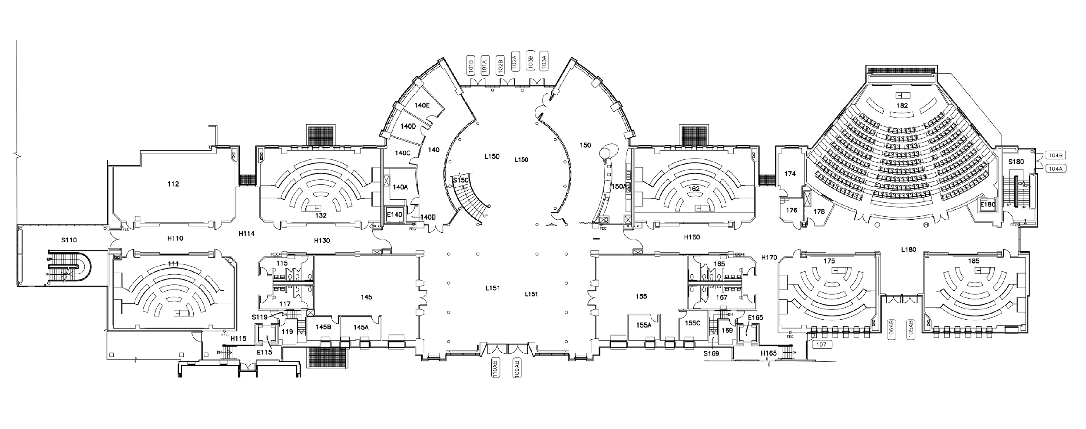
Floor 3, floor 4 similar
Floor 1, floor 2 similar
Notes:
This building has a clear organization of spaces and HVAC systems.
It incorporates daylighting and natural ventilation including a hybrid stack vent system, and night ventilation of mass for cooling.

Slide 8
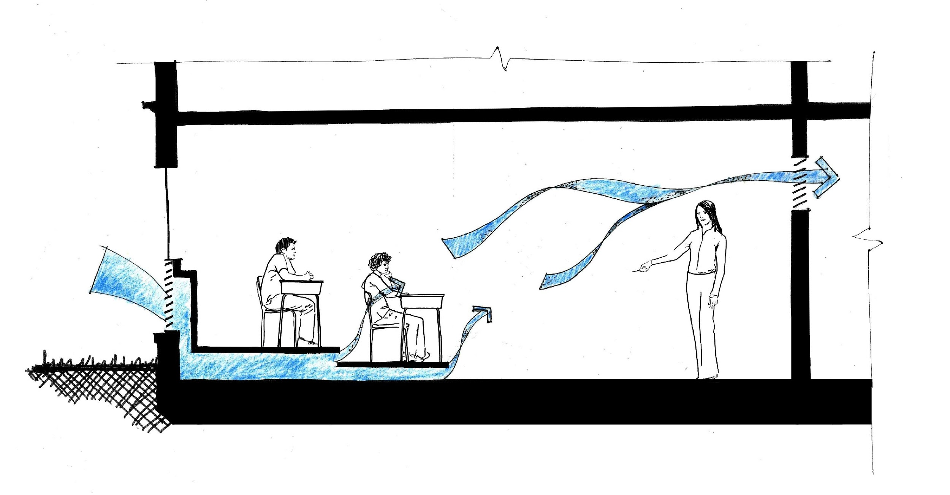
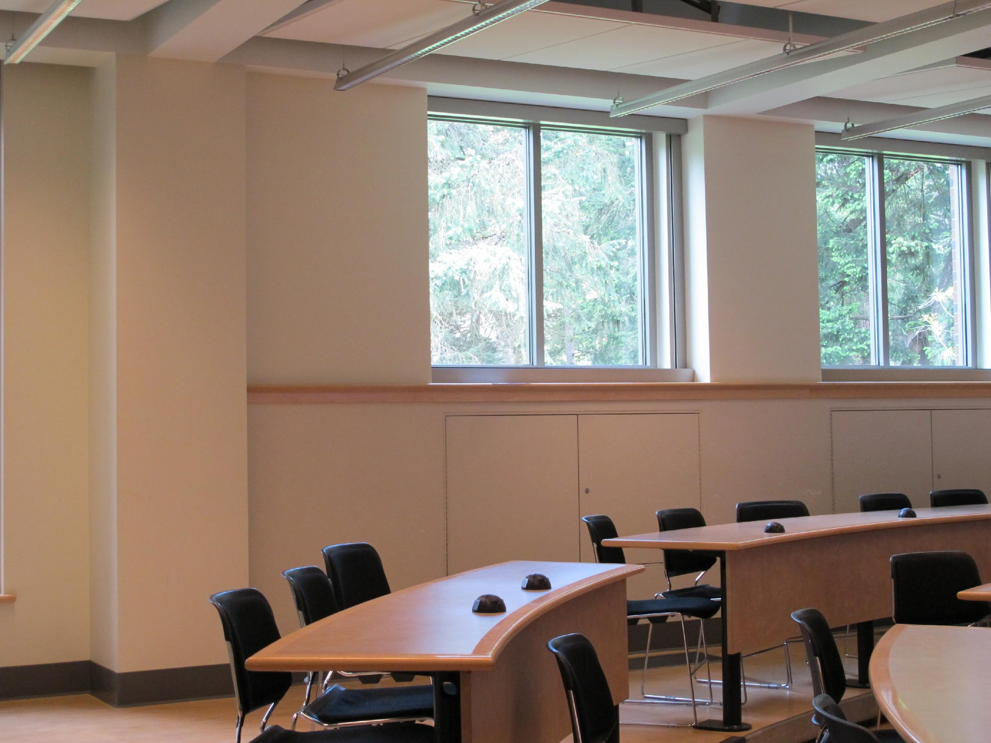
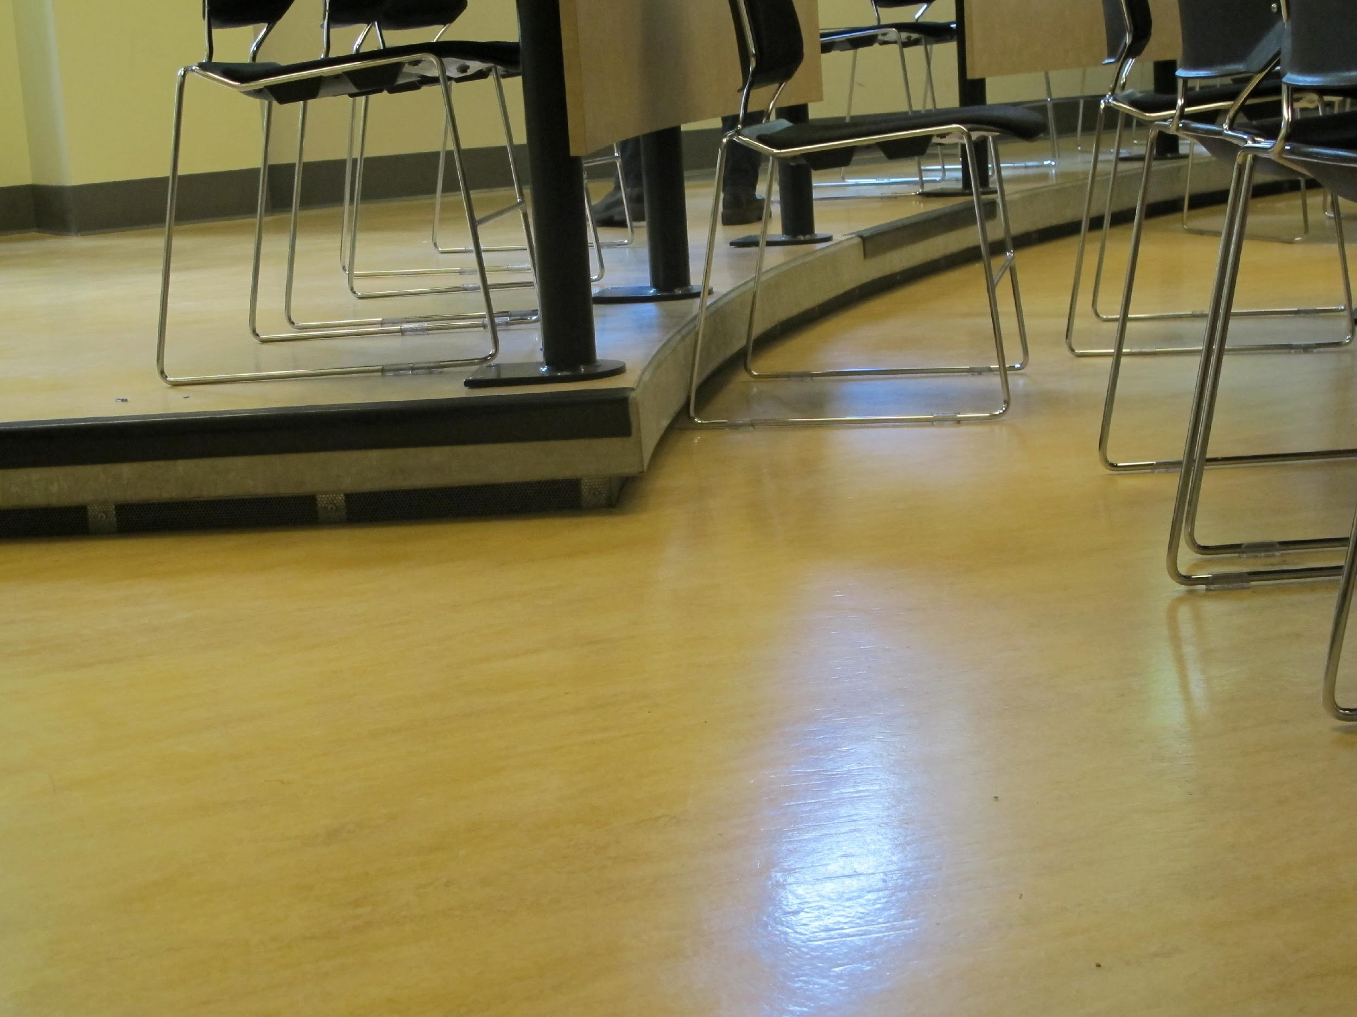
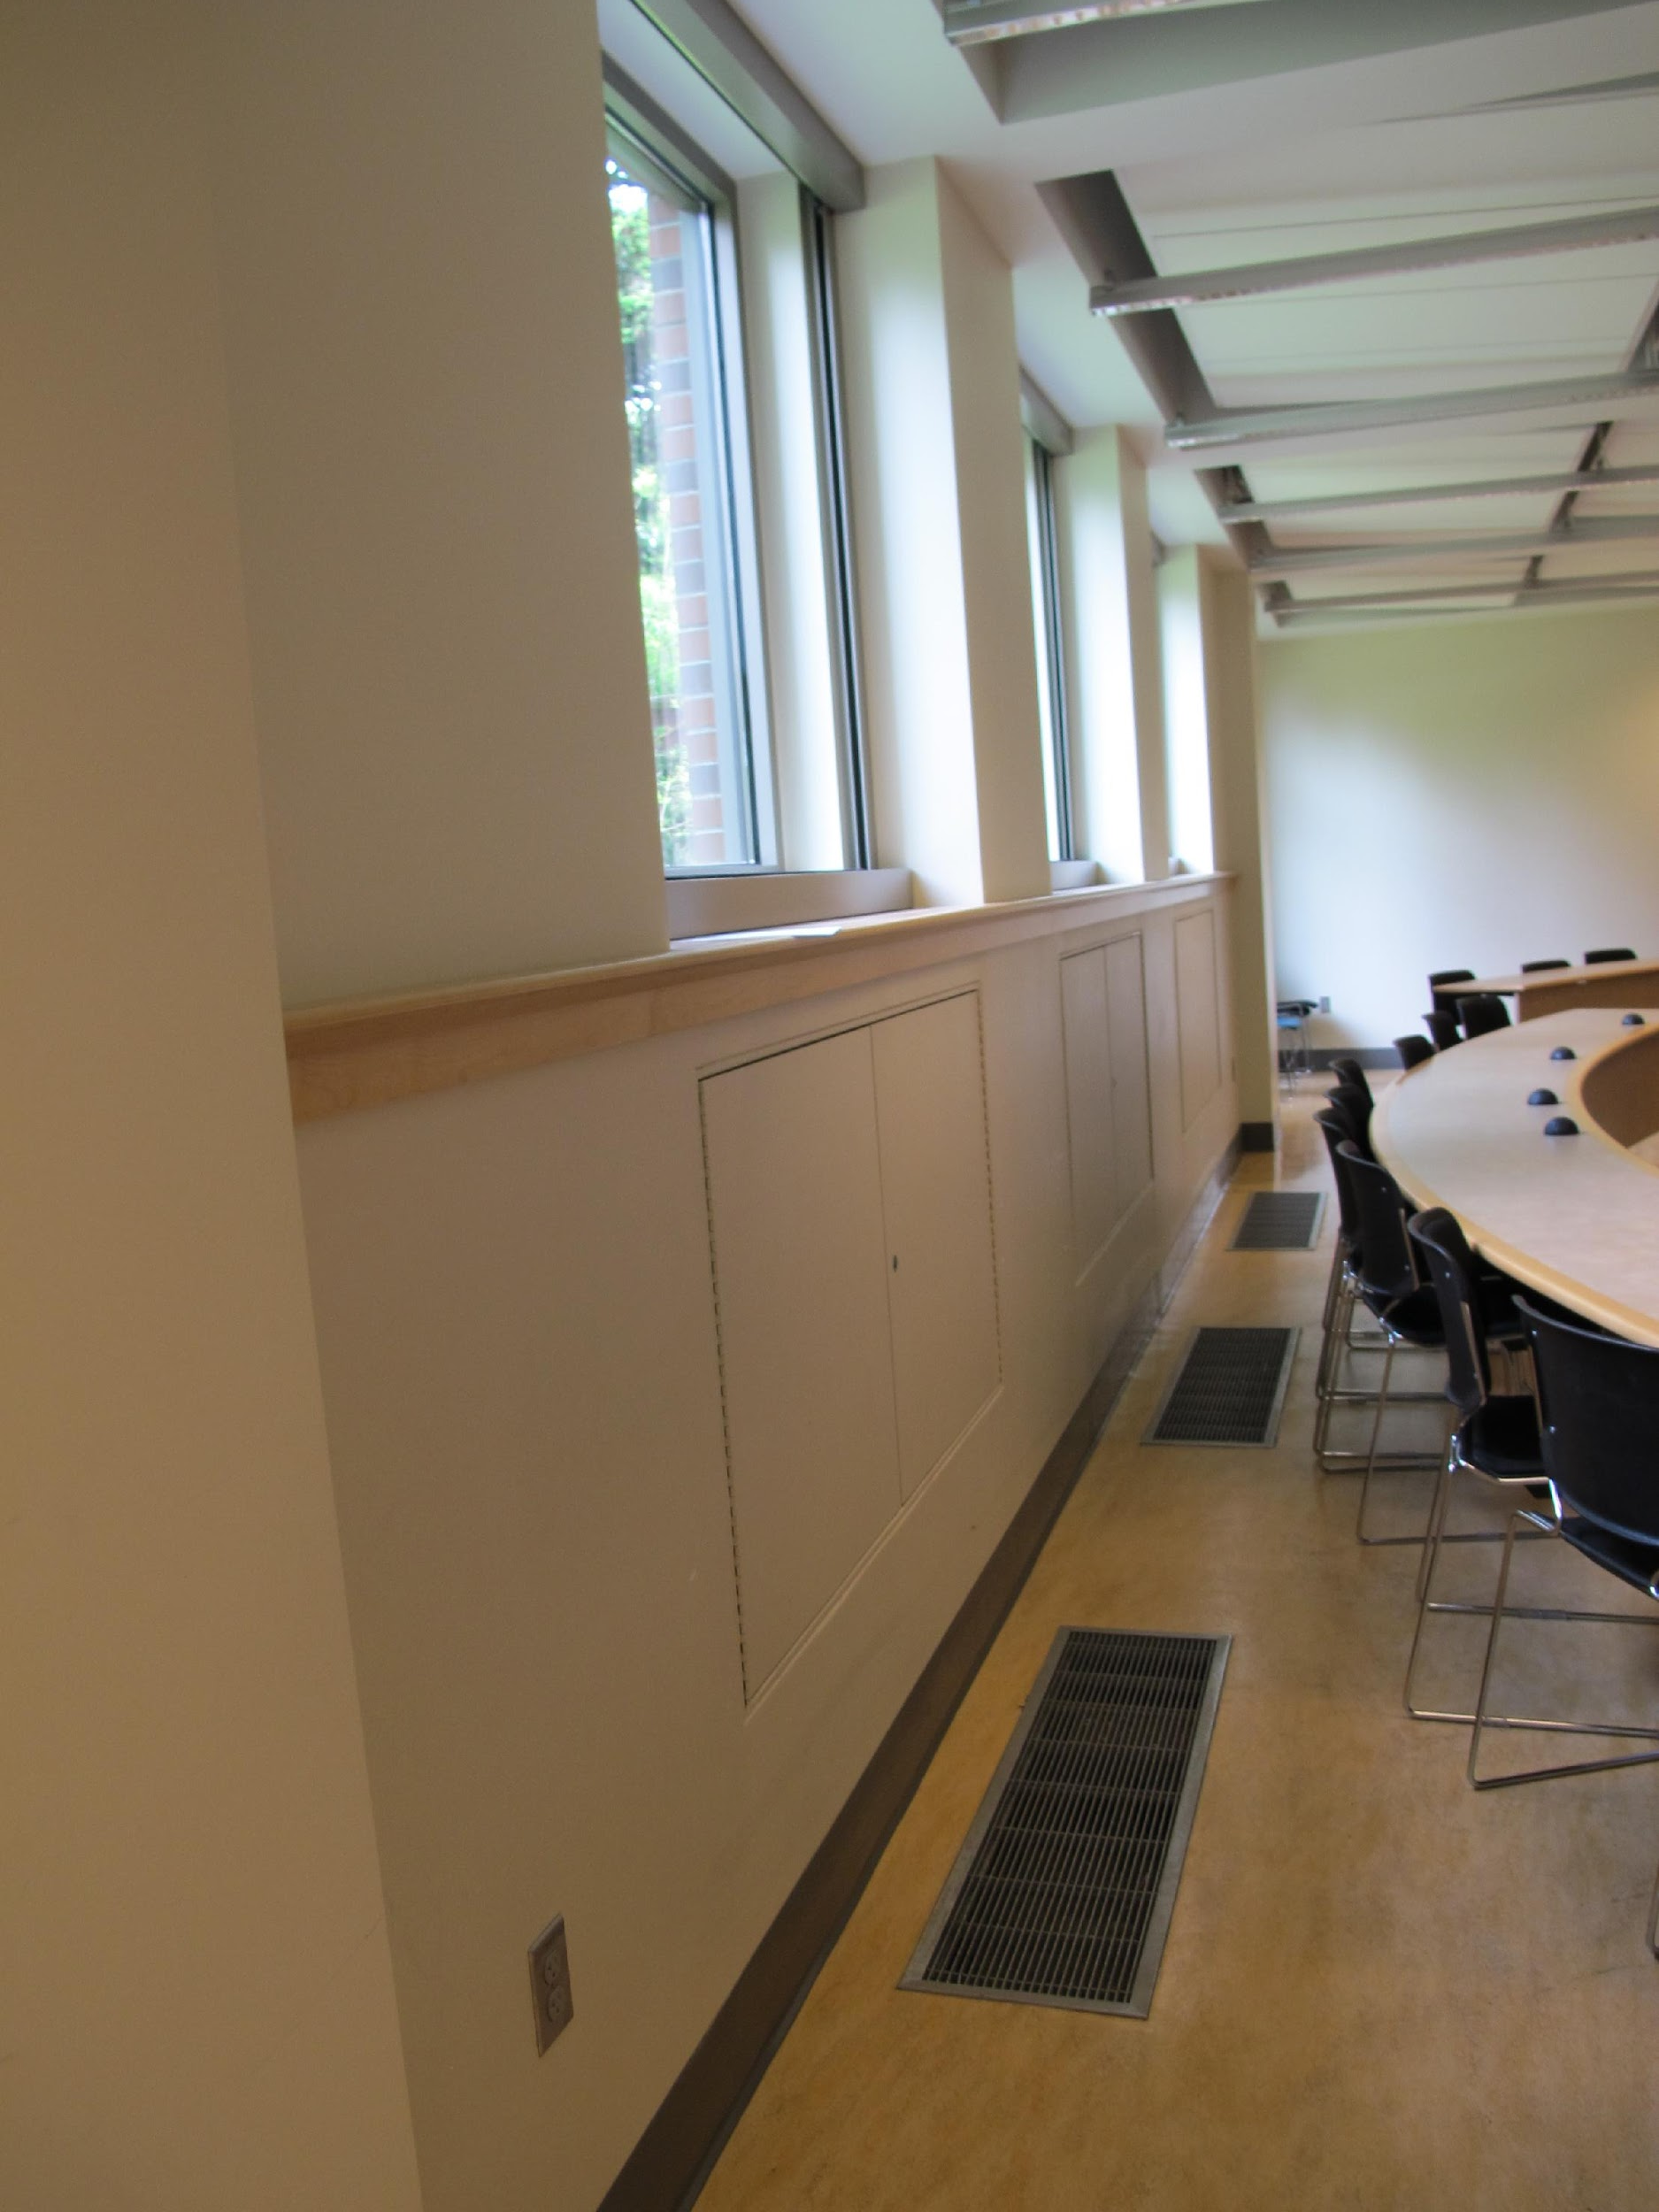
Notes:
This is a diagram of a typical classroom. Daylight falls over the shoulders of students while fresh air enters through a system of louvers to an underfloor plenum.

Slide 9
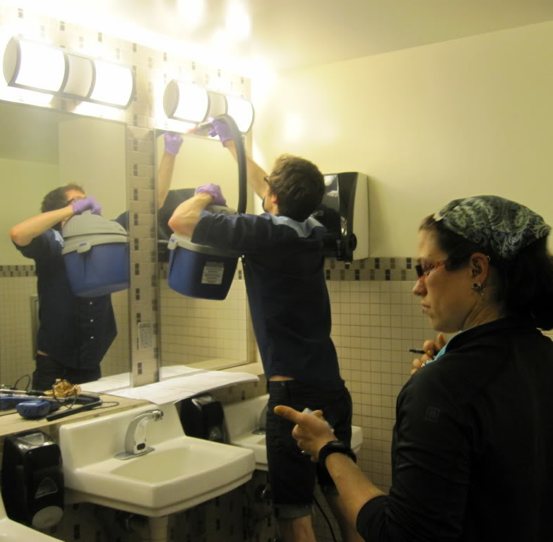
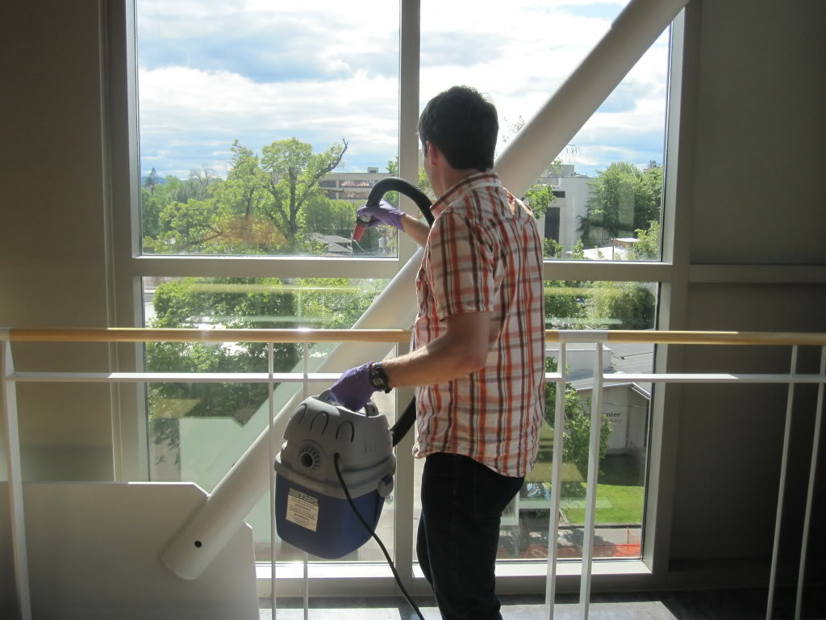
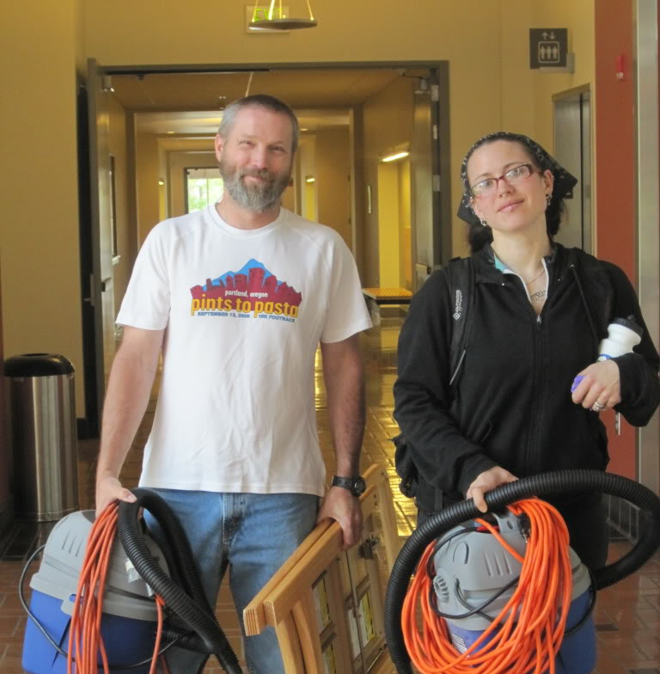
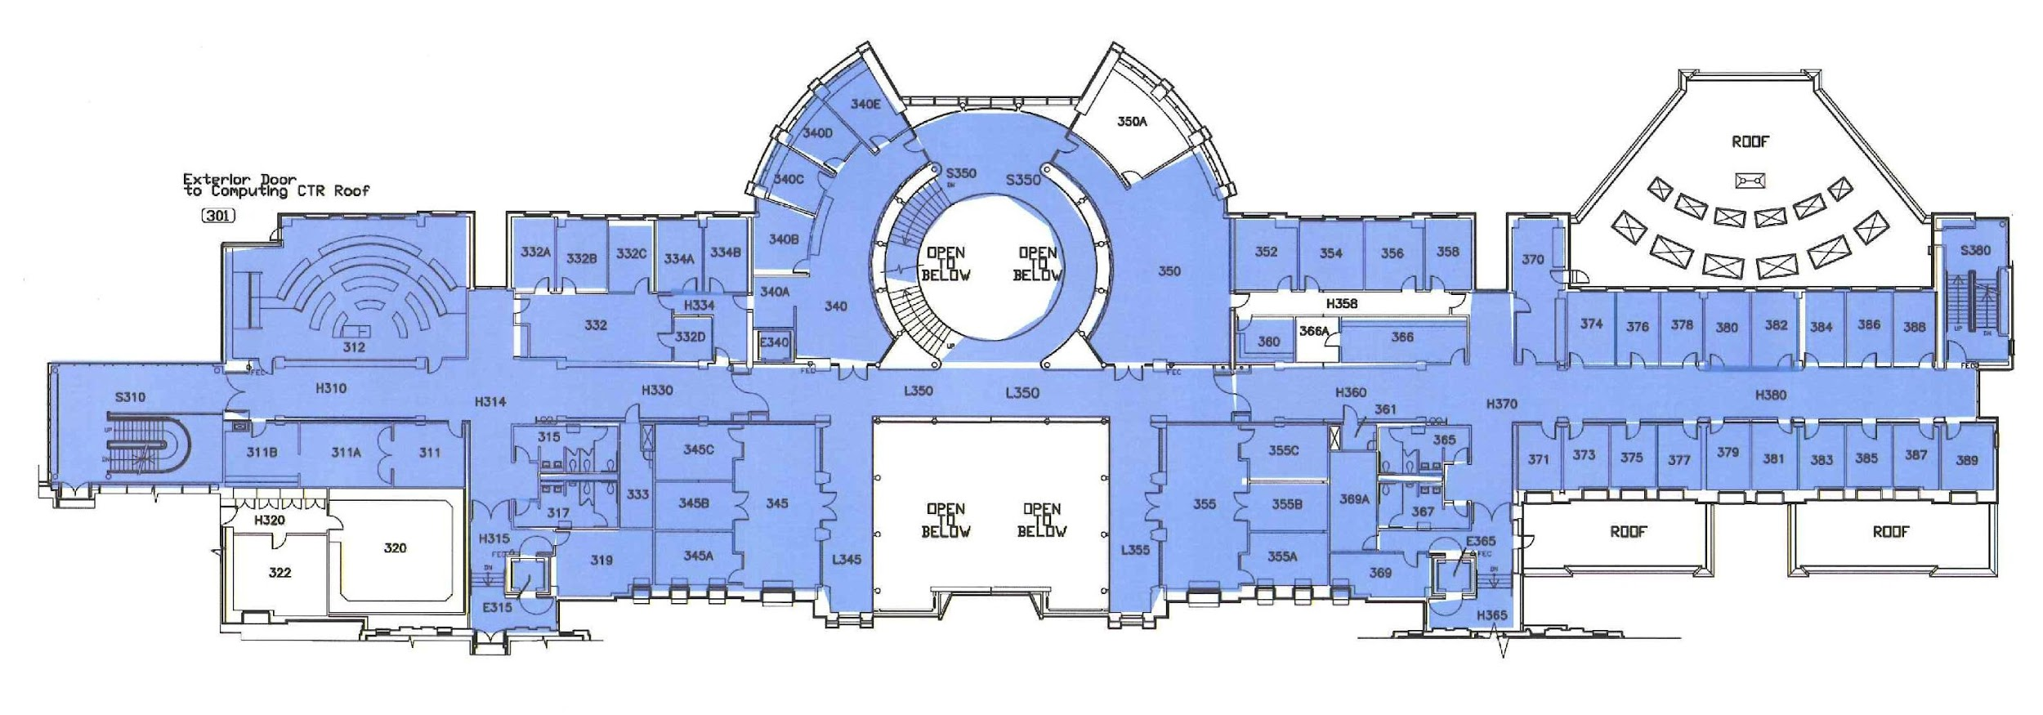
Notes:
A] Fast forward 10 years: the BioBE Center is newly formed with funding by the Sloan Foundation and we wanted to know whether architectural and specifically energy design features influence the formation of bacterial communities.
Dust is believed to represent a microbial “history” so we decided to conduct a building-wide analysis of microbial communities in concert with architectural variables. We chose Lillis Hall because we knew a lot about it’s design and operation and because we cared about it a great deal.
B] We vacuumed almost every space in the building. The shading shows the coverage on the 3rd floor. Science is not glamorous.

Slide 10
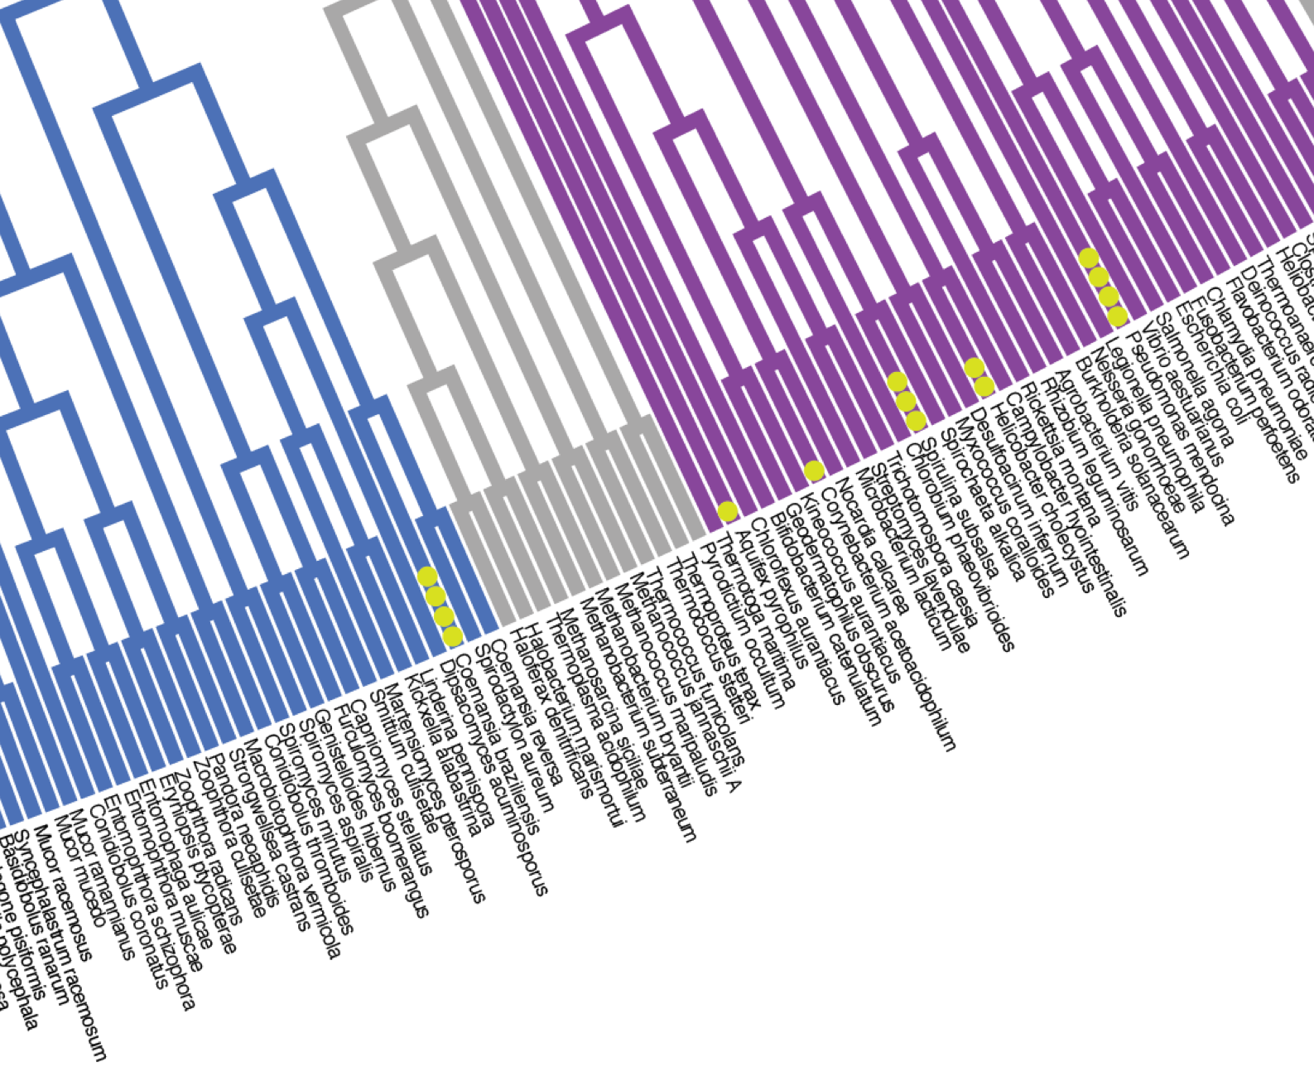
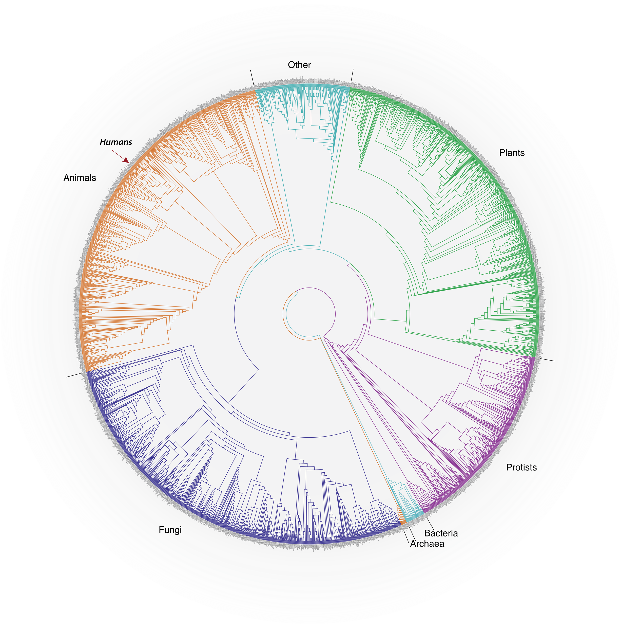
Life: the abridged version
Modified version of original by David M. Hillis, Derrick Zwickl, and Robin Gutell, University of Texas. http://www.zo.utexas.edu/faculty/antisense/DownloadfilesToL.html
Notes:
Let me step aside for a moment and give you a brief description of sequencing.
A] This is that tree of life I showed earlier. It is built up from sequence data. There are about 3000 representative taxa listed around the circumference, less than 0.2% of the species thought to exist. Plants and animals up here and the rest are microorganisms. These lines connect the organisms phylogenically. Humans are here.
B] When we sequence a sample we are identifying the abundances of the organisms in that sample. The particular collection of genes in the sample is called the microbiome
Optional: The number of species represented is approximately the square-root of the number of species thought to exist on Earth (i.e., three thousand out of an estimated nine million species), or about 0.18% of the 1.7 million species that have been formally described and named.

Slide 11
Dust microbial communities within Lillis cluster by space type and are strongly correlated with building centrality and human occupancy
Low human traffic
Similar to outdoor (soil/water) microbiomes
Similar to human microbiome
High human traffic
(http://www.plosone.org/article/info%3Adoi%2F10.1371%2Fjournal.pone.0087093)
Notes:
A] So, we vacuumed and sequenced the dust from most spaces in the building. At the same time we collected occupancy data and catalogued the architectural features. This ordination plot shows one of our results. If you are not familiar with this type of plot, it is used in a multivariate analysis to visualize the strongest explanatory variables, and represents the relative similarity of collections of objects, in this case bacteria. Each of the small dots is a sample composed of thousands of bacteria. The basic idea is that the distance between any 2 points is a measure of how similar the communities are. You can ignore the numbers on the axes.
B] What did we find? Occupancy and space type matters. The larger ovals show sample groupings by space type. While there is a lot of overlap there are also some clear patterns. It shows that microbial communities are strongly linked to space type.
Looking at just the y-axis, there is a gradient explained by space type and human traffic level: spaces near the top receive the least human traffic while spaces at the bottom receive the most.
C] We also found we could characterize the communities in terms of their similarity to other known microbiomes. Those spaces near the top have microbiomes most like outdoor microbiomes while those near the bottom were more likely to be similar to human microbiomes (gut, skin, etc.). Remember this distinction as we’ll come back to it.
To recap, there are 2 messages: the organization of spaces matters and occupancy is important
NMDS based on unweighted UniFrac
Ignore: eventually layer labels and ovals so they can be animated in

Slide 12
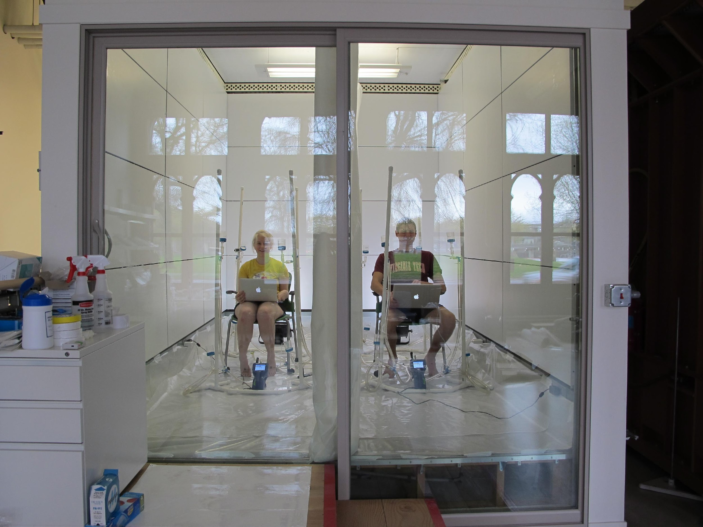
Humans have approximately the same number of bacteria cells as human cells
Sender, R., Fuchs, S., & Milo, R. (2016). Revised estimates for the number of human and bacteria cells in the body. bioRxiv. Retrieved from http://biorxiv.org/content/early/2016/01/06/036103
Notes:
A] Let me talk briefly about occupancy. We’ve used our climate chamber to poke more deeply at this question.
B] Microbial communities and buildings are both extremely complex systems which makes them challenging to study. The climate chamber is ideal for running controlled and repeated experiments to look at mechanisms of microbial community formation. We can control all of the environmental variables that impact human thermal comfort, including air and radiant temperatures, humidity, and air velocity. We can also control ventilation rates, direction and filtration. In this way we can eliminate variables that might otherwise confound the results.

Slide 13
Meadow, J.F., Altrichter, A.E., Bateman, A.C., Stenson, J., Brown, G.Z., Green, J.L., Bohannan, B.J.M. 2015. Humans differ in their personal microbial cloud. PeerJ 3:e1258 https://dx.doi.org/10.7717/peerj.1258
P = 0.001
Notes:
A] In our first such experiment we looked for evidence of a human microbial cloud or signature, which had not been quantified in this way before. We subdivided the chamber, put subjects one at a time in one side and left the other side unoccupied, and sampled both the occupied vs. unoccupied sides. These are more of those ordinations where distance between points represents similarity. Circles are occupied samples and triangles unoccupied. The colors distinguish between the 3 subjects.
We could easily distinguish between occupied and unoccupied sides.
Could also distinguish individuals using their personal microbiome “fingerprint” with a long enough sampling period
Ignore We also calculated about 1 million microbes

Slide 14
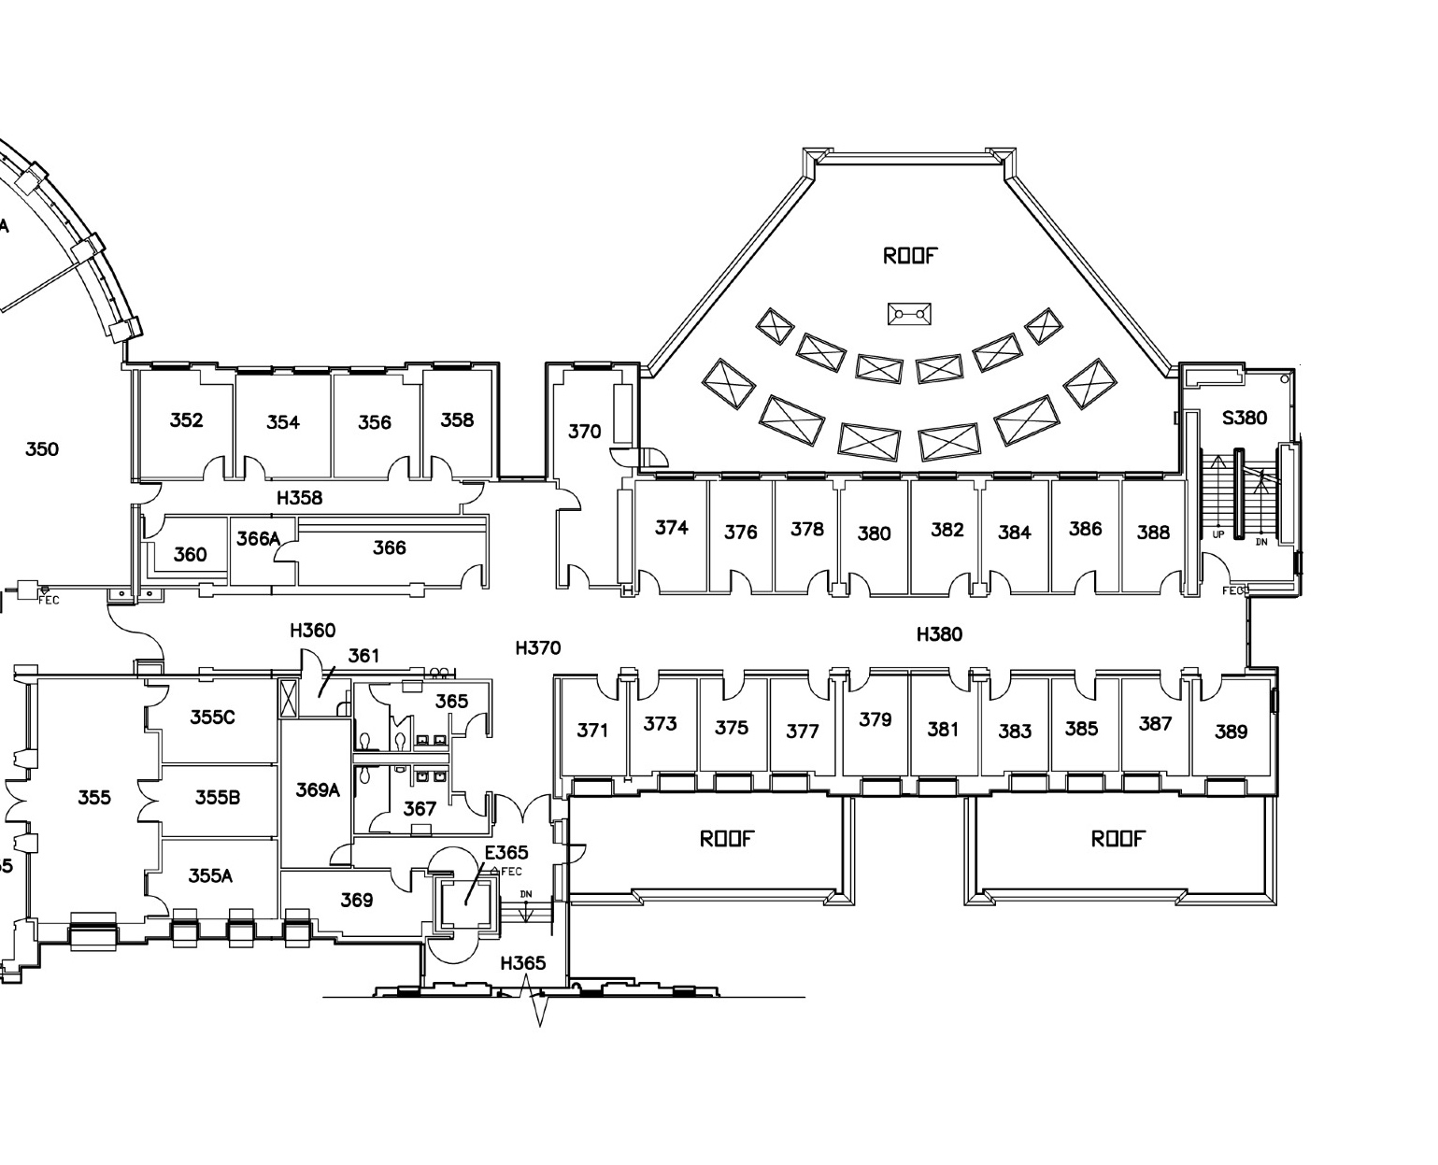
Notes:
A] I have one more insight from Lillis Hall to pass on and that is that ventilation design influences MBs. Let's go back to the design process briefly. The user group for the design included faculty, of course, and they had a problem. Some of the faculty wanted operable windows to be able to have breezes and to cool without needing air conditioning. In Eugene though we have awful pollen seasons in the spring and summer and other faculty said no, we need filtered air. The architects and mechanical engineers told the group that it was too expensive to provide both window and mechanical ventilation (in addition to the cost of the operable windows and mechanical cooling, you also need sensors and controls to turn off the A/C to a room when the windows are open).
The solution?
B] It was suggested that there be 2 types of offices. Make the south offices, that have high solar loads, air conditioned without operable windows, and make the north offices have operable windows for fresh air and to cool through night ventilation of mass. The north offices also have louvers below the windows.

Slide 15
P = 0.005
(http://www.plosone.org/article/info%3Adoi%2F10.1371%2Fjournal.pone.0087093)
Notes:
A] This is section through one of the office floors. You can see the mechanical supply on the south side and window and louver supply on the north.
B] As we were analyzing our dust data we realized we had an ideal natural experiment. When we looked at microbial data for these offices we found a pattern. Here is that human vs soil/water scale again.
With our dust we found that offices on the north were more likely to have MBs similar to those found outdoors while the south side were more likely to be similar to human microbiomes
Ventilation air source matters

Slide 16
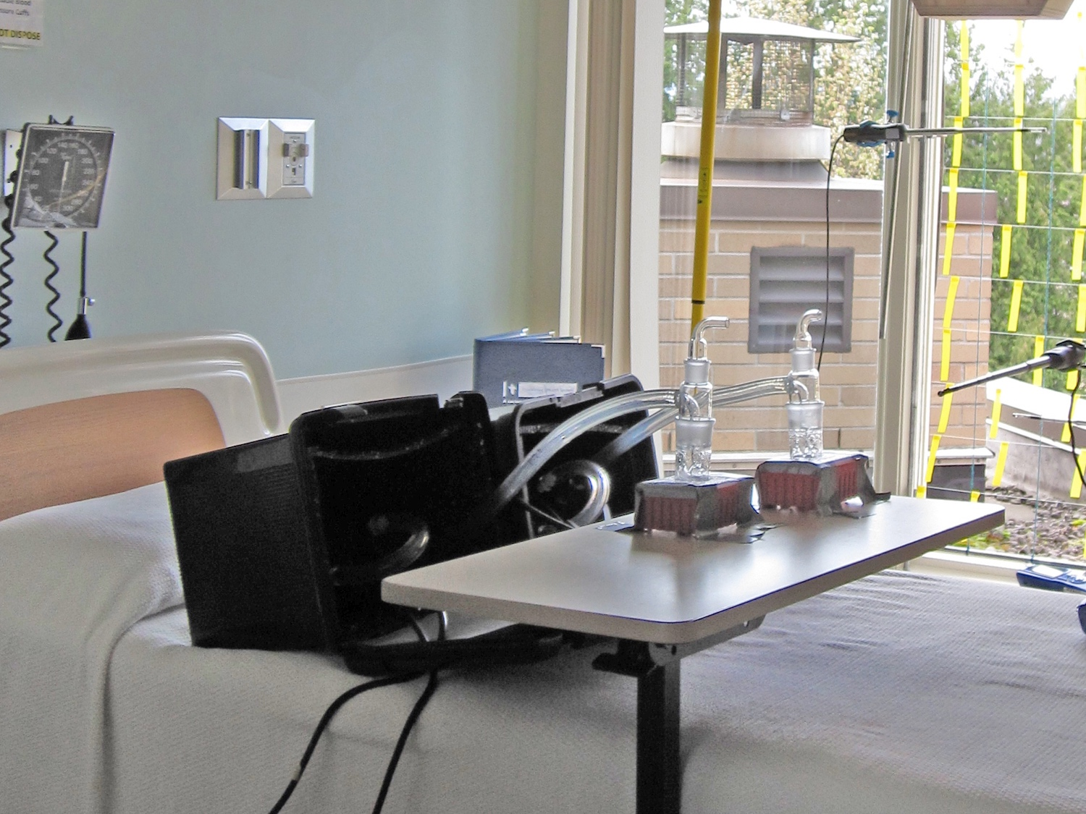
4% of U.S. energy consumption attributable to healthcare
Notes:
A] We had earlier studied hospital patient rooms, and how the source of ventilation air affects the microbiome at the patient bed.
B] We compared rooms with window-supplied ventilation to rooms with mechanically-supplied ventilation, as designed. At the same time we sampled the outside air at the mechanical intakes. This time we were actively collecting air using a device called a liquid impinger and pumps.

Slide 17
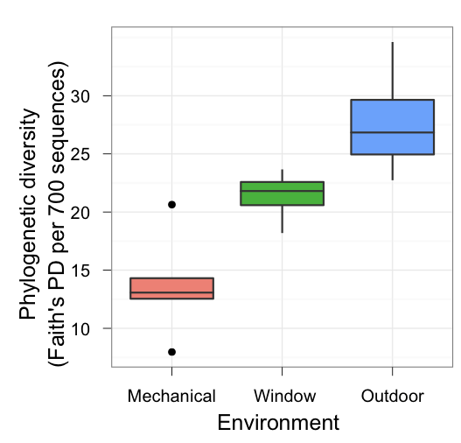
Diversity Varies with Air Source
Phylogenetics is the study of evolutionary relationships among groups of organisms (e.g. species, populations), which are discovered through molecular sequencing data and morphological data matrices (Wikipedia)
P = 0.005
Notes:
Describe graph
We found that the phylogenetic diversity of airborne bacterial communities was lower indoors than outdoors, and mechanically ventilated rooms contained less diverse microbial communities than did window-ventilated rooms. For those of you like me who rely on Wikipedia here is the definition of phylogenetics

Slide 18
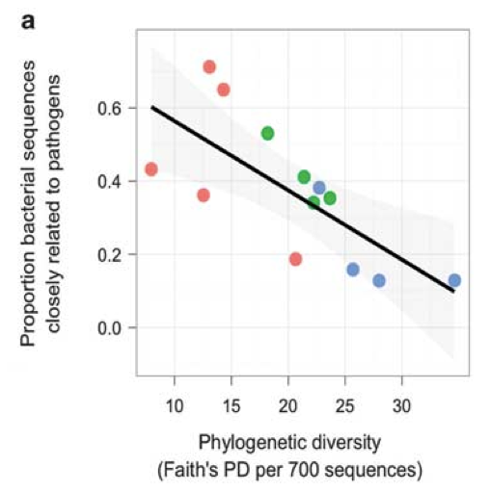
R² = 0.53
P = 0.005
Notes:
This plot shows the samples we collected. Same color scheme: red = mechanical supply, green is window supply and blue is outdoors. There was a relationship between diversity and the proportion of sequences closely related to pathogens. Remember, this is microbes in ventilation air, not dust as at Lillis.
Big caveat: the sequencing technology we used in 2009 did not allow to drill down far enough to say whether pathogens were present, only that there were related taxa

Slide 19
Drug-resistant bacteria cause estimated 23,000 deaths and 2 million illnesses each year in the U.S.
National Action Plan to Combat Antibiotic Resistance
Notes:
A] So, from our past projects we've learned that design, operation, and occupancy patterns of buildings all play a role in shaping bacterial communities. If I have time now, I want to describe 2 ongoing projects that explore other facets of BEMBs.
The first of these the important issue of ABR.
Why does BioBE care?
B] Besides personal hygiene products and pencils, there are many building materials embued with antimicrobial compounds. (I'm not picking on particular manufacturers). Some antimicrobials leave long-acting residues on the surface to be disinfected and thus have a prolonged action (referred to as “residue-producing”). Common examples of this group are triclosan, triclocarban, and benzalkonium chloride.
We are trying to determine the extent of the presence of antimicrobial compounds, their correlation with antibiotic resistance genes found in the built environment and whether those genes are being expressed.

Slide 20
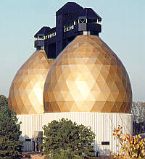
wastewater treatment plant
8
*
log(Antibiotic-resistance gene mexB copies)
0 mg/kg triclosan
500 mg/kg triclosan
3
Day 0
Day 17
McNamara, P.J. et al. Environ. Sci. Technol. 48, 7393-7400 (2014)
Notes:
Brief version if time short:
previous studies by others have found a relationship between AMCs and ABRGs. For example in a WWTP the addition of triclosan, an AMC, caused an increase in the abundance of a gene that codes for ABR.
Long version
In WWTPs, TCS is found at 500 - 12,000 ng/g (Environ Sci Pollut Res (2012) 19:1044-1065)
triclosan can change the function of microbial communities, specifically by inducing multidrug resistance
This study by McNamara looked a microcosm of an anaerobic digester, looking at the copy number of the mexB antibiotic resistance gene. When triclosan was added the number of mexB copies in the community increased by over an order of magnitude in only 2 weeks.

Slide 21
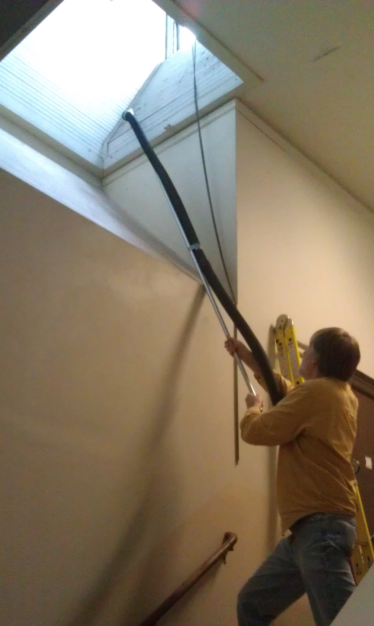
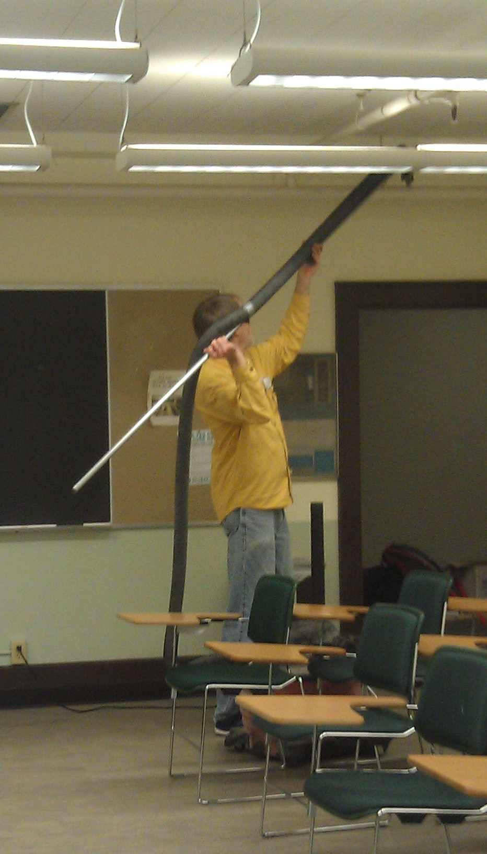
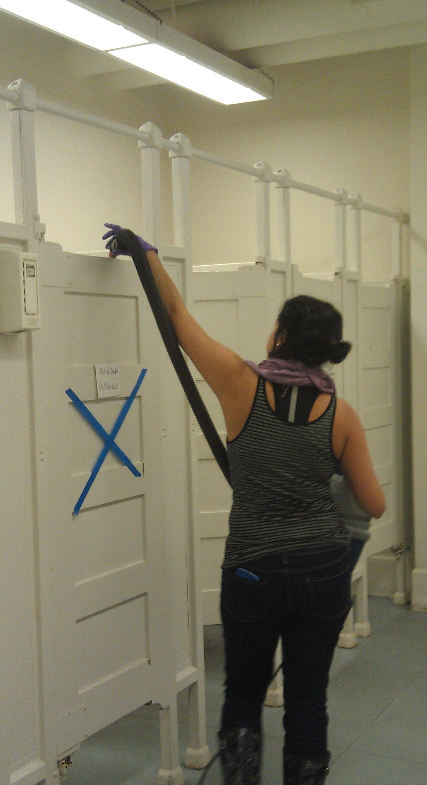
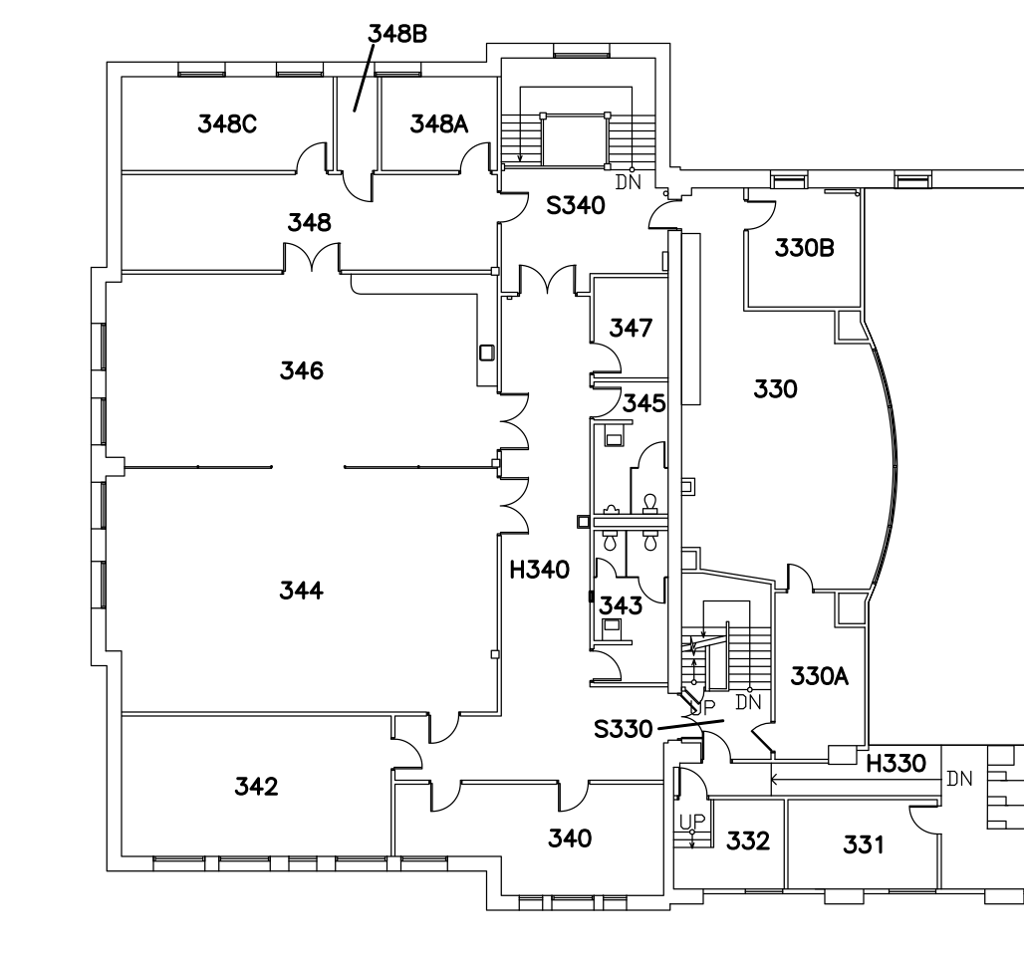
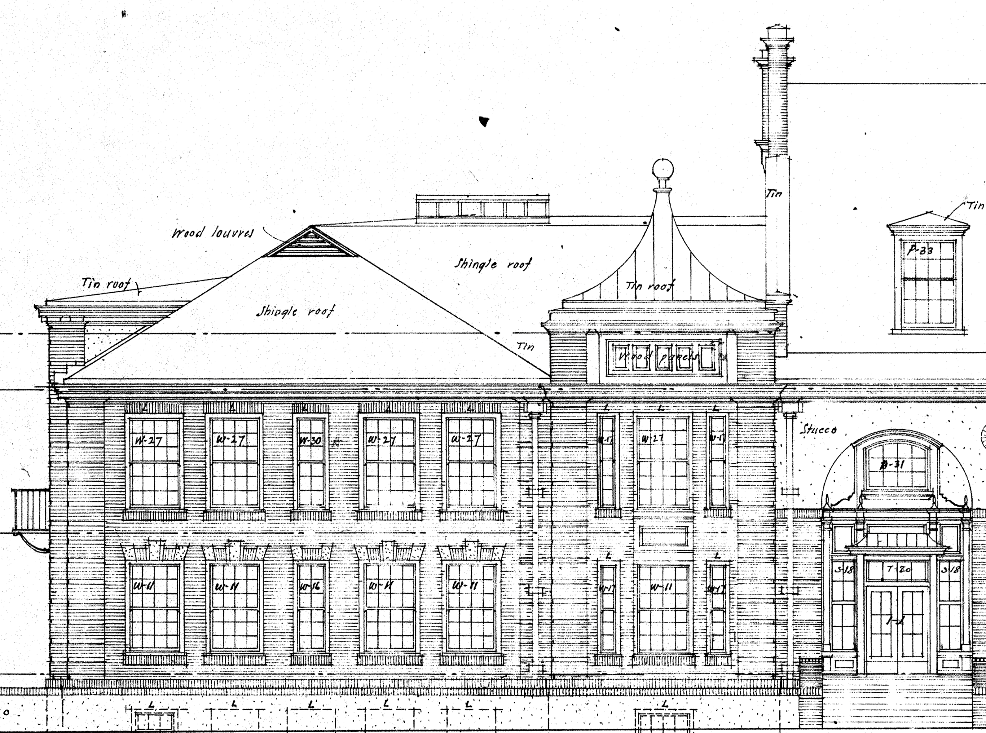
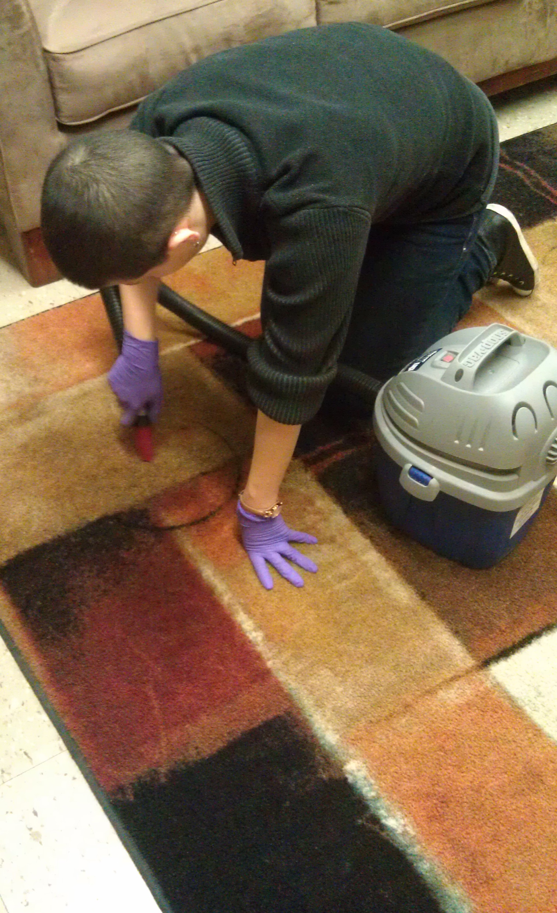
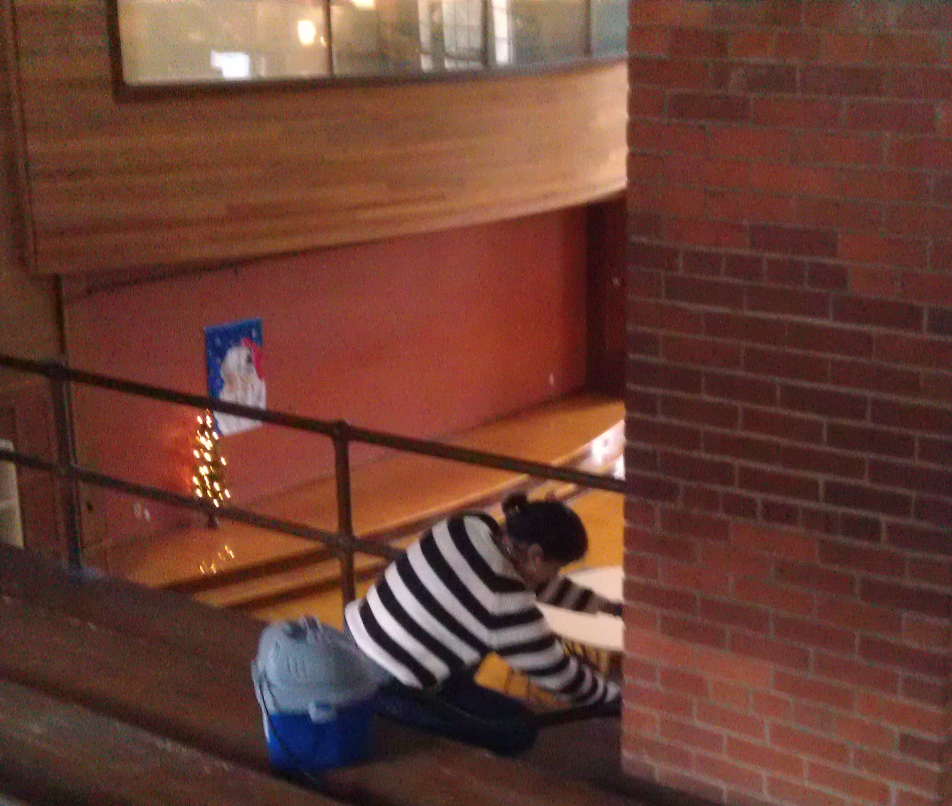
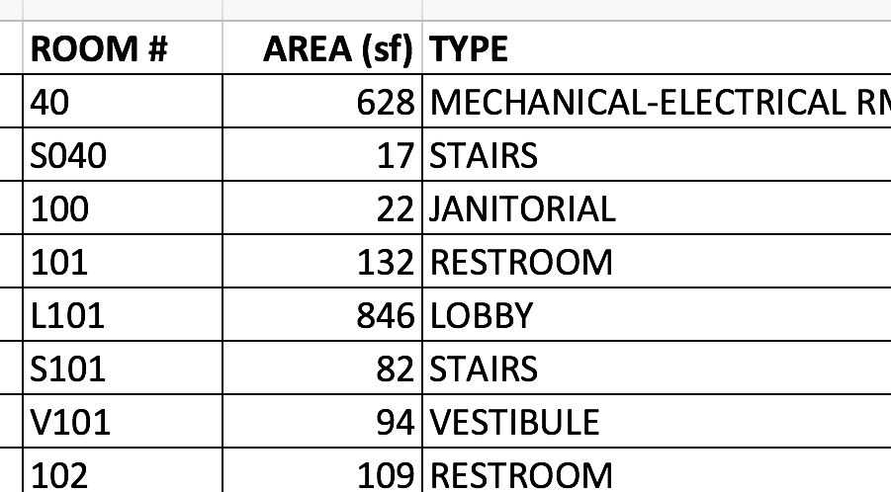
Notes:
So want to see whether there is a similar relationship in buildings.
We’ve completed a pilot with a single building. Off we went with our vacuums again. They love us on campus: finally researchers making themselves useful.
This building is about 100 years old and very leaky. 31 spaces sampled high and low. We also collected data on the building occupancy and envelope characteristics.
We quantified antimicrobials in the dust we collected. We also sequenced the genes looking for genes involved in antibiotic resistance.
Long version
Measured extracted chemicals using LC-MS/MS
Identified and quantified antimicrobials against internal standards
Shotgun sequenced DNA extracted from dust to obtain full genome sequences
Identified antibiotic resistance genes from databases of known antibiotic resistance genes
Quantified genes based on short marker sequences

Slide 22
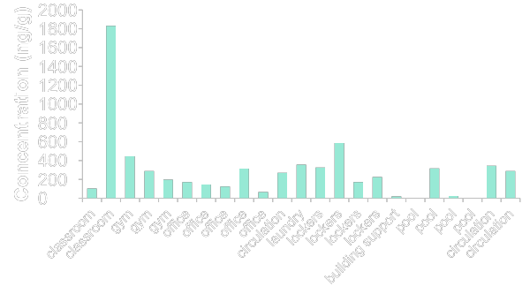
Triclosan concentrations in dust vary throughout the building
Location | n | Detection (%) | Median Concentration (ng/g) | Reference
China | 47 | 96 | 570 | Lu, X. et al. Analytical Methods 5, 5339 (2013)
Canada | 63 | 100 | 571 | Fan, X. et al. J. Environ. Monit. 12, 1891-1897 (2010)
Belgium | 18 | 100 | 220 | Geens, T. et al. Chemosphere 76, 755-760 (2009)
Spain | 10 | 100 | 702 | Canosa, P. et al. Anal. Chem. 79, 1675-1681 (2007)
median triclosan concentrations in other studies: 220-702 ng/g
Hartmann et al., Environ. Sci. Technol. 50 9807-9815 (2016)
Notes:
We found that triclosan concentrations varied throughout the building in quantities similar to those found in other studies around the world

Slide 23
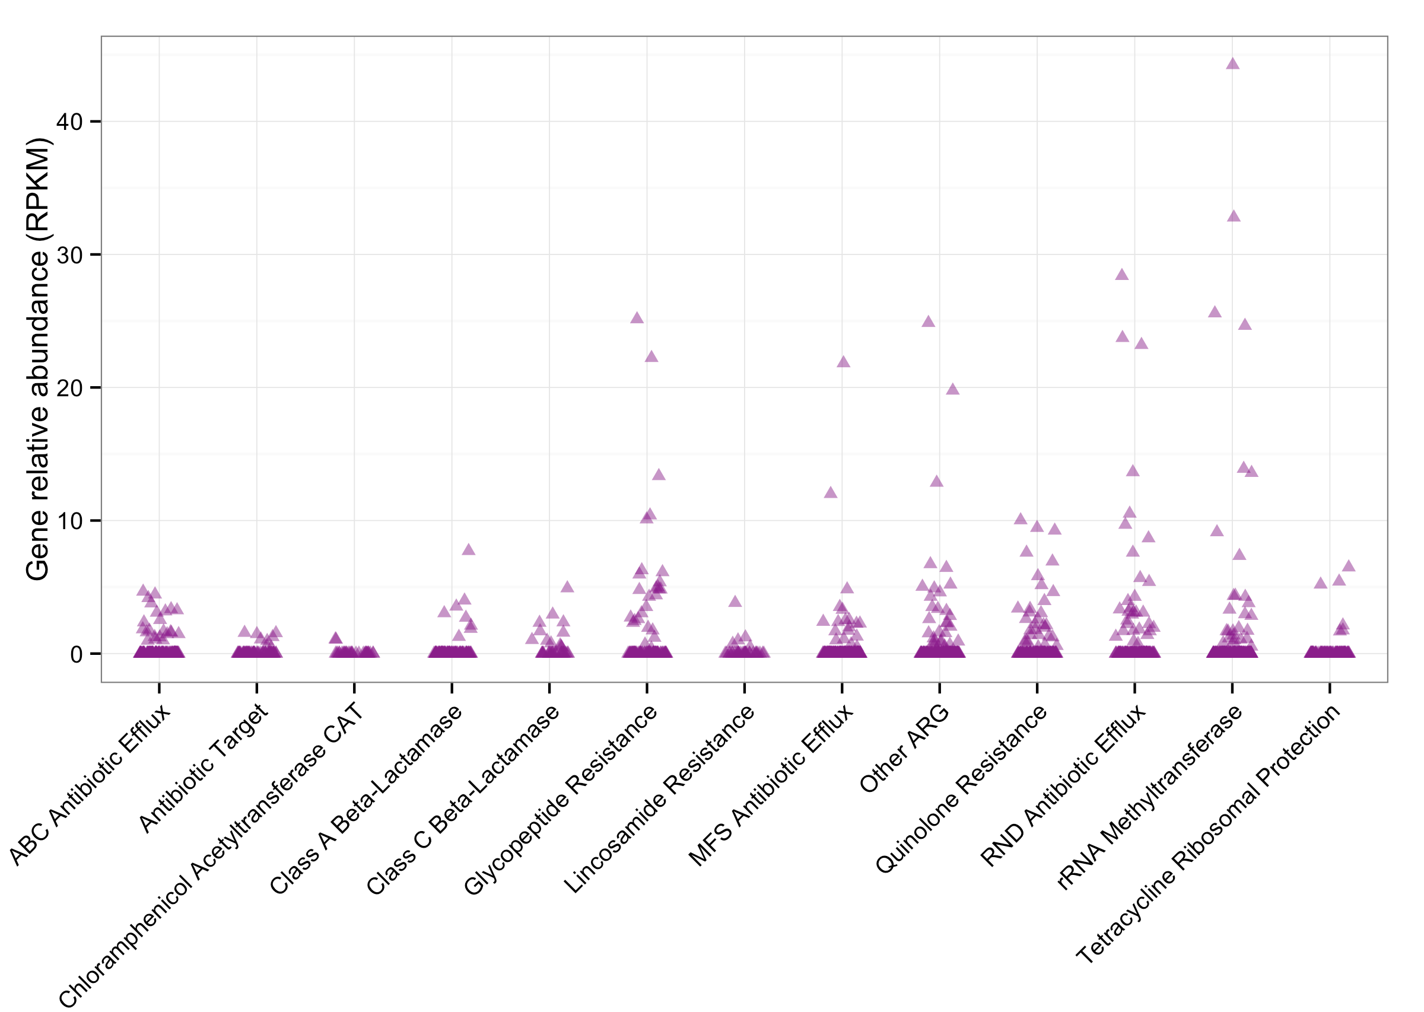
Antibiotic resistance genes are diverse,
Not abundant
Hartmann et al., Environ. Sci. Technol. 50 9807-9815 (2016)
Notes:
ABRG on X-axis, y-axis is gene relative abundance.
The abundance of antibiotic resistant genes was not great but the genes were diverse, covering a range of ABR mechanisms

Slide 24
Antibiotic resistance correlates with triclosan concentration
Description | Similarity Score | p-value
23S ribosomal RNA methyltransferase | 0.86 | 0.001
tetracycline resistance efflux pump | 0.83 | 0.001
streptogramin resistance efflux pump | 0.65 | 0.001
Hartmann et al., Environ. Sci. Technol. 50 9807-9815 (2016)
Notes:
We found that ABRG abundance correlating with the concentration of triclosan.

Slide 25
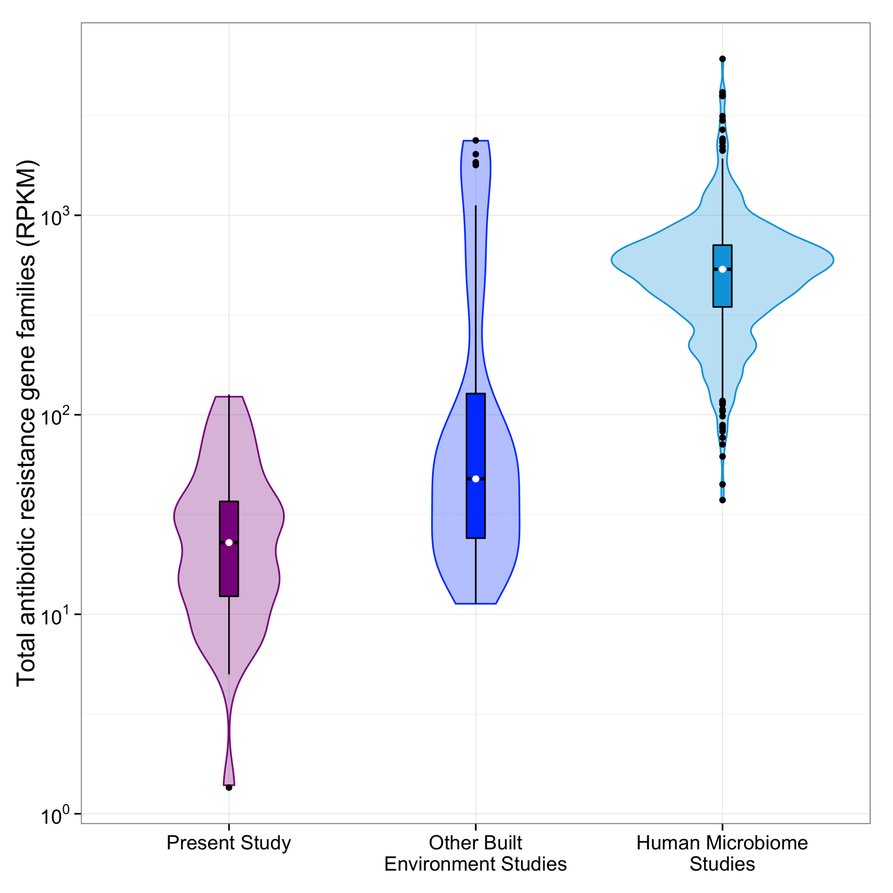
Built environment resistance is much less than human-associated resistance
Hartmann et al., Environ. Sci. Technol. 50 9807-9815 (2016)
Notes:
To set your mind at ease perhaps, this plot compares our findings with others. Violin plot, showing the median (white dot) and quartile ranges (box and whiskers) as well as the density distribution (shaded area) of the relative abundance of all antibiotic resistance gene families (in RPKM) from the present study (purple, n=36), other built environment microbiomes (blue, n=40), and the human microbiome (teal, n=552).
And this is consistent with a recent meta-analysis showing that the human gut has the most antibiotic resistance of any environment surveyed.

Slide 26
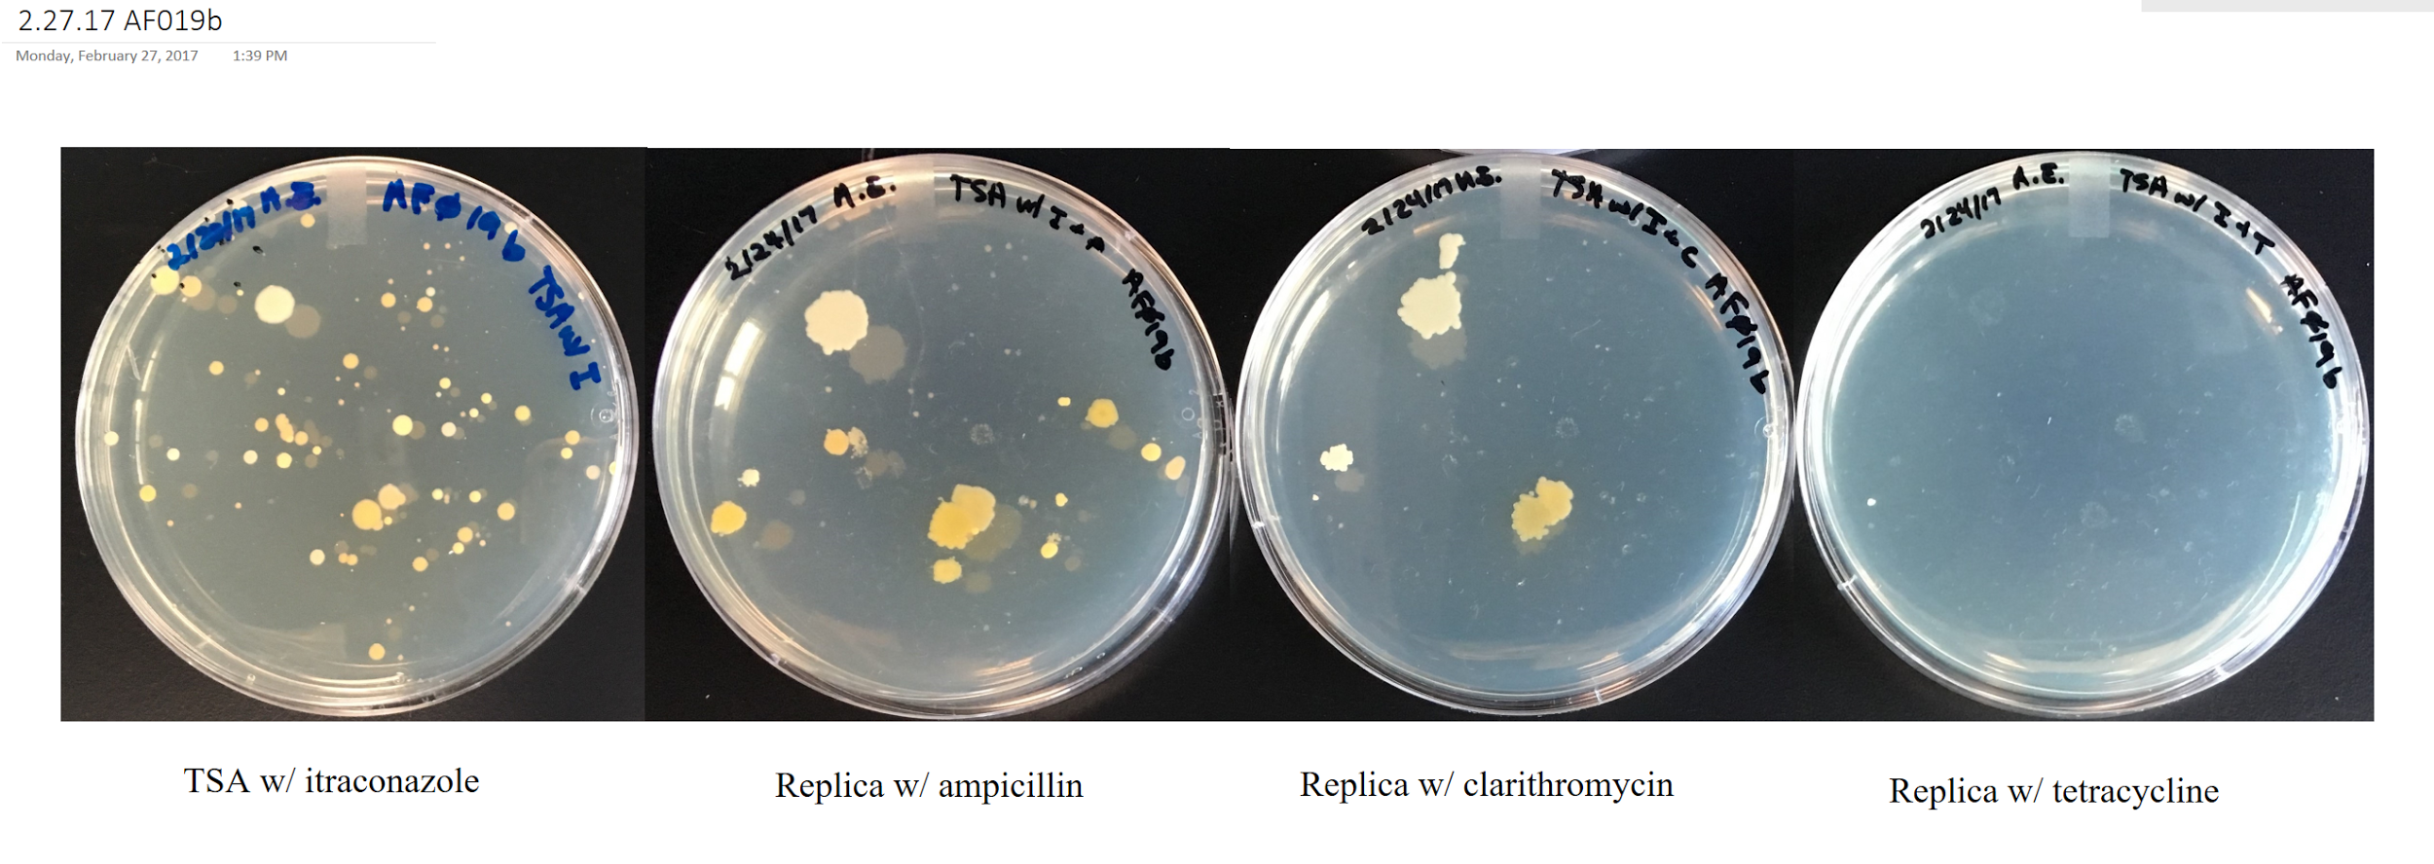
Notes:
It is important to understand that the sequencing technology used here tells us what genetic functions are present, not whether they are being used. We are analyzing a new dataset from similar multi-use buildings and this time we are also culturing the microbes found and exposing them to antibiotics to see whether they actually are using those functions.

Slide 27
How does home weatherization impact microbial ecology and human health?
Portions of this presentation was developed under an agreement awarded by the U.S. Environmental Protection Agency. It has not been formally reviewed by EPA. The views expressed are solely those of (name of recipient) and EPA does not endorse any products or commercial services mentioned.
Notes:
A] Next study--we are in the midst of looking at homes and specifically at the climate change mitigation strategy of weatherization.
B] There have been studies on wx and air quality and a lot is known about the health impacts of pollutants. We believe ours is the first study to simultaneously look at wx, health, behavior, IAQ and microbial ecology.
It is highly interdisciplinary, with researchers in 3 domains. It is focused on envelopes and ventilation systems affected by WX, and has recruited homes across 2 climate zones

Slide 28
Field measurements
+ survey
Field measurements
+ survey
Survey only
Comparison homes
weatherization
Treatment homes
inside – outside = envelope + ventilation + occupants
N = 72
Notes:
A] The treatment in the study is weatherization. WX measures always include envelope tightening and a mechanical ventilation system and often insulation and other measures. Envelope tightness is measured by the contractors or other auditors by pressurization testing.
B] We recruit comparison homes in parallel to the treatment homes to be able to account for variation we are not measuring directly

Slide 29
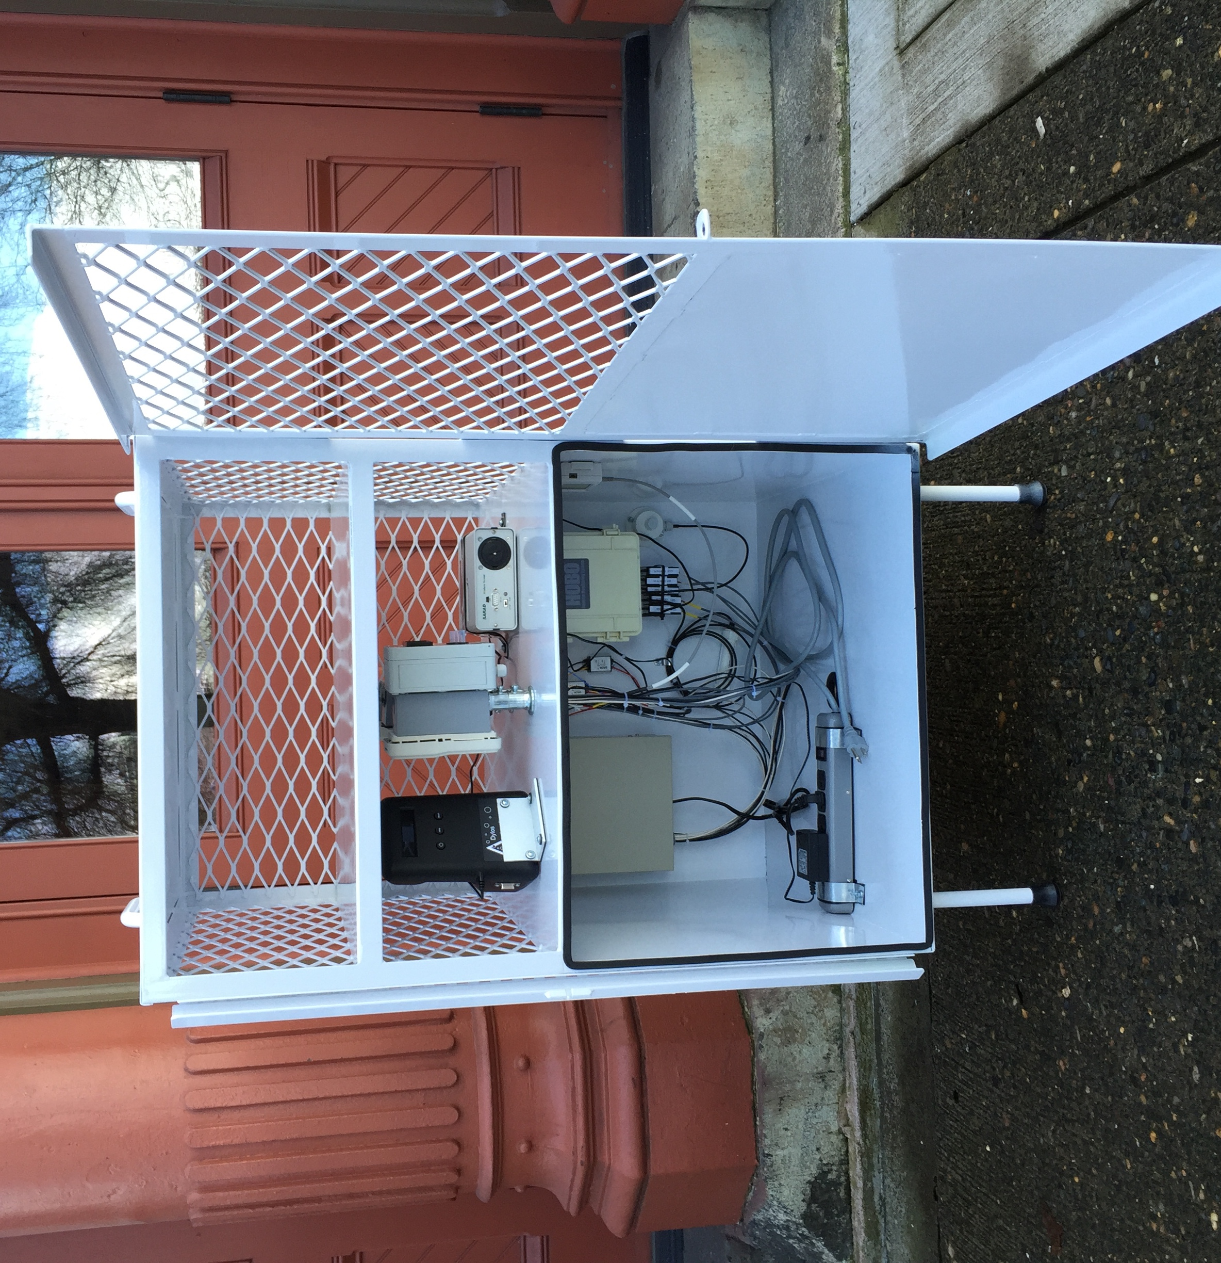
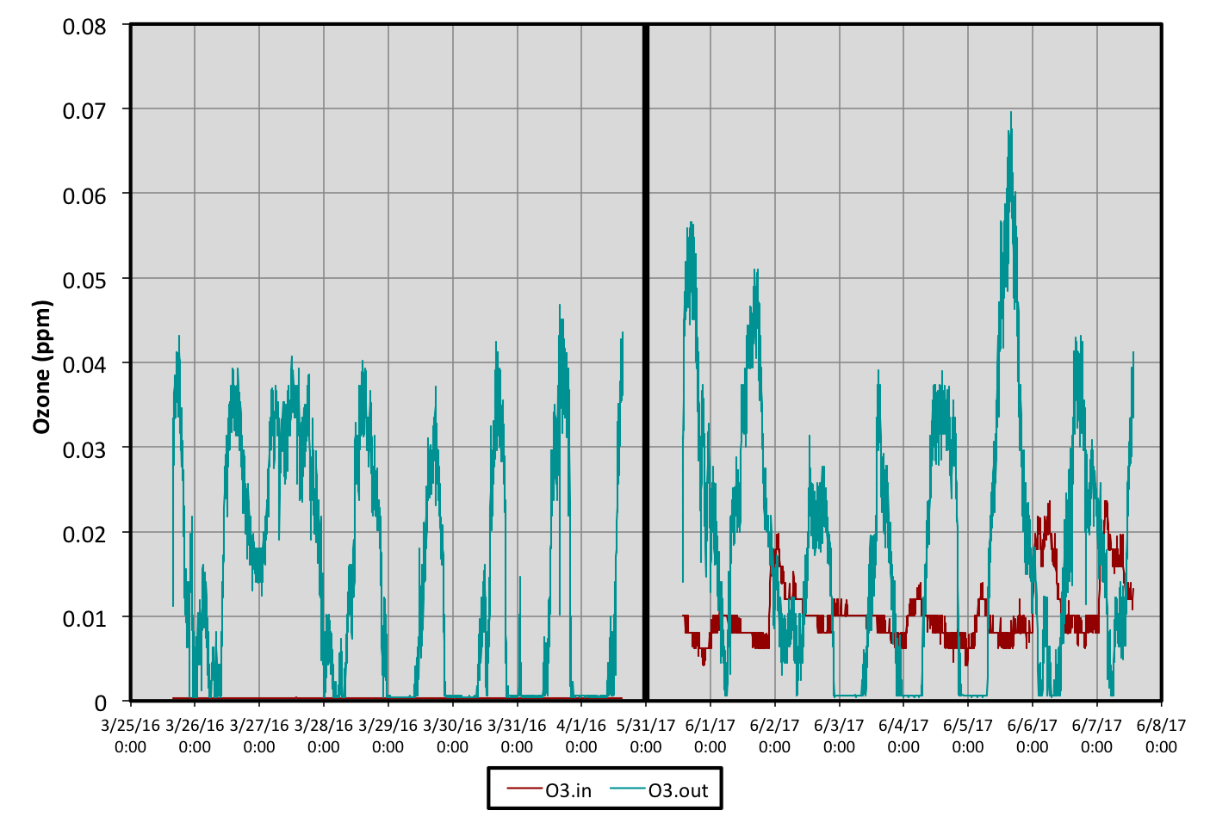
Carbon monoxide
Carbon dioxide
Ozone
Formaldehyde
Volatile organic compounds
Particulates
Radon
Temperature
Relative humidity
Pressure
Air velocity
Solar gain
Wind speed, direction, and gusts speed
23% of global deaths (and 26% of deaths among children under five) are due to modifiable environmental factors
Africa, S., Kong, H., Republic, D., April, I., Feinstein, D., Collins, S., … WHO. (2012). Preventing disease through healthy environments. Mercury, viii(6), 1–6. http://doi.org/10.1155/2013/959637)
Notes:
A] This is one of our sampling kits. Settling dishes are placed in the upper meshed enclosure and the AQ sensors below them. The bottom shelf contains the power supplies and data loggers.
B] We are just beginning to analyze the data. This is a sample of air quality data from one of the homes before and after weatherization.

Slide 30
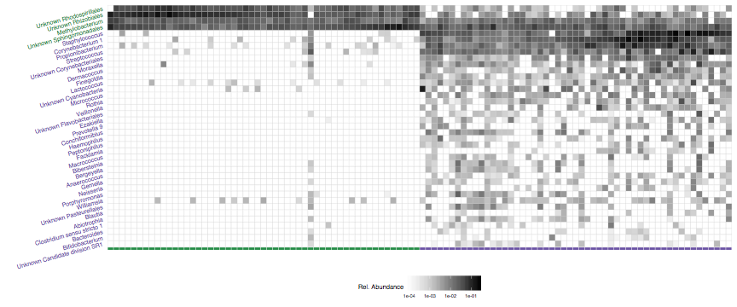
INDOOR
Bacteria
OUTDOOR
Notes:
This is a sample of the bacterial data for the first of 2 cohorts of homes. This is a heatmap where most abundant taxa are listed on the y-axis. Samples collected outdoors are on the left and the indoor samples on the right, and each cell is a home. The darkness represents the relative abundance of the taxa. You can see there is clearly a difference between the inside and outside samples. This agrees with past studies that show that occupants exert a strong influence on bacterial communities.
We are also analyzing fungal communities for this study.

Slide 31
Thank you
Jeff Kline, jkline@uoregon.edu
for
The Biology and the Built Environment Center
University of Oregon
Dr. Green (Biology)
Prof. G.Z. Brown (Architecture)
Dr. Van Den Wymelenberg (Architecture)
Dr. Curtis Huttenhower, Harvard School of Public Health
Dr. Rolf Halden, Biodesign Center for Environmental Security, Arizona State University
Major collaborators
Dr. Johnson-Shelton, Oregon Research Institute
Enhabit
Multnomah County
NeighborImp[act
TEAM
Adam Altrichter
Ashley Bateman
Clarisse Betancourt
Brendan Bohannan (founding co-director)
Jing Chen
M.J. Christopher
Ryan Clemmer
Ryann Crowley
Scot Davidson
Steve Divan
Dan Elliott
Ashkaan Fahimipour
Jose Flores
Mark Fretz
Ken Hanna
Erica Hartmann
Roxy Hickey
Daniel Hundley
Tiffany Hsu
Steph Irish
Ann Klein
Jeff Kline
Alejandro Manzo
James Meadow
Gwynne Mhuireach
Dale Northcutt
Ali Rahnavard
Randall Schwager
Jason Stenson
Steph Swanson
Doug Turnbull
Roo Vandegrift
Gary Walsworth
Koji Yasuda
Tim Zimmer
Notes:
That is it for me. The work I’ve presented is the effort of many people over the last 8 years. The BioBE center was founded by Dr. Jessica Green, Prof. GZ Brown, and Dr. Brendan Bohannan, and is currently directed by Dr. Van Den Wymelenberg.

Slide 32
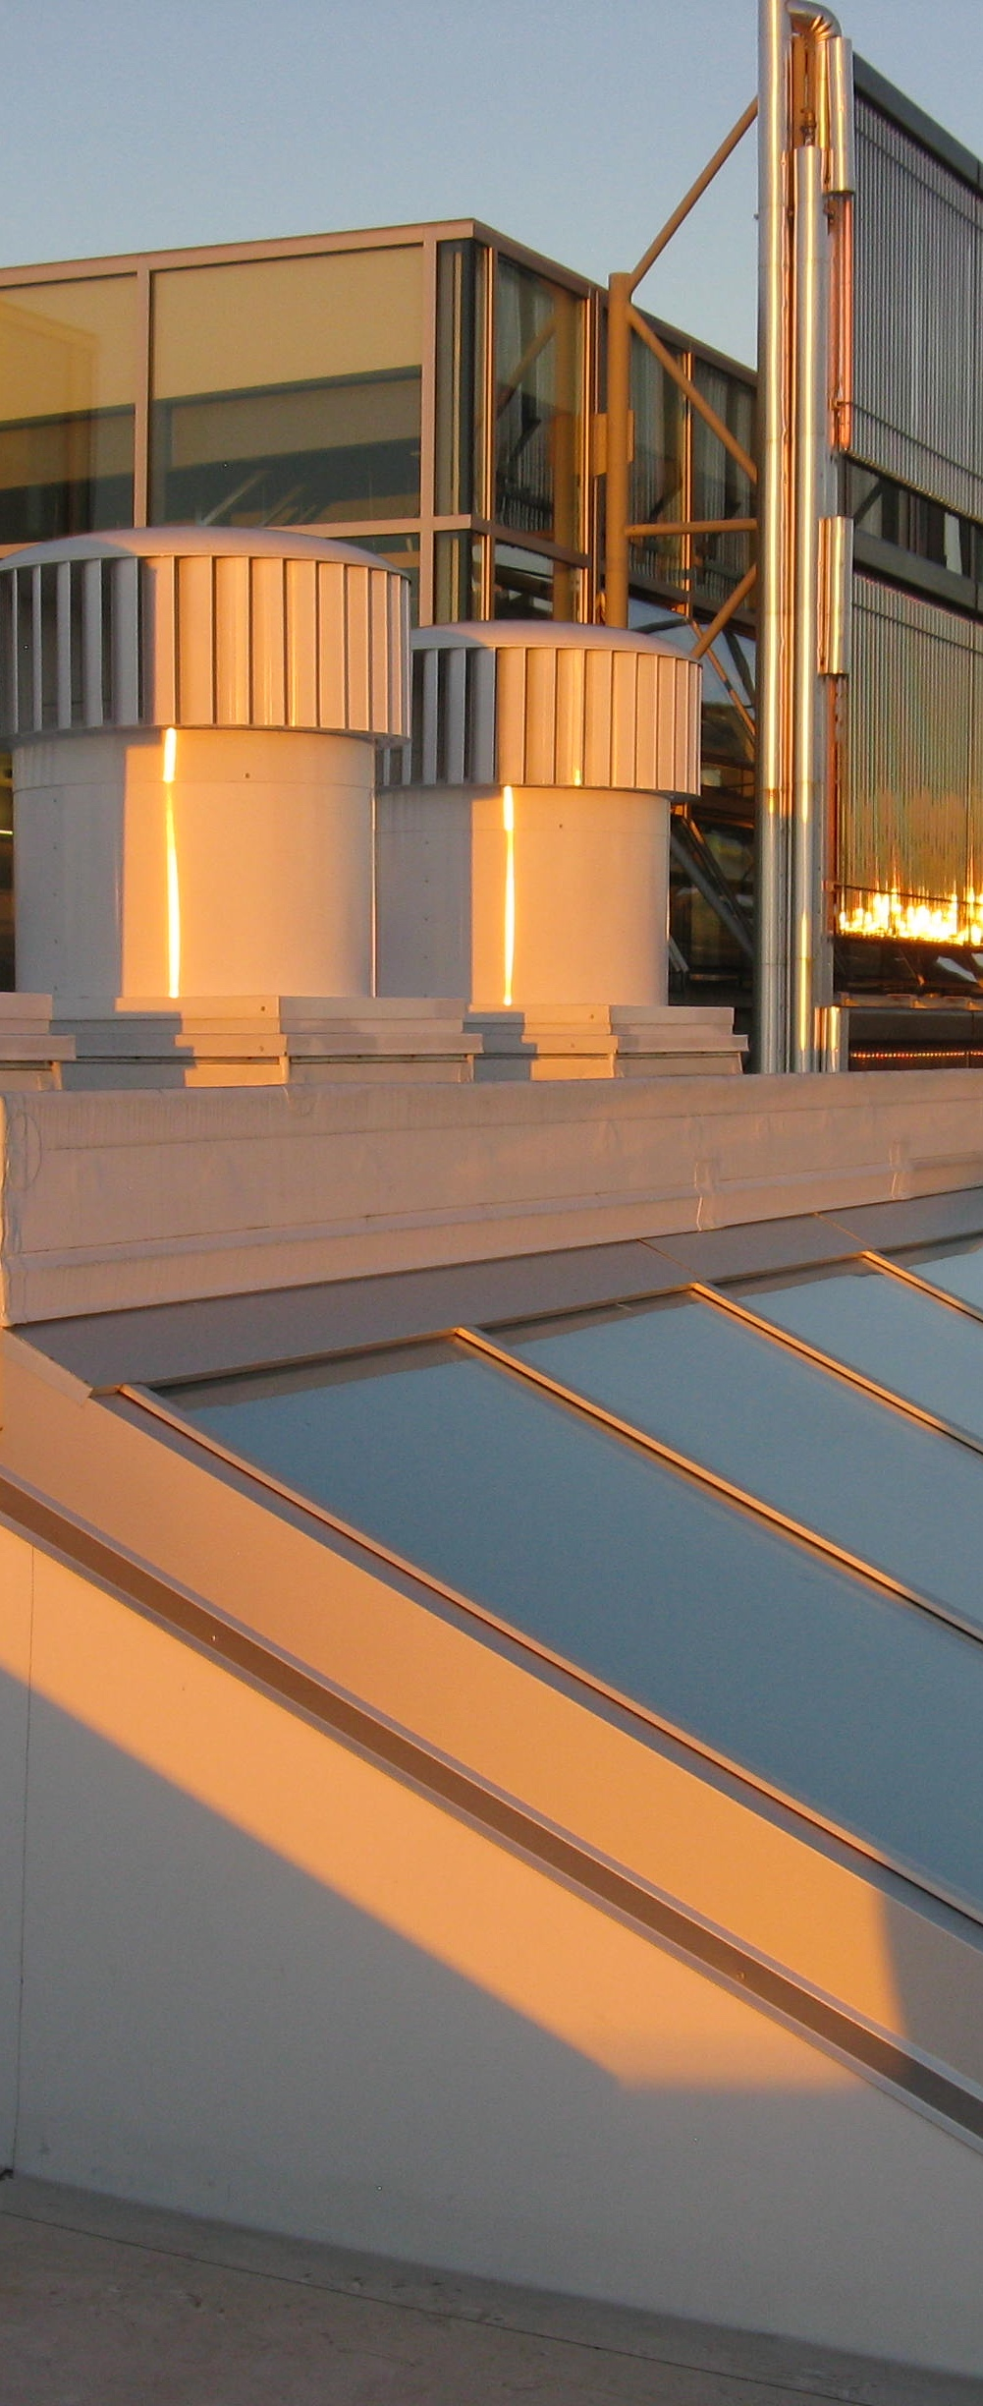
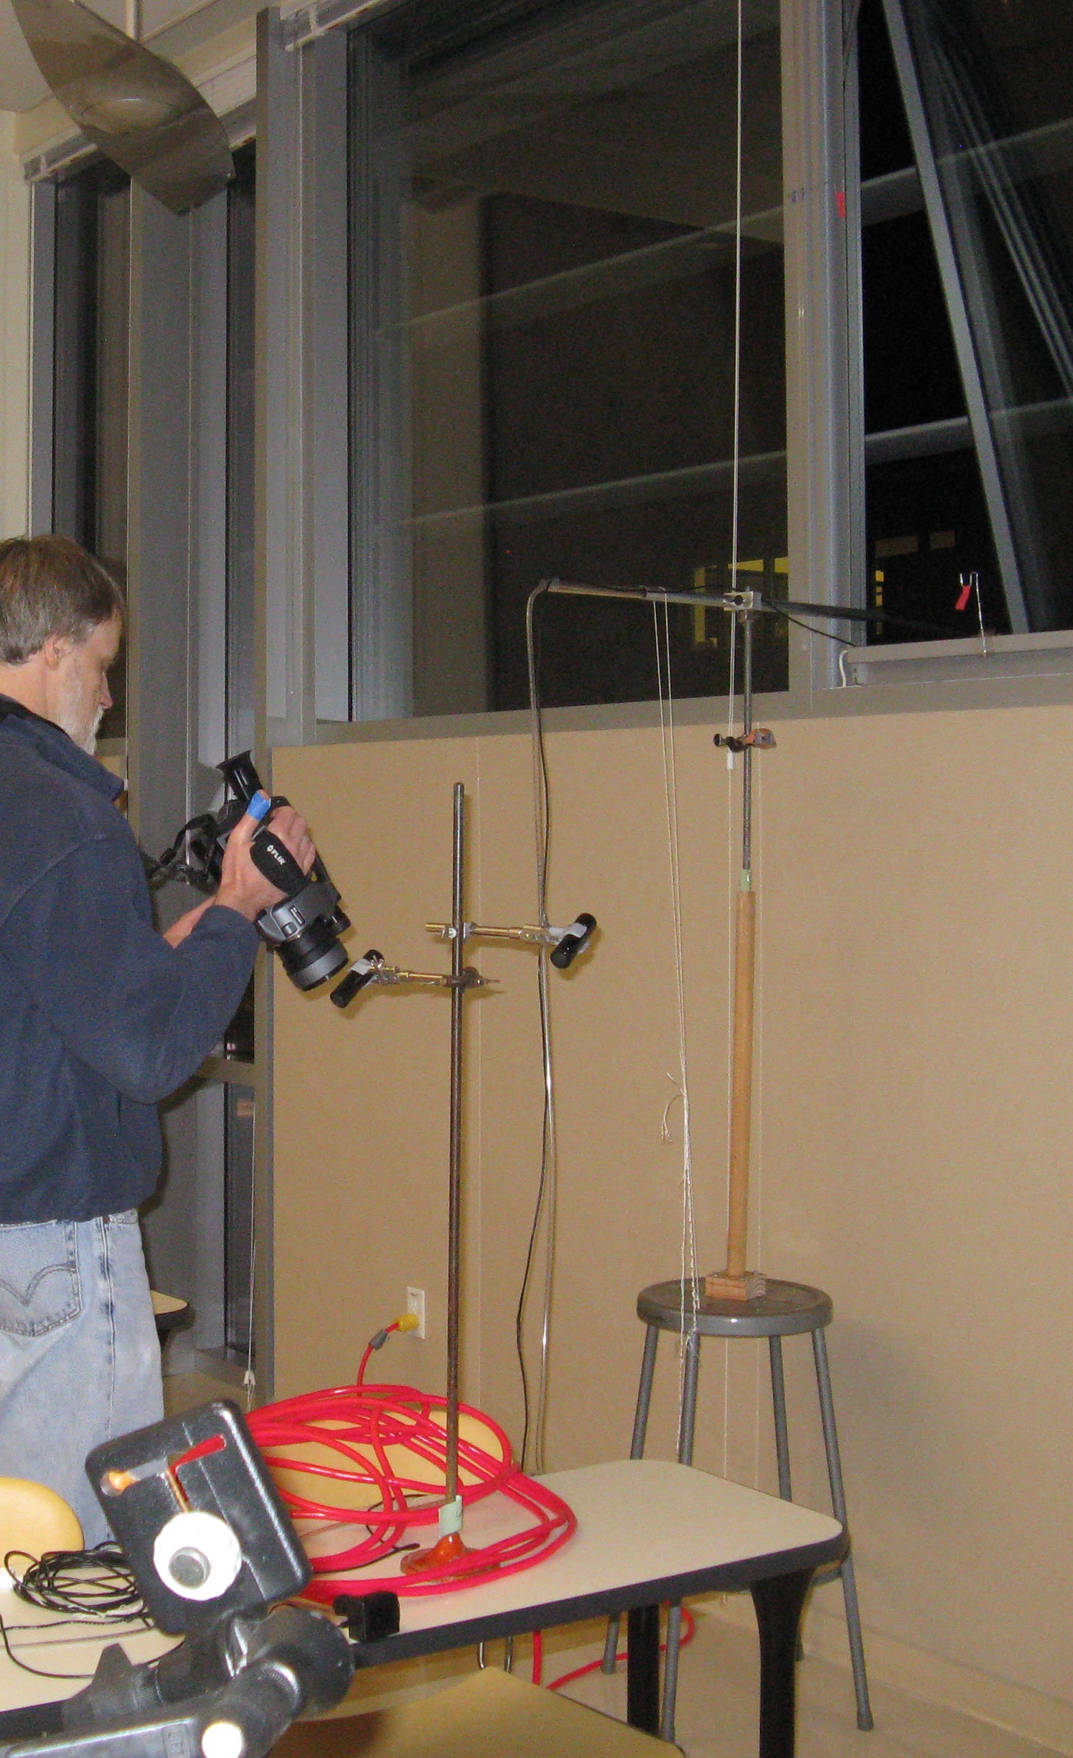
Notes:
In closing I want to reiterate the vision of the BioBE Center. Faced with mounting crises in healthcare and global sustainability should we not find ways to improve both?

