Slide 1

Humidity for a better life
Stephanie Taylor, MD, M. Arch

Slide 2





Hello!
Research
Massachusetts General Hospital Infection Control
Harvard Medical InCite Health Fellow
Stephanie Taylor, M.D., M Arch.
ASHRAE
Distinguished Lecturer
Epidemic Task Force
Environmental Health Committee
Presidential Award Winner
Building4Health
CEO and Founder
& Luigi

Slide 3
Acknowledgements
M. Colin Tasi, MD, MBA: Massachusetts General Hospital, Brigham & Women’s Hospital, Harvard Emergency Medicine Program
Stan Finkelstein, MD: Harvard Medical School, Massachusetts Institute of Technology for Data, Systems & Society
Lisa Robinson, MPP: Harvard T.C. Chan School of Public Health, Center for Health Decision Science
John Levy , PhD: Boston University School of Public Health, Department of Environmental Health
Building4Health: Peter Taylor, Olivia Saber, Yaron Yaniv, Francis Caruccio, Gene Lochart, Oliver Zimmermann
Condair Group

Slide 4

Today’s Discussion
1.
How did we get here? Where did this rogue, species–jumping virus come from?
Understanding the powerful role of RH in health and disease
We have essential work to do, and no time to waste!
2.
3.

Slide 5
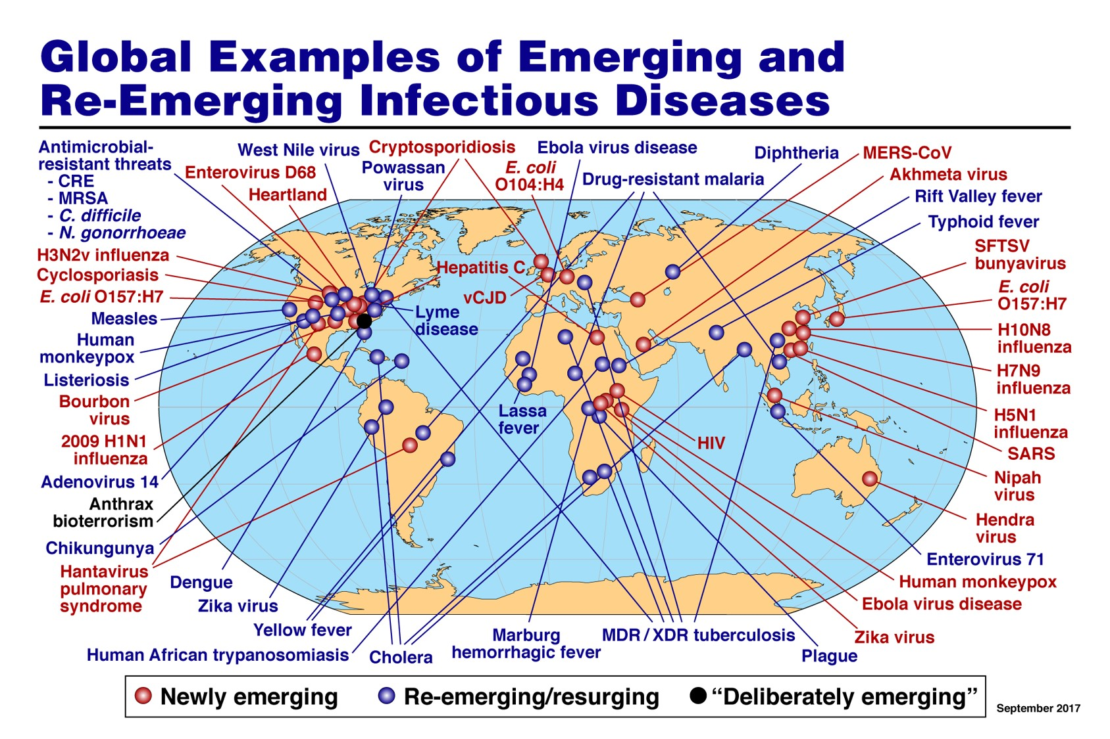
I was not [that] surprised by this pandemic! Were you?
2017

Slide 6
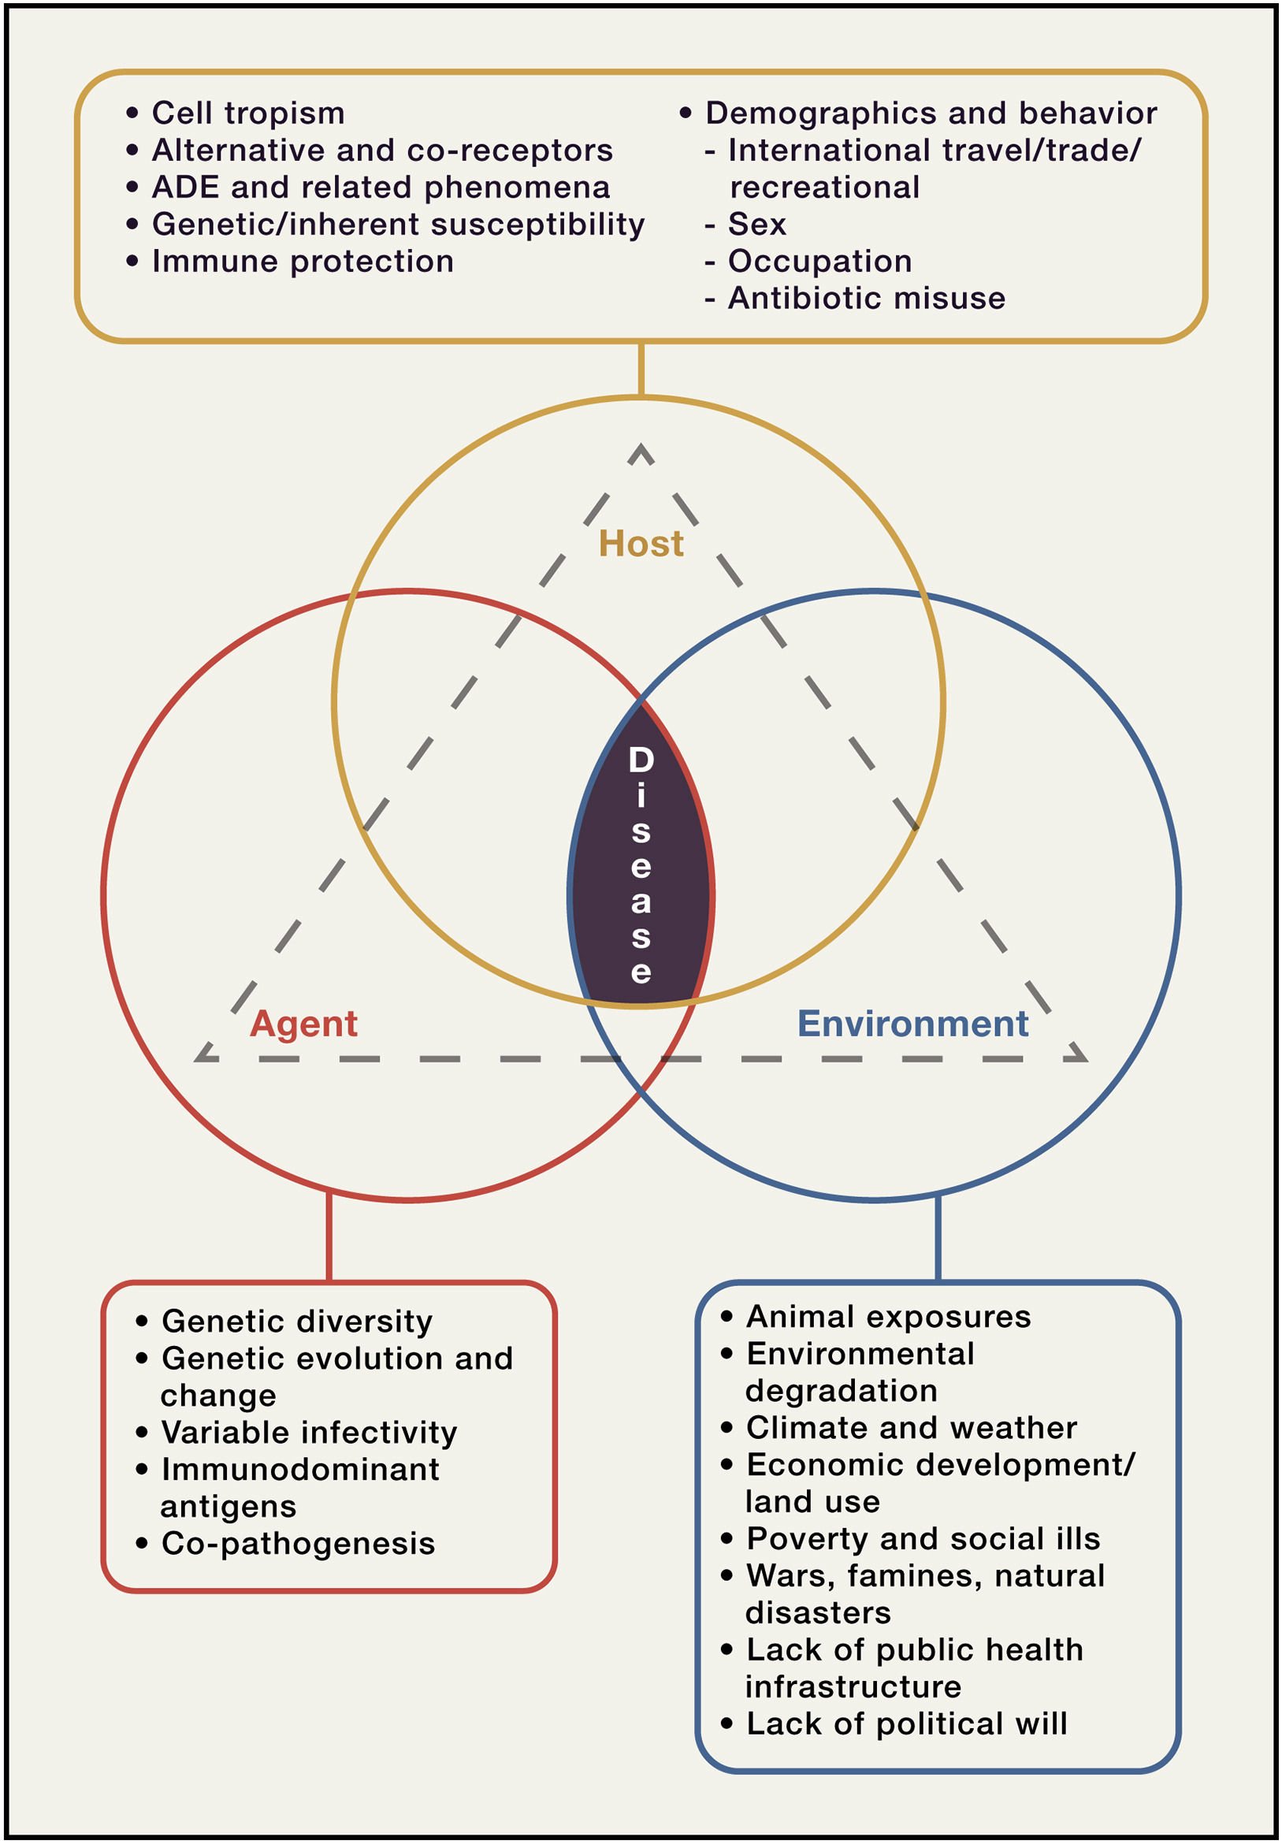
There are three components to infectious diseases
1. The agent (pathogen, particle, gas, etc.):
pathogen infectivity
ability to penetration vulnerable tissues
“collateral damage” disease
2. The host (the human):
inherited (genetic) factors
behavior (exercise, sleep, weight, etc.)
immune system function
3. The environment:
exposure to 1◦ and 2◦ compounds
temp, RH
transmission routes, microbiome, etc.

Slide 7
We are all here to unite these fields
Building Management
  Reduce energy use
  Avoid disasters
  Follow best practices and codes
Medical Care
  Heal patients
  Follow clinical protocols
  Avoid lawsuits
Occupant Health is key to building management
Notes:
Worse case you’ll need to invest in a retro HVAC but most cases you don’t need to do anything large.
Sam and Zane to speak to it to be the exception and the rules.
Sam presenting on why it’s important and his experience with not having the data to understand what or even if a remediation measure would need to be implemented. Test before you Invest! Hand off to Zane to speak about the DS process and how they would partner with B4H if there’s less than optimal air quality readings.

Slide 8
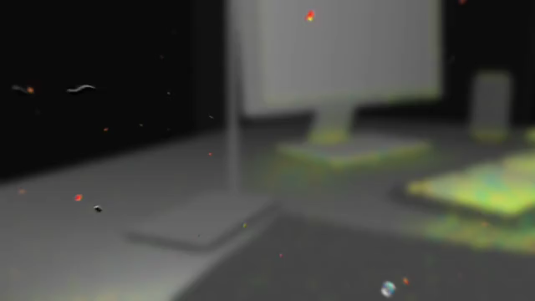
A closer look at our indoor environment

Slide 9



Human habitats before the Neolithic Revolution
2. The host
1. The “agent”
3. The environment
Balanced temperature and water vapor result in mid range RH
Diverse microbial populations in soil, water and air
Human microbiome: gut, respiratory system, skin and mucosal surfaces support 100 trillion microbes that are mostly good for us

Slide 10
Fitness mapping of stable viral and human coexistence
Healthy situation
Viruses would need to overcome significant genetic and immune barriers to jump from non-human to human hosts
Viruses
Humans

Slide 11

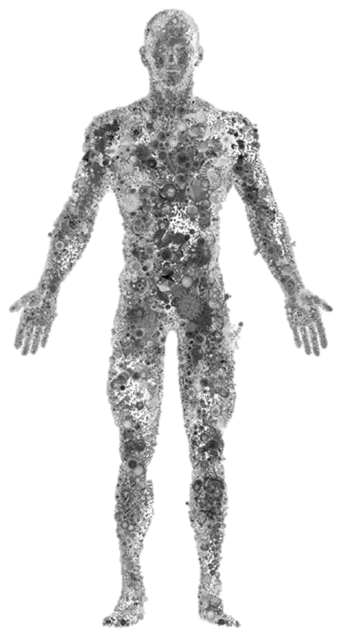

Warm, dry, “disinfected” human-dominated environment
1. The host
1. The agent
3. The environment
Non-diverse building microbiome with many infectious pathogens
Restricted human microbiome, impaired immunity

Slide 12
Low barriers for a species-switching virus to cause a pandemic
Prelude to a pandemic
In this situation, viruses can jump to another species much more easily
Microbes
Humans

Slide 13
Today’s Discussion
1.
How did we get here? Where did this rogue, species–jumping virus come from?
Understanding the powerful role of RH in health and disease
We have essential work to do, and no time to waste!
2.
3.

Slide 14
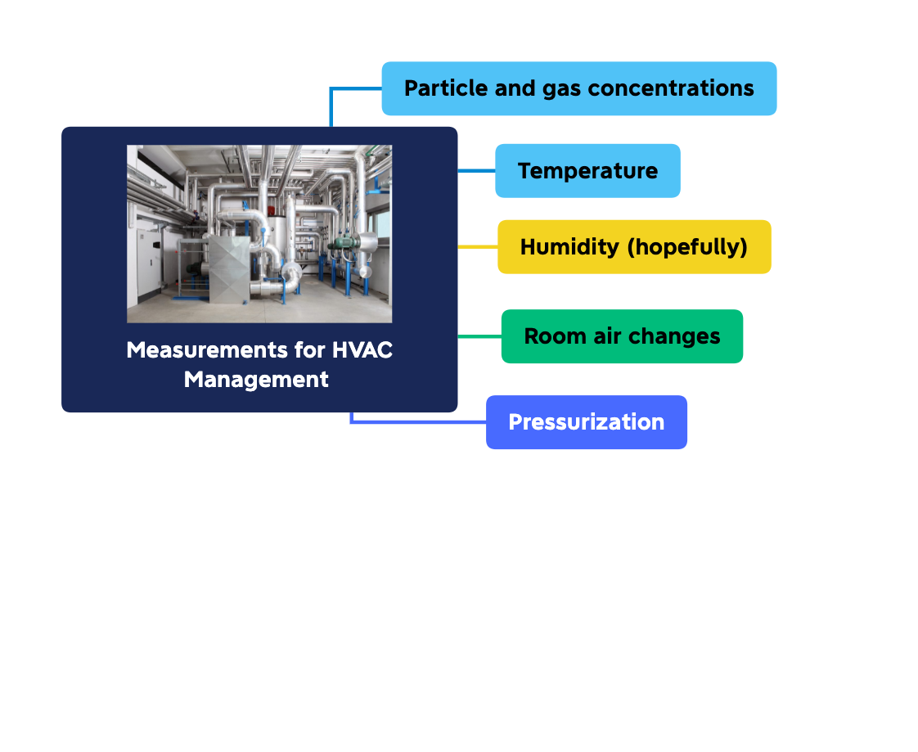
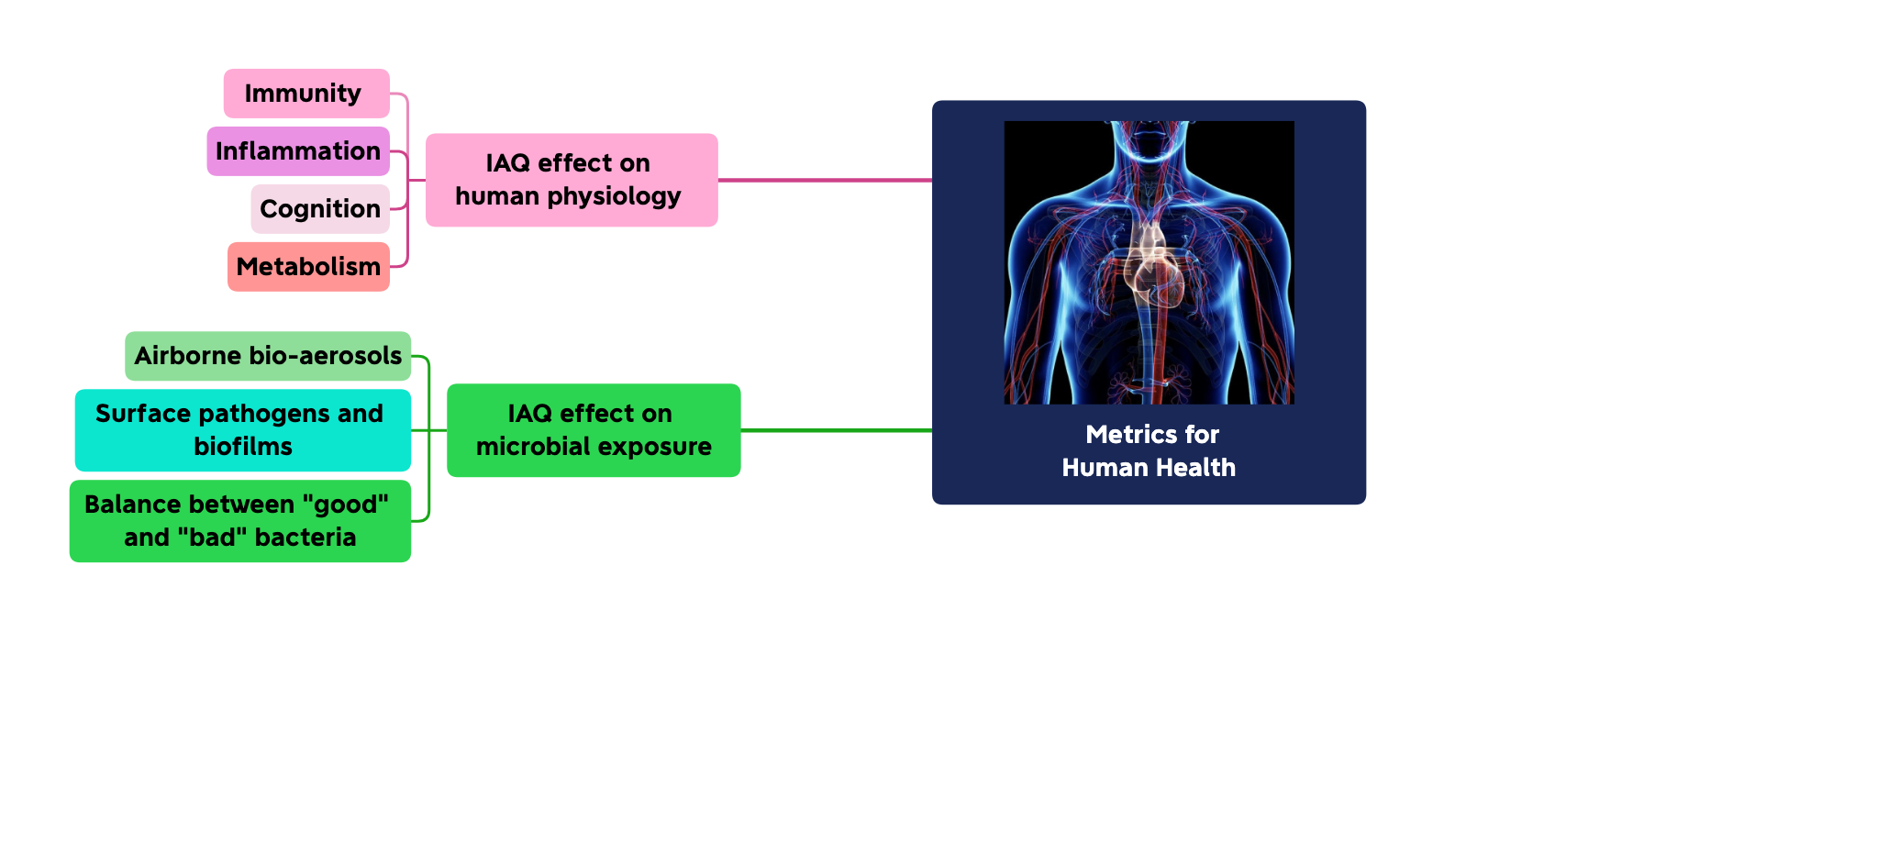
Managing indoor environments for energy and health
Optimize occupant health
Optimize energy savings

Slide 15
IEQ & Human Immunity
1
IAQ impacts the host’s ability to defend against pathogens, regardless of the surface cleanliness of the building:
Dry air reduces respiratory immune defenses
Ozone, NO₂ and other gases are inflammatory and increase tissue vulnerability to penetration
2
IAQ impacts systemic inflammation and associated diseases:
cardiovascular disease
clotting disorders
allergies and autoimmunity

Slide 16
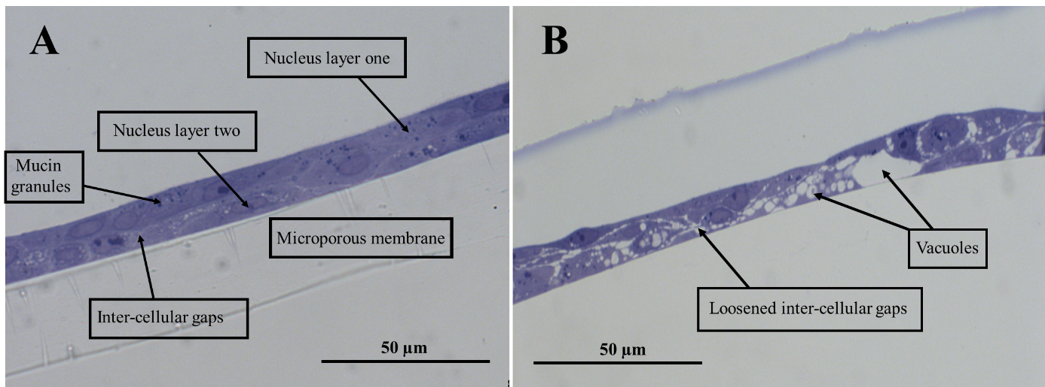
IEQ & Humans Tissues
3
Inhaled ozone (O₃), and nitrogen dioxide (NO₂) induce loosening of inter-cellular junctions
work with Dr. Huttunen, E. Finland Univ.

Slide 17




Penetration of harmful particles and gases into our bodies via inhalation and skin is exacerbated by RH <40
Indoor pollutants interact
NO₂, SO₂, carbon dioxide, carbon monoxide, particles, ozone, radon, volatile organic compounds
The membrane surrounding our cells can be breached
Causing serious illnesses in multiple organ systems
Notes:
Mucosal membranes are also an important level of defense against bacteria, viruses, particles, and organic and inorganic compounds.
Optimizing the function of these membranes increases the body’s ability to stay healthy.

Slide 18
Landmark study at Yale
“Low ambient humidity impairs barrier function and
innate resistance against influenza infection”
Eriko Kudo, Eric Song, Laura Yockey, Tasfia Rakib, Patrick Wong, Robert Homer, Akiko Iwasaki
Proceedings of the National Academy of Sciences, USA. May 19, 2019

Slide 19
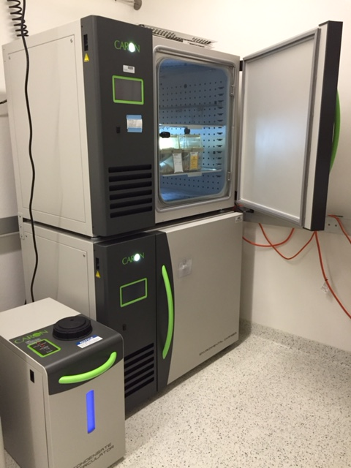

Study setup
Chamber conditions
Precondition: 5 days
Post-infection: 7 days
*
Temp = 20ºC
MX1
Mx1 mice have functional
Type I IFN responses
*
Intranasal
Influenza
Challenge
Remove from chamber
20%RH
3g/m³ AH
50%RH
9g/m³ AH
or

Slide 20
Innate respiratory immunity was optimal at 50% RH, and impaired at RH 20%
Improved muco-ciliary clearance
Enhanced protection induced by Interferon
Decreased inflammation and tissue damage
Enhanced tissue
repair

Slide 21




We have wrongly given (most) microbes a bad reputation
IEQ & Indoor Microbiome
Historical (and Incorrect) Approach to Hygiene
Modern (and Correct) Approach to Hygiene
“Good microbes are essential to our health.”
Overzealous disinfection can result in takeover by pathogens.
“All microbes are bad germs that require total eradication."
In fact, only a small percentage of microbes are disease causing pathogens.
Good microbes actually help prevent disease!

Slide 22
Today’s Discussion
1.
How did we get here? Where did this rogue, species–jumping virus come from?
Understanding the powerful role of RH in health and disease
We have essential work to do, and no time to waste!
2.
3.

Slide 23
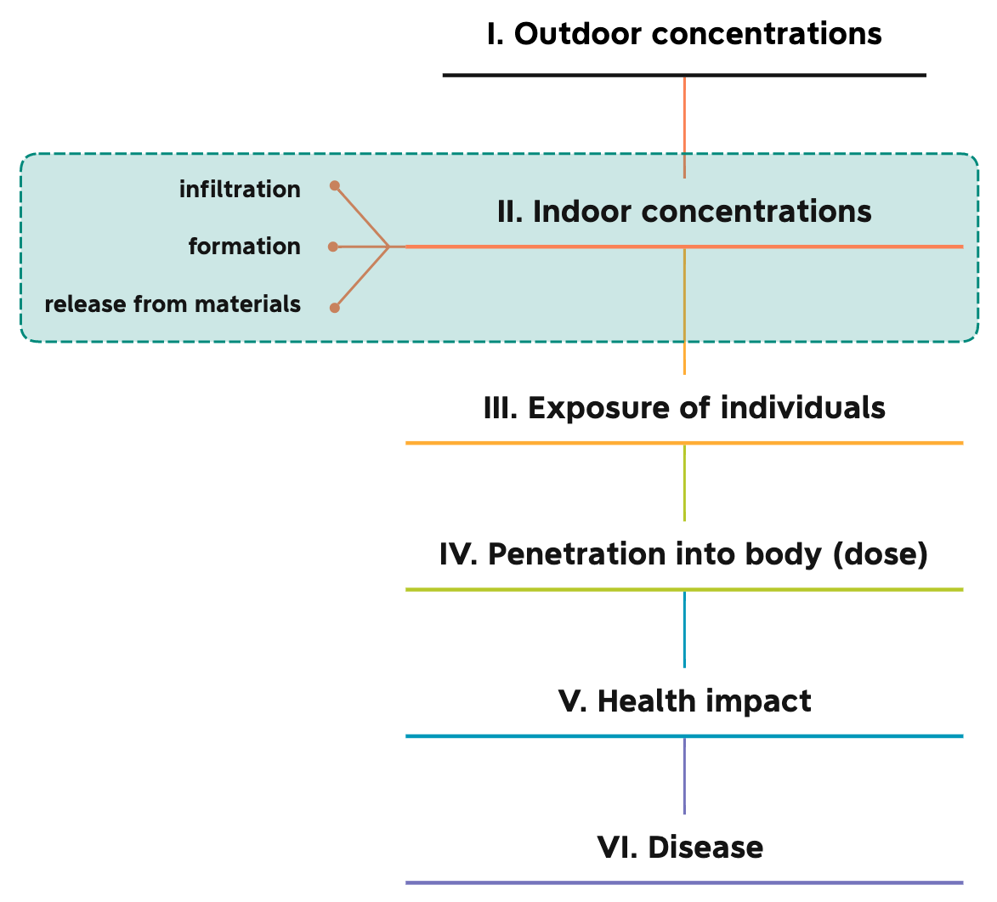
Moving from science to implementation
Starting here

Slide 24







Identify the essential IAQ metrics needed to assess health
11 indoor metrics and secondary compounds formed through interactive indoor chemistry have quantifiable physiological impact on occupant:
  Brain function and productivity
  Short and long-term respiratory health
  Heart function
  Strokes, diabetes, and more

Slide 25
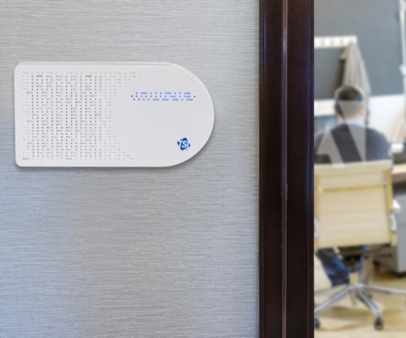
Follow the Data… Continuously Monitor and Measure
Continuously monitor:
  Temp, RH
  Particles (PM_{1.0}, PM _{2.5}, PM ₁₀)
  Total volatile organic compounds
  Gases: O₃, CO, CO₂, NO₂, SO₂
Notes:
The importance of continuous monitoring:
A one-time assessment of IAQ does not account for:
Interactions of different metrics
Changes in use – one of the biggest factors is humans, they shed microbes etc.
Seasonal changes
Know the health impact of your indoor spaces in real time – not a one-time assessment that may or may not be accurate

Slide 26
Do NOT dump all this data on the building manager!

Slide 27


Compile the results and deliver meaningful and actionable data!
RH
HIDDEN LAYERS & INTERRELATIONSHIPS
CONSEQUENCES
TEMP
TEMP
PM 1.0
PM _{1.0}
Immune
System
RH
PM _{2.5}
NO₂
SO₂
PM ₁₀
Inflam.
Health Score
TVOCs
PM 2.5
O₃
Neuro-endocrine
O₃
PM 10
TVOCs
CO
Micro-
biome
CO₂
CO₂
CO
NO₂
SO₂

Slide 28
Examples of reactions that create secondary compounds that influence occupant health and are modulated by water vapor
Oxidation, hydrolysis, acid/base interactions, photolysis, decomposition, and dehalogenation reactions that form:
short-lived radical species
secondary ozonides
oxygenated VOCs
secondary organic aerosols
For example, inhaled compounds that are water soluble impact the upper respiratory tract, whereas less soluble compounds are more likely to infiltrate into the systemic circulation.

Slide 29
Remediation options and flexibility
Why It Matters
TEMP
TEMP
TEMP
TEMP
PM 1.0
PM 1.0
PM 1.0
PM 1.0
RH
RH
RH
RH
NO₂
SO₂
NO₂
SO₂
NO₂
SO₂
NO₂
SO₂
This interrelation allows for both flexibility and precision in where and when remediation is needed. This means a clearer idea of what is needed, and fewer expensive and high-energy fixes.
PM 2.5
PM 2.5
PM 2.5
PM 2.5
O₃
O₃
O₃
O₃
TVOCs
TVOCs
TVOCs
PM 10
TVOCs
PM 10
PM 10
PM 10
CO₂
CO₂
CO₂
CO₂
CO
CO
CO
CO

Slide 30

Real-time health score and, if needed, remediation steps are recommended
The comprehensive Health Score and its components are reported in real-time
Interventions such as humidity control, increased ventilation or filtration, etc. are monitored and reported for efficacy
Notes:
You can see scores for both:
The areas covered by each sensor
The building as a whole
The centralized number keeps you from chasing your tail – instead of trying to figure out the different levels of each indoor air pollutant and derive the impact for yourself, we will tell you in real time how your indoor environment is harming or supporting the health of your residents

Slide 31
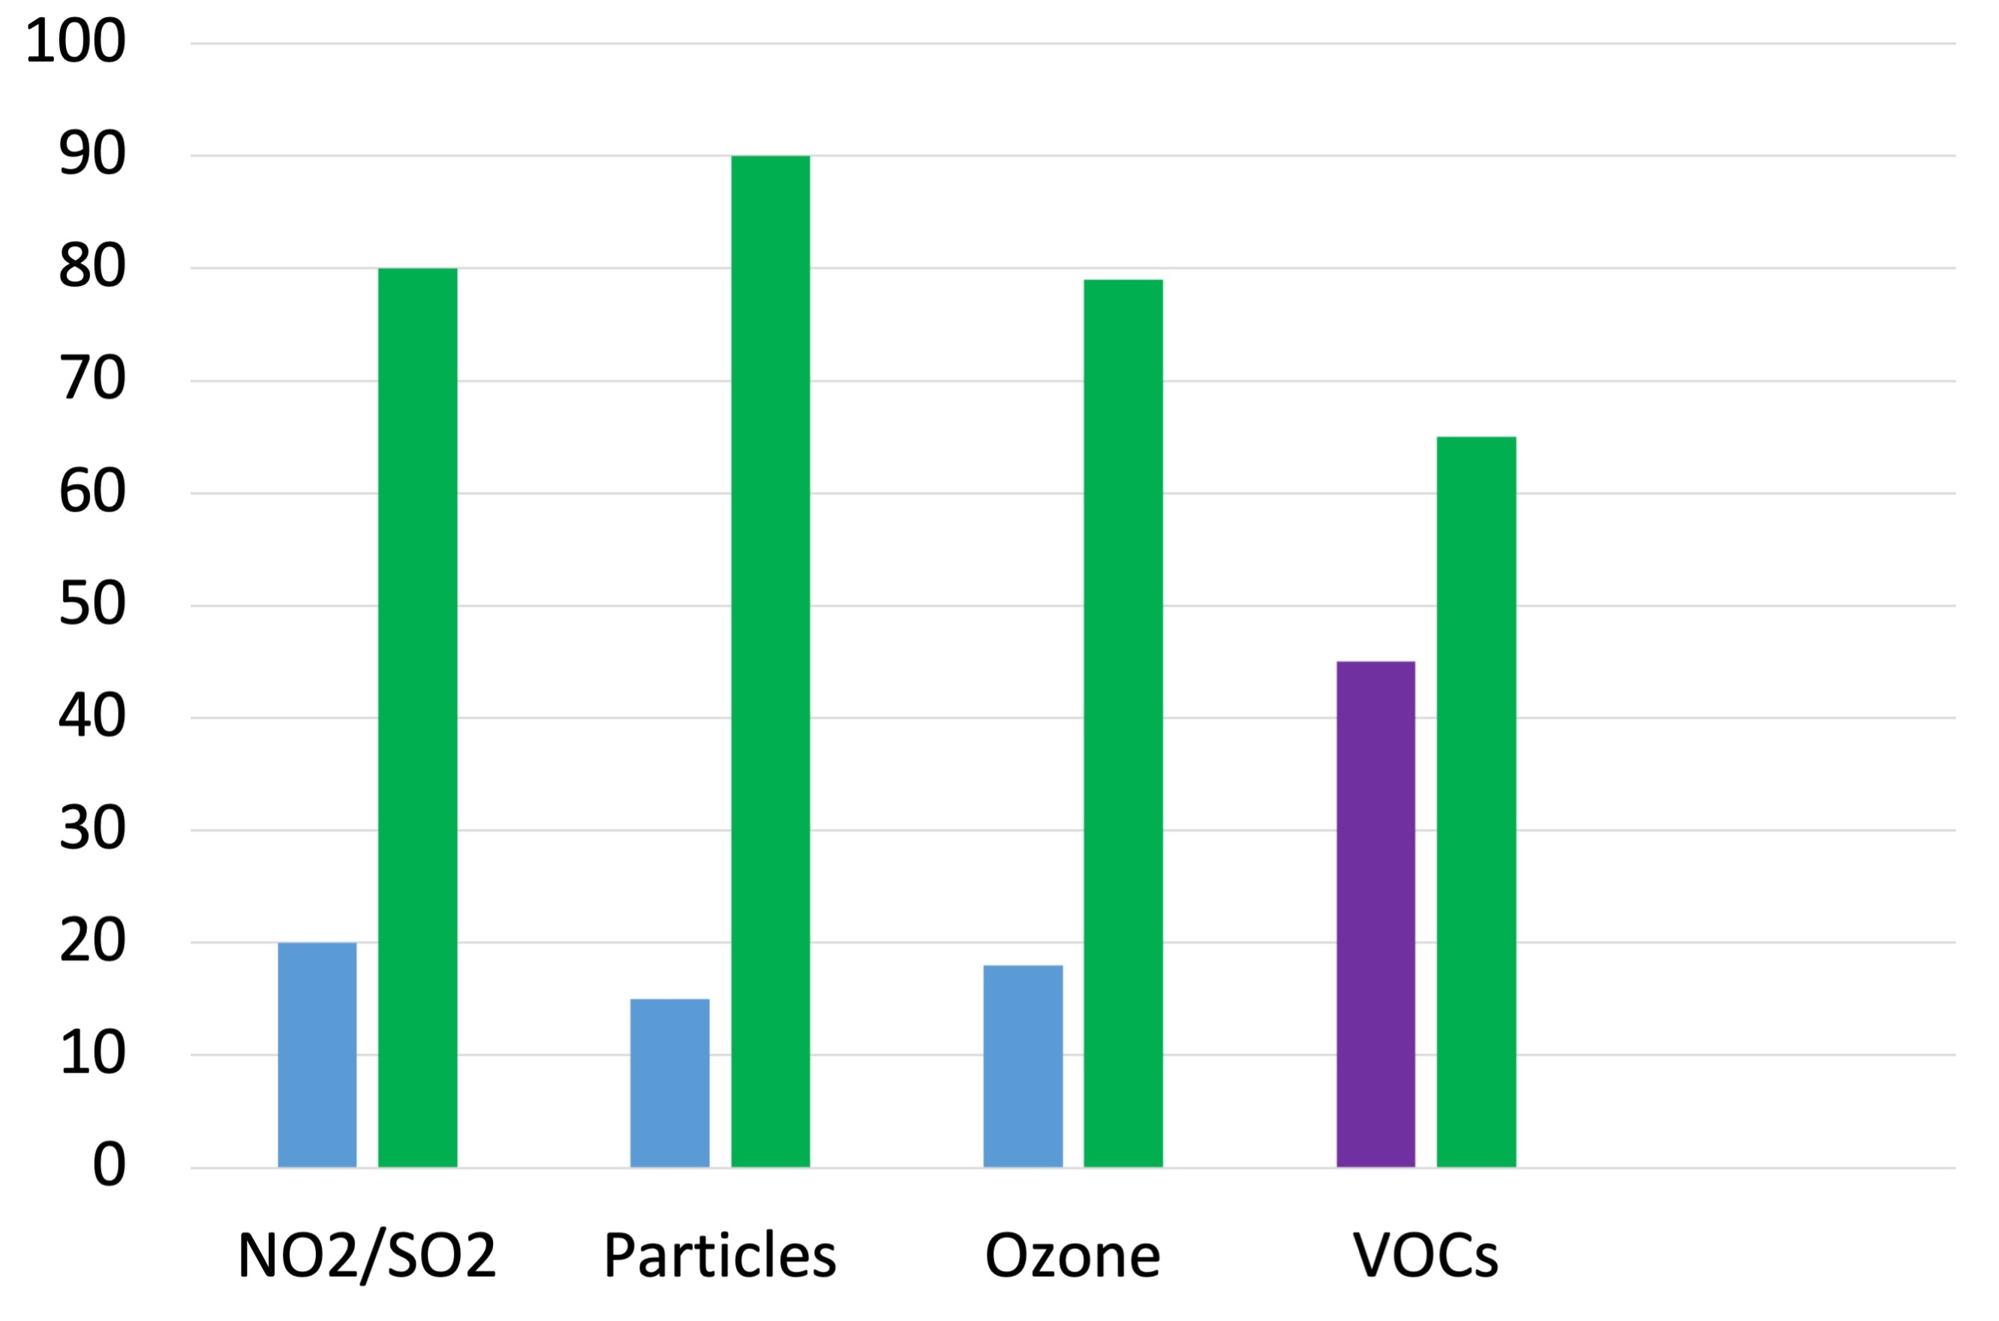
Keeping indoor RH 40–60% decreases health influence from other indoor pollutants
(Good)
RH 40-60
RH < 40
Health Impact Score
RH > 60
(Bad)

Slide 32
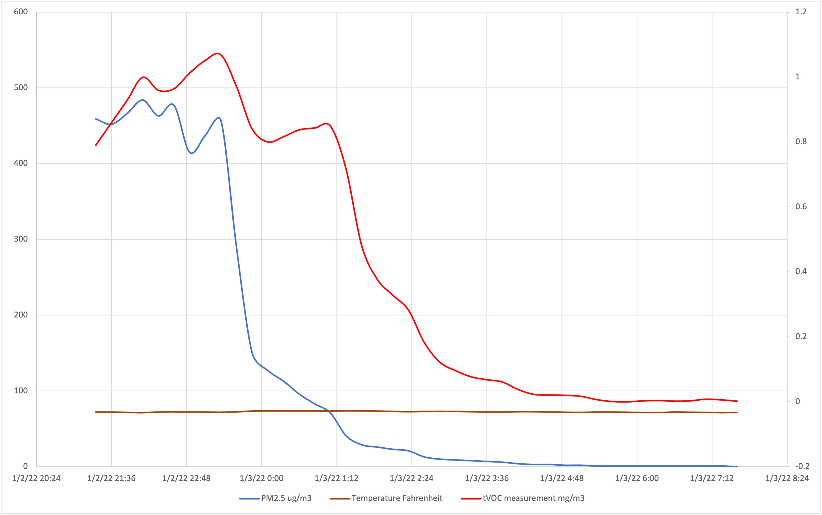
Humidification reduced particles and VOC’s within 15 minutes
Humidification turned on
Bad
Total VOCs
PM_{2.5}
Indoor concentrations
Good

Slide 33
Summary of B4H.Dx Scores over two weeks at Condair Pfaffikon, SZ
Health Index B4H.Dx scores are excellent, all above 70
Relative Humidity (RH) is consistently excellent, with only a few hourly dips below 40%, with a low of approx. 35%
There is variability with indoor conditions detected by several sensors (details in following slides)
The indoor conditions are well modulated by RH, as evidenced by outdoor fluctuations without indoor changes
As outdoor weather changes, the confirmation of indoor conditions that support health should be confirmed by ongoing monitoring and B4H.Dx score reporting throughout the changing seasons

Slide 34
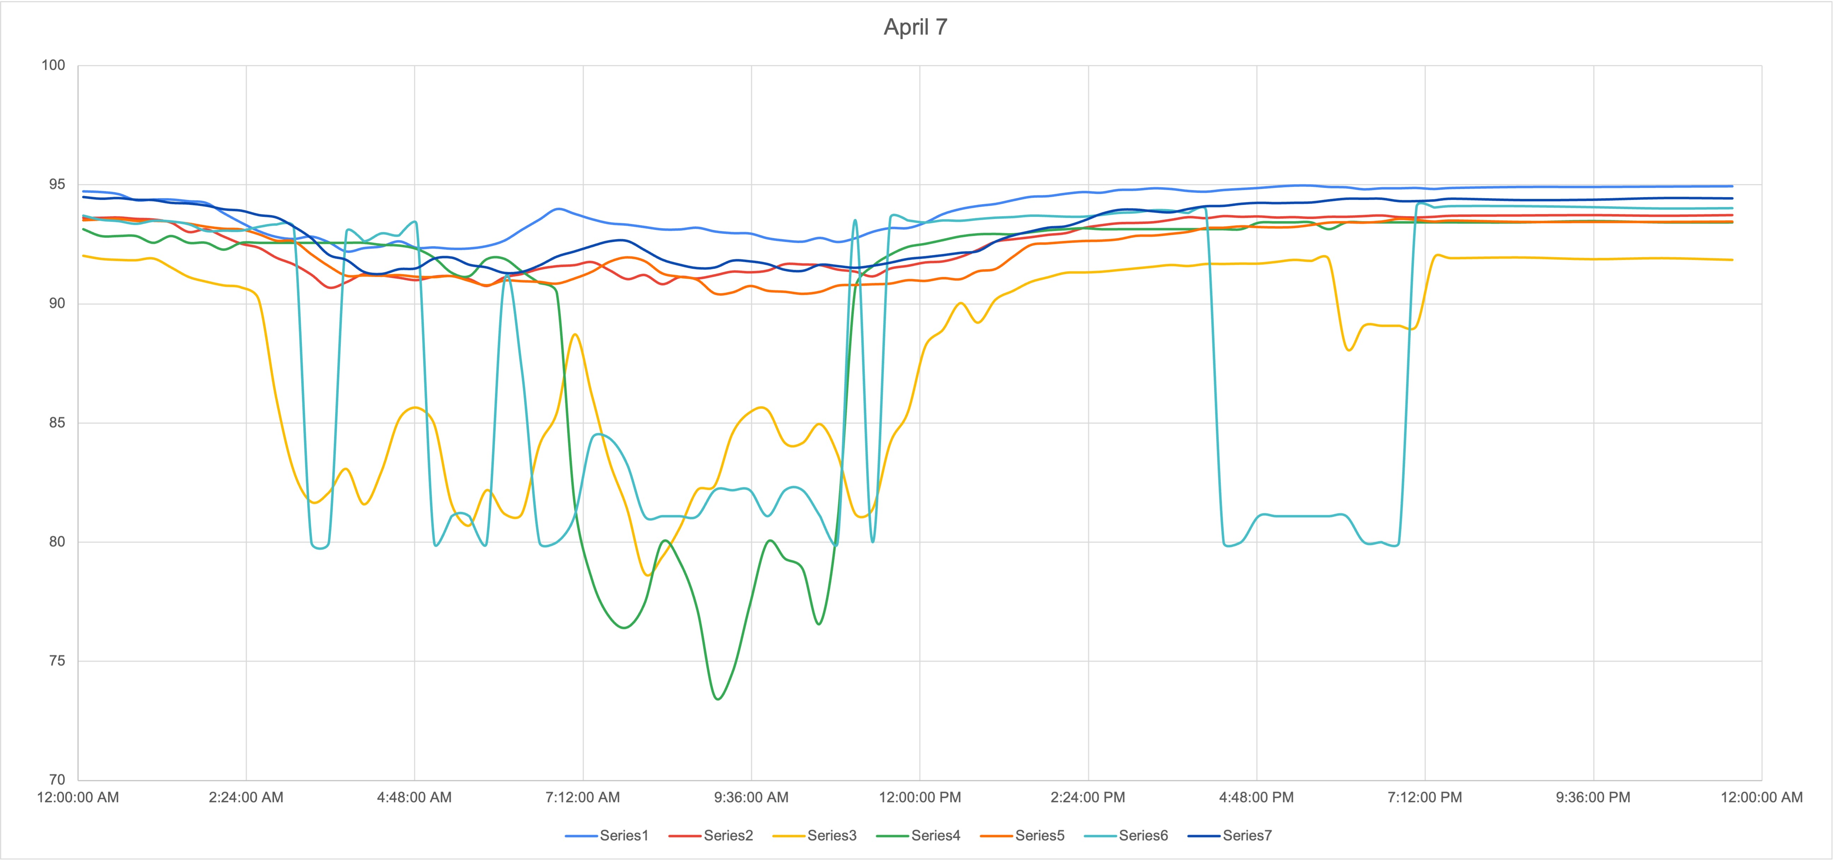
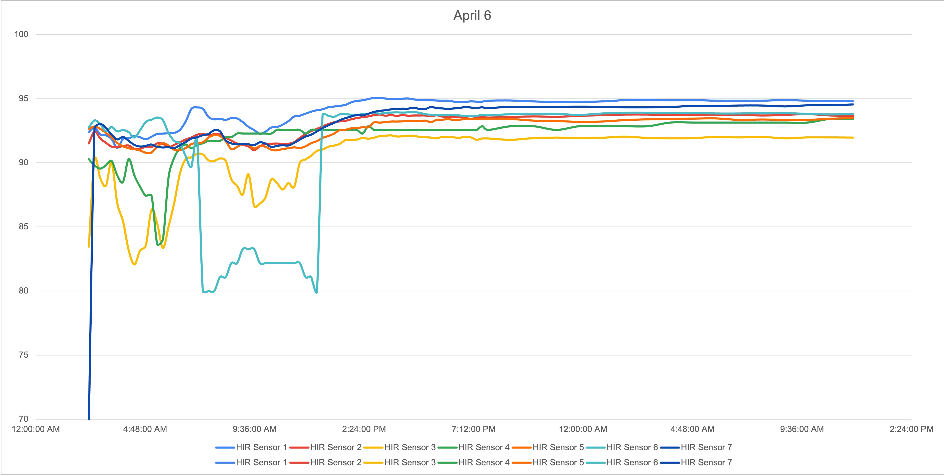
April 7: Health Scores in all areas are excellent
100
B4H.Dx
80
Note: times are in EST

Slide 35
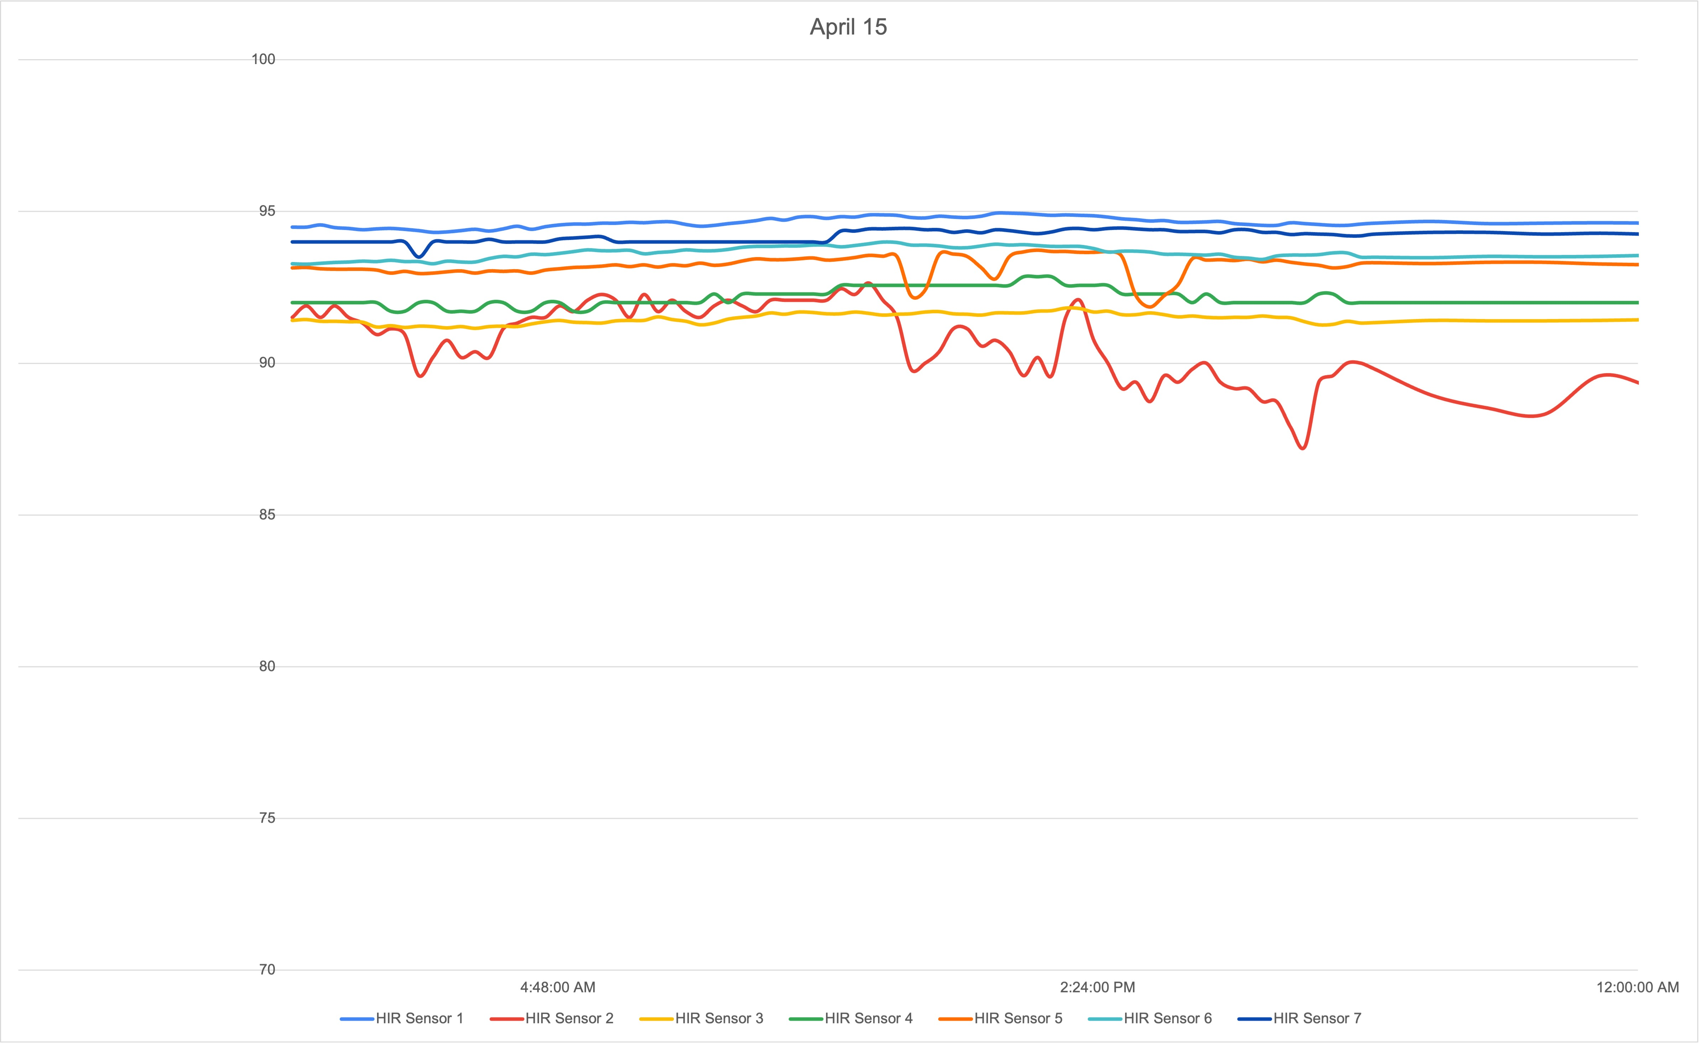
April 15 holiday
100
B4H.Dx
80
Note: times are in EST

Slide 36



Healthy occupants create positive economic returns in every type of building
Commercial Businesses
Schools
Senior Care
Communicable respiratory illness costs the workforce over $225 billion per year due to absenteeism and decreased worker satisfaction and productivity.¹
Properly managed indoor air can:
Increase occupant function & productivity
Attract and retain tenant talent
Differentiate buildings in low occupancy, competitive markets
Poor IAQ reduces individual student grades by 3-7% and lowers the number of students performing in the highest standardized test categories in both math and reading by 3-4%.²
Properly managed indoor air can:
Enhance learning via improved cognitive functioning e.g. concentration, memory, energy level, hand-eye coordination
Decrease absenteeism
Improve test scores
Optimized indoor environments improve resident outcomes by decreasing acute illnesses requiring transfers to hospitals, improving patient memory and balance and decreasing mortality rates.³
Properly managed indoor air can:
Improve resident health and function
Build brand equity via health content and education
Differentiate your brand via
proactive health protocol

Slide 37
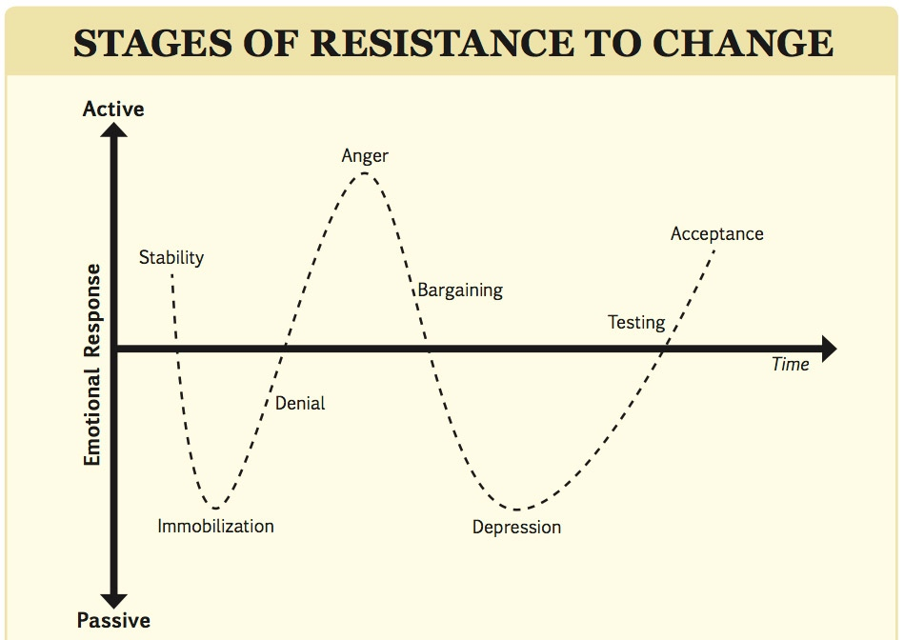

Old Habits Die Hard!
1. Energy focus will be challenged.
2. Building owners resist capital costs.
3. Will health related IAQ data open the door to litigation risks?

Slide 38
COVID-19 has ushered in a new dawn, let us not waste this opportunity
Our job:
Understand that humidification control mitigates harm not only from excessive evaporation, but also from other indoor pollutants such as particles and gases
Continue research, bring awareness through established channels, establish a minimun RH level of 40%
  CONDAIR Network
  ASHRAE committees and Distinguished Lecturer program
  RHEVA, Leapfrog Hospital Safety, Mayo Clinical Proceedings
  B4H, National Science Foundation Innovation Engine grant

Slide 39
Conclusions
By giving visibility to the health impact of the indoor environment, we have a scientific basis for managing IAQ to support occupant health, productivity and learning
By knowing the interactive chemistry, attainable remediation can diminish the harm of interacting indoor pollutants
Humidification to RH 40–60 is a foundational step in supporting health
Healthy people increase the profitability of businesses and the success of our species

