Slide 1

Condair DL: A Breath of Fresh Air
Karly Treleaven, Technical Product Manager
Jerry O’Neill, Regional Sales Manager

Slide 2
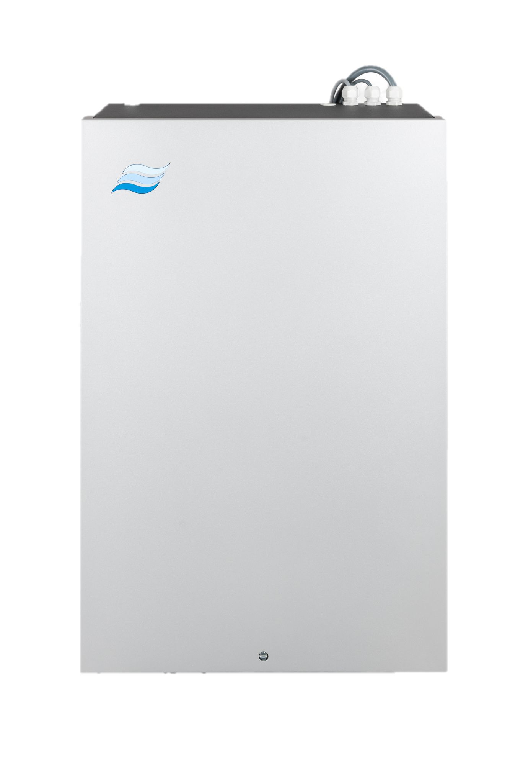
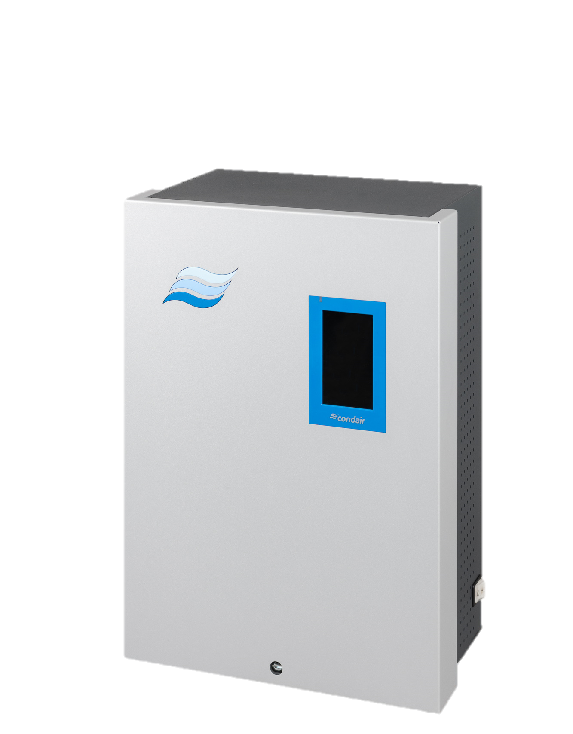
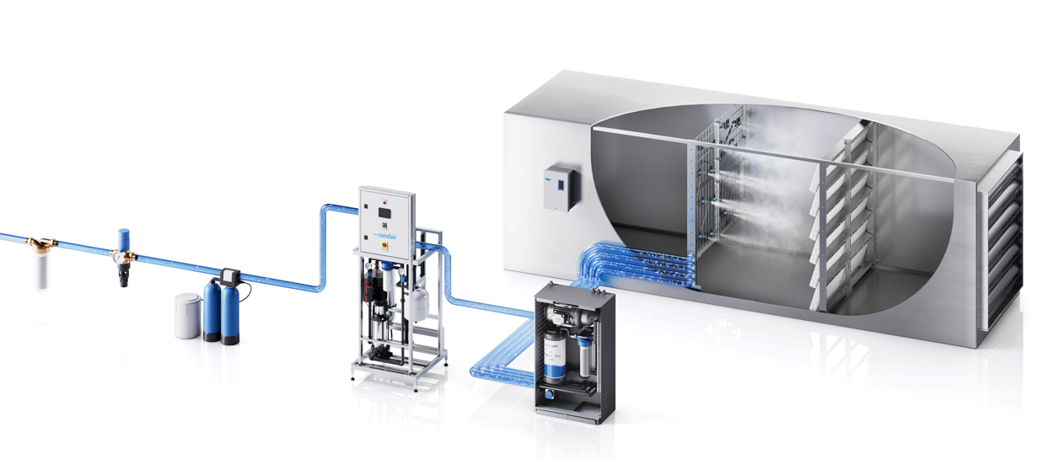
Technical Overview + Benefits
Dual Technology – Condair Exclusive!
Next Generation Integrated Controller
Filter
Reverse Osmosis
Required
Backflow Valve
Softener
Notes:
Explain starting at incoming water
Water filter to remove chlorine
Backflow valve recommended to prevent contamination of the water lines
Softener to remove calcium - required for RO
Reverse osmosis - remove any contaminants to purify water for spraying into the air stream
Next generation integrated controller - BTL certified BACnet and Modbus as standard, new user interface & functionality, new modernized look for control and central units

Slide 3
Technical Overview + Benefits
Dual Technology – Condair Exclusive!
Next Generation Integrated Controller
Low-Pressure Nozzles
43.5 psi – 101.5 psi
Patented Ceramic Media
Very low pressure drop, <0.20 IWC @ 500 fpm
Filter
Reverse Osmosis
Required
Backflow Valve
Softener
VFD Booster Pump
DL Type A
HygienePlus System
Patented silver ion dosing of supply water
Notes:
Low-pressure nozzles - operate between 43.5-101.5 psi, less energy consumption, low wearing (less maintenance), full spray coverage of media
Ceramic media - lower pressure drop than traditional media (also makes it ideal for retrofits), increase efficiency, decrease installation length, do not require replacement
VFD booster pump - Type A systems. Improves modulation above 60-70% unit capacity by boosting supply water pressure
HygienePlus system - Continuously treats the water circuit - Hoses, nozzles and ceramics. As water evaporates off the ceramic, silver ions are left behind sterilizing the ceramic plates as well. Silver ion dosing concentration is calculated based on the system demand (demand-controlled dosing), so there is minimal silver ion concentrations in the discharge air and drain water

Slide 4
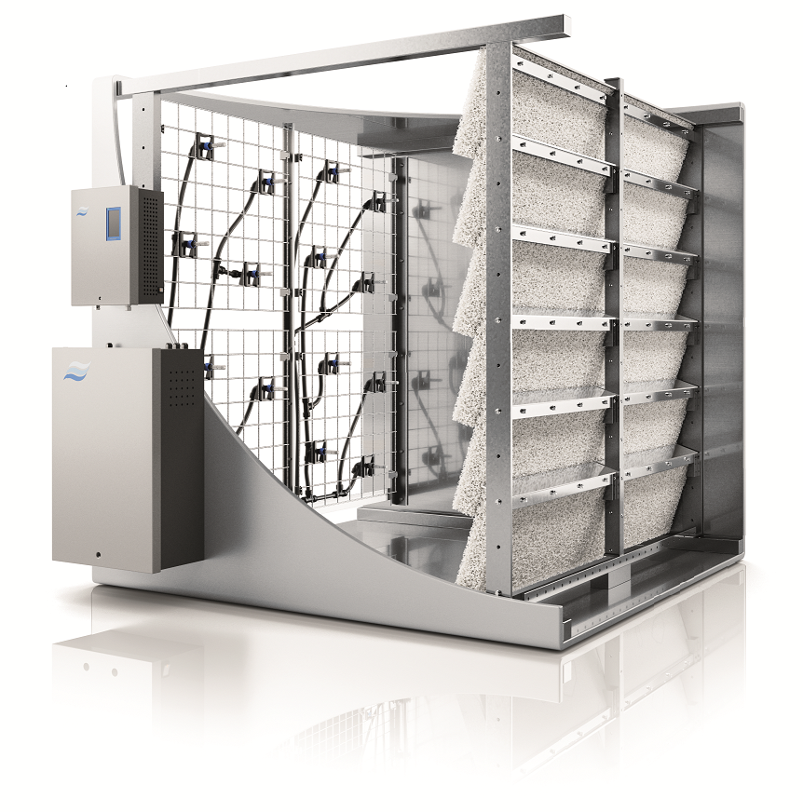
DL Quick Facts
Customizable size, staging, and modulation
Compatible with RO water (0.5 – 15 μS/cm)
Outdoor enclosure available
Versatile humidifier, engineered for adaptability
7, 15, or 31 stages of control
4 ft installation length including recommended clearances
Minimum install length 23.6”
Dimensions | Min. | Max. | Increments | Capacity
Width* | 18” | 165” | 1.9” | Up to 2200 lb/hr
Height | 18” | 157” | 1.9”
*Custom widths up to 330”
Notes:
Flexible system customized to the users specific needs
Width from 18-330" and heights from 18-157"
High degree of controllability
Maximum capacity of 220 lbs/hr for a single system
Shortest installation footprint -- Just 4 feet required including clearances, can be minimized up to 23.6"
Outdoor enclosure available
footprint

Slide 5

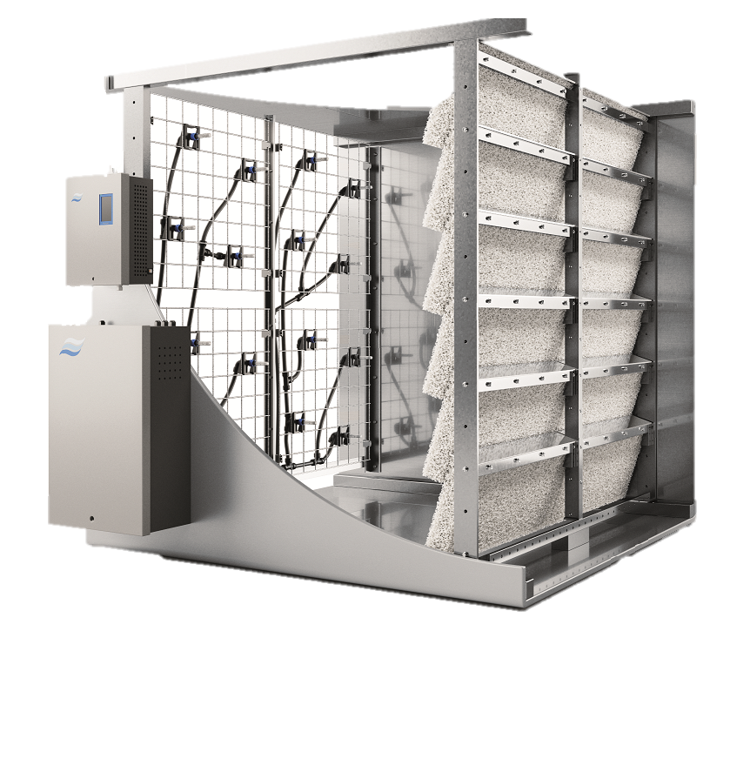
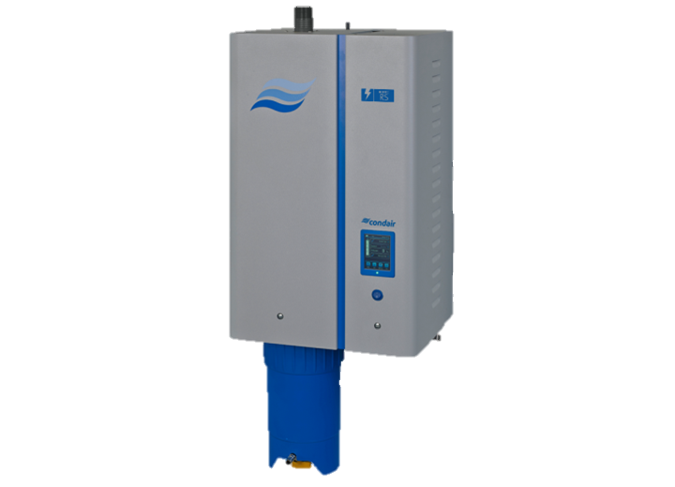
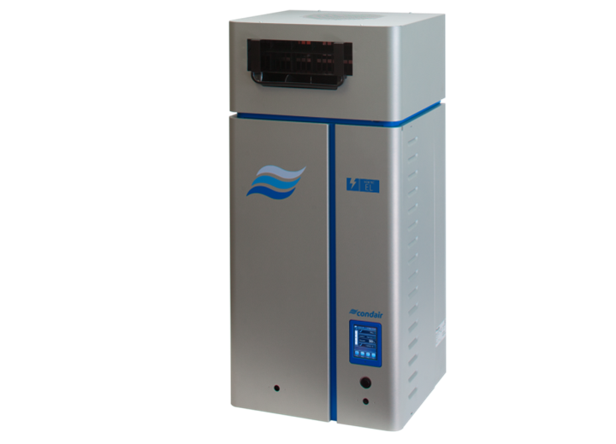
ELECTRIFICATION
Application: Hospital
Load: 2200 lbs/hr
 | Power Consumption (kW) | 2000 hours @ $0.08/kW
DL Series
RS Series
EL Series
2.6
$416*
780
$124,800
737
$117,920
*With beneficial evaporative cooling

Slide 6
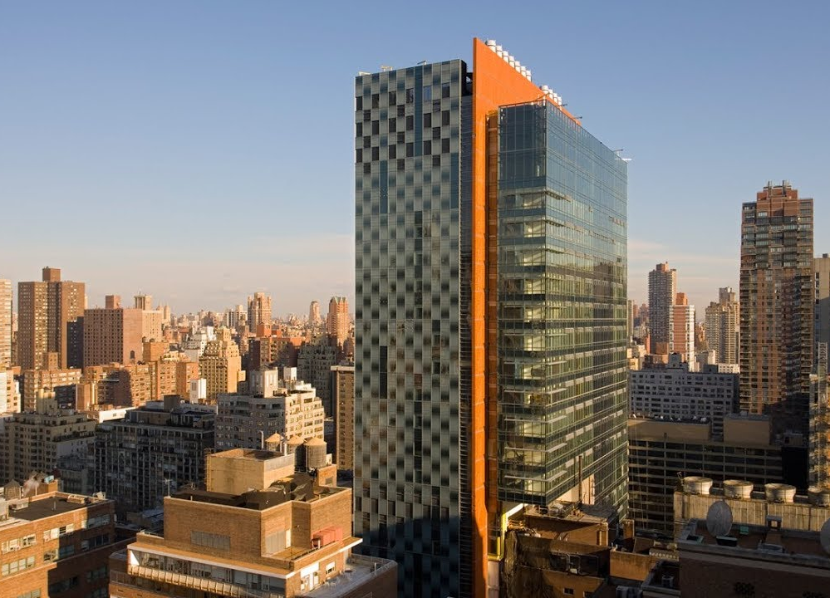

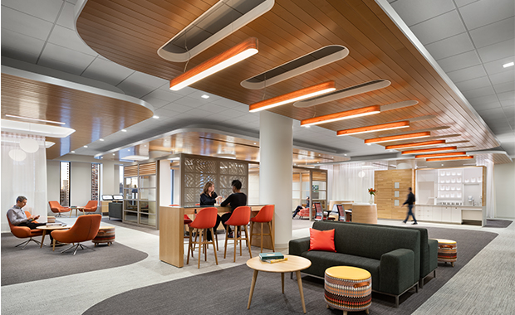

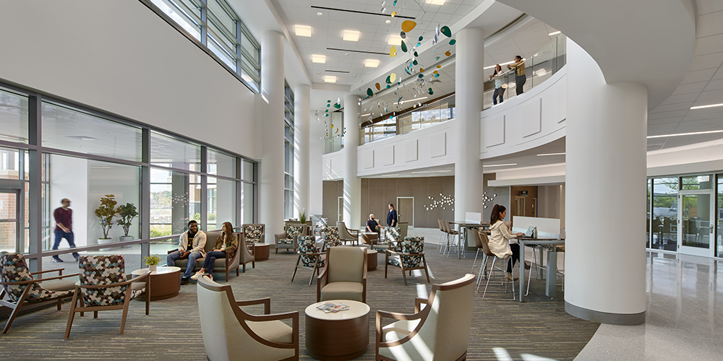
Existing DLs
All projects additionally included installation & annual maintenance contracts
$$$
Memorial Sloane Kettering – New York, NY
David H. Koch Center for Cancer Care
$420k
Essentia – Duluth, MN
$650k
University of Maryland Medical Systems – Largo, MD
Prince Georges Regional Medical Center
$700k
Notes:
All reps signed installation, annual maintenance, etc.

Slide 7
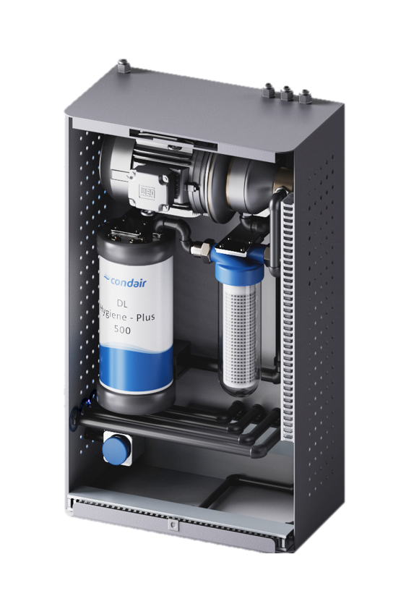

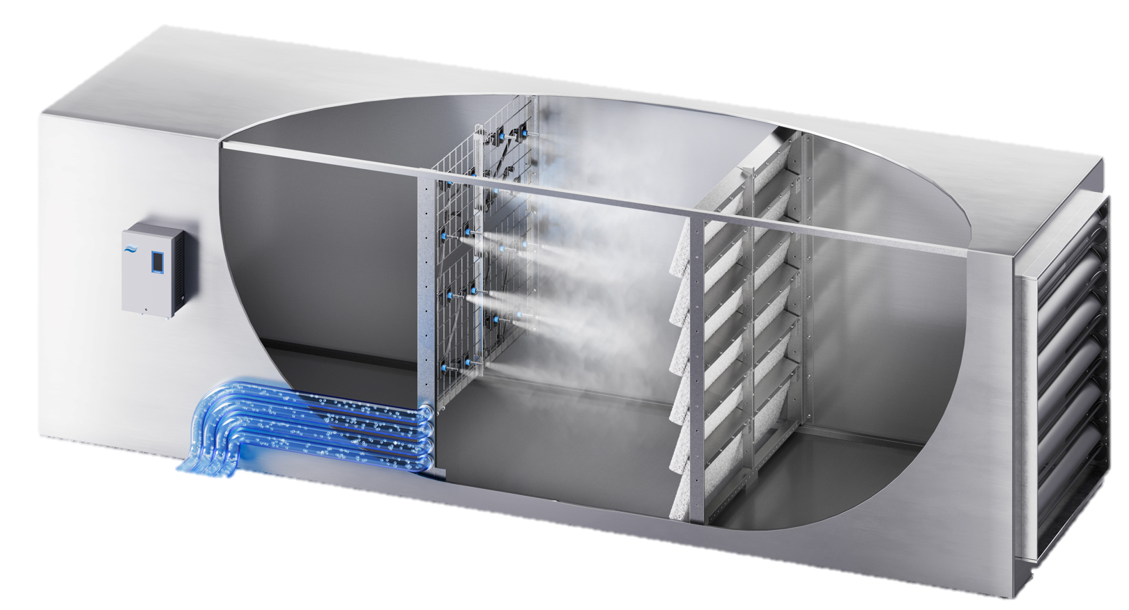


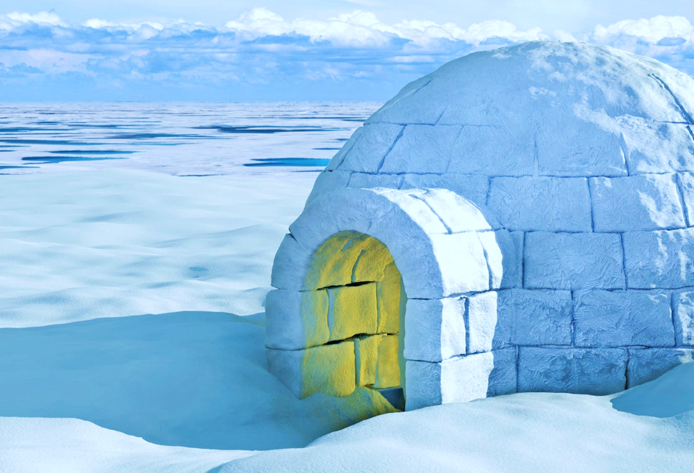
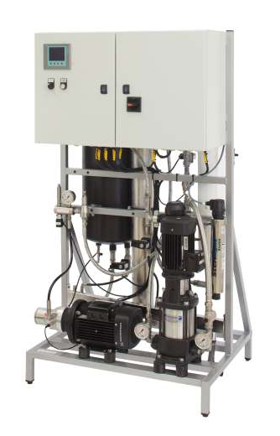
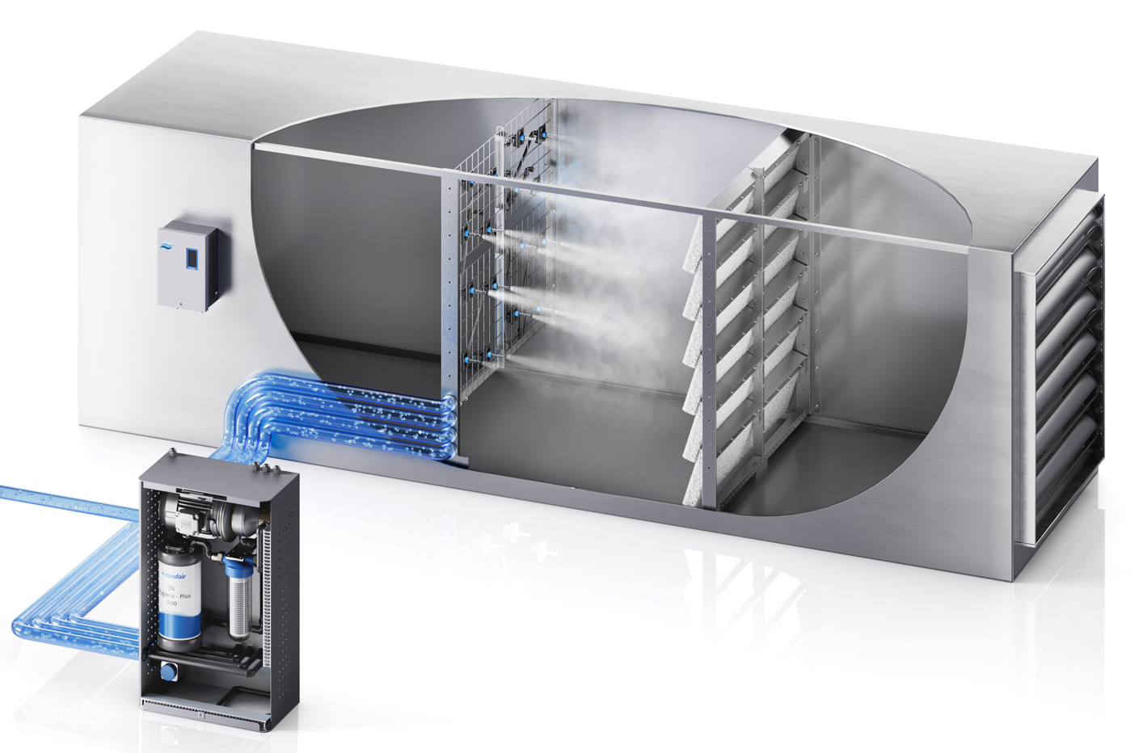
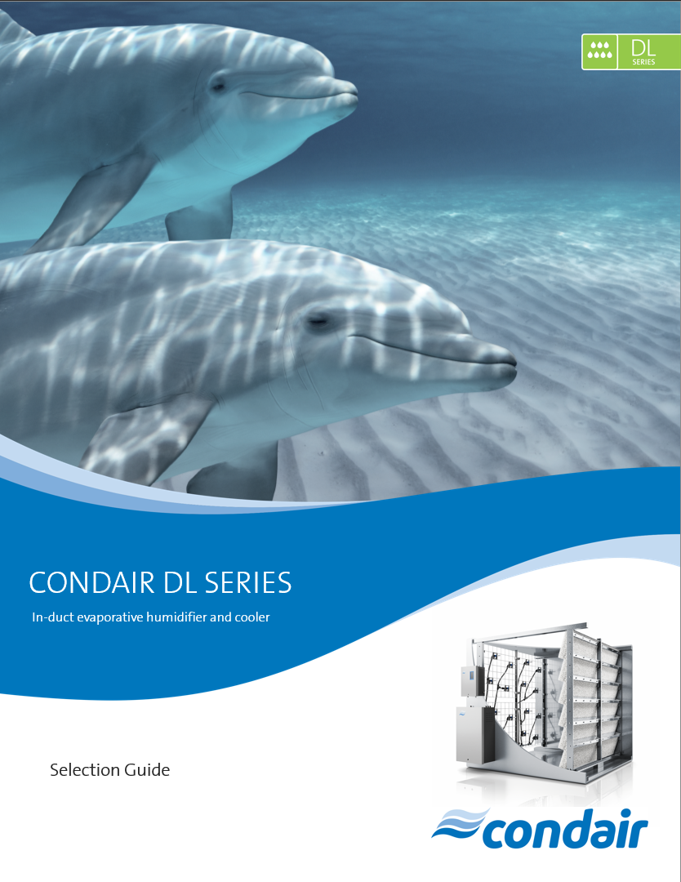
FAQ
Can one DL central unit feed multiple AHUs?
Is the DL only suitable for warm, dry climates?
One MLRO skid can feed multiple DL units!
The DL is suitable for any application, in any climate.
Check out the new DL Help Selection Guide!
Notes:
Common misconception – mix up with HP which is common in-duct technology
Because HP pump skids can feed multiple units it is often assumed that the DL can do this as well
DL is fed from central unit (booster pump, hygieneplus) so each system requires it's own central unit
However, one RO skid can feed multiple DL units
DL is only suitable for warm, dry, climates - no! The DL is suitable for any application, in any climate.
Learn more about how to properly size and select the DL for your application's specific needs - DL Selection Guide

Slide 8
Key Takeaways
It’s a unique product!
Unique system Nothing else like it on the market!
Suitable for every application Canada to Mexico, retrofit to new build!
Most energy efficient & hygienic humidifier
Full service No call backs or site visits, Condair can take care of it all!
Installation, owner training, service & preventative maintenance packages
One and done! Minimal maintenance, silver ion canister is only consumable
The Next Generation of humidification is here.
Notes:
Nothing else like it on the market
Great for retrofits or limited-space, applications where hygiene is important, where you need a high degree of control or a more energy efficient option
Condair offers installation, owner training, service & preventative maintenance packages so you don't have to worry
Minimal maintenance, silver ion canister is only consumable and lasts for about 4000 hours @ 100% output

Slide 9
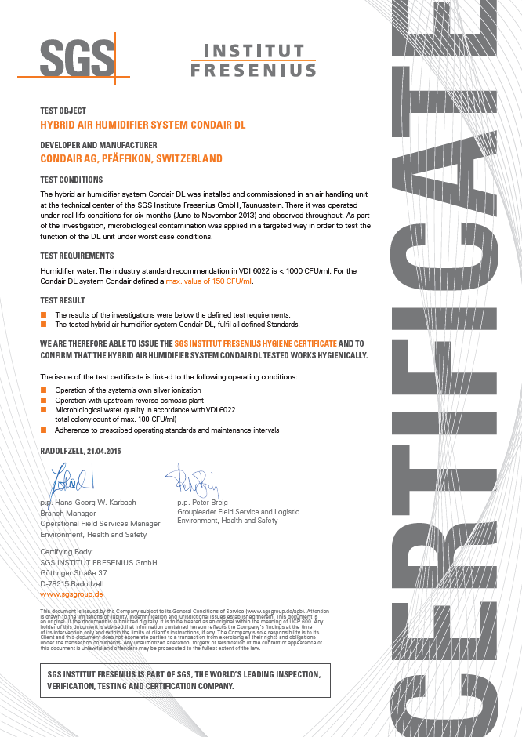

Fresenius Hygiene Certificate
One-of-a-Kind Hygienic Humidification
Certified by SGS Fresenius Institut, the world’s leading inspection, verification, testing and certification company
DL is the only humidifier to have this
Third party hygiene certification
Very strict hygiene requirements
Notes:
Engineers/customers have hygiene concerns
European hygiene certification required for hospital equipment like kidney dialysis treatment
Certified to a higher standard than their regular VDI 6022

Slide 10
Thank you!
Karly Treleaven
Karly.Treleaven@Condair.com

