Slide 1
Condair Adiabatic in AHU
WE OWN the Playing Field!

Slide 2
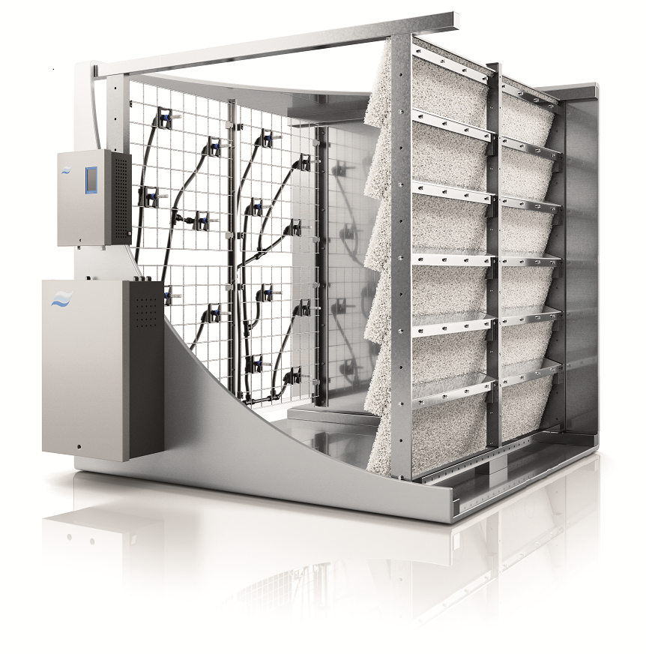
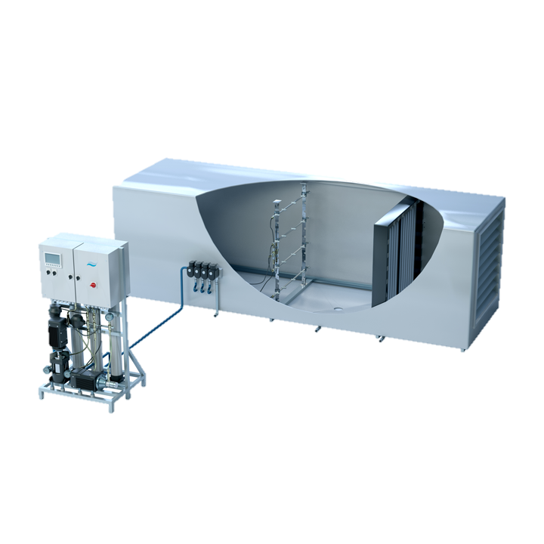
ME vs. DL vs. HP in AHU
ME
Minimum Installation Length
44” / 3.7 feet
46”- 58” / 4-5 feet
84” / 7-10 feet
ME Series
Evaporative Media
DL Series
Low Pressure Nozzles
+ Ceramic Media
HP Series
High Pressure
HEATING COIL
COOLING COIL
18” min. 20” 6”
DL
HEATING COIL
COOLING COIL
18” min. 24” 4”
HEATING COIL
NOZZLES
COOLING COIL
MIST ELIMINATOR
18” 60”- 96” 6”
 | HP | ME | DL
Installation | Duct | Duct | Duct
Requirements | Wet Section (5ft), Assembly | Assembly | Wet Section (3-5ft), Assembly
Modulation | 1 - 15 stages ± 2% Or Custom | 1 - 5 stages ± 10-15% | 1 - 15 stages ± 2%
Start Up Time | Instant | 15-20 min. | Instant
Water Types | RO / DI | All | RO / DI
Noise | Moderate | Very Low | Low
Pressure Drop | Negligible – 0.15" | 0.25" - 1.0" | 0.15” – 0.5”
Capacities | Up to 2860 lbs/hr | Up to 1800 lbs/hr | Up to 2200 lbs/hr
Maintenance | Pump, RO System | Media, UV Light | RO, Silver Ionization

Slide 3
Condair High Pressure Flexibility

Slide 4
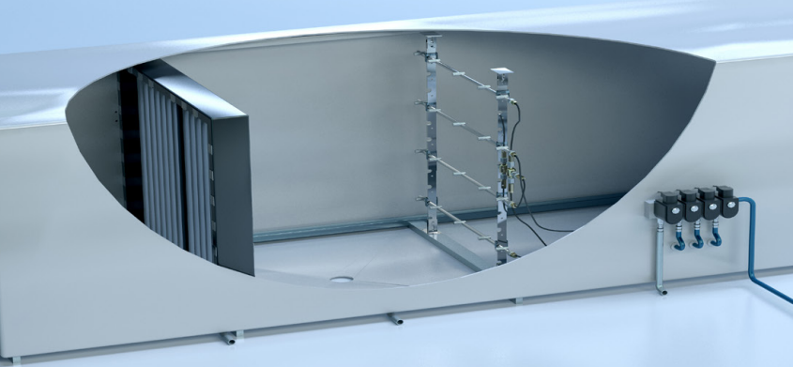
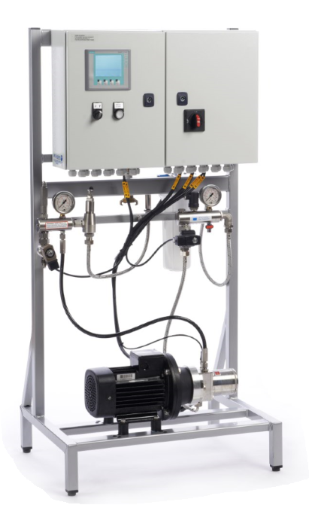
Up to 2,860 lbs/hr with One Pump System

Slide 5
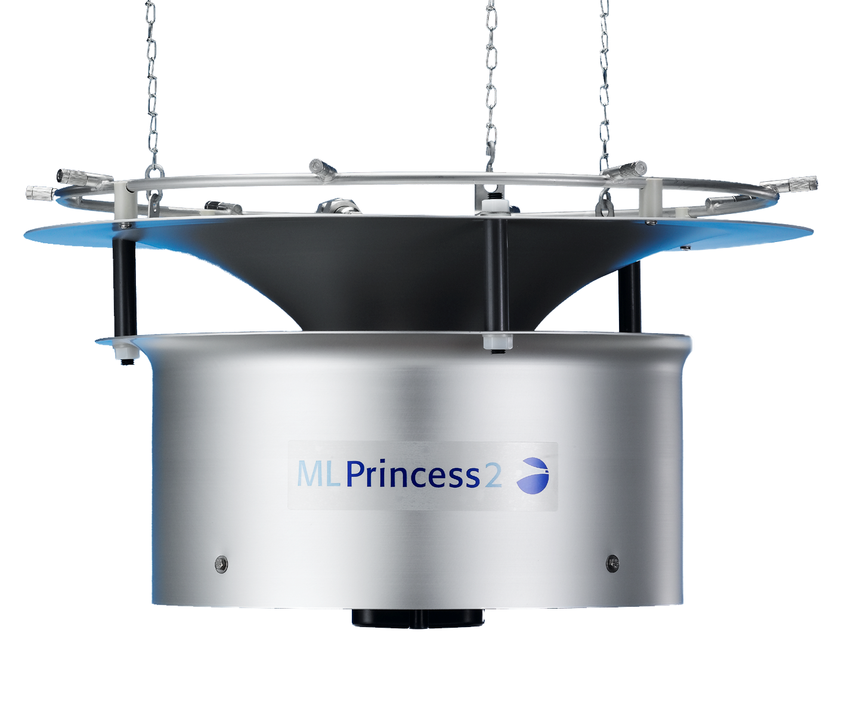
Up to 2,860 lbs/hr with One Pump System

Slide 6
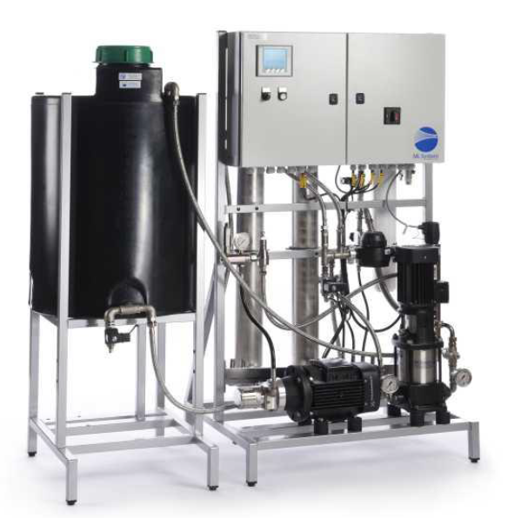
Up to 2,860 lbs/hr with One Pump System
Integrated RO System

Slide 7
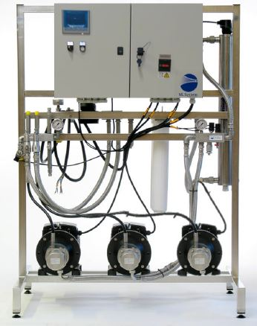
Up to 7,937 lbs/hr
Three Pump System
Offers Redundancy

Slide 8
Run Pump A for 1,000 hours
Run Pump B for 1,000 hours
Run Pump C for 1,000 hours

Slide 9
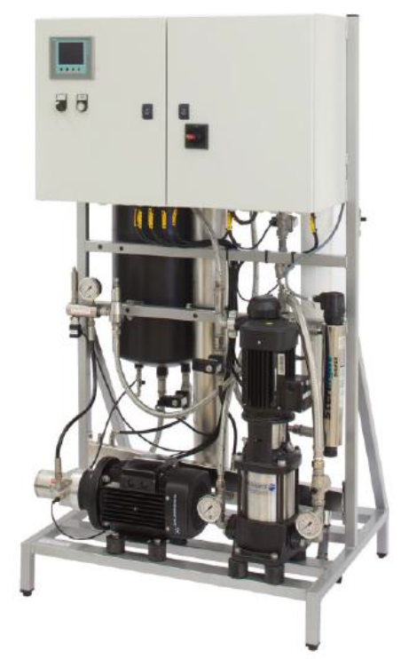

Slide 10
Custom High Pressure
Smithsonian Air and Space complete building renovation
3 MLPRO Skids (RO and HP)
33 AHU’s throughout the museum.
All three skids are tied together for redundancy.
Primary Skid = 70% of full load
Secondary Skid = 30% of full load
Backup Skid = ready if needed
Full Pump AND RO redundancy
We are the ONLY one to offer this flexibility

Slide 11
A look at the competition for High Pressure
MeeFog
GoFog
Oil Cooled Pumps
Brass, lot’s of Brass….
Same pumps used for your local car wash…
Don’t offer Redundant skids, only pumps...
Still doing belt driven pumps.
Condair offers the most flexibility of any competitor

Slide 12
A look at the competition for High Pressure
DriSteem
Late to market
Aren’t truthful when it comes to water usage or length of tunnel.
Desperate to sell HP against the DL… They will say their High Pressure will do the same as a DL. Don’t take the bait, call us for help and support.

Slide 13
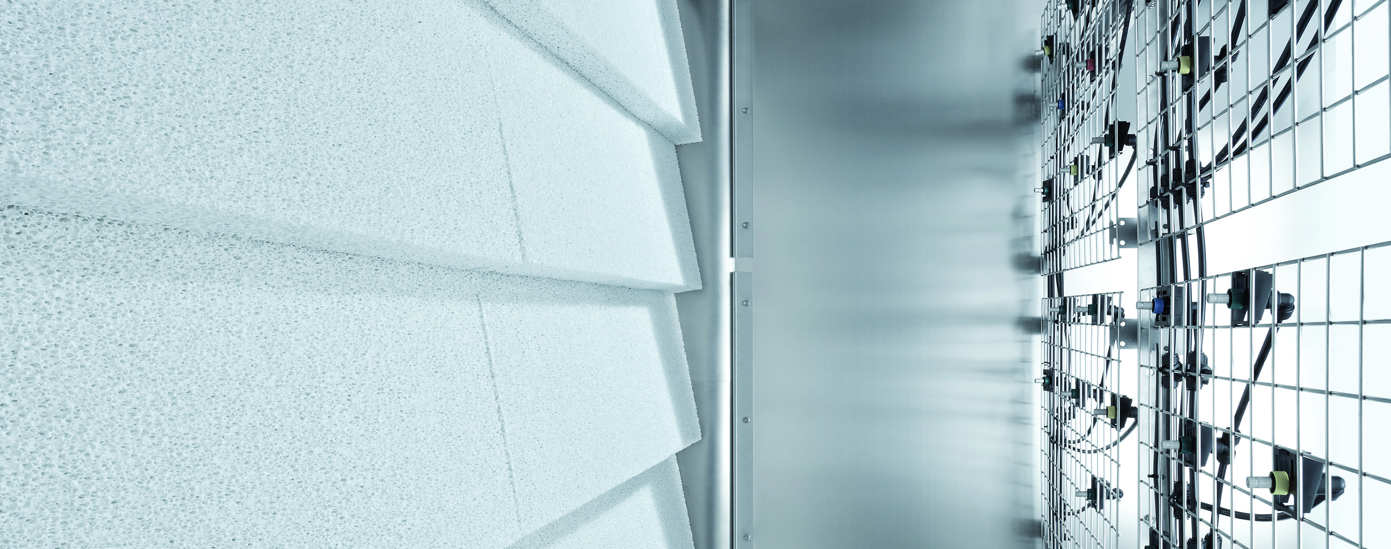
Condair DL vs. in AHU ultrasonic

Slide 14
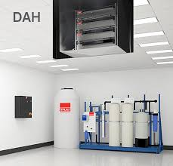
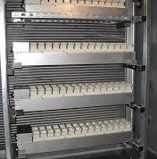
Stultz Ultrasonic vs DL and HP
Stultz Ultrasonic in Duct/AHU
Expensive
Typically have both an Ultrasonic Tank AND Auxillary Blower (for AHU speeds below about 200 fpm)
Difficult to maintain (remember it’s inside the AHU)
They won’t say how long of a tunnel is needed, or recommend a mist eliminator
Thus, they won’t say how much water they waste
DL typically ½ the cost with none of the maintenance headaches.
DL also MUCH shorter installation distance.
Hygiene, Hygiene, Hygiene

Slide 15
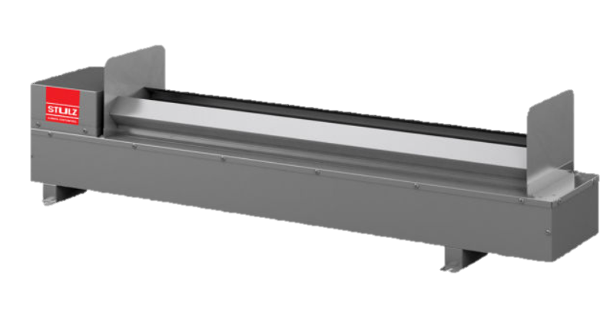
DL vs. HP vs. Ultrasonic (stultz)
Minimum Installation Length
46”- 58” / 4-5 feet
84” / 7-10 feet
98” / 8 - 11.3 feet
DL Series
Low Pressure Nozzles
+ Ceramic Media
HP Series
High Pressure
Ultrasonic* by Stultz
*Not a Condair product!
DL
HEATING COIL
COOLING COIL
18” min. 24” 4”
HEATING COIL
NOZZLES
COOLING COIL
MIST ELIMINATOR
18” 60”- 96” 6”
US
HEATING COIL
COOLING COIL
MIST ELIMINATOR
20” 14” 60” – 96 (Unpublished)
 | HP | ME | DL
Installation | Duct | Duct | Duct
Requirements | Wet Section (5ft), Assembly | Assembly | Wet Section (3-5ft), Assembly
Modulation | 1 - 15 stages ± 2% Or Custom | 1 - 5 stages ± 10-15% | 1 - 15 stages ± 2%
Start Up Time | Instant | 15-20 min. | Instant
Water Types | RO / DI | All | RO / DI
Noise | Moderate | Very Low | Low
Pressure Drop | Negligible – 0.15" | 0.25" - 1.0" | 0.15” – 0.5”
Capacities | Up to 2860 lbs/hr | Up to 1800 lbs/hr | Up to 2200 lbs/hr
Maintenance | Pump, RO System | Media, UV Light | RO, Silver Ionization

Slide 16
Ultrasonic vs. DL
Cyber security laboratory – West Point
Making swap due to price and hygiene.
Great story of how our agent was able to work along side the contractor to gain acceptance.
Contractor was tasked with trying to make some sort of rail system so modules could be slid out of the AHU for cleaning and repairs.
Better water utilization.
DL has none of the downside and can allow for a shorter AHU.
Easy to Maintain
Hygienic
GO ARMY! BEAT NAVY!!!

Slide 17
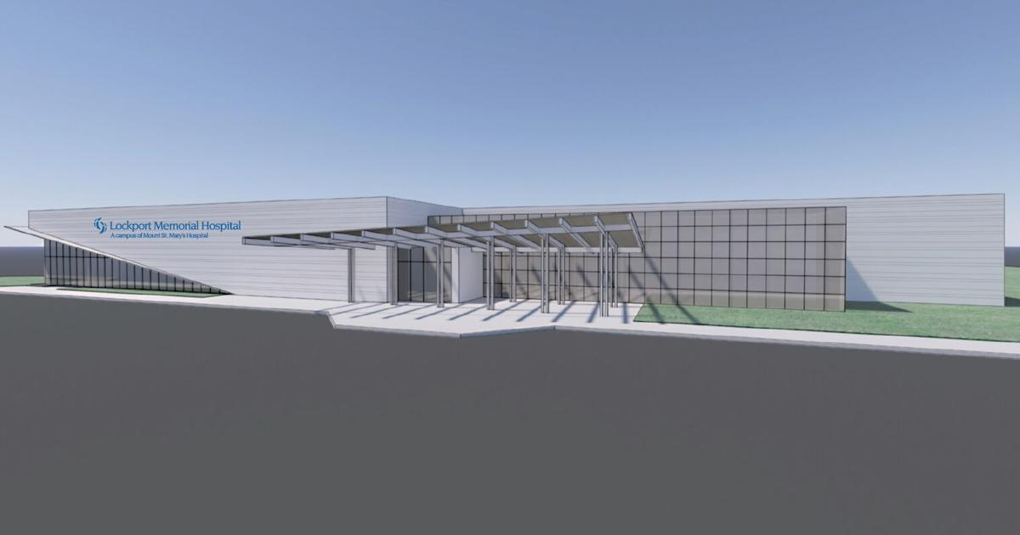
Ultrasonic vs. DL
Lockport Memorial Hospital
Congratulations to our newest agent, JW Swanson in Buffalo NY.
Their sales engineer, Dan Arnold, was able to convince his design engineer to move to DL from Ultrasonic.
They did this in the first week of business with Condair!!!!
4 DL humidifiers.
Order placed, and more business is on the way through this success and great relationship.

Slide 18
Next Steps?
TALK TO EVERY ENGINEER IN YOUR AREA!
TALK TO EVERY DESIGN/BUILD CONTRACTOR!
CALL ON YOUR END USERS AND MAKE THEM AWARE OF THE BENEFITS.
If you don’t talk to them about using Adiabatic in their designs, one of the “One Trick Pony’s” will.
Tout your objective stance…. We have ALL of the options, not just one (or two).
If you have an isothermal project with 250 lbs or MORE of load…
Present an adiabatic option… Along with an energy analysis.

Slide 19
Thank you!
Thom Klein
Country Manager USA

