Slide 1
Better Products for a Better Life
Retrofit Systems

Slide 2
Agenda
When is the right time to upgrade?
Why Retrofit?
Energy Efficiency
Reliability
Maintenance
New Technology
The Opportunity
Notes:
Our vision: To create healthier built environments and increase productivity with the optimal humidity for a better life.
Our mission: Driven by our customers’ needs and supported by science, we engineer reliable, sustainable solutions.

Slide 3
Why Retrofit?

Slide 4
Improve Energy Efficiency
Asten Johnson
The Scope:
Improve Energy Efficiency
In-space Electrode Steam serving a 100,000 sqft. facility
They needed to Increase productivity and reduce product waste
Solution: High Pressure Adiabatic DRS
Condair provided design, installation, testing, and training
Annual savings of approximately $60,000 (CAD)
More economical to run
Consumes less energy
Designed to reduce our collective Carbon footprint
adiabatic minimizes the need to rely on AC units

Slide 5
Improve Reliability
Rock and Roll Hall of Fame
The Scope:
What makes us more reliable?
Unique Glass covered main design building
Previously used 6 humidifiers w/ 2 always being down for maintence
Solution: RS Series and High Pressure Adiabatic DRS
Condair provided design, installation, testing, and training
Integrated the system into their BMS
Precise and accurate humidity control
Lower operating costs resulting in energy savings
Protects museum artifacts

Slide 6
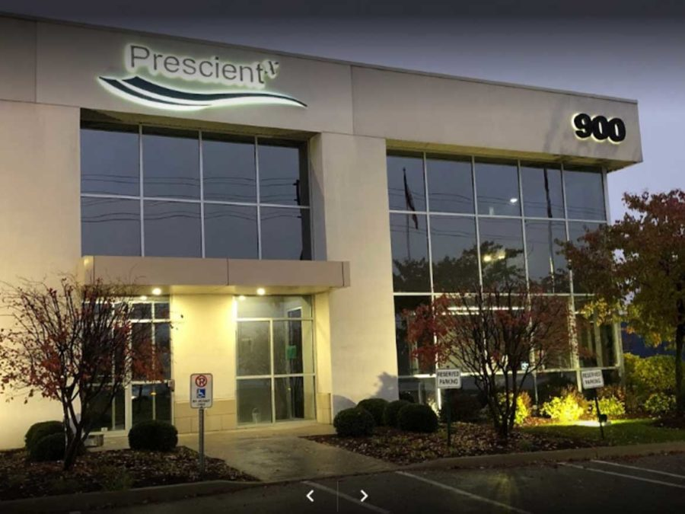
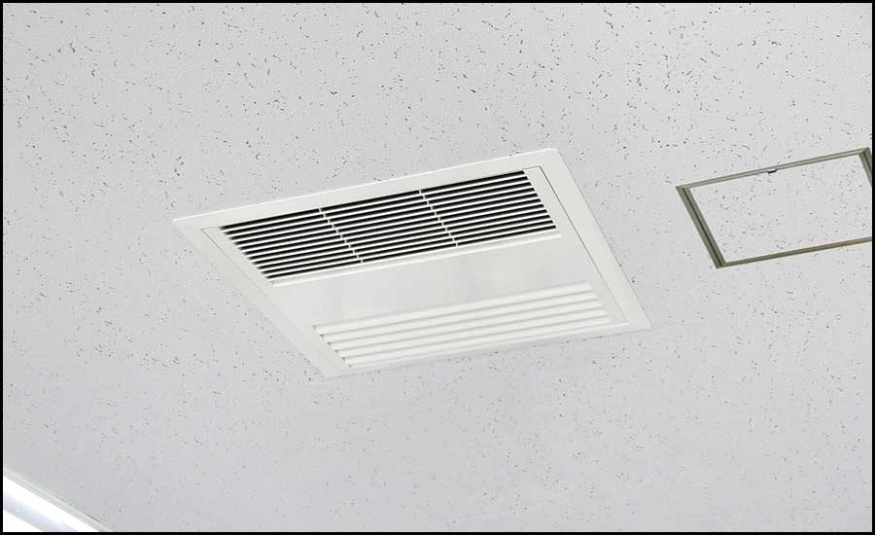
Improve Maintenance
Prescientx
The Scope
Easier to Maintain
Create Healthy and safe environments
Keeping facility 40%-60% rH to produce a healthy work environment
Mix of office and production spaces
Easy Installation and minimal maintenance
Solution: EL and TE Series
No contractor is needed for regular maintenance.
They were able to stay open during pandemic due to ensuring a safe and clean indoor space, impressing the ministry of Labour.
Engineered with maintenance in mind
Systems are built to last and maintain!
Notes:
Easier to Maintain
Engineered with maintenance in mind.
Systems are built to last and maintain!

Slide 7
Introduce Innovative New Technology
Newman Center for Performing Arts at Denver University, Denver CO
The scope:
Why the new technology??
Previous generator was a gas unit w/ short absorption manifolds
Needed to update the system w/in the same footprint
Installed DL and RO w/in the same footprint
Improve air quality in vulnerable times
Resistive, Steam Exchange, Gas, Direct Room and In Duct whatever solution is needed can be found
Improving load capacity to maintain 40-60%. The results are in… Healthy living is necessary!

Slide 8
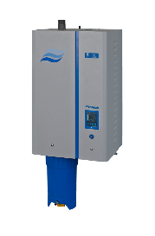
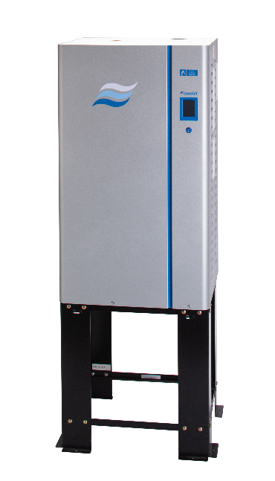
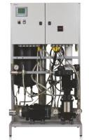
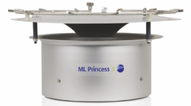
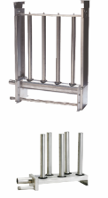
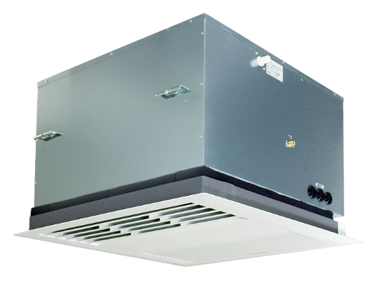
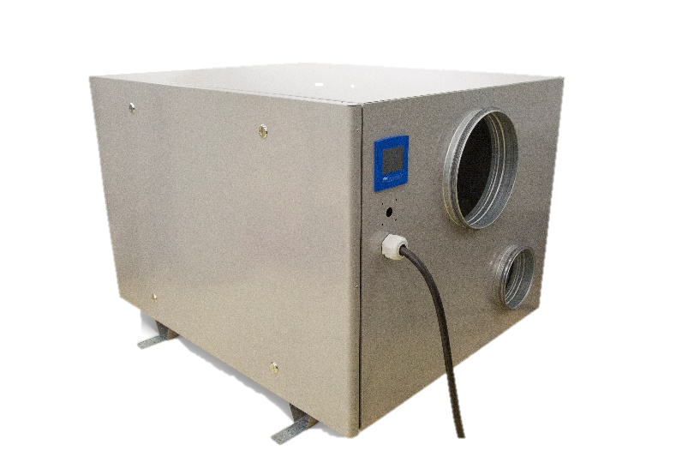
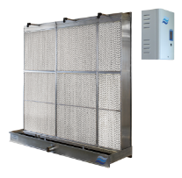
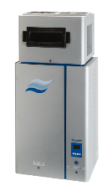
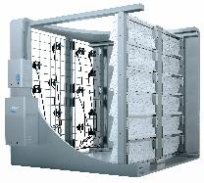
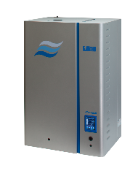
The Opportunity
Better Products for a Better Life
Notes:
Our mission: Driven by our customers’ needs and supported by science, we engineer reliable, sustainable solutions.

Slide 9
Thank you!
David Ball
Northern Regional Sales Manager
Sagar Shah
Technical Product Manager

