Slide 1

Product Technical Factory Training
Presented by: Sagar Shah, TPM

Slide 2
Agenda
  Introduction
  Product Overview
  Installation
  Features & Benefits (USPs)
  Applications

Slide 3
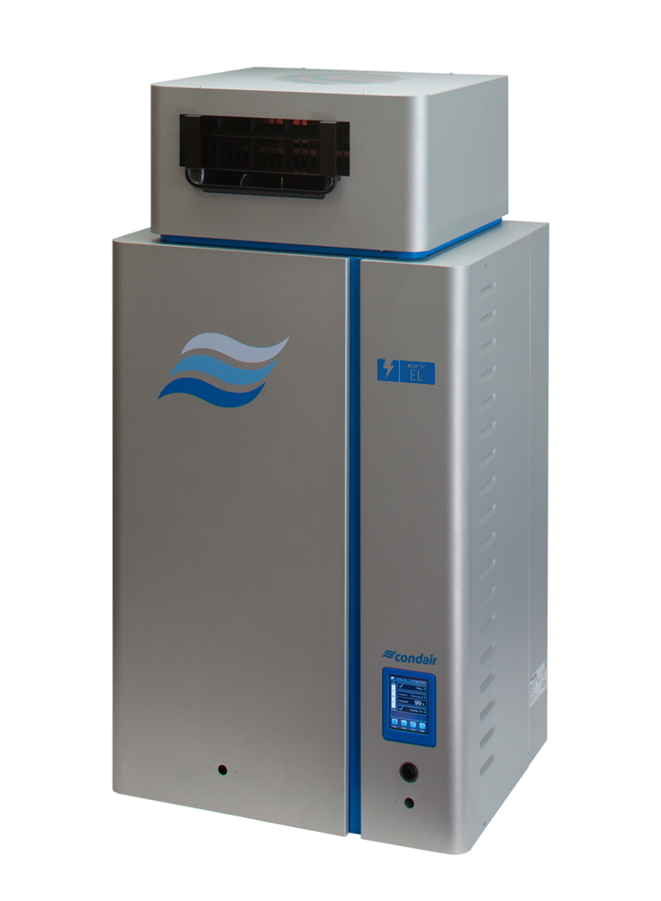
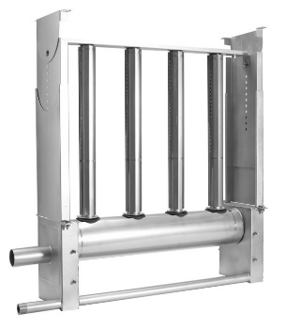
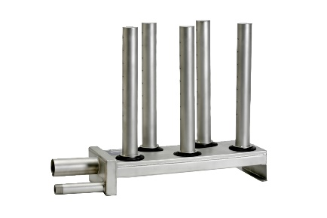
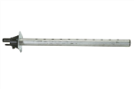
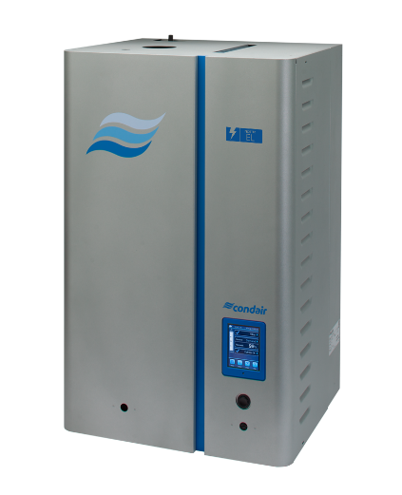
Steam Distribution
Direct Room Application
Duct Application Distributors
SAM-e
Mini SAM-e
xSD
Remote Mounted or Space Model

Slide 4



Condair SAM-e
Short Absorption Manifolds

Slide 5
Why SAM-e?
Why SAM-e
Short Absorption Manifold
Easy to install; made with 304 SST
Lower cost & easier to install than multiple LS distributors
Can be used with atmospheric steam or pressure (boiler) steam
10 years standard warranty
Your AHU manufacturers like it!

Slide 6

Product Overview
Short Absorption Manifolds

Slide 7
Product Overview
SAM-e Components
Mounting Frame
Steam Tubes
Header
Inlet Adapter
Condensate Drain

Slide 8
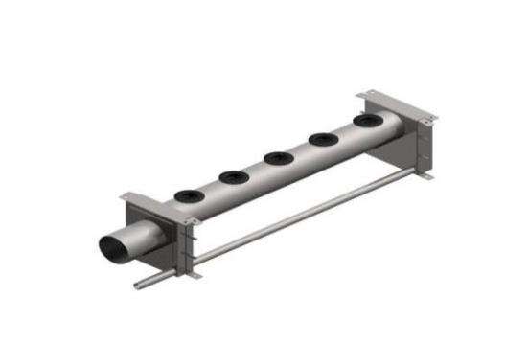
Product Overview
SAM-e Header
Fits ducts 18” – 144” wide
3”, 6”, 9”, 12” spacing
Atmospheric or pressure steam
Atmospheric up to 800lbs/hr
Pressure up to 3200lbs/hr
9.0”
Spacing
8.7”
Width

Slide 9
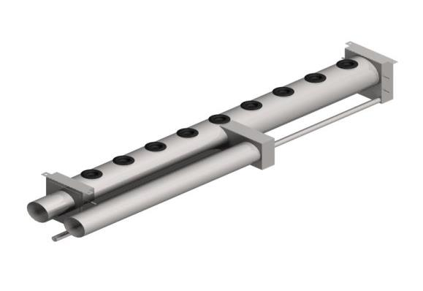
Product Overview
SAM-e Header 801-1200 lb/hr
8.7”
Atmospheric steam
3”, 6”, 9” or 12” spacing
Fits ducts 42” – 144
9.0”
Spacing
Width

Slide 10
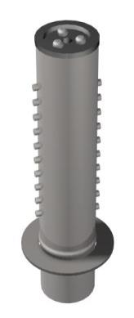
Product Overview
SAM-e Steam Tubes
Lengths from 6” to 132”
4 Types:
Type A: 15 lbs/hr
Type B: 35 lbs/hr
Type B+: 55 lbs/hr
Type C: 75 lbs/hr
Length

Slide 11
Product Overview
How SAM-e Steam Tubes Work
Airflow
Tube wall
Steam Tube Cross Section
Hot Steam
Nozzles
Condensate

Slide 12
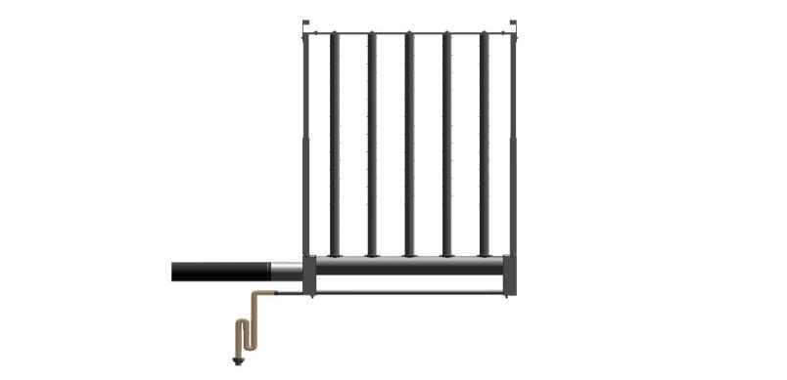
Product Overview
Atmospheric Installation
Atmospheric Steam
Trap and
Funnel

Slide 13
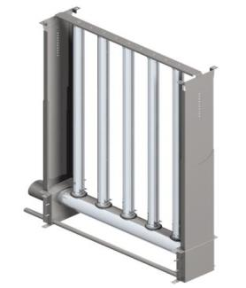
Product Overview
Why Insulate?
SAM-e Insulated Option
Wasted energy - Lost heat is lost money
Wasted Water (Condensate)
Air stream heat gain
Low humidifier output
Low system efficiency

Slide 14
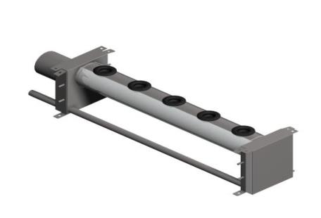
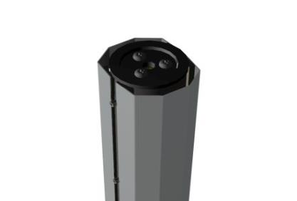
Product Overview
Types of Insulation
Header Insulation
Tube Insulation

Slide 15
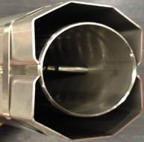
Product Overview
Benefits of Insulation
Thermal Resistance,
R = 0.66 ft-ºF-hr/Btu
Up to 70% condensate reduction
120°F max surface temperature
Reduce heat gain
Improved efficiency
Saves money!

Slide 16
Product Overview
Insulated Tube
Cool Airflow
Insulated Steam Tube Cross Section
Stainless steel
shielding
¼” Air-gap
Hot Steam

Slide 17
Tube Performance
Condensate Losses per Linear Foot

Slide 18
Header Performance
Condensate Losses per Linear Foot

Slide 19
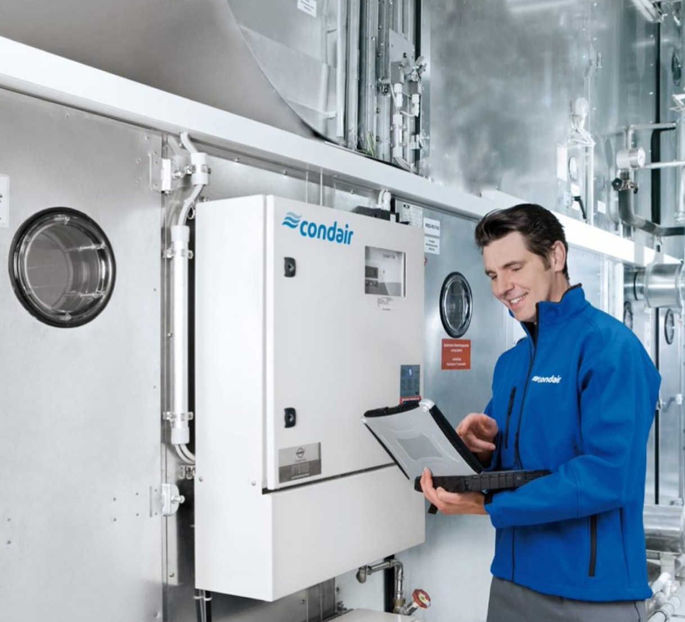
Installation
Condair SAM-e

Slide 20
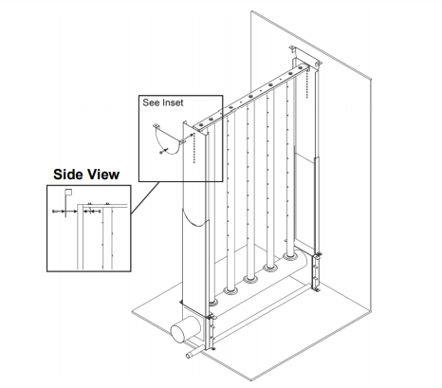
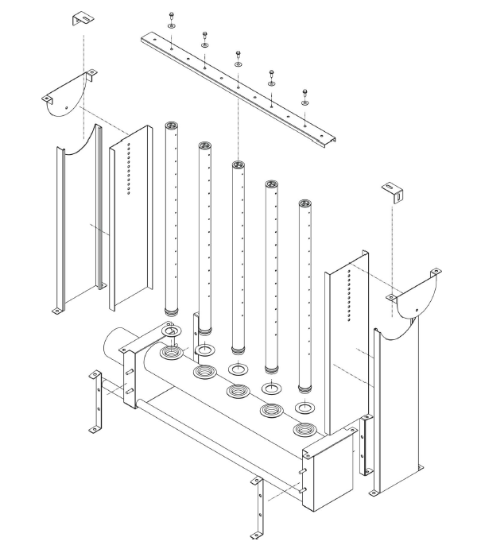
Installation
SAM-e Mounting Options
Header sits on duct floor
Mounting frame
Optional 12” or 20” support stands
In-Duct Mounting

Slide 21
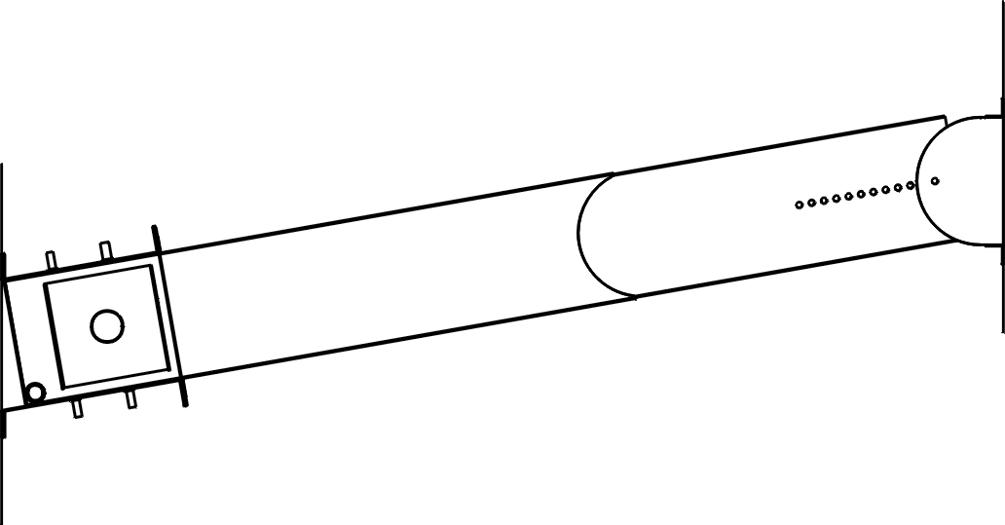
Installation
SAM-e Mounting Options
Mounting frame required
10 – 30° angle
Vertical Duct Mounting
10-30°

Slide 22
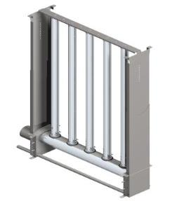
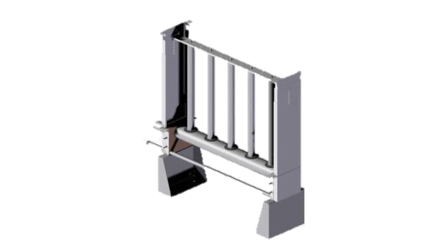
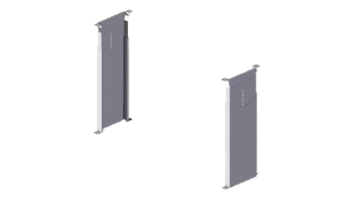
Installation
SAM-e Accessories
Insulation
Stand Kit
Mounting Frame

Slide 23

Features & Benefits
Short Absorption Manifold

Slide 24
Features & Benefits
304 Stainless Steel parts
  Less Maintenance
10 years warranty
OSHPD Certified

Slide 25

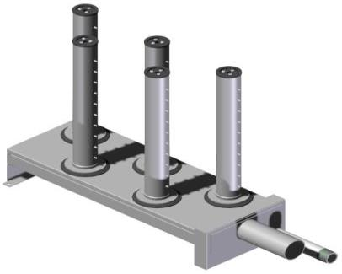
Mini SAM-e
Condair Mini SAM-e

Slide 26
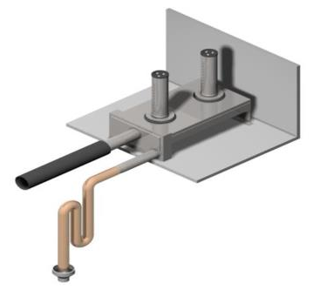
Mini SAM-e
Mini SAM-e
For ducts 12” x 8” to 24” x 24”
Horizontal flow standard
Vertical flow as special
Capacities up to 210 lbs/hr

Slide 27
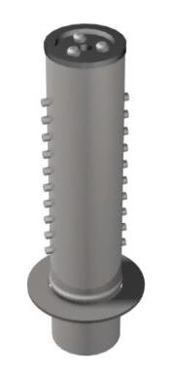
Mini SAM-e Steam Tubes
Mini SAM-e Steam Tubes
Lengths from 5” to 21”
3 Types:
Type MA: 10 lbs/hr
Type MB: 20 lbs/hr
Type MC: 30 lbs/hr
Length

Slide 28
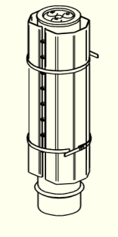
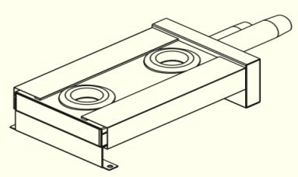
Insulated Mini SAM-e
Insulated Mini SAM-e
Header Insulation
Tube Insulation

Slide 29
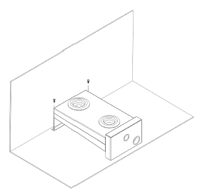
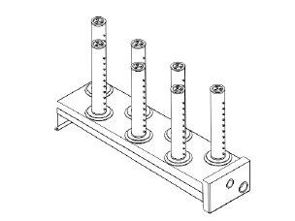
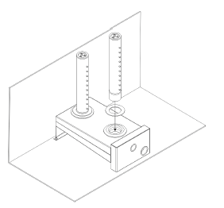
Installation
Place header on duct floor
Install steam tubes with insertion stop washers

Slide 30


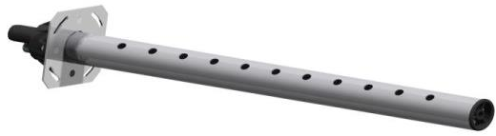
Single Tube Distributor
xSD (ASD, BSD, CSD)

Slide 31
Single Tube Distributor (xSD)
Type of Tubes Tubes
  Steam Distributor (A-B-CSD)
Type | Max output (lbs/hr) | Min Duct width (in) | Max duct width (in) | Min duct height (in)
ASD | 25 | 10 | 66 | 8
BSD | 35 | 10 | 102 | 10
CSD | 115 | 24 | 144 | 14
Distributor Nozzle | 8 | 8 | None | 8

Slide 32
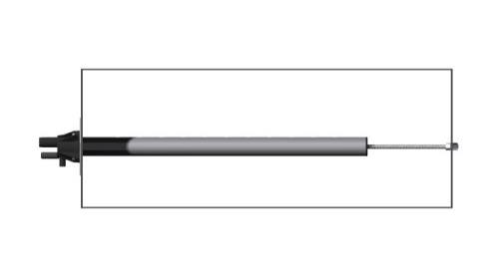
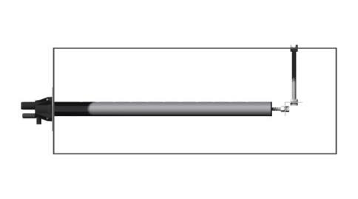
Installation
Mounting Distributors Tubes
5/16” UNC Threaded Rod and Nut (by Others)
Mount Level
L Bracket by Others
*Support rod mandatory for distributors longer than 36” (915mm)

Slide 33
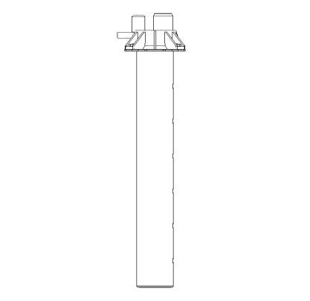
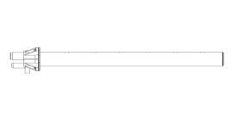
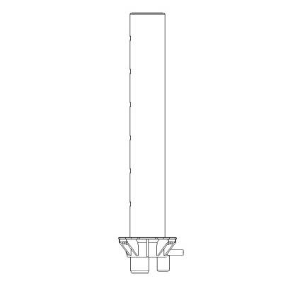
Installation
Steam Distributors Tubes
WRONG!
*Steam distributors must be mounted level

Slide 34
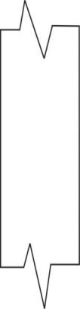
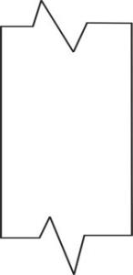

Installation
Steam Distributors Tubes - Clearances
Horizontal Airflow
Vertical Airflow
2/3 H
H
1/2 W
1/2 W
1/3 W
1/3 H
2/3 W
A
H
B
W
W
Distributor | H Min. | A | B
ASD | 8” | 5” | 3”
BSD | 10” | 6” | 4”
CSD | 14” | 9” | 5”
* Min. W = 8” (203mm)

Slide 35
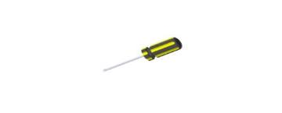
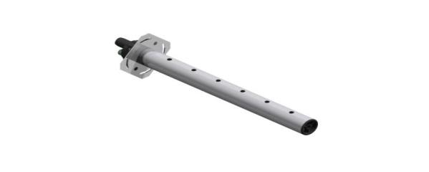
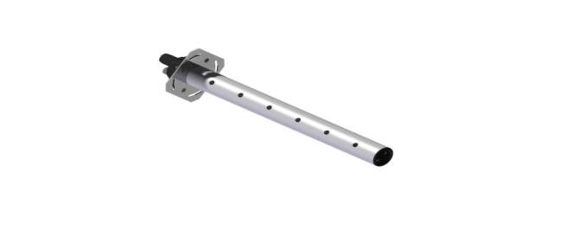
Installation
Steam Distributors Tubes
  Vertical Duct Applications
1
2
3

Slide 36
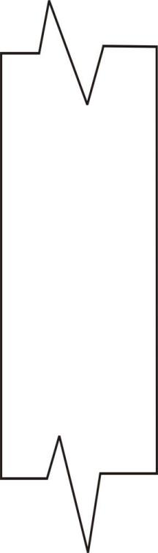

Installation
Steam Distributors Tubes - Installation
B
B
H
B
A
Steam Header
Distributor | H Min. | A | B
ASD | 18” | 3” | 5”
BSD | 22” | 4” | 6”
CSD | 32” | 5” | 9”
*Steam Header or Splitting Manifolds recommended for even steam distribution

Slide 37
Installation
Steam Distributors Tubes - Clearances
Abs. Dist x 2
  In Duct Near an Elbow
6
'
M
i
n
.
Mount steam distributor at least 6’ (2m) downstream from elbow
Multiple distributors can reduce this distance

Slide 38
Installation
Steam Distributors Tubes - Location
The Mini SAM-e is a great alternative for these situations!
B
r
a
n
c
h
D
u
c
t
D
r
a
i
n
P
a
n
D
r
a
i
n
P
a
n
To Drain

Slide 39
Installation
Steam Distributors Tubes - Location
  Air Handling Unit

Slide 40
Installation
Steam Distributors Tubes - Location
  Air Handling Unit
LOCATION ADVANTAGE DISADVANTAGE
LOC. 1 MOST recommended.
Assuming there is sufficient High velocity may create long absorption
  straight duct for absorption. distances.

Slide 41
Installation
Steam Distributors Tubes - Location
  Air Handling Unit
LOCATION ADVANTAGE DISADVANTAGE
LOC. 2 Warm air. Any unabsorbed steam may condense on the coils.
Good absorption. Capacity drop due to eventual condensation on the
coils.

Slide 42
Installation
Steam Distributors Tubes - Location
  Air Handling Unit
LOCATION ADVANTAGE DISADVANTAGE
LOC. 3 Warm air. If absorption distance is too long it may damage the fan

Slide 43
Installation
Steam Distributors Tubes - Location
  Air Handling Unit
LOCATION ADVANTAGE DISADVANTAGE
LOC. 4 Heating coils help evaporate Absorption may be a problem due to low mixing temperatures
Air is mixed well Cold Air, No drain pan on coil

Slide 44
Installation
Steam Distributors Tubes - Location
  Air Handling Unit
LOCATION ADVANTAGE DISADVANTAGE
LOC. 5 Not recommended Filters may get wet and saturated
Cold Air

Slide 45
Installation
Steam Distributors Tubes - Location
  Air Handling Unit
LOCATION ADVANTAGE DISADVANTAGE
LOC. 6 Not recommended Outside air may cause condensate problems
Problematic RH control

Slide 46
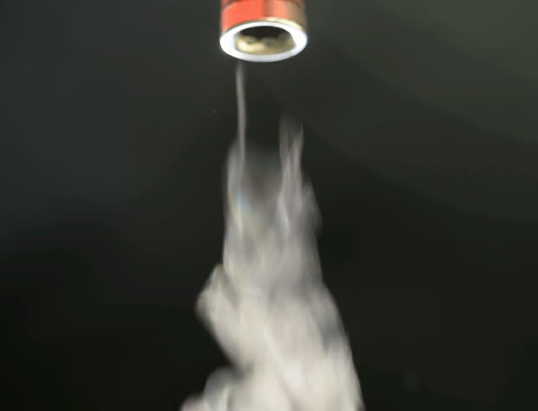

Steam Line Rules
Main Rules for Atmospheric Steam lines
Follow recommended materials, size and length
Always Insulate with 1” pipe insulation
Slope the steam lines
Trap condensate

Slide 47
Steam Line Rules
Recommended Materials for Steam lines
Model | Steam Line
 | Maximum Equivalent Length | MED-L Copper Pipe Diameter | Stainless Steel Pipe Diameter | Steam Losses***
EL005 | 7 ft (2 m) | ¾ in (20 mm) | ⅞ in x 0.049 wall (22 mm x 1.25 mm wall) | 0.06 lb/h/ft (0.09 kg/h/m)
EL010 | 12 ft (3.5 m)
EL020 | 17 ft (5 m)
EL030 | 22 ft (6.5 m)
EL050 | 43 ft (13 m) | 1-1/2 in (40 mm) | 1¾ in x 0.065 wall (45 mm x 1.65 mm wall) | 0.11 lb/h/ft (0.18 kg/h/m)
EL075 EL100 | 47 ft (14 m)
EL150* EL200* | 50 ft (15 m)
* Use a single steam line for each steam cylinder. Do not combine lines except at a distributor, and only if using the humidifiers in parallel. *** Based on 1 in (25 mm) insulated copper.
DI water requires Stainless steel steam lines!

Slide 48
Steam Line Rules
Recommended Materials for Steam lines
Model | Over-sized Steam Line**
 | Maximum Equivalent Length | MED-L Copper Pipe Diameter | Stainless Steel Pipe Diameter | Steam Losses***
EL005 | 14 ft (4 m) | 1 in (25 mm) | 1⅛ in x 0.049 wall (29 mm x 1.25 mm wall) | 0.06 lb/h/ft (0.09 kg/h/m)
EL010 | 24 ft (7 m)
EL020 | 34 ft (10 m)
EL030 | 44 ft (13 m)
EL050 | 86 ft (26 m) | 2 in (50 mm) | 2 in x 0.065 wall (50 mm x 1.65 mm wall) | 0.11 lb/h/ft (0.18 kg/h/m)
EL075 EL100 | 94 ft (28 m)
EL150* EL200* | 100 ft (30 m)
* Use a single steam line for each steam cylinder. Do not combine lines except at a distributor, and only if using the humidifiers in parallel. ** The over-sized lines may require a reducer at the humidifier and the steam distributor.

Slide 49
Steam Line Rules
Equivalent Lengths
Nominal Tube Diameter, inches | Standard 90 degree Elbow | Standard 45 degree Elbow | Side Outlet Tee
¾” – 7/8” | 2 ft | 1 ft | 4ft
1 ½” – 1 ¾” | 3.5 ft | 1.75 ft | 7 ft
3” | 5 ft | 2.5 ft | 11 ft
4” | 8 ft | 4 ft | 15 ft
*Valve in full open position

Slide 50
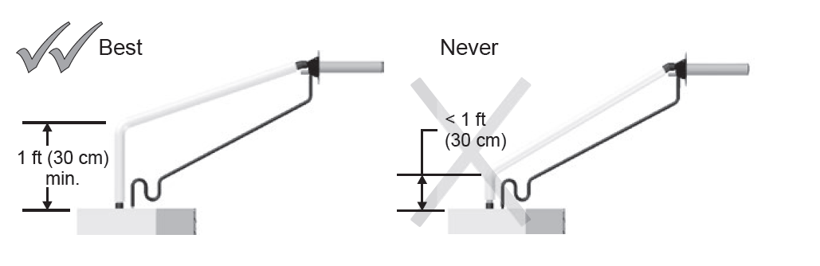
Steam Line Rules
Rule # 1
1) Always install at least 12” of vertical run directly from the humidifier before any slope or bend occurs.
  *Condensate returned to
  Unit or drain
  *Condensate should not be routed back to a sink used frequently
  by personnel.

Slide 51
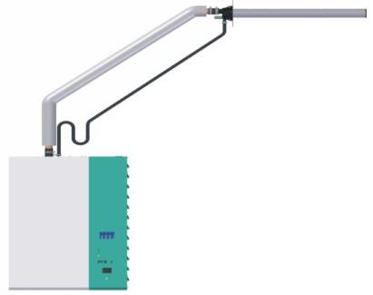
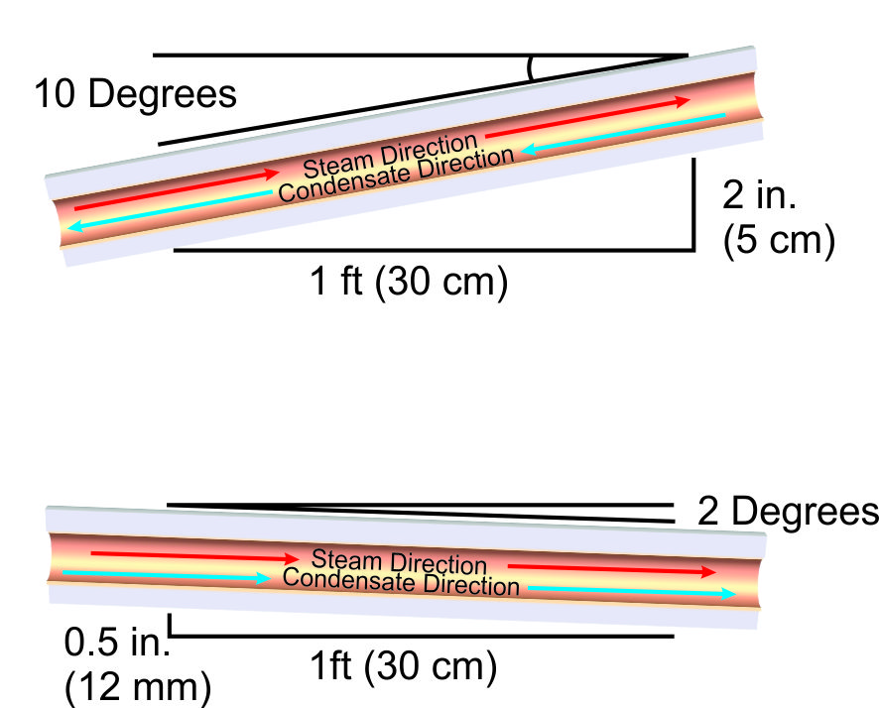
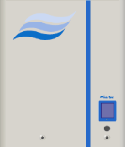
Steam Line Rules
Rule # 2
  12”
2) For upward slopes in steam lines, minimum allowable slope is 10 degrees grade (2” vertically up per 12” horizontal run)
  2”

Slide 52
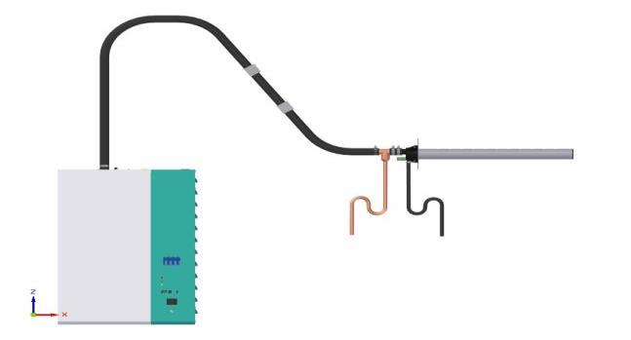

Steam Line Rules
Rule # 3
  12”
  0.5”
3) For downward slopes in steam lines, minimum allowable slope is 2 degrees grade (0.5” vertically down per 12” horizontal run).

Slide 53
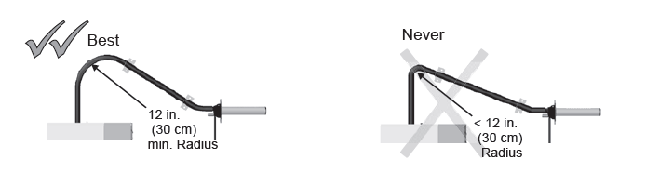
Steam Line Rules
Rule # 4
4) Always ensure a minimum bend radius of 12” when using flexible steam hoses or 5 times the internal diameter for rigid steam lines.

Slide 54
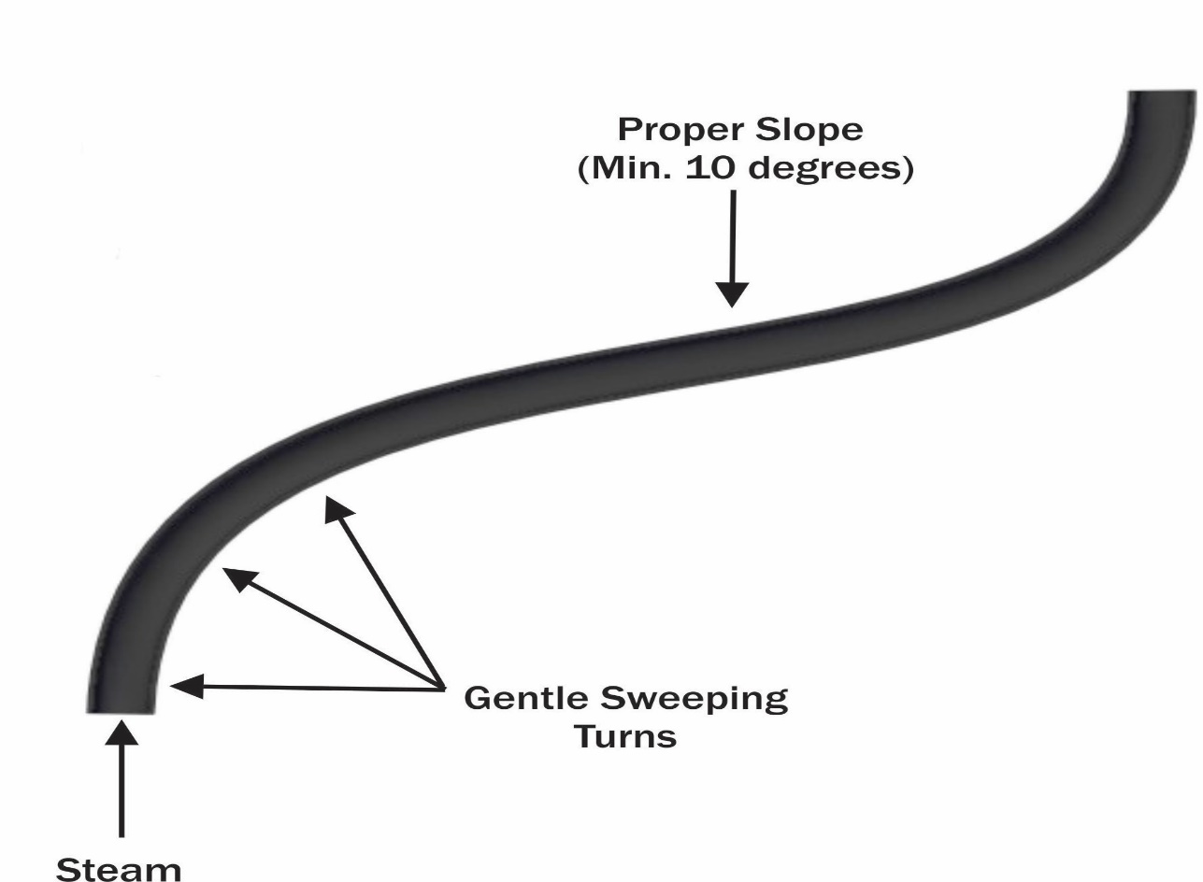
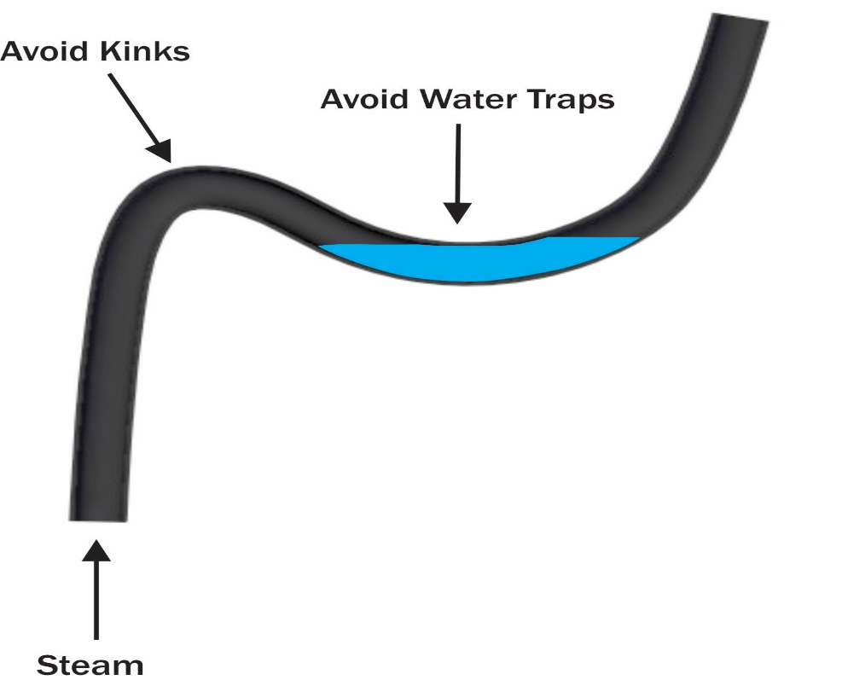
Steam Line Rules
Rule # 4.5
4.5) When using Nortec steam hose, ensure line is properly supported

Slide 55
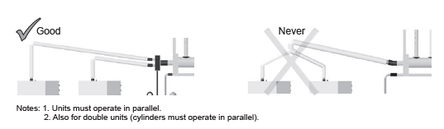
Steam Line Rules
Rule # 5
5) When supplying a single distributor by multiple humidifiers, always run separate steam lines for the entire run. Connect the steam lines by a Nortec Adapter Box at the distributor. Never connect lines on an upward slope.

Slide 56


Steam Line Rules
Where to Use Condensate Traps
As a minimum guideline, condensate traps must be installed along the steam line for each of the following scenarios:
a. At the base of a horizontal to vertical transition.
b. At any low point along the steam line.
c. After a length of steam line run 15 feet or greater.

Slide 57


Steam Line Rules
Condensate Traps
  Full Size Tee Condensate Trap
  Copper Tee
12” drop to top of P-trap
  Cap
  Condensate Line
8” or Duct S.P. + 2”

Slide 58

Steam Line Rules
Horizontal to Vertical Transitions

Slide 59

Steam Line Rules
Horizontal to Vertical Transitions
  Full Size Copper Tee
  Condensate Drain

Slide 60






Steam Line Rules
Place the Condensate Trap
  6 ft.
  17 ft.
  5 ft.
  1 ft.

Slide 61
Key Takeaways
SAM-e comes with 10 years warranty
Can be used for Atmospheric and pressurized steam
OSHPD (Seismic) certified

Slide 62
Questions?

Slide 63

Time for a Break!!!

