Slide 1

Market Trends and Sales Tools
Sales Opportunities and Tools

Slide 2
Agenda
Global Trends to Watch
    Macro
    HVAC + Building Industry
Emerging Markets and Applications
Selling Condair
    Apps and Devices
    Web + Social Tools

Slide 3



Macro Trends
Global Economic Drivers
Sustainable Supply Chains
    Decarbonization
    Resilience
    Rapid Investment in Reshoring
Geopolitical Issues
    Inflation / Monetary Policy
    Economic and Military Conflict
Population Trends
    Boomer Retirement / Great Resignation
    Widening gap between rich and poor
https://assets.kpmg/content/dam/kpmg/cn/pdf/en/2021/12/2022-ten-macroeconomic-trends.pdf

Slide 4



Macro Trends
Global Economic Drivers
Disruptive Business
    Consolidation of small businesses
    Democratization of currency
    ESG as a core focus of business
    Decarbonization as marker driver
Uneven Economic Recovery
    Wider divergence among economies
    Protectionism
Worsening Climate Crisis
    Disruptions to food, energy, water
https://assets.kpmg/content/dam/kpmg/cn/pdf/en/2021/12/2022-ten-macroeconomic-trends.pdf

Slide 5
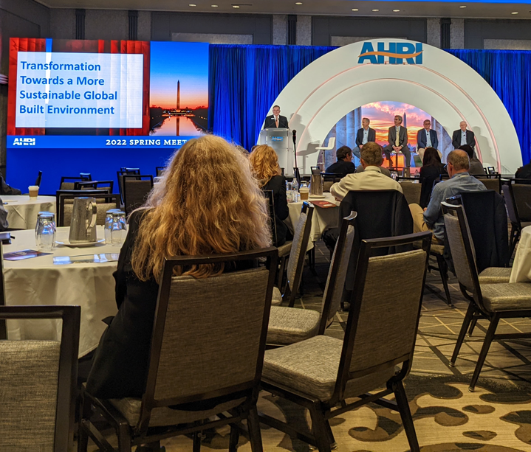
HVAC Industry Trends
Supply Chain + Decarbonization + ESG
Decarbonization is major industry theme
Legislation / Codes for Carbon Continue
Gas Fired Equipment: Rapid H₂ Conversion
Environmental, Social, Governance ESG
    Expected by large customers
    Embodied Carbon
    Continued improvement
AHRI Spring Conference 2022

Slide 6

Decarbonization and HVAC
Understanding Decarbonization
Decarbonization: Reduction of direct and indirect emissions from energy & water use, embodied carbon, and refrigerants
Industry Drivers:
  Incentive Programs
  Regulations: "Buy Clean" Acts, New York City Law 77, etc
  ESG – Sustainable investing [e.g. Blackrock]
  Economics – Savings
Top Trends
  Energy efficiency
  Energy recovery - reuse waste
  Electrification
  Heat Pumps (leading electrification strategy)
  Energy Storage / demand shifting
  Low GWP refrigerants
  Advanced Controls - Sequencing, self-learning, real-time grid response
Source: AHRI Transformation Towards a More Sustainable Built Enviroment

Slide 7

Electrification
Understanding Electrification
Electrification is an approach for decarbonizing buildings by utilizing electricity, ideally clean electricity, instead of fossil fuels
  Not all electricity is equally clean, but grid improvement continues
  Significant clean generation will need to be brought online to meet increased demand
  On-site power generation contributes and increases resilience
  Technically viable in warm and cool climates, but energy cost differences remain a challenge
  Heat pumps are major topic

Slide 8
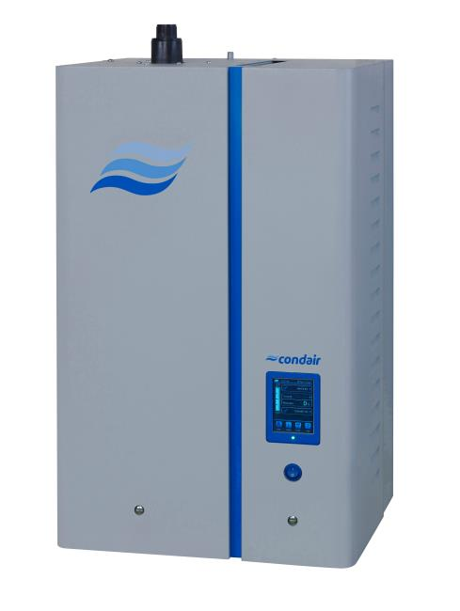
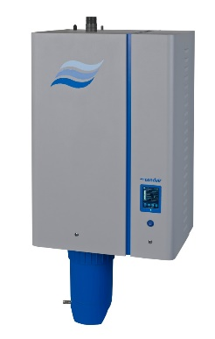
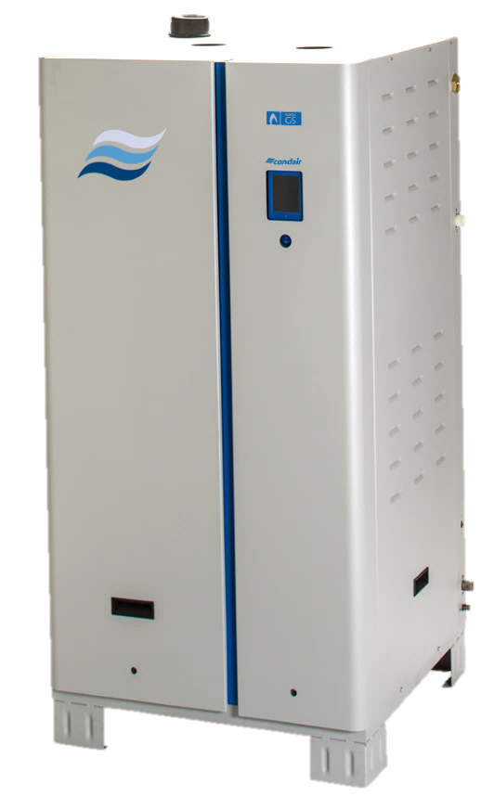
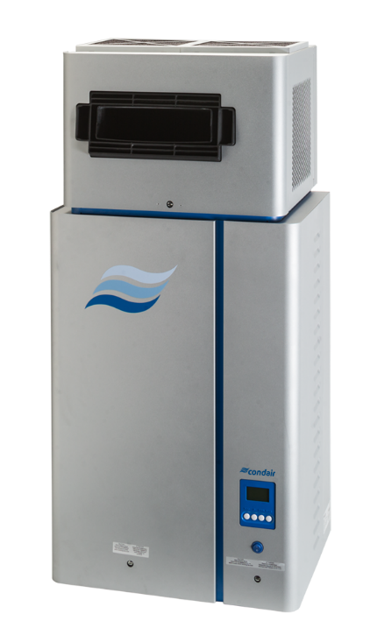

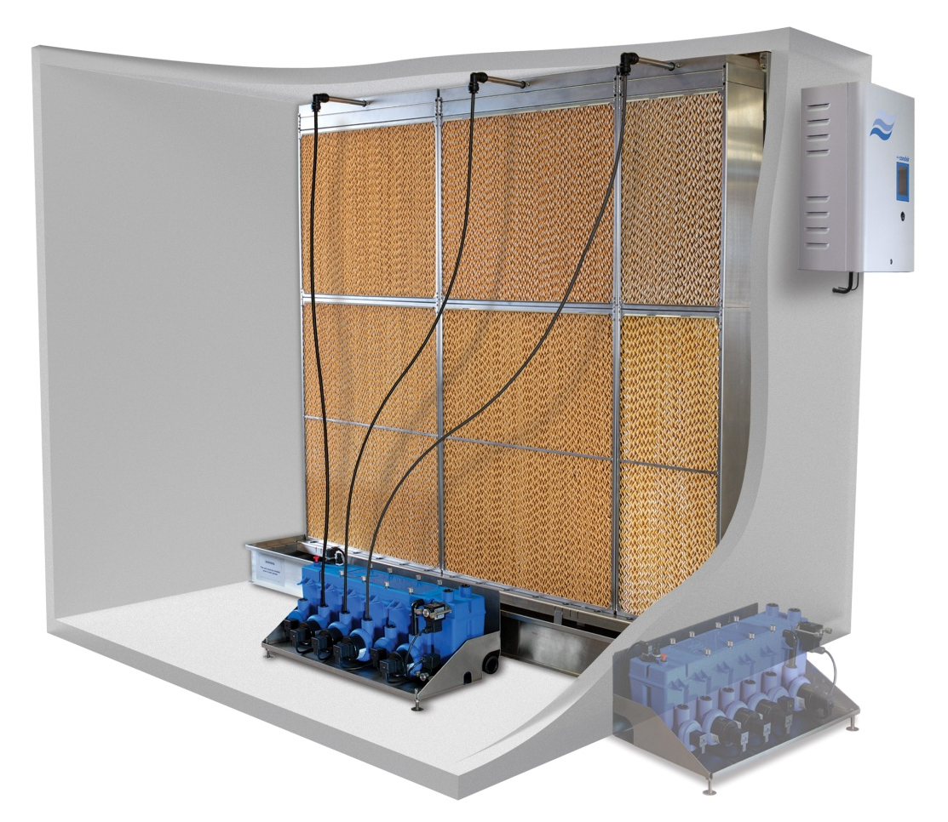
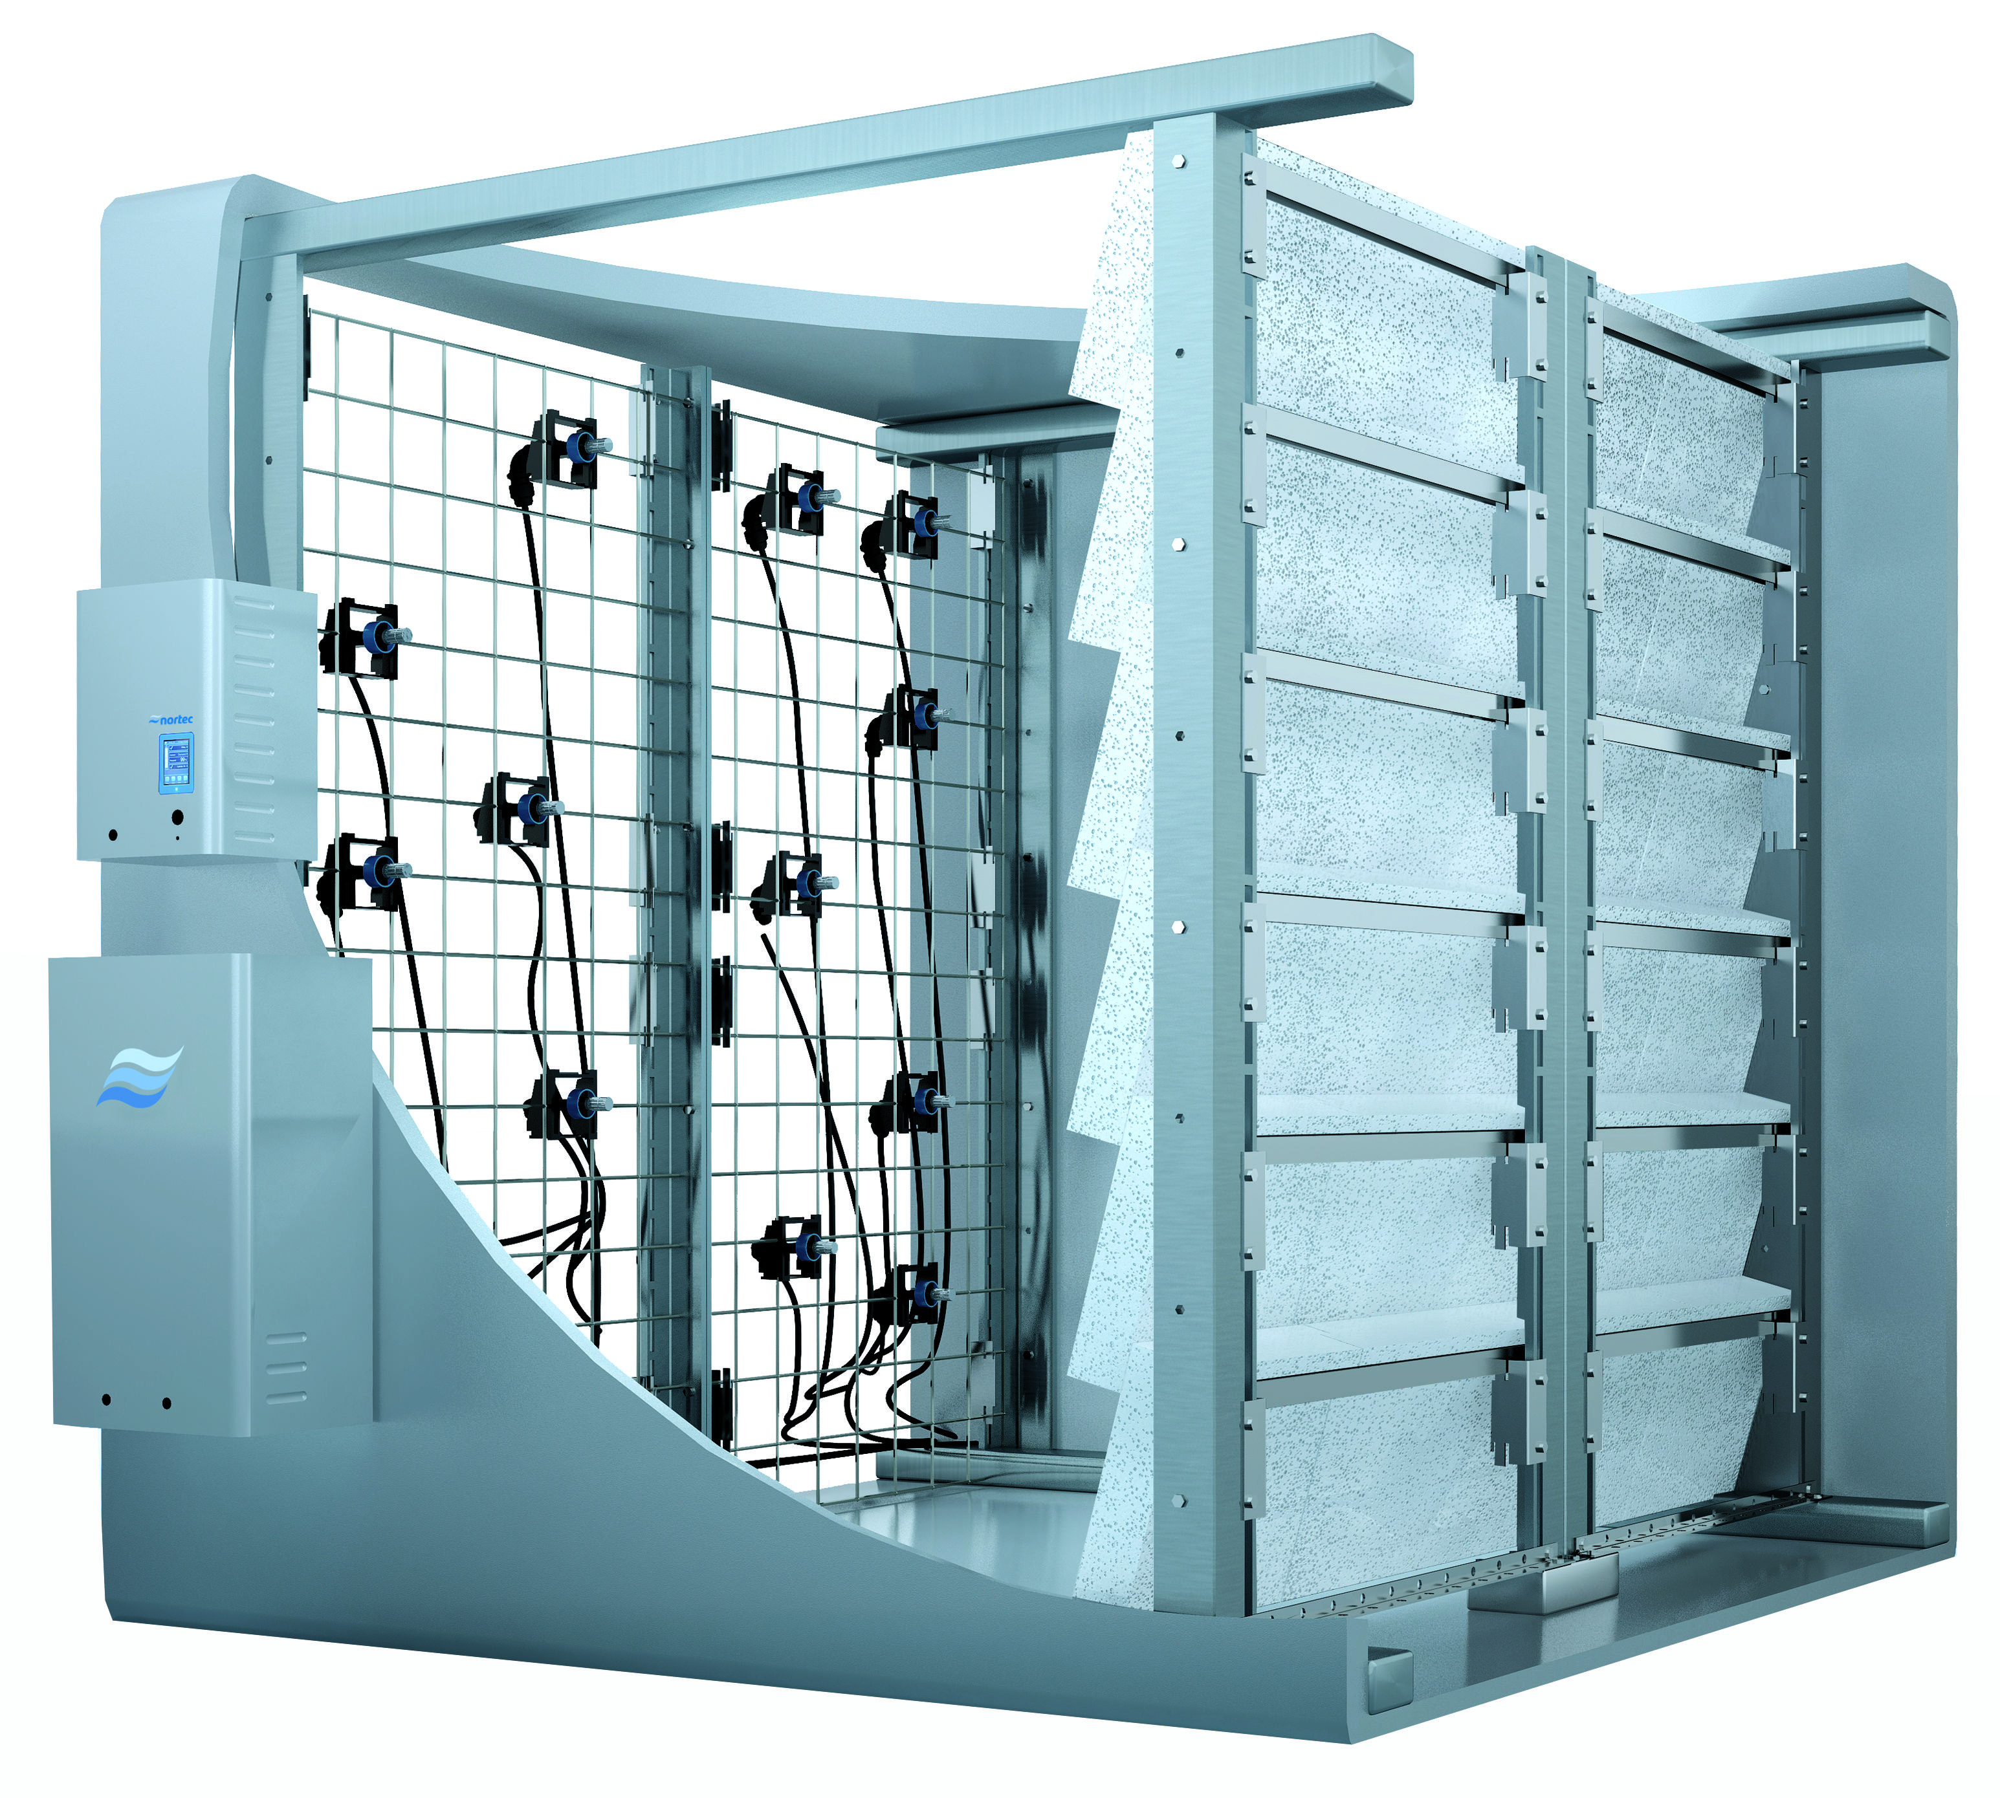
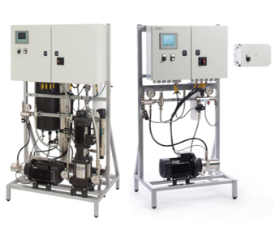
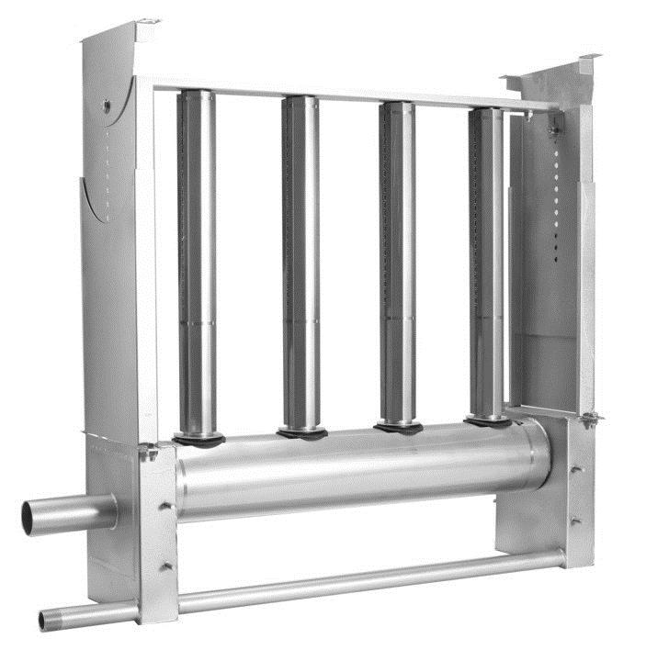
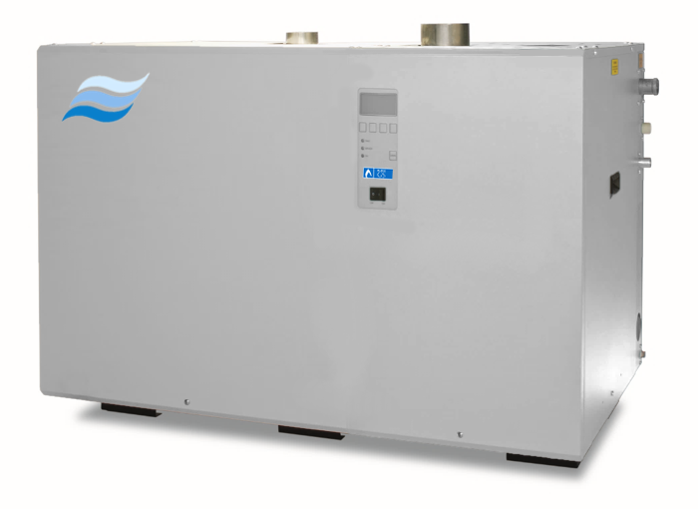
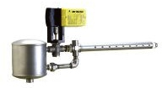
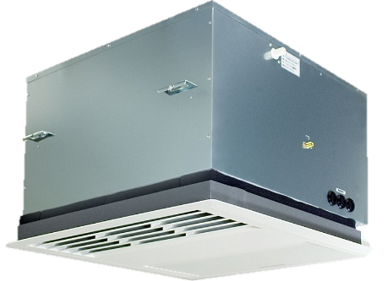
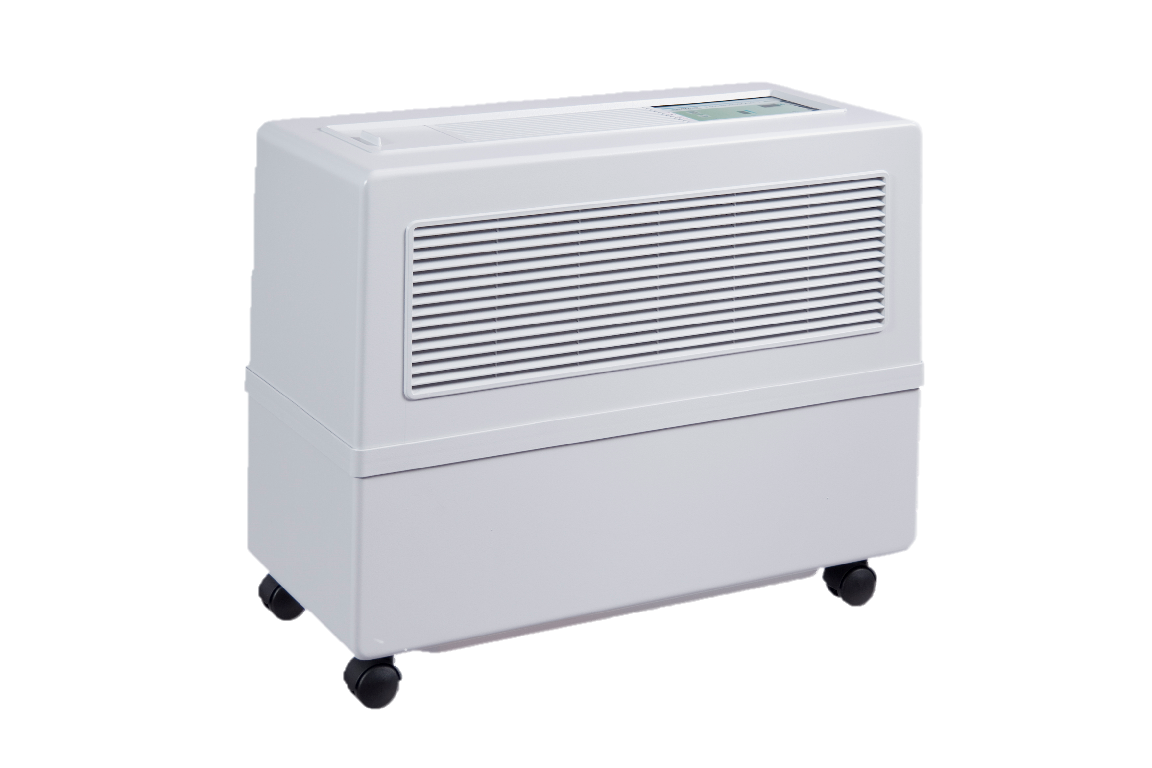
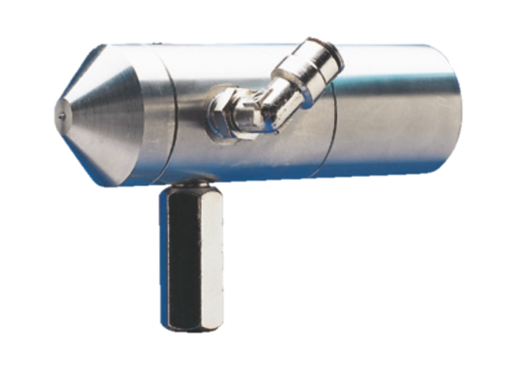
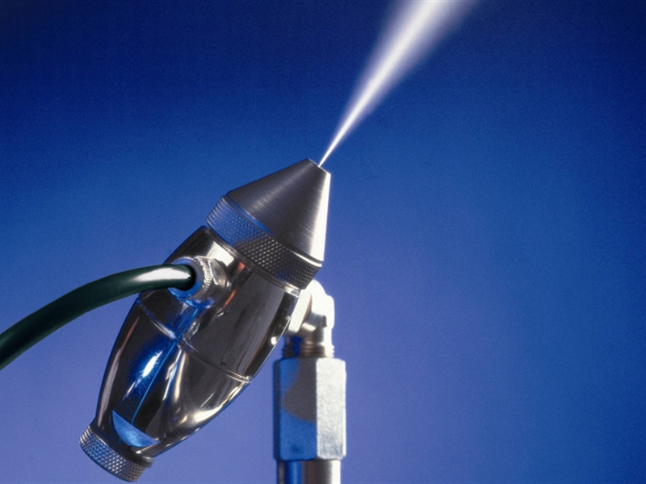
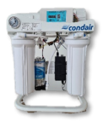
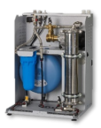
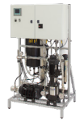
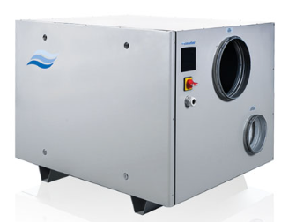
Electrification
Leveraging Condair Technology
Electrification ready: Steam and Adiabatic (don’t forget adiabatic cooling too!)
Isothermal
Adiabatic
EL
RS
GAS
Distribution
Central steam
ME/ MC
US
DL
HP
DRS
```
Live Steam
Steam-to-steam
SAM-e
Dehumidification
Water Treatment
TE
Portable
AirFog
JetSpray
DA
RO-H
RO-A
MLRO

Slide 9

Emerging Applications
Health and Wellness
Retirement trends:
  Baby Boomer retirement driving massive construction in this sector
  Long term care needs expected to double by 2035
Health and IAQ drive humidity needs
  40 – 60% is key for Health
  Selling feature for facilities
  https://www.condair.com/humidifiers-for-nursing-retirement-homes

Slide 10

Emerging Markets
Industry and Manufacturing
Construction of new factories in North America
Drivers:
Reshoring Initiatives
USA CHIPS and Science Act
  $52B in subsidies for semi-conductor manufacturing
  Tens of billions for Federal R&D + Regional Startups
Friendly Supply Chains
  Reduction of reliance on hostile countries
  Ethical sourcing

Slide 11

Emerging Markets
Data Centers and Cooling Applications
Data Center construction continues to boom
  IoT / Smart Device Infrastructure
  Increasing demand for cloud and streamed content
  Edge computing trends
Consider evaporative cooling solutions
  ME / MC / DL / HP
  Many other cooling applications
Note: Water consumption becomes major topic in some areas

Slide 12
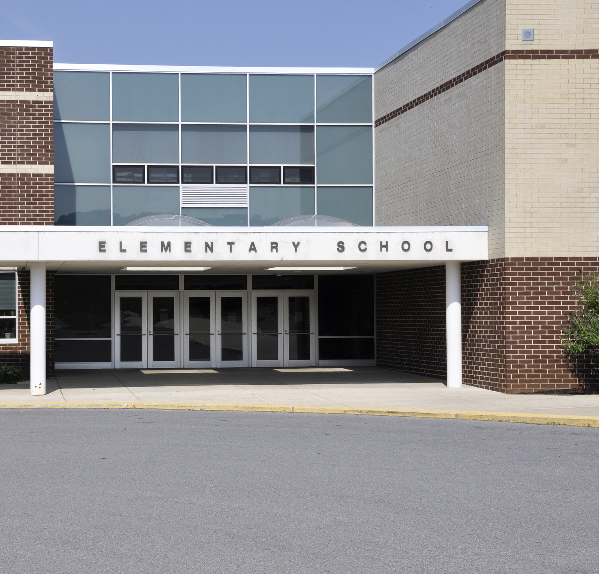
Initiatives and Federal Funding
Government Investments in Healthy and Resilient Infrastructure
United States
  Build Back Better Framework – Significant Investments in Sustainable Constructions
  Most funding through American Rescue Plan
  ~$10 Billion funding for HVAC + Healthy Building Upgrades
  https://event.on24.com/wcc/r/3840057/3602B7DB55080DCC1E6F9DD90FF40FBC
Canada
  ~$3.3 Billion Investing in Canada Infrastructure Program
  $1.5 Billion Green and Inclusive Community Buildings program
  https://www.infrastructure.gc.ca/partners-partenaires-eng.html

Slide 13
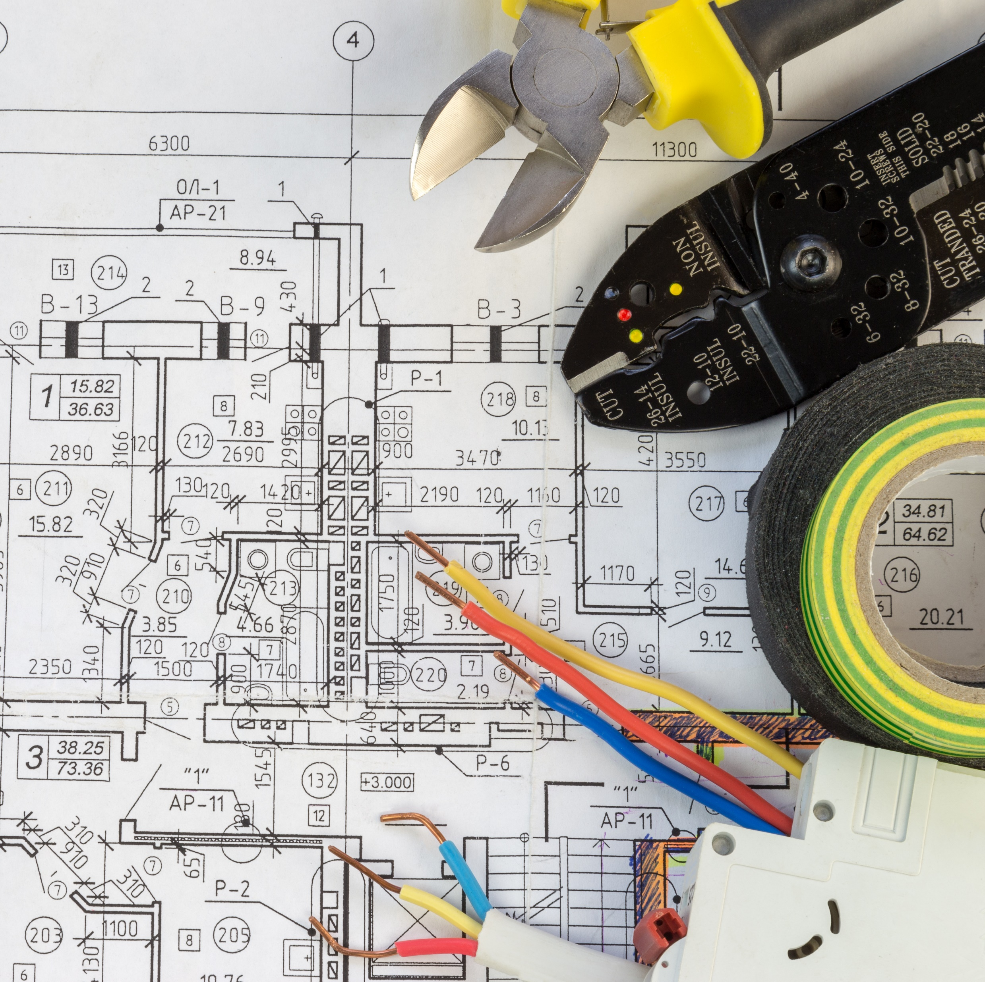
Trends Summary
Global Trends lead to challenges and opportunities
  Data Centers
  Long Term Care
  Industry
  Electrification
  Government Incentives
Condair is well positioned for the future
Introduce your engineers to adiabatic and electric solutions

Slide 14

Sales Tools
Apps and Devices

Slide 15

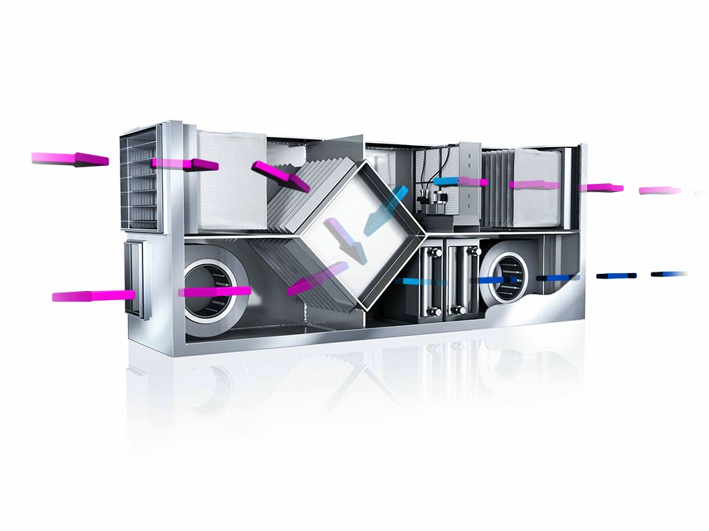




Simulation Tool: myCoolblue
For Indirect Evaporative Cooling
Condair ME Series
Developed by Condair Germany
Indirect Evaporative Cooling
Hourly energy simulation and analysis
Detailed report outputs
www.myCoolblue.com / iOS App Store (iPad only)

Slide 16
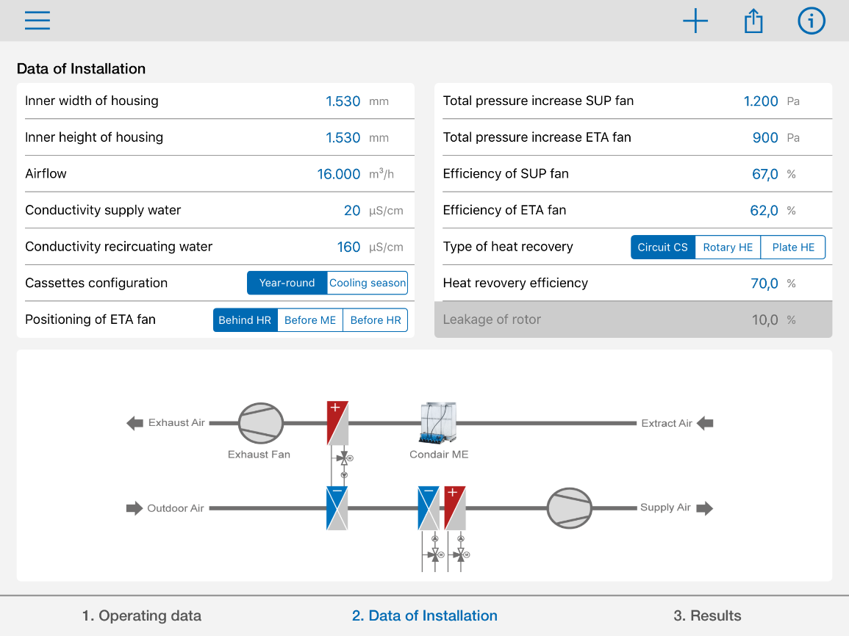
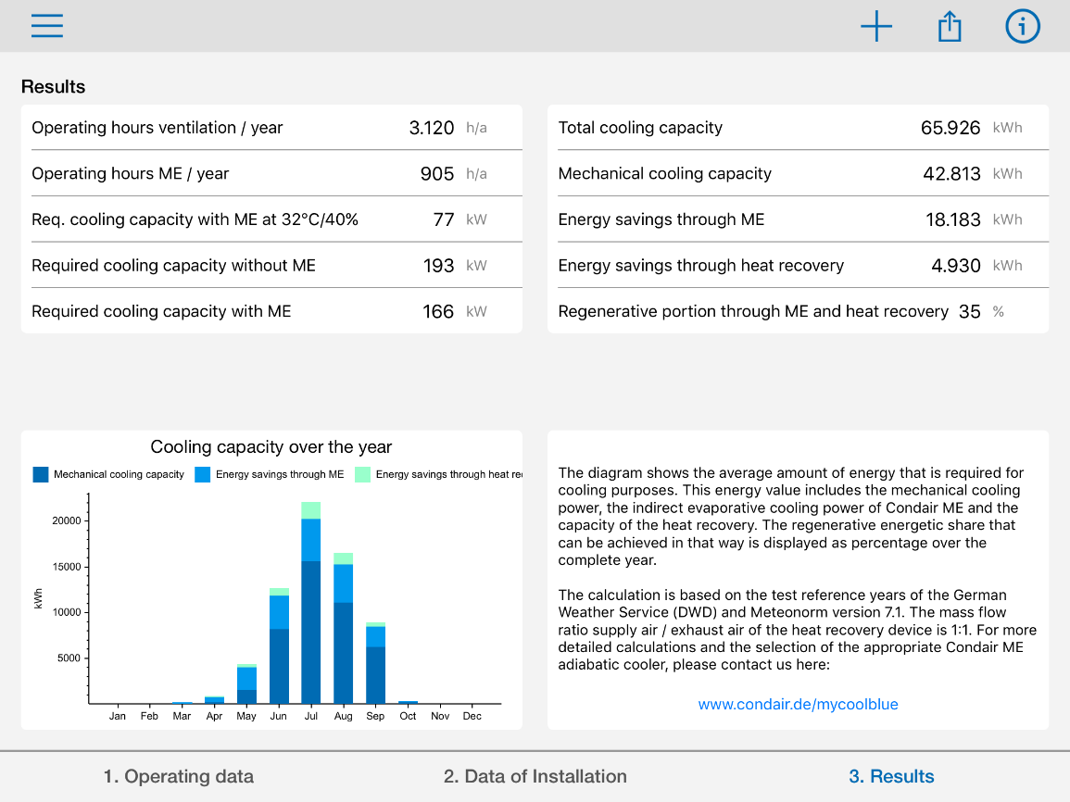
Simulation Tool: myCoolblue
For Indirect Evaporative Cooling

Slide 17

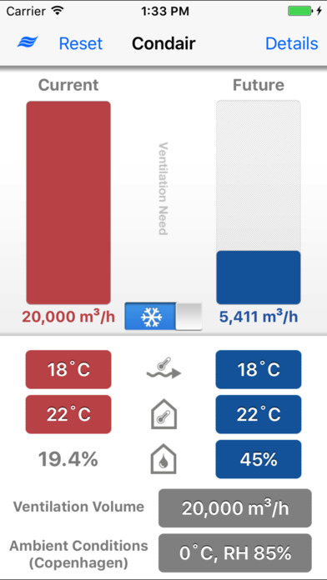
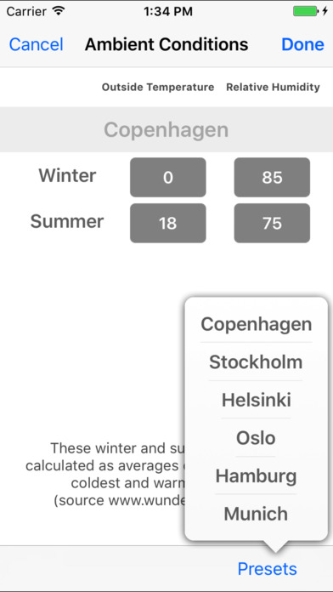



Simulation Tool: Condair Industrial Energy App
For Direct Room Industrial Applications
Freely available on iOS and Android
Ideal for industrial waste heat
Calculates cooling with direct fogging
Useful for estimating savings

Slide 18
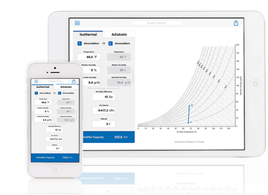

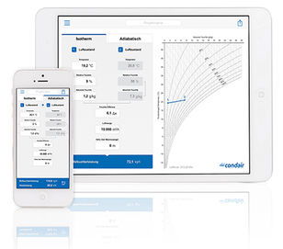


Apps: Psychrometric / H,x Apps
Helpful Promotional Tools for iOS and Android Devices
Psychrometric or H,x Diagrams
Visualize processes
Email PDF Results

Slide 19

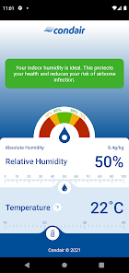
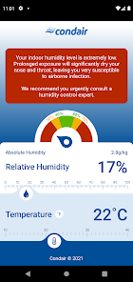


Apps: Humidity Checker App
Helpful Promotional Tools for iOS and Android Devices
Enter Room Parameters
Humidity revel recommendations
Promotes 40 – 60% RH

Slide 20

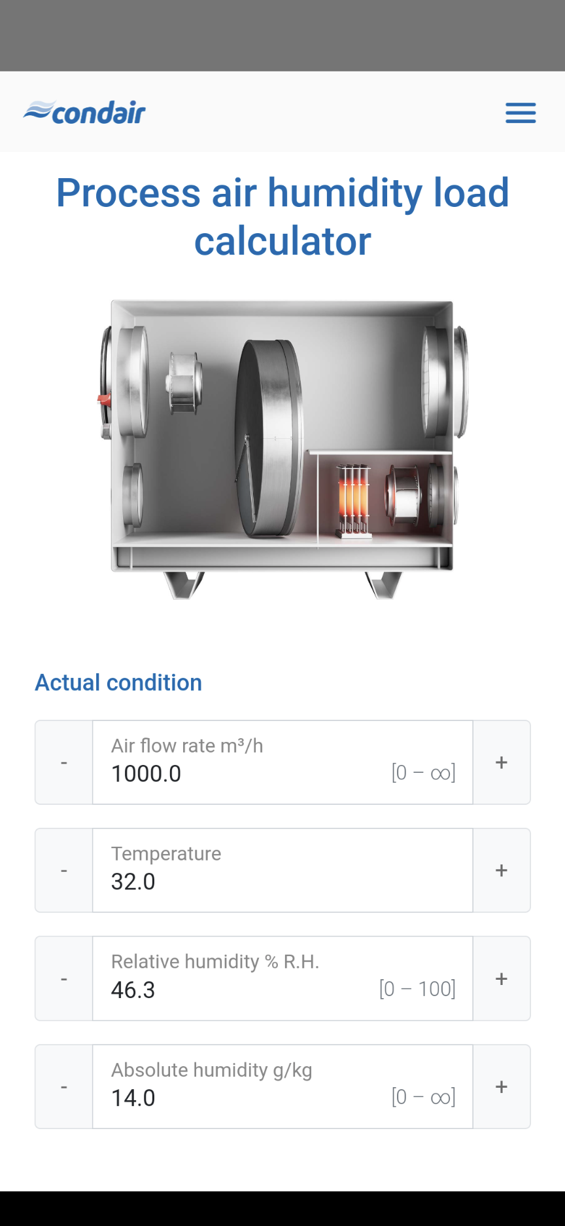
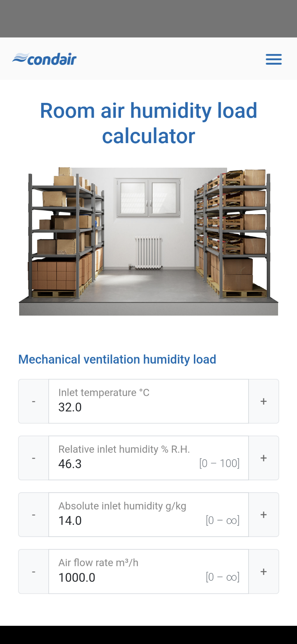


Apps: Dehumidification App
Quick Dehumidification Calculations in Your Pocket
Simple dehumidification calculations for:
  Storage
  Industry
  Pools
Metric units

Slide 21


Sales Tool: Condair Cube
Indoor Air Quality in Your Pocket

Slide 22



Sales Tool: Condair Cube
Temperature, Humidity, CO₂
Parameter | Parameter | Optimal | Rationale
 | Temperature | 20°^{C} – 23°^{C} | Thermal comfort Minimize environmental stress for occupants
 | Relative Humidity | 40 – 60% | Health / immune system support Reduce particle float time Reduce particle infectiousness
 | Carbon Dioxide | 800 – 1000 ppm (Maximum) | Surrogate for exhaled particles Baseline 400 ppm Exhaled air ~40,000ppm +400 ppm ~ 1% of exhaled air

Slide 23
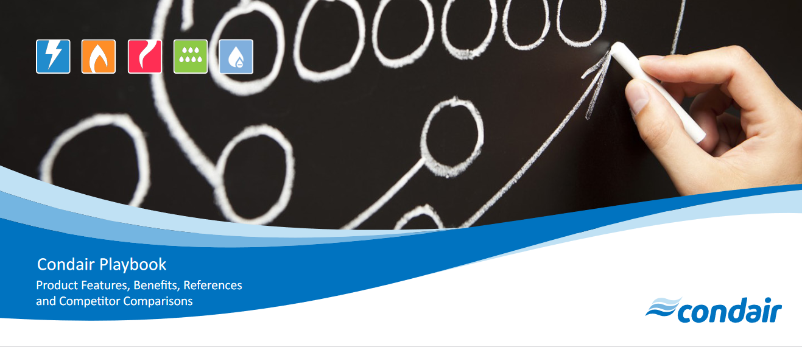
Sales Tool: Condair Playbook
Condair Playbook

Slide 24

Sales Tools
Web and Social

Slide 25
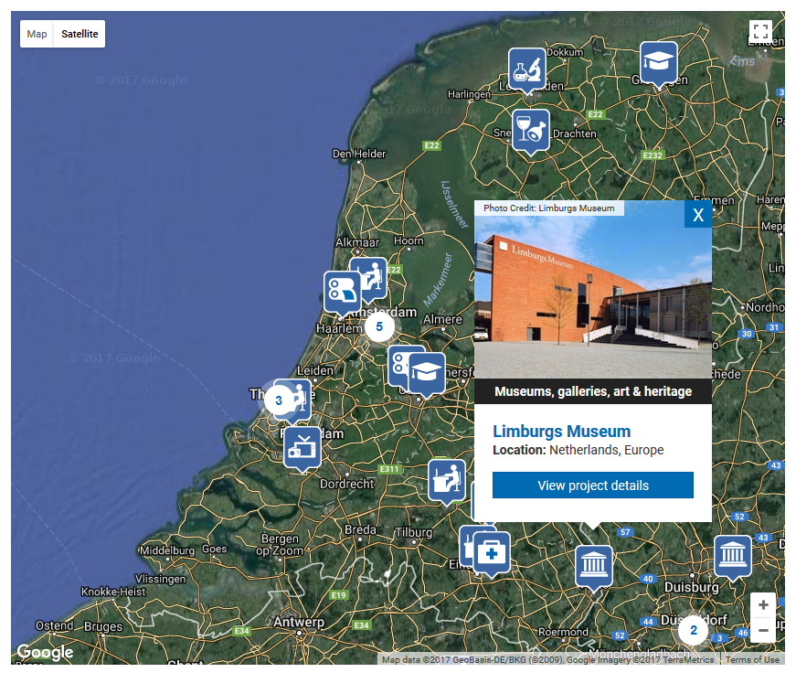

Condair Website
References and Resources
www.Condair.com
Application know-how
Sales brochures
Links to tools and software
“Condair’s World” references
Condair’s World

Slide 26
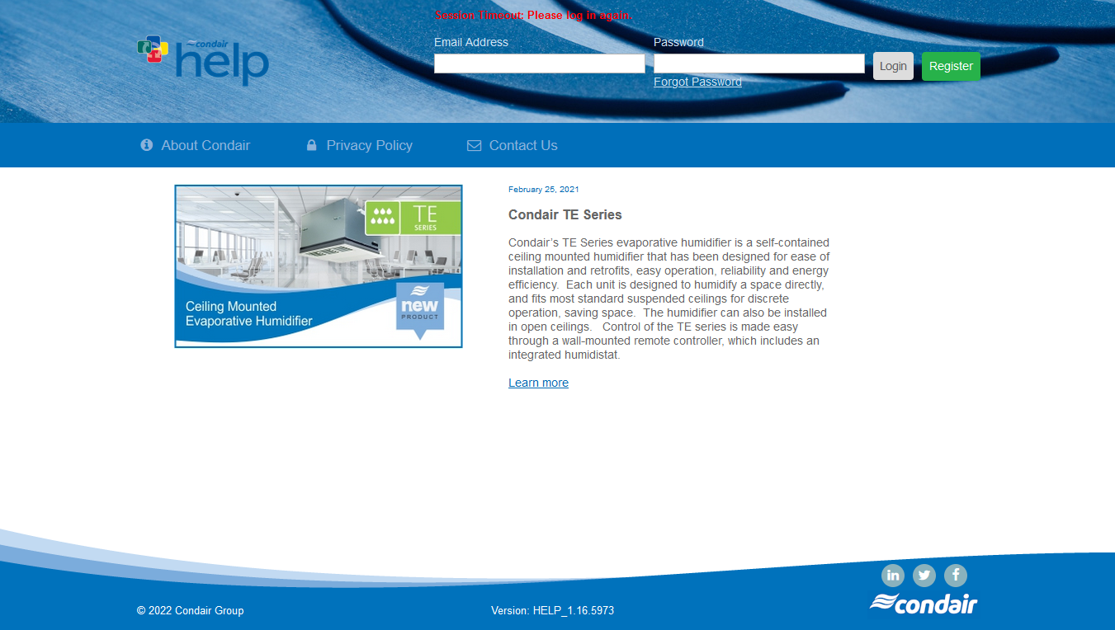

Condair Help
Selection Software and Ordering
Sizing and selection tools
Pricing and submittals
Complete product catalog
Application knowledge tool
Resources and key documents
Electronic ordering

Slide 27
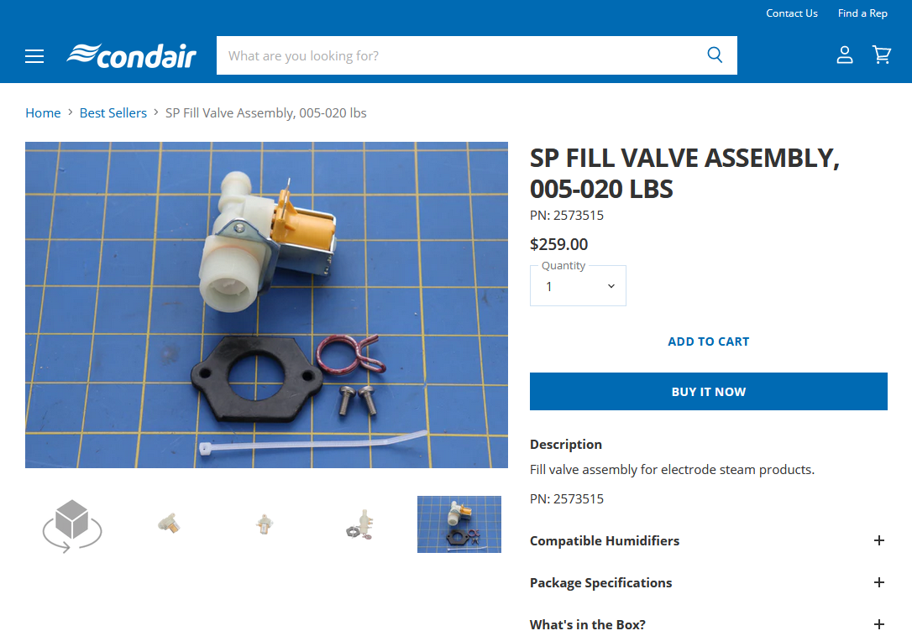




CondairParts.com / CondairParts.ca
Parts are only a click away!
Spare Parts with 3D views
Exploded Views
What’s in the Box
Compatible with mobile devices
Leads + Commission for end-user sales
Register to order with terms!

Slide 28
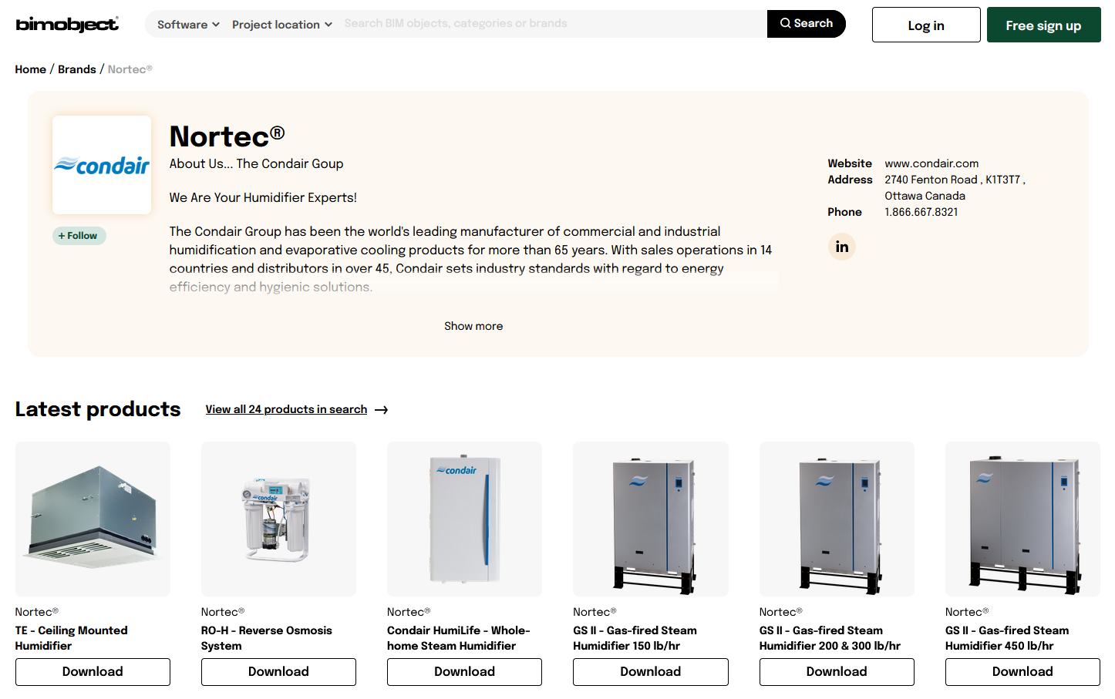

BIM / Revit / 3D Models
Parts are only a click away!
Hosted by BIMObject.com for easy access in common BIM tools
Detailed 3D BIM models
2D CAD blocks
Performance and other useful data

Slide 29

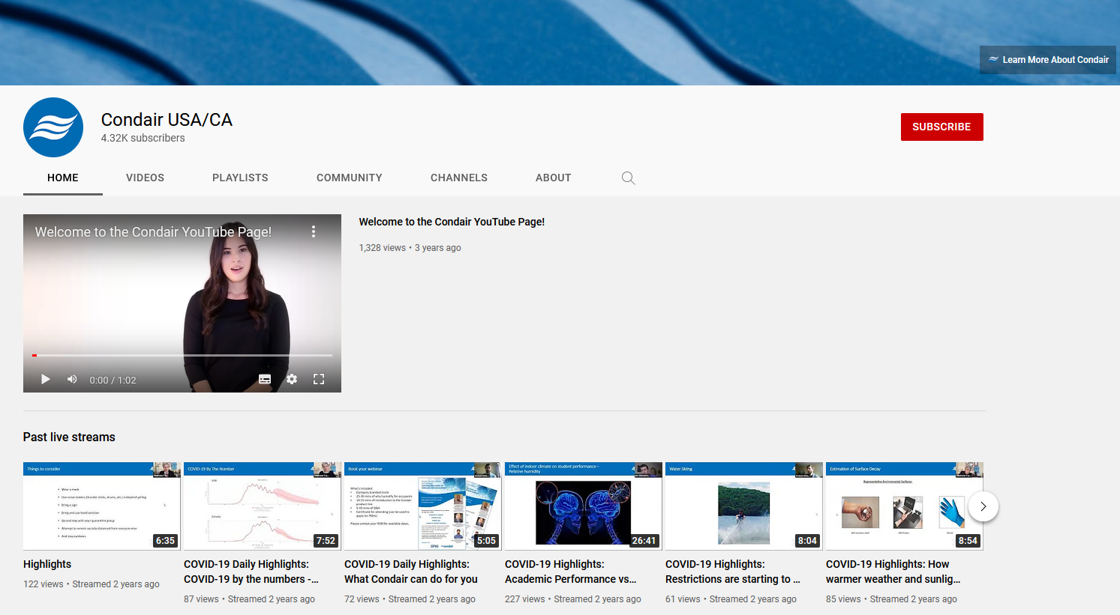




Condair on YouTube
Expert Video Content
Condair North America
Condair HumiLife
Condair North America
Residential Content
Condair Group
Condair GmBH
Corporate Videos
Great technical videos

Slide 30
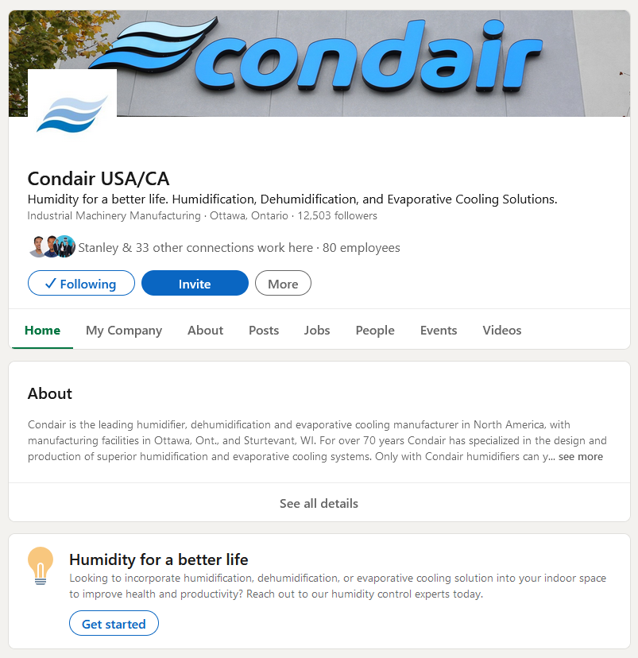


Condair on LinkedIn
Stay in Touch!

Slide 31
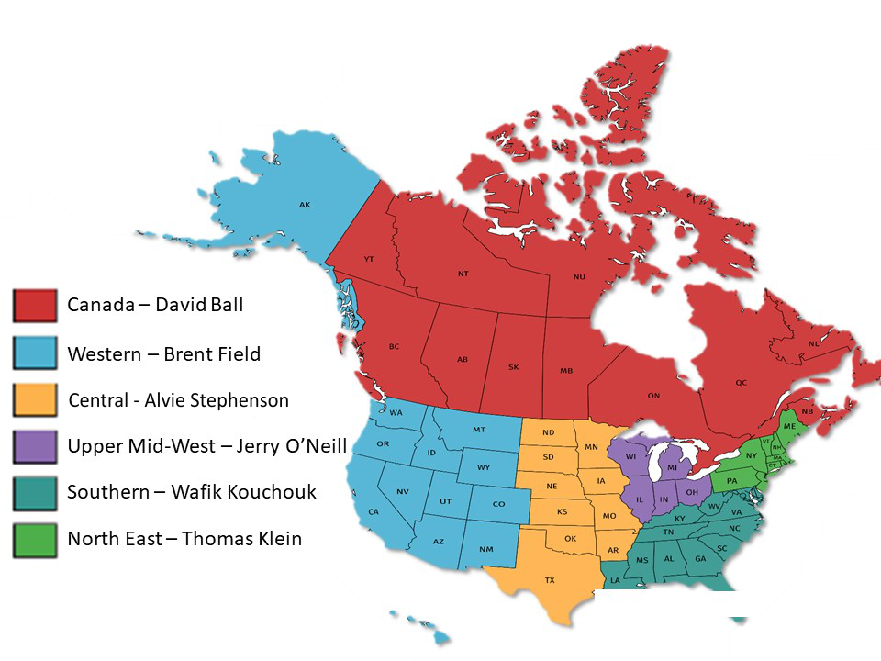
Selling Condair
Your Contact List
Regional Sales Managers
Application Engineering
Account Management, Training, Discounts
Pre-sales Support and Advice
na.applications@condair.com
Technical Support
After Sales Support, Troubleshooting
na.Support@condair.com
Customer Service
General Inquiries, Orders, Billing
na.inquiries@condair.com
na.orders@condair.com

Slide 32

Sales Tools Summary
Leverage Sales tools to drive business
  Mobile apps are great sales tools on the go
  Consult the reference guide!
Condair Web content:
  Simplifies applications
  Explains important concepts
  Simplifies work for engineers and consultants
We are here to help you grow your business!
  RSMs
  Technical Support
  Application Engineering
  Customer Service

Slide 33

Thank-you for joining us!
Humidity for a better life

