Slide 1

Humidity 101
Stanley Tom & Marlee Spiegelberg

Slide 2
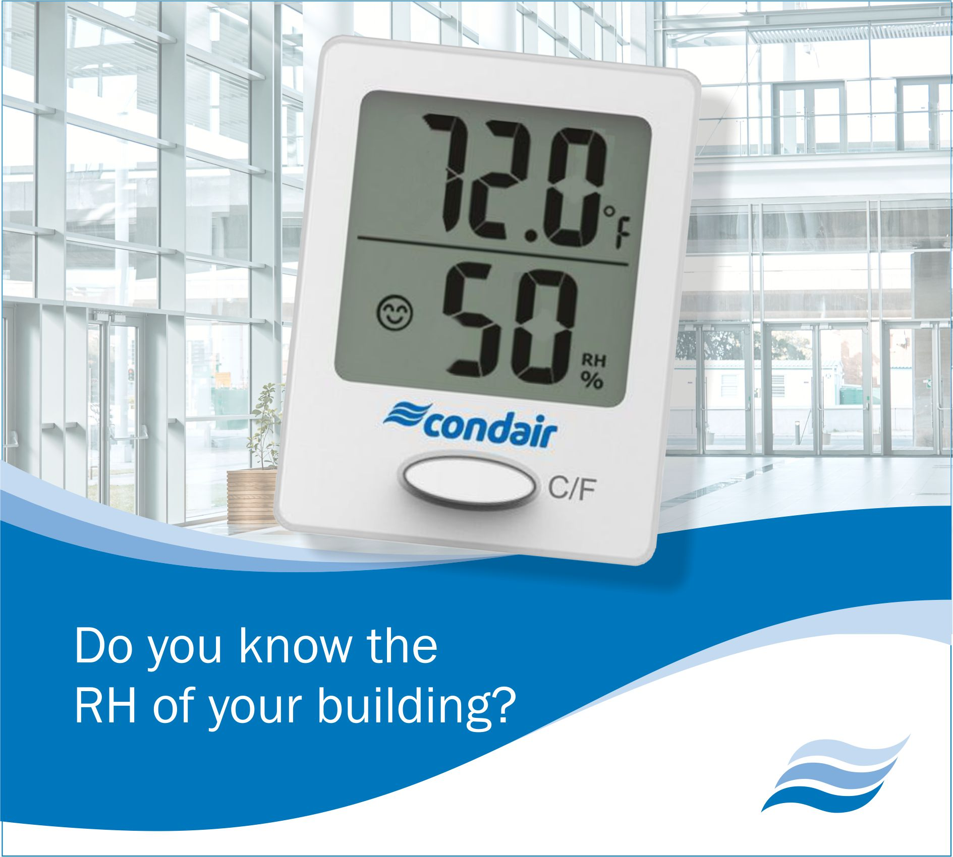
Outline/Agenda
Humidity 101
Why Buildings Get Dry
Dryness and Seasonality
Dryness in Process
Dryness and People
The Latest in Humidity Research
Practical Humidity Control

Slide 3
Humidity 101
Absolute Humidity is measured by mass (gr/lb, g/kg)
Relative Humidity is relative to temperature (%)
1 lb (0.5 kg) Air
35°^{F} (2°^{C})
30 gr (2g/kg)
1 lb (0.5 kg) Air
72°^{F} (22°^{C})
30 gr (2g/kg)
Sensible Heating
100% RH
25% RH

Slide 4
Humidity vs. Temperature
Absolute Humidity
100% RH
120 gr (8g/kg)
25% RH
30 gr (2g/kg)
35°^{F}
(2°^{C})
72°^{F}
(22°^{C})
120°^{F}
(49°^{C})
Temperature

Slide 5
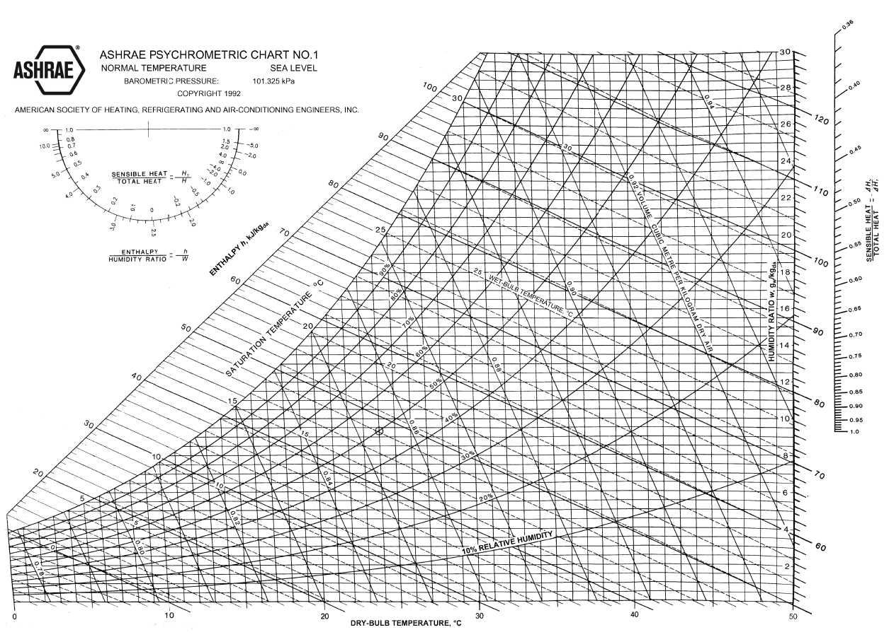
The Psychometric Chart

Slide 6


What Causes Dryness?
Outside air with low absolute humidity dries building
Sensible Heating
Outside Air
6°F (-14°C)
53% RH
4 gr/lb (0.6 g/kg)
Inside Air
70°F (21°C)
4% RH
4 gr/lb (0.6 g/kg)
Ventilation
In/Exfiltration
Image: Free Stock Photos 14413

Slide 7
Seasonal Dryness: Fixed Air Volume Ventilation Example
Indoor
Dryness
October
January
March
April
May
June
July
August
September
November
December
February
Indoor
Dampness

Slide 8
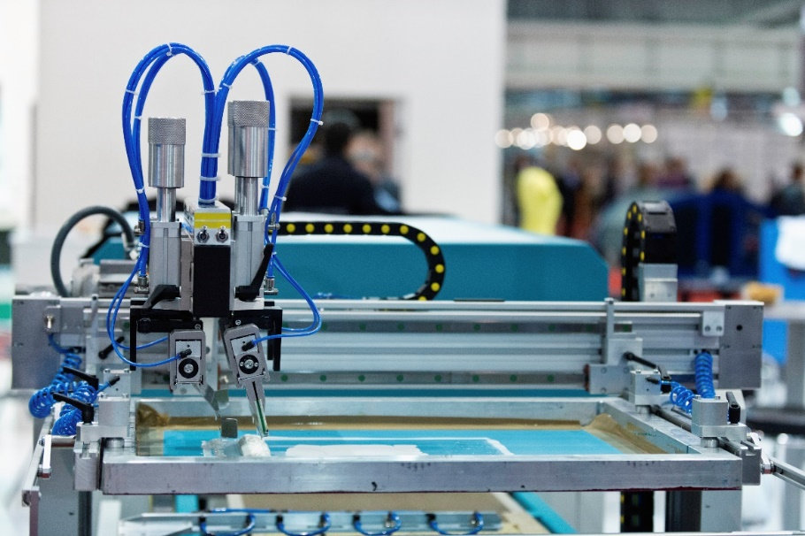

Is Dryness A Problem?
Manufacturing and Processes
Occupant Health and Wellness
iStock: 000030384618X
Licensed from www.peopleimages.com

Slide 9



Manufacturing and Process
Evaporation
Rates
Hygroscopic
Materials
Static
Charges

Slide 10

Evaporation Rates and Drying
Vapor pressure differential drives moisture flow
Quality concerns:
  Water based sprays / paint
  Shrinkage
  Adhesion
  Runs / Drips
iStock: 000002955937

Slide 11
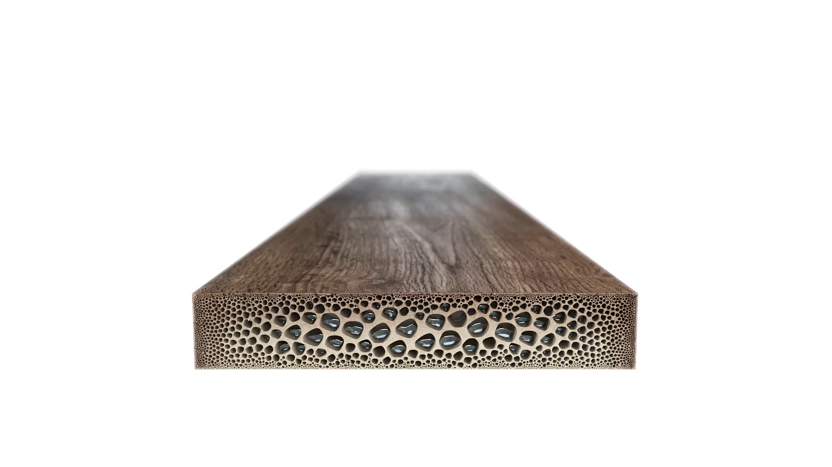
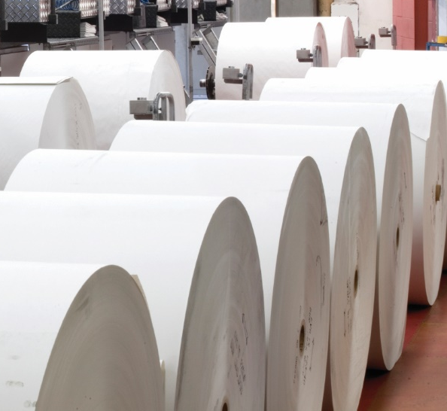
Hygroscopic Materials
Moisture absorbs/desorbs in hygroscopic materials
Quality concerns:
  Dimensional instability
  Cracking / deterioration
  Coating delamination
Examples
  Printing
  Building Finishes
Animation Courtesy Condair Group AG
iStock Images

Slide 12

Static Electricity
Moisture provides conductive path for electrons
Quality concerns:
  Component damage
  Static cling
  Unpredictable spray pattern
  Paint Defects
  Ignition of volatile compounds
1
¹ Graham Hearn, Wolfson Electrostatics, Controlling Static Electricity in Modern Buildings
iStock: 000002955937

Slide 13

Humidity and Building Occupants

Slide 14
Occupant Health and Wellness
Human Body Response
  Human body is ~60% water
  Body doesn’t sense moisture well
Ambient Humidity Affects:
  Eyes
  Skin
  Throat
  Nose
  Hydration
  Immune System

Slide 15
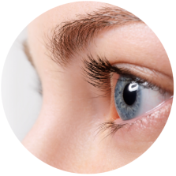
Human Body: Eyes
Our Eyes
  Protected by thin tear film
  Dry air causes increased desiccation
  Compounded by computer use
  Discomfort increases with time if dew point is below 26°^{F [1]}
Typical Symptoms
  Eye discomfort
  Redness
  Photosensitivity
  ¹ J.E. Laviana, F.H. Rohles, Jr. and P.E. Bullock, Humidity Comfort and Contact Lenses (ASHRAE, 1988) 94(1), 3-11.

Slide 16
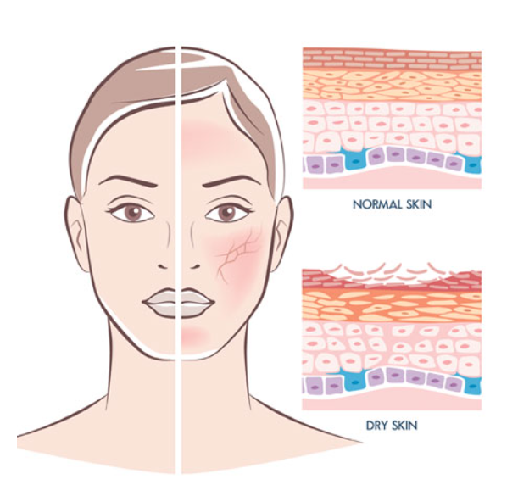
Human Body: Skin
Our Skin
  Skin provides protection and thermal regulation
  Thermal regulation via evaporative cooling
  Dry environments disrupt moisture balance
    Increased evaporation rates
  Below 30% RH skin becomes dry ^{[1]}
Typical Symptoms
  Thermal discomfort
  Dryness of skin surface
  Inflammation / aggravation of skin conditions
¹ Sunwoo Y, Physiological and Subjective Responses to Low Relative Humidity in Young and Elderly Men, (J Physio Anthropol, 2006 May), 25(3):229-38.

Slide 17
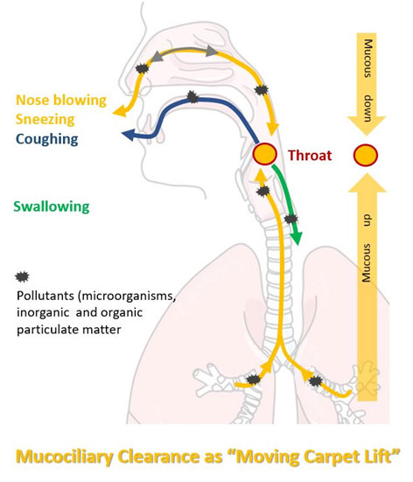
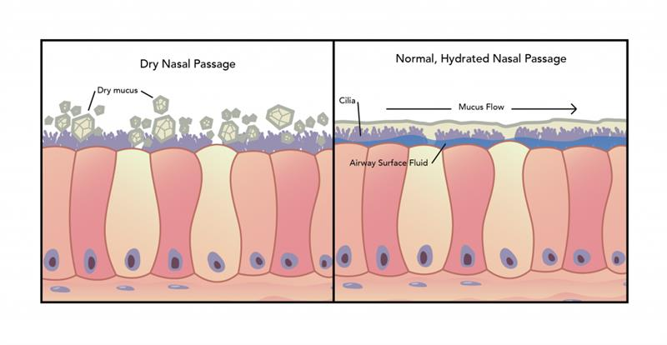
Human Body: Throat
Our Throat
  Provides channel for air to enter lungs
  Conditions air we breathe
  Dry air draws requires more moisture
Typical Symptoms
  Increased need to swallow
  Vocal chord irritation^{[1]}
  US National Institute of Health recommends >30% RH + drinking water
  ¹ National Institute on Deafness and Other Communication Disorders, Taking Care of Your Voice, https://www.nidcd.nih.gov/health/taking-care-your-voice (December 14, 2016)

Slide 18
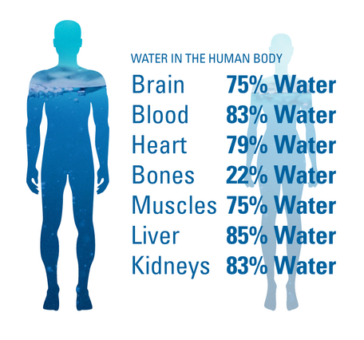
Human Body: Hydration
Our Body and Brain
  Rely on water for many processes
  Brain is ~85% water
  Dry environments increase water loss
Possible Symptoms
  Decreased cognitive function at 2% dehydrated
  Reduced short term memory
  Increased fatigue and moodiness
https://www.usgs.gov/special-topics/water-science-school/science/water-you-water-and-human-body

Slide 19
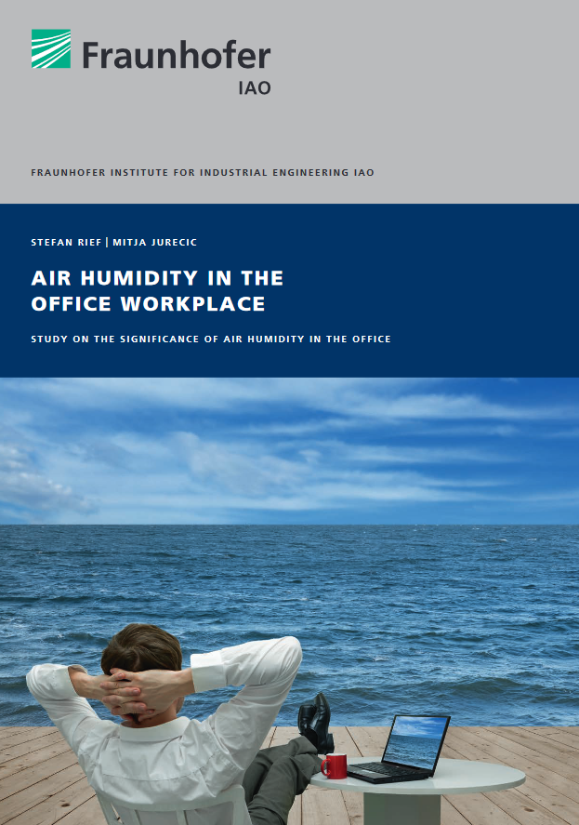
Fraunhofer Study: Air Humidity in the Office Workplace (2014)
Research started with occupant surveys via internet
Experiment related to “I feel air is often too dry”
  No Humidifier, Placebo Humidifier, Active Humidifier
“Air humidity at the workplace can thus be assessed as a building block for increasing a person's well-being and for possibly reducing health risks.” ^{[1]}
  Reduced eye strain
  Reduced vocal strain
  Reduced allergy and asthma impact
  Increased employee performance
  Mental acuity
  Improved perceived comfort (“humidex”)
^{[1]} Rief S and Juric M, Air Humidity in the Office Workplace, Fraunhofer IAO, 2014

Slide 20
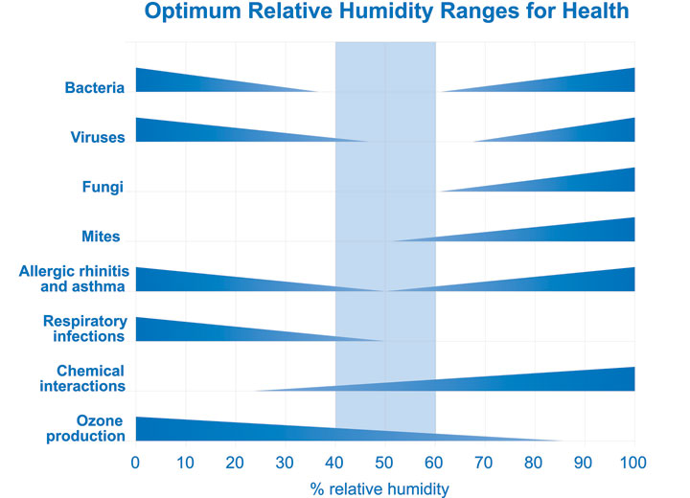
What Does ASHRAE Say?
The Sterling Chart
  Common design reference
  Optimal mid-range 40 - 60%
ASHRAE Standard 55
  “There are no established lower level humidity limits for thermal comfort, consequently, this standard does not specify a minimum humidity level.
  NOTE: Non-thermal comfort factors such as skin drying, irritation of mucous membranes, dryness of the eyes, and static electricity generation may place limits of the acceptability of very low humidity environments.”

Slide 21
ASHRAE Research Project 1630
“Update of the Scientific Evidence for Specifying Lower Limit Relative Humidity Levels for Comfort, Health and IEQ in Occupied Spaces”
Literature Review: 600 articles of interest, 70 detailed reviews
Focused on comfort, health, and IEQ
Findings consistent with Sterling Chart in ASHRAE Handbook
  Lower humidity decreased house dust mite allergens
  Lower humidity increased virus survival for influenza
  Health, comfort, skin dryness, eye irritation, and static electricity increased as humidity decreased
Low and High humidity control is important for comfort, wellness, and health

Slide 22
Humidity and Health: Research
Humidity and Respiratory Infections
  Evidence of link between moisture and cold / flu transmission
  Clinical trials between 1963 and 1985 showed significant reduction of respiratory infections when mid-range humidity was maintained [1-5]
1. Ritzel G, Sozialmedizinische Erhebung zur Pathogenese und Prophylaxe von Erkältungskrankheiten, sog. «Kindergartenstudie» Zeitschrift für Präventivmedizin 1966, 11. 9-16
2. Sale C, Humidification to Reduce Respiratory Illnesses in Nursery School Children, Southern Medical Journal, July 1972, Vol 65
3. Green G H, Winter humidity and related absenteeism in Canadian hospitals, Digest of the 3rd. CMBES
4. Green G H, The effect of indoor relative humidity on absenteeism and colds in schools, ASHRAE Trans., Vol. 80, Part II
5. Gelperin A, Humidification and upper respiratory infection incidence, Heating, Piping and Air Conditioning, 45:3, 1973

Slide 23
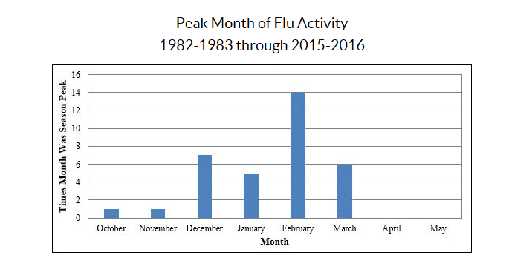
Humidity and Health: Seasonality of Influenza
¹ https://www.cdc.gov/flu/about/season/flu-season.htm

Slide 24
Humidity and Health: Seasonality of Influenza
Why?^{[1]}
More time indoors in proximity to others
Drying of nasal mucous membrane weakens respiratory system
Influenza virus is most stable at lower RH^{[2]}
Exhaled aerosols float longer in lower humidity
¹ Anice Lowen, et al, Influenza Virus Transmission Is Dependent on Relative Humidity and Temperature (October 19, 2007)
²J. Metz, et al, Influenza and Humidity – Why a bit more damp may be good for you! (June 2015)

Slide 25
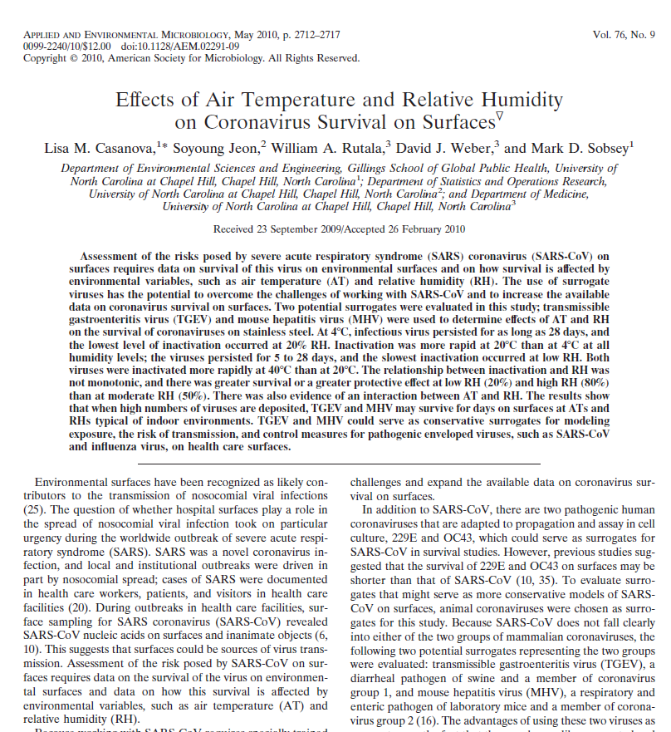
2010 CDC Funded Study on SARS-CoV Coronavirus Survival
“”there was greater survival or a greater protective effect [for the virus] at low RH (20%) and high RH (80%) than at moderate RH (50%).”
“Greater survival of other enveloped viruses, including vaccinia virus, Venezuelan equine encephalitis virus, and influenza virus, at low RH has been observed previously (11, 12, 13, 26, 27).”
“…maximum rates of Maillard reactions
occur when the RH is 50 to 80%) (9), possibly providing a partial explanation for why viral inactivation appears to be more rapid at 50% RH than at 20% or 80% RH.”
https://www.ncbi.nlm.nih.gov/pmc/articles/PMC2863430/

Slide 26
Infectious Particles: NIOSH/CDC Simulated Cough Experiment
Travel Distance
1m
10+m
Droplet Size
100μm
50μm
<5μm
Infectious payloads travel farther
Particles lose mass quickly in dry environment
Smaller light particles fly farther (0.5 µm particles float up to 41 hours)
Influenza Infectivity is retained^{[1]}
[1] Noti JD et. al, High Humidity Leads to Loss of Infectious Influenza Virus from Simulated Coughs, PLoS ONE 8(2): e57485, 2013

Slide 27
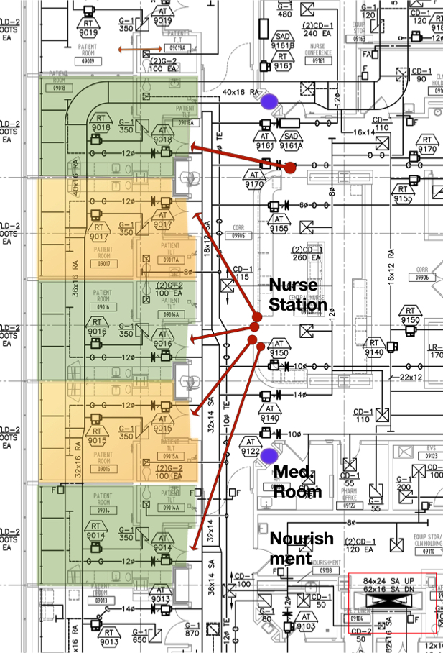
Infections: Research in LEED Silver Hospital
Hygiene and sanitization have gotten better, why have HAI rates not improved?
Room environment vs. patient infection rates
Microbiome study in a new LEED Silver hospital in the USA
240 single-occupancy inpatient rooms
52 ICU beds. 28 operating suites
A three layer study over 13 months
10 monitored patient rooms (300 patients)
9 continuously measured parameters
(Room ach, visitor traffic, outdoor air factions, room pressure, temperature, absolute humidity, relative humidity, CO₂, air pressure, lux) ~8 million data points
Image Courtesy Dr. Stephanie Taylor

Slide 28
Infections: Research in LEED Silver Hospital
Results: 15% of Patients contracted a “Healthcare Acquired Infection” (HAI)

Slide 29
Infections: Research in LEED Silver Hospital - Results
Indoor
Relative Humidity
Healthcare-Associated
Infections
As relative humidity decreased infection rates increased
Confidence: (t < 0.02)
Adapted from Source: Colonization and Succession of Hospital-Associated Microbiota [Restyled for readability]
Simon Lax, Daniel Smith, Naseer Sangwan, Kim Handley, Peter Larsen, Miles Richardson, Stephanie Taylor, Emily Landon, John Alverdy, Jeffrey Siegel, Brent Stephens, Rob Knight, Jack A Gilbert

Slide 30

Research in a School:
“Humidity as a Non-Pharmaceutical Intervention for Influenza A”
Hypothesis: “…raising absolute humidity above seasonal lows would impact influenza virus survival and transmission in a key source of influenza virus distribution, a community school.”
Photo Credit: iStock 34019410
Research builds upon NIOSH/CDC and microbiome research
Focused on preschool classrooms
Air and toy samples processed with PCR looking for influenza A
Compared standard rooms with rooms where humidity control was added
[1] J. Reiman et al, Humidity as a non-pharmaceutical intervention for influenza A, 2018
https://journals.plos.org/plosone/article?id=10.1371/journal.pone.0204337

Slide 31
Research in a School:
“Humidity as a Non-Pharmaceutical Intervention for Influenza A”
%RH in classrooms | % Airborne particles carrying virus (PCR) | Virulence of airborne virus | # children absent due to influenza like illness
20% | 49% | 75% | 22
45% | 19% | 35% | 9
Results:
“There were 2.3 times as many ILI [influenza like illness] cases in the control rooms compared to the humidified rooms…”
“… whether there is a causal relationship, and its direction between the number of cases and levels of influenza virus in the rooms is not known.”
“Additional research is required, but this is the first prospective study suggesting that exogenous humidification could serve as a scalable NPI for influenza or other viral outbreaks.”
[1] J. Reiman et al, Humidity as a non-pharmaceutical intervention for influenza A, 2018
https://journals.plos.org/plosone/article?id=10.1371/journal.pone.0204337

Slide 32
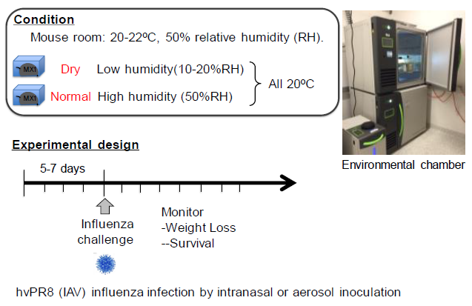
2019: Research of How Humidity Affects Immune System
Studied immune response in mice:
Likelihood of acquiring infection
Mucocilioary performance
Lung tissue response and tissue repair
Results:
Low humidity environments made mice more susceptible to infection
Mechanisms were related to cilia, mucous, and lung tissue function
“These results indicate that exposure to dry air impairs host defense against influenza infection, reduces tissue repair, and inflicts caspase-dependent disease pathology.”
[1] Kudo et al, Low ambient humidity impairs barrier function and innate resistance against influenza infection
Proceedings of the National Academy of Sciences May 2019, 116 (22) 10905-10910; DOI: 10.1073/pnas.1902840116
https://www.pnas.org/content/116/22/10905

Slide 33
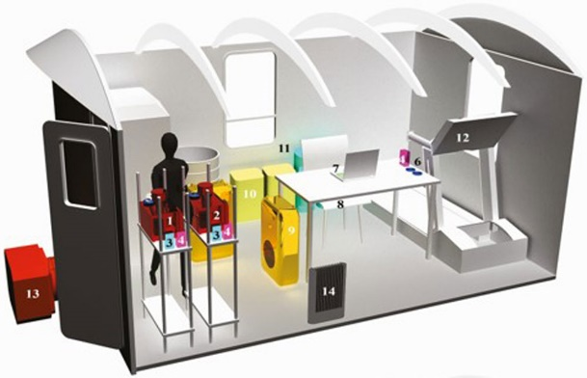
2022: Covid 19 Aerosol Loading
Studied effects of environment conditions on aerosol loading:
11 students diagnosed with Covid-19
Each spent 3 days in controlled chamber
Varied ventilation, filtration, humidity
Results:
Increased ventilation and filtration significantly reduced aerosol and surface viral loads
Higher humidity resulted in lower aerosol and higher surface viral load due to increased rate of particle deposition at higher relative humidity
“The findings indicate that building operation practices such as ventilation, filtration, and humidification substantially reduce the environmental aerosol viral load and therefore inhalation dose, and should be prioritized to improve building health and safety.”
[1] Hooman Parhizkar, Leslie Dietz, Andreas Olsen-Martinez, Patrick F Horve, Liliana Barnatan, Dale Northcutt, Kevin G Van Den Wymelenberg, Quantifying Environmental Mitigation of Aerosol Viral Load in a Controlled Chamber With Participants Diagnosed With Coronavirus Disease 2019, Clinical Infectious Diseases, 2022; ciac006, https://doi.org/10.1093/cid/ciac006

Slide 34

Human Body: Nose / Immune System
Our Nose/ Immune System
  Mucous membrane and cilia filter we breathe
  Capture and drain infectious particles
  Dry environments desiccate and thicken mucous^{[1]}
Possible Issues
  Reduced cilia motion
  Reduced ability for mucous to drain
  Increased risk of infection
¹ J.P. Guggenbichler, R. Huster and S. Geiger, Luftfeuchtigkeit und Immunabwehr
Die Rolle der Schleimhaut und Auswirkungen auf die Klimatechnik (2007) Tab Technik AM, Vol. 38, No. 9

Slide 35







It Is Time to Rethink Indoor Environments
  WE
  THOUGHT
keeping buildings dry is a
strategy for eliminating
microbes and preventing
health problems
low w_{a} water activity (w_{a}) high w_{a}
WE KNOW
Dampness creates conditions favorable to mold
Mid-range RH
Supports health!
low RH intermediate RH high RH

Slide 36
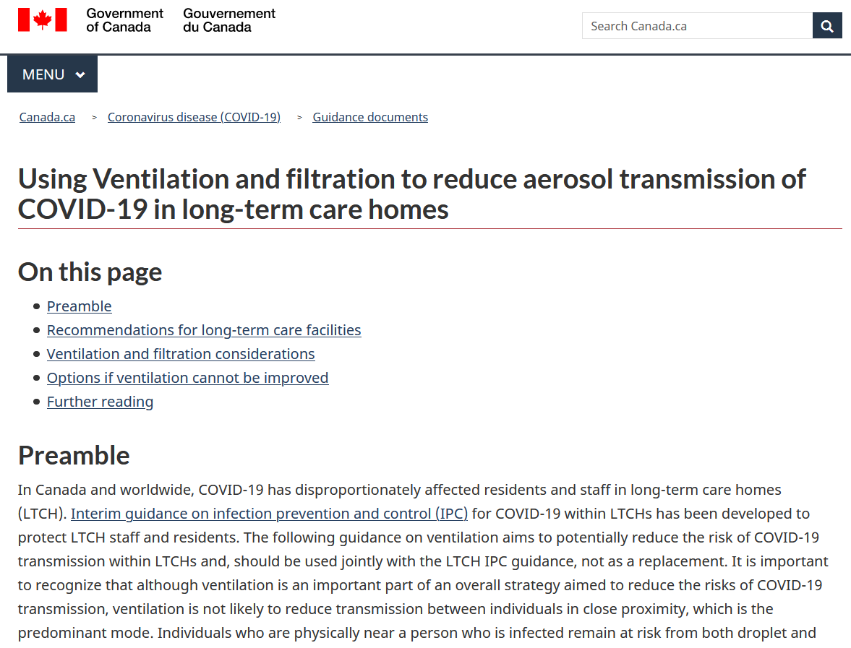
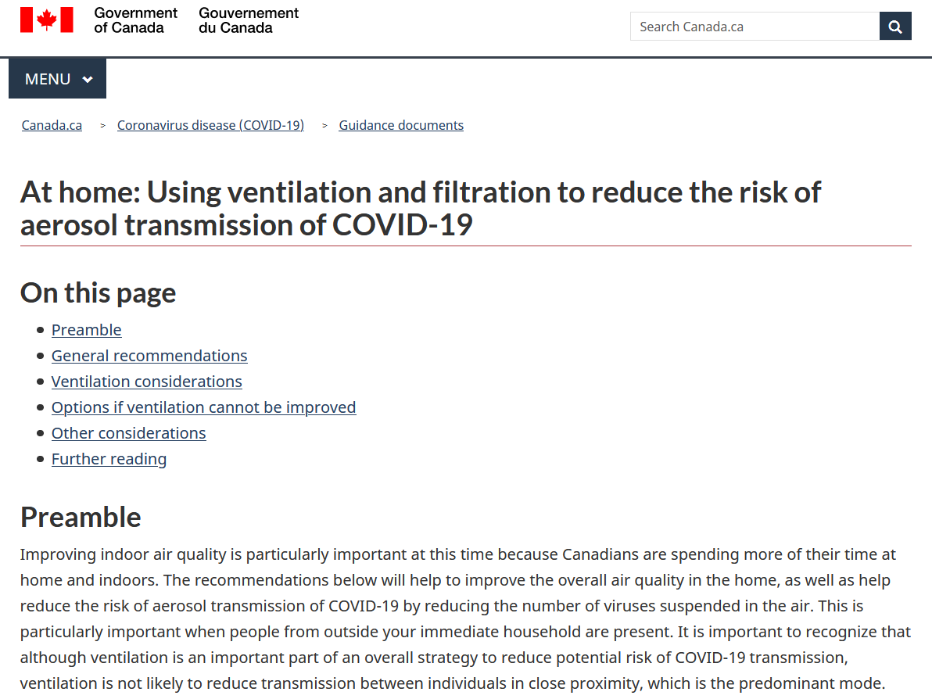
COVID-19: New Guidance at Home and Long Term Care
“While humidifiers do not remove SARS-CoV-2 virus from the indoor air environment, they could impact the duration that particles that contain virus are suspended in the air, and how long they remain infectious. It is therefore important to maintain an optimal humidity level, between 30% and 50% in indoor settings.”
https://www.canada.ca/en/public-health/services/diseases/2019-novel-coronavirus-infection/guidance-documents/guide-home-ventilation-covid-19-pandemic.html
https://www.canada.ca/en/public-health/services/diseases/2019-novel-coronavirus-infection/guidance-documents/guide-ltch-ventilation-covid-19-pandemic.html

Slide 37



Temperature, Humidity, CO₂: Simple Tools for Healthy Buildings
Parameter | Parameter | Optimal | Rationale
 | Temperature | 20°^{C} – 23°^{C} | Thermal comfort Minimize environmental stress for occupants
 | Relative Humidity | 40 – 60% | Health / immune system support Reduce particle float time Reduce particle infectiousness
 | Carbon Dioxide | 800 – 1000 ppm (Maximum) | Surrogate for exhaled particles Baseline 400 ppm Exhaled air ~40,000ppm +400 ppm ~ 1% of exhaled air

Slide 38
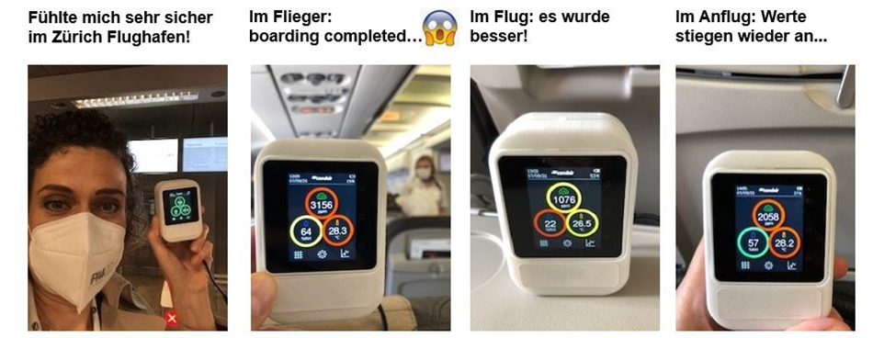
Temperature, Humidity, CO₂ in Practice
Feeling very safe
In Zürich Airport!
In aircraft:
boarding completed…
In flight: it’s gotten
better
On approach: values
rise again

Slide 39
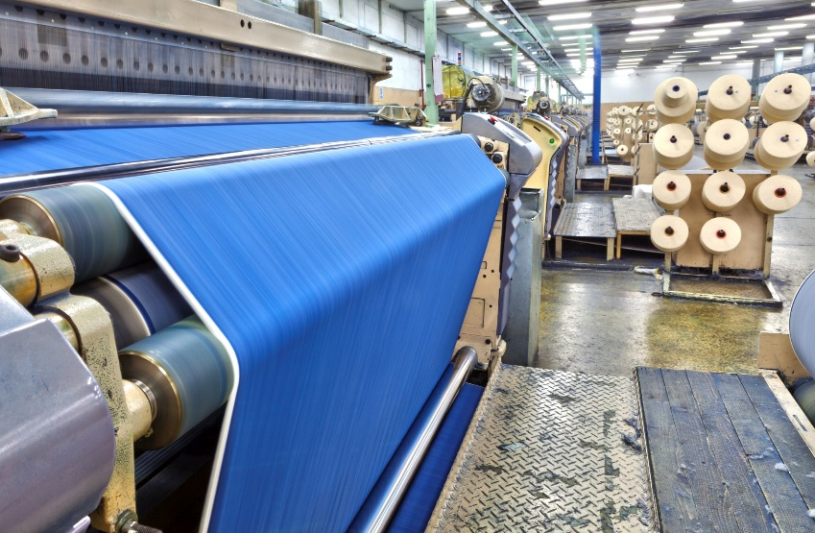
Humidity Targets
For People:
40 – 60% RH (Ideal)
Photo Credit: iStock 000018649460
For Process:
Varies with Process
Photo Credit: iStock 000022275438

Slide 40

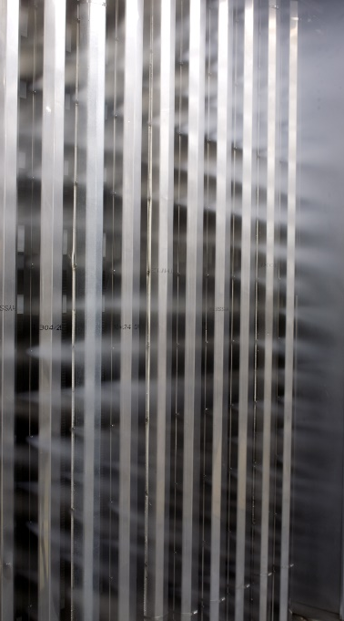
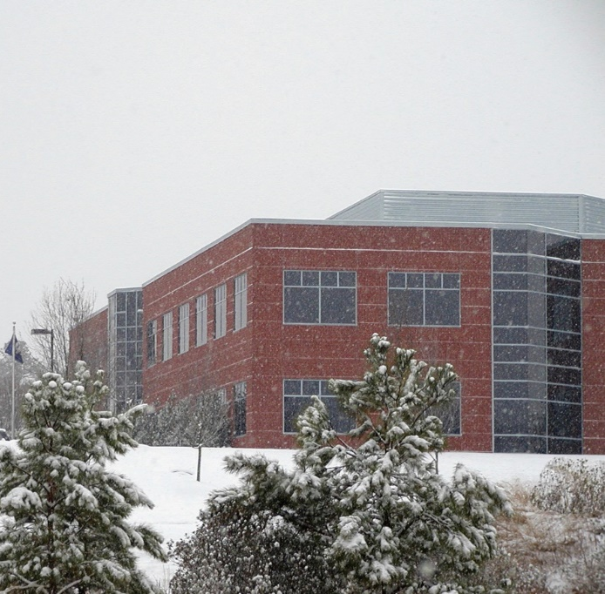


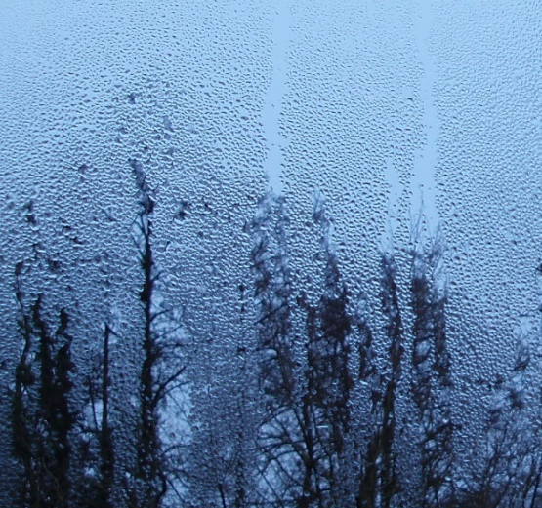
Humidity Control in Practice

Slide 41


Practical Humidity : Adding Moisture to the Air
Water Vapor
Heat of Evaporation:
970 – 1075 BTU/lb
2257 - 2500 kJ/kg
Liquid Water
Steam: Energy comes from electricity, gas, or heat exchange process
Spray / Evaporative: Energy comes from the air
= SENSIBLE COOLING!

Slide 42
Practical Humidity : Managing Energy
Humidification load is proportional to outside air volume
  Use minimum outside airflow when possible
  Caution with high performance standards that reward high ACH
  Use a set point of 40 - 45%
Use total energy (enthalpy) recovery wheels / plates
  Recover up to 70% of moisture in exhaust
  Bonus: Reduce dehumidification loads in summer
Be careful with airside economizer optimization
  Large quantities of cool outside air cause dryness
  Look at total enthalpy not just temperature

Slide 43
Practical Humidity: …But What About Mold?
Scott (1953 &1957): Water activity factor determines growth of mold
[1]
Water Activity Factor: A measure of the energy status of water in a system
$$w_{a}≈Relative Humidity. Example: 60\% RH≈0.6$$
High w_{a} + nutrient rich substrate = mold
Most organisms require w_{a} > 0.7 with optimal conditions
[1]
Keys to Avoid Mold:
Avoid prolonged exposure of building to RH > 60%
Minimize localized areas of high %RH (air leaks, cold pipes, etc.)
Avoid condensation
[1] Carter, Brady. 2015. How Dry Am I? Presented at the 2015 ASHRAE Summer Conference, Atlanta, Georgia, June 28

Slide 44

Practical Humidity : Avoiding Condensation
Condensation occurs when humid air interacts with temperatures below the dew point
Fenestration, Exterior Walls, Pipes
Strategies:
Cold temperature setback: 45% → 30%
Condensation sensors
Ventilate / supplemental heat for glass
Focus on quality in construction / vapor barriers
Image Credit: creativity103.com, Cropped
Resources: ASHRAE Journal Column: Building Sciences by Joe Lstiburek

Slide 45
Conclusion: Defeating Dryness and Getting Humidity Right
Buildings dry out when outside is drier than target levels
Humidity affects processes
Humidity affects occupant health
Optimum indoor range for occupants: 40 – 60% RH
(and 20°^{C} – 23°^{C}, <1000 ppm)
Planning for humidity helps achieve great results

Slide 46

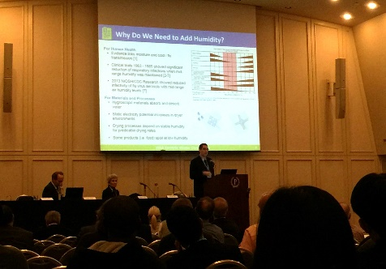
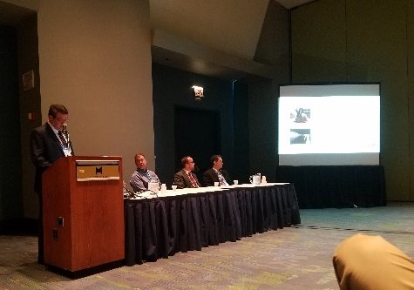
Want To Learn More?
ASHRAE TC 5.11 - Humidifiers
  www.ashrae.org/
  www.ashrae.org/joinatc - Join by web call!
©ASHRAE, www.ashrae.org
ASHRAE Resources
  Humidity IS Health (ASHRAE Bookstore)
  Putting People First: The Healing Power of Indoor Air (ASHRAE Virtual Conference)
  2020 Systems and Equipment Handbook Chapter 22
  Position Document on Airborne Infectious Diseases
Photo Credit: W. Truong
AHRI Free Education Resources
  Archived AHR Expo Presentations
  Other helpful resources
  ahrinet.org/humidifiers
Photo Credit: J. Kane

Slide 47
Thank you!

