Slide 1
Livesteam and Steam Exchange
Stanley Tom

Slide 2
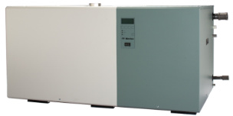
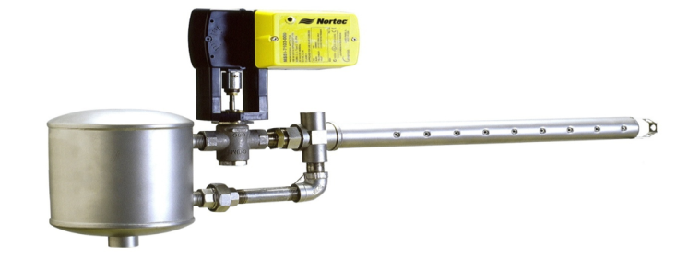
Agenda
Livesteam
Introduction
Model Overview
Operation
Installation
SETC
Introduction
Model Overview
Operation
Installation
Features

Slide 3
Introduction
Livesteam

Slide 4
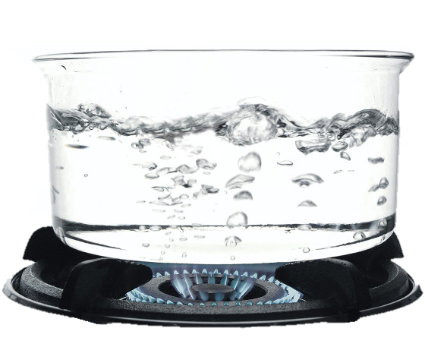
Introduction
What is Livesteam?
LiveSteam humidifiers utilizes existing facility boiler steam for humidification in one of two ways:
Directly introduce boiler steam into the duct work for humidification * *Any decaling chemicals in the boiler will be in the airstream
Utilize boiler steam as the energy source to generate clean steam for humidification

Slide 5
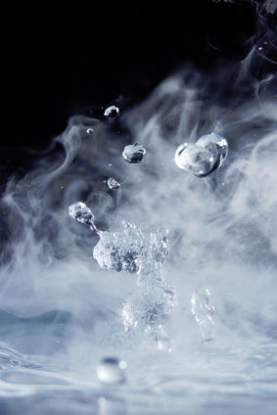
Introduction
Why Livesteam?
A source of central steam is available
Inexpensive or “free” steam
No added operational costs for humidification
Energy efficient
Great for retrofits – Use what is already available!

Slide 6
Model Overview
LS Series

Slide 7
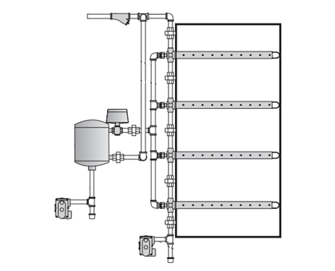
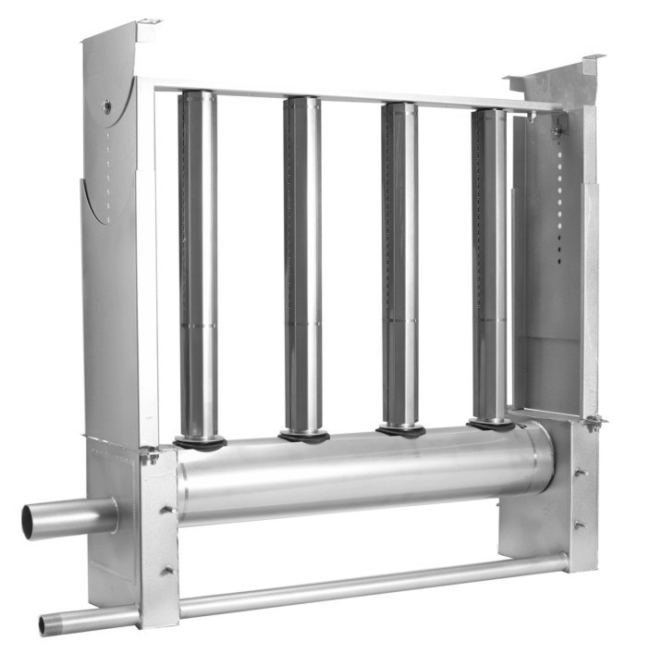
Model Overview
LS Series
Single tube
Multiple tubes
Sam-e

Slide 8
Model Overview
LS Series – Types
Type | Available Sizes | Capacities | Diameter | Valve Size
LS1 | 12" - 48" (6" increments) 60" - 144" (12" increments) | 100 lbs/hr 150 lbs/hr | 1.5” | 1/2”
LS2 | 12" - 48" (6" increments) 60" - 144" (12" increments) | 150 lbs/hr 250 lbs/hr | 2.0” | 3/4”
LS3 | 24" - 48" (6" increments) 60" - 144" (12" increments) | 400 lbs/hr 550 lbs/hr | 3.0” | 1-1/4”
Available: Standard, Insulated, DI, and Insulated DI
Jacketed steam tubes with 97% coverage

Slide 9
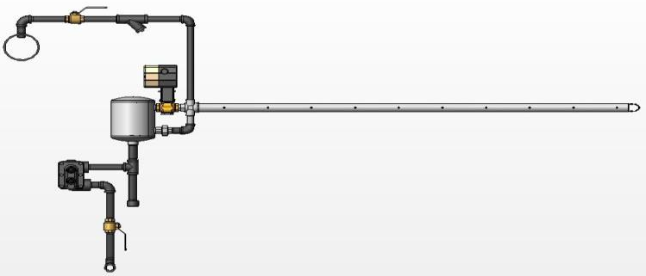
Operation
LS Series - Overview
Manual Shut-Off Valve
Strainer
*All Red Components By Condair
Actuator
Steam Valve
Distributor Tube
Steam Main
Steam Separator
F&T Steam Trap
Interconnecting Piping
Manual Shut-Off Valve
Pressurized Condensate Return

Slide 10
Operation
LS Series

Slide 11
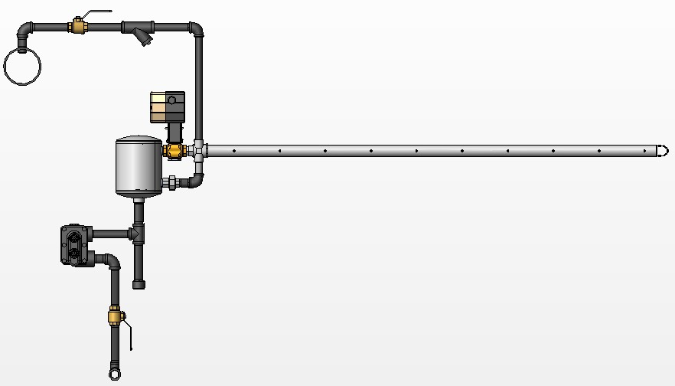
Operation
Principle of Operation – Single Tube Distributor
Notes:
Please note that in some cases you will need to select the actuator based on the steam pressure to the unit and the close off pressure of the actuator. Take for example a system that requires a 2” bronze valve operating at 25 psi. You would not be able to use P/N 1507549 because the available close off pressure is only 20 psi, you would need to select P/N 1507552.

Slide 12
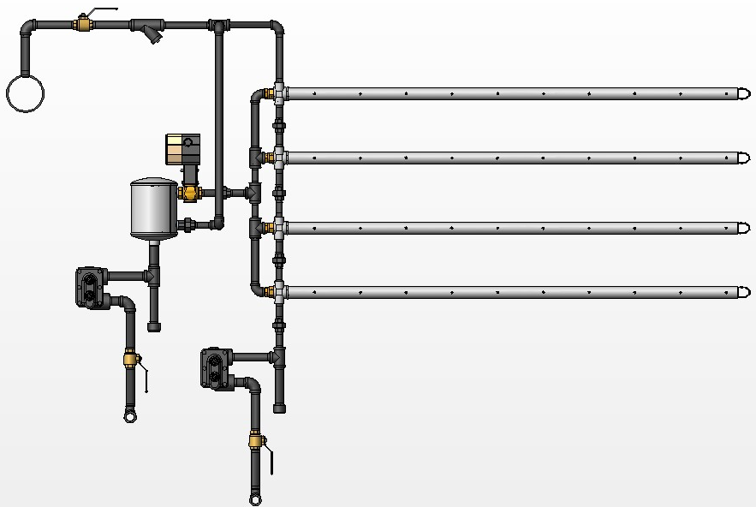
Operation
Principle of Operation – Multiple Tube Distributor
NOTE:
Distributors must be supported by team piping and duct support bracket.
Notes:
Please note that in some cases you will need to select the actuator based on the steam pressure to the unit and the close off pressure of the actuator. Take for example a system that requires a 2” bronze valve operating at 25 psi. You would not be able to use P/N 1507549 because the available close off pressure is only 20 psi, you would need to select P/N 1507552.

Slide 13
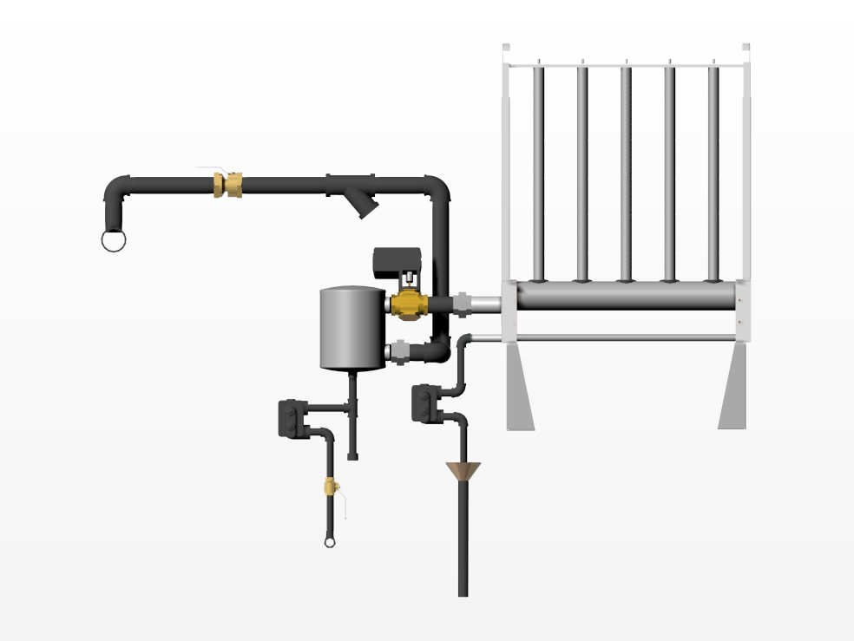
Operation
SAM-e Pressure steam
With external separator
Notes:
Next in the product family, we have our SAM-e, or Short Absorption Manifold - Enhanced. The SAM-e is designed to introduce steam directly into the duct work.
The SAM-e works as a distribution method with either Pressurized direct injection humidifier such as the LS or can work with Atmospheric humidifiers.
What do you think a consulting engineers worst nightmare is when steam is put into a duct system? Duct wetting! So to avoid this problem you’ll need a distributor with short absorption distances, which is exactly what you get with a SAM-e.
So why else would you want to use a SAM-e?

Slide 14
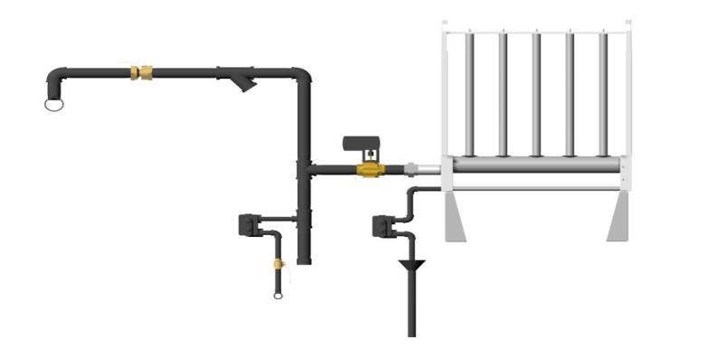
Operation
SAM-e Pressure steam
Without External Steam Separator
Notes:
Next in the product family, we have our SAM-e, or Short Absorption Manifold - Enhanced. The SAM-e is designed to introduce steam directly into the duct work.
The SAM-e works as a distribution method with either Pressurized direct injection humidifier such as the LS or can work with Atmospheric humidifiers.
What do you think a consulting engineers worst nightmare is when steam is put into a duct system? Duct wetting! So to avoid this problem you’ll need a distributor with short absorption distances, which is exactly what you get with a SAM-e.
So why else would you want to use a SAM-e?

Slide 15
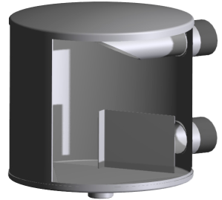
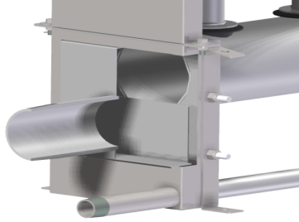
Operation
SAM-e Pressure steam
SAM-e Internal Baffle
Notes:
Next in the product family, we have our SAM-e, or Short Absorption Manifold - Enhanced. The SAM-e is designed to introduce steam directly into the duct work.
The SAM-e works as a distribution method with either Pressurized direct injection humidifier such as the LS or can work with Atmospheric humidifiers.
What do you think a consulting engineers worst nightmare is when steam is put into a duct system? Duct wetting! So to avoid this problem you’ll need a distributor with short absorption distances, which is exactly what you get with a SAM-e.
So why else would you want to use a SAM-e?

Slide 16
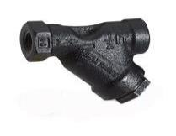
Operation
LS Series – Wye Strainer
Used to filter out large impurities and debris preventing damaging vales or traps

Slide 17
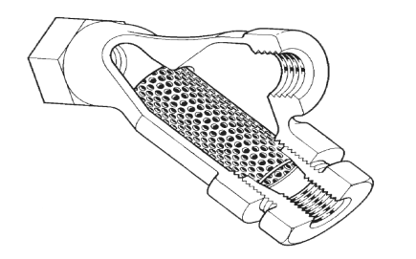
Operation
LS Series – Wye Strainer
Wye type strainer
Sizes from ½ to 3 inches
Cast iron with stainless steel mesh OR
316L stainless steel with 316 stainless mesh

Slide 18
Operation
LS Series – Distributor Tube
Available in various lengths and types
Jacketed
Can be insulated
Standard and DI version available

Slide 19
Operation
LS Series – Distributor Components
Duct Plate Support
Support Bracket
Length, L
Stainless Steel Sheath
Distributor Cross Section
Duct Plate Support
2 Piece Adjustable
Insulated Distributor (Optional)
Cross Section

Slide 20
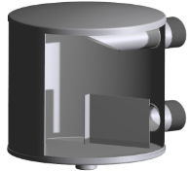
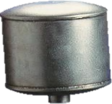
Operation
LS Series – Steam Separator
Separates steam from condensate before entering the airstream
Prevents spitting from distributor
Uses baffle plate to separate steam

Slide 21
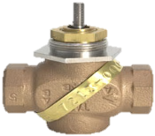
Operation
LS Series – Steam Valve
Maximum pressure 50 psig
½” to 2” (CV 0.10 to 40.0)
Bronze body with stainless steel components OR
Stainless steel body with stainless steel components

Slide 22
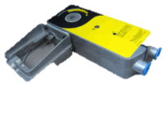
Operation
LS Series - Actuator
Electric on/off and modulating actuators
Pneumatic actuators

Slide 23
Operation
LS Series - Actuators
Description | Part Number | Valve Body | Valve Dia. | Max. Pressure
 |  |  | (NPT) | (PSIG)
Modulating Actuator 0-10 Vdc 24 V | 150 7549 | Bronze | 1/2-3/4 | 250
 |  |  | 1 | 150
 |  |  | 1 1/4 | 90
 |  |  | 1 1/2 | 35
 |  |  | 2 | 20
 |  | SST | 1/2-3/4 | 250
 | 150 7552 | Bronze | 1 1/2-2 | 65
 | 150 7556 | Warren SST | 1, 1 1/2 & 2 | 50
Modulating Actuator 4-20 mAdc 24 V | 150 7550 | Bronze | 1/2-3/4 | 250
 |  |  | 1 | 150
 |  |  | 1 1/4 | 90
 |  |  | 1 1/2 | 35
 |  |  | 2 | 20
 |  | SST | 1/2-3/4 | 250
 | 150 7553 | Bronze | 1 1/2-2 | 65
 | 150 7557 | Warren SST | 1, 1 1/2 & 2 | 50
On/Off Actuator 24 V | 150 7551 | Bronze | 1/2-3/4 | 250
 |  |  | 1 | 150
 |  |  | 1 1/4 | 90
 |  |  | 1 1/2 | 35
 |  |  | 2 | 20
 |  | SST | 1/2-3/4 | 250
 | 150 7554 | Bronze | 1 1/2-2 | 65
 | 150 7558 | Warren SST | 1, 1 1/2 & 2 | 50
*Maximum pressure for LiveSteam 50 PSIG (15 PSIG on Steam Exchange humidifiers)
Notes:
Please note that in some cases you will need to select the actuator based on the steam pressure to the unit and the close off pressure of the actuator. Take for example a system that requires a 2” bronze valve operating at 25 psi. You would not be able to use P/N 1507549 because the available close off pressure is only 20 psi, you would need to select P/N 1507552.

Slide 24
Operation
LS Series - Steam Traps
Removes condensate without losses of live steam
Two types available
F&T traps (Float and thermostatic)
Inverted bucket traps
Materials are cast Iron or stainless steel
Notes:
Please note that in some cases you will need to select the actuator based on the steam pressure to the unit and the close off pressure of the actuator. Take for example a system that requires a 2” bronze valve operating at 25 psi. You would not be able to use P/N 1507549 because the available close off pressure is only 20 psi, you would need to select P/N 1507552.

Slide 25
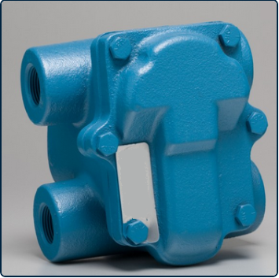
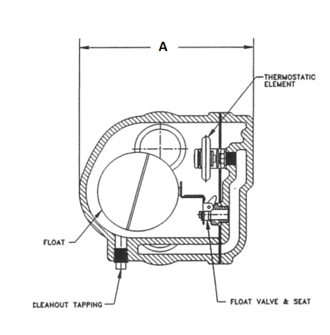
Operation
LS Series – F&T Traps
Float and Thermostatic (F&T) Trap
Cast iron cover with stainless steel interior
Drainage occurs when float rises or temperature passes thermostatic threshold
Drain rates depend on pressure differentials* *can be used on atmospheric or pressure side
Requires a drip leg or drop for pressure differential
Notes:
Please note that in some cases you will need to select the actuator based on the steam pressure to the unit and the close off pressure of the actuator. Take for example a system that requires a 2” bronze valve operating at 25 psi. You would not be able to use P/N 1507549 because the available close off pressure is only 20 psi, you would need to select P/N 1507552.

Slide 26
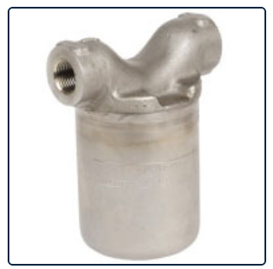
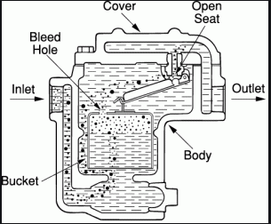
Operation
LS Series – Inverted Bucket Traps
Inverted bucket trap
Completely stainless steel
Drainage occurs when inverted bucket rises
Inlet and outlet are on same plane
Requires less space to install
MUST BE INSTALLED ON PRESSURE SIDE Pressure is required for the bucket to rise
Notes:
Please note that in some cases you will need to select the actuator based on the steam pressure to the unit and the close off pressure of the actuator. Take for example a system that requires a 2” bronze valve operating at 25 psi. You would not be able to use P/N 1507549 because the available close off pressure is only 20 psi, you would need to select P/N 1507552.

Slide 27
Installation

Slide 28
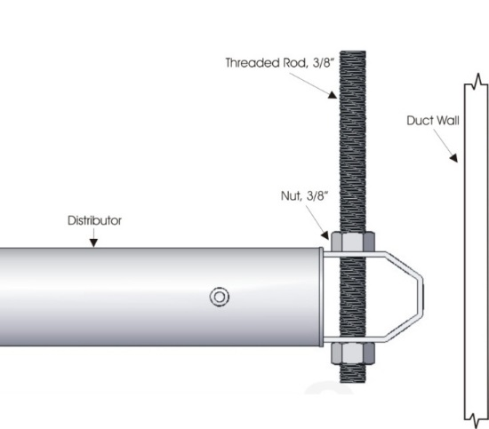
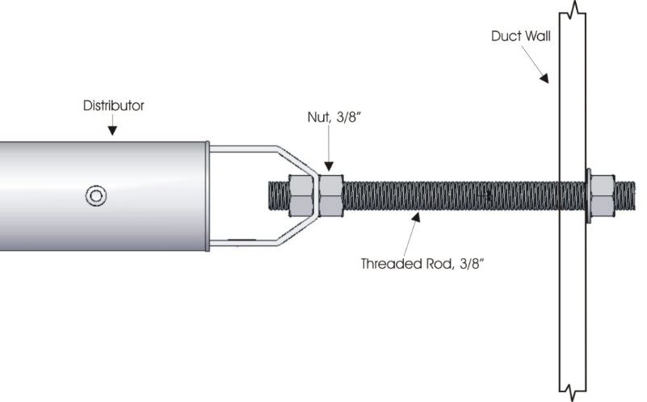
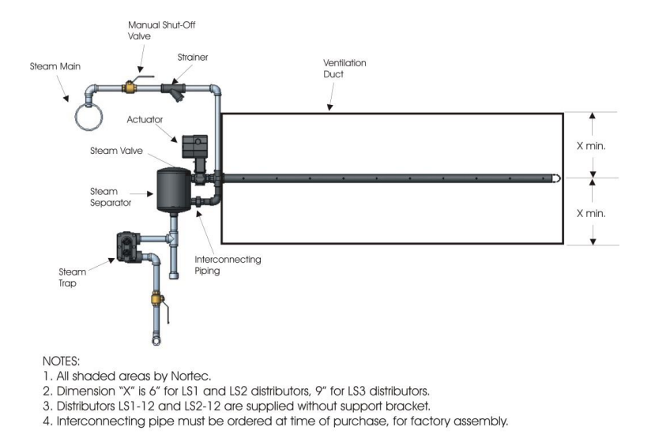
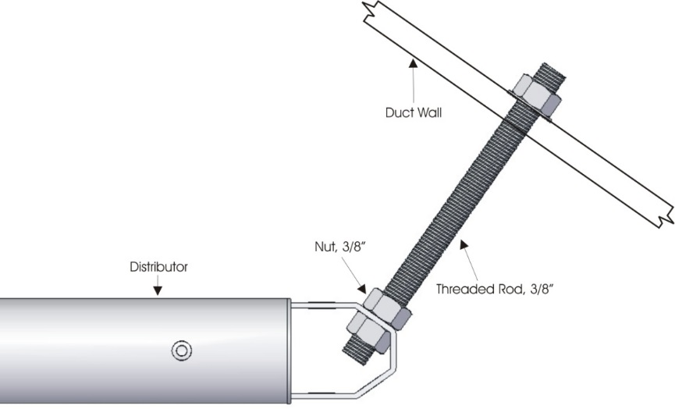
Installation
LS Series – Single Tube
Drill hole into AHU making sure the distributor is center
minimum 6” from the base and ceiling
Supporting the distributor with the support bracket
Make Steam connections
Installing Steam trap

Slide 29
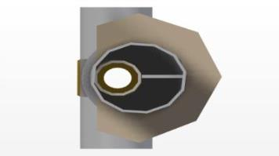
Installation
LS Series – Install Direction
Uninsulated
Steam
Airflow
Insulated
Steam
Airflow

Slide 30
Installation
LS Series – Steam Separator
Model | 200 | 300 | 450 | 600 | 800
Inlet | ½" NPT | ¾ " NPT | 1" NPT | 1 ½ " NPT | 2" NPT
Outlet | ½" NPT | ¾ " NPT | 1" NPT | 1 ½ " NPT | 2" NPT
Spec Label
Outlet
Inlet
¾” NPT

Slide 31
Installation
LS Series – Steam Traps
F&T or Inv bucket trap
F&T trap only
Notes:
Please note that in some cases you will need to select the actuator based on the steam pressure to the unit and the close off pressure of the actuator. Take for example a system that requires a 2” bronze valve operating at 25 psi. You would not be able to use P/N 1507549 because the available close off pressure is only 20 psi, you would need to select P/N 1507552.

Slide 32
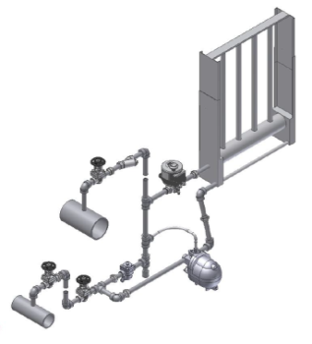
Installation
New Pressure Powered Trap
Re-uses condensate instead of dumping to drain
No electricity for pressure powered method
Cost effective
Minimal maintenance

Slide 33
Installation
New Pressure Powered Trap
Steam enters SAM-e
Condensate created has little lift
Condensate collects in the Pump-trap.
Reservoir continues to collect

Slide 34
Installation
New Pressure Powered Trap
A Float rises as condensate collects
Once at trigger point, Snap action occurs: -valve closed on inlet, -valve opened on outlet, -valve on pressure motive line pushes condensate out
Condensate is now pushed and can return to boiler *Motive pressure must be greater than 7psi

Slide 35
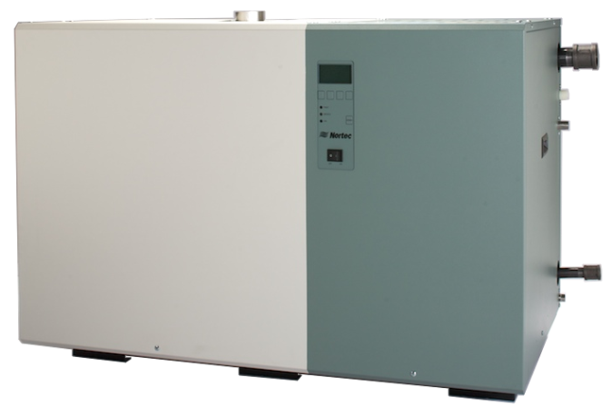
Introduction
SE Steam Exchanger Humidifier

Slide 36
Introduction
Why SE
When existing facility boiler steam is available
When air quality is a concern and cannot have chemical additives
Clean atmospheric steam
Complete packaged product
Steam valve and Actuator
F&T traps
Drain water cooler
Wye strainer

Slide 37
Model Overview

Slide 38
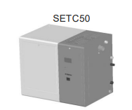
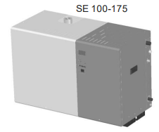
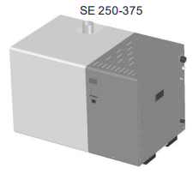
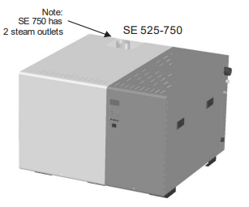
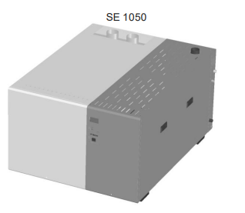
Model Overview
Indoor
Inlet Pressure steam up to 15 psig
Voltage 120V/1ph/60hz
Floor stand Available for all models
Ceiling kit SETC50 only

Slide 39
Model Overview
Clearances
SE 100/175
SE 250/375
SE 525/750
SE 1050
Model | Width | Height | Depth | Clearance(Min)
 | in | In | in | Left (in) | Right(in) | Front(in) | Top
SE 100/175 | 44.6 | 32* | 20 | 0 | 30 | 30 | 36
SE 250/375 |  |  | 26.4
SE 525/750 |  |  | 42
SE 1050 |  |  | 57.6 | 18**
* All capacities fit through a 32" door.
**Recommended clearance for cleaning back of the tank from the top.

Slide 40
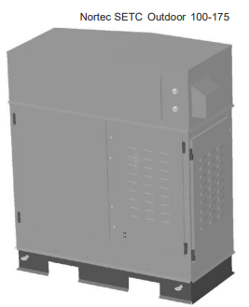
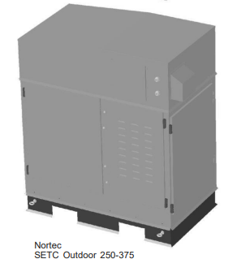
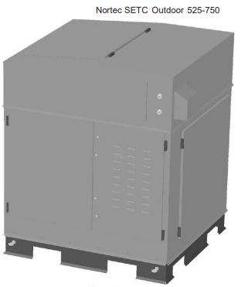
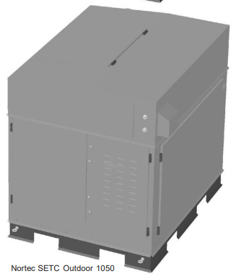
Model Overview
Outdoor
Inlet Pressure steam up to 15 psig
Voltage 120V/1ph/60hz
Outlets On the back of units
Rating -40°F to 104°F (-40°C to 40°C)

Slide 41
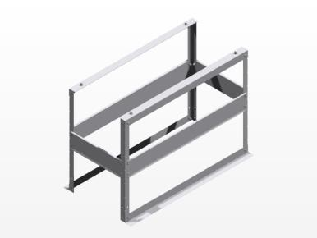
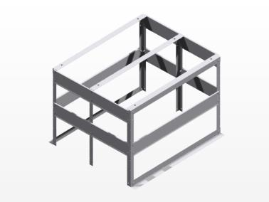
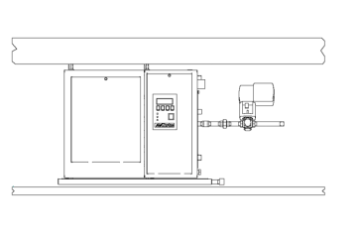
Model Overview
SE Installation Accessories
Floor Stands
SE-050 Ceiling Kit
Notes:
Some of the options for the SE include floor stands and ceiling kits.
The floor stands are used to raise the unit off the ground to allow easy access to the cleaning ports and keypad.
The ceiling kit is only available for the SE 50, and is used to install the humidifier directly into the ceiling space. These are commonly installed into ceiling spaces of ICU’s or OR’s. A drip pan is also included with the kit.

Slide 42
Operation
SE Series

Slide 43
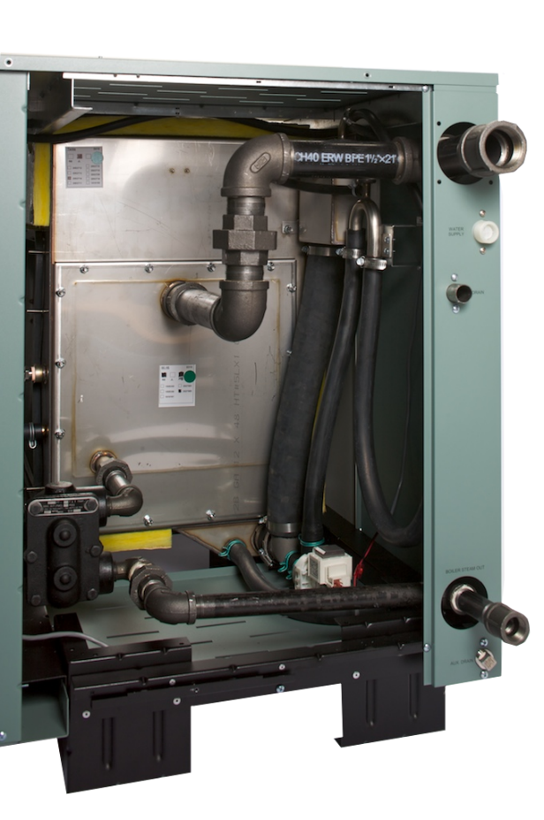
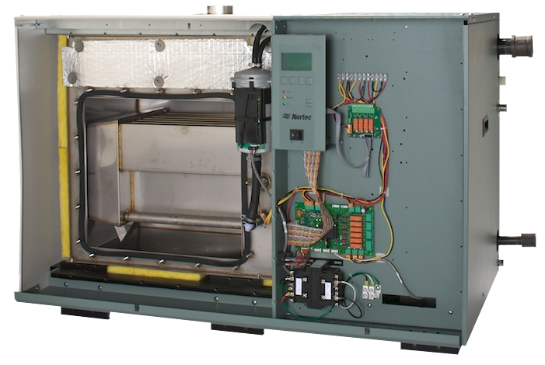
Operation
Main Components
Total
Controller
Steam outlet
Steam Inlet
External
Float Chamber
Water inlet
Drain outlet
Tank and Heat
Exchanger
F&T Trap
Condensate
Drain
Cleaning Access
Auxiliary Drain

Slide 44
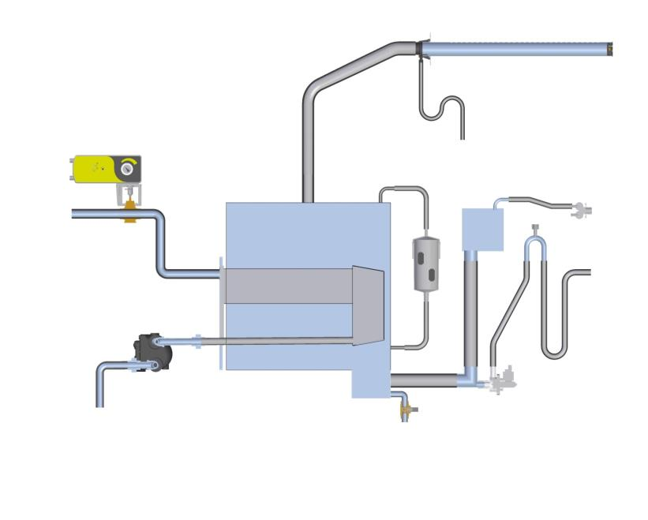
Operation
Principle of Operation
Valve/Actuator Assembly
Dual Fill Valve
Tank
Float Chamber
Fill Box
Steam from
Boiler
Vacuum Break
Steam Trap
Condensate to Boiler or Drain
Drain
Outlet
Drain Pump
Heat Exchanger
Auxiliary Tank Drain

Slide 45
Operation
Capacities
Operating Steam Pressure
Unit Output Lbs/hr (kg/hr)
Model | 5 psi (0.34 Bar) | 8 psi (0.55 Bar) | 10 psi (0.69 Bar) | 12 psi (0.83 Bar) | 15 psi (1.03 Bar)
SE 50 | 13 (6) | 24 (11) | 32 (14) | 39 (18) | 50 (23)
SE 100 | 26 (12) | 48 (22) | 63 (29) | 78 (35) | 100 (45)
SE 175 | 46 (21) | 84 (38) | 110 (50) | 136 (62) | 175 (80)
SE 250 | 65 (30) | 121 (55) | 158 (72) | 195 (88) | 250 (114)
SE 375 | 98 (44) | 181(82) | 236 (107) | 292 (132) | 375 (170)
SE 525 | 137 (62) | 253 (115) | 331 (150) | 408 (185) | 525 (239)
SE 750 | 195 (89) | 362 (164) | 473 (215) | 584 (264) | 750 (341)
SE 1050 | 273 (124) | 506 (230) | 662 (301) | 817 (371) | 1050 (477)

Slide 46
Installation
SE Series

Slide 47
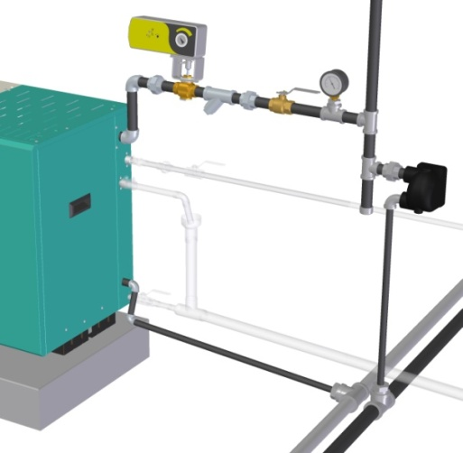
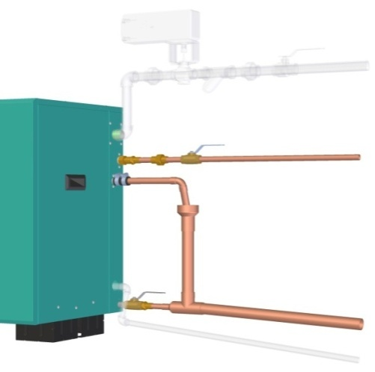
Installation
SE Installation
Boiler Steam Connections
Plumbing Connections
Notes:
Some of the options for the SE include floor stands and ceiling kits.
The floor stands are used to raise the unit off the ground to allow easy access to the cleaning ports and keypad.
The ceiling kit is only available for the SE 50, and is used to install the humidifier directly into the ceiling space. These are commonly installed into ceiling spaces of ICU’s or OR’s. A drip pan is also included with the kit.

Slide 48
Installation
SE Installation
Boiler Steam Connections
Plumbing Connections
Boiler Steam
5-15 psi
CV Valve and
Actuator
Water Supply
30-80 psig
Wye Strainer
F&T Trap
(By others)
Drain Outlet
Condensate Drain Line
Air Gap
Auxiliary Drain
Notes:
Some of the options for the SE include floor stands and ceiling kits.
The floor stands are used to raise the unit off the ground to allow easy access to the cleaning ports and keypad.
The ceiling kit is only available for the SE 50, and is used to install the humidifier directly into the ceiling space. These are commonly installed into ceiling spaces of ICU’s or OR’s. A drip pan is also included with the kit.

Slide 49
Maintenance
SE Series

Slide 50
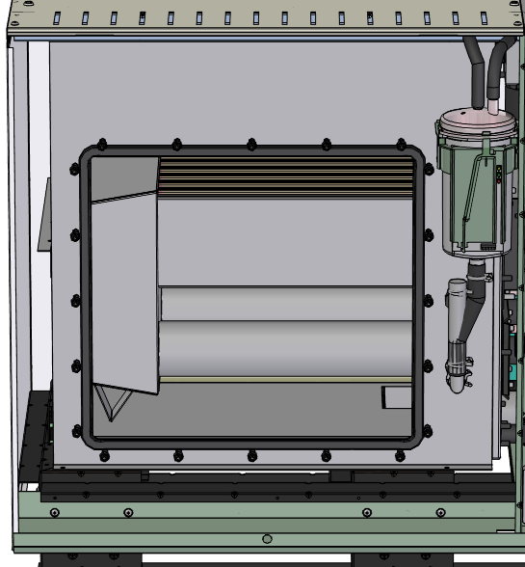
Maintenance
Tank Maintenance:
Scrape scale from tank (use plastic
Scrape scale from heat exchanger
Clean scale from float chamber
Inspect drain pump and auxiliary drain for leaks
Clean out the wye strainer
Replace cleanout doors gasket
Notes:
Some of the options for the SE include floor stands and ceiling kits.
The floor stands are used to raise the unit off the ground to allow easy access to the cleaning ports and keypad.
The ceiling kit is only available for the SE 50, and is used to install the humidifier directly into the ceiling space. These are commonly installed into ceiling spaces of ICU’s or OR’s. A drip pan is also included with the kit.

Slide 51
Maintenance
SE Maintenance
Consumables | Replace
Sacrificial Anode | As needed (~12 months)
Tank Door Gasket | After each cleaning
Float Chamber | As needed (~24 months)
Fill Valve | As needed (~60 months)
Drain Pump | As needed (~60 months)
Inspect drain pump
Inspect F&T trap
Check for any leaks
Notes:
Some of the options for the SE include floor stands and ceiling kits.
The floor stands are used to raise the unit off the ground to allow easy access to the cleaning ports and keypad.
The ceiling kit is only available for the SE 50, and is used to install the humidifier directly into the ceiling space. These are commonly installed into ceiling spaces of ICU’s or OR’s. A drip pan is also included with the kit.

Slide 52
Features
SE Series

Slide 53
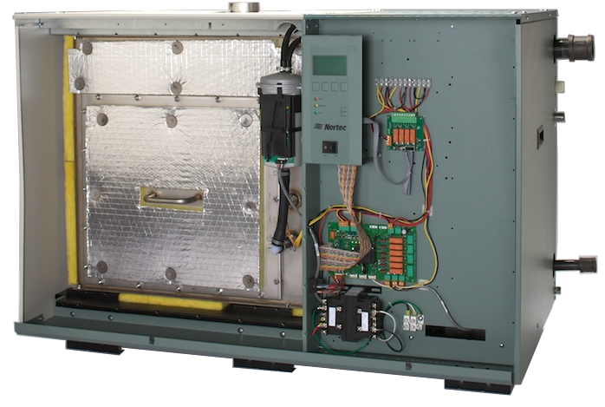
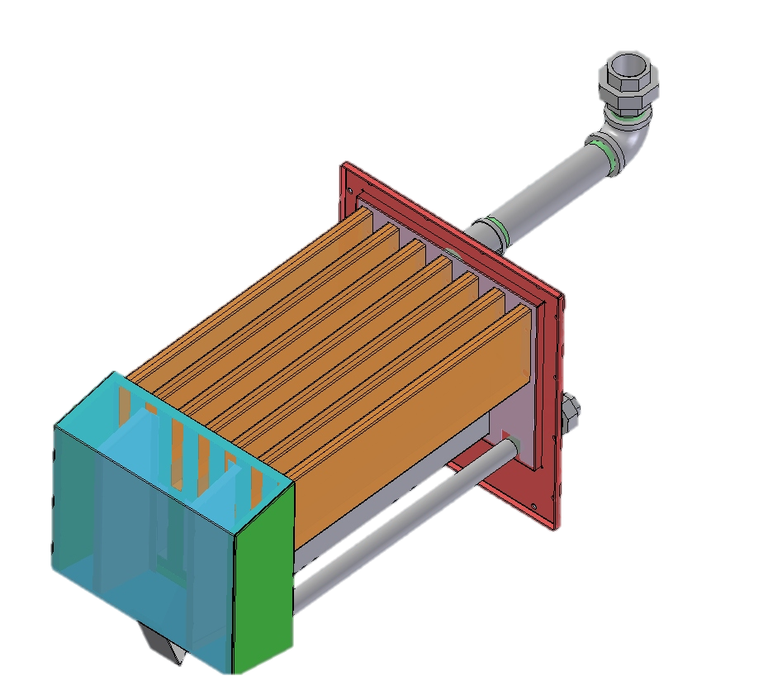
Features
SETC Features
50 lbs/hr to 1050 lbs/hr output
Steam Valve and Actuator
Built-in F&T Trap(s)
Built-in P-Trap
Built-in Drain Water Cooler
Insulation and Cabinetry
Fill System & Blow Down
Heat treated 316 SS heat Exchanger
Easy Access Cleaning ports
Keep warm function for faster response

Slide 54
Applications
Abrasives
Ceramics
Electrical instruments
Fur storage
Hospitals
Leather manufacturing
Lenses
Paints
Pharmaceuticals
Plastics
Printing
Tobacco
Educational facilities
Office Spaces
*Older buildings retrofits with boilers available

Slide 55
Thank you!
Stanley.Tom@condair.com
Application Engineer

