Slide 1
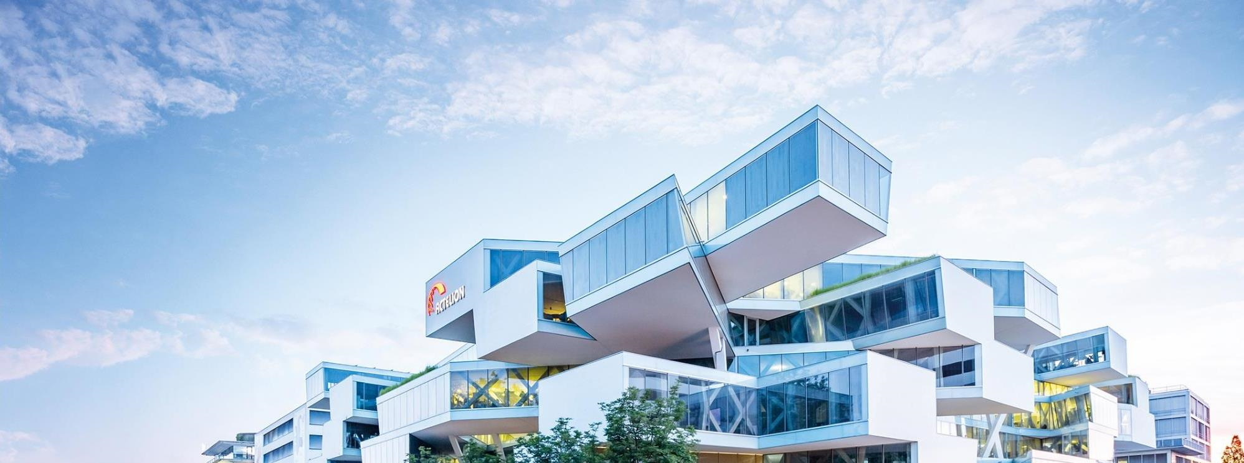
In-Space Adiabatic: TE/US/AF Series
Karly Treleaven
Technical Product Manager

Slide 2
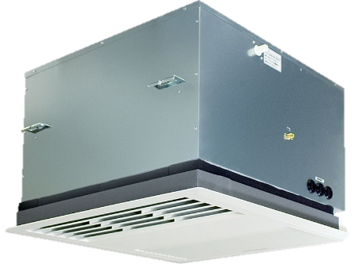
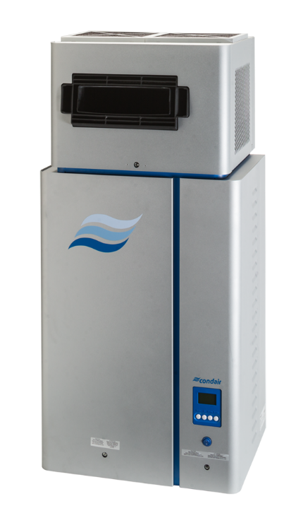
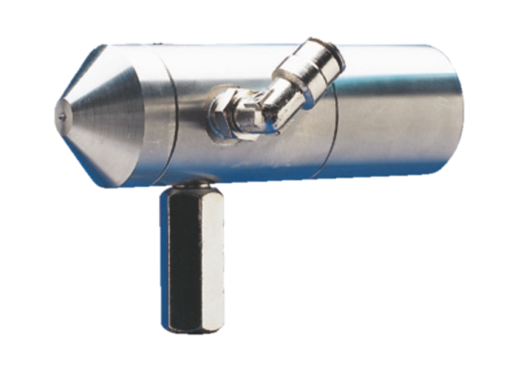
Agenda
  Introduction
  Model Overview
  Operation
  Installation
  Maintenance
  Features/ Benefits (USPs)
  Applications
AF Series
US Series
TE Series
Key Takeaways

Slide 3
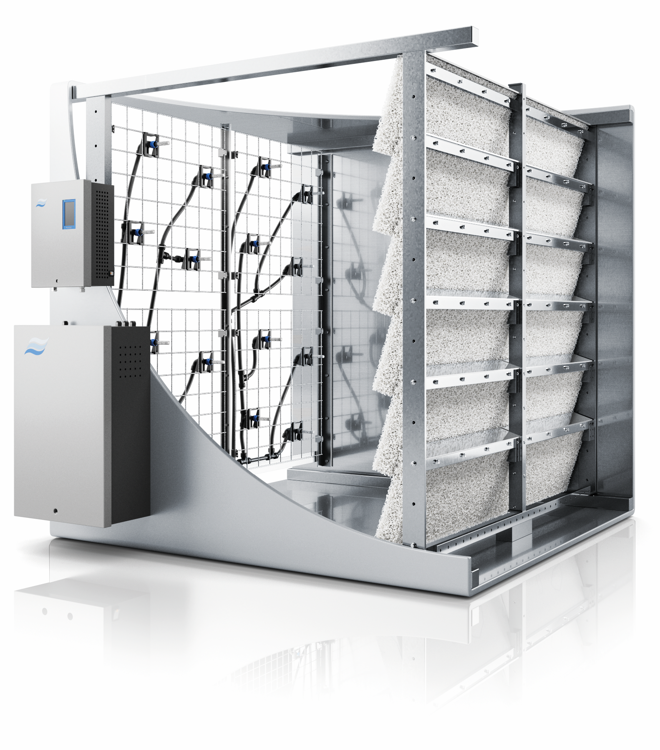
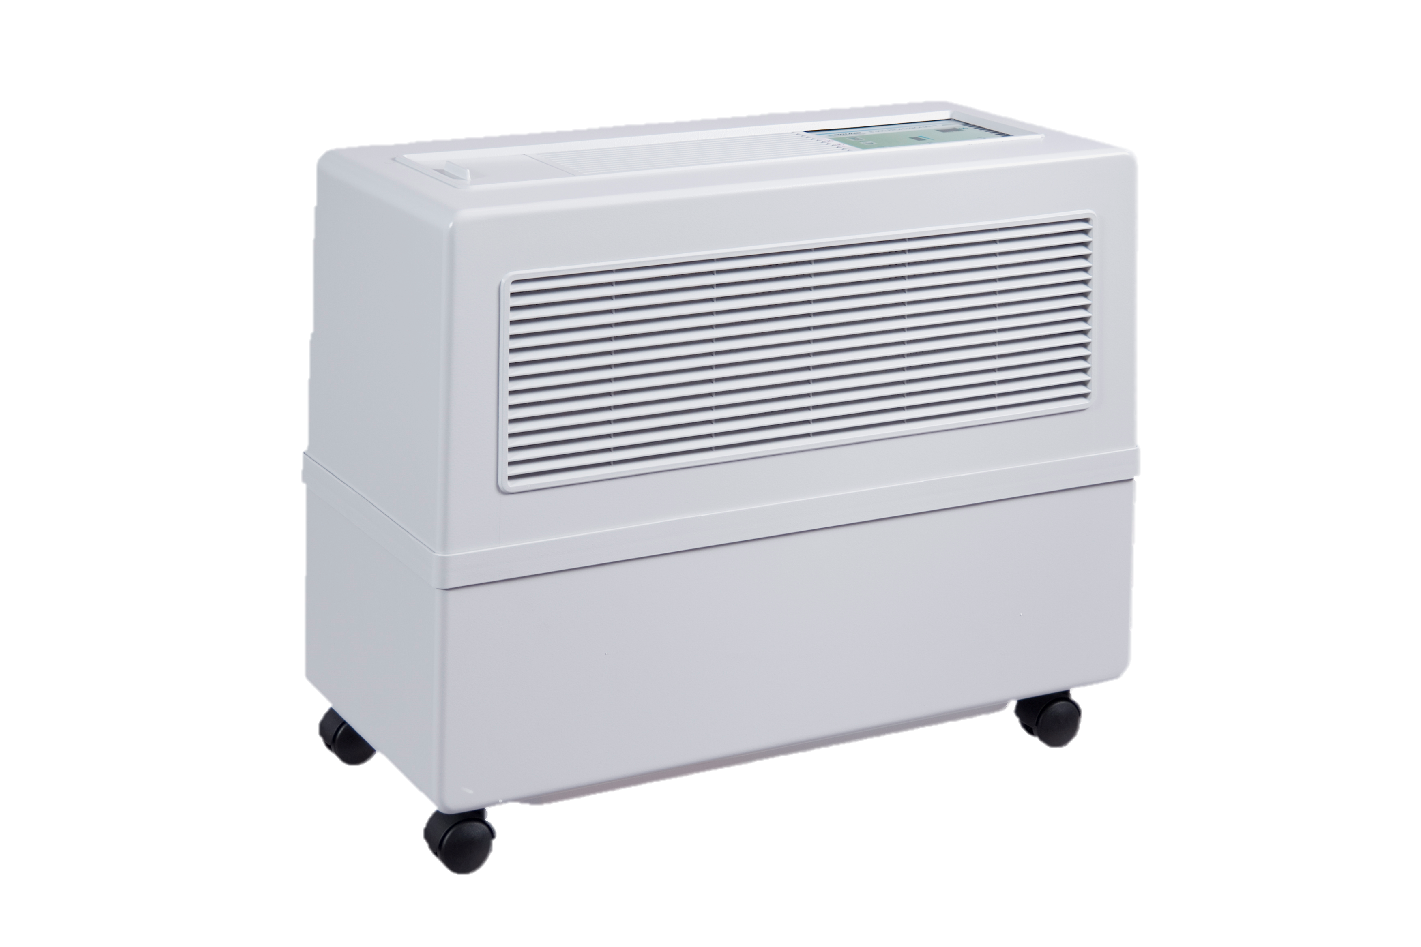
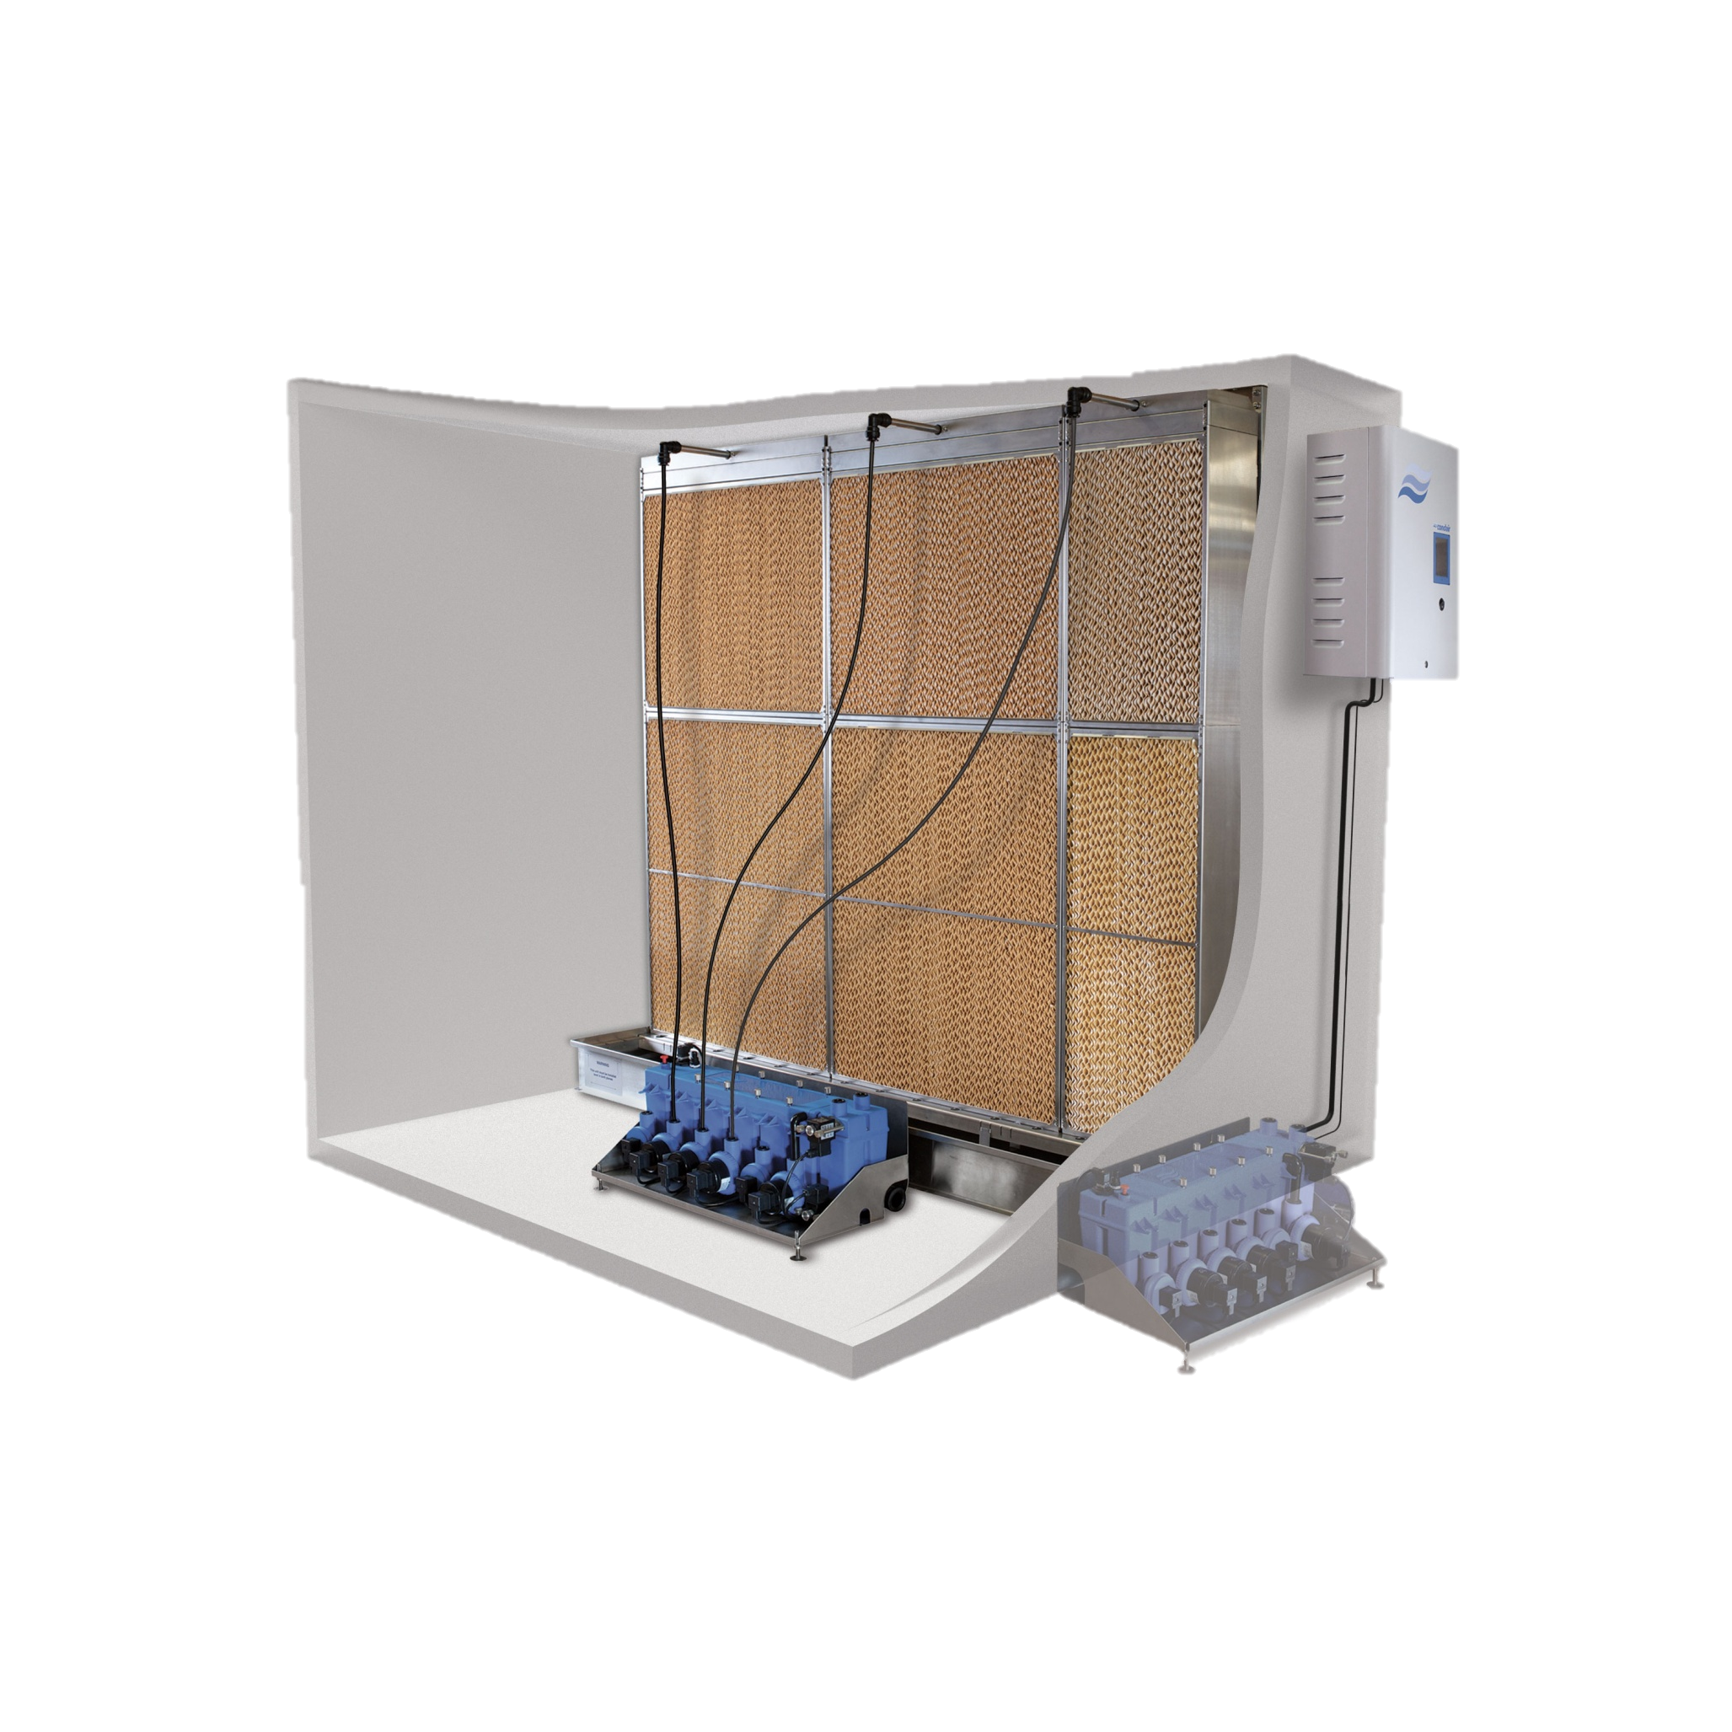
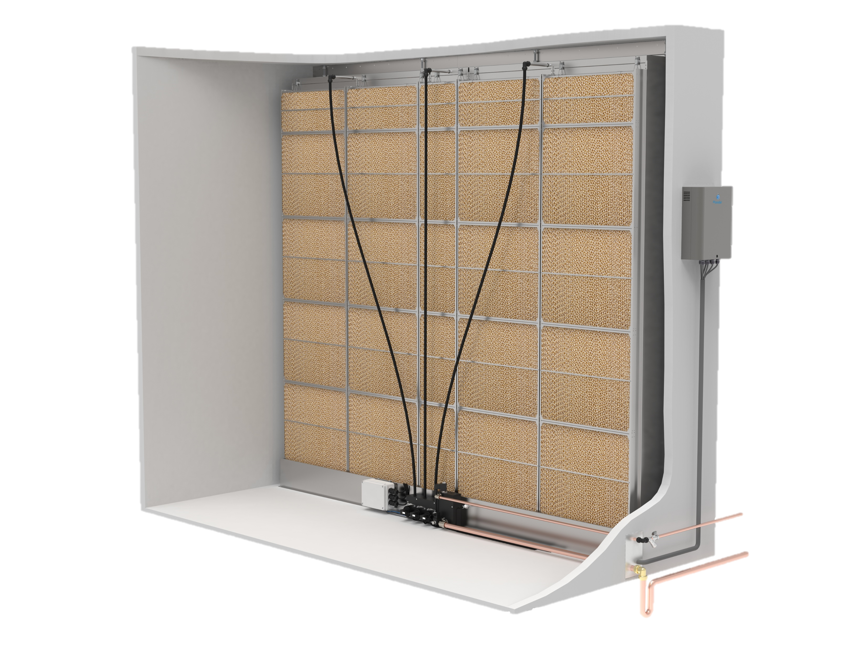
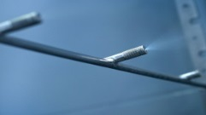
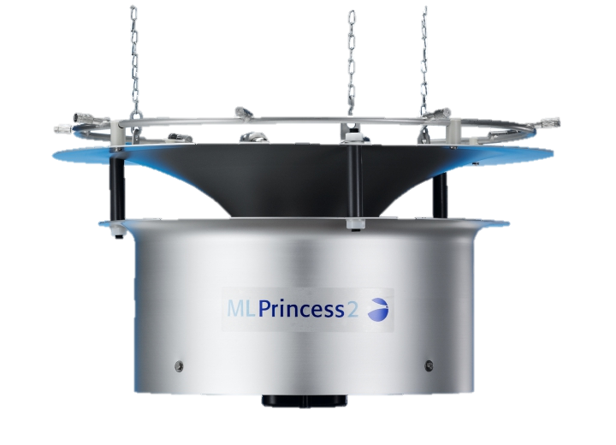
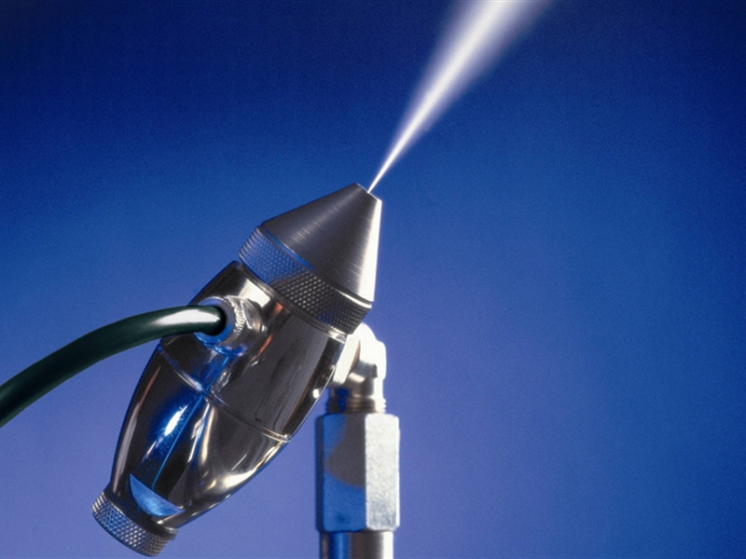

Introduction
Adiabatic Portfolio Overview
HVAC (duct applications)
Direct Room Systems (in-space applications)
Evaporative Media
High Pressure Nozzles
Hybrid
(Low Pressure Nozzles + Evaporative)
High Pressure Nozzles
Compressed Air Nozzles
Compressed Air + Water Nozzles
Ultrasonic Nebulizer
Mobile Evaporative
Ceiling Evaporative
ME Series MC Series
HP Series
DL Series
ML Series
AF Series
JS Series
US Series
B500 Series
TE Series

Slide 4
Introduction
AF / US / TE Series
AirFog (AF) Series | Ultrasonic (US) Series | Tile Evaporative (TE) Series
Compressed air nozzles | Ultrasonic nebulizer | Evaporative media

Slide 5
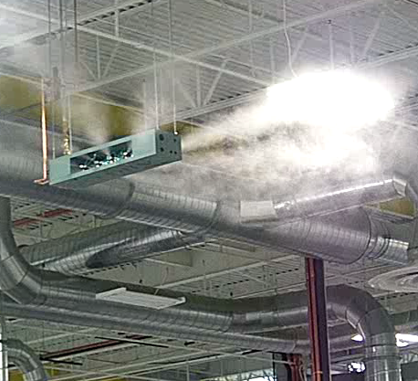

AF Series
Compressed Air Nozzle System

Slide 6





AF Series
Introduction
Compressed air system
Packaged or modular system
Systems are scalable to meet almost any load requirement
Minimal maintenance required
Simple installation
Energy efficient operation, low operating costs
Accurate control
On/off or modulating control

Slide 7
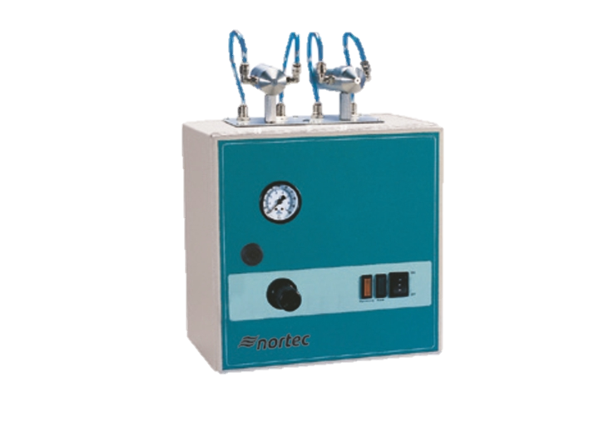
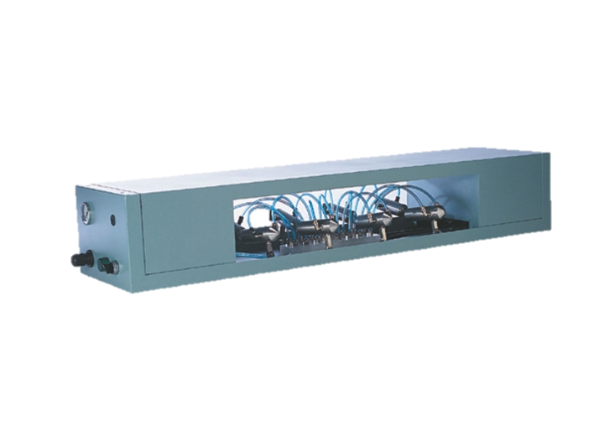
AF Series
Model Overview
AFE |  | Mini |  | Octo
Modular nozzle system |  | Packaged wall-mount system |  | Packaged ceiling-mount system
1 nozzle 16 nozzles *per vacuum valve/zone 64 nozzles *4 zones per control panel | 15 lbs/hr 240 lbs/hr 960 lbs/hr | Mini 1 Mini 2 | 15 lbs/hr 30 lbs/hr | 4 nozzles 6 nozzles 8 nozzles | 60 lbs/hr 90 lbs/hr 120 lbs/hr

Slide 8
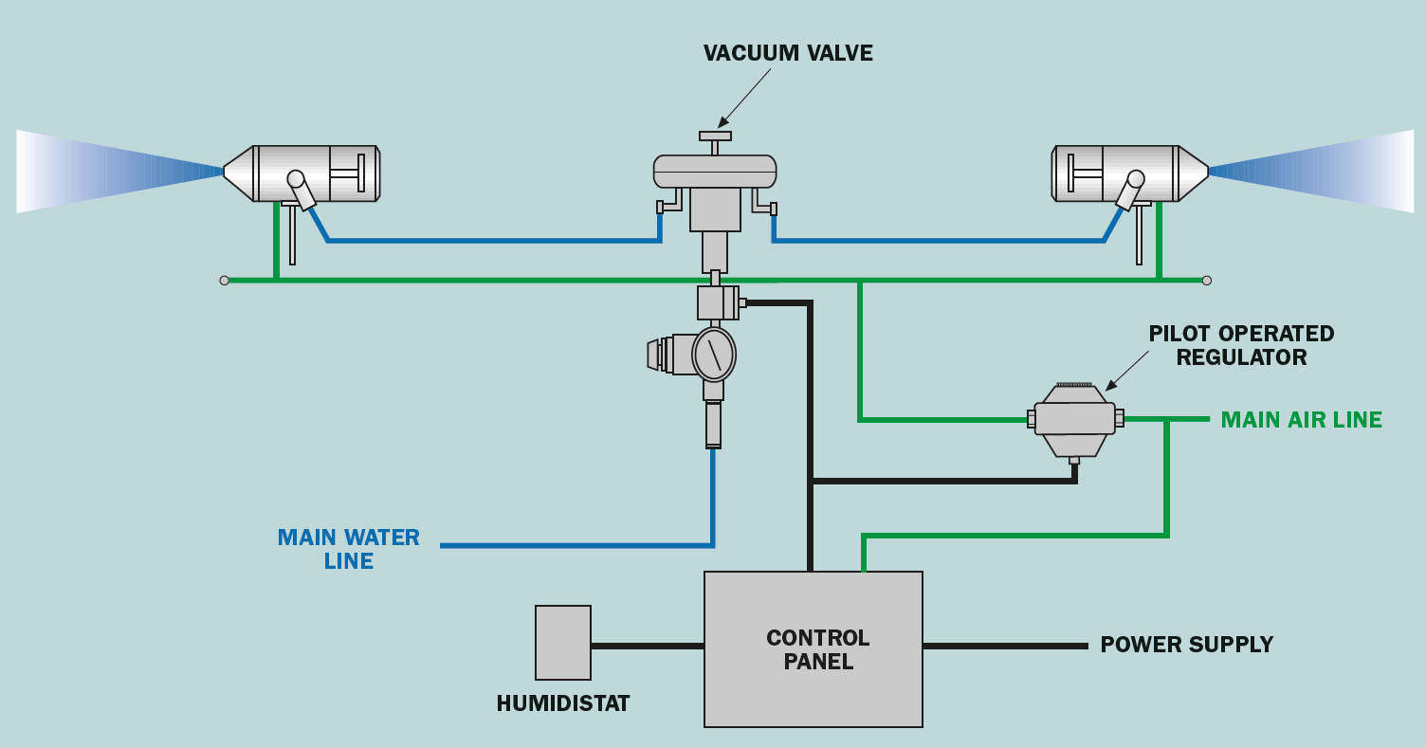
AF Series
Operation
Creates a fine mist using water and compressed air
Water droplets are injected directly into the air
Vacuum valve automatically stops water flow if air pressure drops.
Nozzle design ensures equal output across all nozzles.
Programmable timer for self-cleaning.
Can be mounted on walls, columns or suspended from ceilings.
Water particle size of 3 to 10 microns.
High quality 316 stainless steel components.
15 lbs/hr (6.8 kg/hr) from a single nozzle.

Slide 9
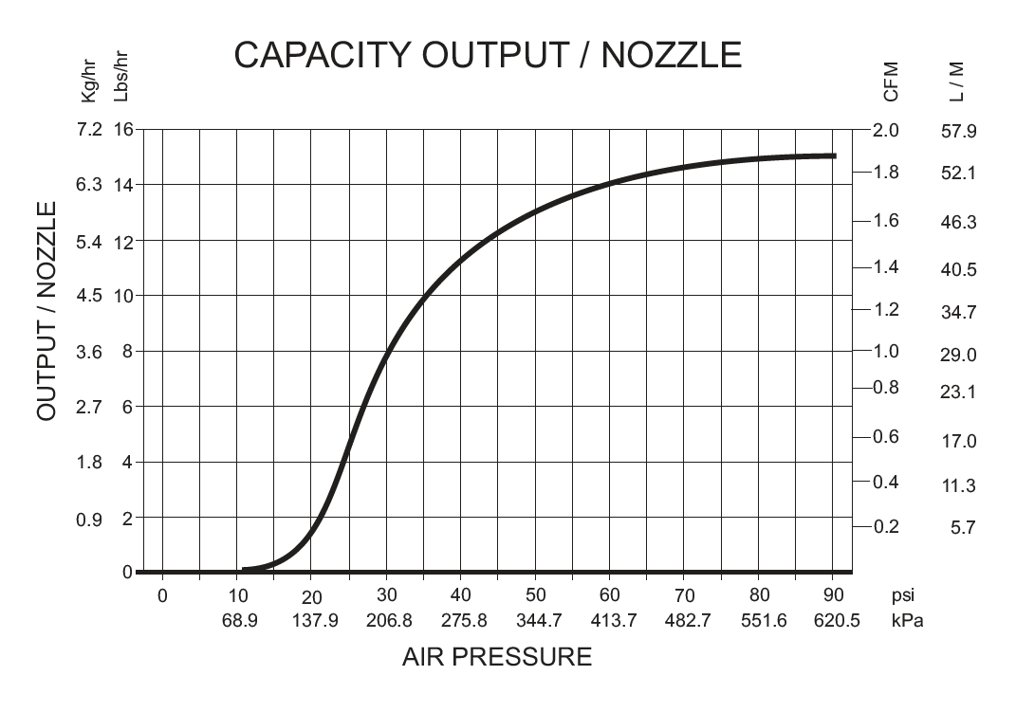
AF Series
Installation
Connection to electrical power, water, and compressed air
Vacuum valve must be installed at a greater height than nozzles
Always adhere to recommended clearances
Absorption distance is affected by many factors:
  Temperature
  Humidity levels
  Air pressure
  Etc.

Slide 10
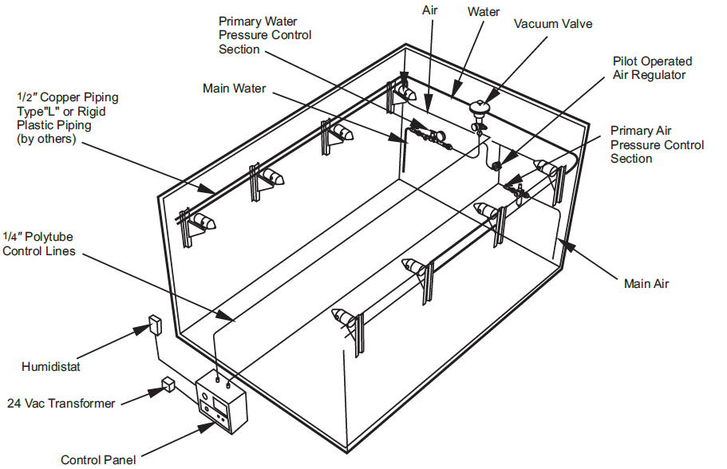
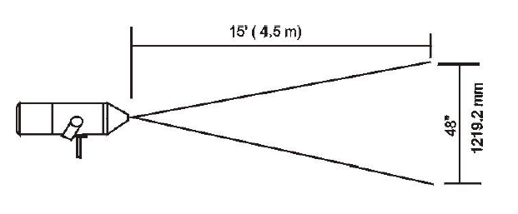
AF Series
Installation
Clearances

Slide 11
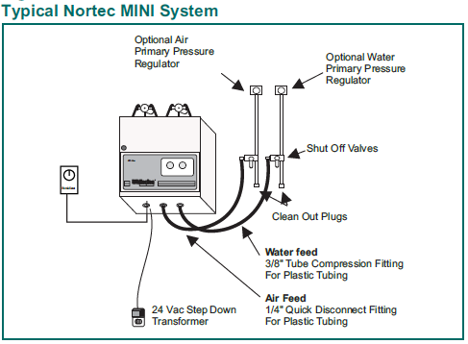
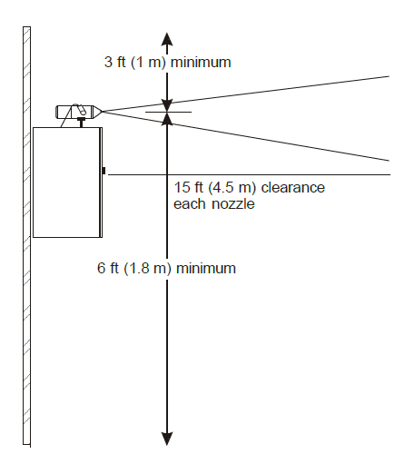
AF Series
Installation
Clearances

Slide 12
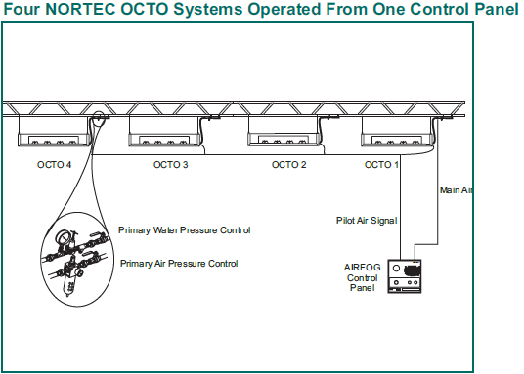
AF Series
Installation
Clearances

Slide 13
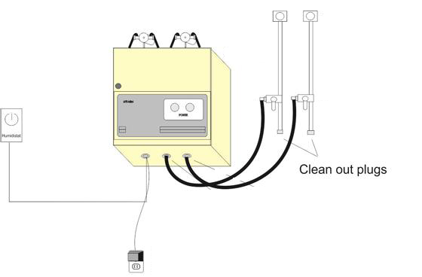
AF Series
Maintenance
Recommended Annual Maintenance:
Clean & lubricate nozzles
To prevent accumulation of dirt/mineral deposits
Clean and inspect all system components
Tighten connections
Replace parts where necessary
Check for and repair any leaks in air and water lines

Slide 14
AF Series
Features & Benefits
Flexible systems to suit a wide range of applications
  Available as packaged or modular
  Systems are scalable to meet almost any load requirement
Energy efficient
  A “no cost” air cooling benefit due to evaporation extracting heat from the air (adiabatic cooling)
  Low operating costs
Lower frequency of maintenance
  Maintenance is primarily focused on keeping the air compressor operational
  Change of components is fast and requires minimal system disassembly
Stainless Steel construction
Accurate control

Slide 15
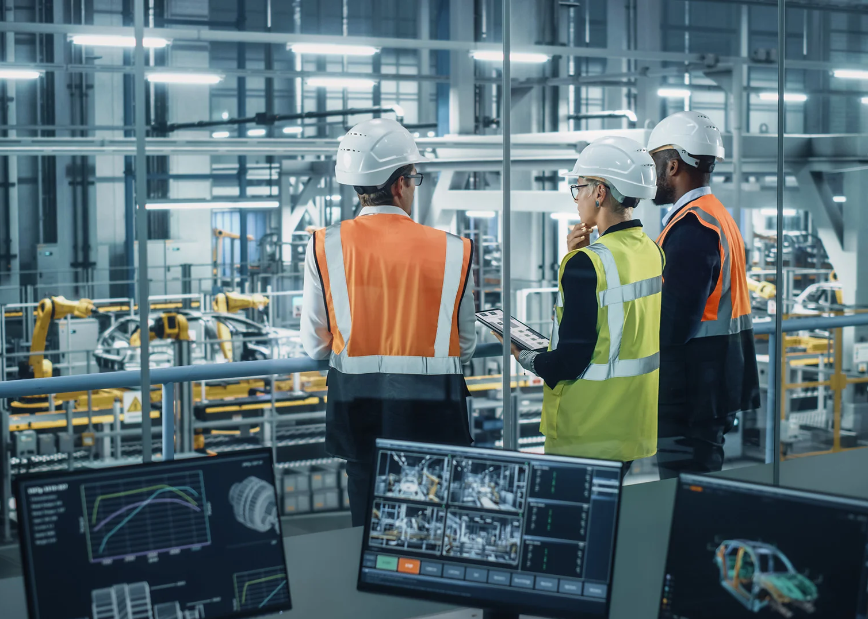
AF Series
Applications
Manufacturing
Cold Storage
Painting
Textile manufacturing
Woodworking
Storage
Poultry
Electronics manufacturing
Printing
Automotive
Concrete curing
Warehouses

Slide 16
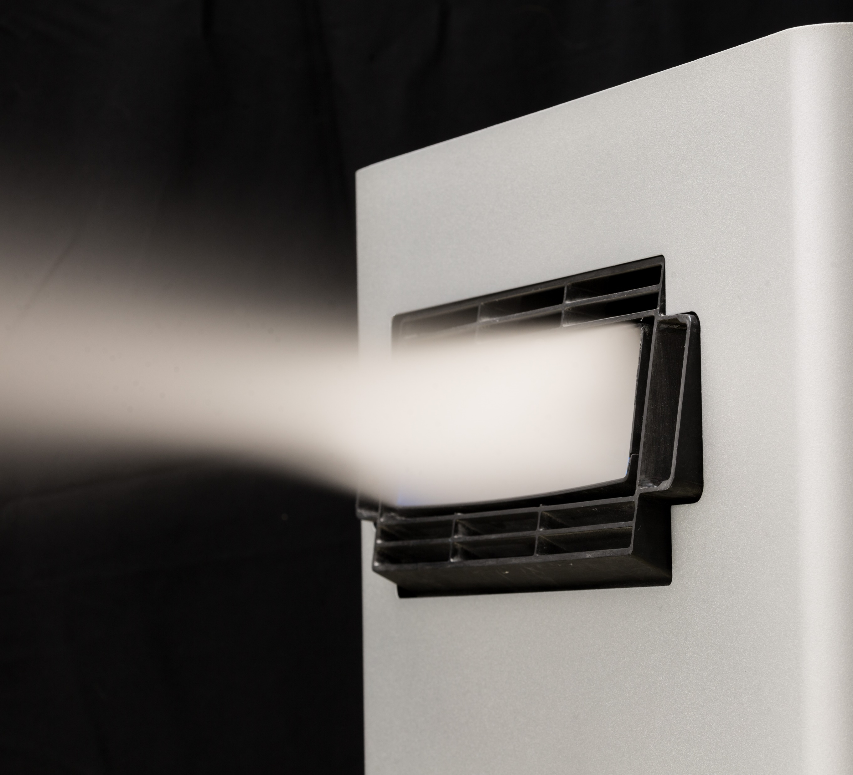
US Series
Ultrasonic Nebulizing System

Slide 17
US Series
Introduction
Compact in-space humidifier for small to medium applications
Elegant design – all necessary parts in one cabinet, no separate wiring to control panel
    Cabinet includes everything except mist distribution (blower pack), filter and water treatment
Hourly flushing during operation and automatic self-flushing in standby mode
Cost savings - Low energy consumption (Approx. 33W per lb/h)
    Free additional adiabatic cooling
Fast start-up and exceptional control (up to ±1%)
UL998 approved

Slide 18
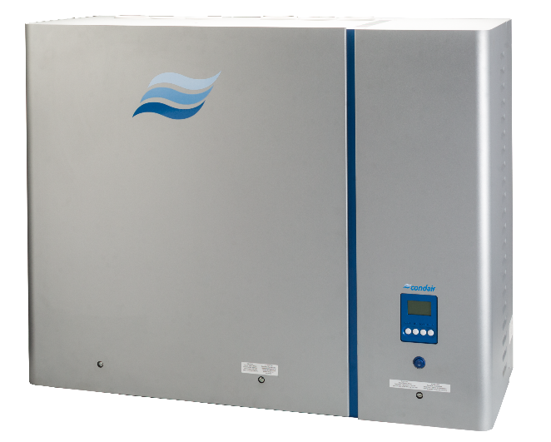
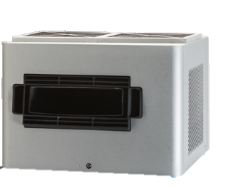
US Series
Model Overview
Single Cabinet
7, 13, 20 lbs/hr
Double Cabinet
40 lbs/hr
2 blowerpacks required!

Slide 19
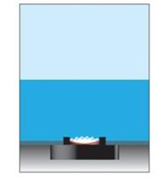
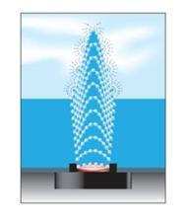
US Series
Operation
Principle of Operation
Piezoelectric transducers @ 1.7 MHz
Extra fine atomization (1-3 micron) of RO or DI water
Mist is distributed directly into the space via blowerpack
High absorption efficiency
Extremely low energy consumption
Exceptional control accuracy (up to +/- 1%)

Slide 20

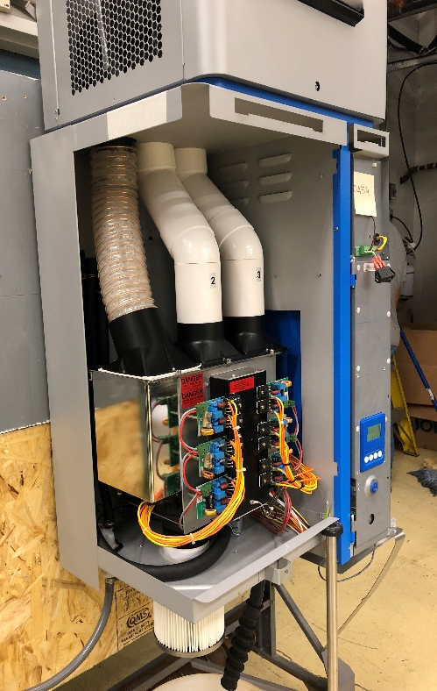
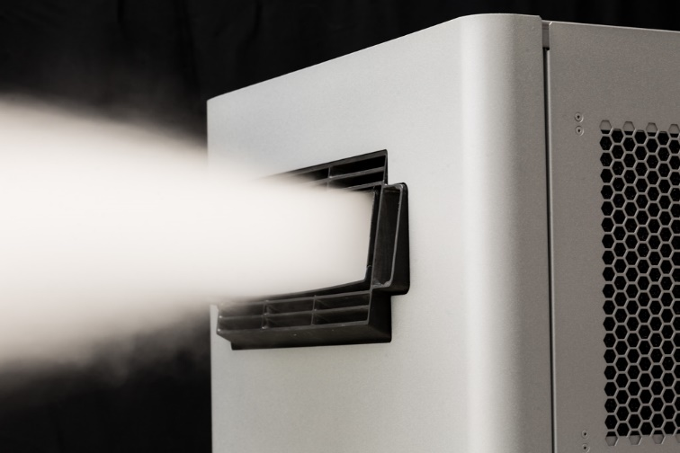
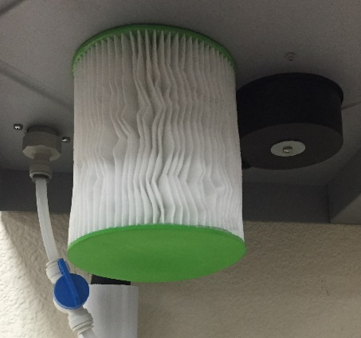
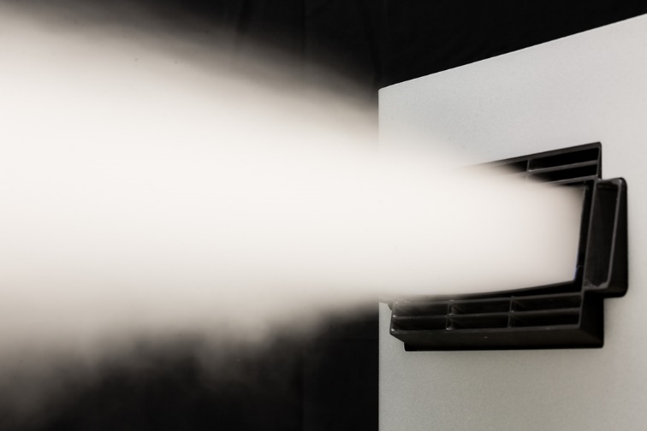
US Series
Operation
Blowerpack
Remote option available for both single and double cabinet
Fast absorption <12 feet for 20lbs load
Antimicrobial mist channel
Hygiene
Internal flex tubing: antimicrobial, antistatic, food grade
Stainless Steel chemically polished tank, food grade
UV lamp
No water stagnation: Hourly flushing cycles. Automatic drain if no demand with 24 hr standby complete flushing cycle
Intake Air: Merv 12 filter (99.93% efficiency, .2 to 2 micron)

Slide 21
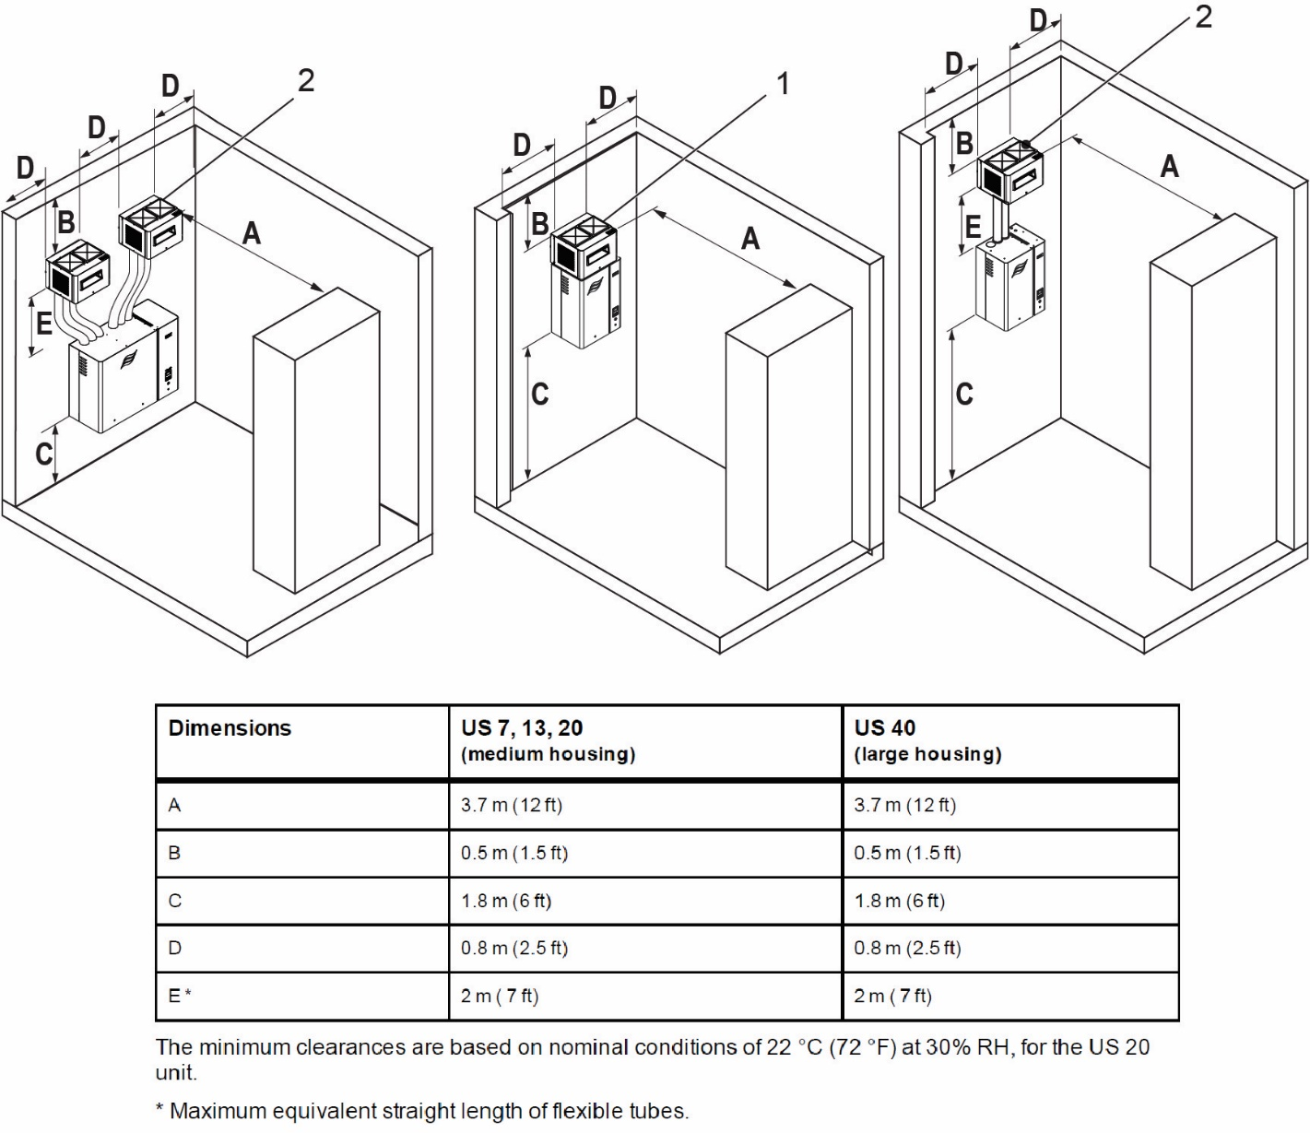
US Series
Installation
System Requirements
Humidifier cabinet
Blower Pack
– Single cabinet – built-on or remote mount
– Double cabinet – remote mount only
Water treatment (RO/DI)
– By Condair or others
Controls
– Standard demand, transducer or on/off signal by Condair or others
– BACnet connection available

Slide 22
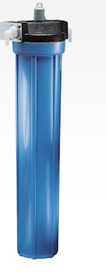
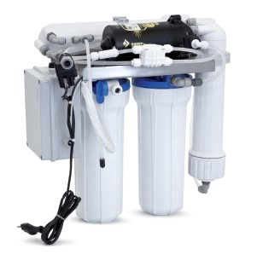
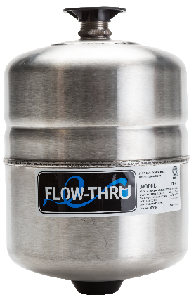
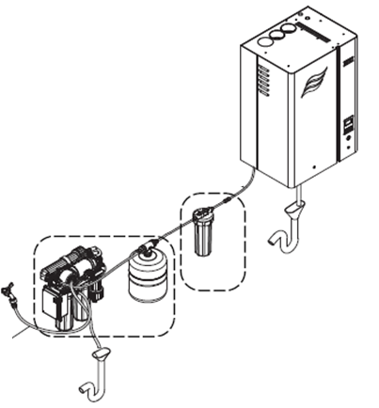
US Series
Installation
Condair RO-U Water Treatment
  Optional
  120 to 24VAC transformer
  5 micron pre-filter, carbon filter
  Booster pump
  Buffer tank-Flow through incl. fittings and mounting assembly
Why Condair water treatment systems?
  5 micron pre-filter and carbon filter remove water contaminants
  High quality RO membrane removes 98% of mineral content
    Eliminates risk of dusting for most water qualities, ensuring hygienic operation & long system lifetime
  Water quality monitoring protects equipment & space being humidified
    Ensures operation in required water quality range (5-20 Mmhos)
    Ensures maintenance is done on the system
  Integrated booster pump increases performance & allows remote mounting
  Unique flushing sequence prevents clogging
DI
By Condair
RO-U
By Condair

Slide 23
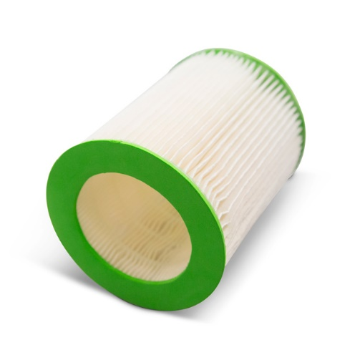
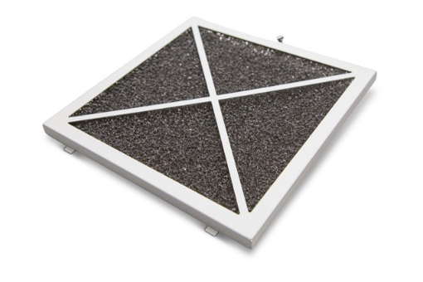
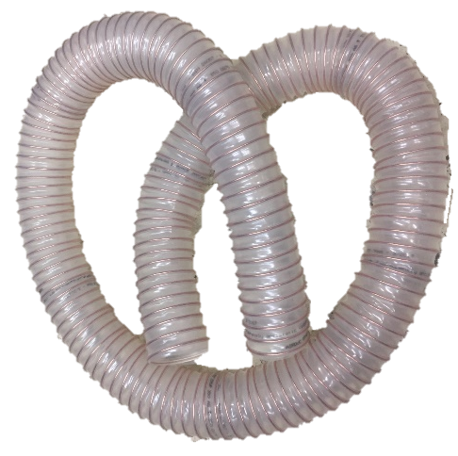
US Series
Installation
Must be ordered separately in Help!
Unit air intake filter (mandatory)
Blower pack filter
Remote blower pack installation kit
Remote tubes and air intake filter quantities
* Mandatory options
Part Description | US-7 | US-13 | US-20 | US-40
*Ultrasonic BlowerPack, UB-07 | 1
*Ultrasonic BlowerPack, UB-13 |  | 1
*Ultrasonic BlowerPack, UB-20 |  |  | 1 | 2
Flexible Tube (x1) for remote BP mount | 1 | 2 | 3 | 6
US Blower Pack filter set | 1 | 1 | 1 | 2
*Air Intake Filter, US Humidifier | 1 | 1 | 1 | 2
Kit, Cleaning & Disinfection | 1 | 1 | 1 | 1

Slide 24
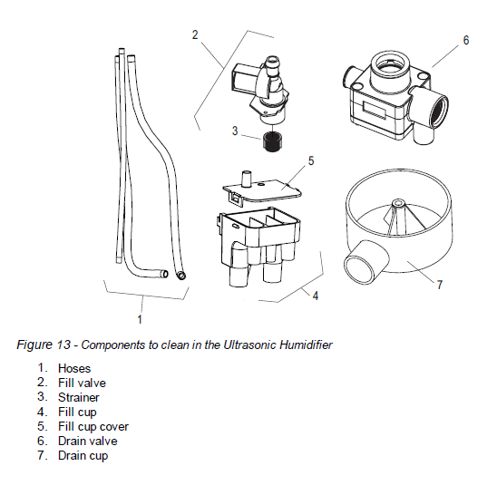
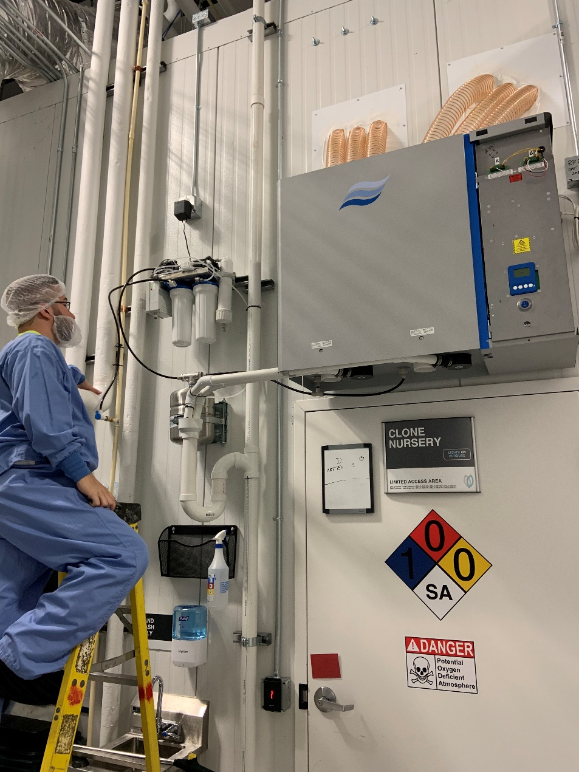
US Series
Maintenance
Regular Maintenance Requirements
Inspect and clean entire system
  Fill & drain valves
  Tubing
  Blower pack
  RO system
  Water reservoir
Annual Maintenance Requirements
Check all electrical connections
Check UV assembly
Replace filters & membranes
Cleaning & Disinfection Kit available
  Descaling solution
  Cleaning solution (H2O2)

Slide 25




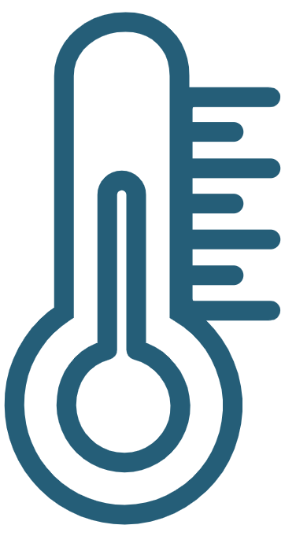
US Series
Features & Benefits
Fast start-up and exceptional control (±1%)
Plug & Play compact humidifier
Electrical: 110-240V / 50-60 Hz / 1ph
Approx. 35 W per lbs/h of humidification
Free additional adiabatic cooling

Slide 26
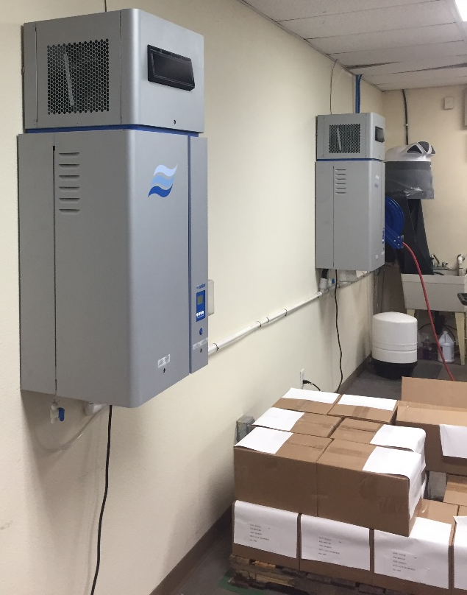


US Series
Applications
Small to medium direct room applications
Data Centers
Printing
Textile
Woodworking
Greenhouses
Tobacco processing

Slide 27
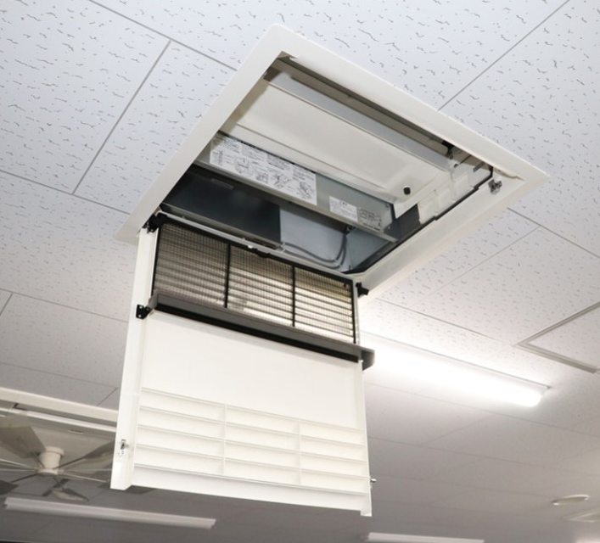
TE Series
Evaporative Media System

Slide 28
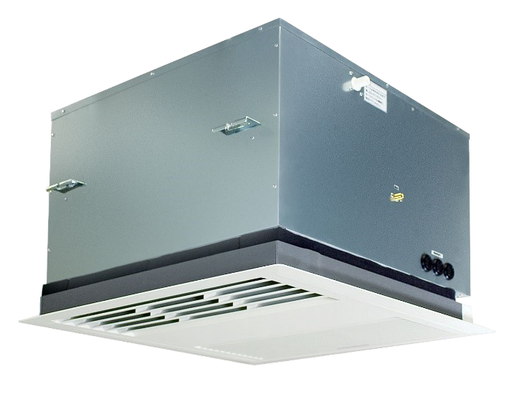
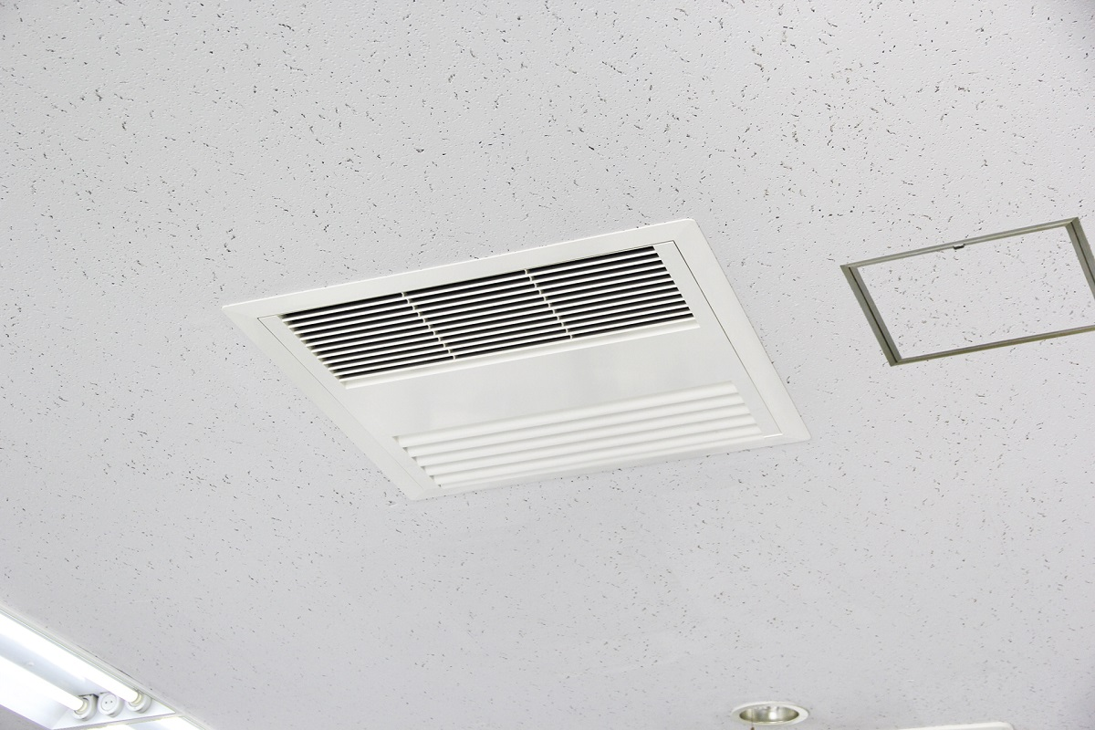
TE Series
Introduction
Tile Evaporative Series
Ceiling-mounted evaporative media humidifier for in-space small to medium applications
Capacity: 2.2 kg/hr (5 lbs/hr)
Modular, expandable design – link up to 10 units!
Easy to install in a standard 2’ x 4’ tile space, or suspended in open ceiling
Potable water
Energy efficient: ~20W per lb/hr of humidification
Ideal for retrofits – central ventilation system not required
Media is the only consumable
Low noise operation

Slide 29
TE Series
Model Overview
 | Evaporative Humidifier
Capacity | 5 lbs/hr (2.2 kg/hr) 2.5 lbs/hr (1.1 kg/hr)
Rated voltage | AC120V 50/60Hz
Rated power consumption | 83/97W (Fan mode: high, Drain pump in operation, 50/60Hz)
Operational weight | 64 lbs
Dry weight | 59 lbs
Supply Water Quality | Drinking water or equivalent
Safety devices | Drain pan high water level detection Water leakage detection Drainage failure detection at drain pump

Slide 30
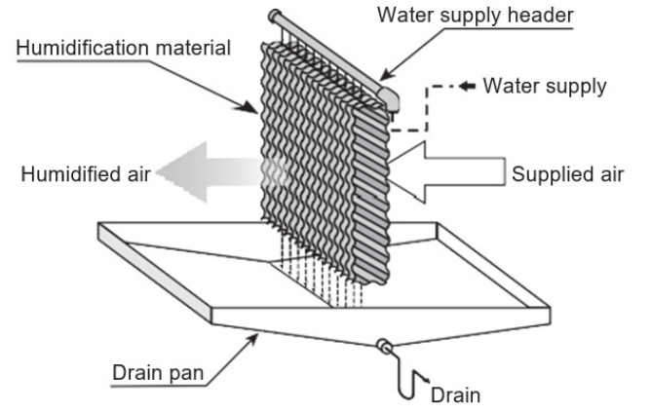
TE Series
Operation

Slide 31
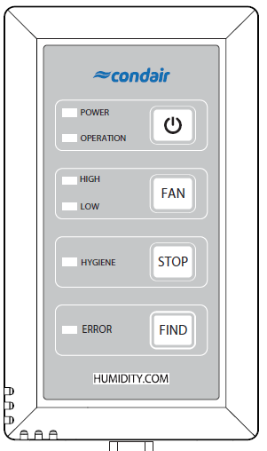
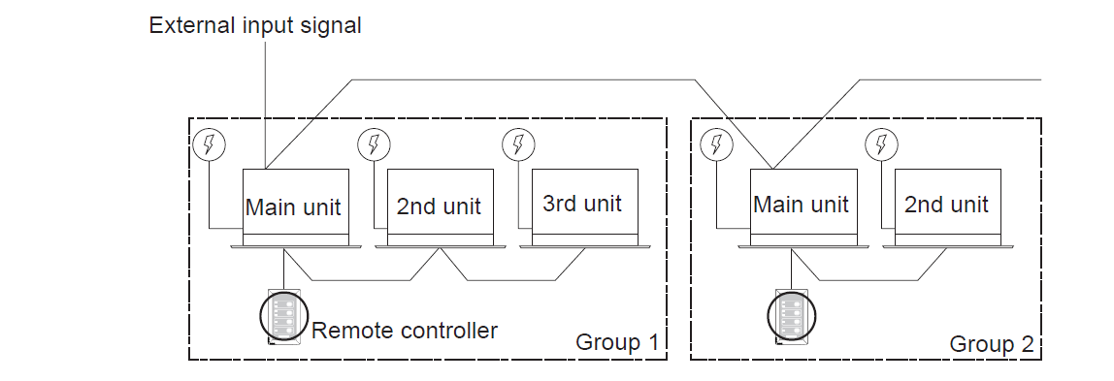
TE Series
Operation
All-in One Remote Controller
Wall mounted remote controller
Integrated Humidistat
Modulating control with different setpoints from 35%–70% RH with 5% increments
Possible to add external humidistat
BACnet possible with a Condair humidistat (optional)
Link up to 10 TE units!

Slide 32

TE Series
Installation
System:
  One-size standard humidification capacity
    Fan High Speed (350 CFM) – 5 lbs/hr
    Fan Low Speed (175 CFM) – 2.5 lbs/hr
  Installation: Drop ceiling (for discrete operation) or suspended.
  Drinking Water quality is required, no need for RO water.
Keep in mind:
  Suited for buildings without central ventilation systems (e.g., VRF or hot water heating).
  Adiabatic cooling effect is negligible.
  No preheat load required.
  Inlet and drain connections - NPT adaptors provided.
  Contractor needs to install non-return valve on the inlet
Dimensions & Clearances

Slide 33



TE Series
Maintenance
Regularly monitor contaminant levels & establish a cleaning cycle
Standard Maintenance Tasks

Slide 34




TE Series
Features & Benefits
Low Energy Consumption | The TE draws approximately 20 W per lbs/hr of humidification. At a full load of 5 lbs/hr, this humidifier draws the same amount of power as most household lightbulbs.
Low Utility Bills | One unit operating in commercial space will operate at approximately $30/year. No need for expensive RO water – potable water can be used.
Low Noise | It meets a Noise Criteria (NC) max value of 40 dB(A) and can be used where a silent atmosphere is required (i.e., classrooms, office spaces, etc.)
Compact Design and Installation | Unit is easy to Install and service, without taking up any floor or wall space. Media is the only consumable in the unit, but it can also be descaled and washed, therefore very little maintenance is required.

Slide 35



TE Series
Applications
Bundle with VRF – Ottawa
Office – Toronto

Slide 36






TE Series
Applications
Small Data Centers
Classrooms
Wine Storage
Office Spaces
Long-Term Facilities
Cigar Storage

Slide 37

Key Takeaways
AF / US / TE Series

Slide 38









Key Takeaways
AF / US / TE Series
Direct room systems are ideal for: Applications with excess process heat Humidify a single zone | AF, US and TE offer self-contained, “plug & play” solutions Simple installation & minimal maintenance | Great for small to medium applications | Cost effective & energy efficient operation Decrease energy costs by up to 95% compared to isothermal

Slide 39
Thank you for working as a team.

