Slide 1

Applications
Product and Sales Support Team

Slide 2
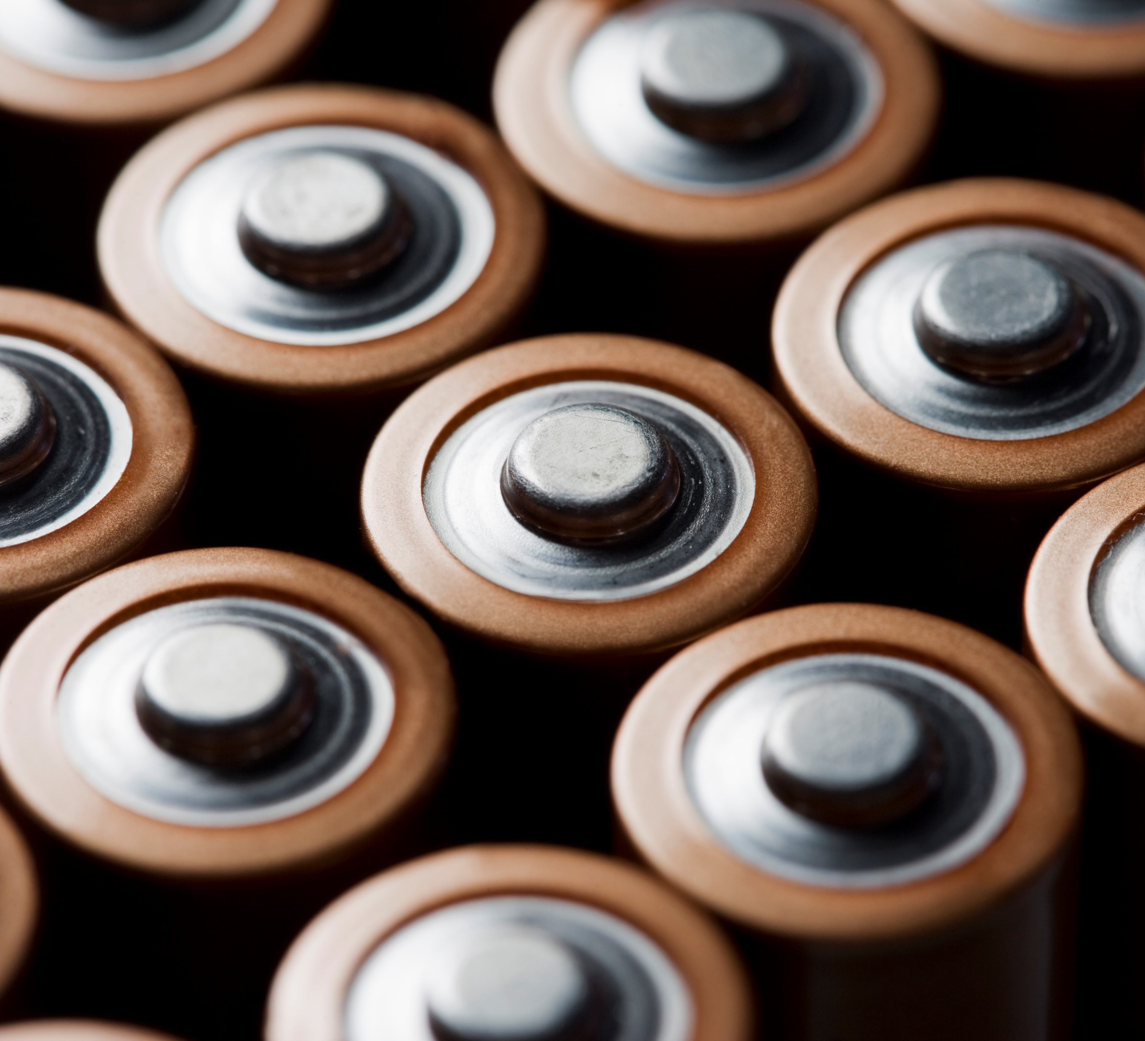
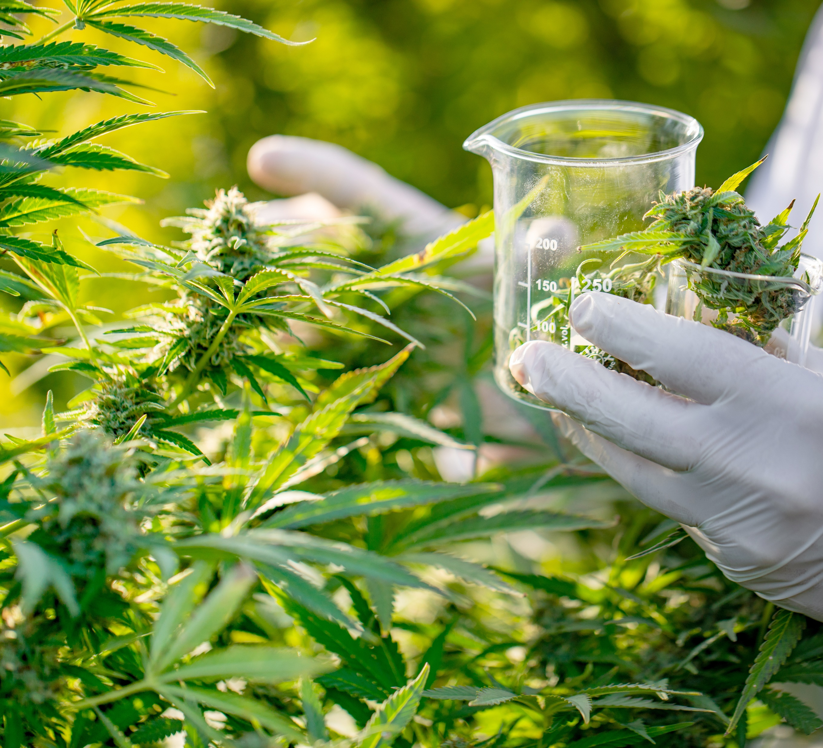


Agenda
Part 1
Wineries/ Distilleries – Mat and Marlee
Healthcare – Stan and Karly
Museums/ Archives – Mat and Marlee
Laboratories – Marlee
Part 2
Batteries - Ashutosh
Data Centers – Karly and Stan
Cannabis – Sagar and Ashutosh
Woodworking – Stan

Slide 3
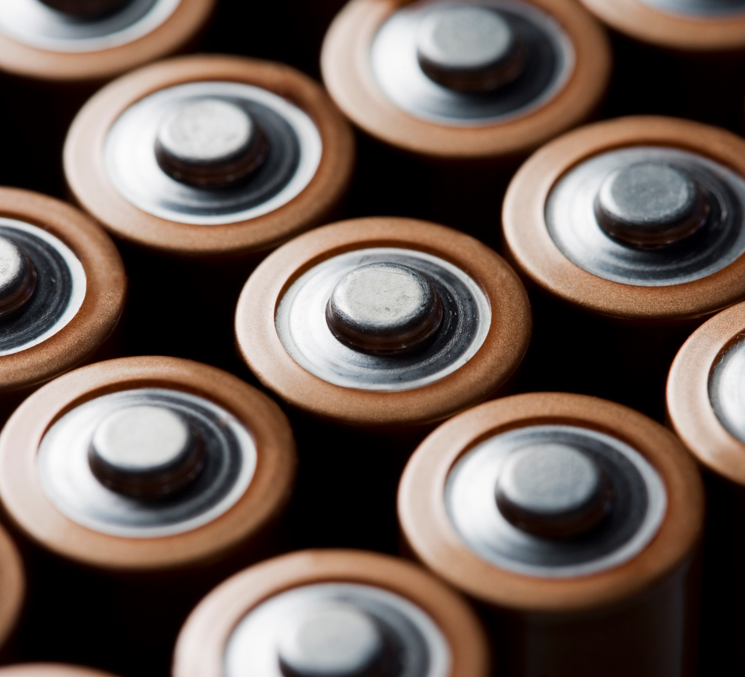

Lithium Battery Plants
with Ashutosh

Slide 4
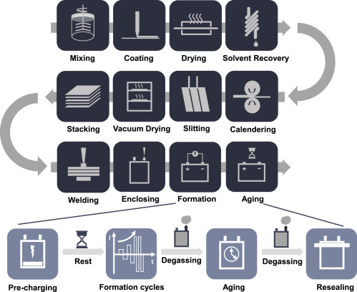
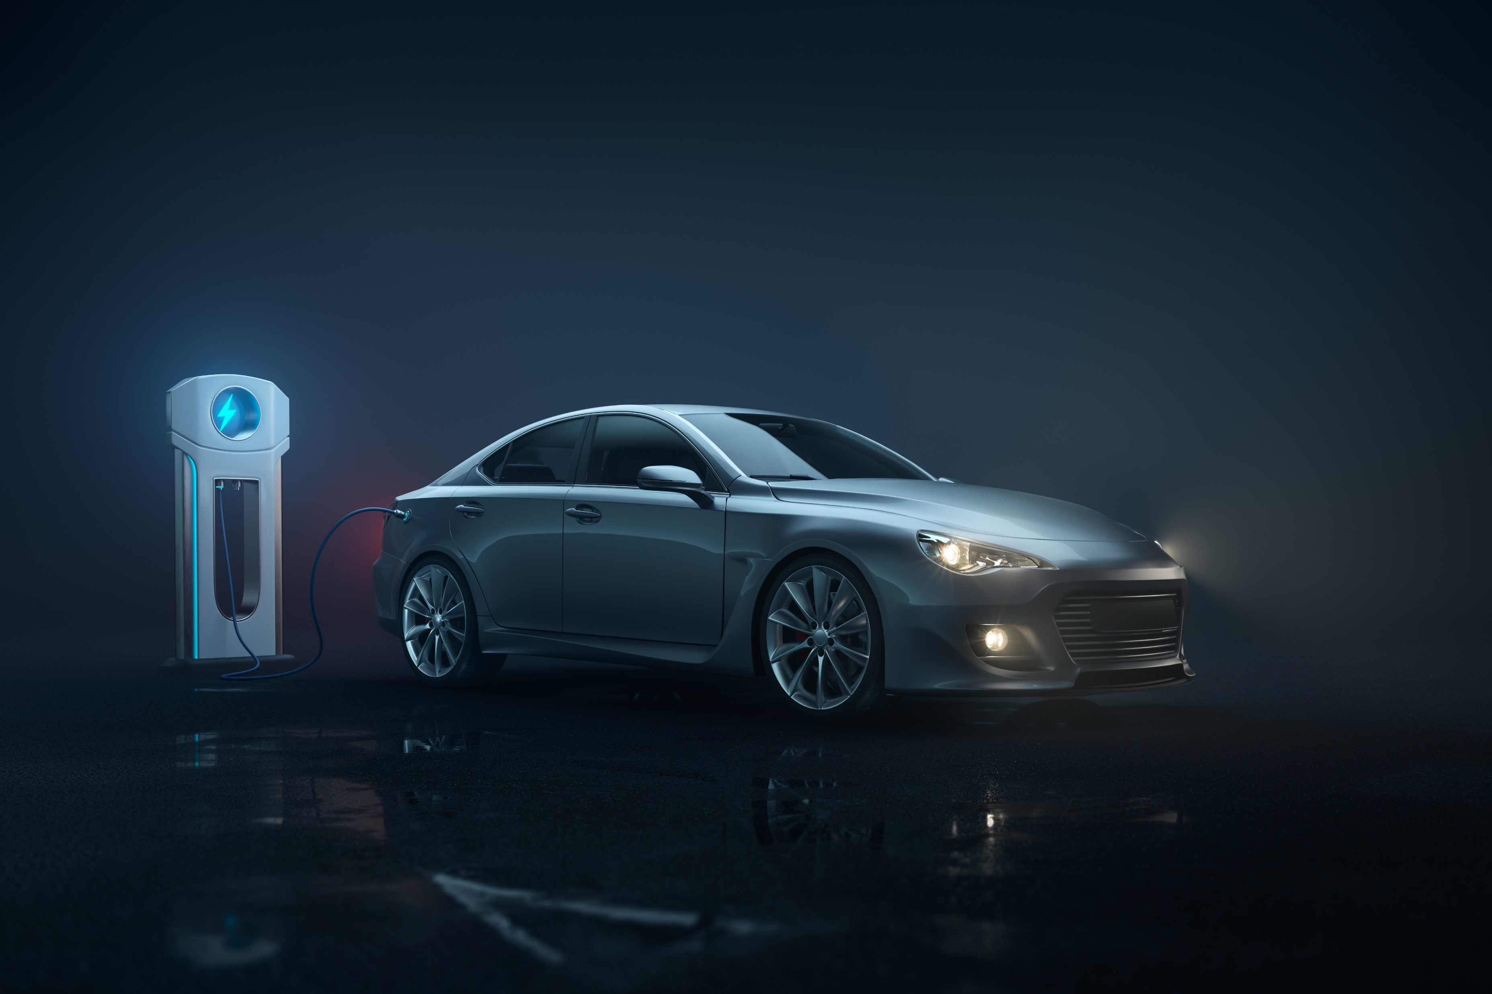
Lithium Battery Plants
Introduction
USA and Canada to invest $5 Billion for Lithium Battery Plants.
The goal is to close the gap in supply chain disruption and accelerate battery production.
Each facility will be 800,000+ sq ft
Extremely low humidity conditions
Manufacturing lithium-ion batteries is a complicated technical process that involves various manufacturing steps.

Slide 5


Lithium Battery Plants
Benefits of Dehumidification
Protection of Product:
Lithium reacts with water vapour and inaccurate humidity control in a battery production area can have severe consequences, as well as leading to a drop in product quality.
With High humidity the cell weight increase due to moisture reaction (contamination)
Operational Cost
With the extreme requirement for moisture control, the energy required for the manufacturing process is significant therefore controlling the conditions accurately with dehumidification has a substantial impact on the probability in the manufacturing operation.

Slide 6
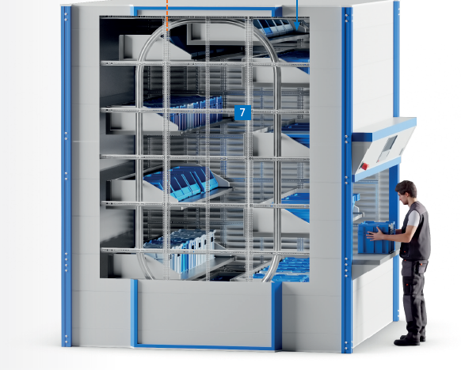
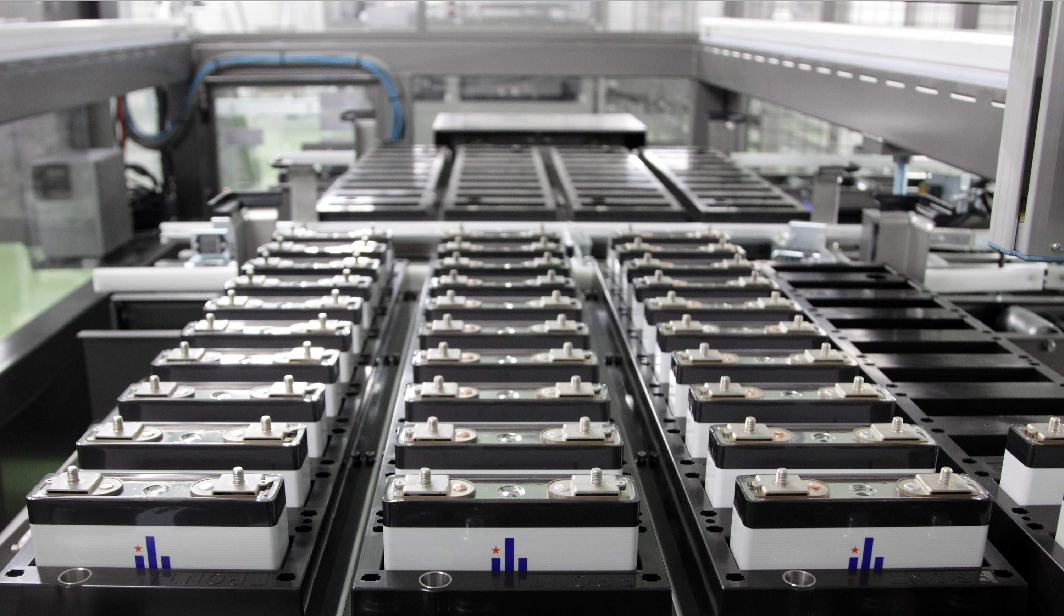
Lithium Battery Plants
Calculating Set Points
For Dry Rooms Important Considerations
Extremely low humidity conditions for dry rooms.
Hermetically sealed from the outside environment
Stable clean dry room environment (ISO class 7 to 6)
A typical specification has a dew point less than -40° F
Battery assembly have lower requirements (<10% RH) than cell manufacturing (<1% RH)
Next generation batteries may need even more stringent conditions (< -90F dew point)

Slide 7
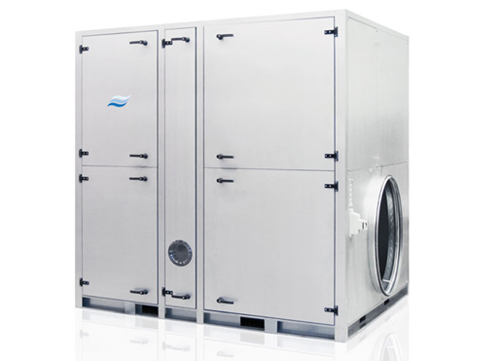
Lithium Battery Plants
Applicable Technologies
Custom Units
Reheat Options
  Steam Reheat (S)
  Medium Temperature Hot Water Reheat (MTHW)
  Hot Temperature Hot Water Reheat (HTHW)
  Direct Gas Fire Reheat (G)
  Electric Heaters (E)
Insulated Housing with panels and inspection doors
Carbon/HEPA Filtration
Outdoor Units IP56 or IP65
Model | CFM | Drying capacity at 20°C – 60% RH
DA 13000 | 7600 | 190 lbs/hr
DA 19000 | 11000 | 265 lbs/hr
DA 27000 | 16000 | 401 lbs/hr

Slide 8
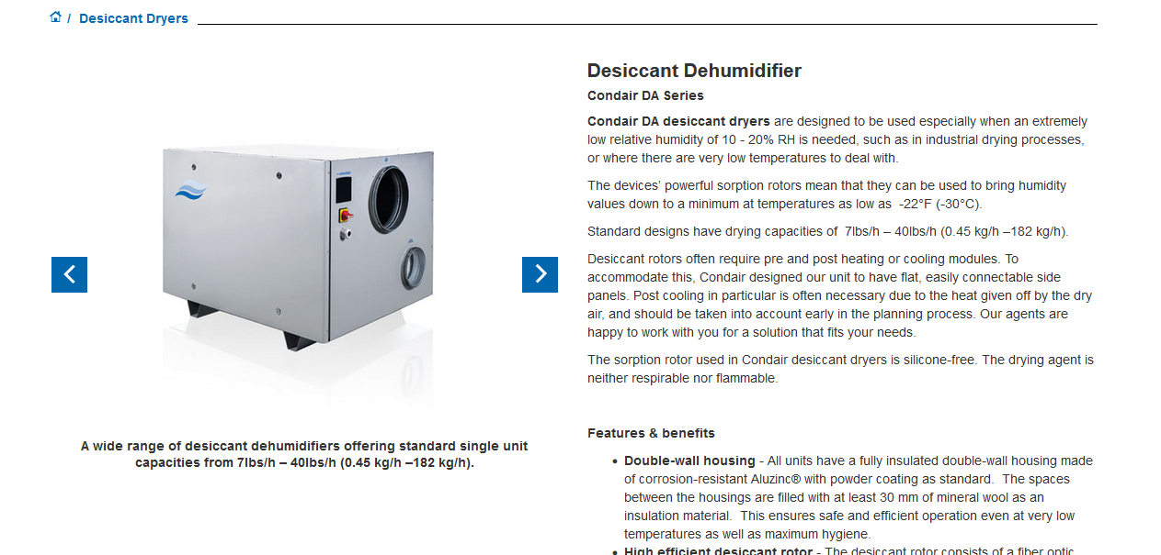

Lithium Battery Plants
Resources
https://www.condair.com/desiccant-dryers

Slide 9
Data Centers
with Karly and Stan

Slide 10
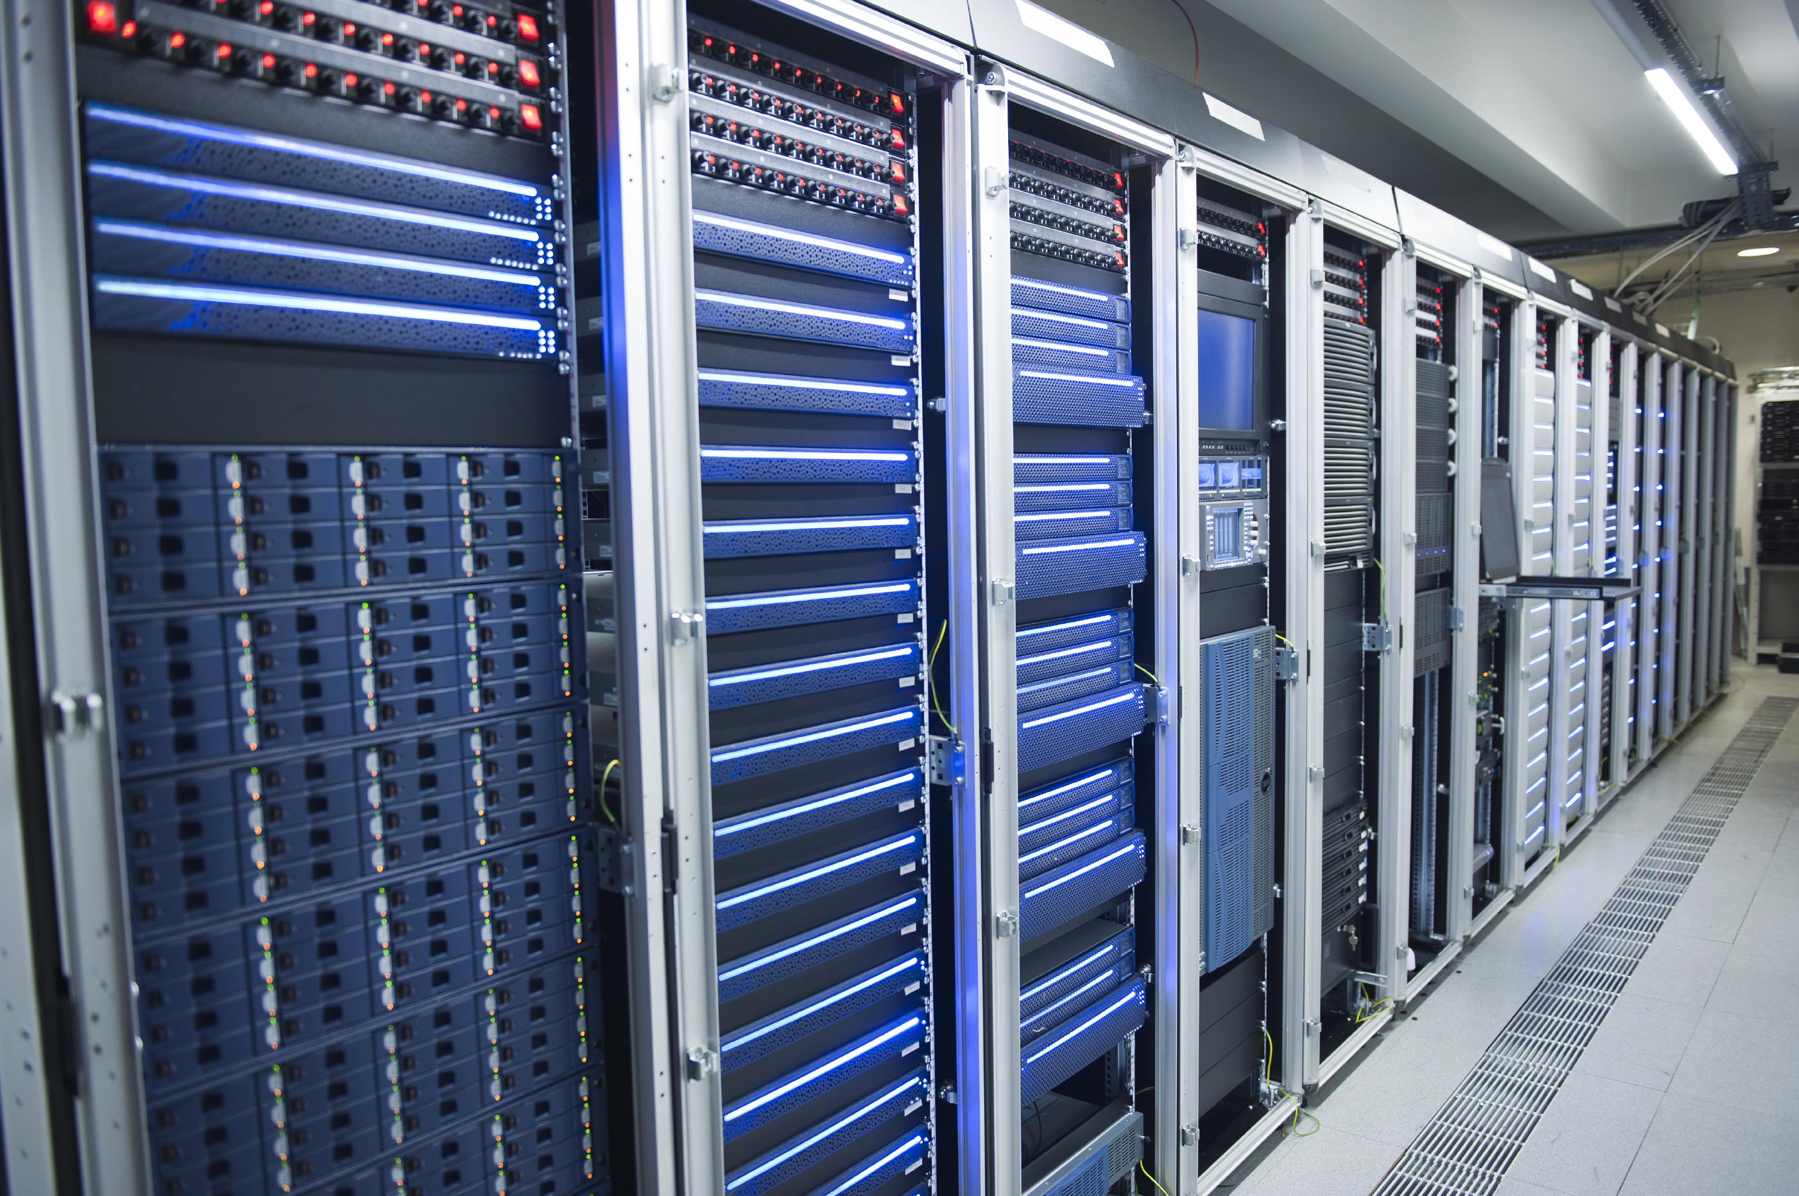
Data Centers
Introduction
Data centers are one of the most energy-intensive building types, consuming 10 to 50 times the energy per floor space of a typical commercial office building.
Data Centers account for approximately 2% of the total U.S. electricity usage in 2021
Hyperscale – Microsoft, Google, Apple
Colocation – Equinix, Coresite, Rackspace
  Build facilities and rent rack space to customers to deloy their own servers
1% efficiency gain = Big $$$ Savings

Slide 11
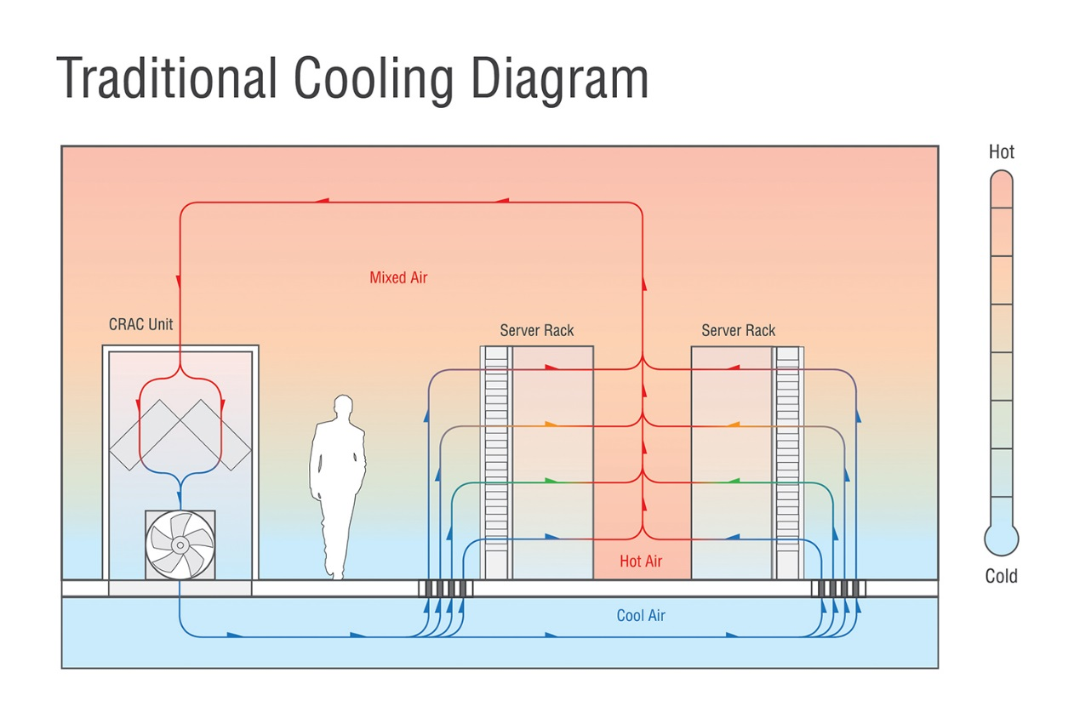
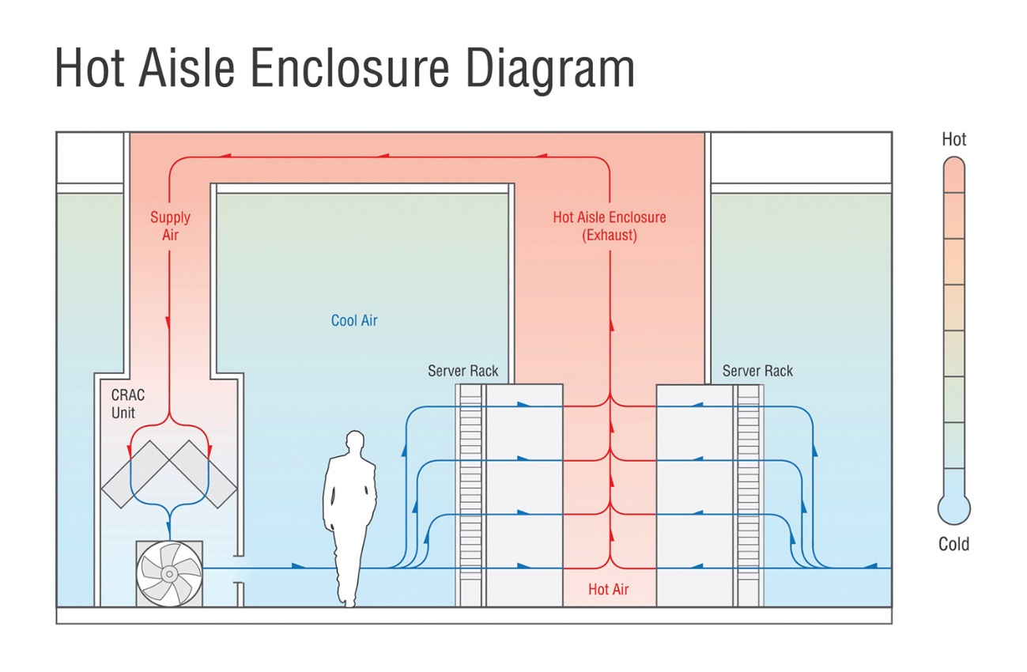
Data Centers
Introduction

Slide 12
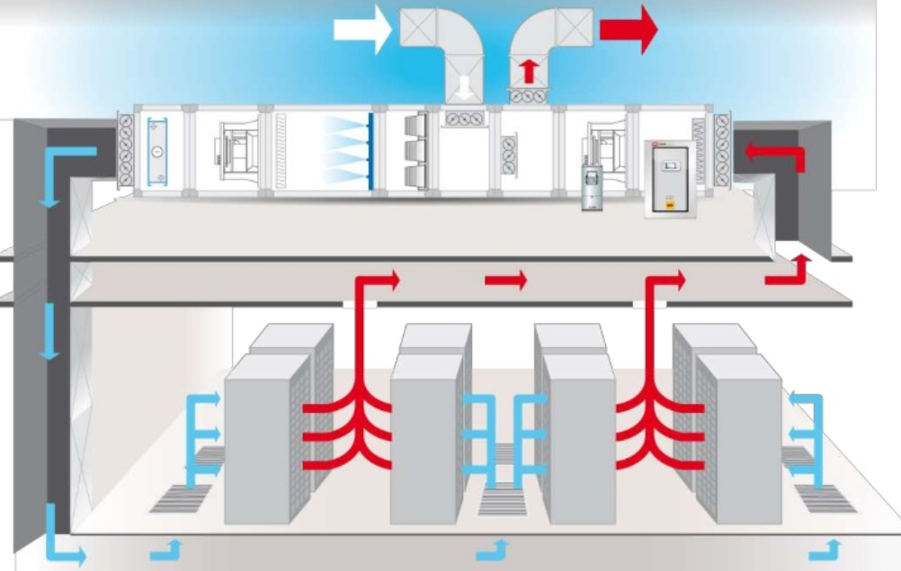
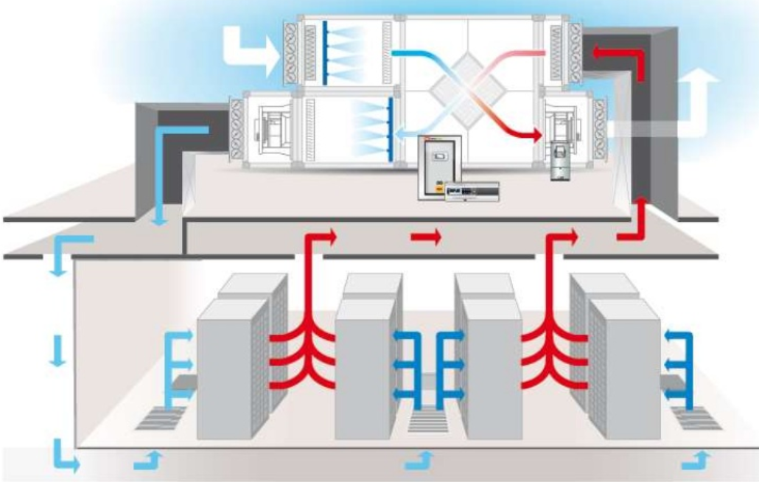
Data Centers
Introduction
Direct Evaporative Cooling
Indirect Evaporative Cooling

Slide 13
Data Centers
Benefits of Humidification & Dehumidification
Optimized Performance
  Equipment is designed to function in an optimal humidity and temperature range. Too much moisture can cause dust adherence inside IT equipment, reducing heat transfer efficiency and performance, and leading to increased failures.
Protection of Equipment
  Dehumidifiers can protect pipework, installations, operating materials and technical appliances from moisture damage, which can lead to rust, corrosion, mold and rot.
  Studies indicate a strong link between humidity control and hard disk failure levels, particularly when humidity levels were elevated. Maintaining proper humidity levels ensures processes remain safe and stable.
  Humidity control in data centers is a key factor in preventing electrostatic discharge (ESD), which can damage electronic equipment.

Slide 14



Data Centers
Benefits of Humidification & Dehumidification
Reduced Operational Costs
  Adiabatic humidifiers both humidify and cool the air. A single evaporative system can provide up to 630kW of evaporative cooling, operating on less than 0.3kW of electricity.
  Data centers can take advantage of both evaporative systems and air side economizers to reduce mechanical cooling loads, which offers significant energy savings. Evaporative media systems increase the cooling capacity of the ventilation system, extending the use of free air cooling into periods when the outside air alone is too warm to meet the required internal conditions.
Sustainability
  By incorporating low energy cooling techniques, a company can significantly reduce or even eliminate the need for mechanical cooling, which results in a significant drop in PUE.
  To encourage greener practices, the Power Usage Effectiveness (PUE) describes how efficiently a data center uses energy. Ideally the PUE would be 1, where all energy is used for computing.
$$PUE=\frac{Total Facility Energy}{IT Equipment Energy}$$

Slide 15
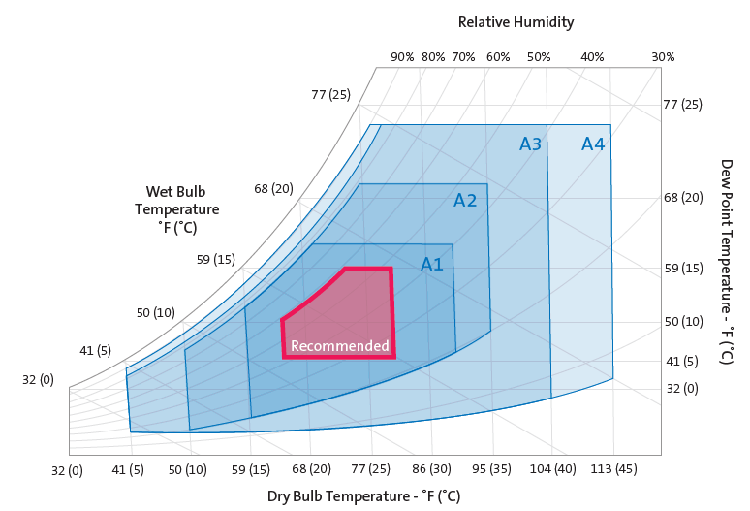
Data Centers
Calculating Set point
For Data Centers, Temperature and RH are Important Considerations
Data centers often use large amounts of cold outside air to cool their servers and keep costs down. However, low RH becomes an issue as the cold air warms up. IT equipment can become damaged if the facility is maintained at temperature and humidity levels outside its tolerable range.
High humidity: increased equipment failures
Low humidity: risk of electrostatic discharge
High temperature: risk of overheating, equipment warranties may be invalid
Low temperature: risk of freezing
Target:
20-80 %rh

Slide 16
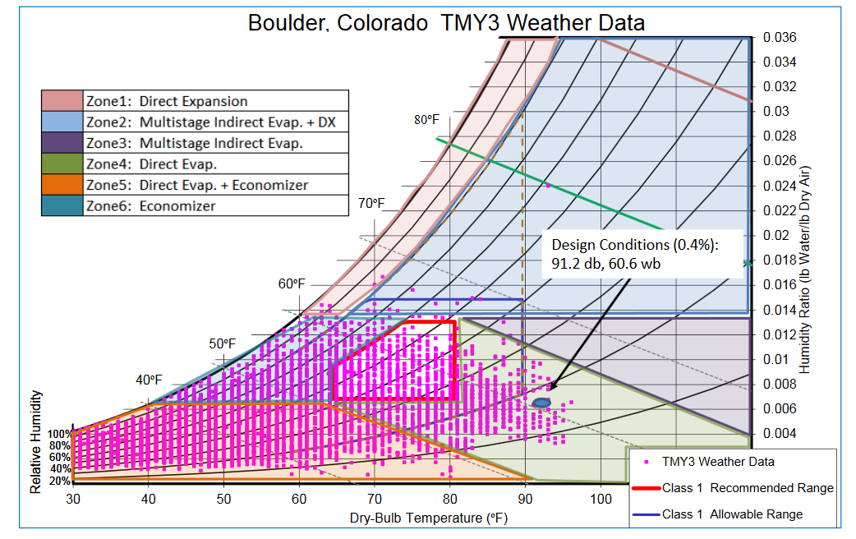
Data Centers
Applicable Technologies

Slide 17
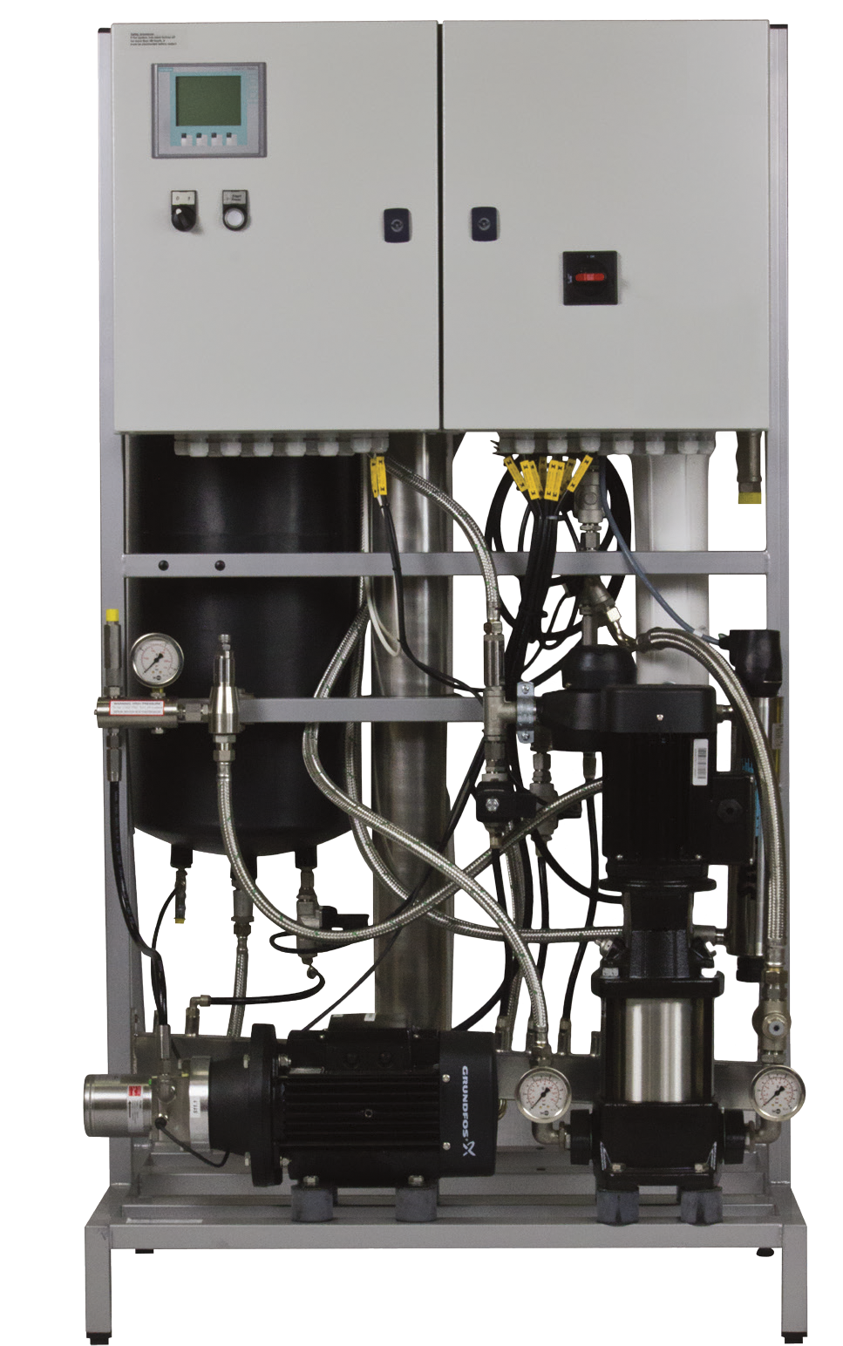
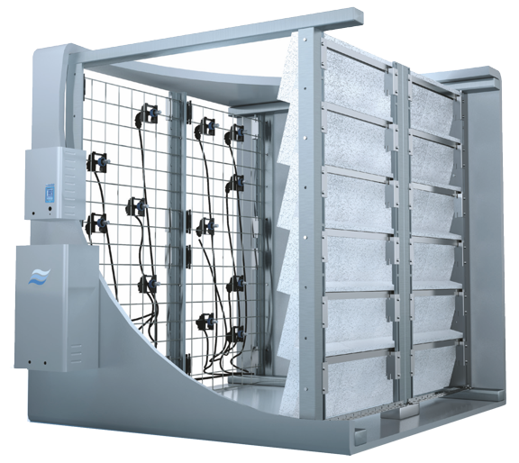
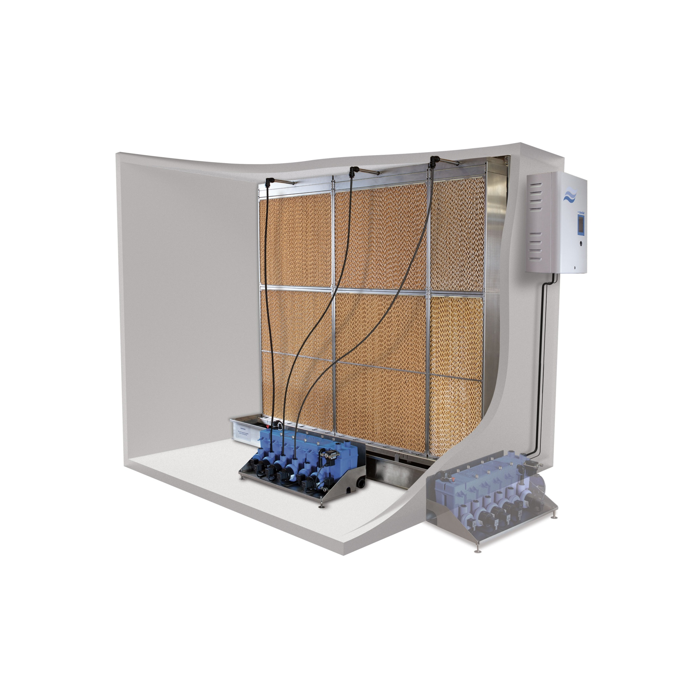
Data Centers
Applicable Technologies
ME Series*
HP Series
DL Series

Slide 18







Data Centers
References
Our North American Data Center Clients Include:
  Amazon
  Bell Canada
  Digital Realty
  eBay
  Facebook, Sweden
  Goldman Sachs
  Hewlett Packard
  MGM Assurance
  Microsoft
  Ministry of Defense

Slide 19


Data Centers
Resources
Why Humidify for Data Centers
https://www.condair.com/m/0/19-70-why-humidify-for-data-centers.pdf
Humidification for Data Centers | Condair
Case Study: Using a single system for cooling and humidification drives costs down and efficiency up
https://www.condair.com/m/0/12-603-case-study-datacenters.pdf
White Paper: 5 Trends in Data Center Facility Management
https://www.condair.com/m/0/white-paper-5-data-center-trends-in-facility-mgmt-2019-1.pdf

Slide 20

Cannabis
with Sagar and Ashutosh

Slide 21
Agenda
Intro
Benefits of Humidification/ Dehumidification
Calculate set point: Where you lose or gain moisture
Applicable technologies
Case studies/ references
Resources

Slide 22
Introduction
Cannabis
Medicinal plants have been used in healthcare since time immemorial. Studies have been carried out globally to verify their efficacy and some of the findings have led to the production of plant-based medicines. Recently, the use of cannabis is gaining traction in the field of healthcare specially in North America.
Cannabis are known to help enhance immune system response while also interact with cells that play major role in the functioning of the gut, block off the bacteria and other compounds that cause inflammation in the intestines.
For the healthcare industries, the prime goal is to extract cannabidiol (CBD) & delta-9-tetrahydrobinol (THC).
In order to take full medicinal advantage of this infamous plant, the air quality, temperature, air circulation & relative humidity are very important.
Notes:
Irrigating the soil.
They off gas 50-60 % moisture
Standard system – small operation need RH unit

Slide 23
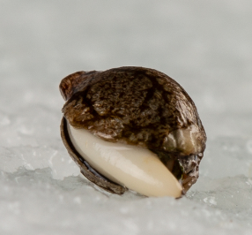
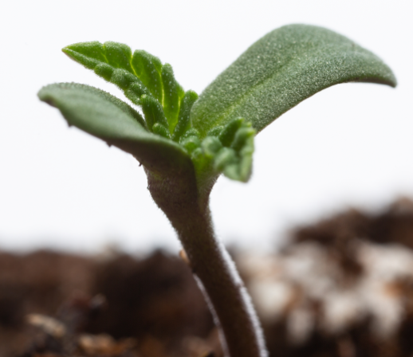
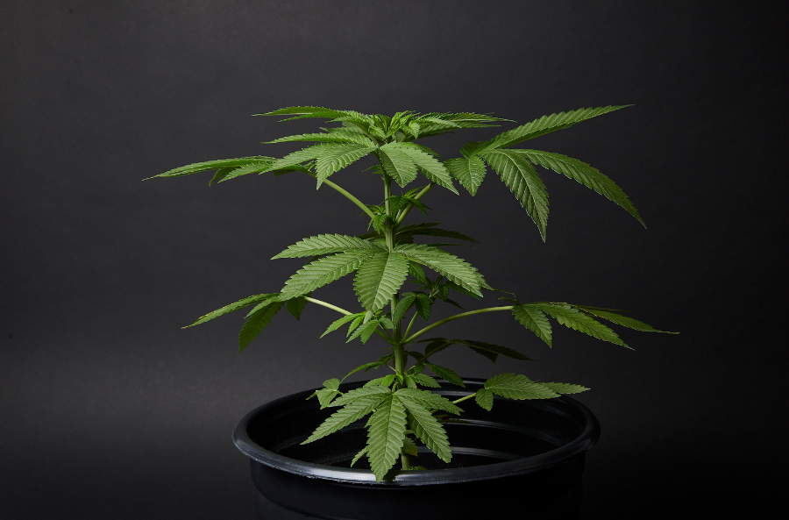
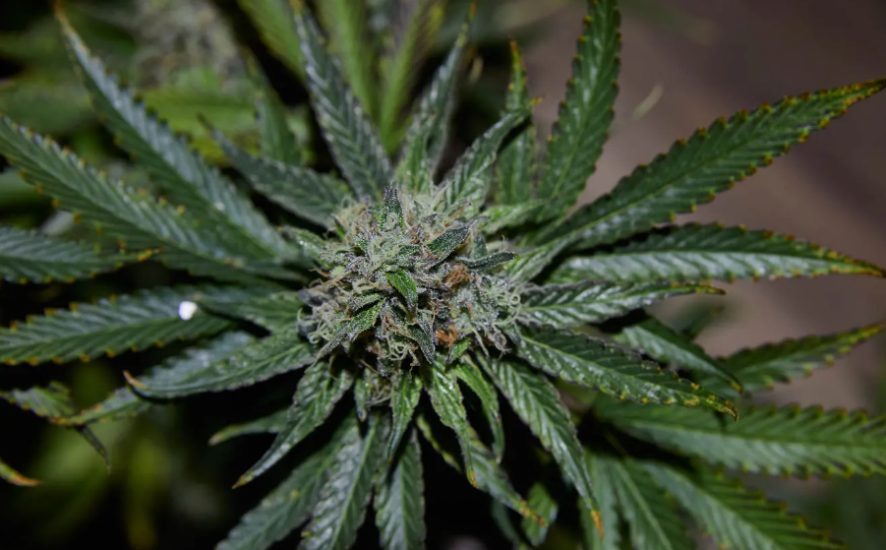
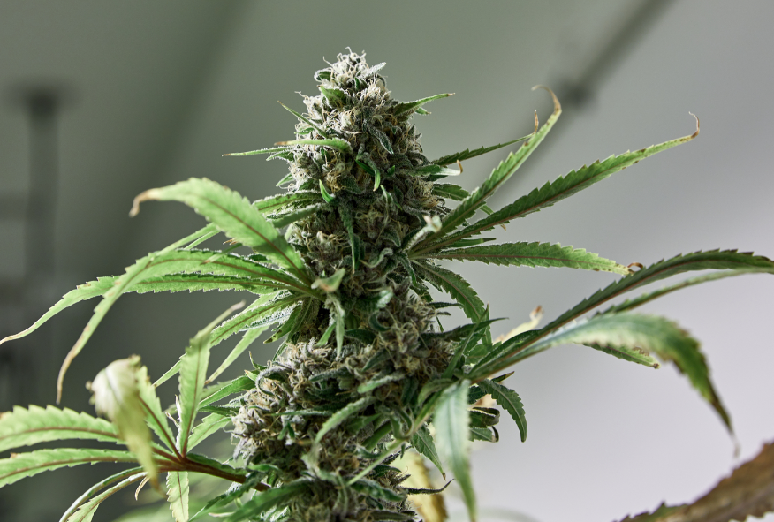
5 stages of Cannabis
Germination
2 hours to 2 weeks
Seedling
2 to 3 weeks
Vegetative
3 to 8 weeks
Flowering
6 to 8 weeks
Harvesting
Fall for outdoor
70%rh
20-25C
18-24 light hours
50%rh
20-24C
12 Hours of Sun
or
18 hours fluorescent light
40-50 %rh
20-28C
12 light hours
50% rh
20-25C
Where humidification vs dehum

Slide 24
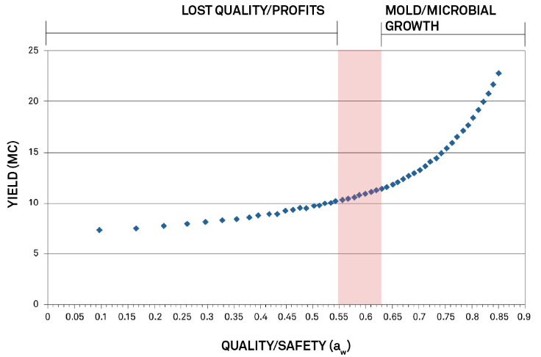
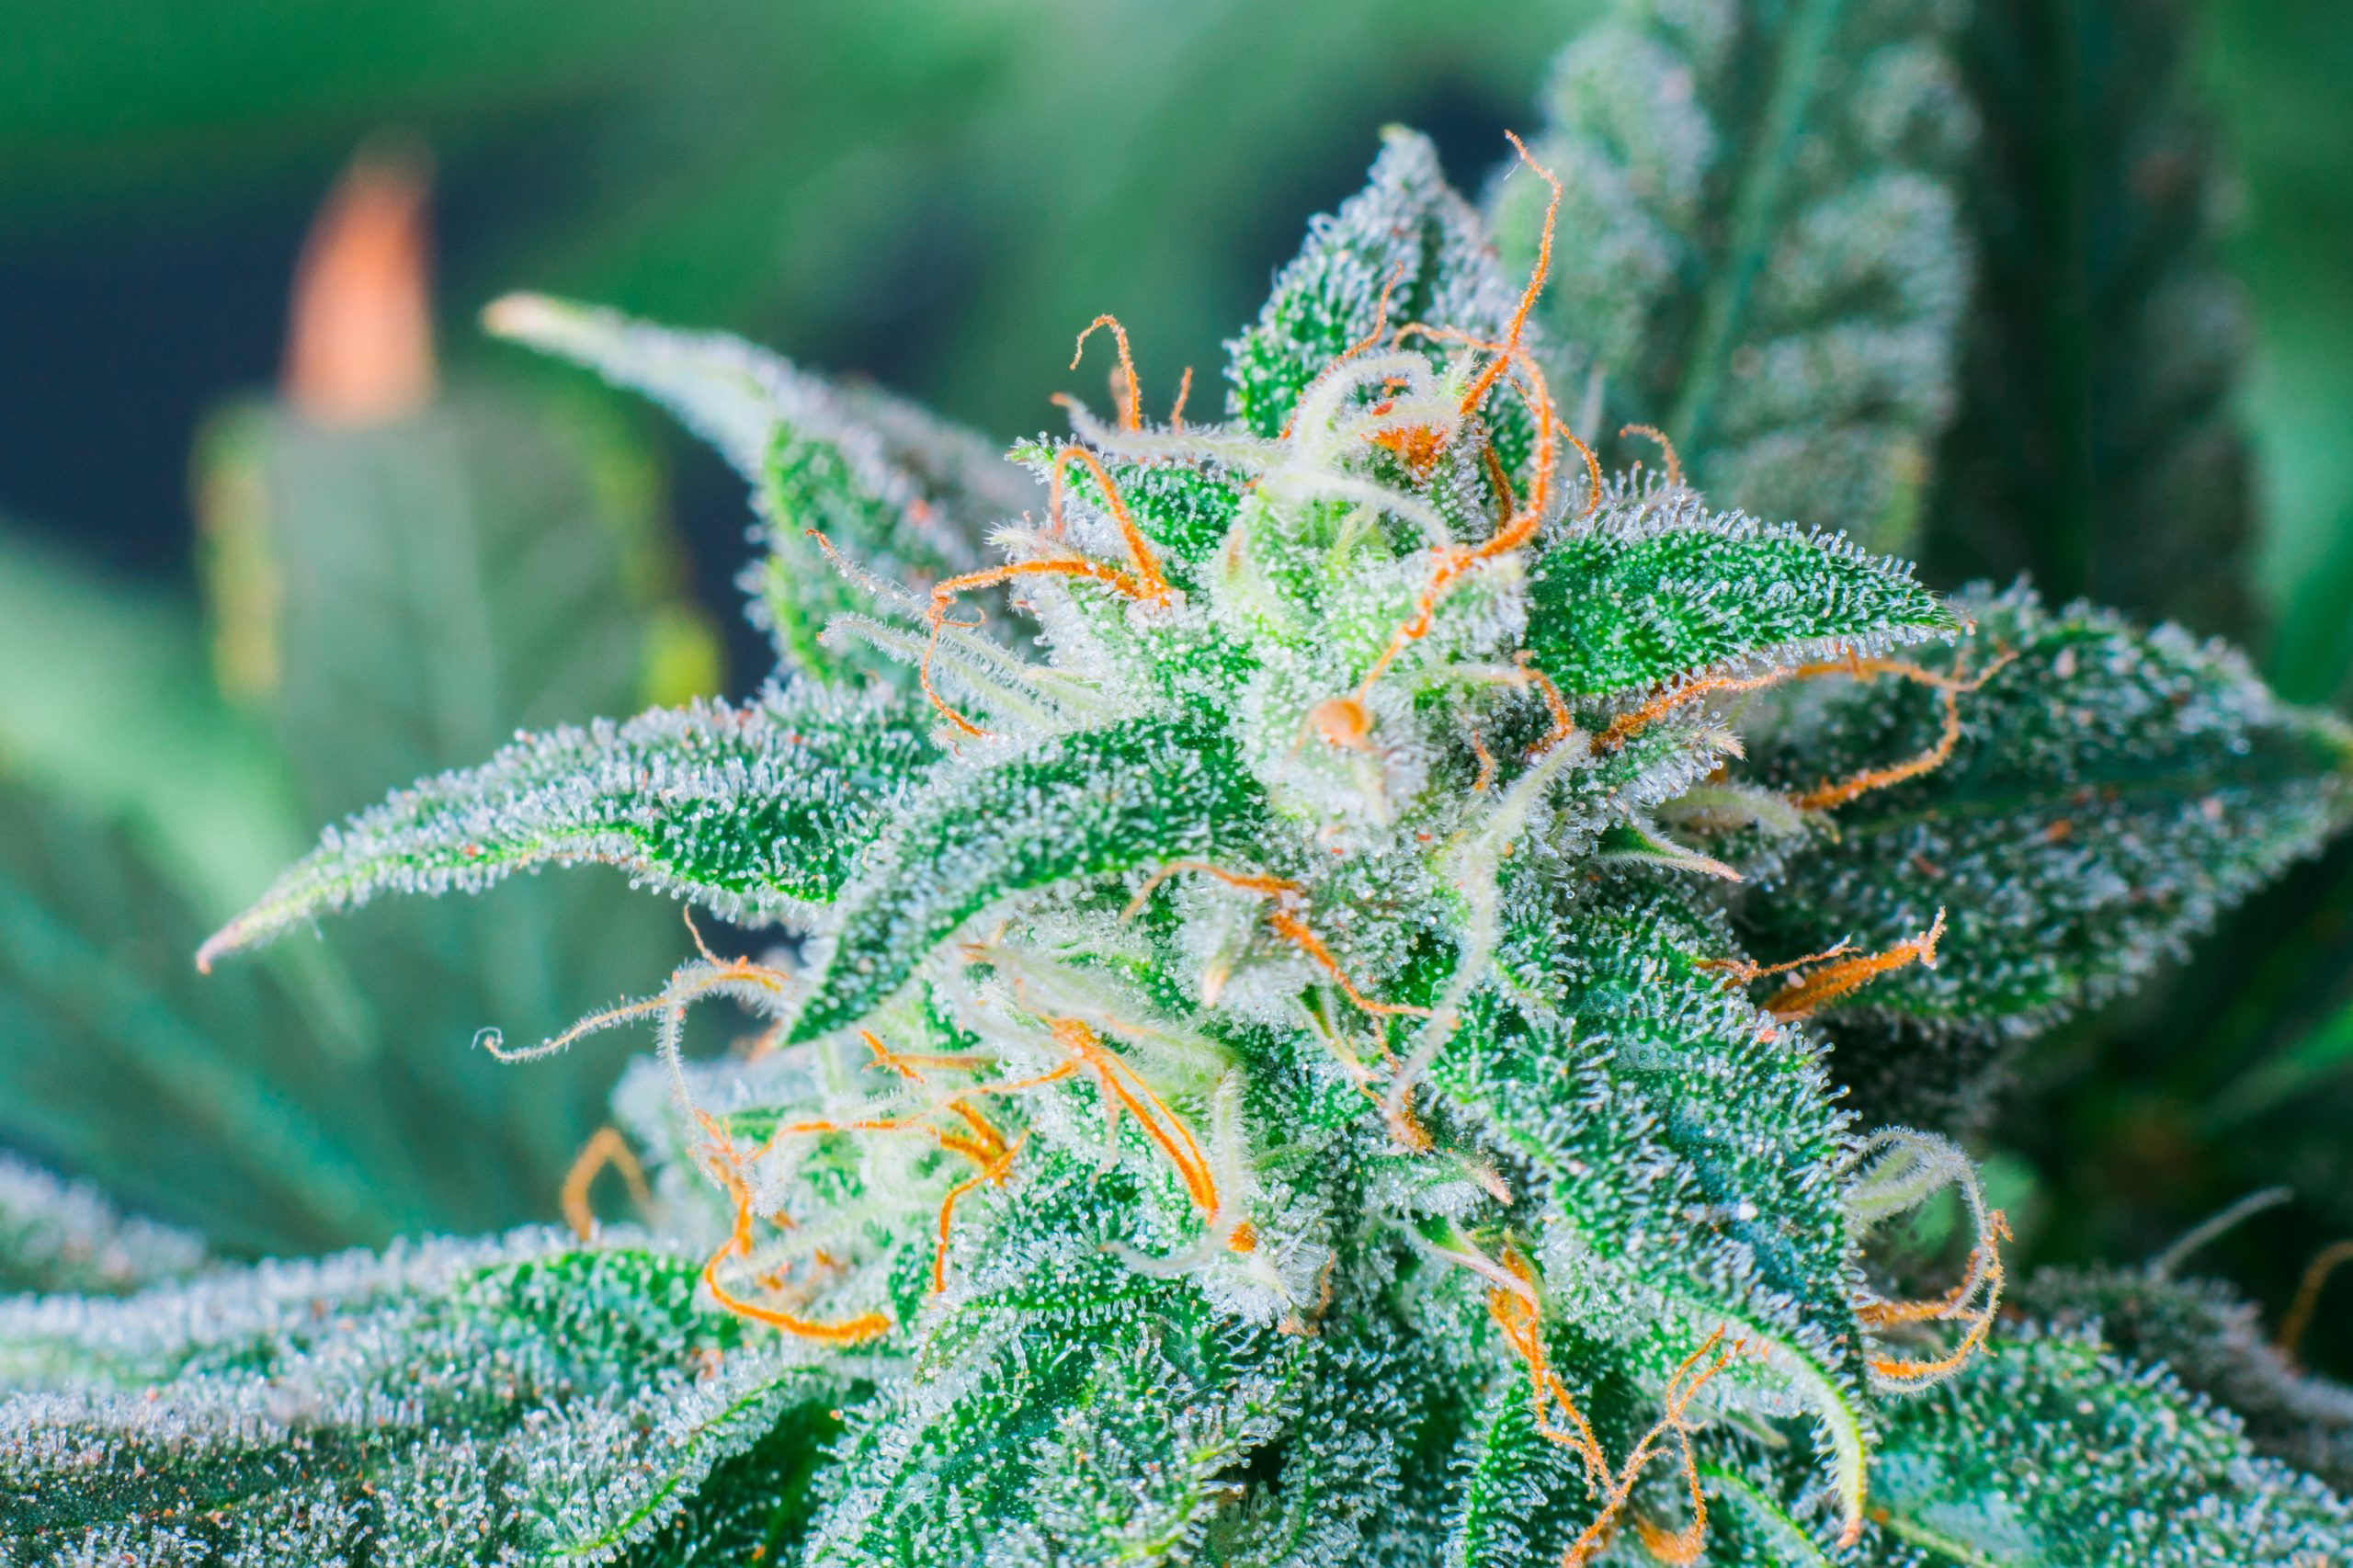
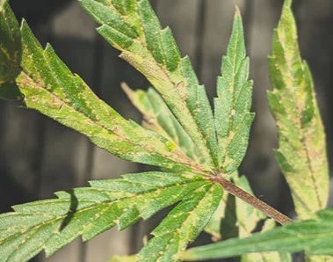
Benefits of Humidification/Dehumidification
Ideal Drying temperature is 20° C
Ideal Humidity 50 to 55% r.h.
Live Cannabis plants are 70 to 80% water
Cannabis drying starts with a plant moisture content around the 25 % mark
Optimum dry condition 10 – 11% moisture content so around the 0.55 Aw
Conditions above 65% lead to mold growth and product damage
Moisture control at this stage is vital. Too much and mould will form. Too little and crop quality suffers.
Notes:
Temperature range: 20°-28°C
Light hours per day: 12, 18-24
Relative Humidity: 70%, 50%, 40-50%

Slide 25
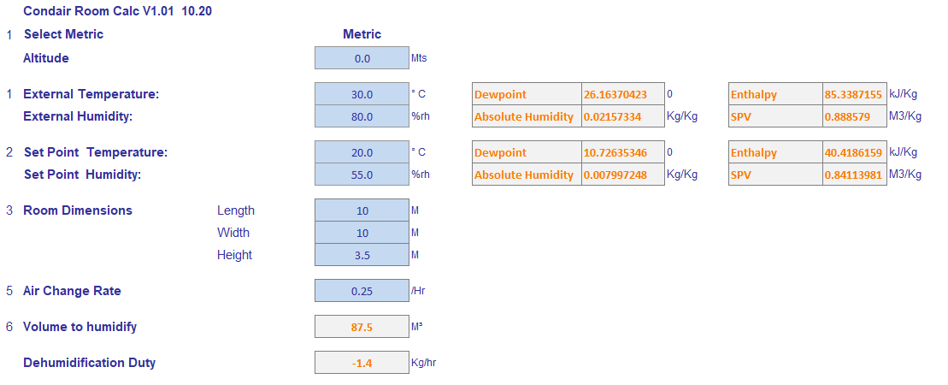
Set Point Calculation
On the basis that the 4 plants weigh 800 grams each and this is 80% water Total Product weight 3200 grams
At the start of the drying process product water content 25% approximately 800 grams of water
Final product moisture content 10%
Moisture to be removed 480 grams
Average product drying time 14 days or around 35 grams/day additional will be the room load by infiltration and ventilation , Oxygen concentration needs to be kept low so minimal air changes
Notes:
Its difficult to calculate a spec duty requirement because there are so many variables from climatic , drying times 7 to 21 days . Plant weight etc etc but taking some average value we can estimate the following
➢ Desired Conditions
o Temperature: 68°F to 70 °F
o Relative Humidity: 40 to 50%
o Velocity near the plants: 100 to 150 ft/min 9

Slide 26
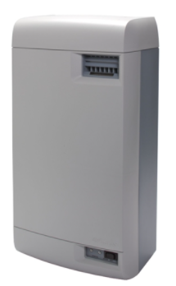
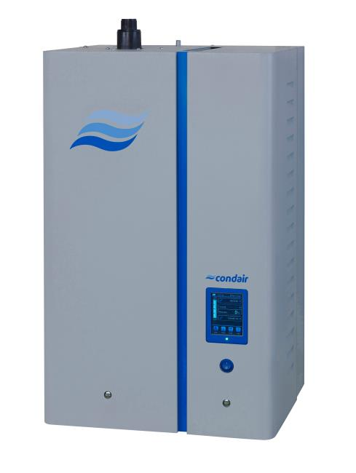
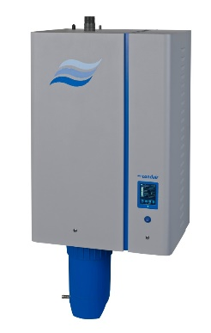
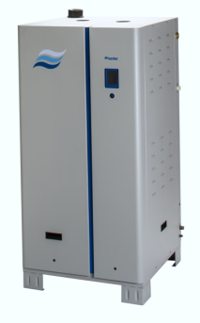
Applicable Technologies
RH Series
EL Series
RS Series
GS Series

Slide 27
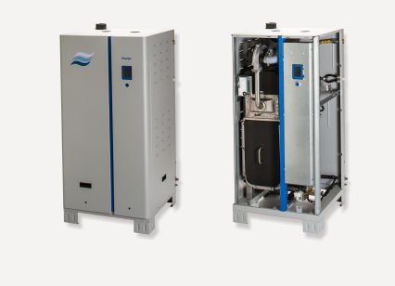
Case Study
From lead to order
How it came about
  Project went to tender in the local Ottawa region
  Mechanical equipment suppliers we’re tasked to find an HVAC solution to meet the multi stage requirements of a cannabis grow operation.
Which solution we offered
  Multiple GS gas fired systems were used to accommodate the various stages of growth
Why this was the right solution
  Gas fired supplied the necessary capacities for each stage.
  Natural gas is much cheaper then electricity in Ontario Canada.
  The GS was able to maintain the necessary moisture tolerances.
  Steam humidification doesn’t require re-heating the space offering further utility saving to nozzle spray systems. Specific to operation not require cooling. Example Ottawa
Notes:
Purple Farms –Long hill Energy
Canopy – two EL

Slide 28

Key Takeaways
Determine the size of the facility/room
Find out outside air quality throughout the year (Temperature & % RH)
Selection of appropriate humidification technology

Slide 29

Woodworking
With Stan and Mat

Slide 30


Why Humidify for Wood Working
Two Main Reasons
Evaporation
Rates
Hygroscopic
Materials

Slide 31
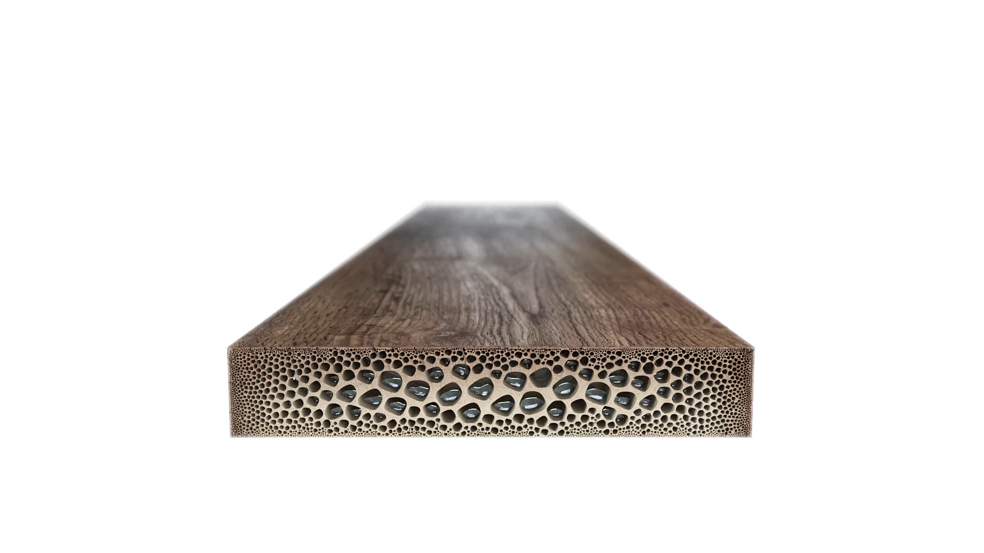
Hygroscopic
Wood tends to absorb moisture in nature
Mechanical Properties:
Cracking
Warping
Shrinking/Expanding

Slide 32

Hygroscopic
Wood tends to absorb moisture in nature
Mechanical Properties:
Cracking
Warping
Shrinking/Expanding

Slide 33
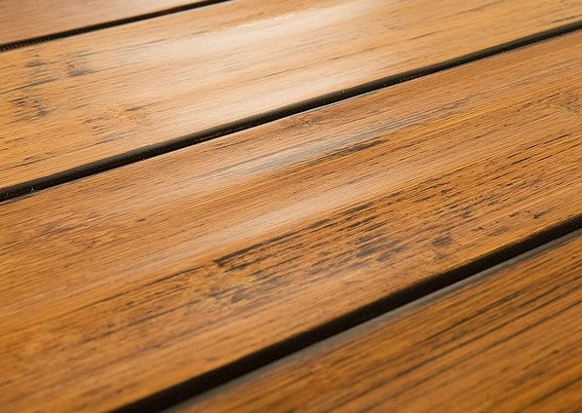
Hygroscopic
Wood tends to absorb moisture in nature
Mechanical Properties:
Cracking
Warping
Shrinking/Expanding

Slide 34

Hygroscopic
Wood tends to absorb moisture in nature
Production Processes:
Painting/Varnishing
Laminate
Dusting/Sanding

Slide 35
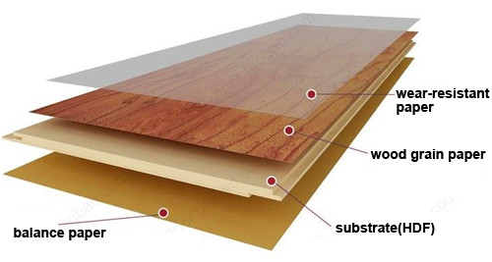
Hygroscopic
Wood tends to absorb moisture in nature
Production Processes:
Painting/Varnishing
Laminate
Dusting/Sanding

Slide 36
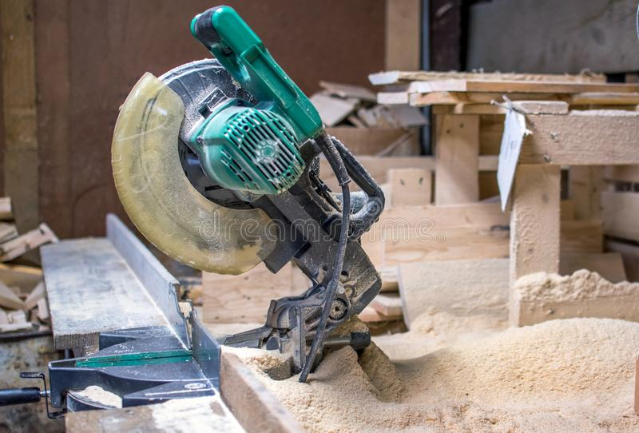
Hygroscopic
Wood tends to absorb moisture in nature
Production Processes:
Painting/Varnishing
Laminate
Dusting/Sanding

Slide 37
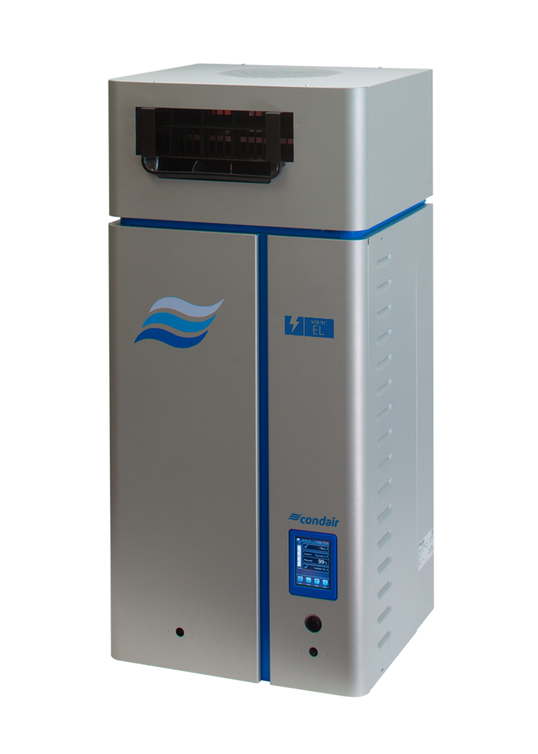
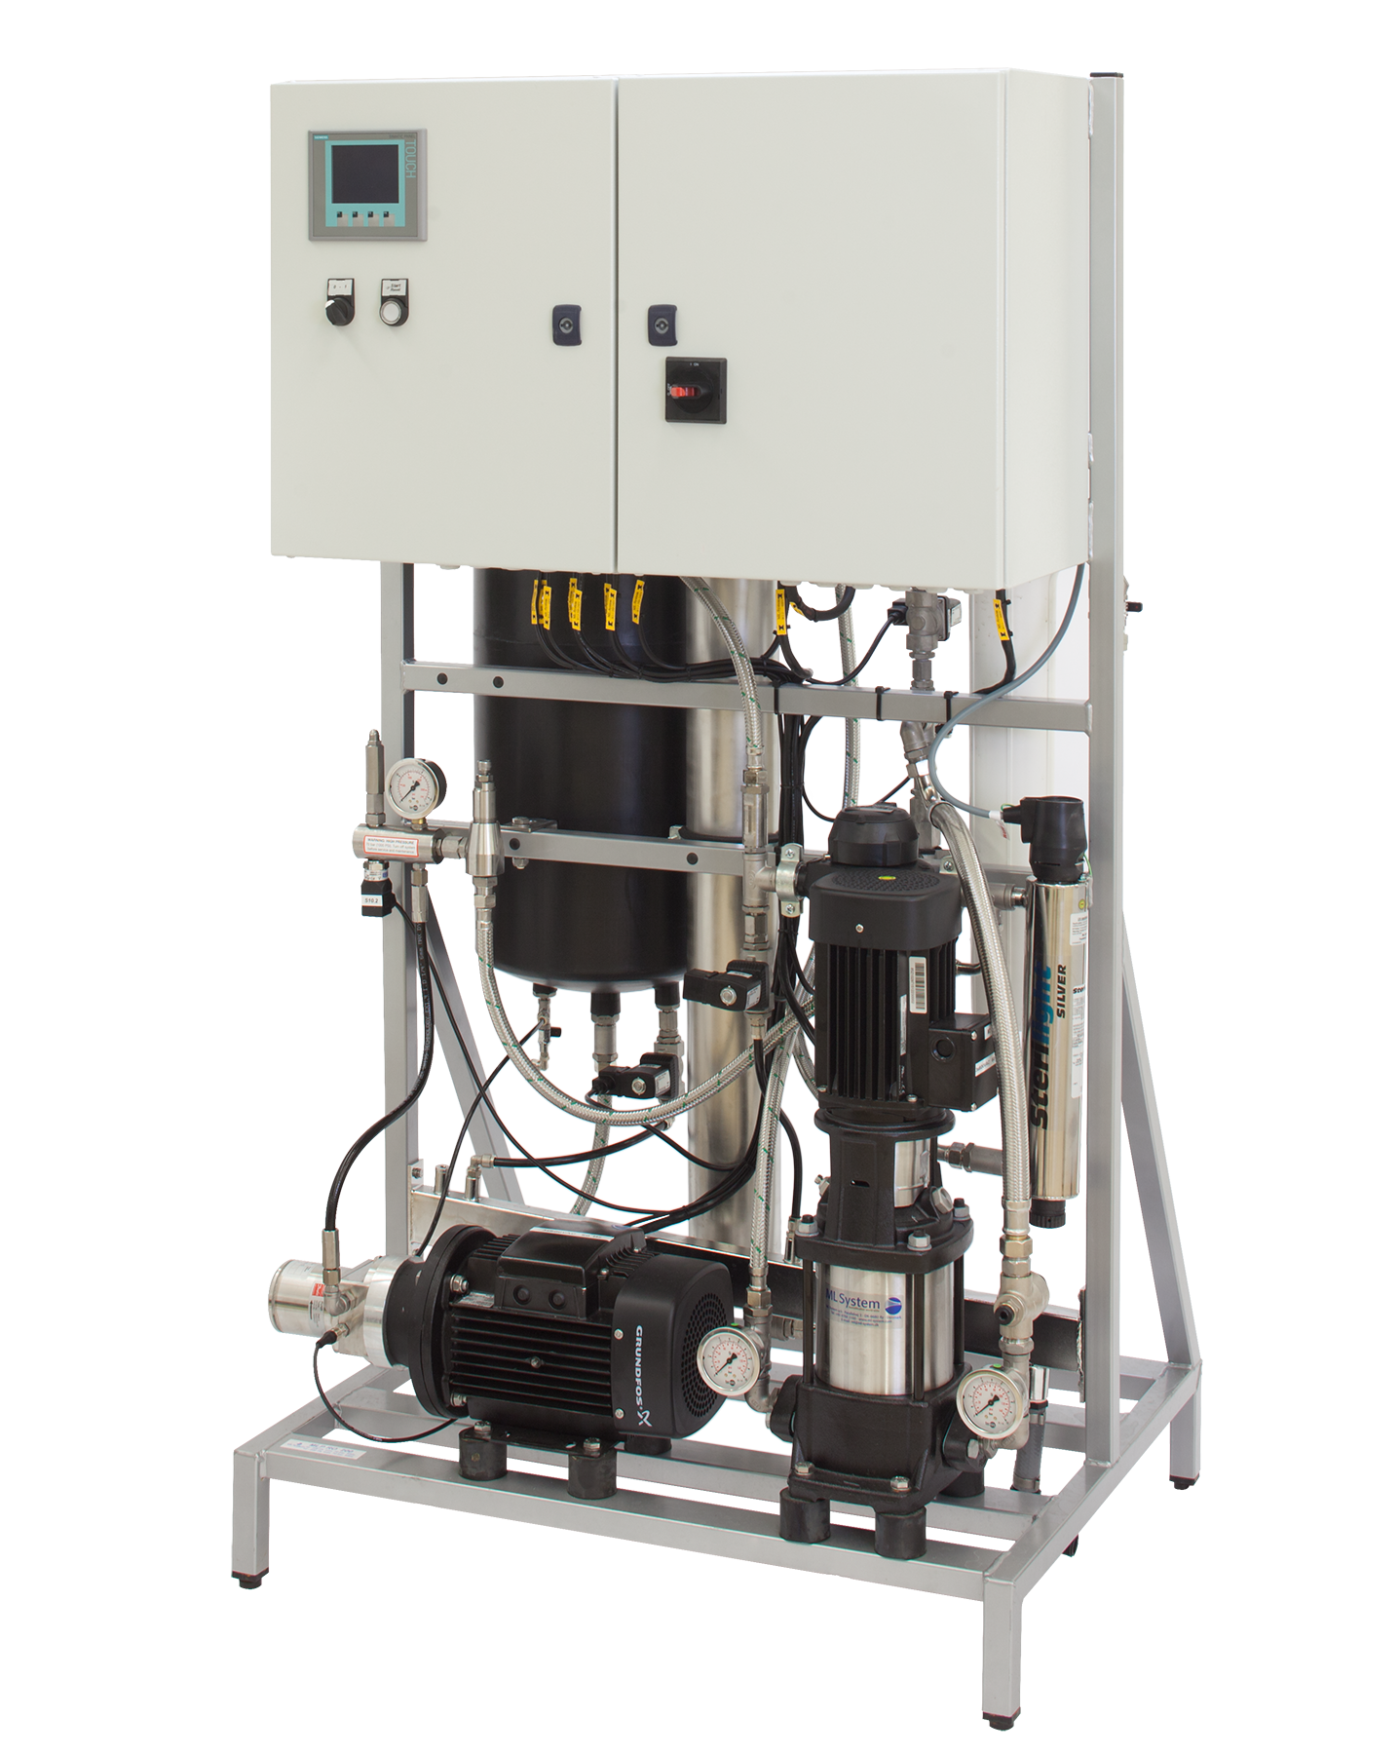
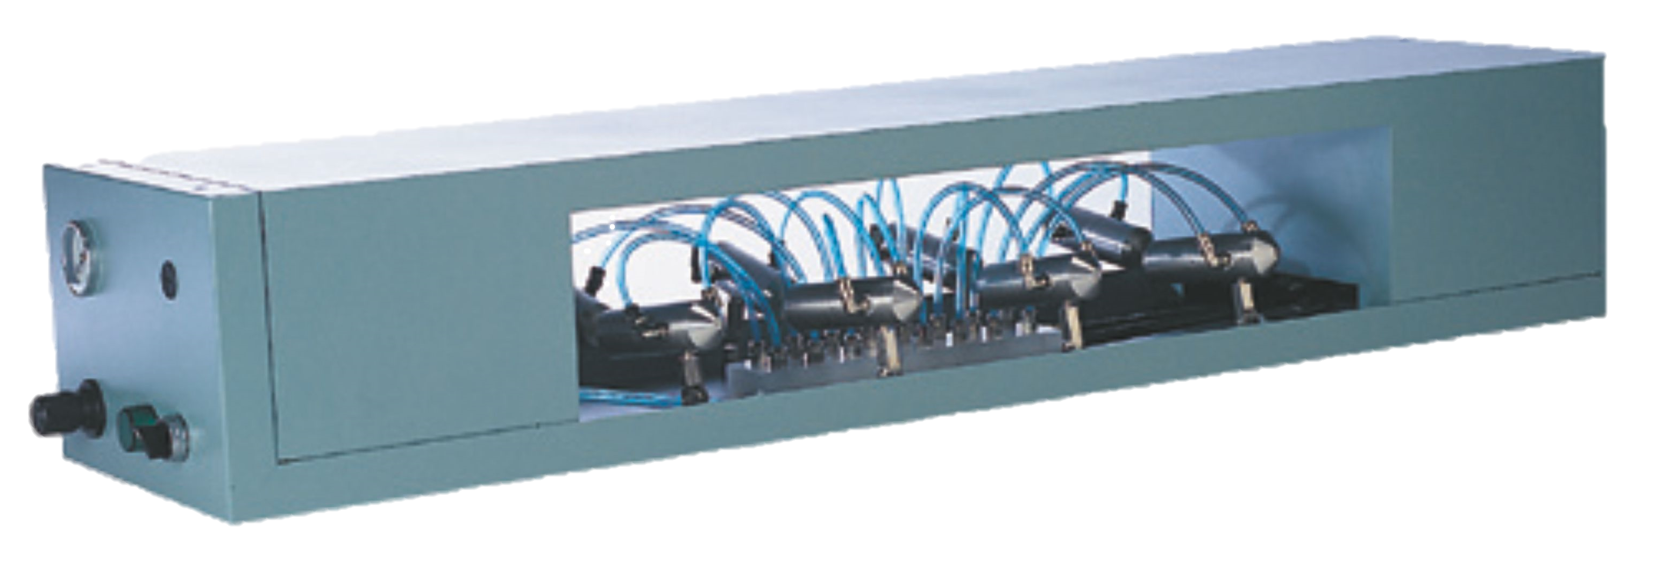
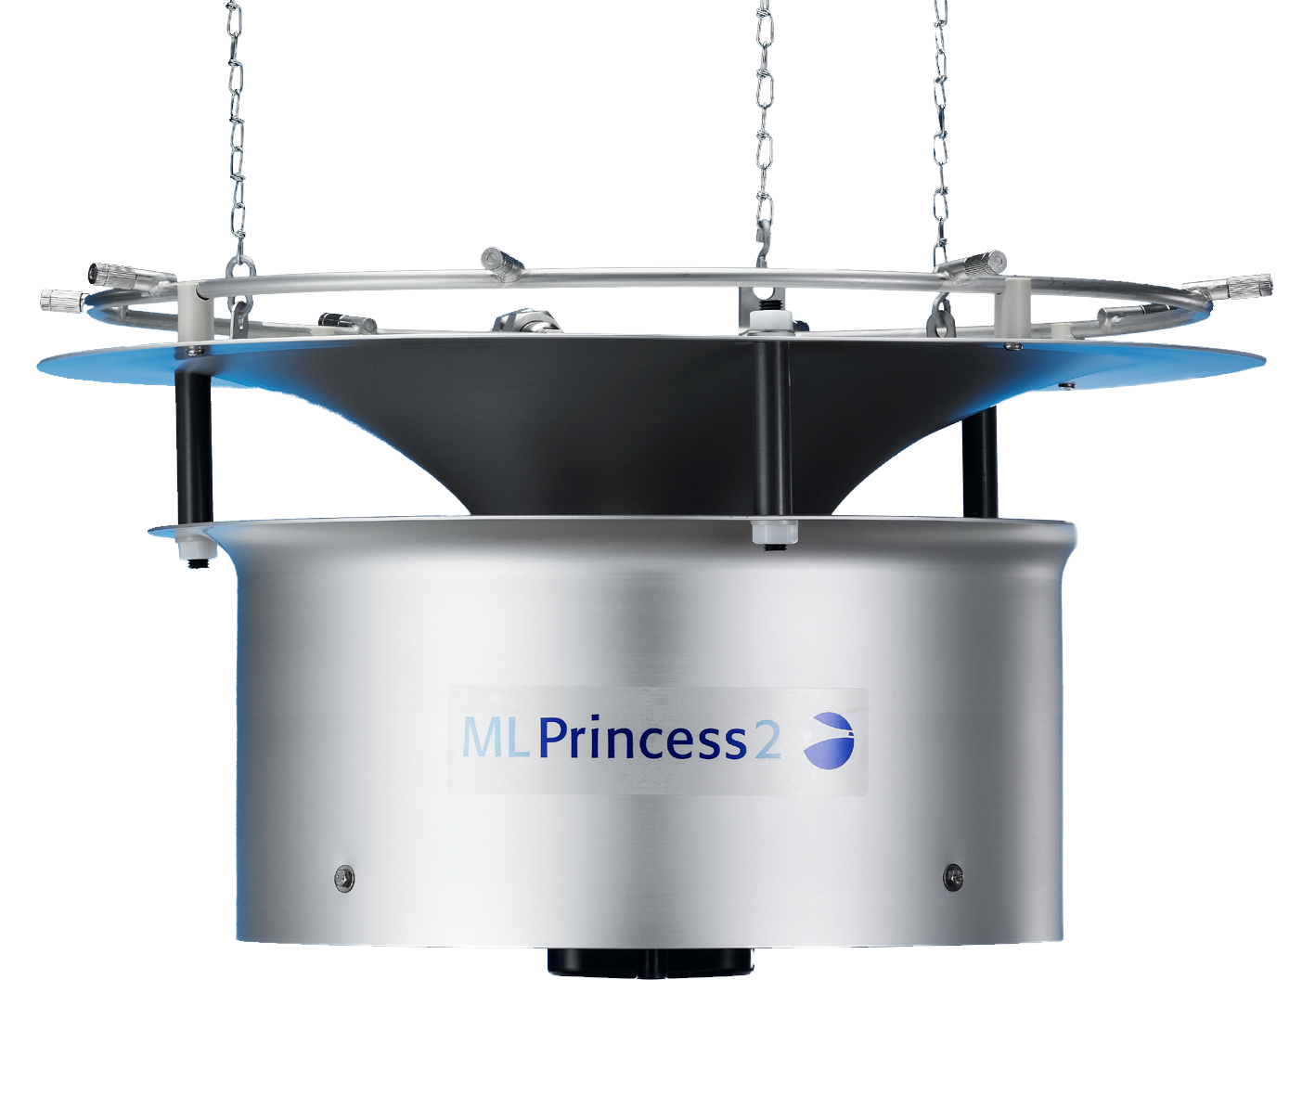
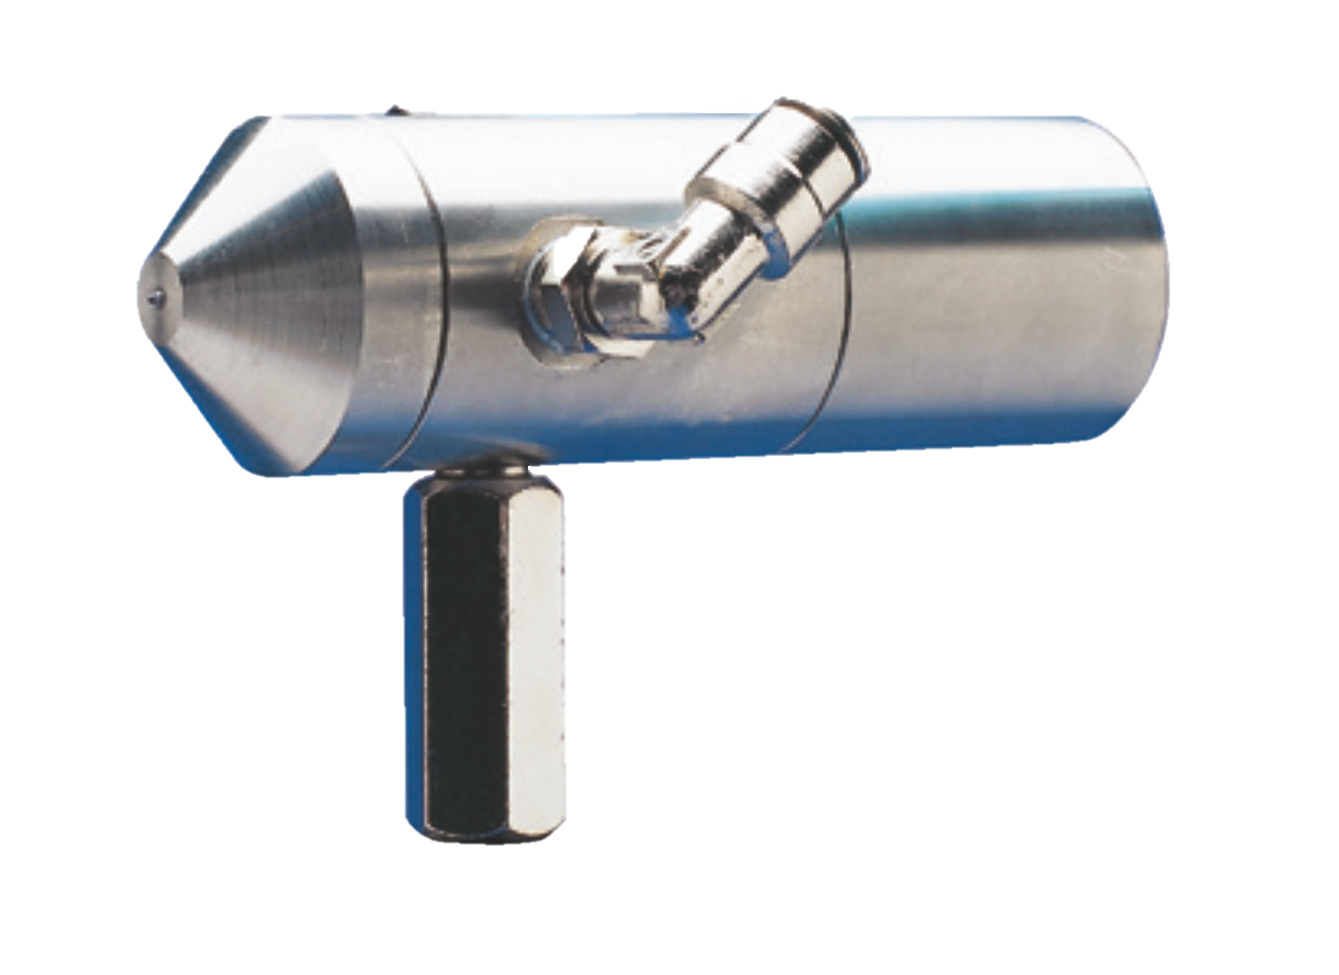
Woodworking
Applicable Technologies
*compressed air typically available on site for woodworking facilities.

Slide 38
Thank you!
na.applications@condair.com

