Slide 1
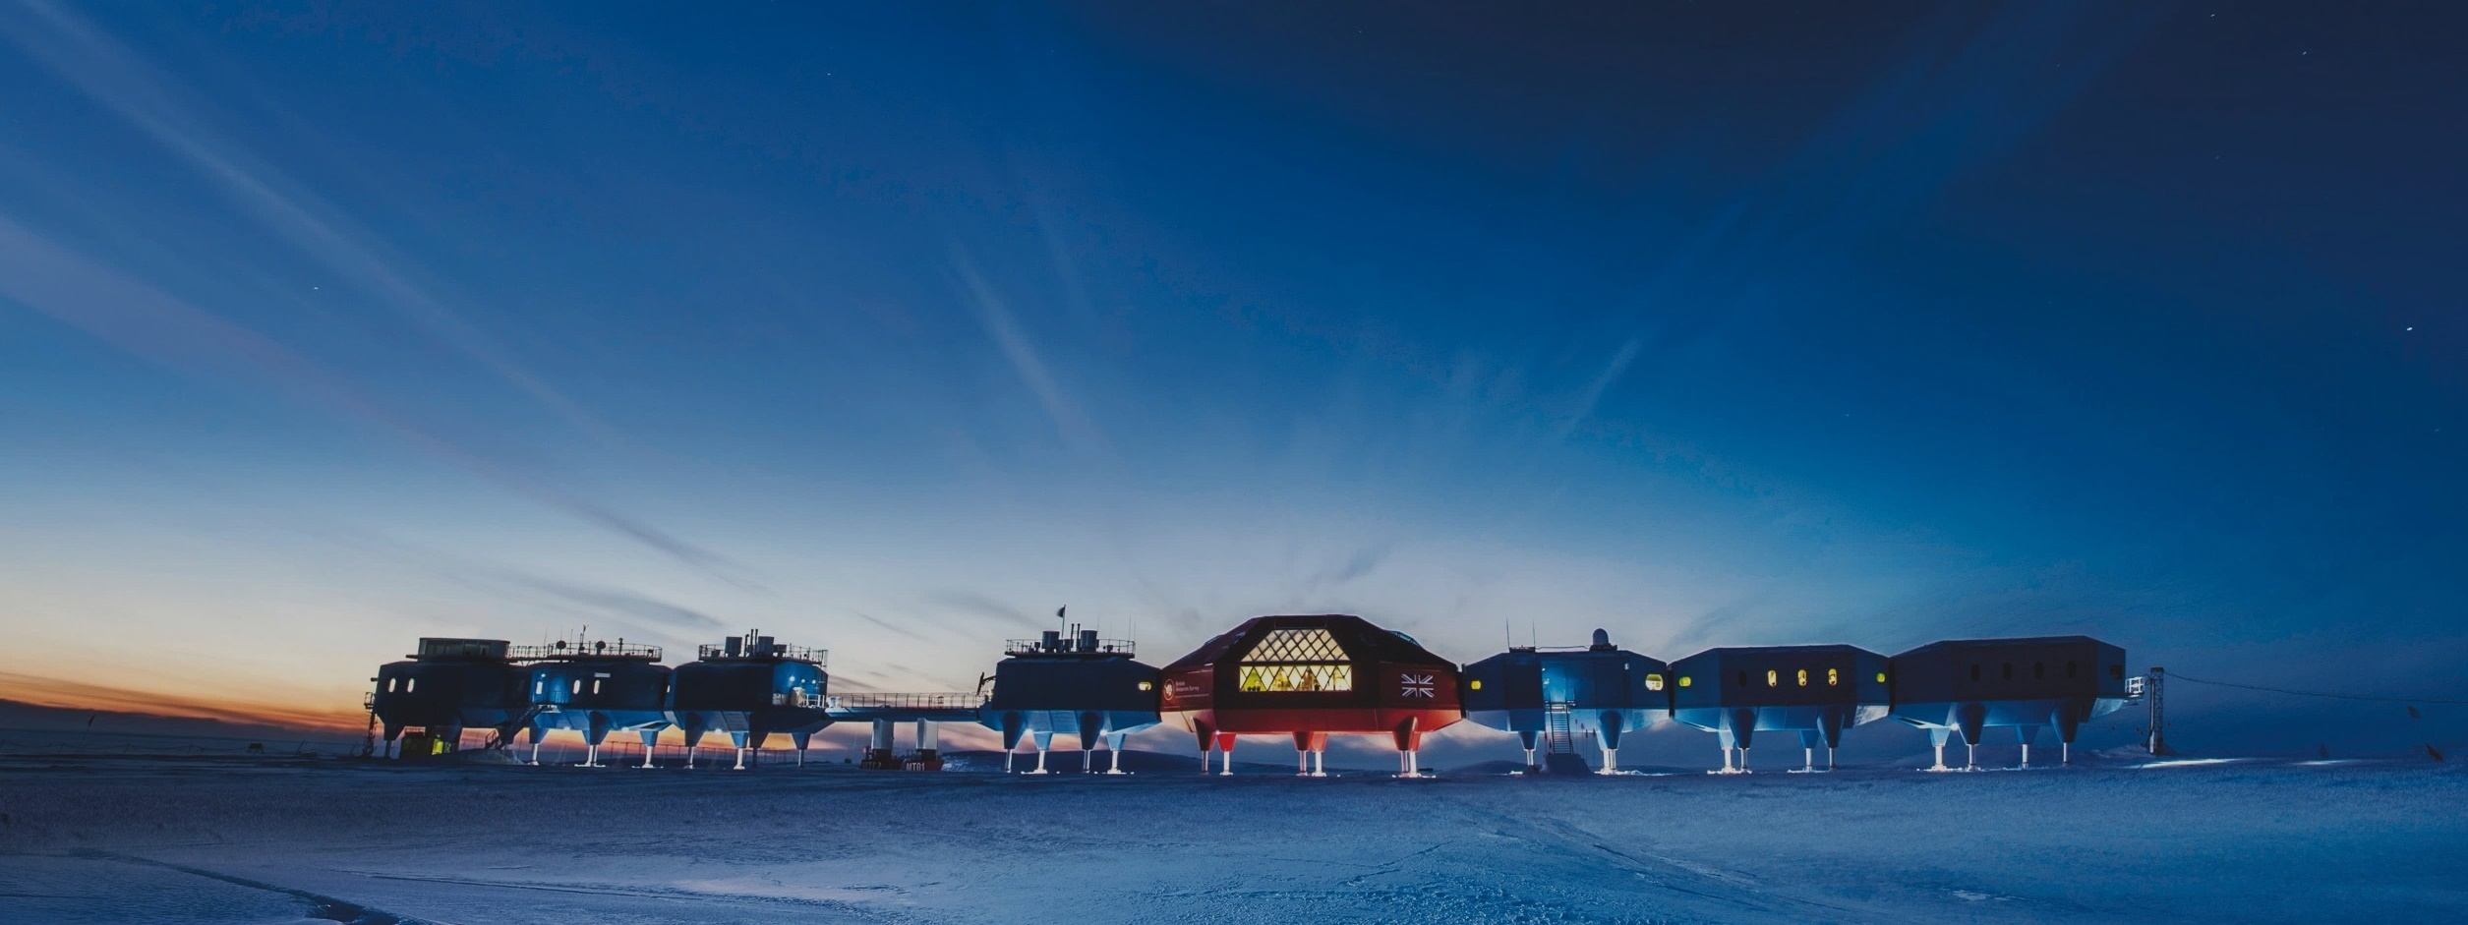
Extraordinary Service for Extraordinary Customers
Condair Service Introduction
Dave Fuson

Slide 2
Agenda
Our Service Theme
Service Basics Concept
Customer Expectations from Service
How do we improve upon a working model?
Future Service Enhancements (One Year Vision)

Slide 3
Our Service Theme
Extraordinary Service For Extraordinary Customers!

Slide 4
Service Basic Concepts
Provide customers a reliable solution for:
Installation
Commissioning
Parts sales
Maintenance
Troubleshooting assistance for customers onsite
Training

Slide 5

Customer Expectations from Service
Trouble free installation, commissioning, or repair of Condair products
Professionally trained service reps on site
Questions or concerns answered as expeditiously as possible
Effective communications with customers
Collaborative efforts by agents and service to form an effective team
Immediately addressing issues and providing viable solutions

Slide 6
How do we improve upon a working model?
Network with agents to understand what common issues are occurring in the field
Offer service packages to simplify order intake, processing and tracking
Simplify the internal processes
Offer Condair service as a tool to be used by agents for greater sales
Use empathy when dealing with customer concerns
Provide a comprehensive training and troubleshooting guide
Use of new technology tools to assist customers

Slide 7
Future Service Enhancements (One Year Vision)
Training facility in Racine serving NA customers
Restructure of service organization to meet and exceed growing business needs
Using technologically advanced tools to save Condair and agents time and money when service is required
Offer easy to understand and calculate service packages
Repair and exchange programs for commonly serviced items

Slide 8
Thank you for your time and attention.
Dave Fuson
David.Fuson@condair.com

