Slide 1

Adiabatic Humidification
Condair Ltd.
www.Condair.com

Slide 2
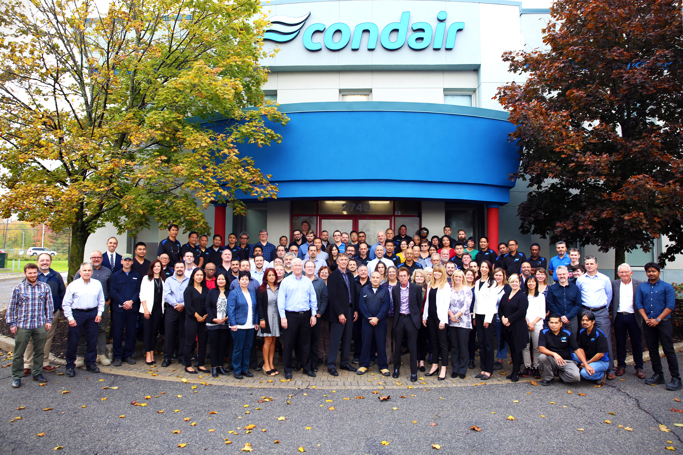
Agenda
Adiabatic Humidification
Introduction to Humidity
Product Overview
      Isothermal
      Adiabatic
      Water
Adiabatic Opportunities
Key Takeaways + Q&A
Notes:
We are excited to be here and happy to discuss any areas/topics. We have an overview presentation we may walk through outlining Humidity, Humidity and Health, Condair products as well a great tools and resources Condair has available to assist when considering and selecting a humidification control technology. With this, may there be any topics/ areas you would like to discuss?

Slide 3


1
Introduction to Humidity

Slide 4
Introduction to Humidity
Humidity vs. Temperature
Absolute Humidity is measured by mass (gr/lb, g/kg)
Relative Humidity is relative to temperature (%)
1 lb (0.5 kg) Air
35°^{F} (2°^{C})
30 gr (2g/kg)
1 lb (0.5 kg) Air
72°^{F} (22°^{C})
30 gr (2g/kg)
Sensible Heating
100% RH
25% RH
2024
4
Notes:
Define humidity in 2 different ways:
Absolute humidity – MASS of moisture in the air (absolute terms). Mass of Moisture contained in Air if we were to WRING the water out.
Relative Humidity – is a measure of %, % of water air is currently holding compared to how much is Could Actually Hold. Eg 50% RH notes air could hold 2X current amount.
RH IS RELATIVE TO TEMPERATURE
Quick Example:
Fully saturated, air can No longer hold moisture
APPLY HEAT (Sensible heat change the temperature of the substance without changing the phase of the substance.)
NO other Variables Changed. Only heat/temperature which resulted in Lower RH
WARMER AIR HOLDS MORE MOITURE THAN COOLER AIR

Slide 5
Introduction to Humidity
Humidity vs. Temperature
Absolute Humidity
100% RH
120 gr (8g/kg)
25% RH
30 gr (2g/kg)
35°^{F}
(2°^{C})
72°^{F}
(22°^{C})
120°^{F}
(49°^{C})
Temperature
2024
5
Notes:
Plot this example on a chart
Horizontal axis temperature starting at 35F moving up in temperature. Vertical Absolute Humidity with 30 grains and 120 grains plotted
From initial condition 35F and 30 grains can plot a curve for 100% RH.
Draw same curve at 25% RH Once we have Heated Air Up to 72F.
Drawing a Psychrometric Chart. As long as you have any 2 parameters where the lines will cross each other, you can determine all other parameters.

Slide 6
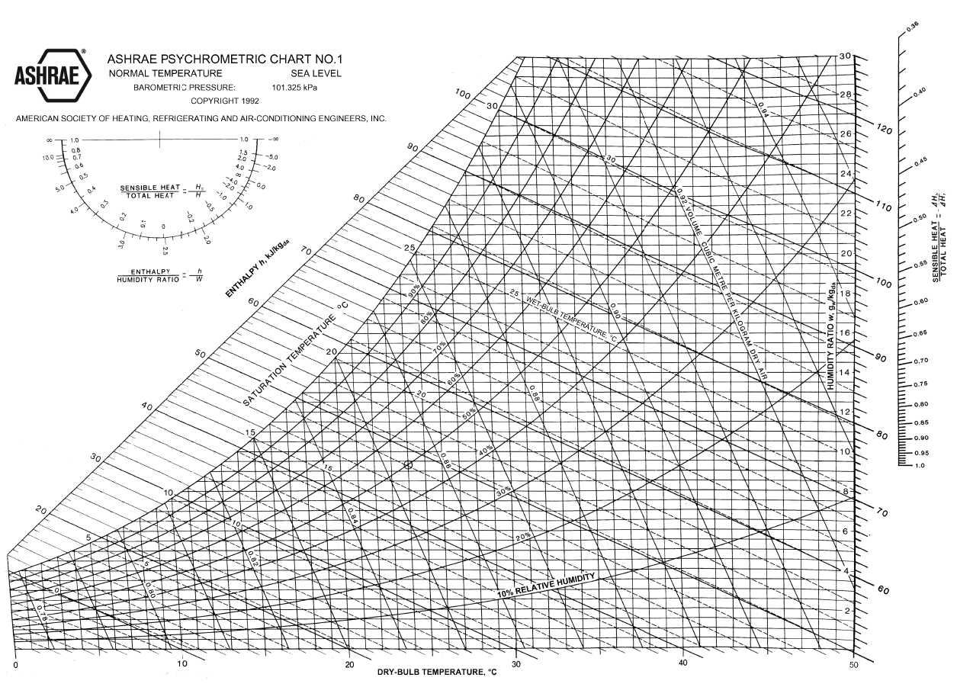
Introduction to Humidity
Psychrometric Chart

Slide 7
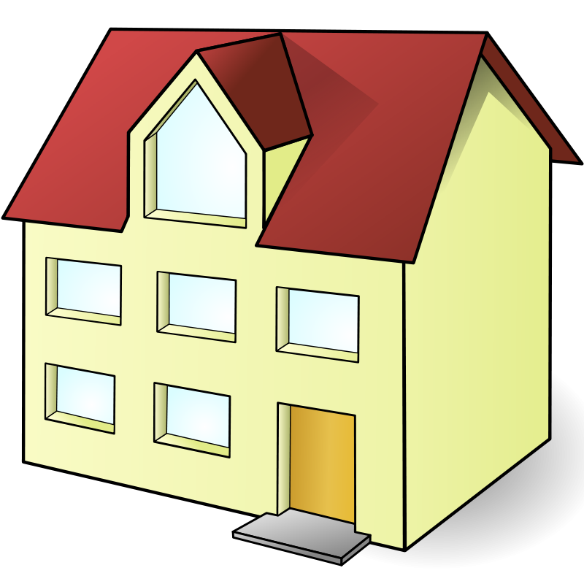
Introduction to Humidity
Why Buildings get Dry
Outside air with low absolute humidity dries building
Sensible Heating
Outside Air
6°F (-14°C)
53% RH
4 gr/lb (0.6 g/kg)
Inside Air
70°F (21°C)
4% RH
4 gr/lb (0.6 g/kg)
Ventilation
In/Exfiltration
2024
7
Notes:
Another example of why building dry our and look at Psychometrics of what is occurring
Outside air is Cool/Cold 6F, at a nice mid range RH% of 53 and corresponds to absolute humidity of 4 grains/lb
Bring this air into building through Mix of Ventilation and Infiltration/Exfiltration
Building needs to be warmer than 6F to be useful/comfortable -> air is Heated up when brought into building -> result of the heat is conditions inside building become DRY we see to 70F corresponds to 4%RH (desert Like) and Absolute Humidity stays same.
Result is any time bring in Outside Air with LOW Absolute Humidity will have a DRYING effect on building. Buildings dry out when outside is drier than target levels (interior design conditions)
Typically occurs in Colder Months when outside Air does not hold very much Absolute Humidity and bring Into Building with Much Warmer Air that Will hold More Moisture. SEE LARGE RH DROP

Slide 8
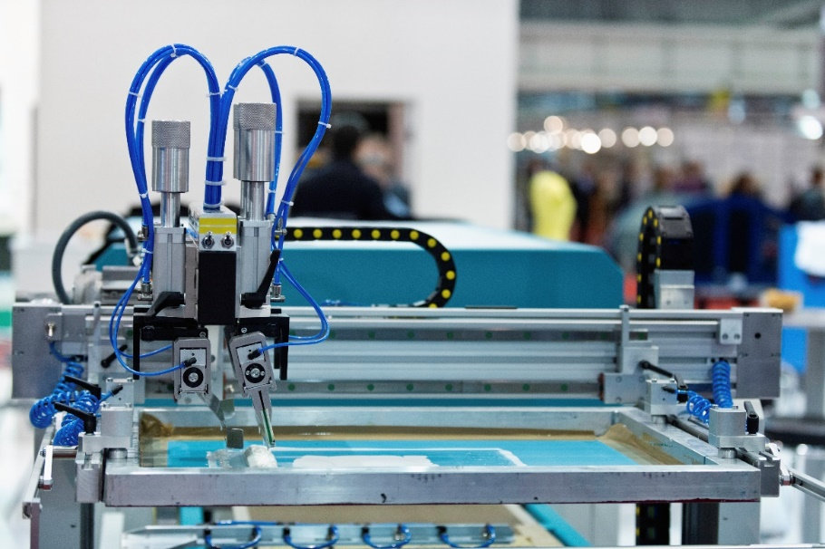

Introduction to Humidity
Is Dryness a Problem?
Manufacturing and Processes
Human Health and Wellness
iStock: 000030384618X
Licensed from www.peopleimages.com
Notes:
Manufacturing and Process – to performance and efficiency. $

Slide 9
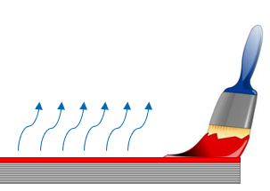
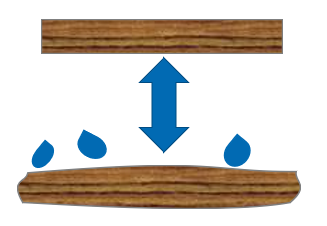
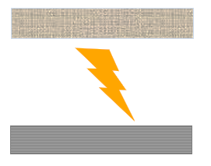
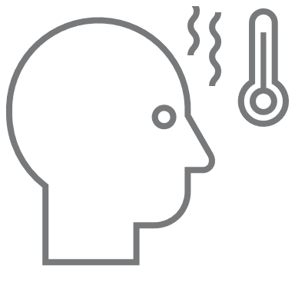
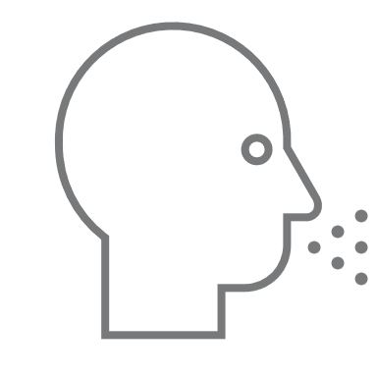
Introduction to Humidity
Is Dryness a Problem?
 | Evaporation Rates | Hygroscopic Materials | Static Charges | Human Health and Wellness
Effects of low rh | Water based sprays / paint Shrinkage Adhesion Runs / Drips | Dimensional instability Cracking / deterioration Coating delamination | Component damage Static cling Unpredictable spray pattern Paint Defects Ignition of volatile compounds | Eye discomfort Thermal discomfort Vocal cord irritation Decreased cognitive function Decreased immune function Increased transmission of cold/ flu
2024
9
Notes:
40-60%

Slide 10
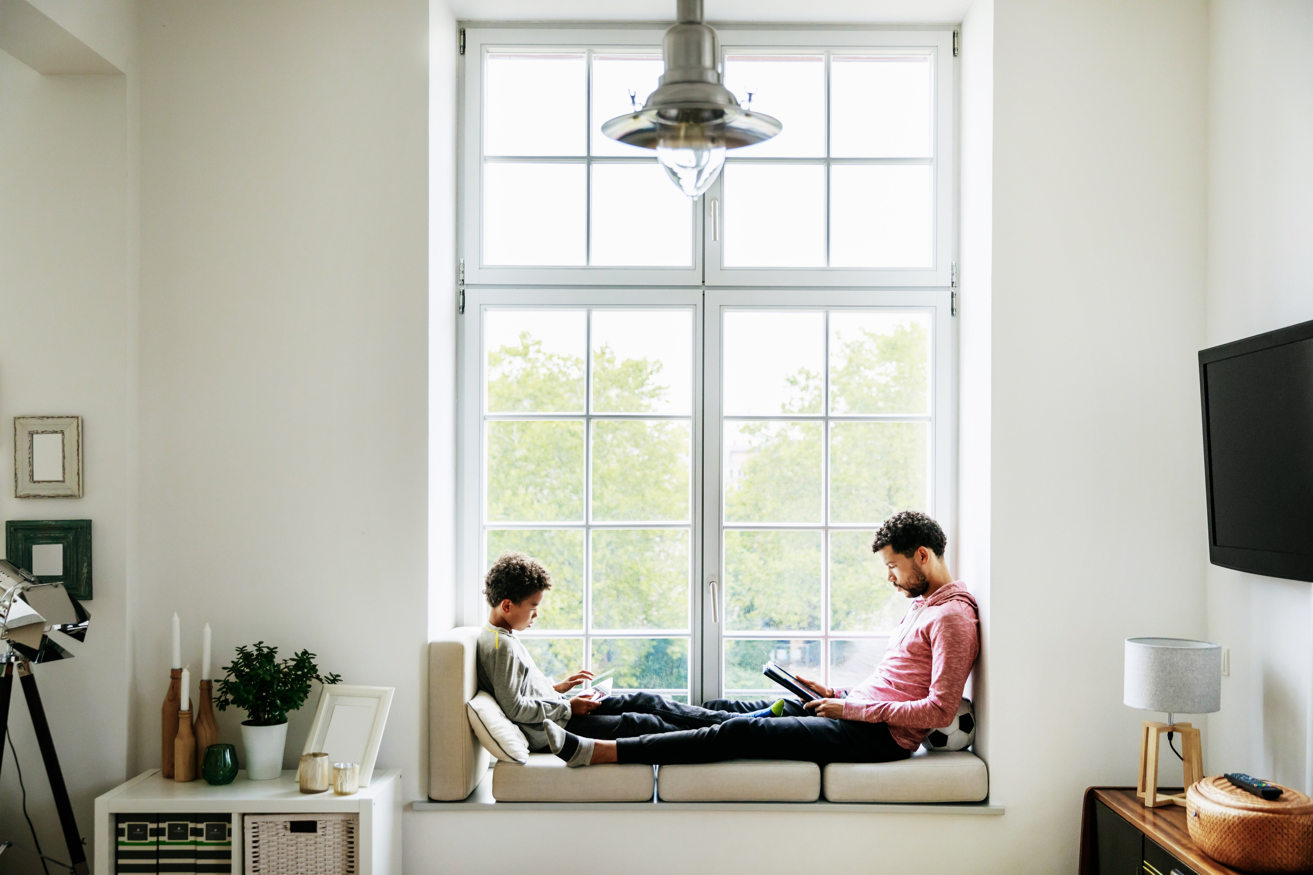
Does anyone know the ideal range for indoor rh% for human health/wellness?
2024
10
Notes:
40-60%

Slide 11
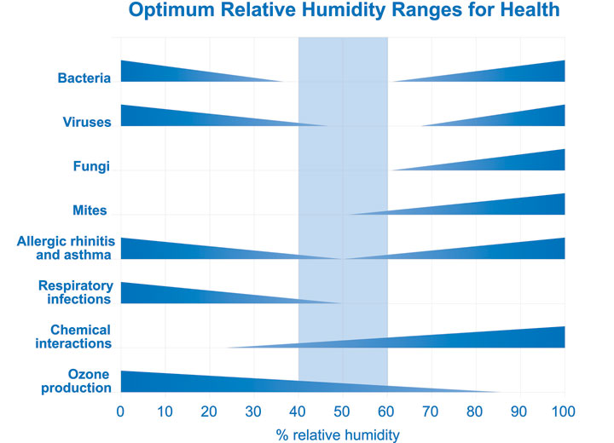
Introduction to Humidity
What Does ASHRAE Say?
The Sterling Chart
  Common design reference
  Optimal mid-range 40 - 60%
ASHRAE Standard 55
  “There are no established lower-level humidity limits for thermal comfort, consequently, this standard does not specify a minimum humidity level.
  NOTE: Non-thermal comfort factors such as skin drying, irritation of mucous membranes, dryness of the eyes, and static electricity generation may place limits of the acceptability of very low humidity environments.”
2024
11

Slide 12
Introduction to Humidity
Summary
Buildings dry out when outside is colder than target levels
Humidity affects processes
Humidity affects occupant health
Optimum indoor range for occupants: 40 – 60% RH (and 20°^{C} – 23°^{C}, <1000 ppm)
Planning for humidity helps achieve great results
2024
12

Slide 13


2
Product Overview

Slide 14
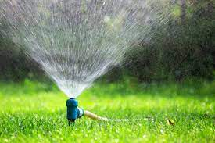
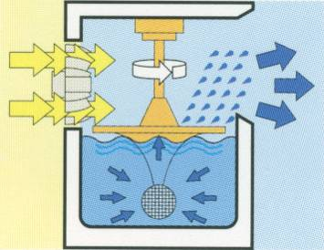
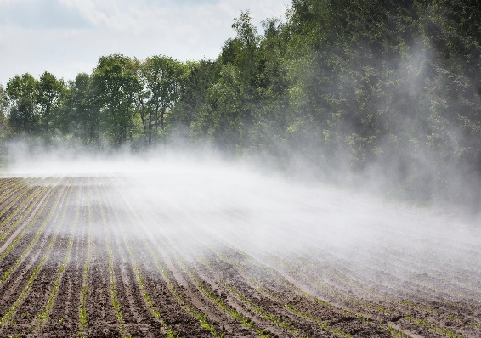
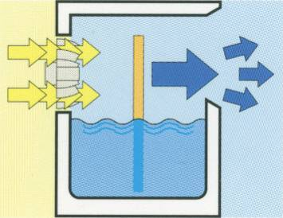
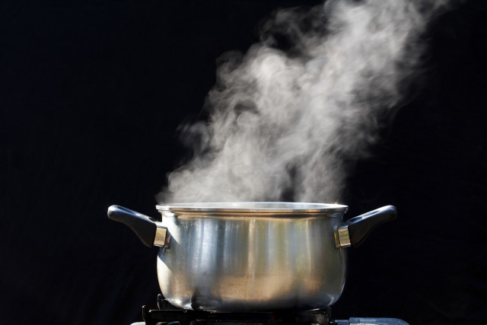
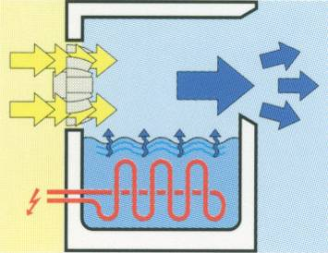
Product Overview
Types of Humidification
Atomization
High Pressure
Nozzles
Ultrasonic
Hybrid
Evaporative Media
Adiabatic
Evaporation
Gas Steam
Electric Steam
Resistive Element
Live Steam
Isothermal
Vaporization
Notes:
Isothermal – involving or possessing a constant temperature. (We add energy (electricity or gas) to boil water/ vaporize. Air temp stays the same.) Very hygienic.
Adiabatic – relating to or denoting a process or condition in which heat does not enter or leave the system concerned. (Air temp changes. No energy added. Energy comes from the Air to perform phase change (liquid to vapor)) humidification and cooling because when water evaporates, it’s pulling the energy from the air which we sense as a change in thermal energy (sensible cooling), or temperature (~1000 BTU/lb to change phase from liquid to gas)
Atomization is the process of water becoming atomized into fine mist (via pressure (nozzle system HP/ML) or high frequency vibration US)
Evaporation is the process of air moving across a liquid. Provides cooling and humidification. Wet pad (ME/MC)

Slide 15
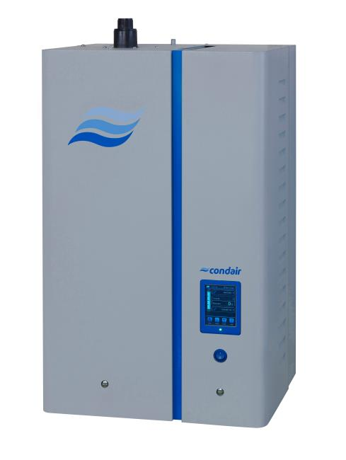
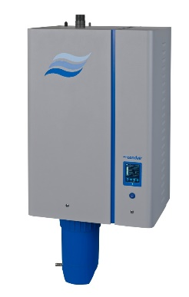
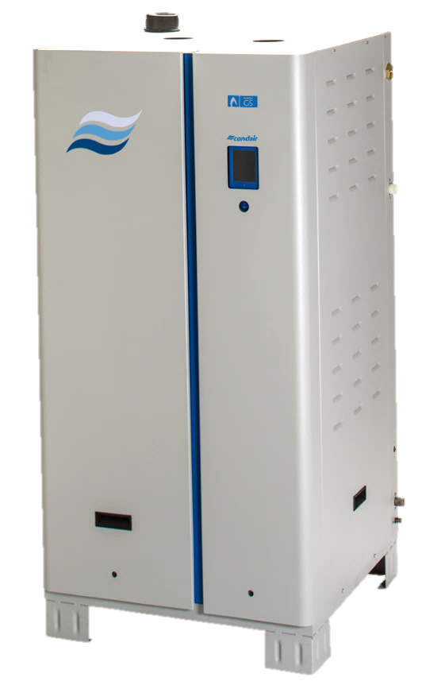
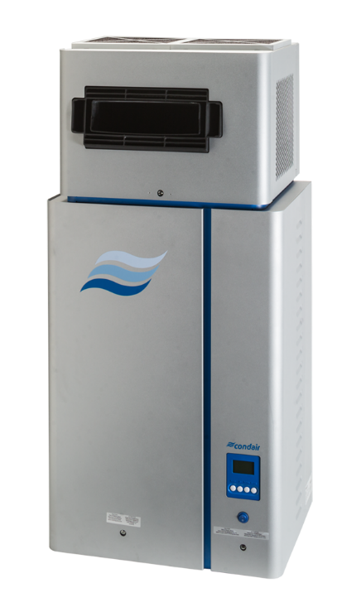

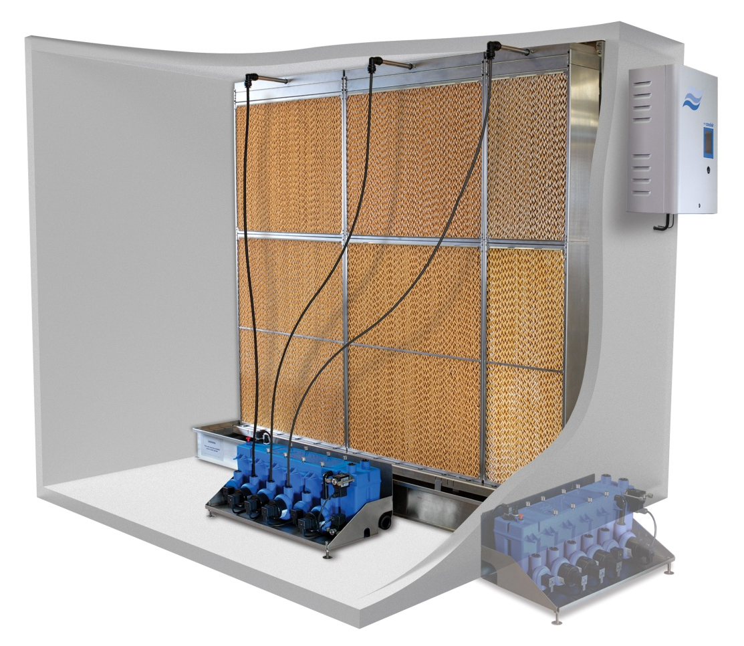
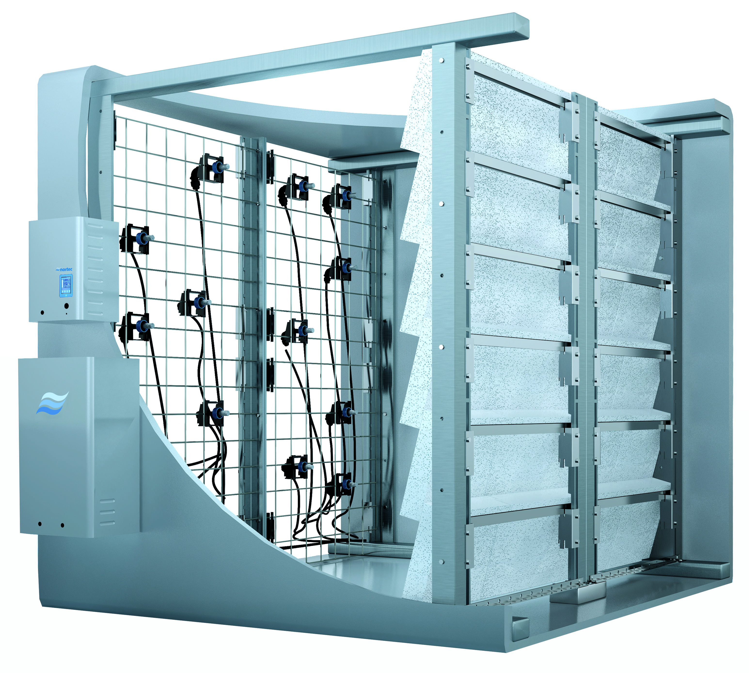
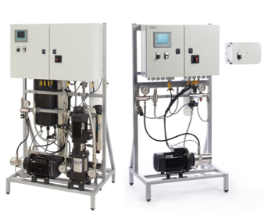
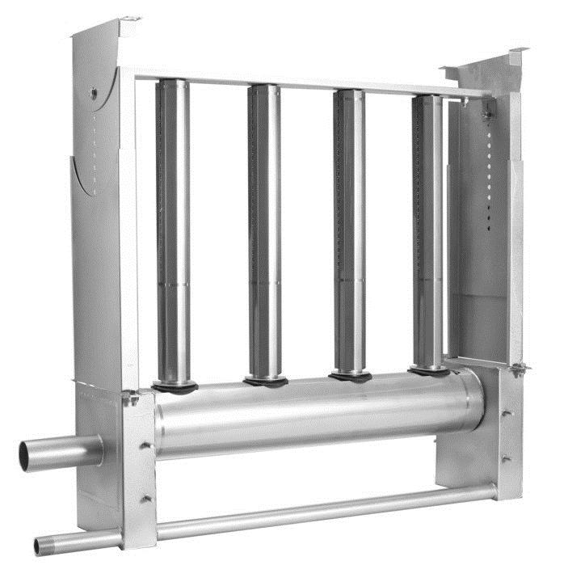
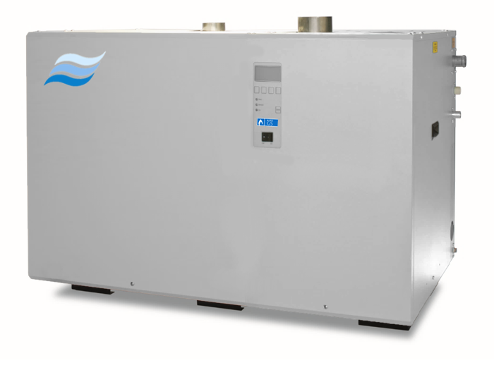
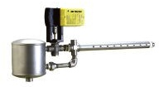
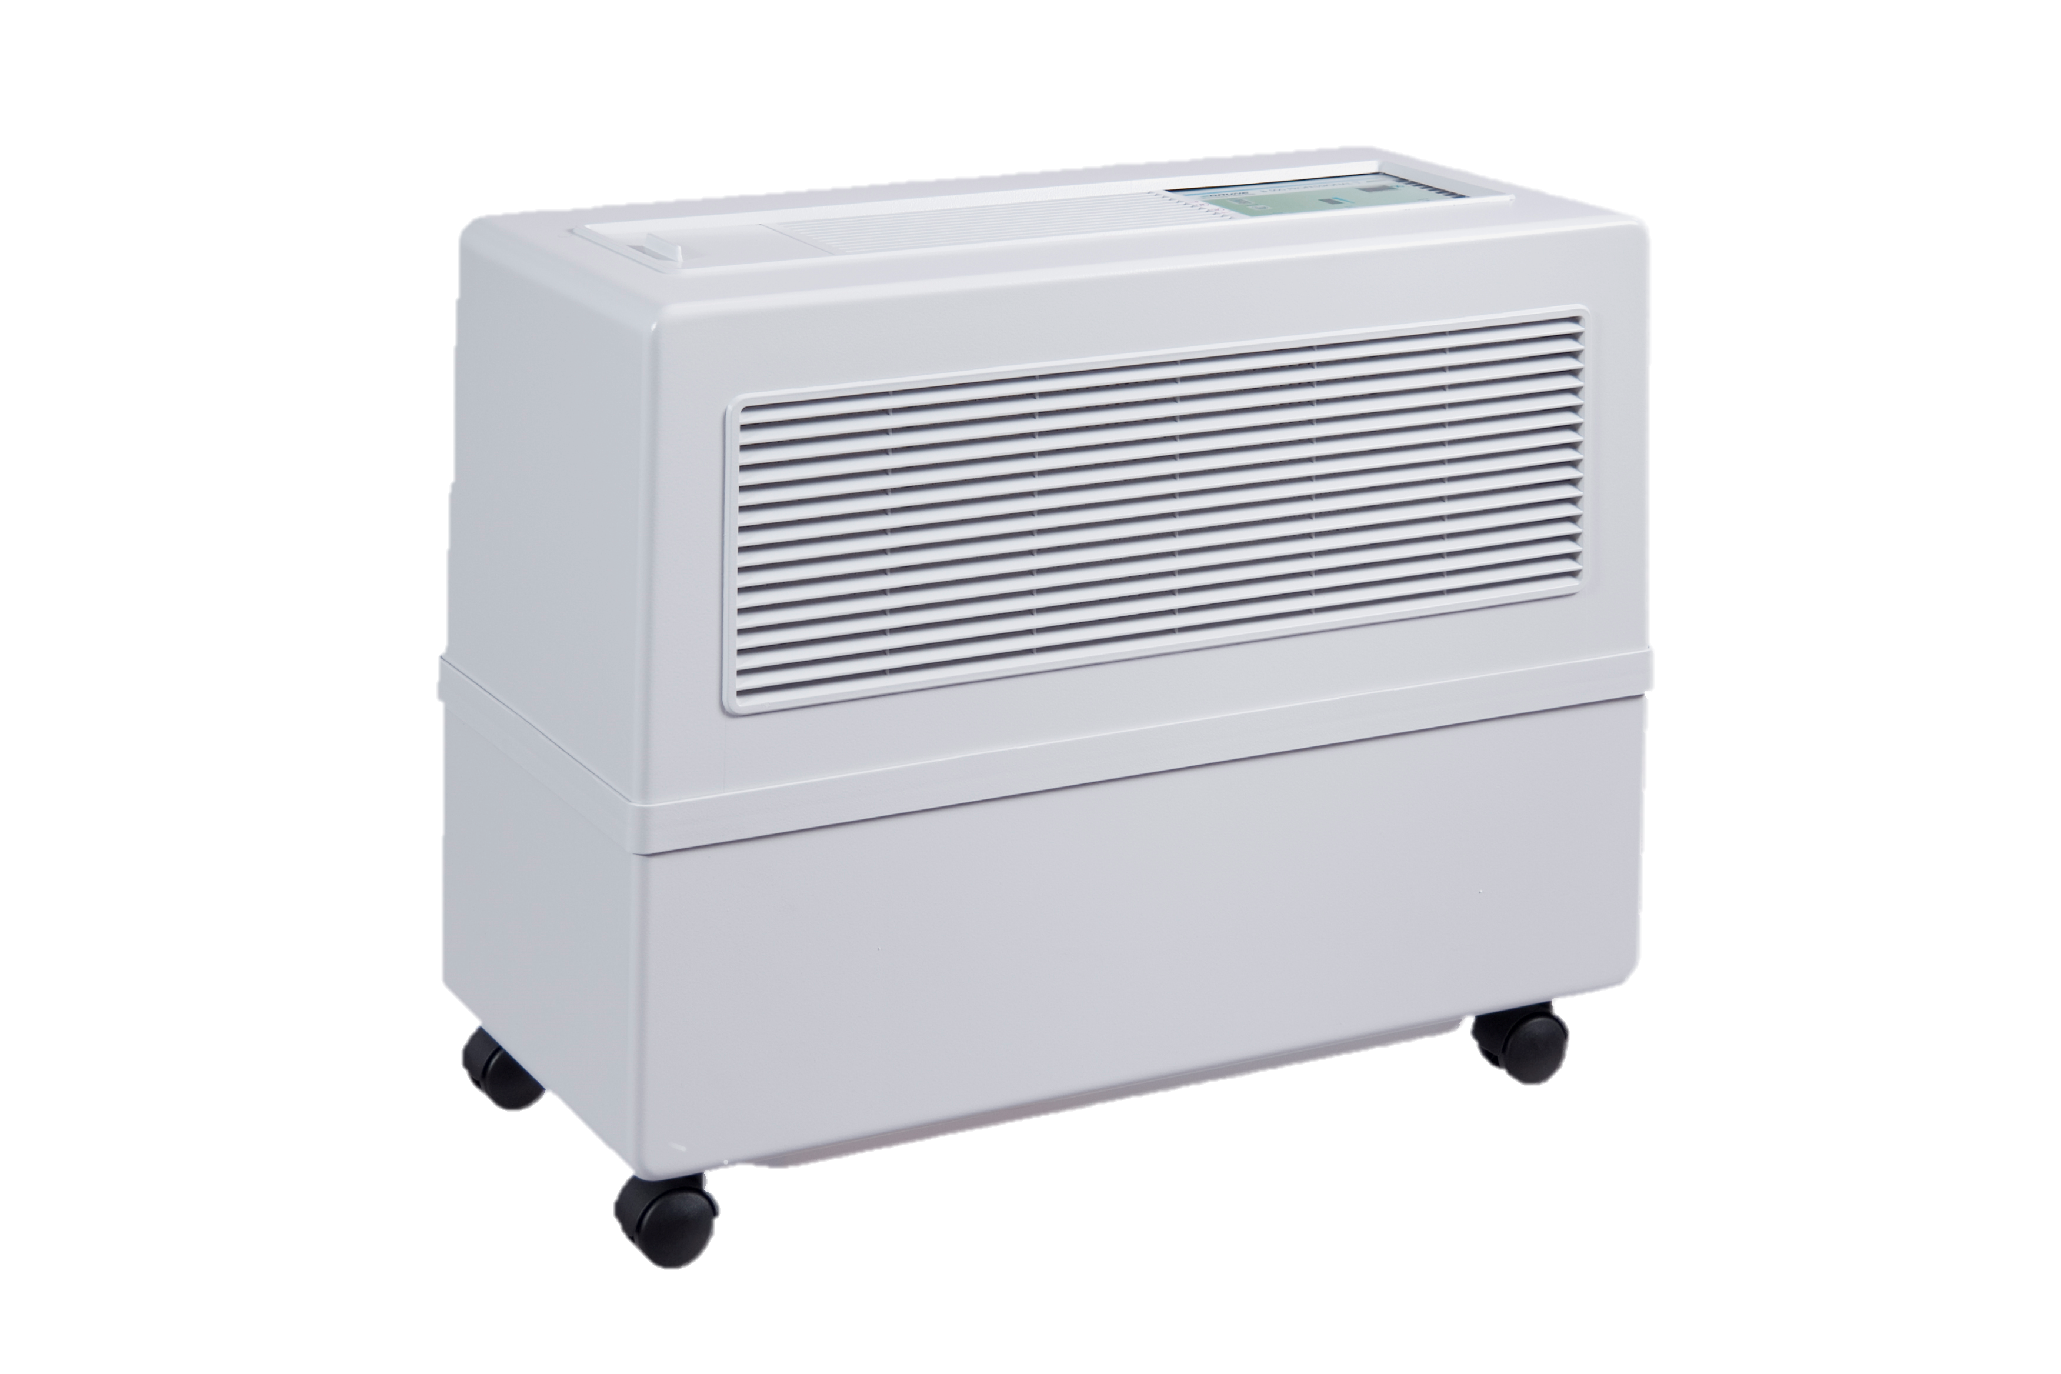
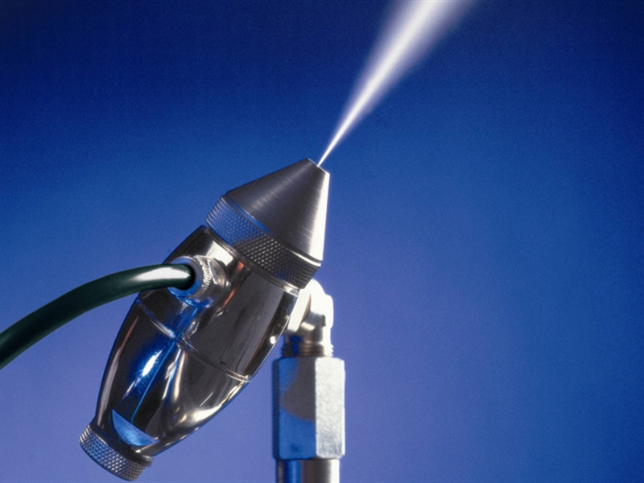
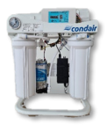
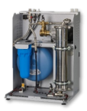
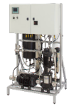
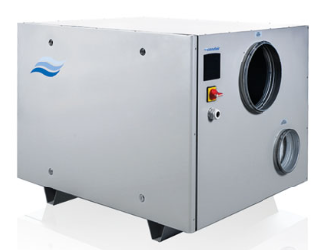
Product Overview
Condair Products Portfolio
Isothermal
Adiabatic
EL
RS
GAS
Distribution
Central steam
ME/ MC
US
DL
HP
ML/ DRS
```
Live Steam
Steam-to-steam
SAM-e
Dehumidification
Water Treatment
B500
JetSpray
DA
RO-H
RO-A
MLRO
Notes:
Condair is a solutions based company.
Shows Condair diverse Product technology portfolio
Condair focuses on end use customer and their specific application needs. Condair has a complete portfolio of Humidification, evaporative cooling and dehumidification products that enables/assists tailoring a solution to the requirements.

Slide 16
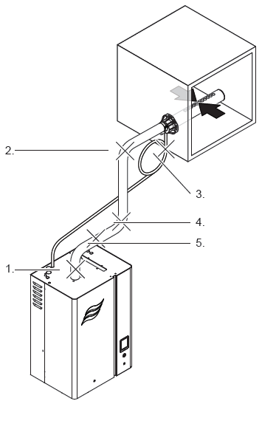
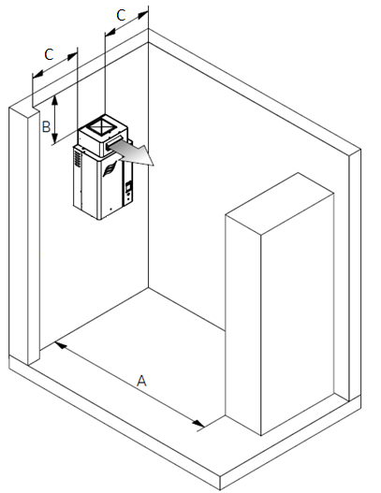
Product Overview
Isothermal Technologies
Overview
Steam humidity source
Clean, atmospheric* steam (*excluding LS which is pressure steam with LS tubes)
Highly specified and reliable technology
Complete packaged products
Easy installation
Simple to order
Complete enclosure/ cabinet, plug and play
Exception: LS which requires some assembly on site

Slide 17

Product Overview
Isothermal Summary
 |  | In Space | In Duct | Benefits | Considerations
Isothermal | EL Series (Electrode) | X | X | Easy maintenance (replaceable cylinder) Highest electrical efficiency (~98%) Patented auto-adaptive cycle Low first cost | Specific water quality requirements Only up to 200 lb/hr on a single unit
 | RS Series (Resistive Element) | X | X | Can use potable, RO or DI water Patented Scale Management option High-Precision Option Maintenance features | Only up to 180 lb/hr on a single unit
 | GS Series (Gas-Fired) | X | X | High Efficiency, low-cost Gas SCAQMD low NOx Large capacities (50-600 lb/hr) Can use potable, RO or DI water | Gas Regulations Requires gas/ supply air connections
 | SE Series (Steam Exchange) | X | X | Economical operation by leveraging existing on-site energy source Boiler chemicals are contained and ​ returned to boiler Large capacities (50-1050 lb/hr) | Easy maintenance (replaceable cylinder)
 | LS Series (Livesteam) |  | X | Lowest first cost and economical operation High accuracy Large capacities (0.5-3250 lb/hr) Minimal maintenance | Potential carryover of any boiler steam chemicals/ contaminants
Notes:
THIS SLIDE IS 5 PRESENTATIONS IN 1
Electrical Grid: Good plant is 30-40% efficiency.
EL
3 cabinet sizes
Turn down to 25%.
EL model works on an electrode heating principle. Very Efficient process (~98%). Require Potable Water – within water quality requirements (Conductivity: 150-750µS)
The electrode boils water by passing electrical current through it. The more current passes through the water, the greater the steam production.
The amount of Current and steam production is dictated primarily by water conductivity (dissolved solids). High conductivity through higher mineral level the more current pass through the water and more steam generated. To maintain an accurate output, need to control the conductivity in the water. This is regulated through water level in cylinder and drainage of over concentrated water and replacement with fresh water. Optimal conductivity level.
We accomplish this through Auto Adaptive Cycle. Algorithm calculates and regulates the water level in the cylinder (water conductivity) to maintain optimal amp draw ( = steam production) across a 36 seconds Boil Down Cycle (optimal).
Adaptive cycles reduces water usage (only drain/fill required), energy and maintenance as increase life of cylinder.
EL Lowest Cost Option, Easy to Install, east to Maintain.
Maintenance:
Cylinders are disposable and can be used up the certain number of hours.
Typically, the cylinders can be used between 500-2000 hours at full capacity.
The life expectancy will also depend on the water quality (grains/gallon of hardness).
RS:
The electrical energy is converted to heat due to the resistance of the heating elements to the current flow
Water in the tank begins to boil from conductive heat transfer from the heating elements to the water
Steam output is controlled by applying more or less heat to the water rather than controlling water level or conductivity. No reliance on water conductivity can use all potable, RO and DI (assists with maintenance)
This results in ability for more accurate humidity control. Demonstrated with the SSR
SSR: This adds the solid state relay after the contactor going to high voltage. What it allows us to do is to allows us to modulate the controls much faster. For regular contactor version, when we are modulating We are doing it on 120 seconds duty cycles. When there is call for 100% humidity, your contactor always pulled in. if you are doing at 50% humidity, the contactor engages for 60 seconds and disengages for other 60 seconds. Using that process we can achieve +/- 5% RH. With SSR, we are cutting down that 120 seconds to 2 seconds so we are now 1 second off and 1 second 1 on. By doing this, we can control the amount of water that we are boiling much more precisely. And using the right controls we can control +/- 1% humidity in space. Quick response time. good for 100% OA (large rapid swings in demand)
Scale tank
Also, easier to control heat to water than conductivity in water. Assist with control accuracy and Modulation. Modulates between 4-100%
GS
It has large capabilities but is very economical in its operation. The capacity goes up to 600 lb/hr for a single unit and won’t use a lot of energy.
It is a complete packaged product
Three different efficiency models as well as the outdoor cabinets.
The main benefits in terms of operation are that we have the true condensing high efficiency options.
Low NOx model is South Coast Air Quality Management District certified.
New venting options. With the condensing units you can use CPVC venting which is much more economical.
There are increased energy savings from high efficiency models, and you can use all three water options with the GS. Potable, RO and DI.
SETC:
Many applications still use live steam as there are applications where facility boiler steam is readily available and used for other processes in the building
The SE ensures that none of the chemicals or impurities in the boiler steam or pressure loop are introduced into the air stream
The smaller SETC50 can be ceiling mounted (ex. Installed in the ceiling above a hospital OR)
The capacities listed are based on a steam supply pressure of 15 psi (min. 5 psi and output is derated at lower pressures)
LS:
LS tubes are a jacketed tube design that has a pre-heat loop to prevent spitting and evaporates any condensate that forms within the dispersion tube– this requires quite a bit more work for installation and plumbing but means there is no need for an atmospheric condensate drain (except on live steam SAM-e’s)
All parts are shipped loose and require installation on site – interconnecting piping is NOT supplied by Condair
Multiple LS tubes can be combined to reduce absorption distance but requires multiple duct penetrations and additional field piping
LS tubes spray into the direction of airflow to help reduce downstream absorption distances

Slide 18
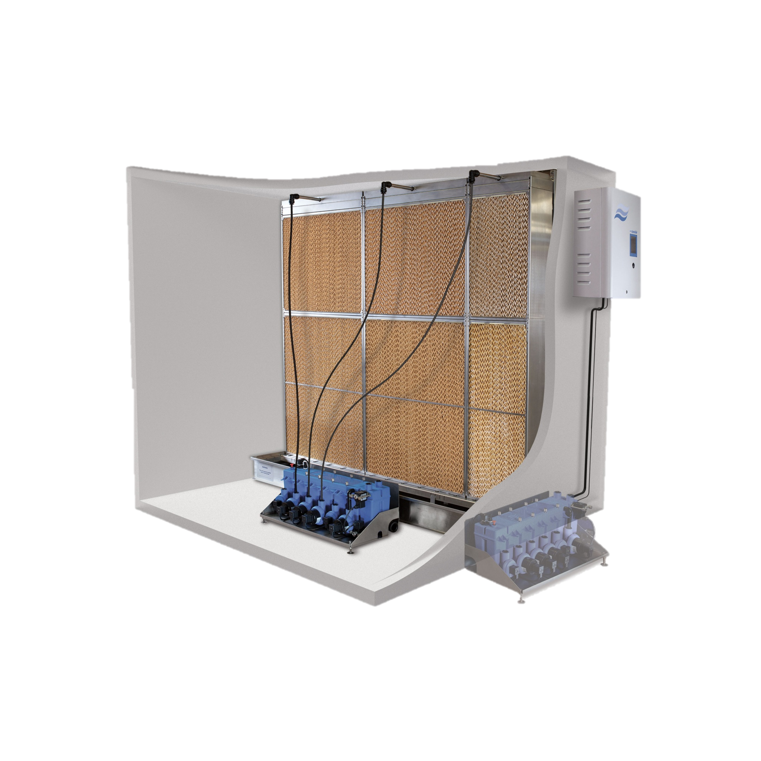
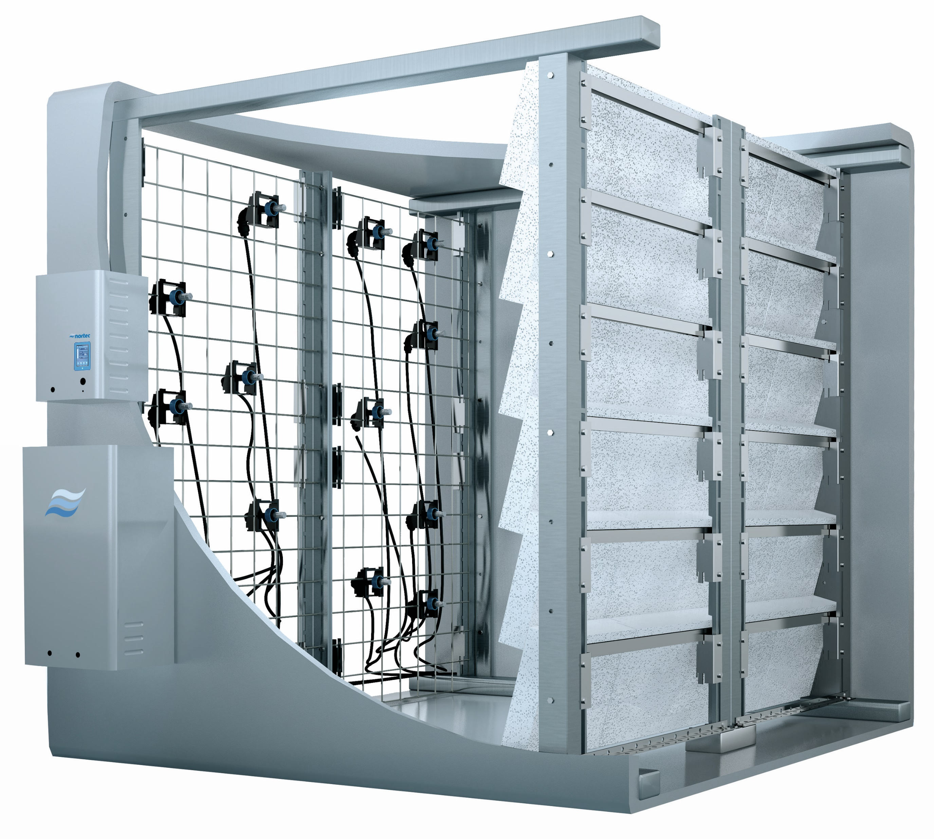
Product Overview
Adiabatic Technologies
Overview
Cold Water Humidification
Evaporative Cooling
Low operating costs
Hygiene Features
Condair Products are equipped with many hygiene features to ensure clean operation. These include:
    Silver ion dosing
    UV light
    Water Treatment

Slide 19
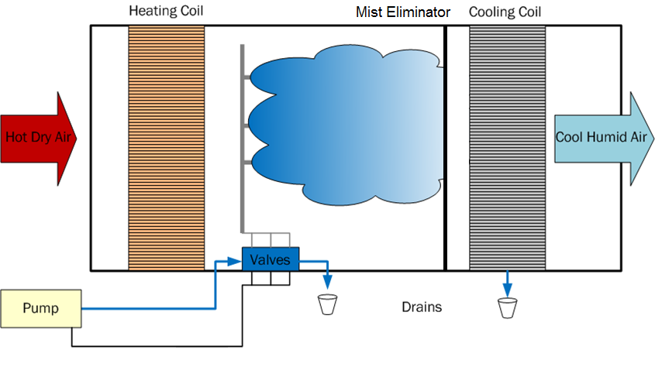
Product Overview
Evaporative vs. Atomization
The Most Efficient Adiabatic Cooler
Short Installation Distance
Hot Dry Air
Cool & Humid Air
Requires a longer Absorption Distance
+/- 2% accurate control
+/- 10%rh Control
ME Series
Media Evaporative
HP Series
High Pressure Atomization
Notes:
Evaporative: water is pumped to the top of the media pad and flows down with gravity. It collects in the tank and is recirculated. As air flows across the media, water pulls energy from thew warm, dry incoming air, to evaporate. The water is then absorbed into the air stream which is cooled and humidified. Evaporative humidifiers are the most efficient coolers.
High pressure: water is treated by RO and distributed into the duct using high pressure nozzles. And similarly to the evaporative system, The water is then absorbed into the air stream which is cooled and humidified. High pressure systems generally have a very high control accuracy

Slide 20
Product Overview
Hybrid Technology
DUAL Technology Humidifier:
Atomization + Evaporation
Notes:
the DL combines both atomization and evaporative technologies with low pressure nozzles and a porous ceramic media. This is why we call it the DUAL system. The DL Features the advantages of both technologies while solving the challenges these technologies face on their own: mainly installation length, and controllability.

Slide 21
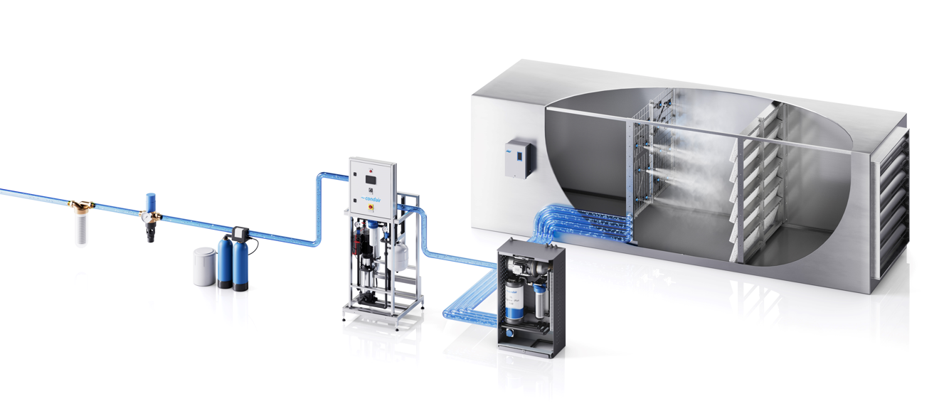
Product Overview
Condair DL Series
Nozzle Grid
43.5 psi – 101.5 psi
Ceramic Media
Filter
Reverse Osmosis
Required
Backflow Valve
Softener
VFD Booster Pump
HygienePlus System
Patented silver ion dosing of supply water

Slide 22
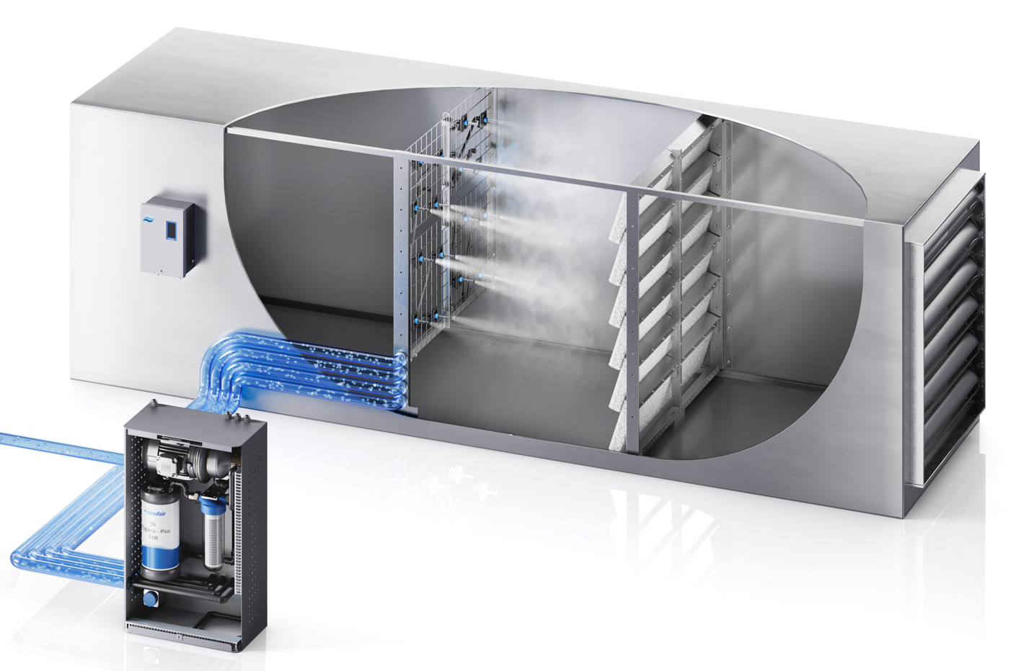
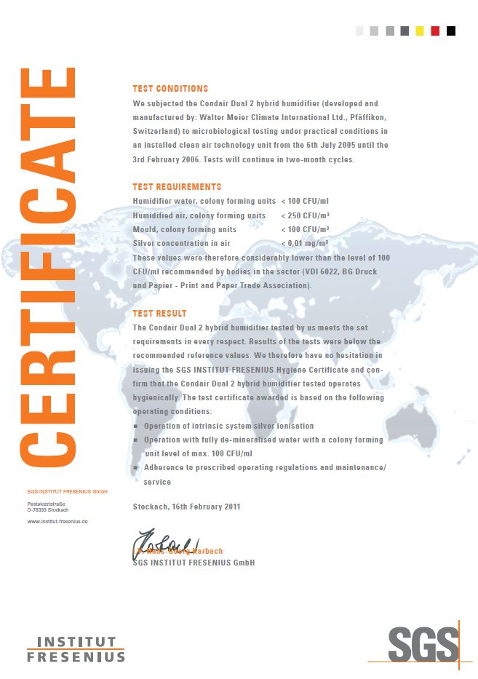
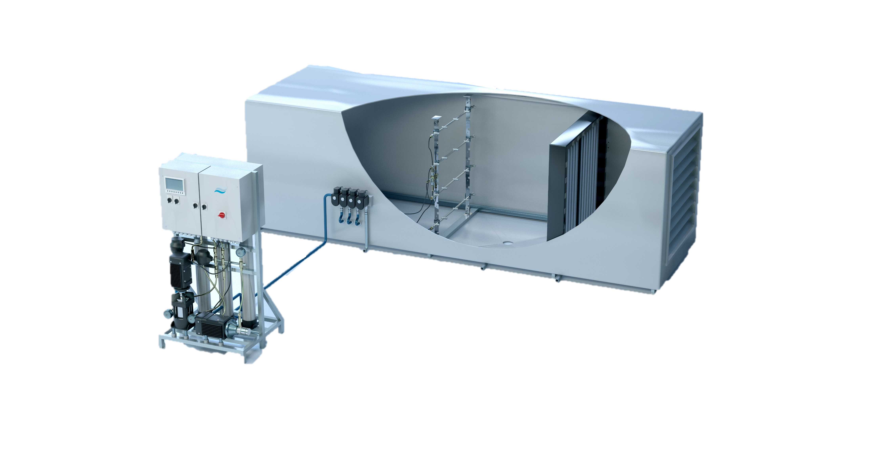
Product Overview
Condair DL Series
The DL improved the existing High-Pressure technologies:
HP systems have been around for 50+ years.
HP systems one of the most common adiabatic technologies but has many design limitations.
The DL was designed to improve these limitations:
Install Length
Energy Efficiency
Water Waste
Hygienic Function
Maintenance
While still offering the same high control accuracy (up to ±2%) as the HP.
DL Series
HP Series
Notes:
High pressure systems have been around for years. Aside from using higher quality components and better pump technologies, it’s a fairly similar system across manufacturers. To solve the design limitations that come along with high pressure systems, and to improve on the existing technology, we added in an evaporative component to get the DL series.
In doing so, the installation length is significantly reduced,
Its very energy efficient due to the reduced nozzle pressure
Water efficiency is increased, because any water that would typically go to drain on an HP system is captured by the ceramic media
It is very hygienic, with active silver ion dosing
And the DL is Low maintenance, ceramic media and its VFD pump do not need maintenance.
The DL features these improvements, while also offering the same high control accuracy of the HP (+/- 2%)

Slide 23
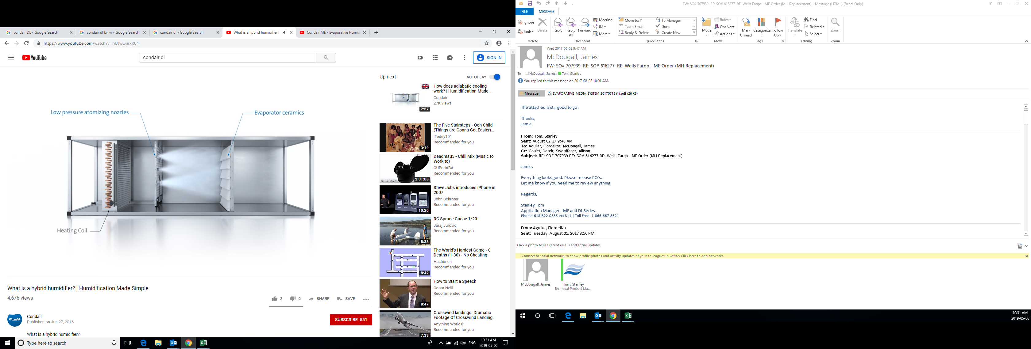
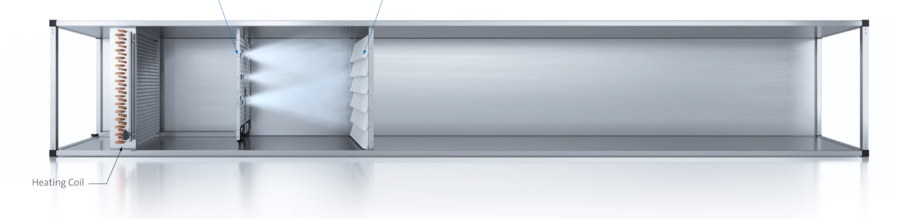
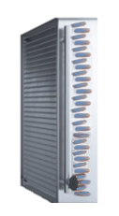
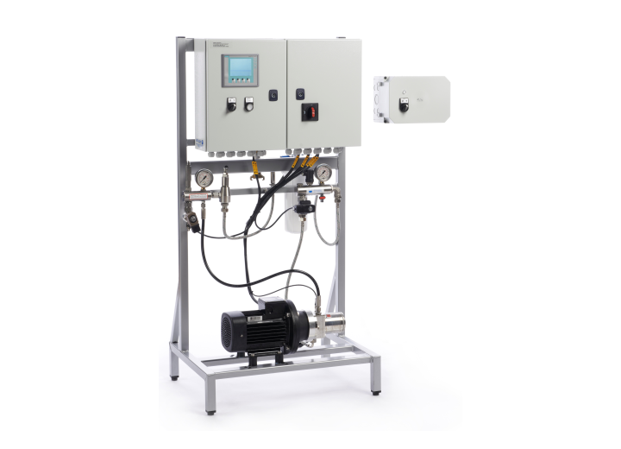
Product Overview
Installation Requirements
20”
24”
4”
Cooling Coil
UNIT
EVAPORATIVE
24”
24”*
*Recommended for service access
20-30”
HIGH PRESSURE
NOZZLES
MIST ELIM
20”
60-96”
20”
Notes:
ME: 44-78 depending on the width of the ME, service access
HP
Depending on airflow, humidification loads, air temp you can have 60-96 (5-8ft) absorption

Slide 24
Product Overview
Condair DL Series
Ceramic Plates
Patented hygienic ceramic material
No risk of aerosols
Very low pressure drop (<0.20 WC @500 fpm velocity)
Maintenance-free & replacement-free
Extremely high surface area = maximum evaporation efficiency
Optional droplet separator available (>600 fpm)
Reduce total unit footprint to just 24”
DL Series
The most hygienic adiabatic humidifier
Single unit can provide up to 2200 lbs/hr
Low energy costs: consumption as low as 55W
Flexible sizing to fit any duct (great for retrofits!)
Offset mechanical cooling costs with free cooling effect
UL Approved
Hygiene
Patented HygienePlus System
Independently certified (Fresenius Institute) for hygienic operation
No recirculation of water
Continuous conductivity monitoring of inlet water
Automatic drain and flush cycles
Nozzle Grid
Stainless steel nozzles
Pressurized water operation (43-101 psi) features low energy consumption and wear
Custom nozzle layout maximizes efficiency
Little to no maintenance
VFD Booster Pump
Improves modulation
Maintenance-free
Intelligent operation
Notes:
Silver ion is carried through hoses, through nozzles, on to plates, inactivating any bacteria it encounters
Silver ions are widely used in industries that require the most sterile environments and is even used by NASA.
Fresenius: is an independent certification institute that provides comprehensive hygiene testing and certification for manufacturing and equipment typically used in hospitals or other applications requiring a high level of hygiene. Installed and ran the DL for months, tested samples from the air stream, water and ceramics.
There are different built in hygiene functions to make sure the system stays free of bacteria:
No recirc
Conductivity measurement
Drain and flush
VFD
Type A DL systems have the booster pump, standard. Pump improves modulation by boosting the supply water pressure to the ideal operating pressure of 7bar. This allows for fine control up to 2%.
Nozzles
Installed on a flexible clip, and can be angled 15degrees in any direction
316 SST – Hygienic function
Low operating pressure – Less energy and wear
Operating pressure and nozzle openings ensure an optimal droplet size, Increasing efficiency at the ceramic stage and Ensures no water carry-over past the ceramics
Ceramics
Patented design – Condair exclusive - Significantly reduces water waste by evaporating water not absorbed from the nozzle grid, creating a water efficiency >90%
Dry ceramics – Hygienic operation!
The media is very porous, helping with the pressure drop <0.20” w.c. @ 500 fpm velocity which means Low energy draw from the supply fans
No need for replacement

Slide 25

Product Overview
Adiabatic Summary
 |  | In Space | In Duct | Benefits | Considerations
Adiabatic | ME Series (evaporative) |  | X | Evaporative Cooling Low energy consumption: highest cooling performance Potable Water No evaporation distance | Media is consumable High pressure drop Lower control accuracy slower response times Not suitable for healthcare
 | DL Series (hybrid) |  | X | Evaporative Cooling Low energy consumption Extremely hygienic Low maintenance requirements Short installation length requirement | Requires RO water Wet section with drain required
 | HP/ML Series (atomizing) | X | X | Evaporative Cooling Low energy consumption High reliability and low maintenance Instant output/ shut off | Requires RO water (same skid for <1000l/h) Longer installation length requirement Pumps, valves, nozzles
 | AF Series (atomizing) | X |  | Scalable performance for large loads​ High-reliability, low maintenance​ Instant output / shutoff | Treated water may be required​ Louder nozzles than high-pressure​ Air compression cost
 | US Series (atomizing) | X |  | Evaporative Cooling Low energy consumption | Requires RO/ DI water Up to 40 lb/hr on a single unit Not suitable for healthcare
Notes:
Highlights:
Couple of highlights from each one
ME:
Benefits: most efficient evaporative cooler, no evaporation distance, no water treatment required
Consideration: media is consumable, lower accuracy
DL:
Benefits: Extremely hygienic, high controllability
Consideration: requires RO water (high level, <15 uS/cm)
HP/ML:
Benefits: High reliability and controllability, multi AHUs
Consideration: Requires RO water, longer install length requirements
AF:
Benefits: scalable, high reliability/ low maintenance, good for low cost/ dusty suppression because you don’t need to treat the water.
Consideration: louder, compressed air
US:
Benefits: low energy consumption
Consideration: RO/DI, small, not suitable for healthcare

Slide 26
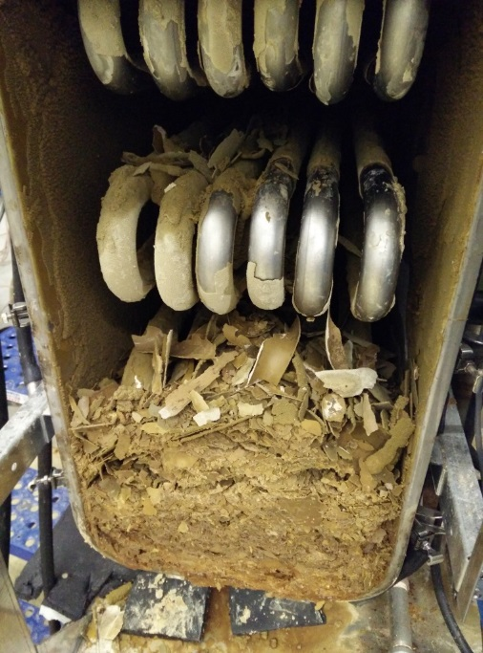
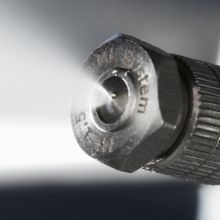
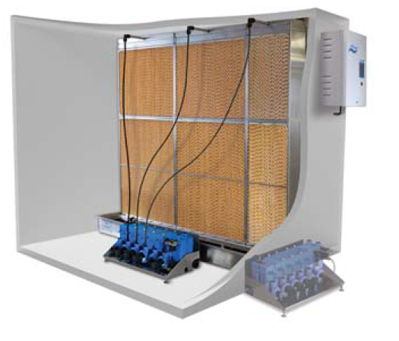
Product Overview
Water and Humidification
1
2
Steam Generation
(Isothermal)
Atomization / Evaporation
(Adiabatic)
Scaling!
Scaling, Dust and Hygiene!

Slide 27
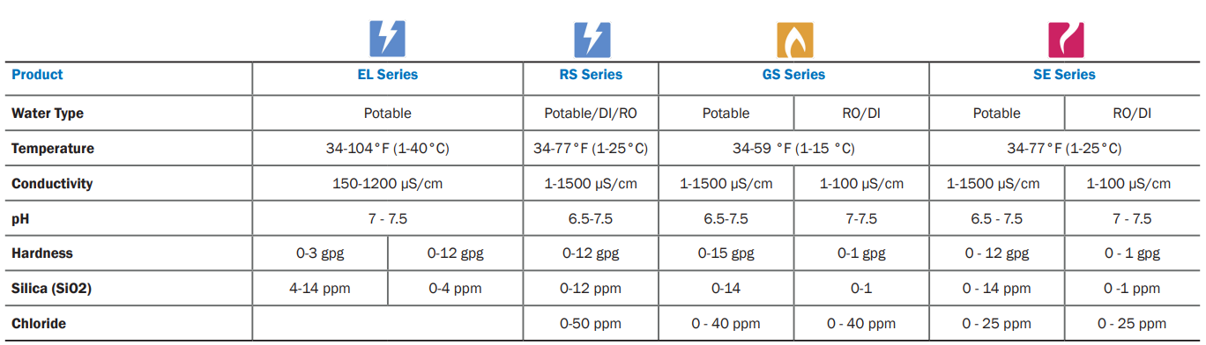

Product Overview
Water and Humidification
Check out our Water Treatment Guide!

Slide 28

Product Overview
Summary
In duct? | X | X | X |  | X | X | X | X | X
In Space? | X | X | X |  |  | X |  |  |  | X | X
> 200 lb/hr single system |  |  | X |  | X | X | X | X | X | X
Water Treatment needed? |  |  |  |  |  |  |  | X | X | X | X

Slide 29

3
Adiabatic Opportunities

Slide 30

Adiabatic Opportunities
Why Adiabatic?
Energy savings
  Steam humidifiers use electricity or gas ($$$)
  Adiabatic humidifiers draw energy from air (¢)
Free cooling
  Drawing energy from air results in sensible cooling that can be used to offset mechanical cooling requirements
Flexible humidification
  Custom setups & redundancy options
  Large single-system capacities (2,200 lbs/hr+!)
Low maintenance
Notes:
Iso – temp is more or less constant
Adiabatic – cooling down surrounding air (due to the constant enthalpy process)

Slide 31




Adiabatic Opportunities
Why Adiabatic?
Application: Hospital
Load: 2200 lbs/hr
 | Power Consumption (kW) | 2000 hours @ $0.08/kW
Adiabatic DL Series
Resistive RS Series
Electrode EL Series
2.6
$416*
780
$124,800
737
$117,920
*With beneficial evaporative cooling
Notes:
Take for example this hospital application requiring 2200 lb/hr of humidification.
With a high load, you can end up with 10 Resistive or electrode units, versus a single adiabatic system.
And if you take advantage of the beneficial evaporative cooling, your energy costs could be 250x less, or less than 1% of an electric isothermal.

Slide 32

NEW Condair Energy Simulator
  The first adiabatic humidification hourly simulation tool
  Full energy and cost breakdown
  Offline tool available now – Please contact your Local Rep.
Notes:
SEPI
I AM EXTREMELY EXCITED FOR O NEW TOOL WE HAVE TO ASSIST IN STRENGHTENING AND SUPPORT/SOLIDIFY THE SELECTION RECOMENDATION.
Over the last 3 years, Condair in conjunction with a consulting engineer - Energy Modeling Division have been developing The first adiabatic humidification Hourly Simulation tool . Full energy and cost breakdown
Process:
Seen Beneficial when used to support the Adiabatic recommendation after EDUCATING.
Available off line through Condair. Have project reach uot to RSM – ROBUST DATA INPUT SHEET
Tool enables us to QUANTITATIVELY DEMONSTRATE BENEFITS OF ADIABATIC IN DOLLARS. (IN MOST APPLICATIONS FIT THE CONDISERATIONS WILL DISCUSS)

Slide 33

Adiabatic Opportunities
Case Study – Hospital in Toronto (retrofit)
Building Density
 |  |  | Peak | Off-Peak
Lighting |  |  | 11.3 | 5.65 | W/m2
Sensible Equipment |  |  | 5.1 | 2.8 | W/m2
Latent Equipment |  |  | 5.41 | 1.78 | W/m2
Average Occupancy |  |  | 21 | 212 | m2/person
Operational Schedule - Peak Hours
 | SUNDAY | SUNDAY | MONDAY | TUESDAY | WEDNESDAY | THURSDAY
Peak Begins | 6:00:00 AM | 6:00:00 AM | 6:00:00 AM | 6:00:00 AM | 6:00:00 AM | 6:00:00 AM
Peak Ends | 7:00:00 PM | 7:00:00 PM | 7:00:00 PM | 7:00:00 PM | 7:00:00 PM | 7:00:00 PM
Air System
HVAC Air Side Type | CV | CV
HVAC Cooling Type | Water-cooled chiller | Water-cooled chiller
HVAC Heating Type | Gas Boiler | Gas Boiler
Total Air Volume | 1,764,904 | 1,764,904 |  | m3/h
Outside Air % | 70 | 70 |  | %
Fan Efficiency | 75 | 75 |  | %
Preheat Energy Source | Natural Gas | Natural Gas
Preheat System COP | 1 | 1
Include Free Cooling? | TRUE | TRUE
Cooling System COP | 3.3 | 3.3
Building Setpoints
 |  |  | Setpoint | Setback
Cooling |  |  | 22.22 | 27 | C
Heating |  |  | 22.22 | 18 | C
Humidification |  |  | 35 | 30 | %
Dehumification |  |  | 60 | 90 | %
Condair Energy Analysis Tool
Opportunity Name | Toronto Hospital
Currency | CAD
Units of Measure | Metric (SI units)
Project Location
Toronto Lester B. Pearson Int, ON | Canada
Building Basic
Project Location WMO | 716,280
Climate Zone | 6
Building Type | Hospital
Total Building Floor Area | 148,144 |  | m2
Building height | 54 |  | m
Number of Floors | 9
Ceiling Height | 3 |  | m
Window to Wall Ratio | 25 |  | %
Envelope Performance | ASHRAE 90.1-2019
Infiltration | Airtight building
Notes:
SEPI
Case Study for a Hospital done in Toronto (retrofit). ACTUAL HOSPITAL ANALYSIS
Focus: assess Energy Usage/Utility Usage/ Savings for an Operational Hospital.
Humidification ~40% of gas being used looking at ways to reduce
Simulation assess key application inputs:
Location
Building Characteristics,
Internal Characteristics
Air System
Utility Rates (Gas, Elec, Water)
Simulation will assess and provide full Energy and Cost Breakdown:
Assess
First Cost: capital cost: initial equipment and installation
Recurring cost of Maintenace
Utility.

Slide 34
Adiabatic Opportunities
Case Study – Hospital in Toronto (retrofit)
Product Selection
Selection Type | Humidification
 | Product 1 | Product 2
 |  |  |  |  | Product 3
System Type | In-Duct | In-Duct |  |  | In-Duct
Technology | DL | GS |  |  | RS
Bypass Dampers | NO | NO |  |  | NO
Water Type | Reverse Osmosis | Potable |  |  | Potable
Water Efficiency | 95 | 85 |  |  | 85
Initial Purchase
Installation Cost
One Time Cost
Recurring Costs
RO System | MLRO
RO System Efficiency | 70
RO System Purchase
Utility Rates
Electricity Rate | 0.13 |  |  | $/kWh
Electricity Demand Charge | 5 |  |  | $/kWh/month
Natural Gas Rate | 0.034 |  |  | $/kWh
Propane Rate | 0.04 |  |  | $/kWh
Central Steam Rate | 0.017 |  |  | $/kg
District Heating Rate | 0.08 |  |  | $/kWh
Water Rate | 0.002 |  |  | $/L
Sewer Rate | 0.0018 |  |  | $/L
Notes:
SEPI
Three Systems Comparison: Will Compare up to 3 systems. (including live steam etc)
Not specifically a business case as left out some input variables eg initial system costs, recuring cost (maintenance)
Demonstrating the like for like in utility costs. This case study, grew from how much energy/ Utility savings may be recognized between systems.

Slide 35
Adiabatic Opportunities
Case Study – Hospital in Toronto (retrofit)
Energy Cost Analysis Summary
Condair Model | DL-A | GS-NX | RS
Water Type | Reverse Osmosis | Potable | Potable
Equipment | $ - | $ - | $ -
Water Treatment | $ - | $ - | $ -
Installation Cost | $ - | $ - | $ -
First Cost | $ - | $ - | $ -
Recurring Costs | $ - | $ - | $ -
Total Electricity (kWH) | 226,025 | 35,677 | 1,4751,231
Fan Energy due to ΔP (kWH) | 183,182 | 18,318 | 18,318
Preheat Energy (kWH) |  | 0 | 0
Electricity Cost ($) | $ 30,611.71 | $ 5,000.25 | $ 1,991,052.47
Beneficial cooling (KWH) | 60,260
Cooling Energy Savings ($) | $ 2,374
Gas Usage (kWH) | 150,300 | 15,902,879 | 0
Gas Preheat Energy (kWh) | 150,300
Natural Gas Cost ($) | $ 5,110.21 | $ 540,697.88 | $ -
Potable Water Usage (gal) | 0 | 5,192,006 | 5,192,006
Treated Water Usage (gal) | 6,636,399 | 0 | 0
Potable Water to Drain (gal) | 0 | 778,801 | 778,801
Treated Water to Drain (gal) | 2,223,194 | 0 | 0
Water Cost ($) | $ 67,996.51 | $ 52,470.16 | $ 52,470.16
Total Utility Cost | $ 101,348.72 | $ 598,168.29 | $ 2,043,522.63
Max. Humidification Load (lbs/hr) |  | 8,374
Annual Humidification Hours (h) |  | 4,822
Annual Costs
Cost Differences | vs. GS-NX | vs. RS
First Cost | $ - | $ -
Recuring Costs | $ - | $ -
Utility Costs | -$ 494,450 | -$ 1,939,804
Estimated EOL Replacement | $ - | $ -
Notes:
SEPI
Very large load (assists with Adiabatic solutions as better suited for larger loads in design)
8,000 + lbs/hr
2.5 million CFM
Humidifying ~ ½ year based on hours (~8,000 hrs year, ~4,000 humidification)
Electricity: RS largest user, Gas minimal
Beneficial Cooling Energy – Only applies to DL (adiabatic solution, saving mechanical cooling)
Subtract from Total Utility Cost
Location very cold winter, good shoulder season- advantage of Extending Economizer Hours (April – June)
Hospital Internal Heat gain assist.
New Construction – tight envelope.
Gas Usage: DL Pre Heat, Gas main energy source (drive phase change)
Water Cost/Usage: DL uses Treated water, Comparison to Gas, RS not a substantial difference in USAGE ~20%. Cost Treated Water ~30% more
Overall:
Key note is the Annual Utility Cost to run/operate the 3 systems varies substantially
Isothermal: Gas is ~6X more costly to run, and Electric RS ~20X
Not suggesting every application with have same results. Few of the considerations which highlight beneficial affects of Adiabatic vs Isothermal:
Type of application, Humidification Load,
Health care typically good based on internal heat gain (take advantage of cooling), larger load
Gov Buildings, Institutions as well.
Utility Rates, Location
This case did not have some of the data inputs, typical see payback of 3-4 years for this type of application.

Slide 36

Adiabatic Opportunities
Case Study – Hospital in Toronto (retrofit)
Notes:
SEPI
Water Usage: again ~20% more water used, bit more going to drain due to RO system and small evaporation efficiency loss

Slide 37
Adiabatic Opportunities
Case Study – Hospital in Toronto (retrofit)
Notes:
SEPI
Paints a very nice picture the dark Blue DL is almost imperceptible in both graphs. Key graphs

Slide 38




Adiabatic Opportunities
Choosing the Right Product
Applications | Considerations
Healthcare (ex: Hospital, LTC) | CSA Hygiene Maintenance Energy Savings
Close-control (ex .Labs) | High-accuracy controls/ operation Sequencing Water Treatment Turndown Temperature control
Reliability (ex. Manufacturing) | Maintenance (less downtime) Redundancy (ex. n+1)
Dust Suppression (ex. Woodworking) | Dusting is fine Ceiling Height
Occupant Health (ex. Schools, Offices) | 40-60% Accuracy is less critical Pandemic: better understanding of science and healthy buildings
Step 1: Application
Step 2: Load Sizing
Step 3: Water Quality
Step 4: Customer Requirements

Slide 39




Adiabatic Opportunities
Adiabatic Retrofits: What to Consider
Load Sizing: ~250 lb/hr and up
Application: In duct or In Space, requirements
Water Quality: Issues and Availability
Energy Analysis: Adiabatic Cooling

Slide 40


Adiabatic Opportunities
Applications
Condair Product
Catalog (p.8)
Notes:
High hygiene, controllability.
Over 80 healthcare applications in the US.
Applications with cooling requirements. Can reduce mechanical cooling costs.
If cooling is not beneficial, preheating is required to offset.

Slide 41




Adiabatic Opportunities
Applications
 | Institutions
 | Healthcare | Educational | Concert Halls | Museums / Libraries
Benefits of Humidification | Human Health/ Comfort Static Protection | Human Health/ Comfort Static Protection | Human Health/ Comfort Preservation | Human Health/ Comfort Preservation
Load Sizing | High | High | High | High Low (specialty items)
Control Accuracy* | Mid (Patient/ general areas) High (OR) | Low (General Areas) High (Lab) | Low (General Areas) Mid (Instrument storage) | Low (General Areas) High (specialty items)
Common Products | DL (pending CSA Z317.2 update) | DL, HP, ML, US, ME | DL, HP | DL, ML, HP, US, (RS)
Load Sizing: High (>1000lb/hr), Mid (250-1000lb/hr), Low (<250lb/hr)
Control Accuracy: High (±2%), Mid (±5%), Low (±10%)
Notes:
High hygiene, controllability.
Over 80 healthcare applications in the US.
Applications with cooling requirements. Can reduce mechanical cooling costs.
If cooling is not beneficial, preheating is required to offset.

Slide 42




Adiabatic Opportunities
Applications
 | Process/ Manufacturing
 | Pharmaceutical | Electronics | Laboratories | Clean Rooms
Benefits of Humidification | Product Quality Static Protection | Product Quality Static Protection | Process Accuracy Static Protection | Process Accuracy
Load Sizing | Mid/ High | Mid/ High | Mid/ High | Low
Control Accuracy | Mid | Mid | High | High
Common Products | DL, HP, ML, US | DL, HP, ML, US | DL, HP | DL, US
Load Sizing: High (>1000lb/hr), Mid (250-1000lb/hr), Low (<250lb/hr)
Control Accuracy: High (±2%), Mid (±5%), Low (±10%)
Notes:
High hygiene, controllability.
Over 80 healthcare applications in the US.
Applications with cooling requirements. Can reduce mechanical cooling costs.
If cooling is not beneficial, preheating is required to offset.

Slide 43




Adiabatic Opportunities
Applications
 | Process/ Manufacturing
 | Woodworking | Paint Booth | Printing | Data Centers
Benefits of Humidification | Dust Suppression | Process Quality | Process Quality Static Protection | Cooling Static Protection
Load Sizing | Mid | Low/ Mid | Mid/ High | All
Control Accuracy | Low | Mid | Mid | Low
Common Products | JS, ML | HP, ML, JS | HP, ML | ME, US
Load Sizing: High (>1000lb/hr), Mid (250-1000lb/hr), Low (<250lb/hr)
Control Accuracy: High (±2%), Mid (±5%), Low (±10%)
Notes:
High hygiene, controllability.
Over 80 healthcare applications in the US.
Applications with cooling requirements. Can reduce mechanical cooling costs.
If cooling is not beneficial, preheating is required to offset.

Slide 44


4
Key Takeaways
Q&A

Slide 45



Key Takeaways
Summary
Condair has a complete product portfolio
Adiabatic humidification provides energy efficient humidification and free cooling, reducing operational costs
Resources are available (Condair Help, Longhill, Condair.com, etc.)

Slide 46
Questions?

