Slide 1


Why Humidify in Healthcare?
Pasquale Demitrio | Healthcare and Life Sciences

Slide 2
Presentation Overview
A
What are the reasons we humidify in Healthcare?
B
What studies do we have? Anything new?
C
Dry building syndrome: Microbes, Humans, Hospitals
D
Obstacles to proper Air Hydration
Notes:
People in many cultures spend up to 90% of their time in buildings, exposed to indoor climates shaped by HVAC systems designed to optimize energy use and preserve building materials. While the primary function of most buildings is to protect the humans inside, the impact of IAQ on health and disease is one of the least understood subjects in the field of public health! Meanwhile, indoor-dwelling people suffer from many infectious, allergic and chronic diseases despite highly sophisticated medical treatments. This webinar will give engineers valuable information to manage indoor climates to better support occupant health and control energy use.

Slide 3
Why do We Humidify in Healthcare?
Try to meet minimum building codes
Eliminate Electro Static Discharge (ESD) for equipment and safety
Because certain Dr.’s like it in operating rooms
That is the way we always did it
Other reasons?

Slide 4
Presentation Overview
A
What are the reasons we humidify in Healthcare?
B
What studies do we have? Anything new?
C
Dry building syndrome: Microbes, Humans, Hospitals
D
Obstacles to proper Air Hydration
Notes:
People in many cultures spend up to 90% of their time in buildings, exposed to indoor climates shaped by HVAC systems designed to optimize energy use and preserve building materials. While the primary function of most buildings is to protect the humans inside, the impact of IAQ on health and disease is one of the least understood subjects in the field of public health! Meanwhile, indoor-dwelling people suffer from many infectious, allergic and chronic diseases despite highly sophisticated medical treatments. This webinar will give engineers valuable information to manage indoor climates to better support occupant health and control energy use.

Slide 5
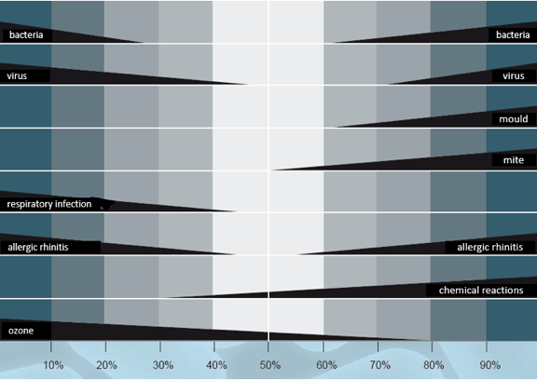
What’s Old? published in 1985,
Sterling Chart with optimal RH level for health of 40%–60%
Sterling Chart

Slide 6
Viability of many viruses is reduced in air with RH 40%–60%
What’s Kinda New? – NIOSH Study - 2013
High Humidity Leads to Loss of Infectious Virus from Simulated Coughs. U. Illinois, 2013
J Noti, et al.

Slide 7
What’s New? – Microbiome Study 2013
Most recent study – Microbiome Study 2013 –
Dr. Stephanie Taylor, MD HMS.
Research study conducted to identify factors contributing to
infections in hospitals.
Conducted in newly constructed Midwest Hospital setting.
Built 2013, LEED Silver, 240 bed single occupancy hospital.
1.2 million total square feet, 100,000 sq ft per floor.
14 month long study. 2 months prior to opening plus 1st year open.
10 Patient rooms and 2 nursing stations on 2 separate floors.

Slide 8
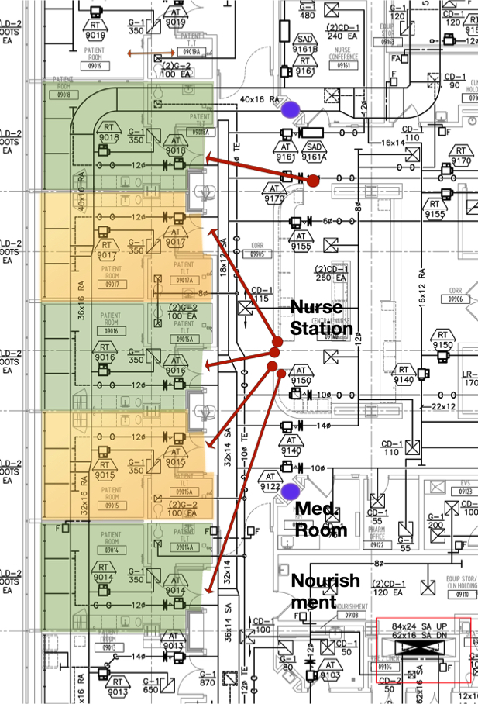
Microbiome Study

Slide 9



New Tools and More Data - PCR
Microscope 1509
Telescope 1608
“Gene-o-scope” 2000”

Slide 10
Patient room information collected every 30 minutes for 1 year after opening.
Staff & visitor hand cleaning
Room air changes
Traffic in & out of room
Temperature
RH, absolute humidity
Lux
Outdoor air fractions
Room pressurization
CO₂ level

Slide 11
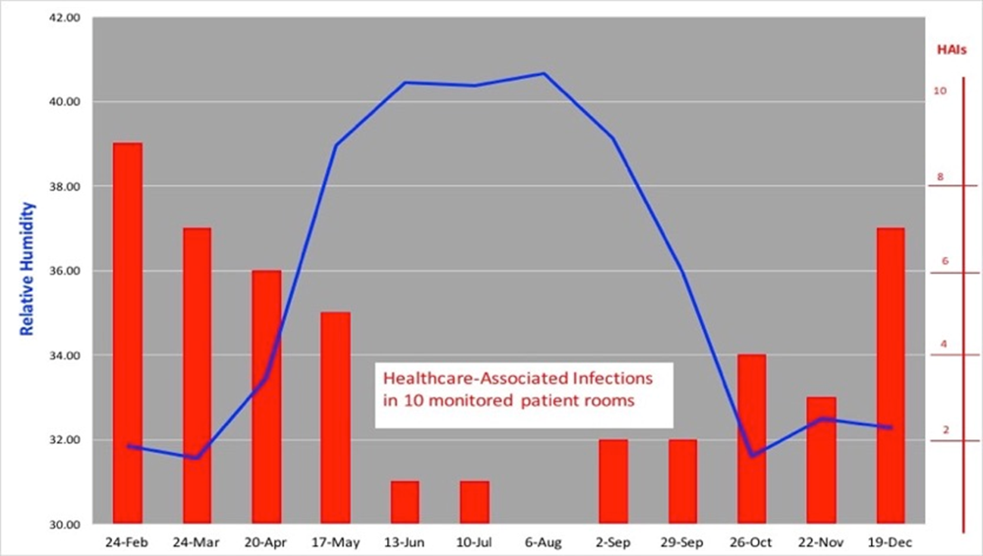
Results - Indoor air RH was found to be the most significant factor associated with patient HAIs.

Slide 12
8 Million Data Points collected
SPSS analysis of relationships between indoor conditions and infections
p< .02

Slide 13
This new data challenges the desire to minimize humidity in occupied spaces
Conclusion
patient infections
as RH

Slide 14
Presentation Overview
A
What are the reasons we humidify in Healthcare?
B
What Studies do we have? Anything New?
C
Dry building syndrome: Microbes, Humans, Hospitals
D
Obstacles to proper Air Hydration
Notes:
People in many cultures spend up to 90% of their time in buildings, exposed to indoor climates shaped by HVAC systems designed to optimize energy use and preserve building materials. While the primary function of most buildings is to protect the humans inside, the impact of IAQ on health and disease is one of the least understood subjects in the field of public health! Meanwhile, indoor-dwelling people suffer from many infectious, allergic and chronic diseases despite highly sophisticated medical treatments. This webinar will give engineers valuable information to manage indoor climates to better support occupant health and control energy use.

Slide 15
Dry air shrinks aerosolized droplets, promoting greater pathogen spread
Droplet diameter in microns (um)
Float time
0.5
41 hours
1
3
10
1.5 hours
100
6 seconds
Distance travelled:
1m
10m+

Slide 16
Dry indoor air promotes pathogen transmission in tiny aerosolized droplets
Pathogens circulate through the ventilation system
Ventilation duct
Infectious droplets are expelled into the hospital environment
Recirculate in turbulent flow
Infectious droplets spread disease to in-patients (HAIs)
Re-contaminate hands and surfaces

Slide 17
With RH of 40%–60%, infectious droplets settle out of the airborne environment
Particle behavior with balanced air hydration
Bedrails and other frequently touched surfaces are more effectively cleaned
Hand hygiene is maintained
Settled infectious droplets are not
re-suspended

Slide 18
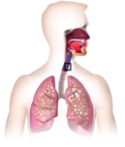
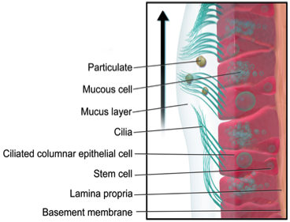
Proper air hydration is essential for our respiratory system defenses
Key functions of respiratory cells:
Cilia wash particles away from delicate lung tissue
Mucus layer allows healthy immune modulation to reduce allergic reactions
Mucous from goblet cells trap pathogens
Dry inhaled air causes:
Increased susceptibility to infections
Increased wheezing from allergic disease

Slide 19


Dry Building Syndrome Harms Our Skin
Skin is essential for:
  wound healing
  immune system training
  protection from injury
  protection from infections
  preserving internal water

Slide 20
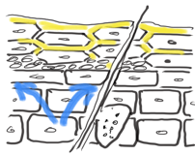
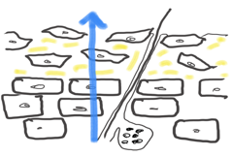
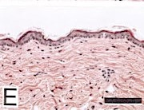
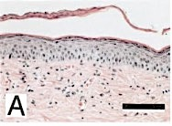
Dry Building Syndrome Harms Our Skin
well hydrated
dehydrated
Notes:
permeability and mechanical barrier function
antimicrobial defense
maintains our epidermis
UV defense
antioxidant defense
In genetically predisposed individuals, damage to this barrier leads to the penetration of environmental allergens and to the initiation of atopic dermatitis and asthma.

Slide 21

Equilibrium (moving towards entropy) is an
irrefutable law of thermodynamics
Dry, thirsty air steals moisture from wherever it can
– a law of physics
Notes:
a “stupid question”? No! Water is a polar molecule with 2 hydrogen atoms an one oxygen atom. These atoms share their valence shell electrons in a covalent bond

Slide 22
What’s Old? Published in 1985,
Sterling Chart with optimal RH level for health of 40%–60%
20%
45%
actual humidity
in winter season
ideal humidity for winter season

Slide 23
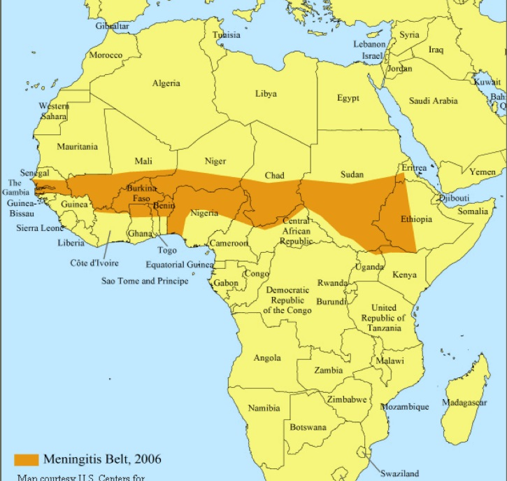
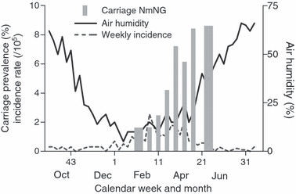
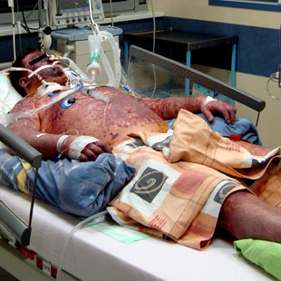
Dry weather reliably predicts meningitis outbreaks
Bacteria spread through the air when the outdoor humidity is low
“Once the humidity exceeds 40%, the epidemic ends”

Slide 24
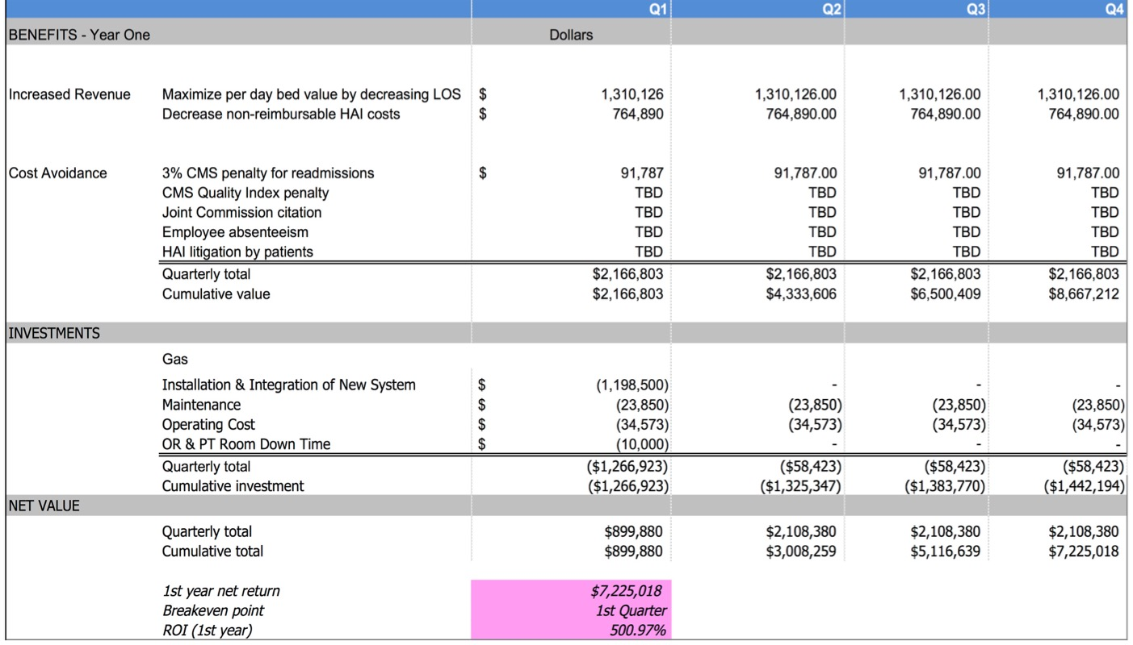
Projected financial benefits from room air humidification for a 250-bed hospital

Slide 25
Why do we Humidify in Healthcare?
Should
Why do We Humidify in Healthcare
To improve patient outcomes and survival
To reduce Healthcare Acquired Infection rates (HAI’s)
Decrease Patient Length of Stay (LOS) and re-admittance rates
Improve quality of care metrics / hospital report card / HEDIS
Improve patient efficiencies and reimbursements
-------------------------------------------------------------------------------------------
Try to meet minimum code requirements
Eliminate Electro Static Discharge (ESD) for equipment and safety
Because certain Dr.’s like it in operating rooms
That is the way we always did it

Slide 26
Presentation Overview
A
What are the reasons we humidify in Healthcare?
B
What studies do we have? Anything new?
C
Dry building syndrome: Microbes, Humans, Hospitals
D
Obstacles to proper Air Hydration
Notes:
People in many cultures spend up to 90% of their time in buildings, exposed to indoor climates shaped by HVAC systems designed to optimize energy use and preserve building materials. While the primary function of most buildings is to protect the humans inside, the impact of IAQ on health and disease is one of the least understood subjects in the field of public health! Meanwhile, indoor-dwelling people suffer from many infectious, allergic and chronic diseases despite highly sophisticated medical treatments. This webinar will give engineers valuable information to manage indoor climates to better support occupant health and control energy use.

Slide 27

The great in airdoor RH debate!
Protect the building
Protect the occupants
RH:
0%
10%
20%
30%
40%
50%
60%
70%
80%
90%
100%
Buildings don’t care about humidity
Facility managers often incorrectly think:
The drier the air the better
Easier to dry the air than fix the envelope construction
Occupants need RH between 40% and 60% for optimal health
Decreased infections
Fewer allergies
Improved hydration
Improved wound healing
Increased work performance
Notes:
bullet.

Slide 28
Barriers to Proper Air Hydration
Cost of Humidifier
  Just an added cost, no value – What about Patient Outcomes, Reimbursements and Employees?
Mold
  Fear of growth – Mold cannot grow from gaseous H2O, needs substrate
Energy
  Uses too much energy – Look at newer Technologies!
Maintenance
  Pain in the tool box to keep running – Look at newer Technologies!
Understanding
  What is the Real value of proper RH levels in Healthcare?

Slide 29
Thank You!
Questions?

