Slide 1

HELPful Tools for a Better Life
National Sales Meeting – Chicago 2022
Ashley Piché – Global Product Manager, Software & Tools
Notes:
HELP your sales
Software and tools for a better life

Slide 2


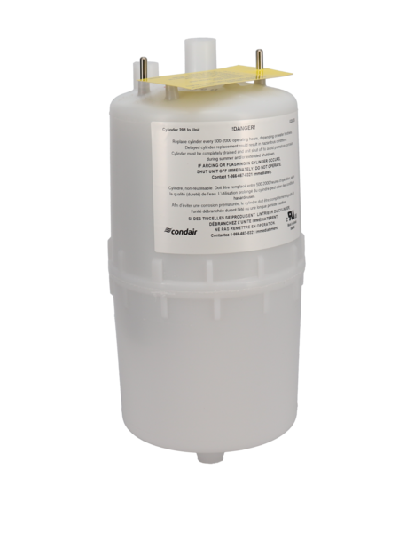

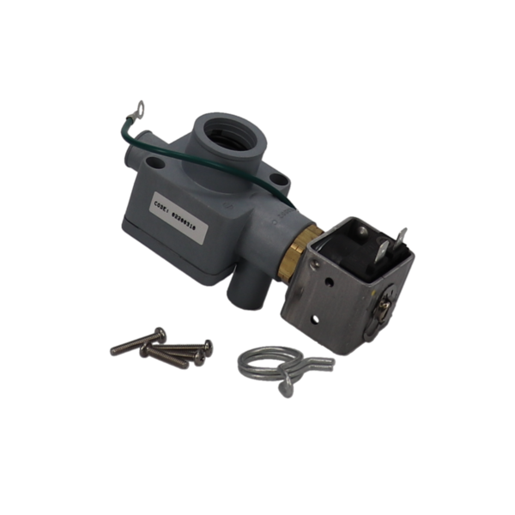
Agenda
Help
  Overview & Reminders
  New Features – Coming Soon
Condair Parts Online
  Overview & Reminders
  New Features – Coming Soon
  Benefits & Opportunities

Slide 3
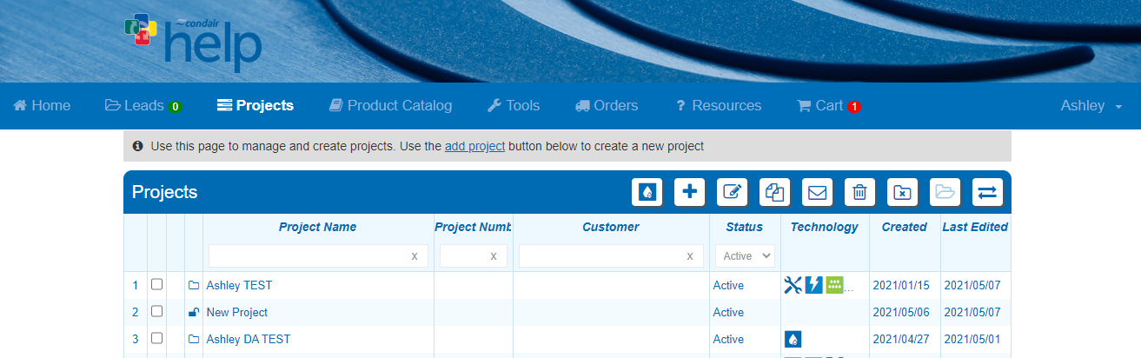
Help
Overview & Reminders
Projects: Wizard Based load sizing and product selection
Product Catalog: Access to full product offering and documentation

Slide 4
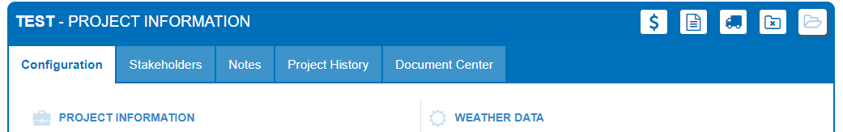

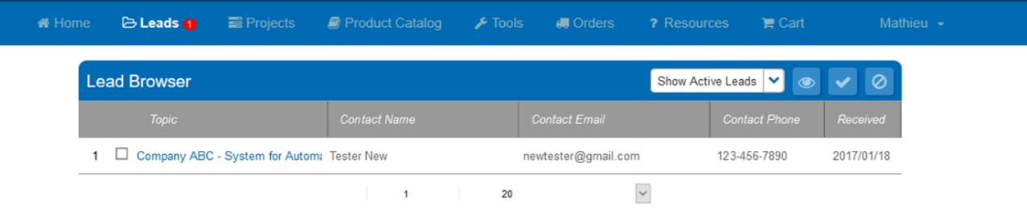
Help
Overview & Reminders
Reminder #1: Order Entry
Submitting orders through help saves time!
You can view your orders in the ORDERS tab
How do I submit an order through Help?
  When you have finished a project and reviewed, simply select the “Create Order” truck icon
Reminder #2: Lead System
New leads sent by email to assigned person from agency
Qualify, disqualify, mark leads in progress in leads section
Add new leads as stakeholders to a project in project info

Slide 5
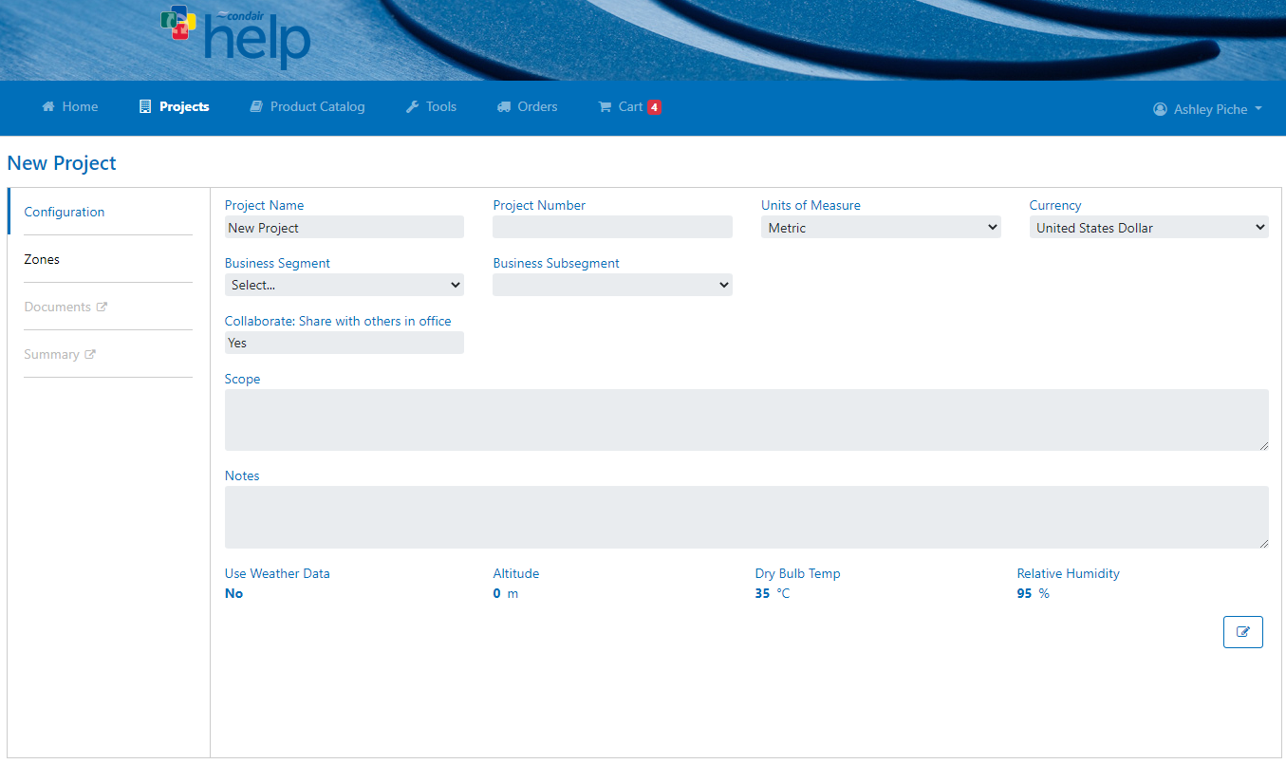
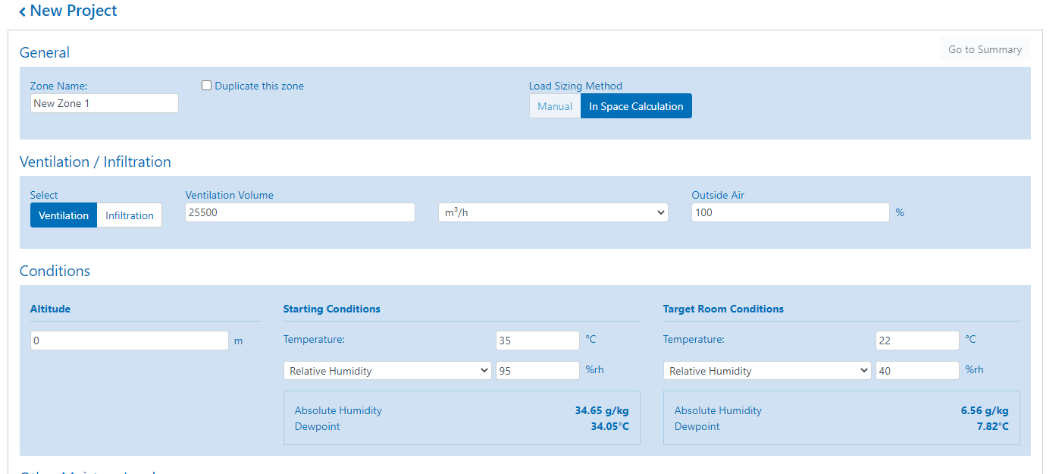
Help
New Features
Incase you missed it:
  New User Interface (DA & MC projects)
  More responsive, more flexible
  Modern Design

Slide 6




Help
New Features – Coming Soon
Tracking Number Integration
Goal:
  Integrate various shipping providers with Condair systems
  Tracking numbers automatically sent to Help
Saves time for sales all:
  Less manual work (phone calls & emails)
  Clear visibility directly in Help

Slide 7
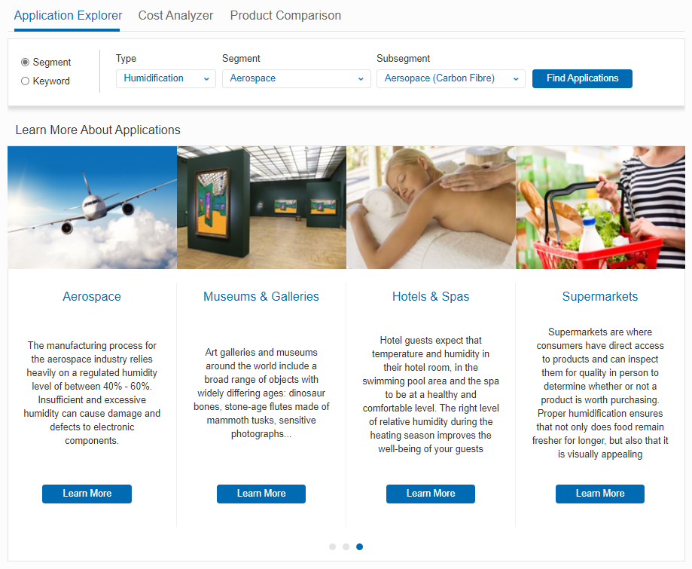
Help
New Features – Coming Soon
Application Knowledge Tool
Notes:
Focus on sales, how it’ll work for them
Application tool: work put in by sales team, first step into becoming application focused, portal to application knowledge, bring info to engineer, genrate report

Slide 8
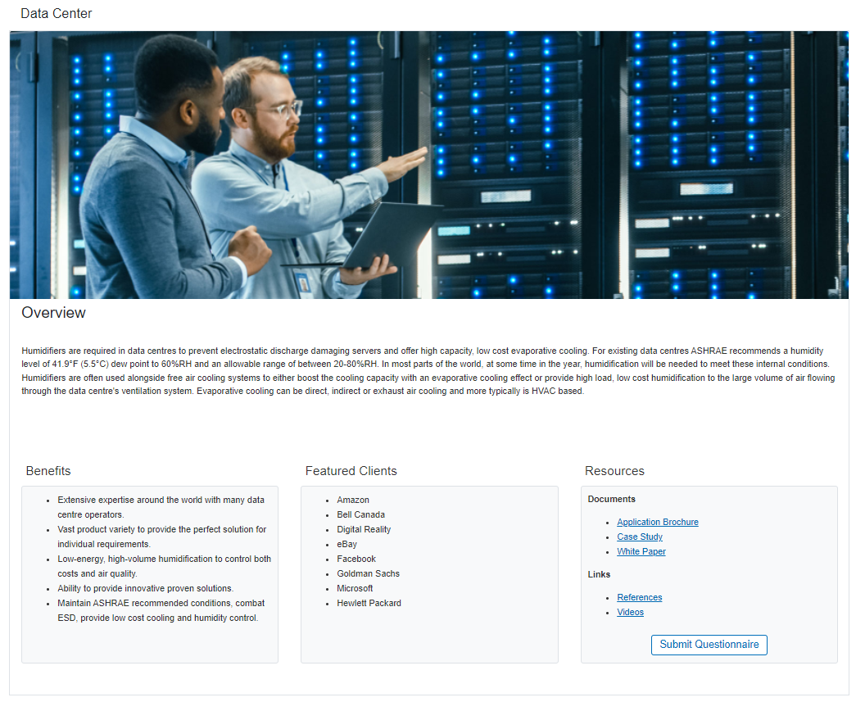
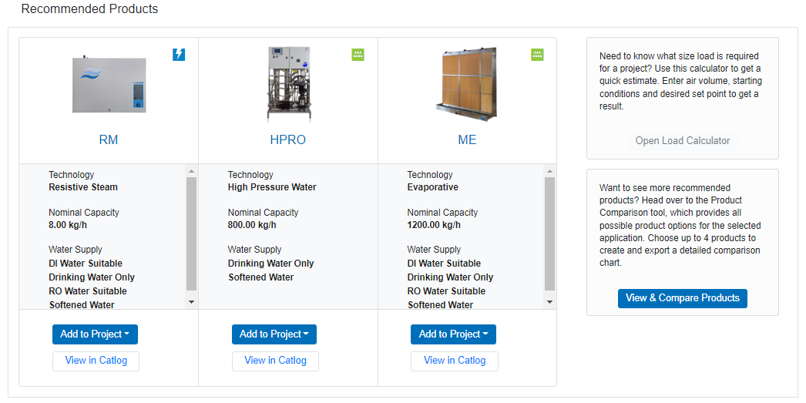
Help
New Features – Coming Soon
Notes:
Focus on sales, how it’ll work for them
Application tool: work put in by sales team, first step into becoming application focused, portal to application knowledge, bring info to engineer, generate report

Slide 9
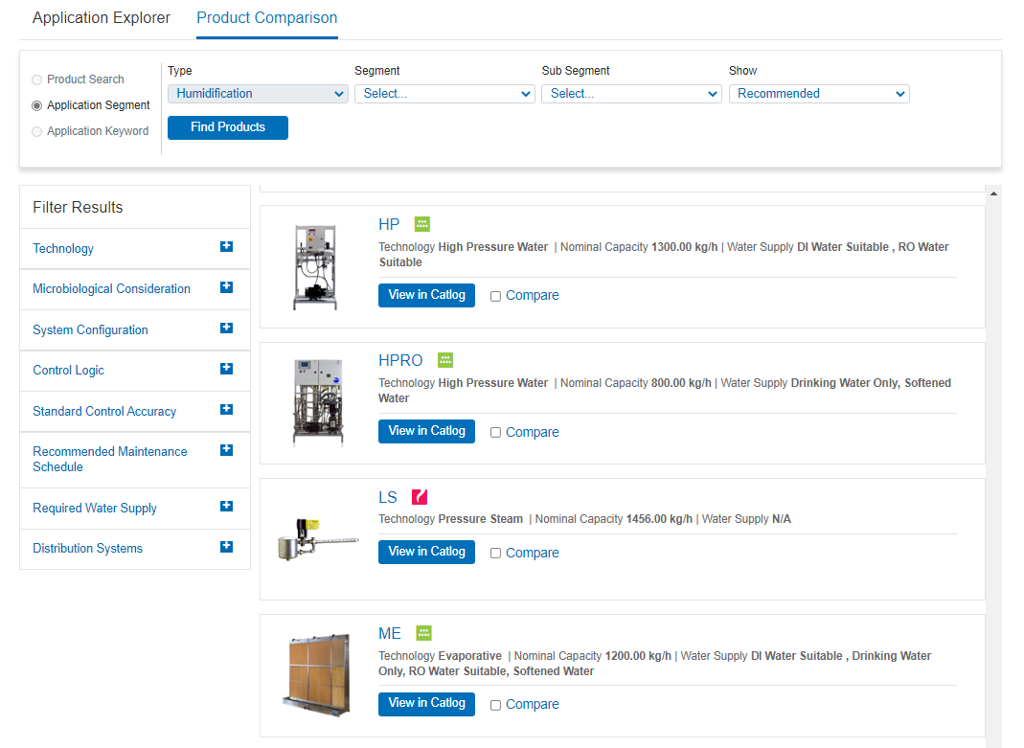
Help
New Features – Coming Soon
Product Comparison Tool
Notes:
Focus on sales, how it’ll work for them
Application tool: work put in by sales team, first step into becoming application focused, portal to application knowledge, bring info to engineer, genrate report

Slide 10
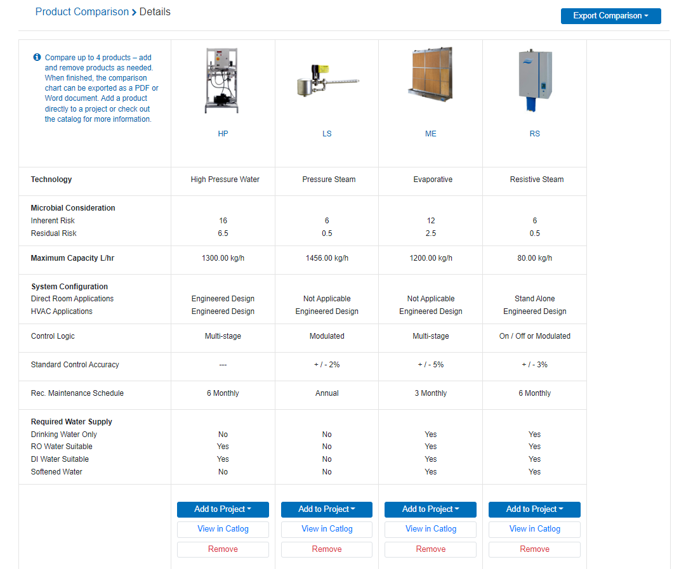
Help
New Features – Coming Soon
Product Comparison Tool
Notes:
Focus on sales, how it’ll work for them
Application tool: work put in by sales team, first step into becoming application focused, portal to application knowledge, bring info to engineer, genrate report

Slide 11
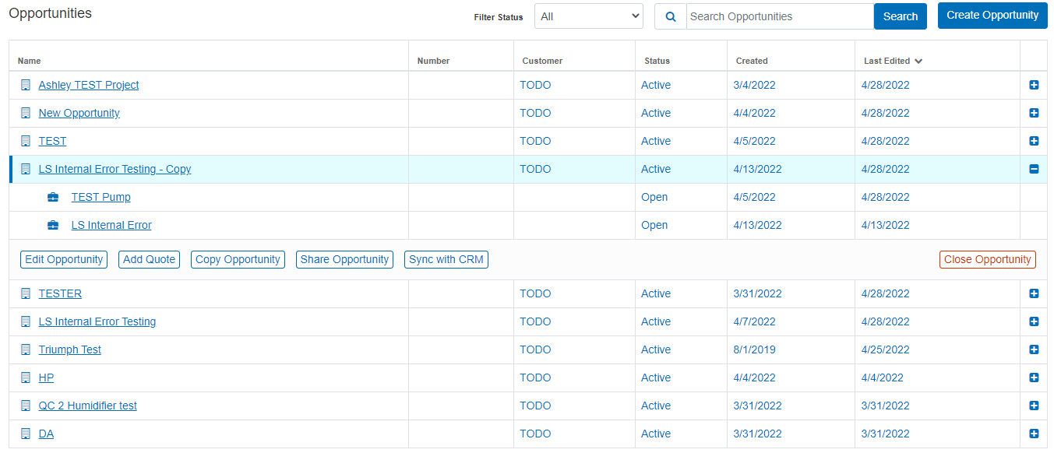
Help
New Features – Coming Soon
Opportunities & Quotes
Notes:
Focus on sales, how it’ll work for them
Application tool: work put in by sales team, first step into becoming application focused, portal to application knowledge, bring info to engineer, genrate report

Slide 12



Help
Key Takeaways
  New UI
    More responsive and user-friendly design
  Tracking numbers
    Improved visibility on shipments
    Automatic updates in Help
  Application Tool
    Improve and share application knowledge
  Opportunities & Quotes
    Cleaner landing page, less duplicate projects
    Group quotes under single opportunity
Notes:
Update takeaways to be more agent oriented

Slide 13
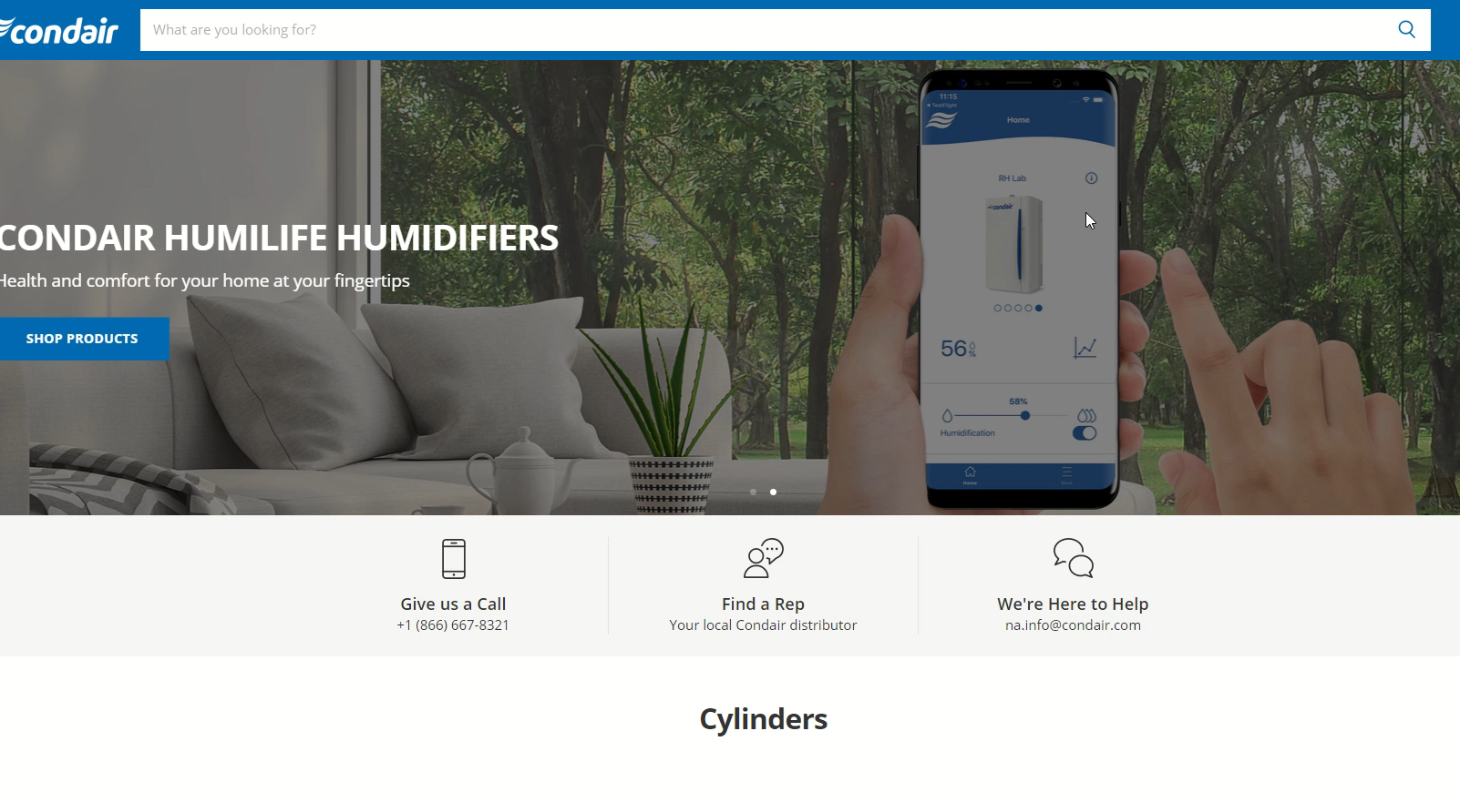
CondairParts.com
Overview & Reminders
Available to all customers USA & Canada (.ca)
Special customer pricing & payment access with login
Notifies agents of sales in territory + 25% commission
Offers top 90% of parts sold and complete Residential line
  Catalog is still growing
Partner with US warehouse & logistics for improved delivery
Provides model compatibility, “What’s in the box” and 360° photos

Slide 14
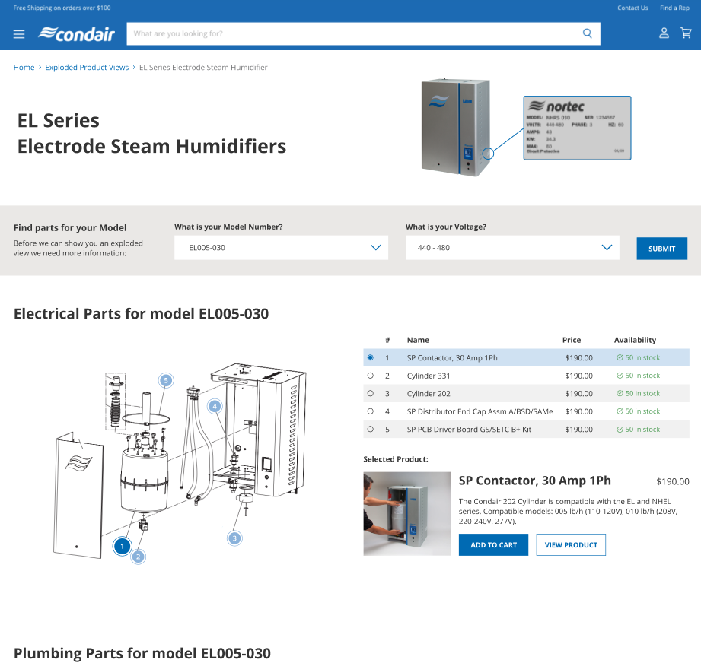
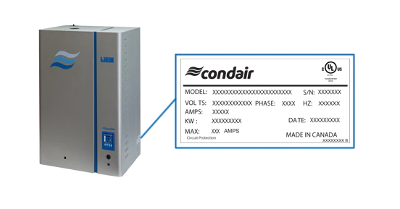
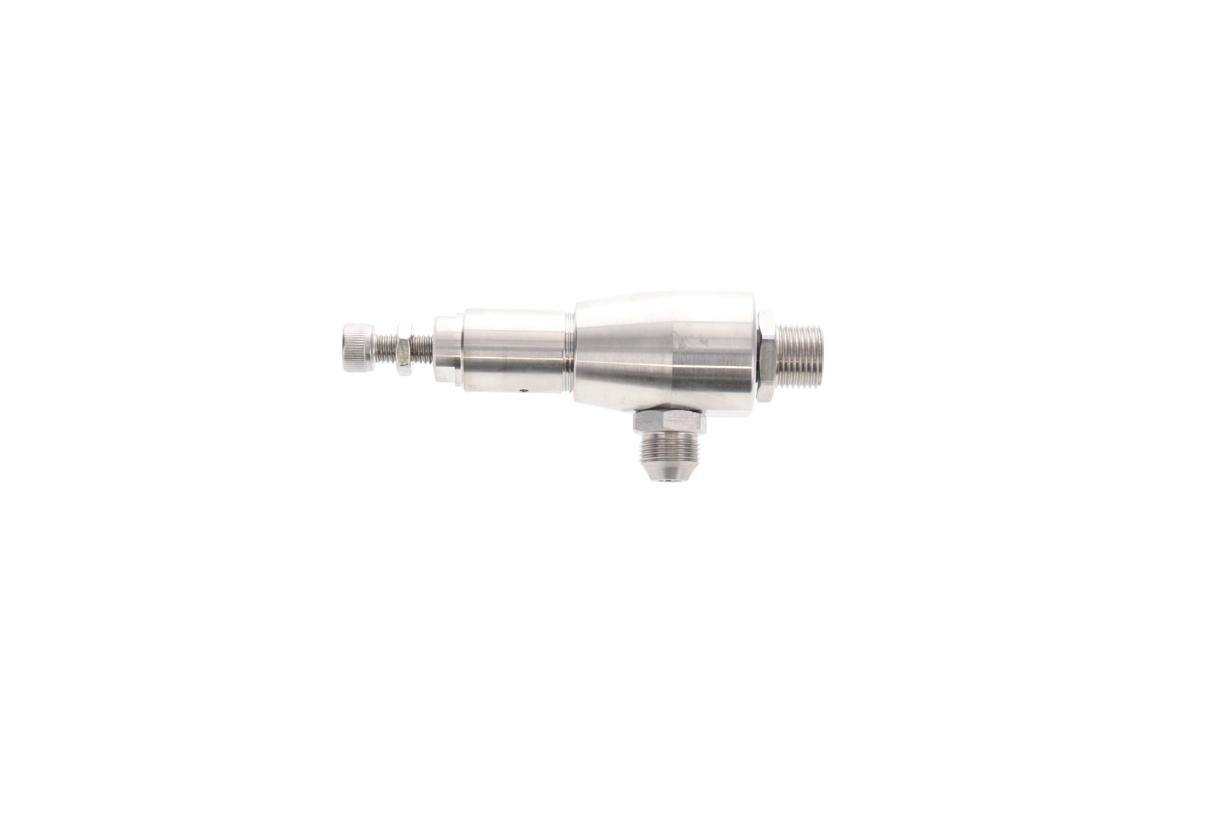
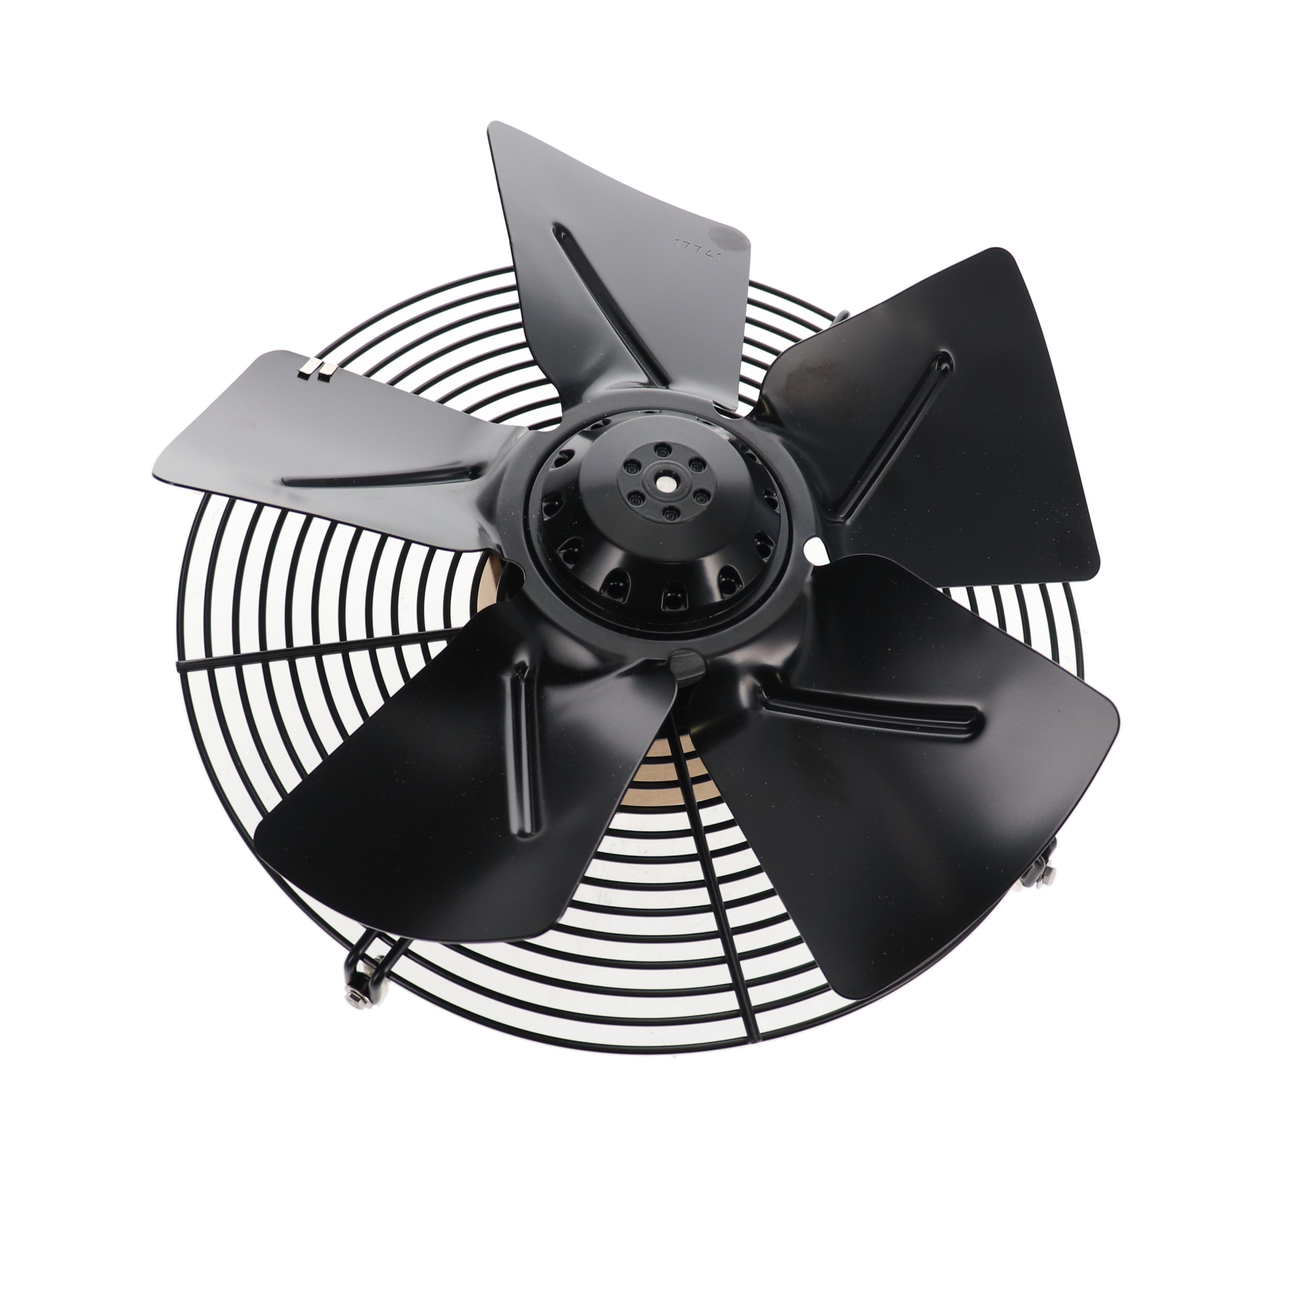
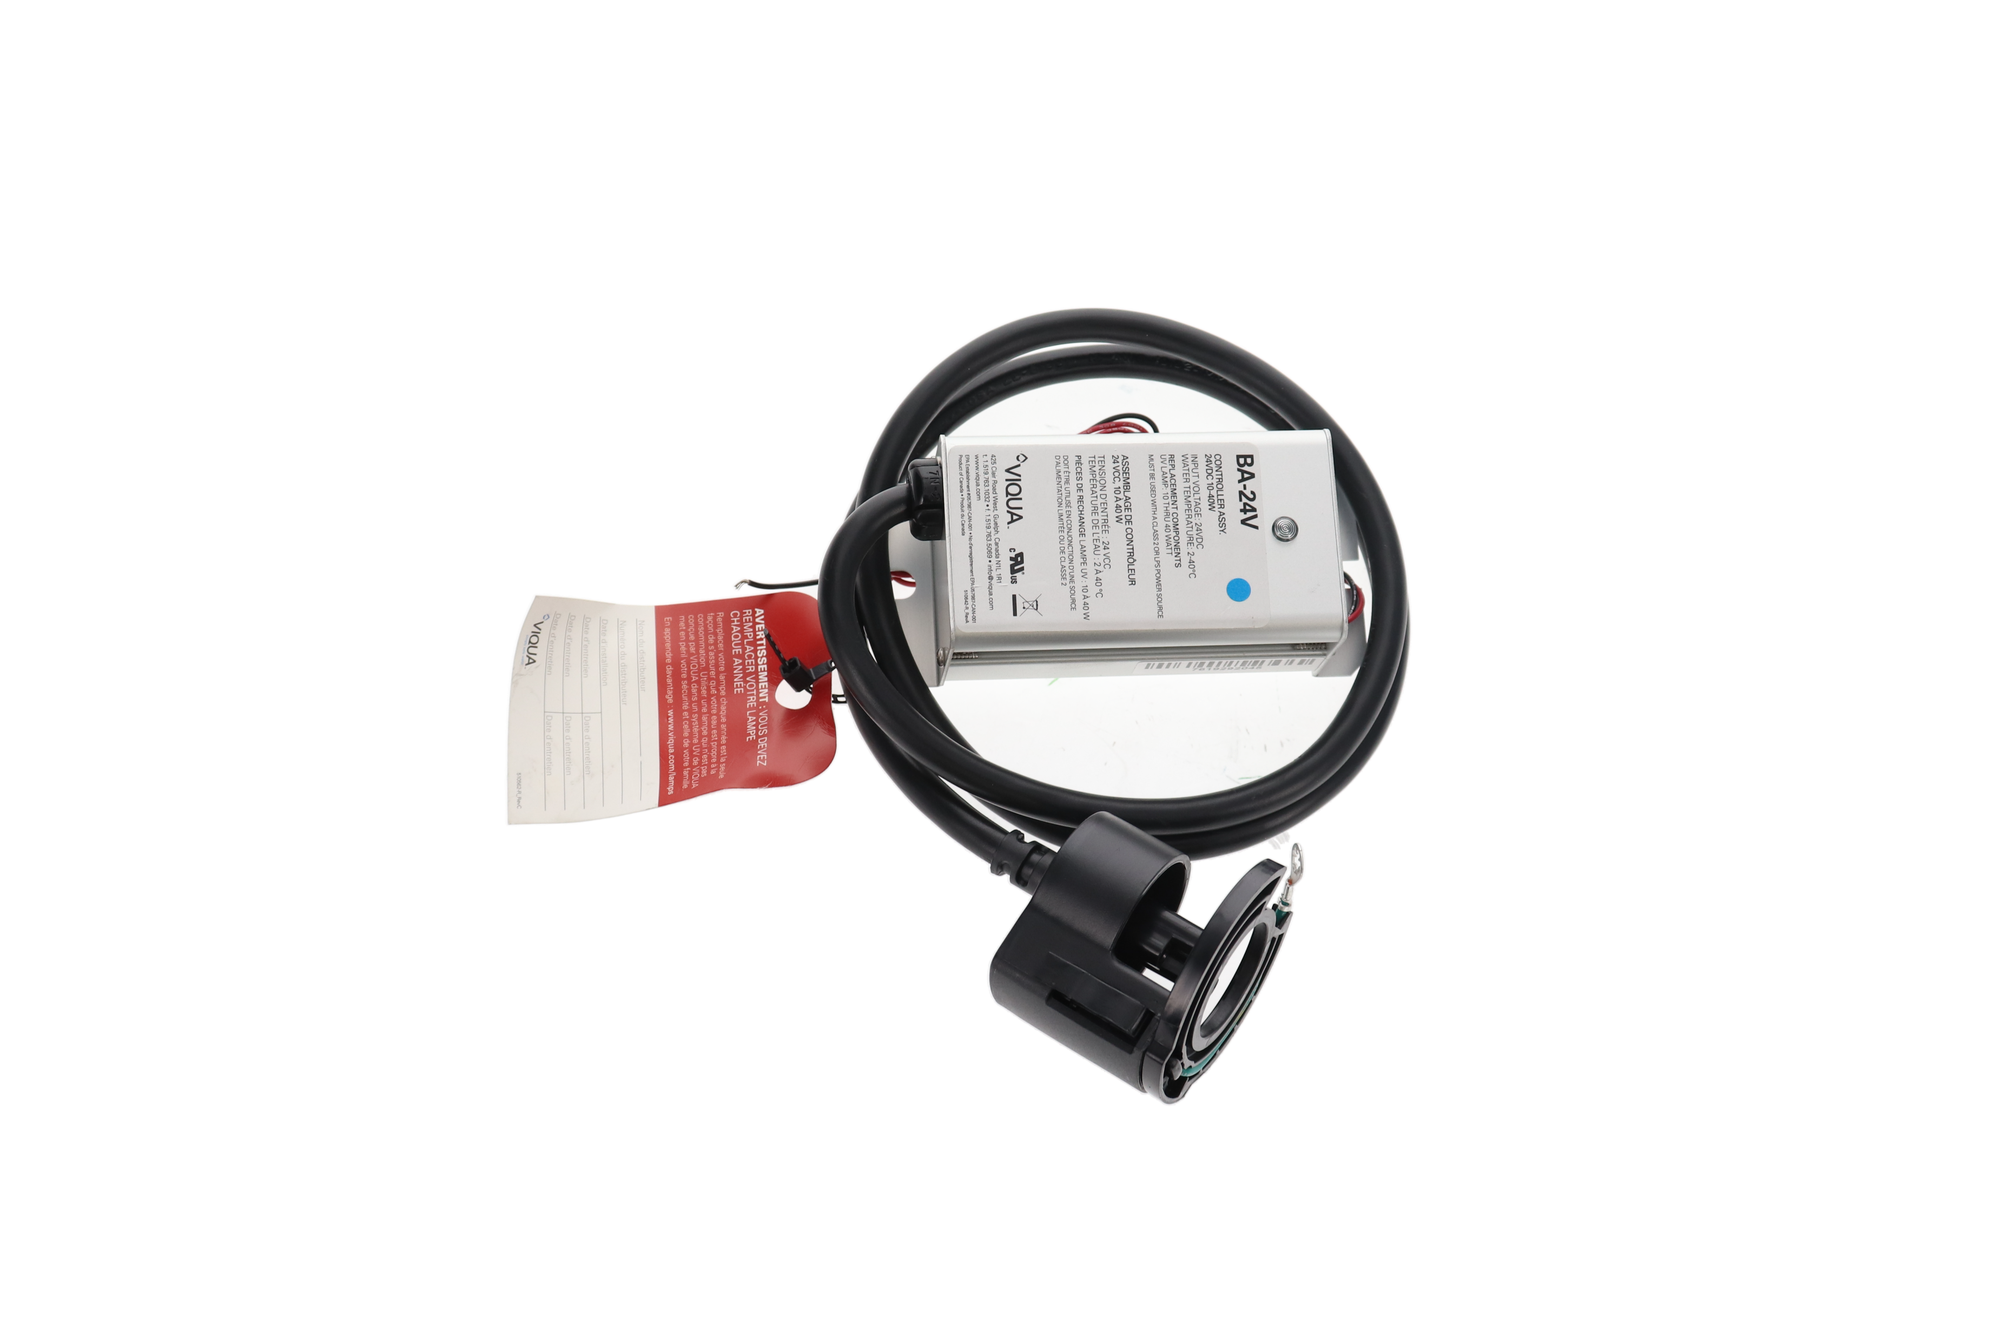
CondairParts.com
On the Roadmap
Interactive Exploded Views
Serial # lookup
Grow product offering
  ML/DRS parts coming soon!

Slide 15
CondairParts.com
Benefits
What’s in it for you?
Opportunities
Easy access to parts information
Convenient shipping/payment options
Useful for any parts professionals
Access to customer sales data
Less manual ordering
Sales commission with no effort
Reach more customers
Leverage customer leads
Increased parts & service revenue

Slide 16

Software & Tools
Summary
Help
  Application Knowledge
  Opportunity & Quote
  Automated Tracking Numbers
Condair Parts
  Direct access to parts and new customer leads
  Faster lead times
  Improve spare parts and service business
Important Takeaways!

Slide 17
Thank You ☺
Ashley Piché
ashley.piche@condair.com

