Slide 1
Methodology for Analyzing Environmental Quality Indicators (EQIs) in a
Dynamic
Operating Room Environment
Notes:
ASHRAE 170 Committee Expectations:
Rick Herman – previously viewed at ASHE PDC
Chris Rousseau, Doug Erickson
Need to start with background – multidisciplinary team to Cost Benefit FGI Committee, SSI, Quantifiable air measurements

Slide 2


Disclosure
Ph.D., CIC
Microbiologist, Infection Preventionist
Managing Partner, OnSite-LLC
Damon G. Greeley
PE, CEM, HFDP, CBCP, EDAC, CHFM
Managing Partner, OnSite-LLC
Dr. Wagner and Damon Greeley are founding members of OnSite-LLC, a company which utilizes Environmental Quality Indicators (EQI) to evaluate and optimize sterile hospital environments.

Slide 3
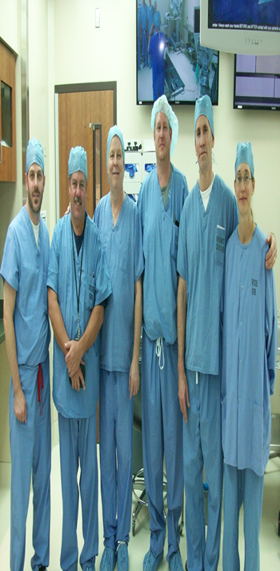
Multidisciplinary Research Team
Dr. Troy Markel – Pediatric surgeon/Associate Professor- Indiana University Health
Dr. Jennifer Wagner, Ph.D., CIC -
Principal- Prism Environmental/Onsite-LLC
Damon G. Greeley
-PE, CEM, HFDP, CBCP, EDAC, CHFM
-Founder & Managing Partner
-Global Health System Inc./ Onsite-LLC
John Ostojic – Industrial Hygienist
-Artec Environmental Monitoring
Dr. Tom Gormley, Ph.D -
Associate Professor -MTSU

Slide 4
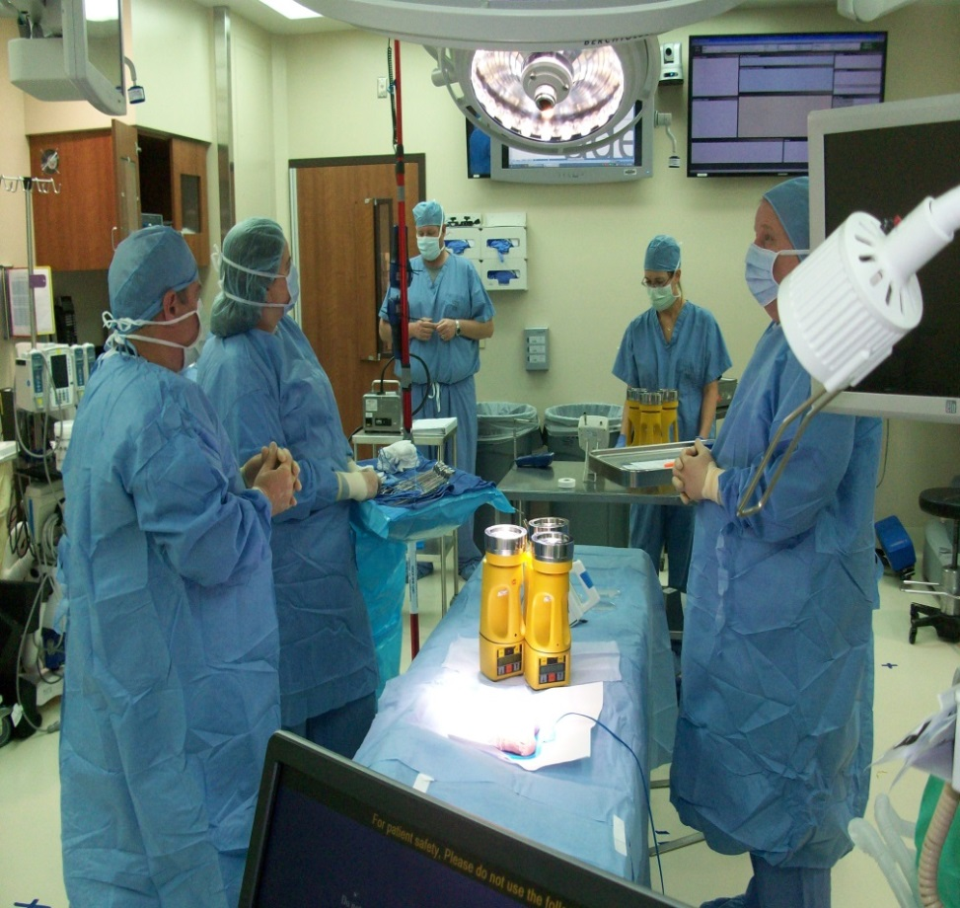
Hypothesis & Cost Benefit Analysis Basis
20 ACH cleaner than 15 ACH
25 ACH cleaner than 20 ACH
5 ACH – typical setback level to save energy when not in use
15 ACH – 2006 Guidelines
20 ACH – 2010 Guidelines
25 ACH - commonly used in the industry and the current set point for all ORs in this study
EQI is a simulated surgical procedure that follows proper techniques for scrubbing and gowning with each team member movements and placements similar to typical procedures while they are generating and gathering data

Slide 5
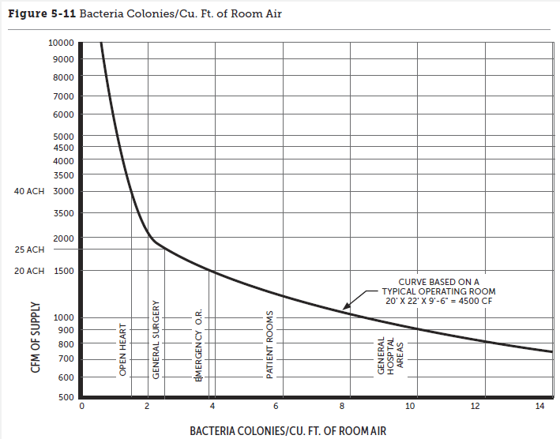
Background: Wide Range in Code and in Practice
*Could Not Find Any Studies for Operating Room In Activity
Examples of Current States
12 ACH allowed in Calif. with 100% outside air
15 ACH prior to 2010 FGI – such as IN, KY
20 ACH after 2010 FGI/ASHRAE – such as TN
20 - 25 ACH – common practice
30 - 40 ACH recommended in certain ORs*
ACH Rate in Guidelines Timeline*
1967 - 12 ACH
1974 - 25 ACH
1987 - 15 ACH
2010/Today – 20 ACH
Source: ASHE

Slide 6
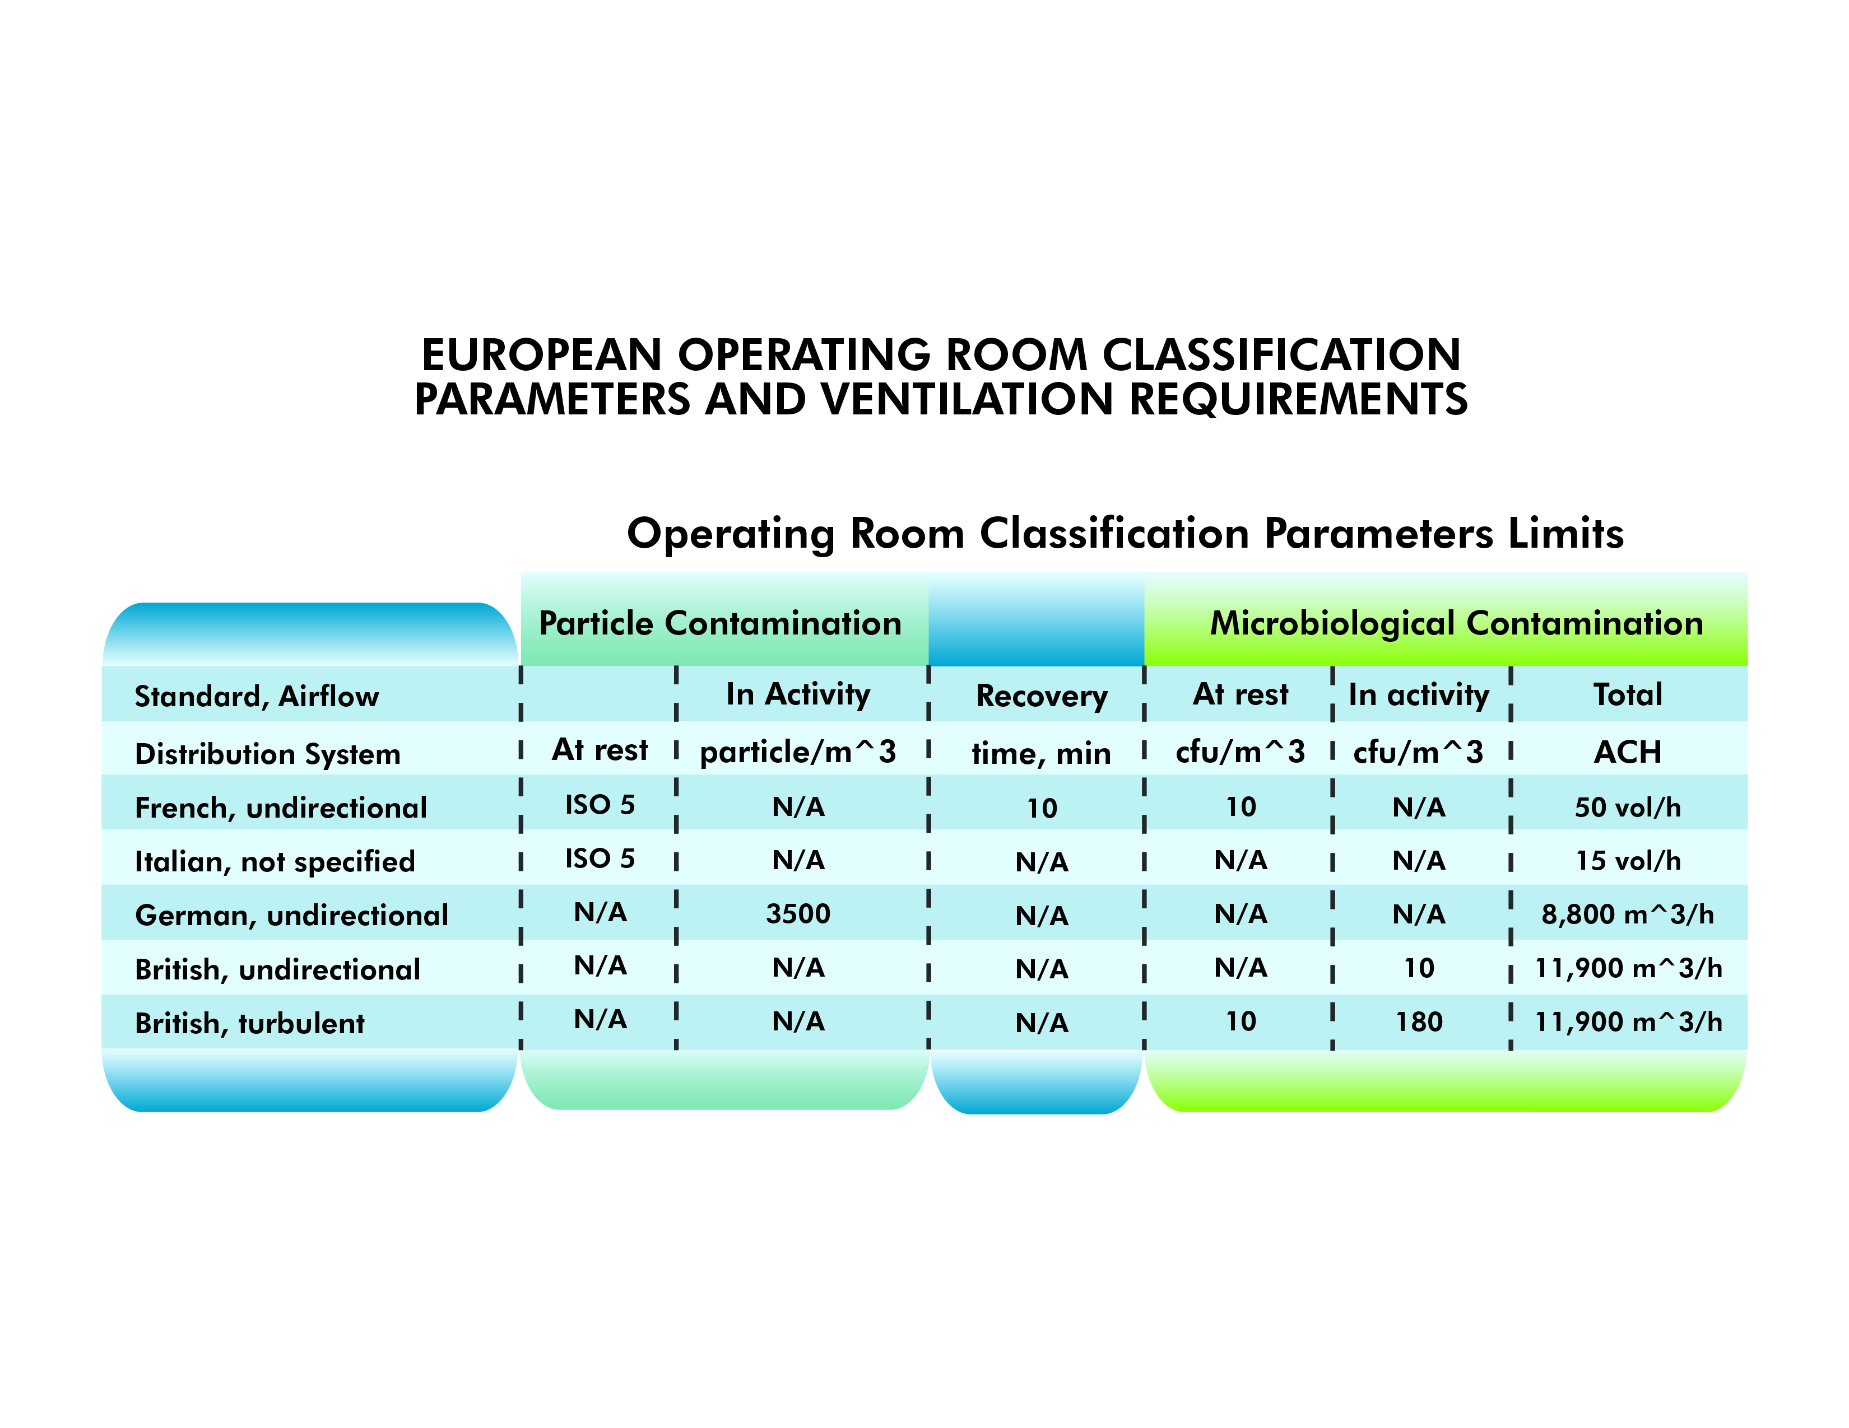
European Approach uses Air Changes Plus Particle and Microbiological Contamination which have Clean Room/ISO Standards
NF –French, UNI-Italian, DIN –German and HTM -British

Slide 7
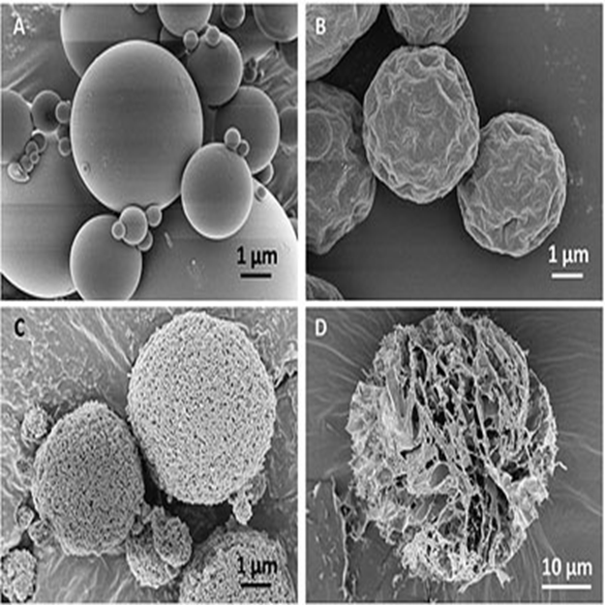
Environmental Quality Indicators – EQIs
Combines US and European healthcare requirements
Utilizes Laboratory and Cleanroom standards
  USP 797
  ISO 14644-1
Continuously measures throughout procedure:
  Temperature
  Relative Humidity
  Air velocity at key points
  Particle counts (0.3, 0.5, 1.0, 5.0 µm)
  Microbial contamination (speciated CFUs)
  Air change or ventilation rates
  Pressure relationships

Slide 8

Factors Relating to HAI During Procedure per NIH
EQi Qualifies & Quantifies Epiphenomenon
Aerosol and droplet transmission dynamics
The nature of the dust levels
The health and condition of individuals naso-pharyngeal mucosal linings
Population density
Ventilation rate
Air distribution pattern
Humidity and temperature
Number of susceptibles
Length of exposure
Number of infected people producing contaminated aerosols
Infectious particle settling rate
Lipid or non-lipid viral envelope or microorganism cell wall
Surrounding organic material
UV light or antiviral chemical exposure
Vitamin A & D levels
Microorganism resistance to antibiotic or antiviral therapy
Type and degree of invasive procedure
Spatial considerations
Contact with a carrier
Persistence of pathogens within hosts
Immuno-epidemiology
Transmission resistance and role of host genetic factors
Dr. Farhad Memarazadeh
Notes:
Farhad reviewed our work, first do no harm, etc…

Slide 9
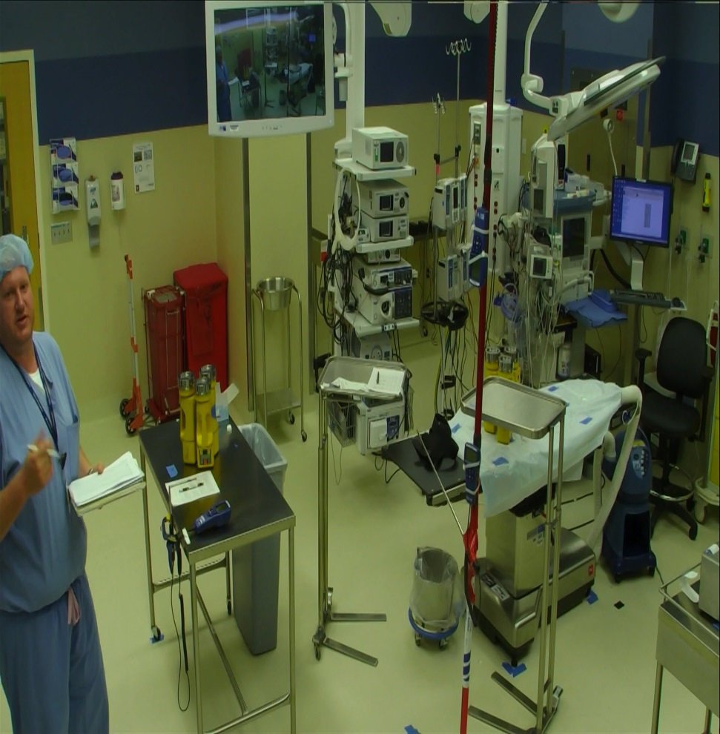
Cost Factors of HAIs
Over 200,000 SSI per year in the US – NIH
SSI 30+% of all HAI – Duke Study
JAMA - Johns Hopkins Study 2013 for patients with an SSI compared to patients without
  Daily total charges $7493 vs $7924,
  Mean LOS 10.56 days vs 5.64 days
  30-day readmission rate 51.94 vs 8.19 readmissions per 100 procedures
  Totals over $500,000,000
Notes:
$500 x 5 x 200,000 = $500,000,000

Slide 10
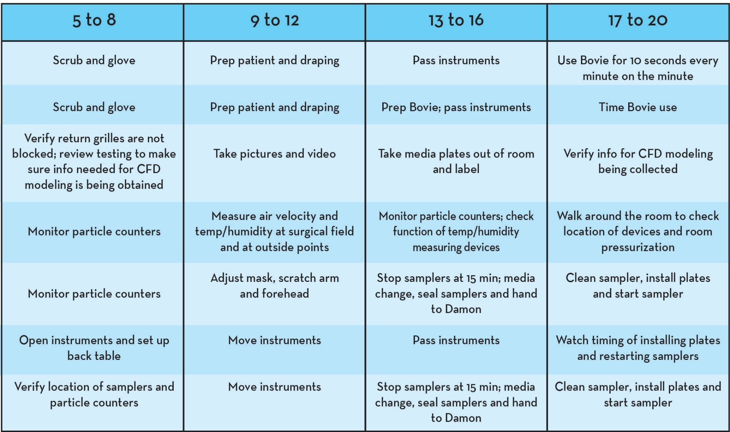
Mock Surgical Procedure
Designed a 1 hour long mock procedure to mimic actual events in an OR, no terminal cleaning prior to
Surgeons and Nurses utilized Sterile Gowning and Gloving
Sterile instruments prepared by each institutions' standard practices
Utilized steak to simulate the patient for Bovie electrocautery device.

Slide 11
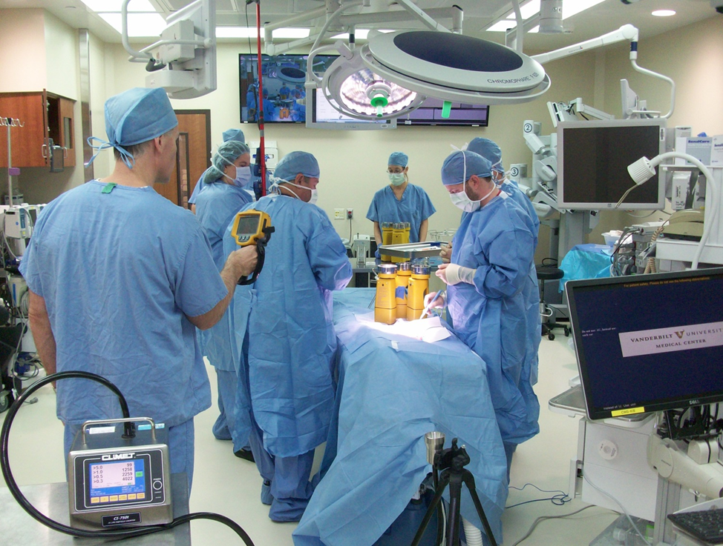
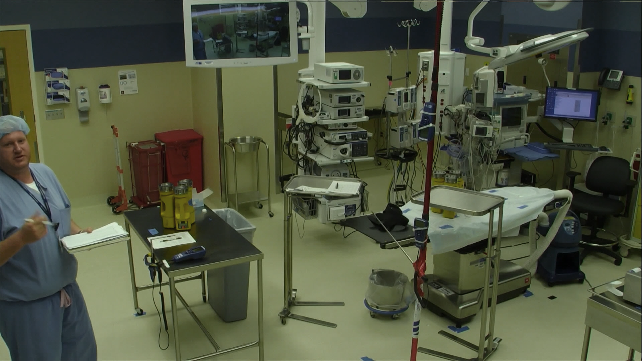
2 min clip from OR procedure

Slide 12
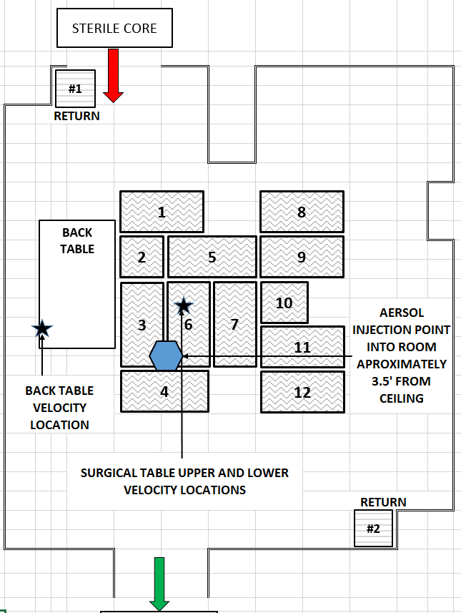
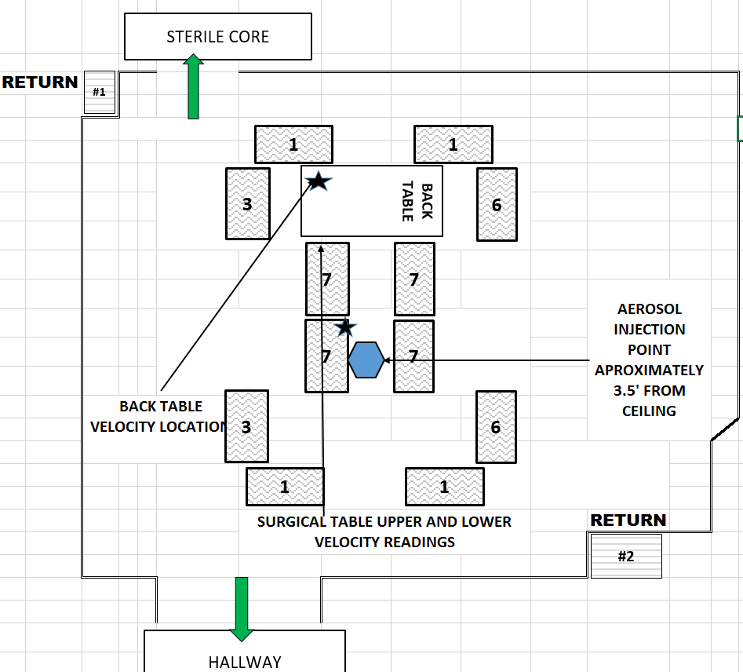
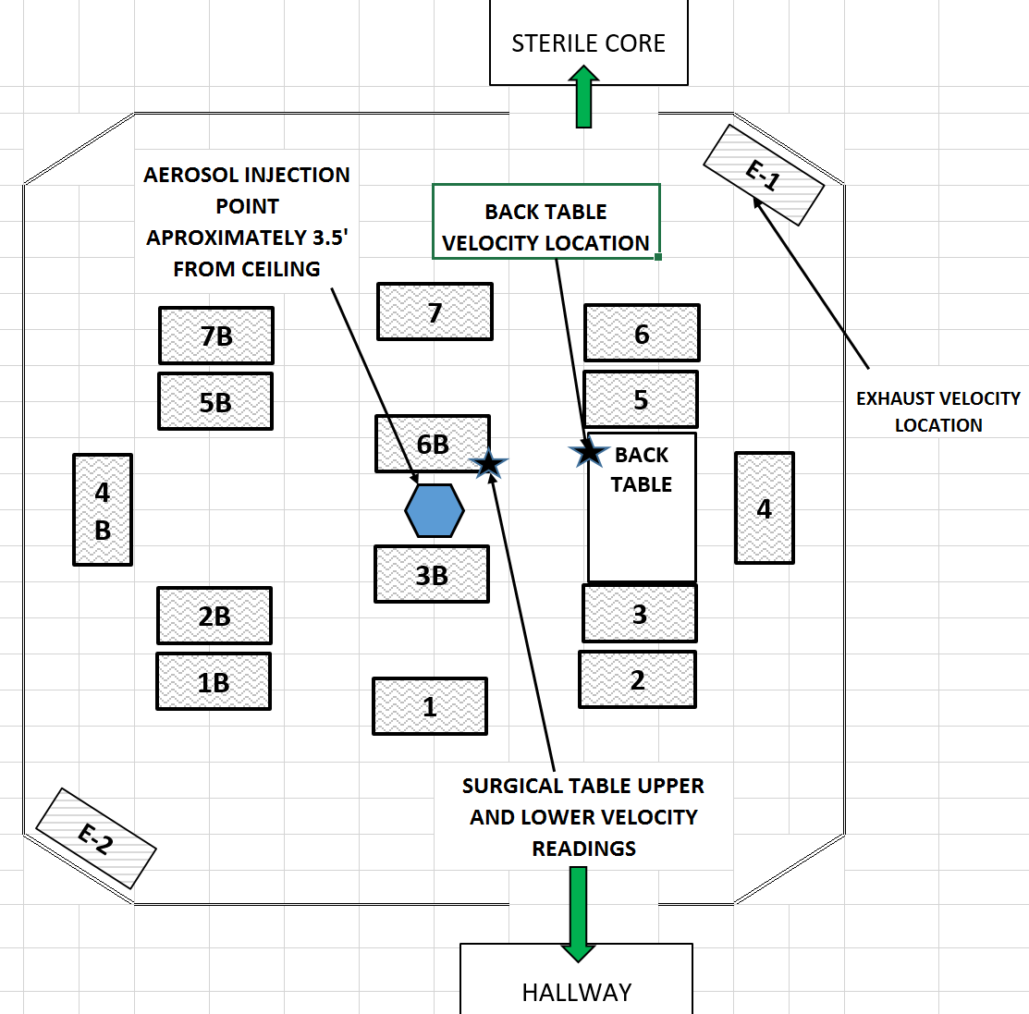
Site OR’s Ventilation Systems Overview
Site | Concentrated Primary Diffuser Array/Unidirectional/2 low returns | ASHRAE 52.2 Room Air Filtration, Normal ACH” | Room Temp & Relative Humidity, Pressure | Pressure Control Method | Notes
A (638 SF) | Yes/Yes/Yes | MERV 17 (terminal) 27 | Avg. 68.5 deg. F, < 60% RH, Positive Pressure | Automatically (BMS) Controlled Room Air Flow Offset | 15 ACPH, 0.0039 neg. pressure to sterile core
B (554 SF) | No/Yes/Yes | MERV 17 (terminal) 26 | 68 deg. F, < 60% RH, Positive Pressure | Direct Pressure Control of Static Pressure Set point
C (505 SF) | No/Yes/Yes | MER 14 (central) 24 | 68 deg. F, < 60% RH, Positive Pressure | Manually Balanced Air Flow to Static Pressure Set point
OR A
OR B
OR C

Slide 13
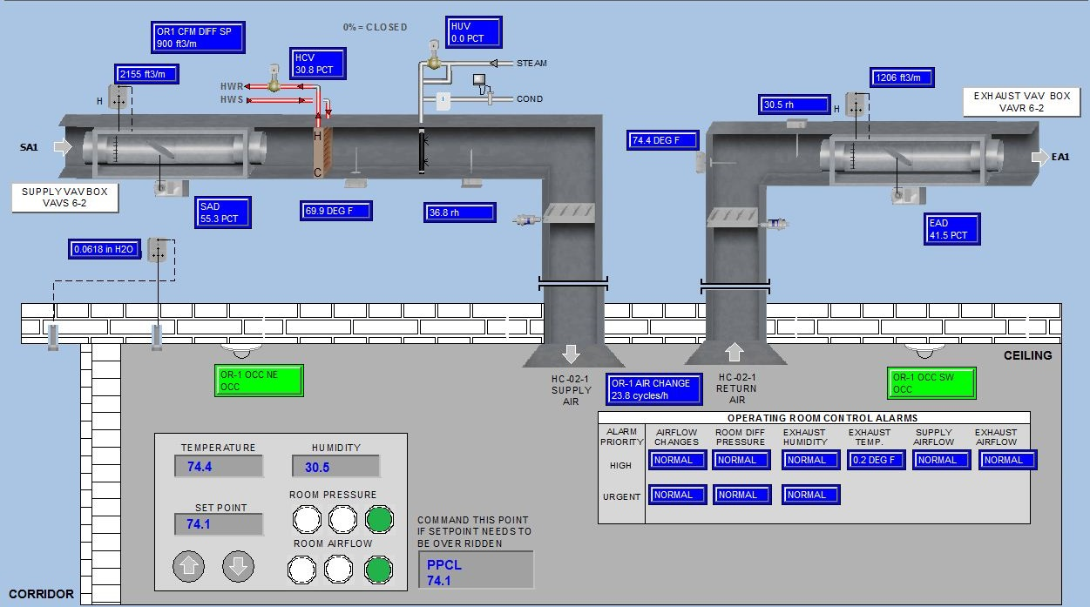
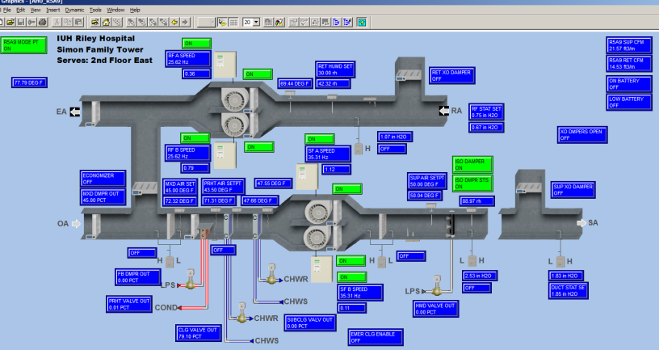
OR Controls & HVAC Configuration – Site A

Slide 14
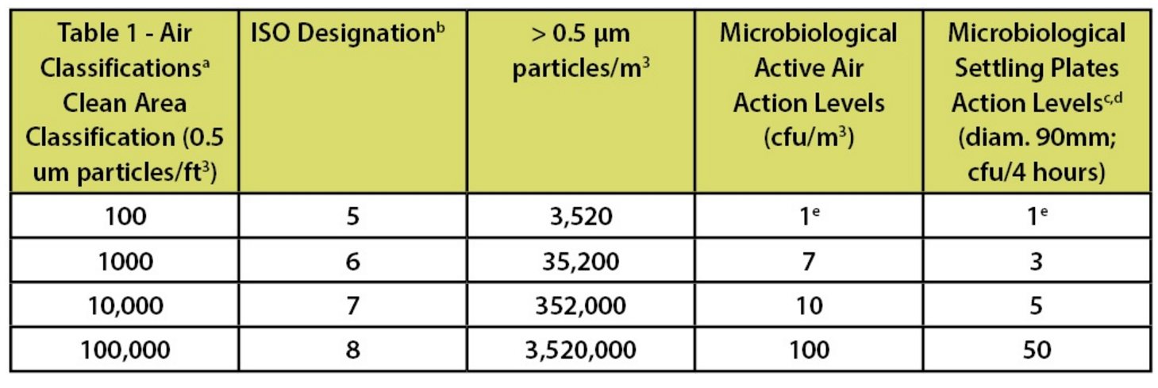
Particulate and Microbial Testing
USP 797 & ISO Standard 14644-1
Note:
ISO Classifications are a range by factors of 10.

Slide 15
Choosing Statistical Procedures for Numerical Benchmarking
In most cases, the microbial and particle data did not meet, either the assumption of normality or the homogeneity of variances and therefore, the median and interquartile ranges were used to determine significance. For velocity data, the assumptions were met and means and standard deviations were used.
Source: University of Tennessee Knoxville

Slide 16
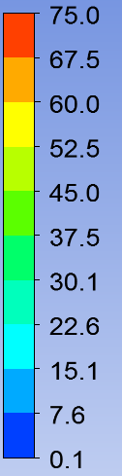
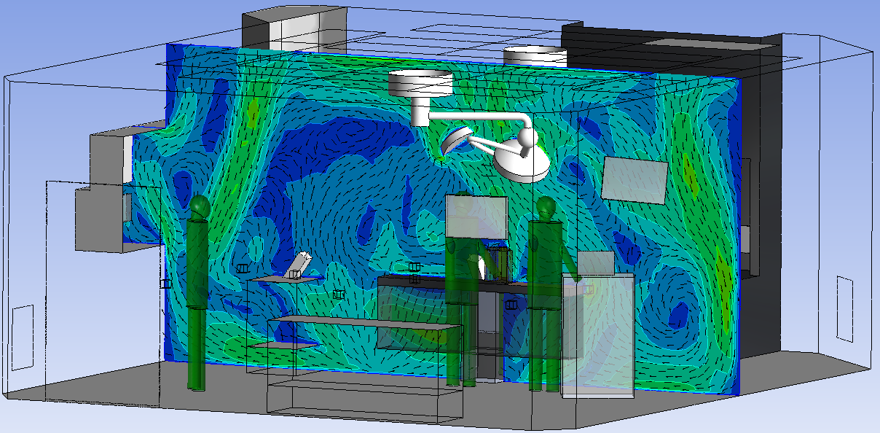
Velocity Contour at Along the Surgery Table
OR C
Ft/min
≥
ACH 25, Supply Temperature: 65 ºF, Return Temperature: 66 ºF
Notes:
NIH as part of review CFD suggested

Slide 17
CFD & Experiment Comparison
OR C Only
 | Lower Supply Velocity (ft/min) |  |  | Back Table Velocity (ft/min)
 | CFD Results | Experiment Results | +/- % Variance | CFD Results | Experiment Results | +/- % Variance
ACH 15 | 11.19 | 12.07 | 7.9 | 8.7 | 8.5 | 2.3
ACH 20 | 8.01 | 13.38 | 67 | 17.5 | 9.42 | 46
ACH 25 | 16.42 | 16.62 | 1.2 | 18.67 | 16.88 | 9.6

Slide 18
Cost Factors for 5 OR ACH/Year Reduction
Sites A, B, and C
20 ACH ~ 2,000 CFM
Electrical Energy - Fans, Pumps, Cooling
Thermal Energy – Preheat and reheat
Steam - Humidification
Utilization Hours:
  Cooling
  Heating
  Economizer
  Dehumidification/Sub Cooling

Slide 19
Operating Cost Savings Summary
$
10,068
7,052
5,218
$
$
- 5.0 ACH
- 5.0 ACH
- 5.0 ACH
OR A
City Thermal
Climate Zone 5
OR B
Campus Thermal
Climate Zone 4
OR C
Self Generated Thermal
Climate Zone 4
Notes:
Formulas were validated by third party for custom utility incentive and national healthcare engineering firm
2. Does not include water costs for humidification

Slide 20
Conclusions
There were differences between the cleanliness of the environment at the sterile field versus the back table.
Level of cleanliness was dependent upon air filtering and air distribution
USP 797 ISO 14644-1 Classification may not be specific enough to benchmark higher environmental quality indicating (EQI) OR environments
Data ‘points’ to greater ACH rates did not consistently and significantly produce a cleaner environment (statistically significant less particles), in some cases it was even less clean

Slide 21
Moving Forward….
Question: Through better or different approaches for “air management” in the operating rooms, could cleaner air could be delivered at key points, such as the back table and sterile field, at no more or maybe even less cost.
Would further testing of the relationship between air distribution at the sterile field and back table be beneficial to support an acceptable qualifiable and quantifiable level of cleanliness?

Slide 22
The EQi Team Thanks You
EQI stands for environmental quality indicators and our team tests the air environment (particulate and microbial counts) of healthcare spaces based upon certain operating parameters, procedures, methodologies, or products that claim to improve efficacies. All of our testing procedures evaluate the micro biome in which we capture, enumerate, and speciate particles and microbes that could be potentially pathogenic to both healthy and immunocompromised patients that are undergoing some type of treatment or procedure.
Supported by Global Health Systems Inc.
www.globalhealthsystemsinc.com

