Slide 1

Humidity and Beyond: DA Series
Absorption Dehumidifiers

Slide 2

Agenda
Dehumidification Types
DA Product Overview
Applications
Sales Tools

Slide 3
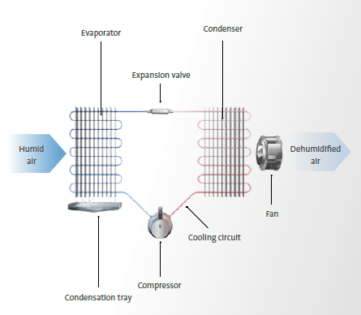
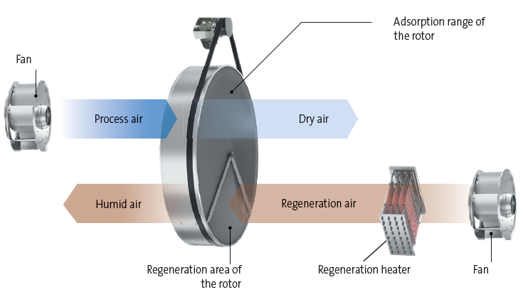
Dehumidification Types
Condensing Vs Absorption
Condensation Dehumidifiers
Absorption Dehumidifier
Notes:
Highlight which one we sell

Slide 4
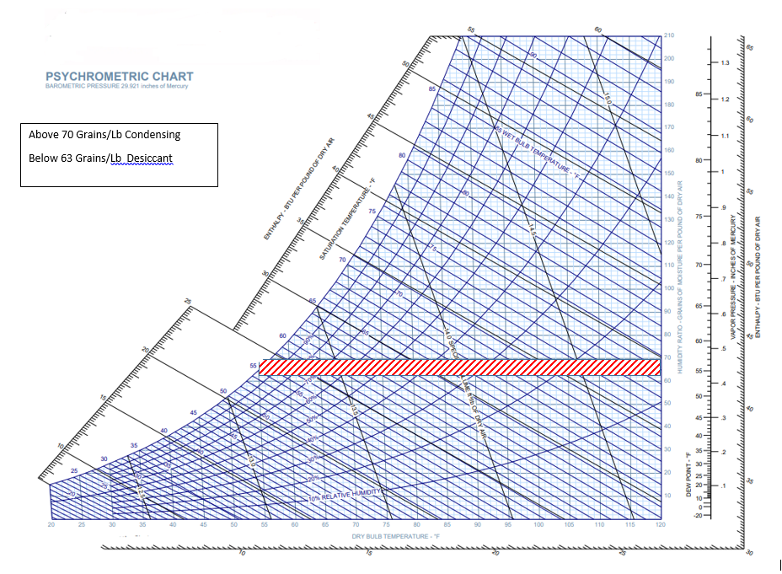
Dehumidification Types
Which dehumidifier to Use?
Starting Absolute Humidity:
> 70 gr/lb: Condensation
< 63 gr/lb: Absorption
Notes:
When you look at the absolute humidity when would you use
Desiccant
When the temperature is low
When the moisture content is low (lower than approximately 8-10 g/kg)
When a precise moisture level is needed.
Condensing
When the temperature is High
When the moisture content is Higher (Higher than approximately 10 g/kg)
When a less precise moisture level is needed.

Slide 5

DA Series
Product Overview

Slide 6
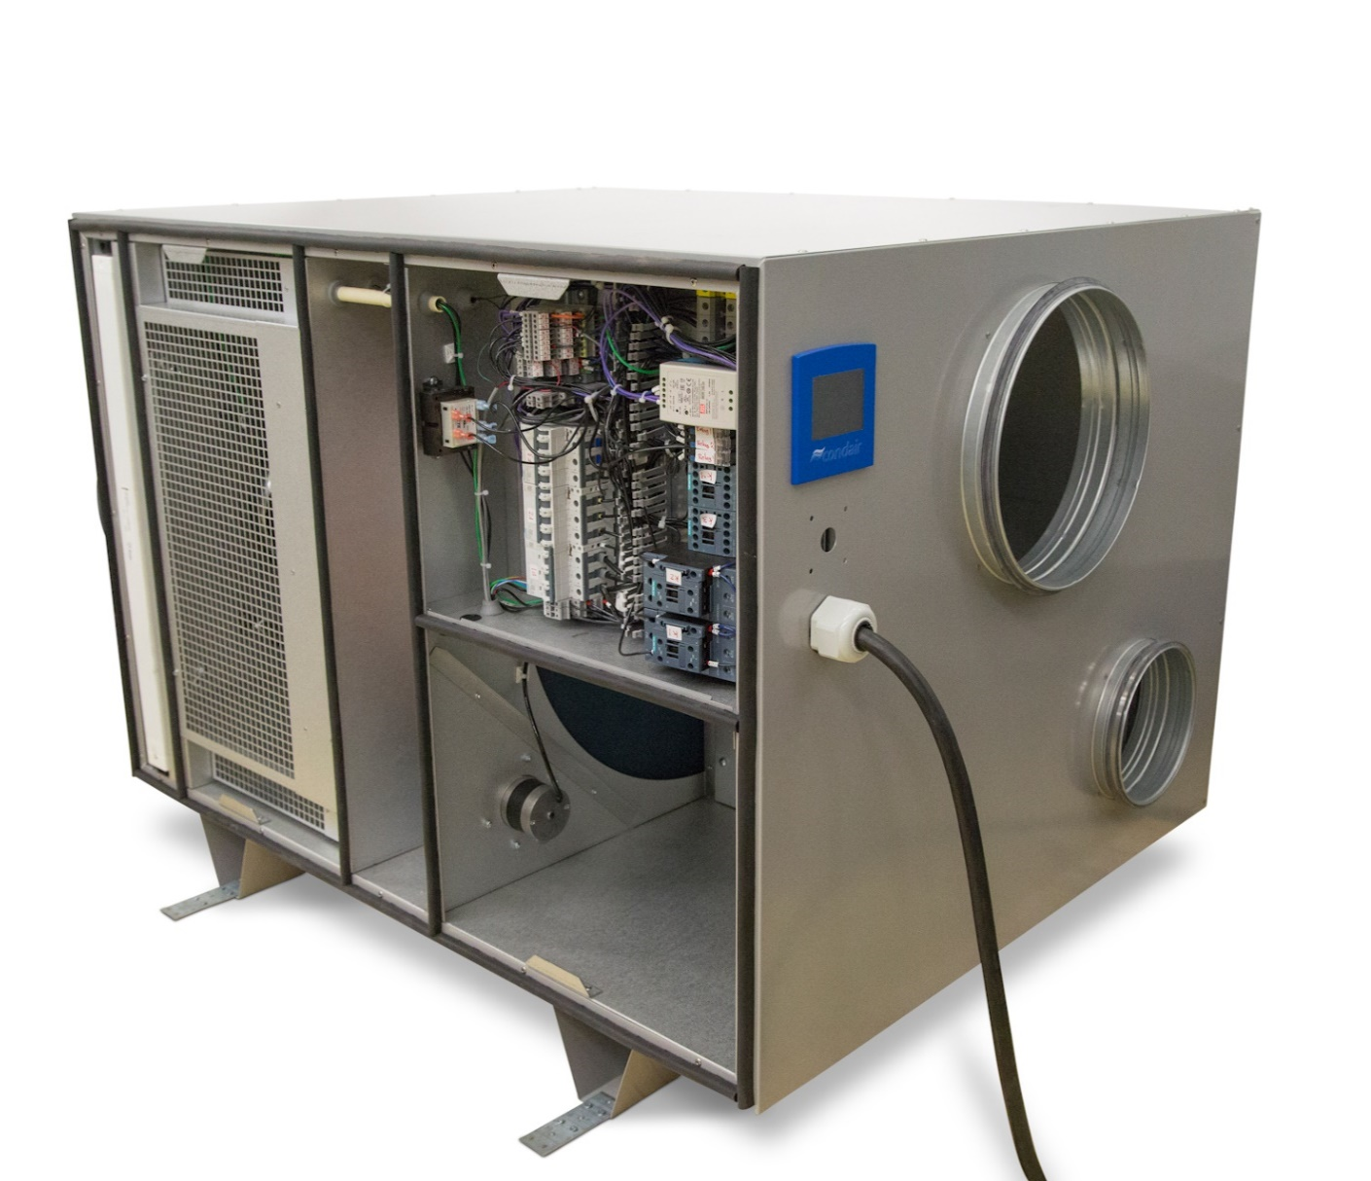
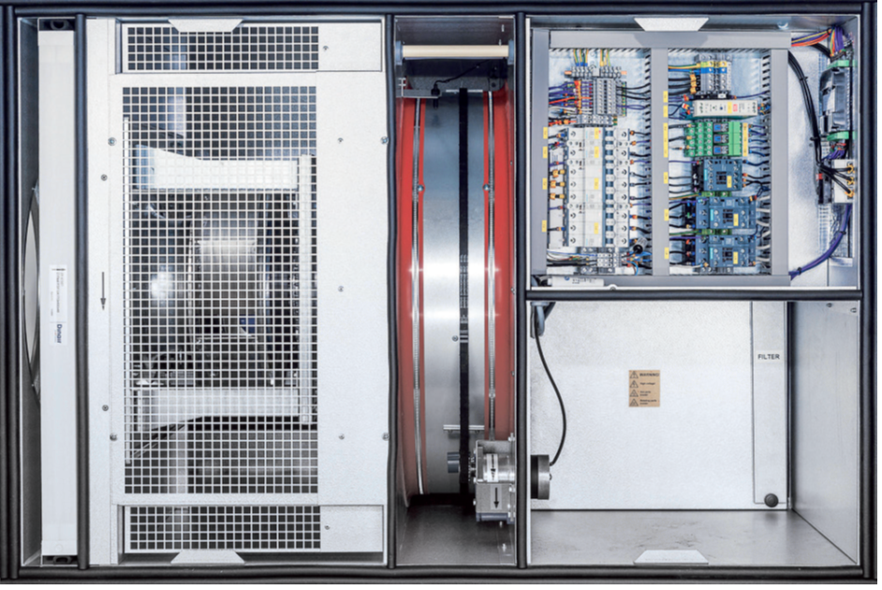
DA Product Overview
B
G
A
C
E
A: Process Air Filter
B: Process Air Pushing Fan
C: Rotor
D: Motor
E: Reactivation Section
F: Reactivation Air Filter
G: Electrical
F
D
7

Slide 7
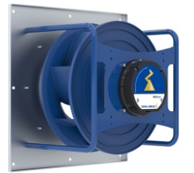
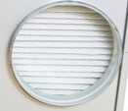
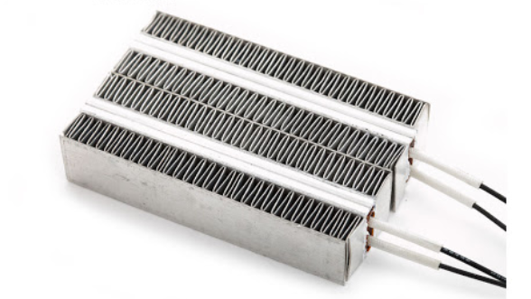
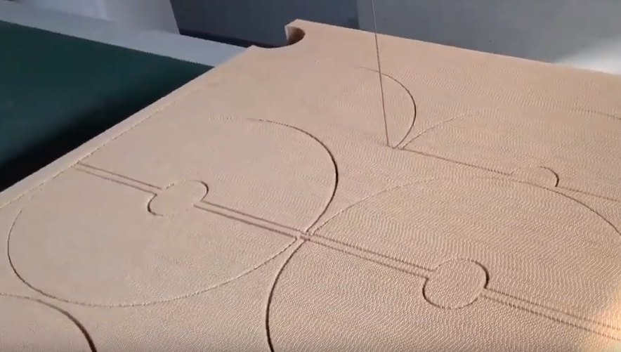
DA Product Overview
Key Features
PTC Heater | Fan | Rotor | MERV 7 Filter
Electrical reactivation with self-regulating PTC heater | Direct drive variable speed pushing fans | Vertically mounted silica gel rotor with large surface area and low-pressure loss. | All units supplied with filters on process and regen air as standard
Eliminates overheat risk | Allows fan speed adjustment and flexibility between process and reactivation air | Very high absorbency, better operation efficiency. Consistent equipment footprint. | Improves air quality, lifecycle of rotor

Slide 8
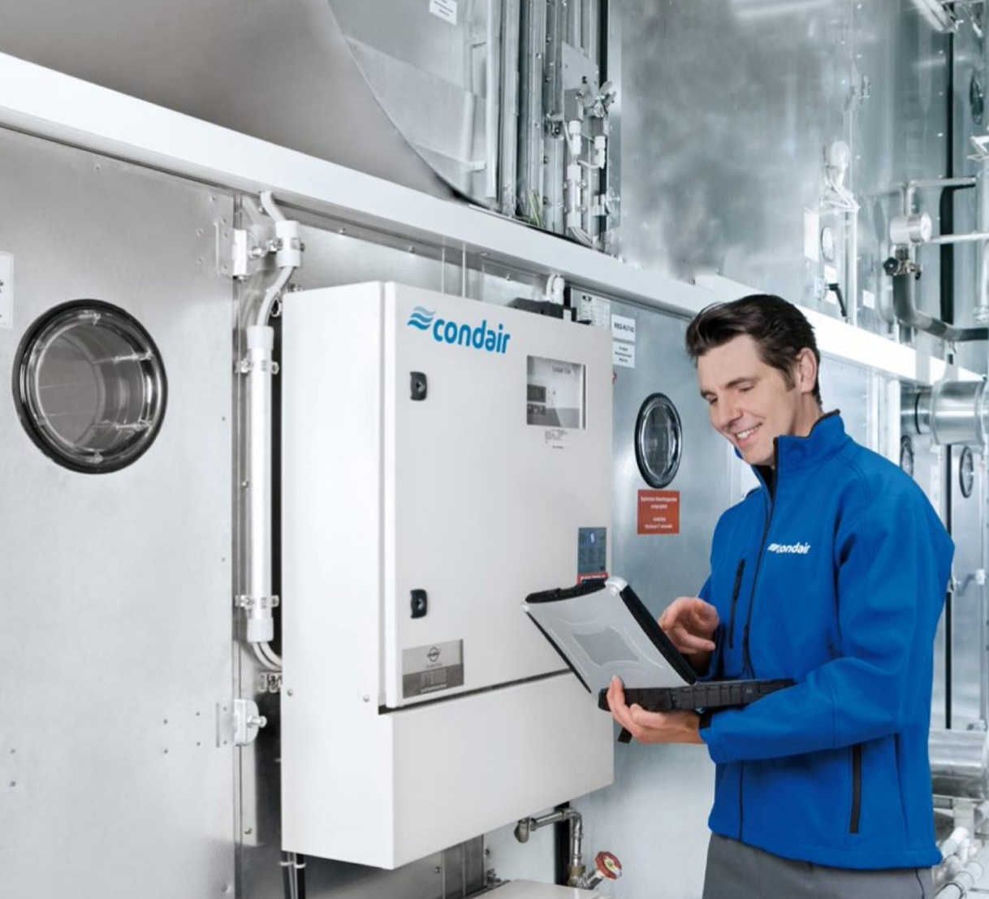

Applications

Slide 9
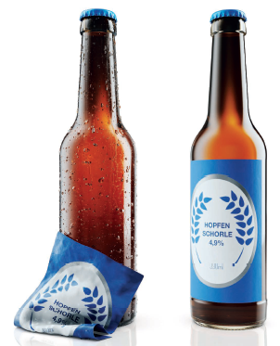
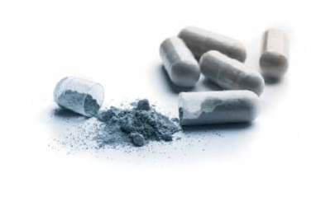
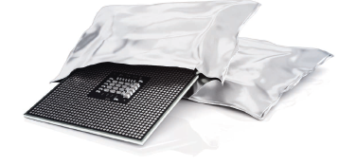
Applications
Common Applications
Laboratories
Food Industry
Pharmaceutical Industry
Electronic Industry
Breweries
Power Plants
Storage
Cold Storage
Notes:
Controlling humidity levels in production process
Drying of temperature sensitive products
Maintaining correct humidity in storage areas
Protection of equipment sensitive to corrosion
Controlling humidity levels in museum and archives
Drying after water damage and drying of buildings during construction
Climatic improvements in damp areas.

Slide 10

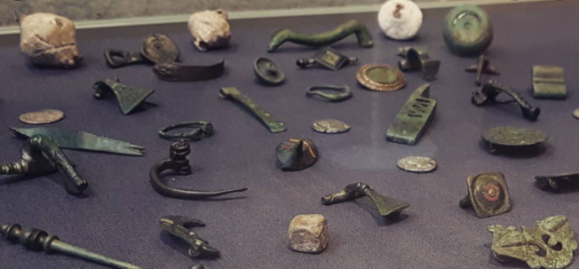
Applications
Museum and Archives Facilities
Material degradation (historical books, paintings, objects, etc.).
Decay of paper and painting through fading of dyes and colors
Corrosion of metals
High humidity levels expediate the process of organic corrosion
The goal is to controlling humidity levels in museum and archives
30%-50%RH depending on the application.

Slide 11

Application
Lithium-Ion Battery Plants
US Department of Energy (DOE) to invest $3 Billion
The goal is to close the gap in supply chain disruptions and accelerate battery production.
800,000+ sq ft plant.
Extremely low humidity conditions.
Custom units available for up to 16,000cfm for special projects.
Notes:
With global Lithium-ion battery expected to grow rapidly in the next decade, DOE is making it possible for the US to be prepared for the market demand. The goal is to close the gap in supply chain disruptions and accelerate battery productions in America.

Slide 12


Sales Tools

Slide 13
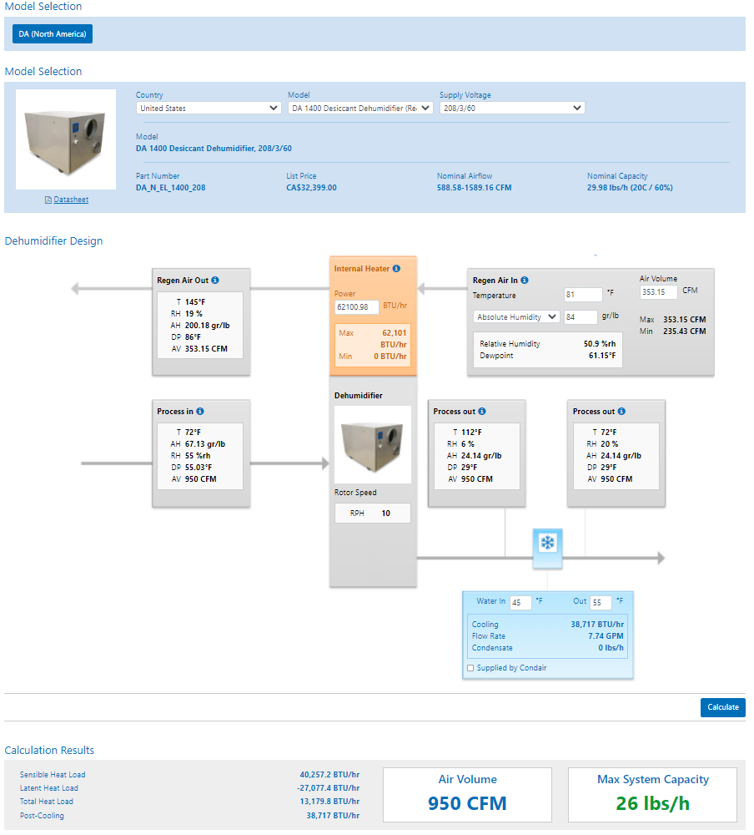
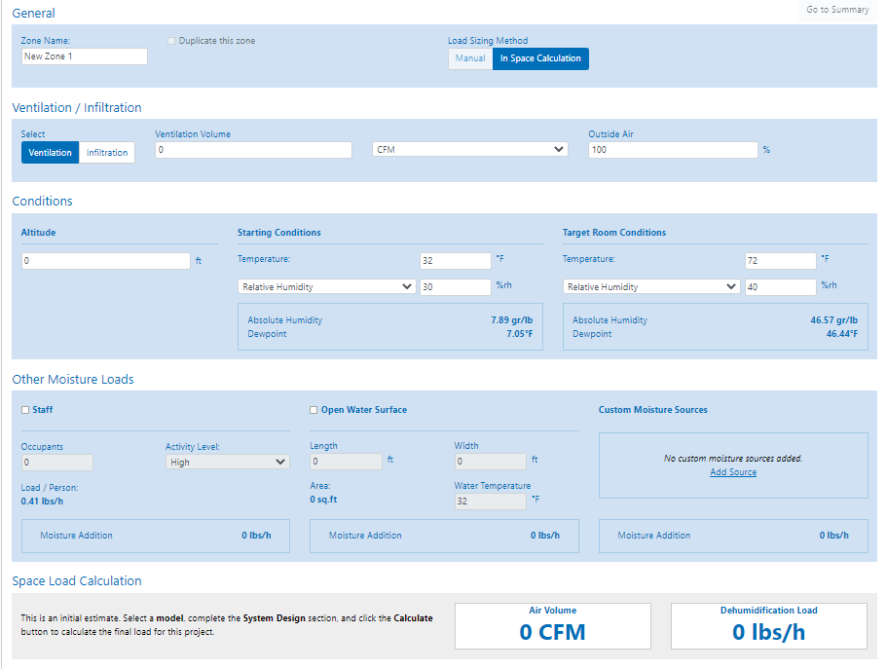
Sales Tools
HELP Software

Slide 14
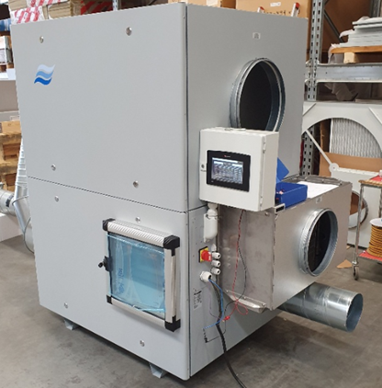
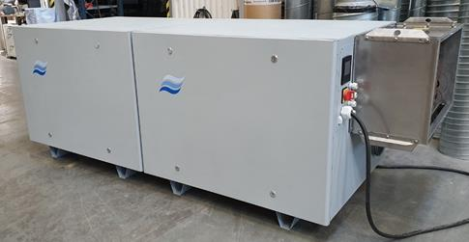
Sales Tools
Cooling Coil
Pre-Cooling Coils
Precooling (sensible) or Precooling/dehumidification (latent)
Used to adjust total performance
Post-Cooling Coils
Used to trim temperature (sensible only!)
Available in Help!

Slide 15
Sales Tools
Additional Support
Technical Product Manager (ME)
Regional Sales Managers
(Thom, David, Brent, Wafik, Jerry, Alvie)
Applications Engineering
na.applications@condair.com

Slide 16
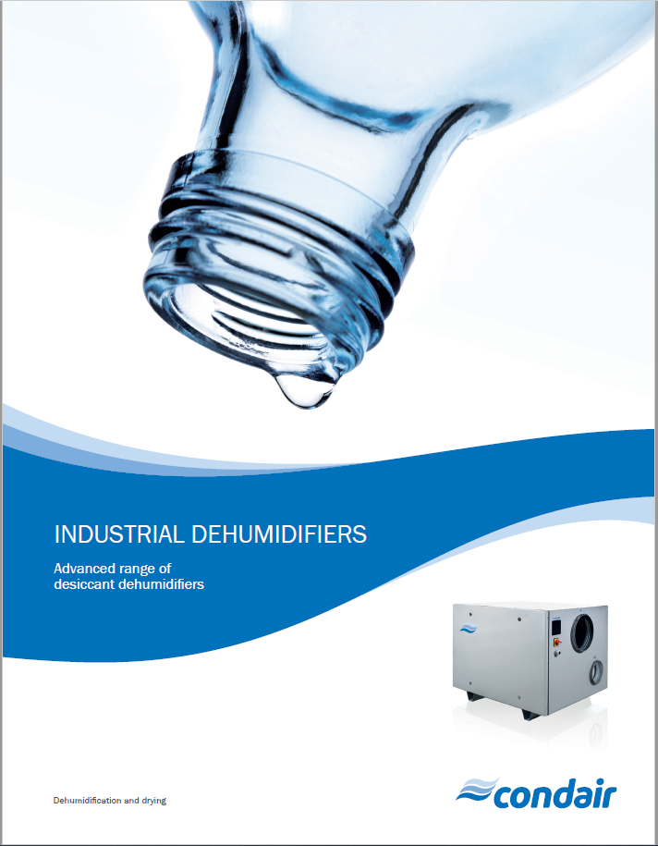
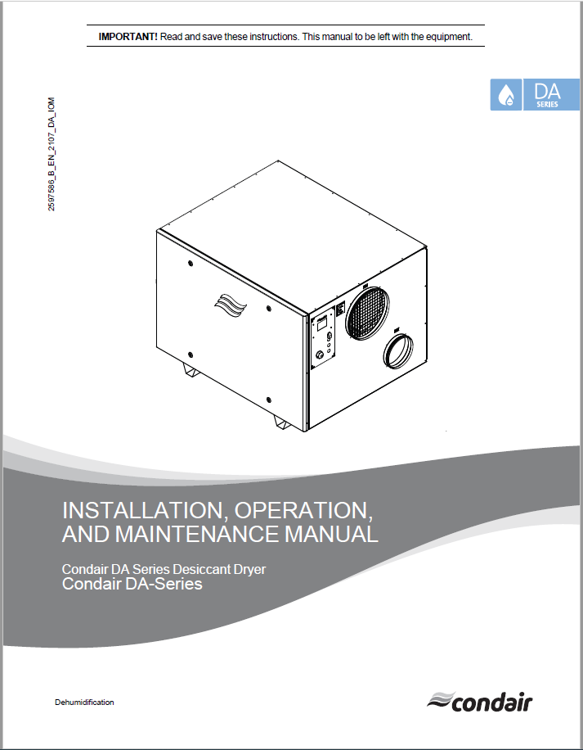
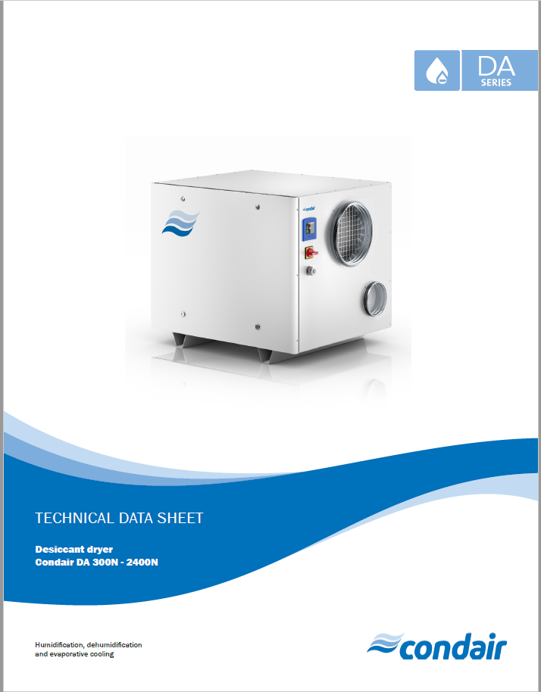
Sales Tools
Technical Manuals
Technical Brochures
Installation Manuals
Technical Data Sheets

Slide 17
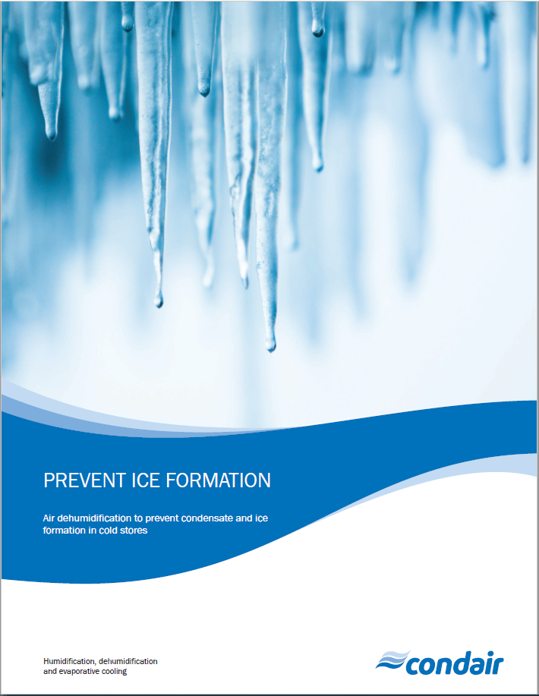
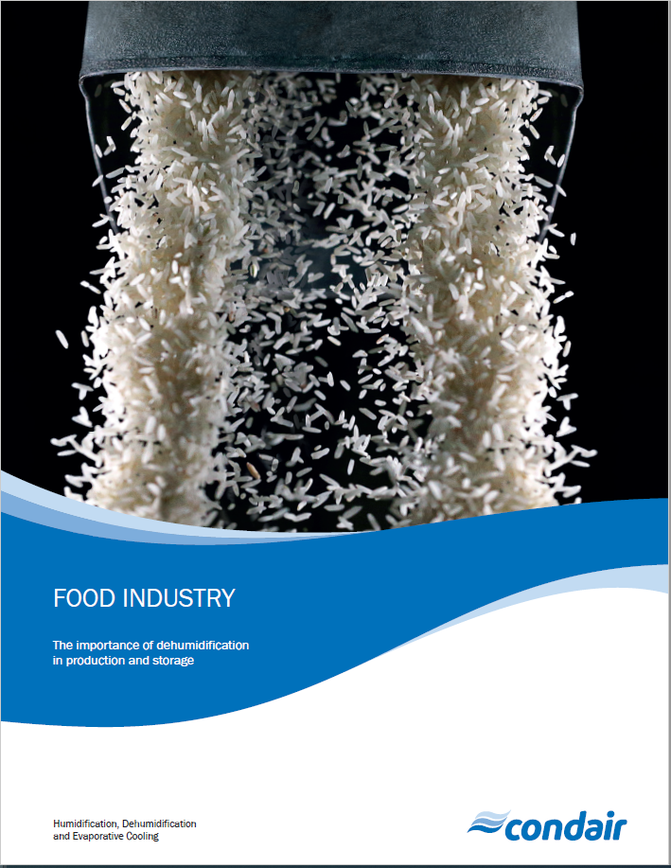
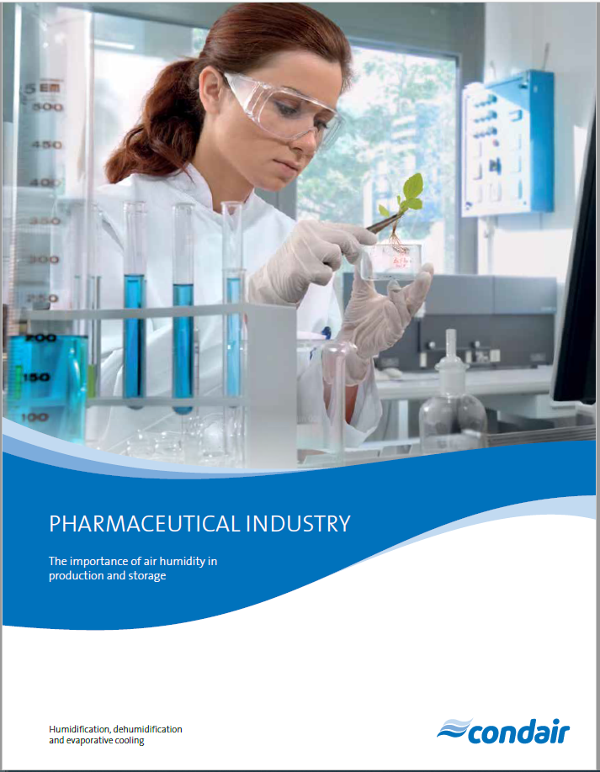
Sales Tools
Application Brochures

Slide 18

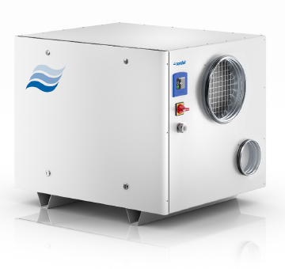
Summary
Premium quality product
Strong Condair name
UL Certified
Call regional managers for custom applications.
Product selection through HELP software and strong application support.
LET'S GET OUT THERE AND SELL DEHUMIDIFICATION!

Slide 19
Thank you!
Ashutosh Upadhyaya
Technical Product Manager

