Slide 1
Humidity control in Healthcare
Thomas Klein
Condair Country Manager, USA
thomas.klein@condair.com

Slide 2
Agenda
ASHRAE 170 and it’s effect on healthcare
Trends in the Market
Humidity Control as a competitive advantage
How Condair can help to meet those goals

Slide 3
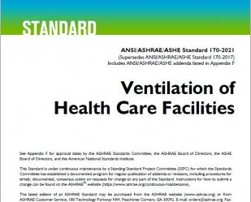
ASHRAE 170
Ventilation of Healthcare Facilities
Sets recommended minimums on air changes, positive or negative pressure, filtration, air quality (in a way) and humidity.
Provides a guideline for technologies to be utilized for humidification: (Isothermal and Adiabatic)
Engineers typically design to these standards as a minimum but can deviate as needed on a project-by-project basis.
Owners, can require/request additions to their buildings where the standard doesn’t have a recommendation (ie. RH% 40-60)
Needless to say, all healthcare projects use this standard as a starting point for their Ventilation, Filtration and Humidification goals

Slide 4
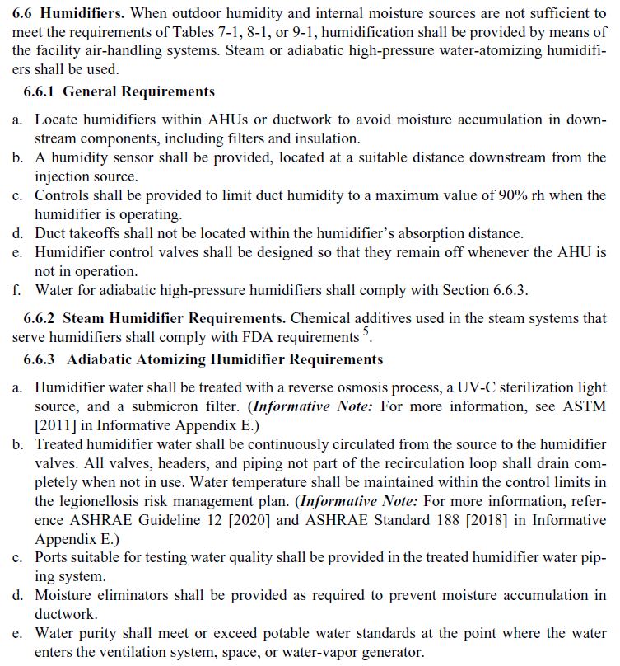
ASHRAE 170 and Humidifiers

Slide 5
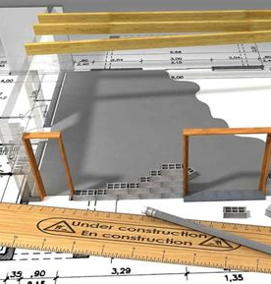
What is the INTENT of ASHRAE 170?
How do you meet it with good economics and practice?
ASHRAE 170 changed 3 years ago to allow pressurized water to be utilized in a hospital setting along with all traditional isothermal options. WHY?
A member of the 170 board was designing a new hospital and was MANDATED to save energy while at the same time meeting recommended and desired humidity levels.
The only solution… Adiabatic humidification. This is and will be a major trend that will continue for all healthcare in the US market. (Decarbonization, Electrification, Green Buildings)
With that in mind there are two goals that are outlined in the standard to utilize this technology:
A. No Stagnate/Standing Water! Water must not sit in the lines feeding the system or have standing water inside the unit.
B. No Legionella! Utilize UV lights to control organic material and assure that water does not stand OR get too warm.

Slide 6
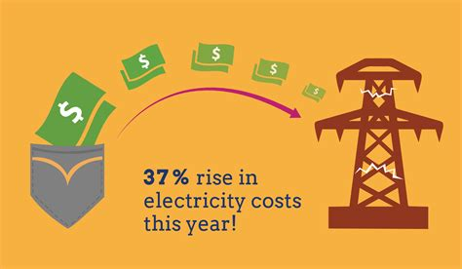
Market Trends
What’s driving the current market and buildings?
Market consolidation: New facilities
Green Building
Decarbonization / Electrification
Goal of Zero Boilers
Energy Costs
The Joint Commission
13.05.2024
6

Slide 7
Market Consolidation
The trend continues (covid didn’t slow it down either)
Fewer but larger groups
Heavy competition for new patients
New needs for better HVAC (Covid)
Old hospitals get decommissioned for new high-tech buildings (first hot water only Hospital in the USA)
Air Quality as a competitive advantage (Patients, Employees and Visitors)

Slide 8
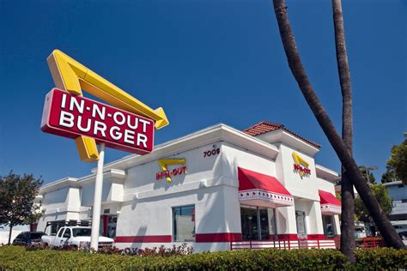
Pop Quiz Time!!!!!
What industry uses the most energy?
Pharma
Healthcare
Manufacturing
Industrial applications
Hospitality
Data Centers
Fast Food
Homes
Office Buildings
Transportation
Healthcare is second!

Slide 9
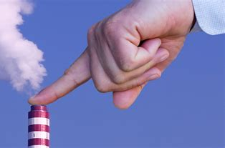
Energy / Carbon / Electricity and Green Buildings
Zero Boiler steam! (Move away from Gas)
Good community participant!
Electrification!
Green Buildings!

Slide 10
Energy Savings
We’re going to build a new building anyway….
Some municipalities are requiring reductions as a condition of a new building
Cost of Energy!
Allows for a new approach to the building as a whole
Need for a comprehensive view of the HVAC system specifically
Provides opportunities for retrofit as well!
Any place we see loads of 200 lbs of humidity or greater is a great place to access alternative methods (Move to Adiabatic is a trend)

Slide 11
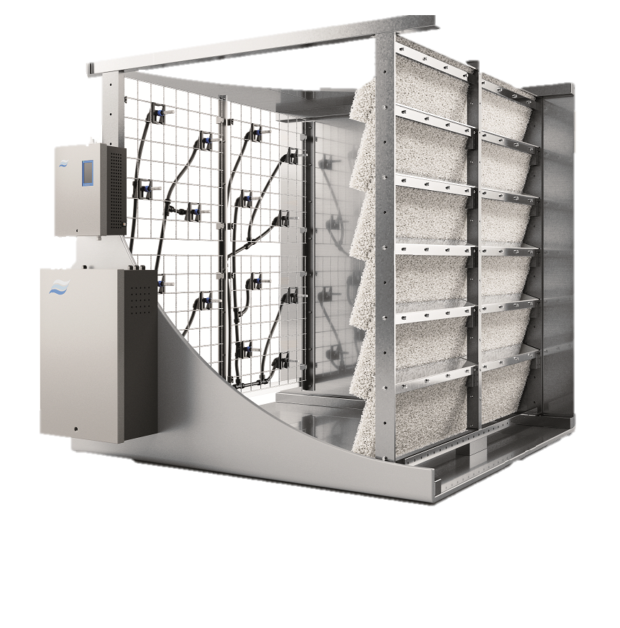
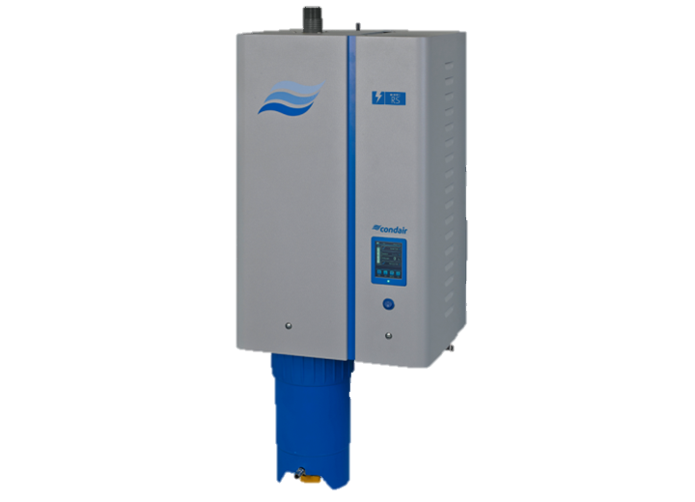
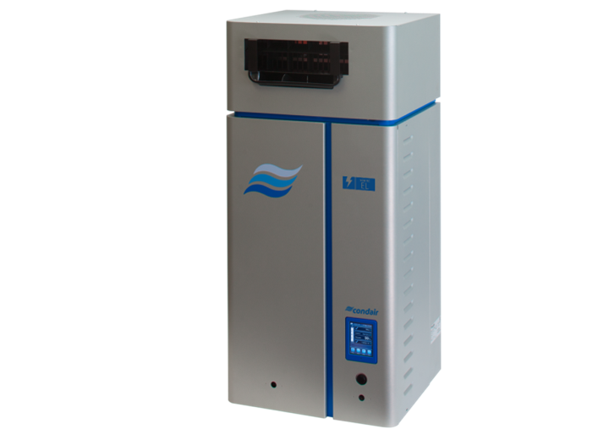
Energy Savings
Trend: Electrification
Application: Hospital
Load: 2200 lbs/hr
 | Power Consumption (kW) | 2000 hours @ $0.08/kW
DL Series
RS Series
EL Series
2.6
$416*
780
$124,800
737
$117,920
*With beneficial evaporative cooling
Notes:
2.6 kW = all the lights turned on in your house
780 = heavy machinery operating 24/7
Considering reheat for when free cooling is not wanted

Slide 12
Average Annual Operating Costs by Technology
Title -subtitle
Assuming 1000 lbs/hr (~300kW cooling), 3500 hr/yr
Does not include water treatment or pre-heat/reheat costs

Slide 13
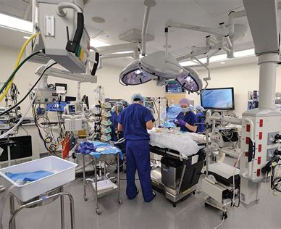
The Joint Commission (and others)
Closer monitoring… on both ends of the spectrum

Slide 14
Humidification as a competitive advantage

Slide 15
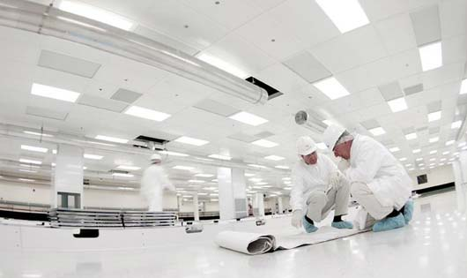
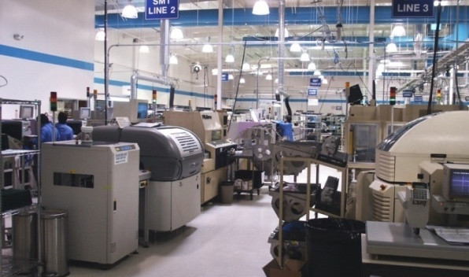
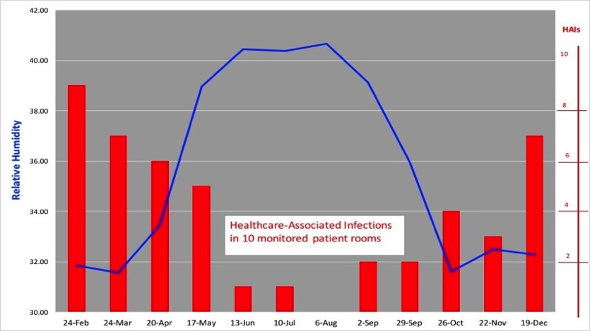
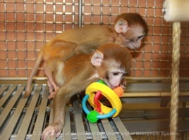
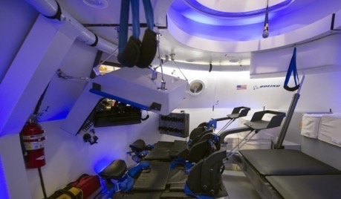
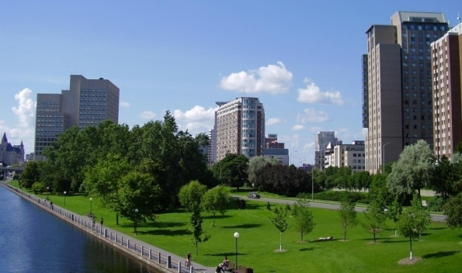
As competition heats up….
Give yourself a competitive advantage!
For Process
For People
For Profit / Cost Savings
Manufacturing
High-Tech
Laboratories
Data Centers
‘Green’ Buildings
Healthcare
Aerospace
Defense
Lower Flu/Cold Transmission
Higher Productivity
Dry Indoor air correlated with Patient HAI’s!
National Institute of Health animal facility: $22k to replace a primate
NASA spacecraft: Cost to train an astronaut: $50 mil (2006)
The Louvre: Mona Lisa value: 780 mil

Slide 16
Proper humidity levels is good business
Send patients home sooner with less complications!

Slide 17
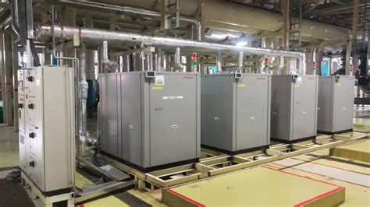
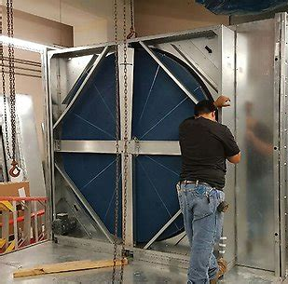
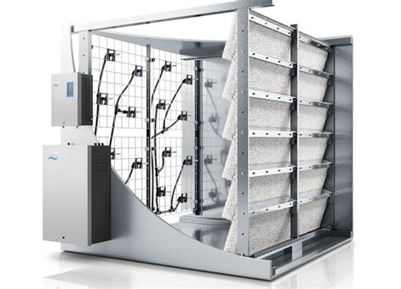
Energy Savings as a competitive advantage
You can have your cake and eat it too…
“Bridging the gap between ASHRAE 90.1 and 62.1”
We have an energy calculator to show savings

Slide 18
ASHRAE Epidemic task force
Humidity is the missing leg in healthcare
Ventilation
Filtration
Air Cleaning
Humidity (when building envelope allows)

Slide 19
Condair

Slide 20
How Condair can help you meet those goals
The Worlds Leader in Humidification Control
Over 75 years of success as a humidity control company
It’s in our DNA to make everyone's life better through proper humidity levels
Global HQ in Switzerland with production and sales offices globally placed
We offer SOLUTIONS not products!
Our local service team is available for post sales PM
Our North American sales and support team stands ready to address any project big or small!

Slide 21
Condair Portfolio

Slide 22
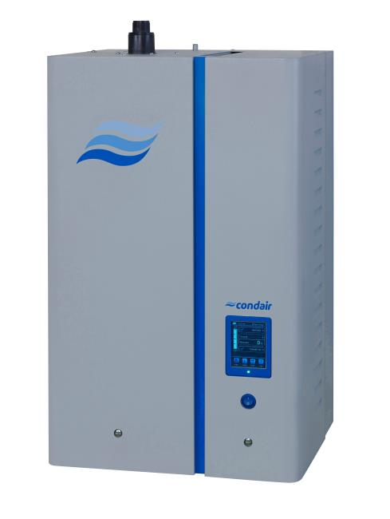
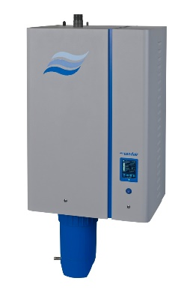
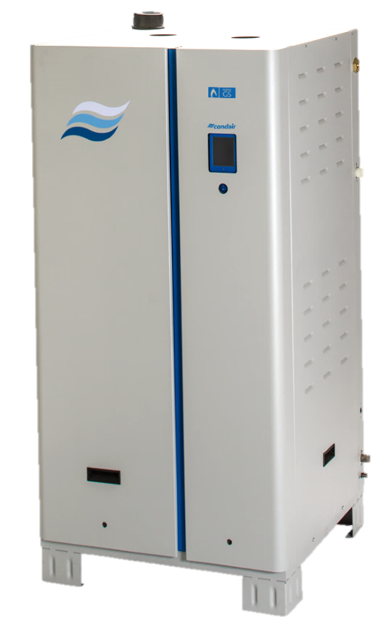
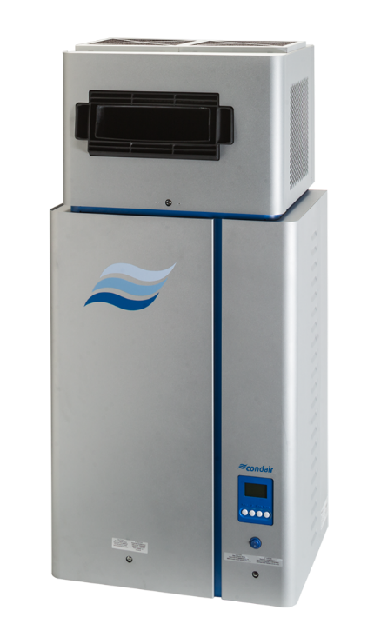
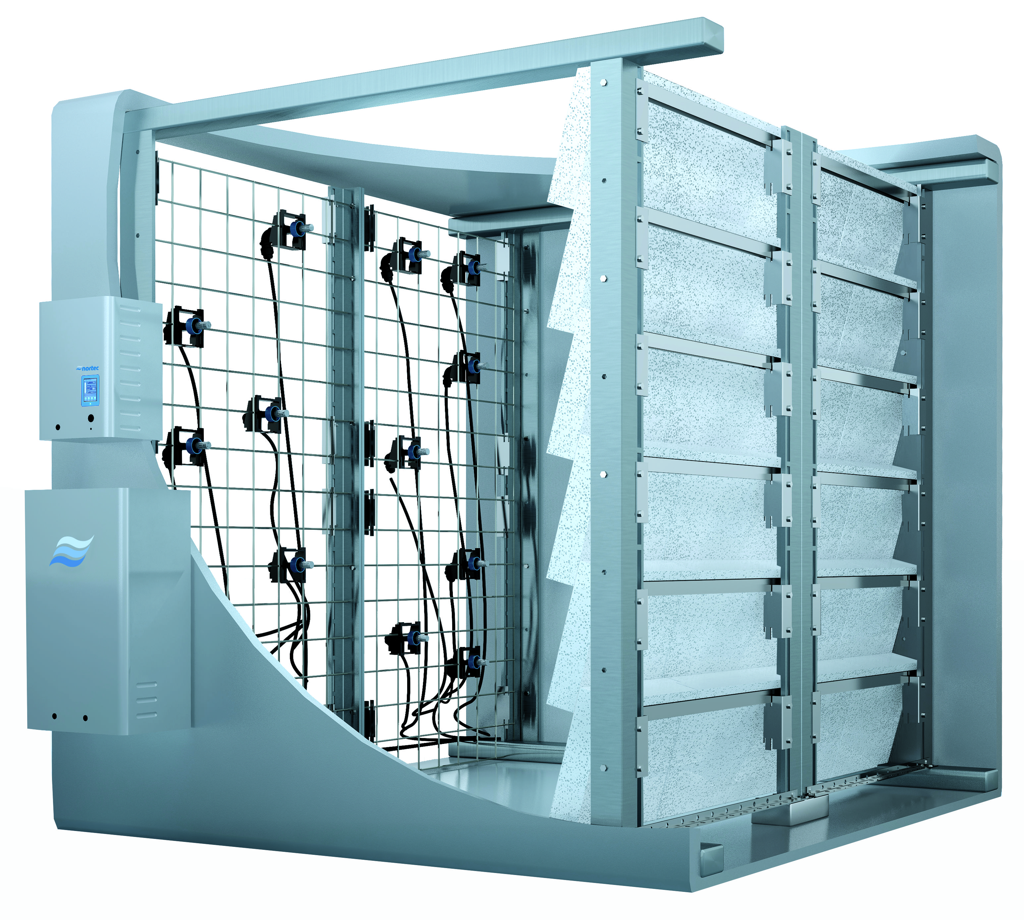
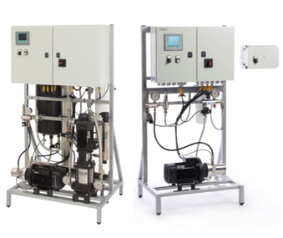
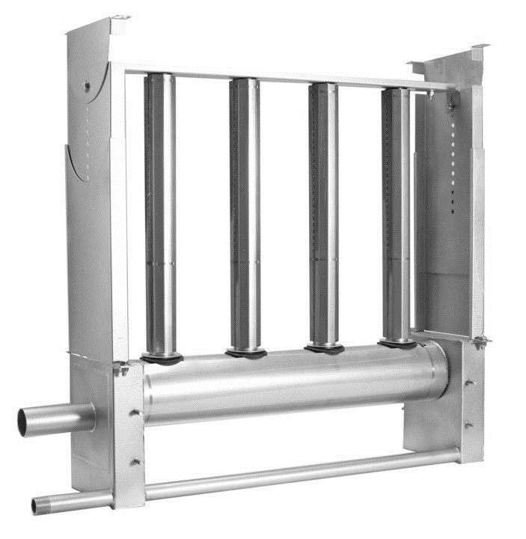
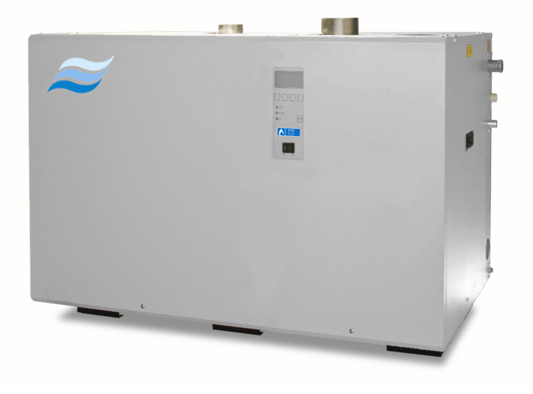
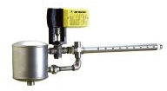
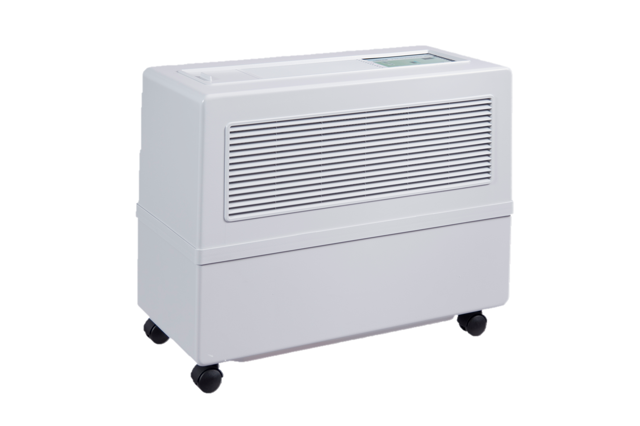
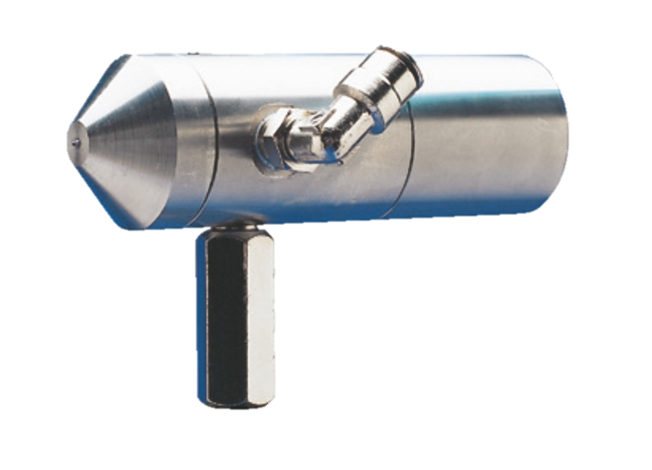
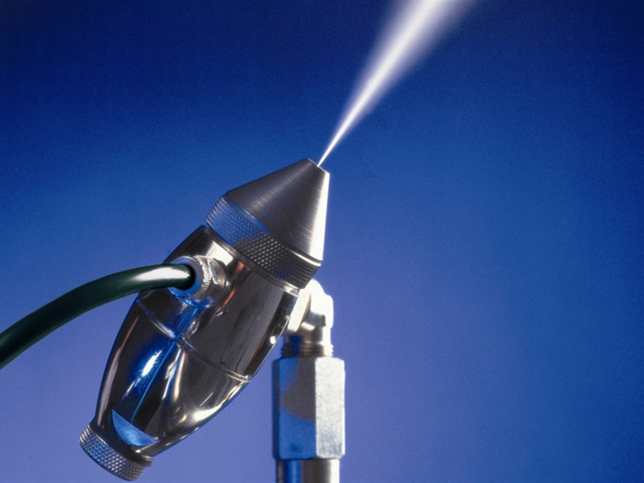
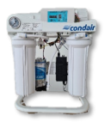
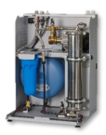
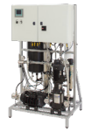
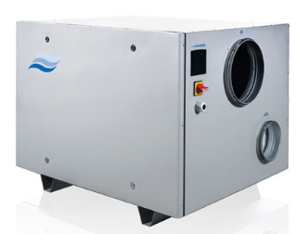
Condair Portfolio
Condair Products Portfolio
Isothermal
Adiabatic
EL
RS
GAS
Distribution
Central steam
ME/ MC
US
DL
HP
DRS
```
Live Steam
Steam-to-steam
SAM-e
Dehumidification
Water Treatment
Portable
AirFog
JetSpray
DA
RO-H
RO-A
MLRO
Notes:
Central to Condair’s strategy is having the “right tool for the job”. To this end, we offer a comprehensive portfolio of steam humidifiers; including offerings powered by electricity, gas, and steam. A complete line up of adiabatic products for applications both large small. For industrial applications we offer dehumidification solutions based on desiccant technologies. And finally our portfolio of complimentary water treatment products provides the optimal water for our humidification products.

Slide 23
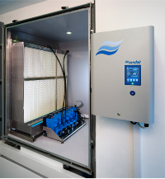
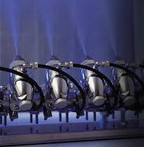
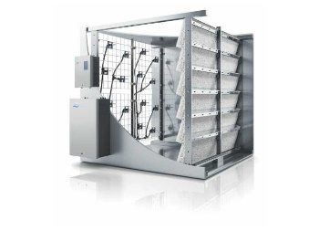
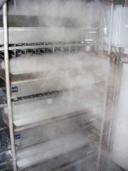
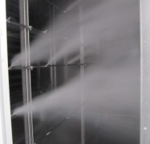
Condair Portfolio- What are your adiabatic ‘induct’ options?
ME/ MC
Width of Media
Wetted Media/ Direct or Indirect Evaporative Cooling is primary use. 27 to 31 ½ inches (Primary use Data Center Cooling)
(NOT for Hospital applications)
JetSpray
3 feet/ High Pressure Air
Compressed Air/ Direct 36 inches
Can see aerosolization in AHU
(NOT for Hospital applications)
DL
2-3 feet
Very Good Water Eff.
Hybrid Humidifier 24 – 36 Section
18” before 4” after (OK for Hospitals)
US
6-8 feet of section length to achieve
Good Water Efficiency (must have mist eliminator
Ultrasonic Units (Not offered by Condair in Duct or AHU) (NOT for Hospital applications)
HP
High Pressure (Fogging) Humidifier
(OK for Hospitals)
6-8 feet of section length to achieve
Good Water Efficiency (must have mist eliminator
Notes:
Central to Condair’s strategy is having the “right tool for the job”. To this end, we offer a comprehensive portfolio of steam humidifiers; including offerings powered by electricity, gas, and steam. A complete line up of adiabatic products for applications both large small. For industrial applications we offer dehumidification solutions based on desiccant technologies. And finally our portfolio of complimentary water treatment products provides the optimal water for our humidification products.

Slide 24
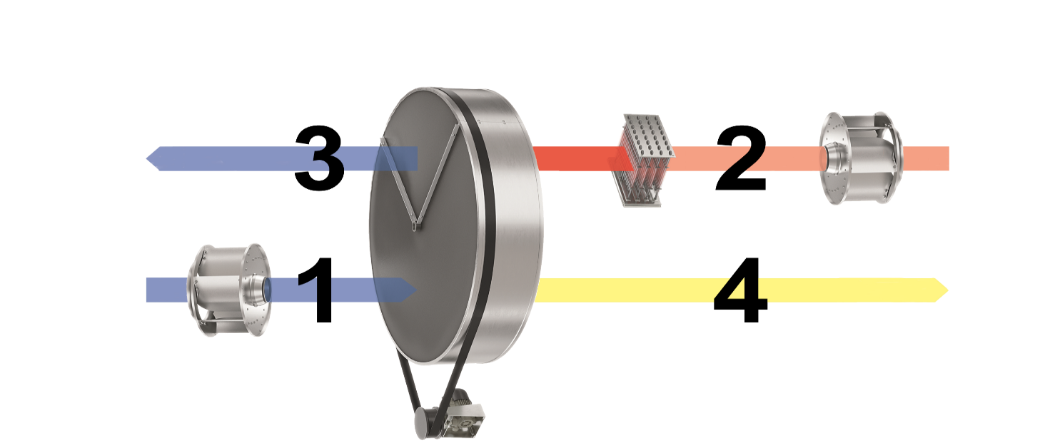
Absorption Dehumidification
Principal of Operation
Wet Air
(Exhaust)
Regeneration Air
(Intake)
Dry Air
(Supply)
Process Air
(Intake)
Process air to be dehumidified enters the rotor.
Water molecules are adsorbed in the desiccant silica gel rotor.
Rotor is reactivated by another air stream which is heated. Ideal regeneration air temperature 194 -248 °F
Moisture leaves the rotor as warm, wet air

Slide 25
Let’s make life better together!
Thomas Klein
Country Manager, USA
thomas.klein@condair.com

