Slide 1
Humidity for a more Profitable life
Leveraging and multiplying large projects successes in your market

Slide 2
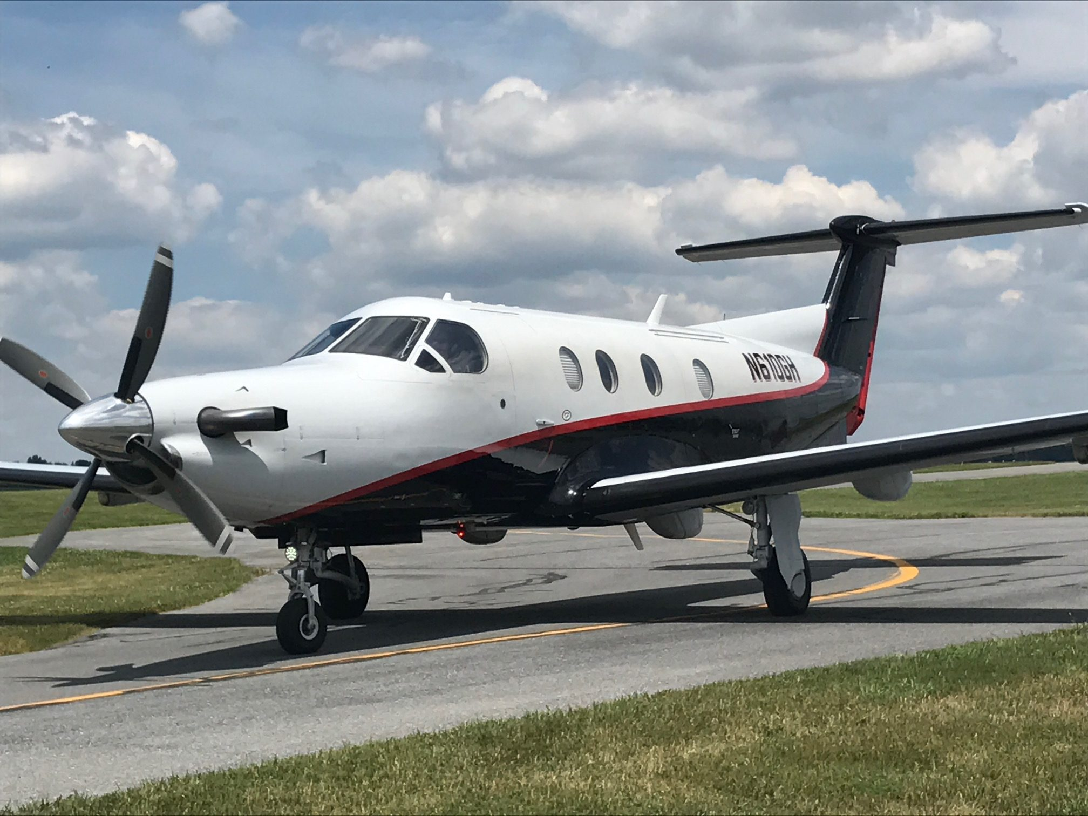
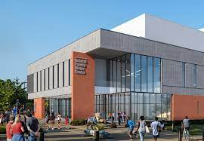
The Anatomy of a HUGE success
ATS and Condair DL and RO
Leech Wallace
Associates / now WSP
University of Maryland Medical System
Prince Georges Regional Med.
BeBee Healthcare
System
UMMS: St. Joseph
Agent ancillary business
Commission through House Accounts
Air Filtration
VFD Drives
Air Flow Measurement/Control
UV lights
Air Handlers
“Engineers LOVE 1 stop shopping!”
Peninsula Healthcare
System
UMMS: Guldelski
GBMC Healthcare
System
UMMS: Upper Chesapeake
UMMS: Shock Trauma
Calvert Healthcare
System
UMMS: More to come

Slide 3
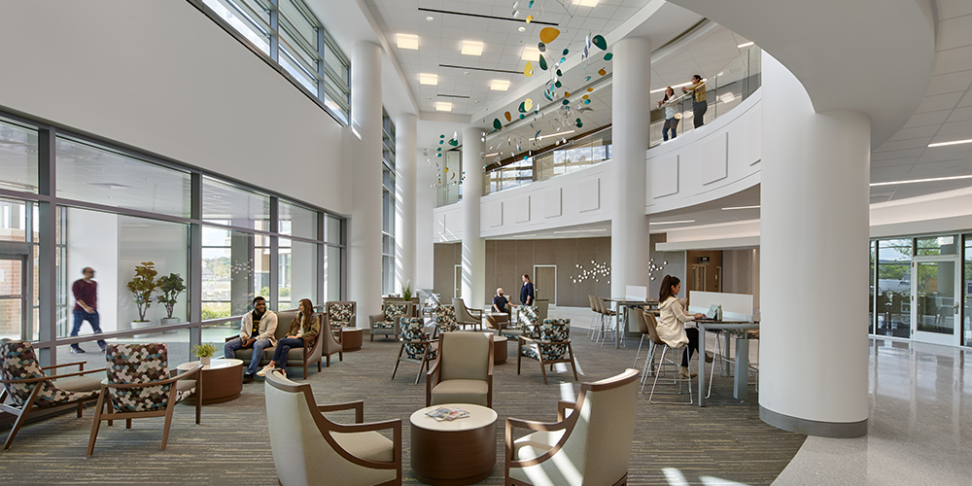
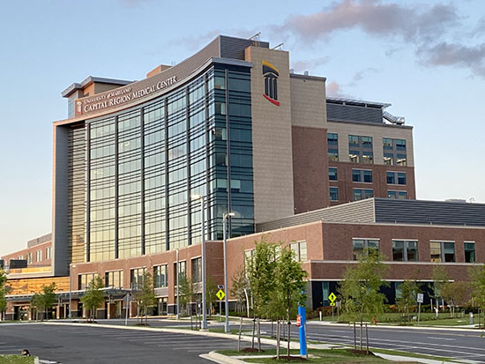
University of Maryland Medical Systems
Prince Georges Regional Medical Center, MD
In Operation
Brand New Building
7 Custom Air Enterprises AHU’s (Wall in middle of tunnel to allow for efficient turndown/redundancy
14 Condair DL units, 5 MLRO (reverse osmosis) units
Each rooftop vestibule has 1 RO system feeds multiple DL units.
Building 100% humidified to target of 45% Rh
Hospital is believed to be the first in the USA with ZERO boiler steam.
Saving for Hospital: No boiler techs, extended economizer, no steam on site and minimal maintenance.
Less energy expended by not making the phase change from liquid to water vapor.
Increased use of economizer through direct evaporative cooling.

Slide 4
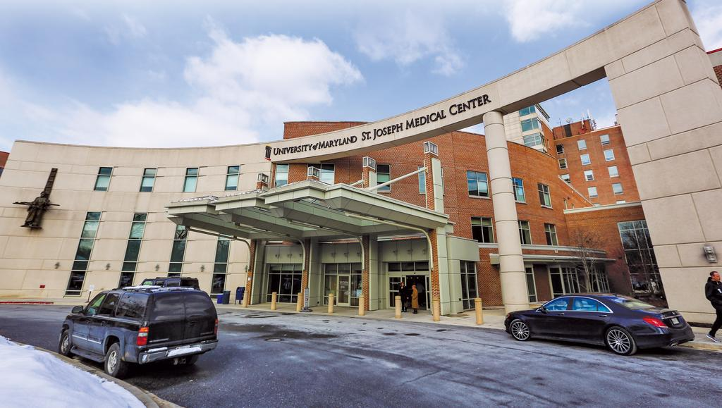
University of Maryland Medical Systems
St. Joseph Medical Center, Towson MD
In Operation
2 Custom Air Enterprises AHU’s
AHU replacement (assembled on site during Covid)
2 Condair DL units
1 Condair RO water system.
Part of the Univ of Md Medical center modernization program.
Steam pre-heat utilized.

Slide 5
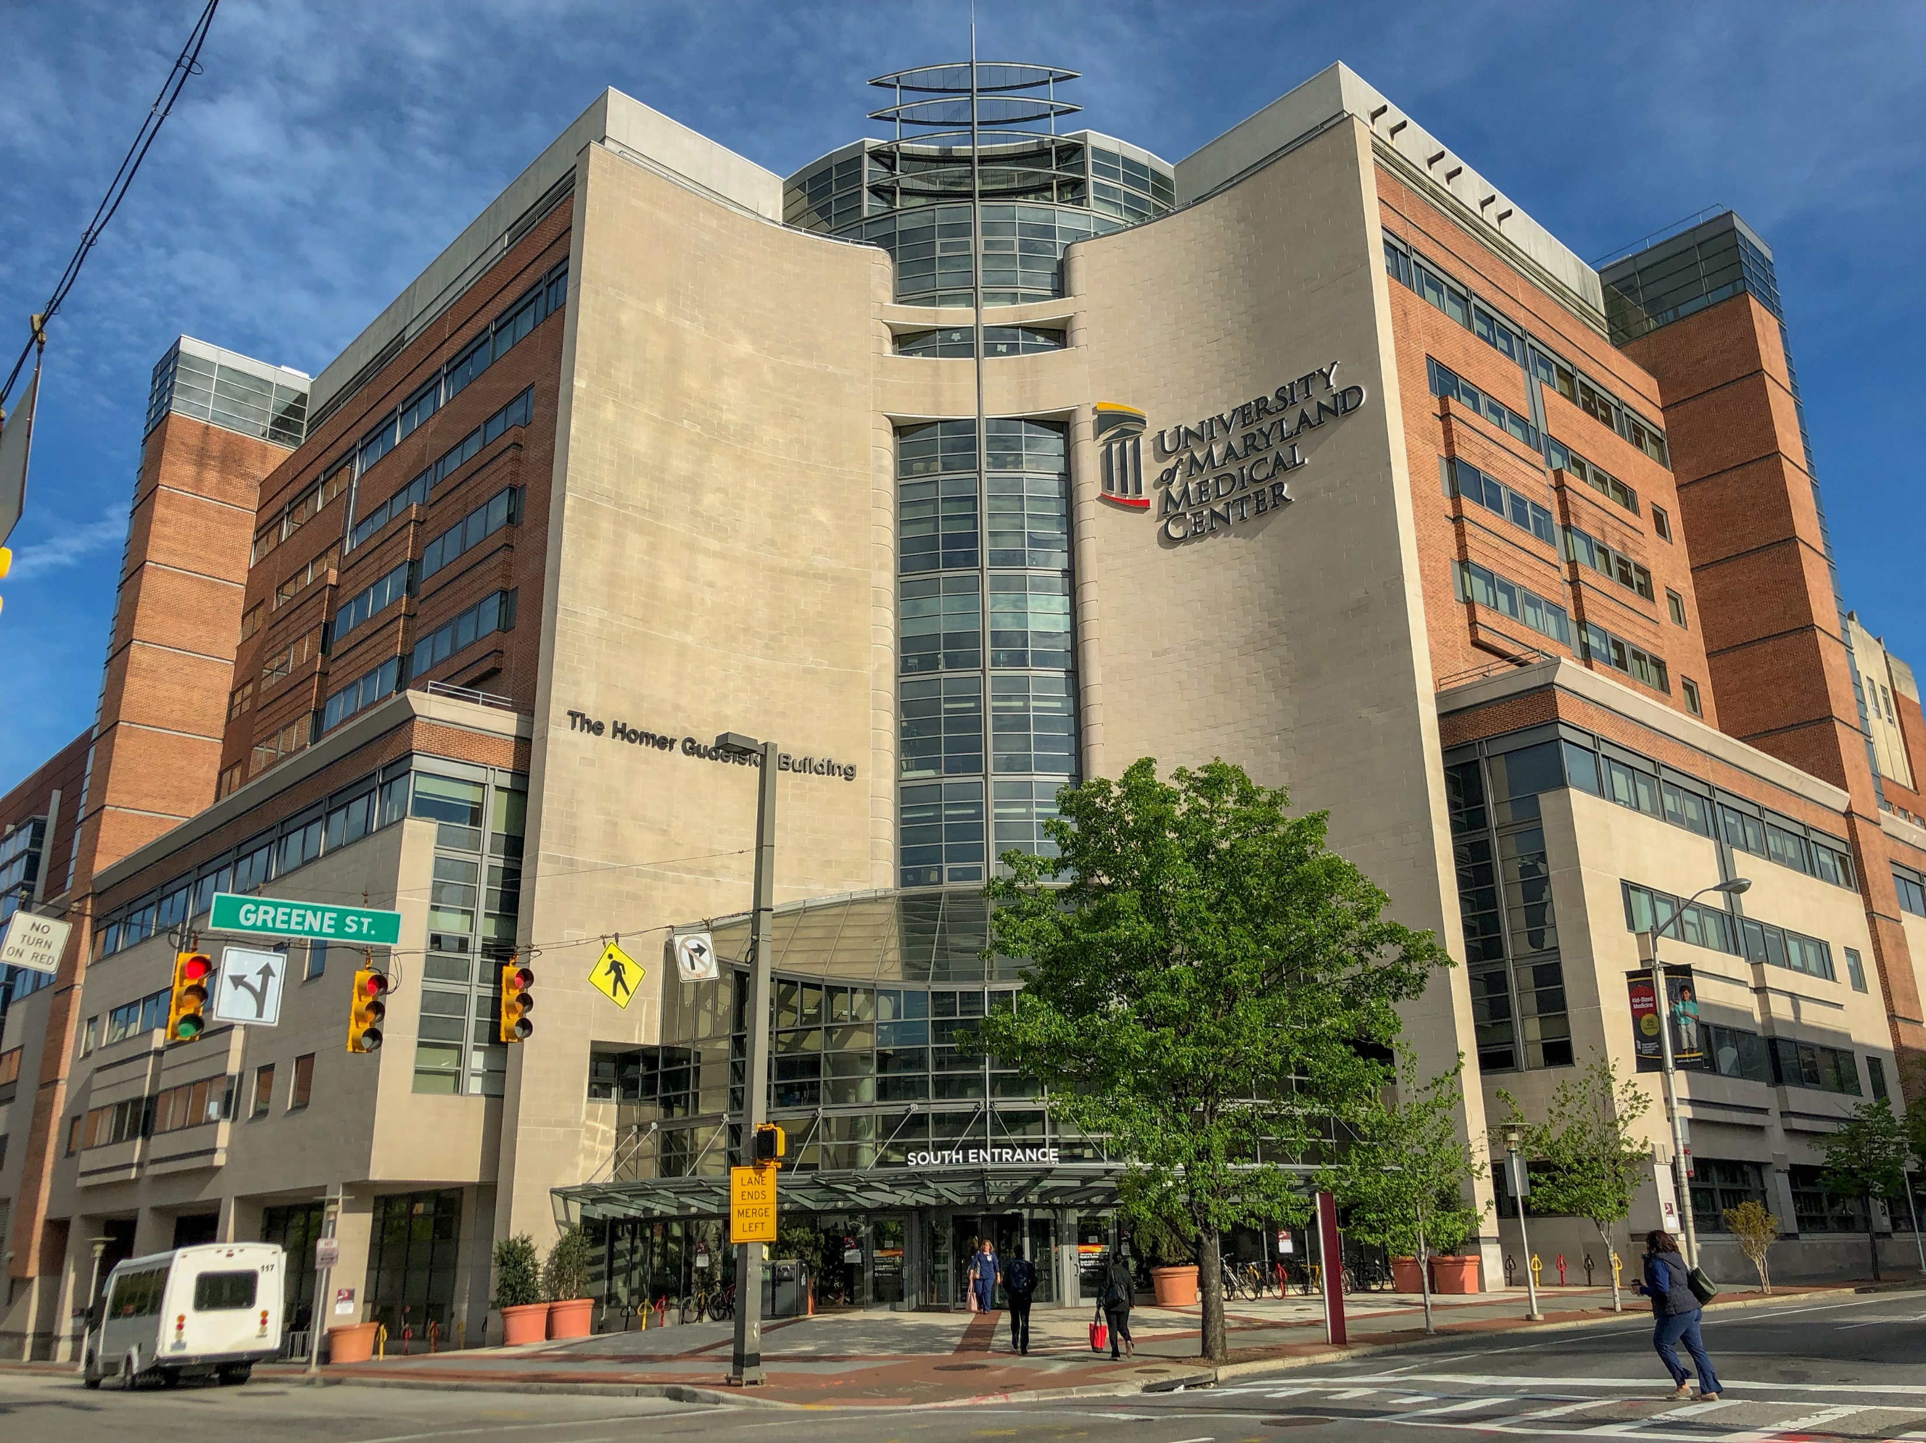
University of Maryland Medical Systems
Henry Adams - Gudelsky, Towson MD
In Operation
4 Buffalo custom AHU’s (Wall in middle of tunnel to allow for efficient turndown/redundancy
AHU replacement (assembled on site during Covid)
4 Condair DL units
2 Condair RO water system.
Part of the Univ of Md Medical center modernization program.
2 more in planning

Slide 6
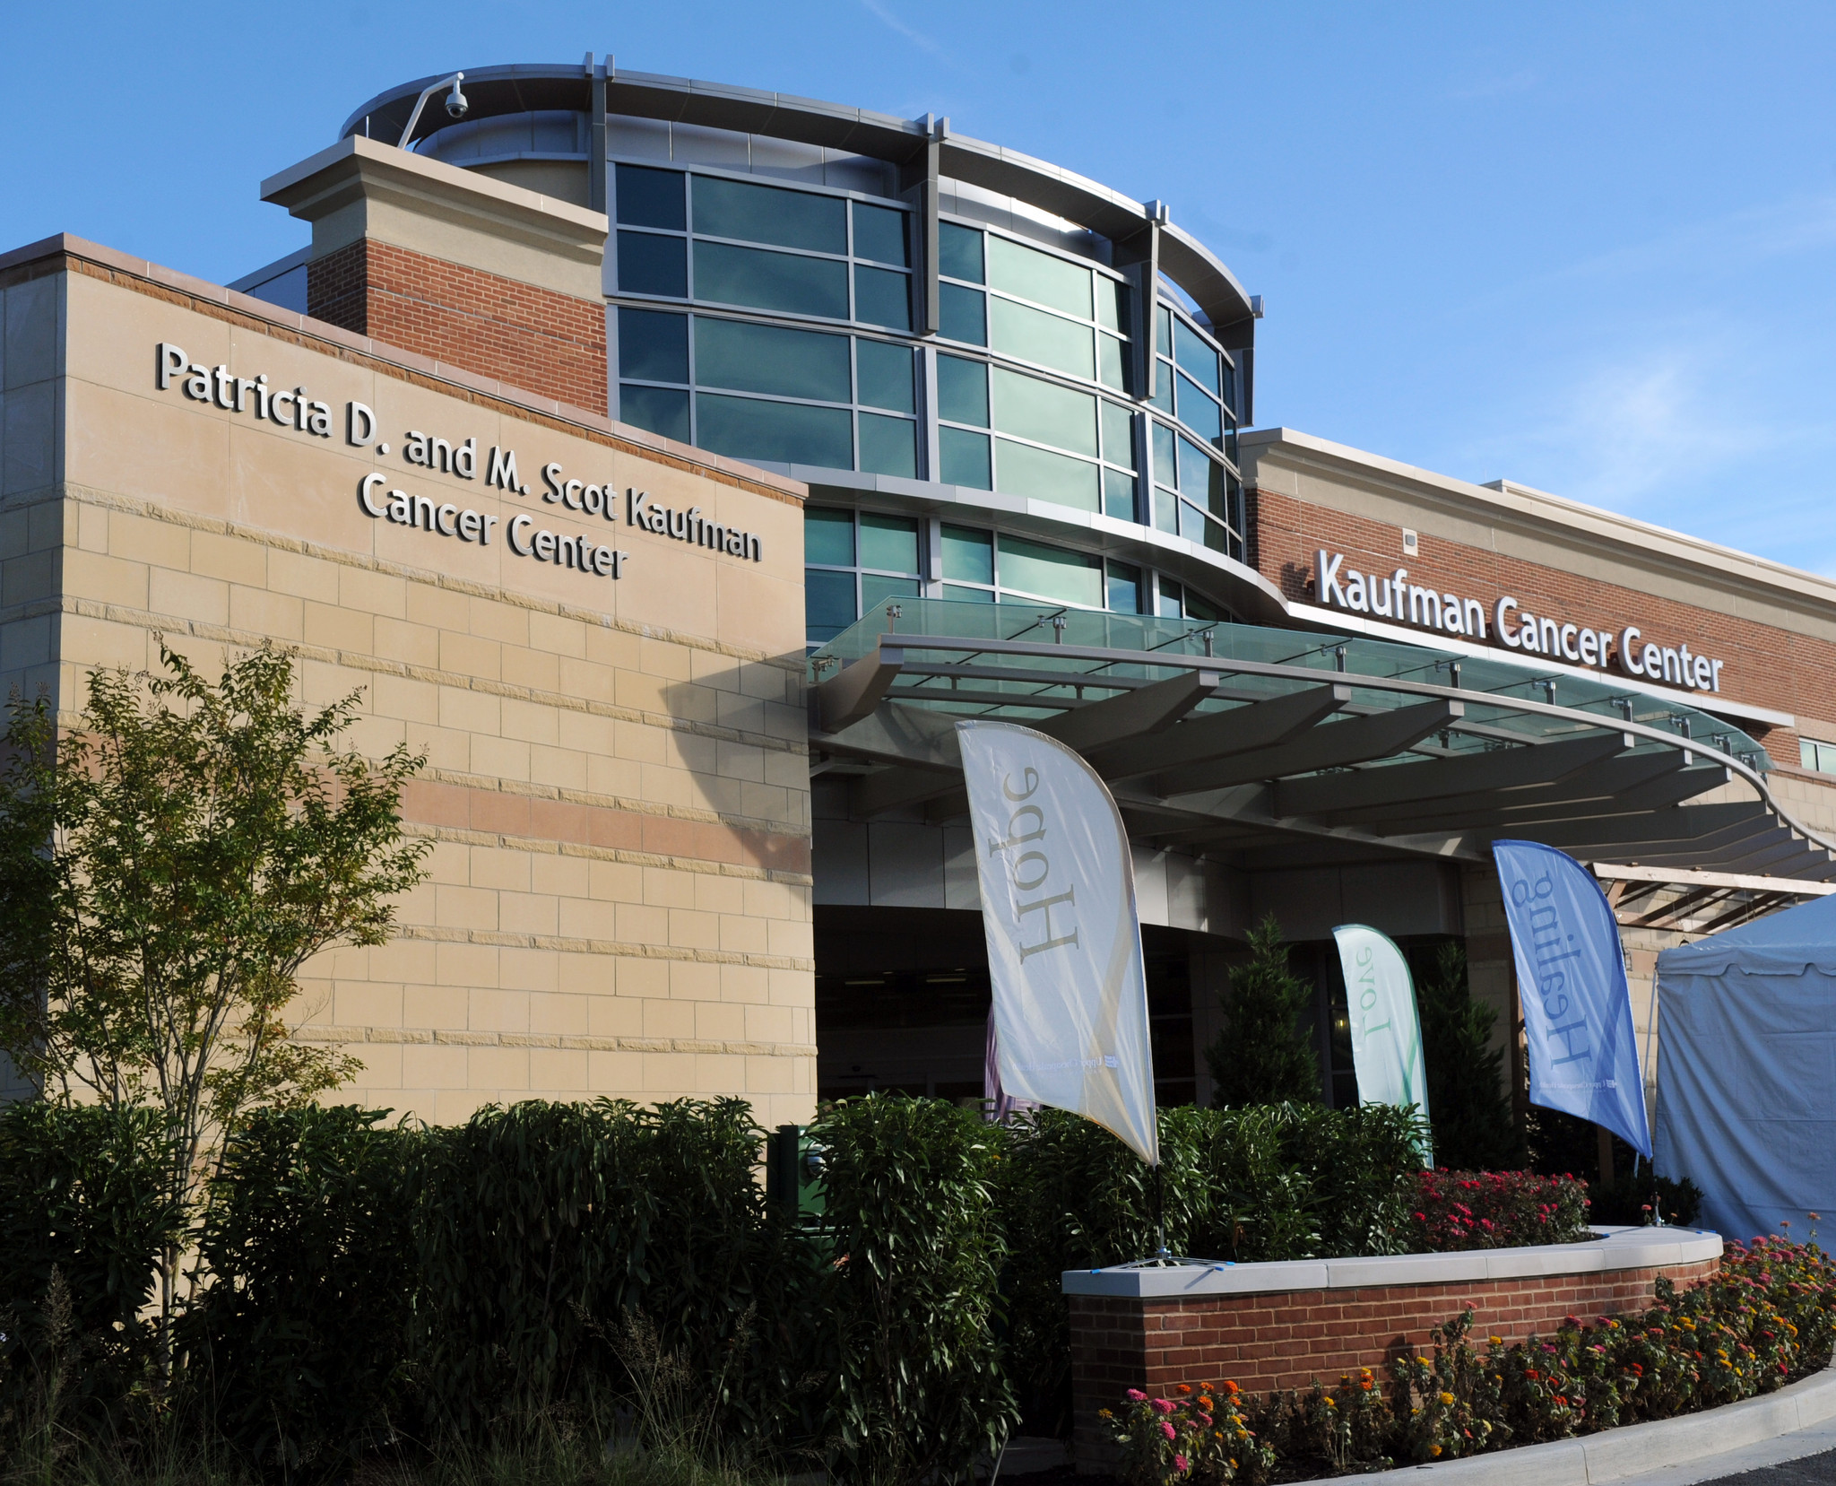
University of Maryland Medical Systems
Upper Chesapeake Health Kaufman Cancer Center, MD
Released for Delivery
Two 90,000 CFM AHU’s
One 20,000 CFM AHU
Building 100% humidified to target of 45% Rh
Three DL units
Two RO systems by Condair
Leech Wallace Engineering

Slide 7
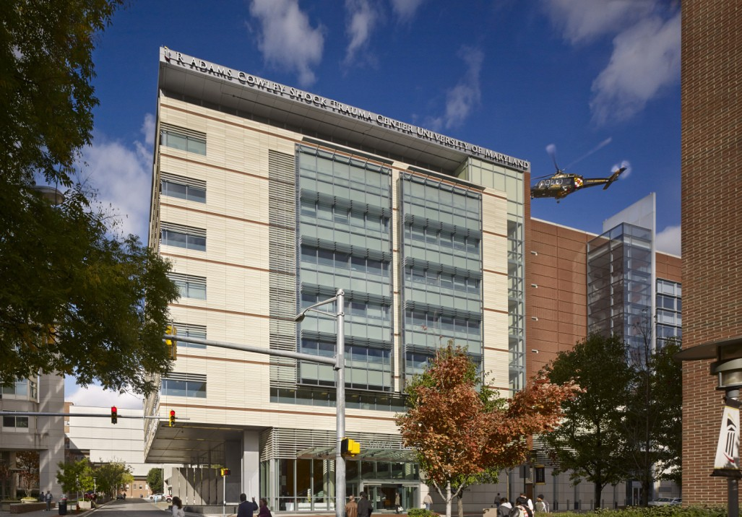
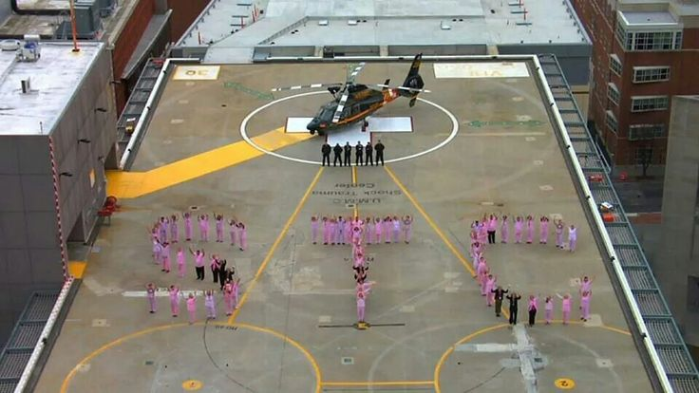
University of Maryland Medical Systems
Shock Trauma, Baltimore MD
Released for Delivery
Two DL units
1 RO systems by Condair
Leech Wallace/ WSP Engineering

Slide 8
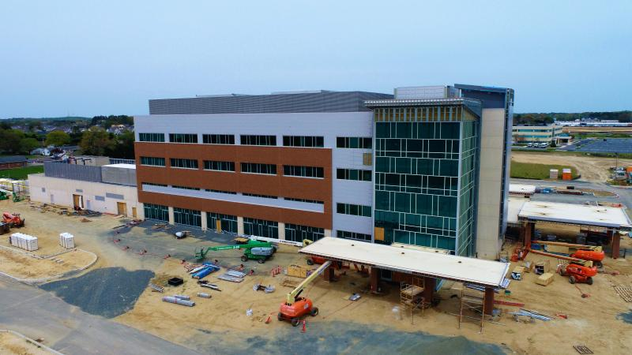
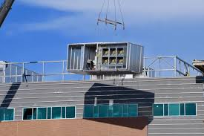
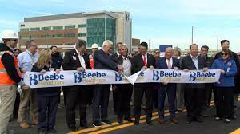
BeeBe Healthcare Rehoboth Surgery Hospital
Rehoboth, DE
In Operation
3 Custom AHU’s: (2) 55,000 CFM & 25,000 CFM
3 Condair DL units, 2 MLRO (reverse osmosis) units
Building 100% humidified to target of 45% Rh
Leech Wallace Engineering

Slide 9
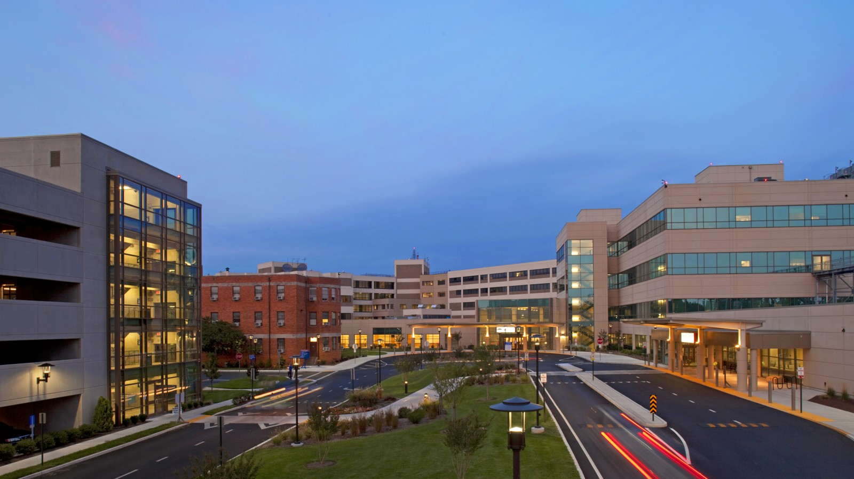
Peninsula Regional Medical Center
AHU Prepurchase, MD
In Operation
One 95,000 CFM AHU
One DL
RO water provided by others
Leech Wallace / WSP

Slide 10
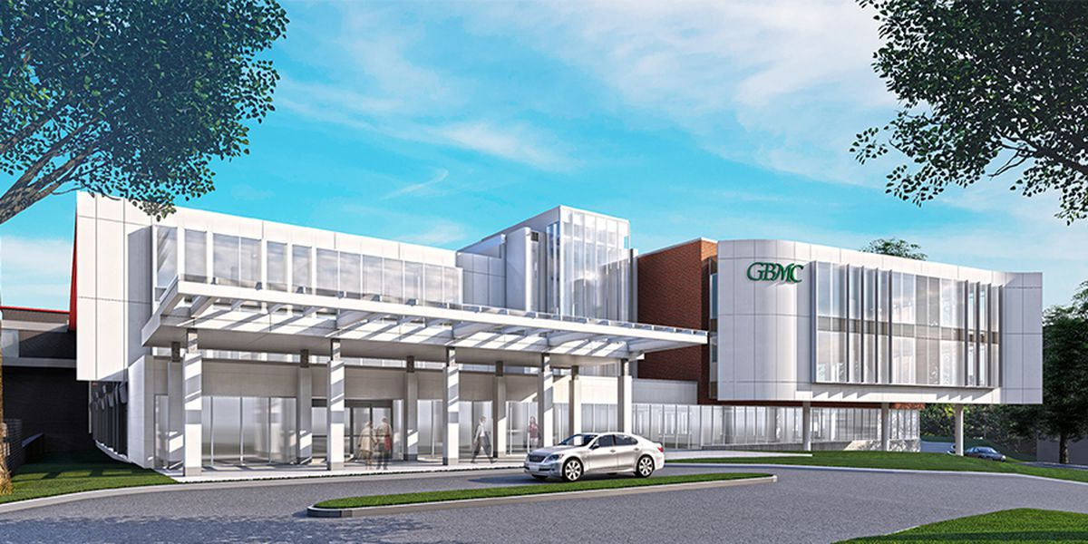
GBMC – Promise Project
Baltimore, MD
Released for Delivery
Two 25,000 CFM AHU’s
One 40,000 CFM AHU
Three DL Units
One MLRO-1000 unit for all three DL units
WSP (Leech Wallace) Engineering

Slide 11
Calvert Health – Medical Penthouse Expansion
Baltimore, MD
In Bid Process (Basis of Design)
Three 14,000 CFM AHU’s
One 15,000 CFM AHU
Four DL Units
One MLRO-800 unit for all DL units
WSP (Leech Wallace) Engineering

Slide 12
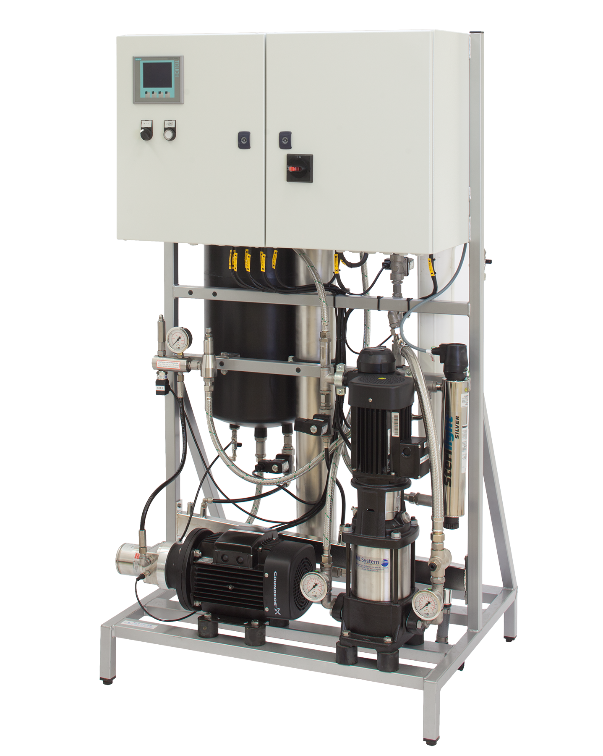
DL - United States Summary
UMMS and WSP: 35 DL units and 15 RO.
UMMS and WSP (Leach Wallace) have contributed over $3.0M to their bottom line just with Condair Equipment.
DL technology over 20 years of operation worldwide
Over 80+ DL units in Hospitals across the United States since the change of ASHRAE 170
80% of units utilize Condair matched RO water systems
Condair offers BOTH High Pressure (HP) and Hybrid Adiabatic (DL) technologies (design considerations gave DL the advantage for owners and engineers)

Slide 13
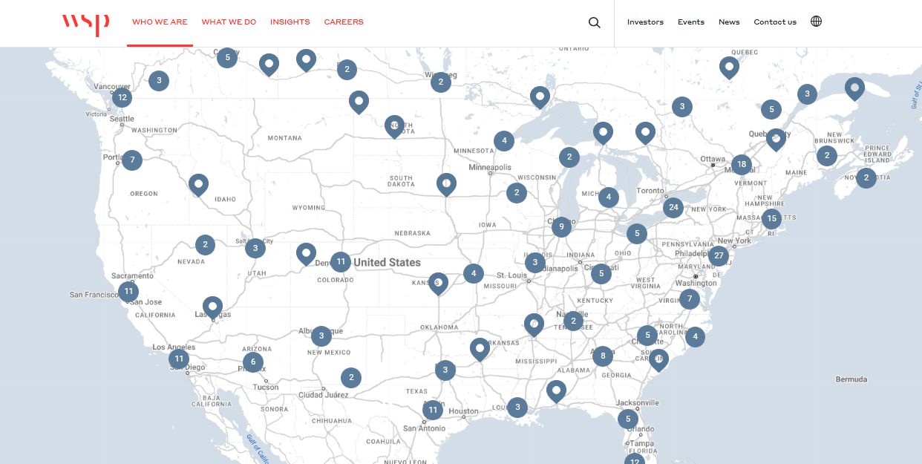
High Challenge
Who’s got an WSP office…
probably you!
CALL ON THEM!
LET’S DO A LUNCH AND LEARN!

Slide 14
Princeton University, a different kind of Large Project

Slide 15
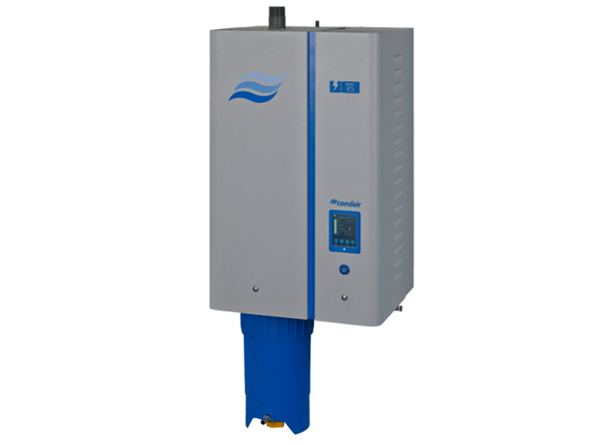
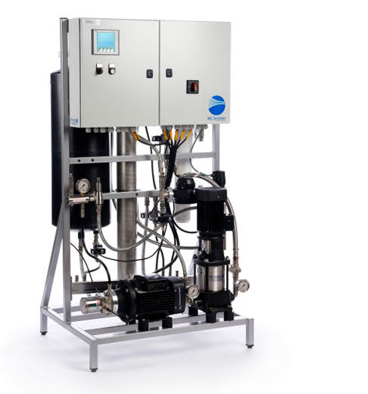
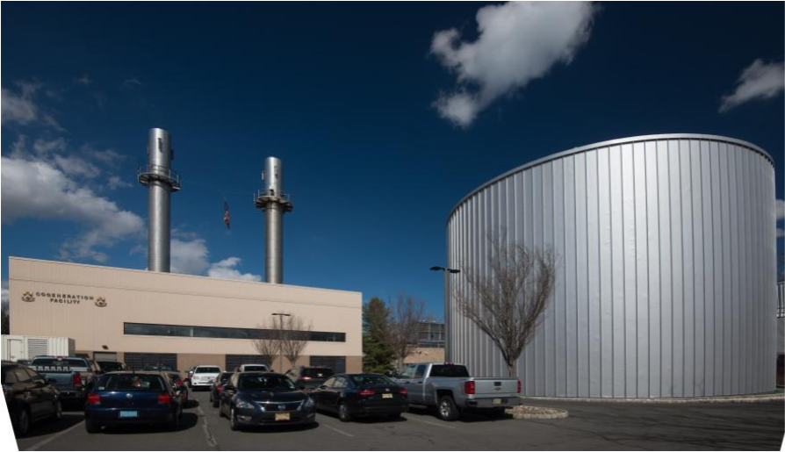
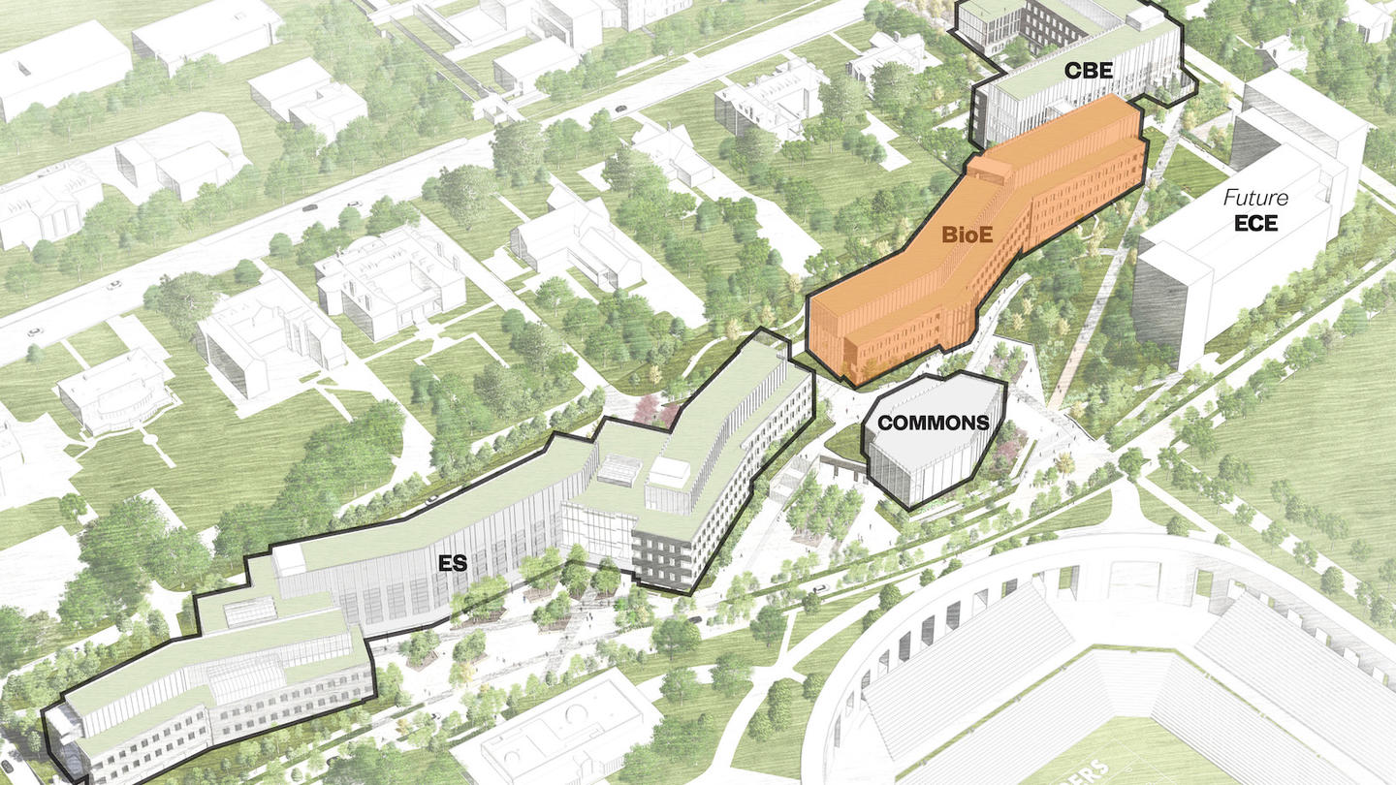
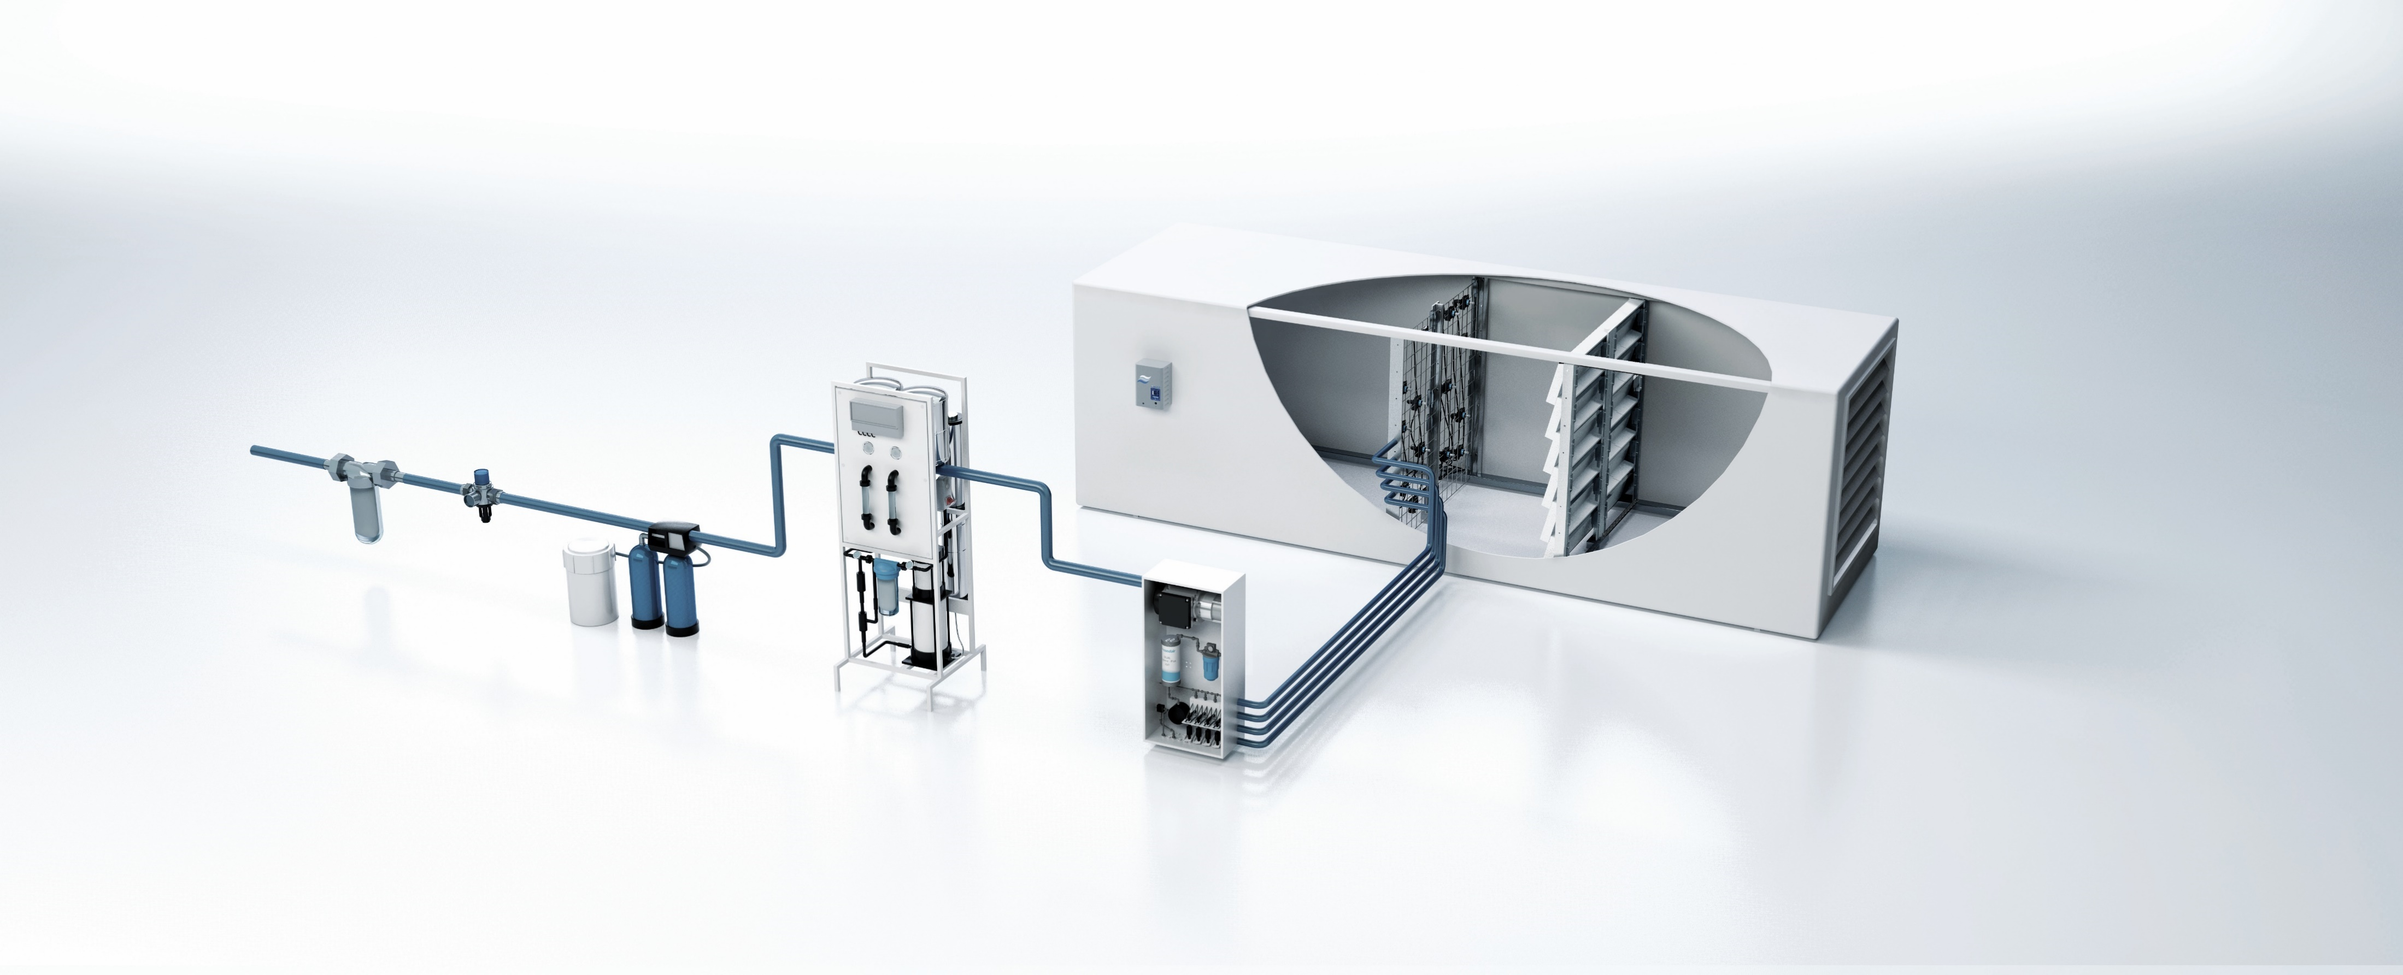
Princeton University, a different kind of Large Project
Net Zero by 2046… it’s starting now….
26 Year Old Gas Co-gen Plant

Slide 16
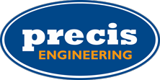
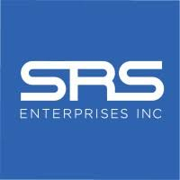
Princeton University, a different kind of Large Project
A rising tide floats ALL boats, we rely on our agents to coordinate/communicate with ALL engineers, contractors and end users.

Slide 17
Let’s go find more large projects!
Thomas Klein
Country Manager, USA
717.405.8434
Thomas.klein@Condair.com

