Slide 1
Let’s Get Outside!
Outdoor Products
Marlee Spiegelberg

Slide 2
Agenda
Outdoor Products
Condair Outdoor Products
*NEW* RS OC with Precision
*COMING SOON* GS Outdoor
Let’s get outside!

Slide 3
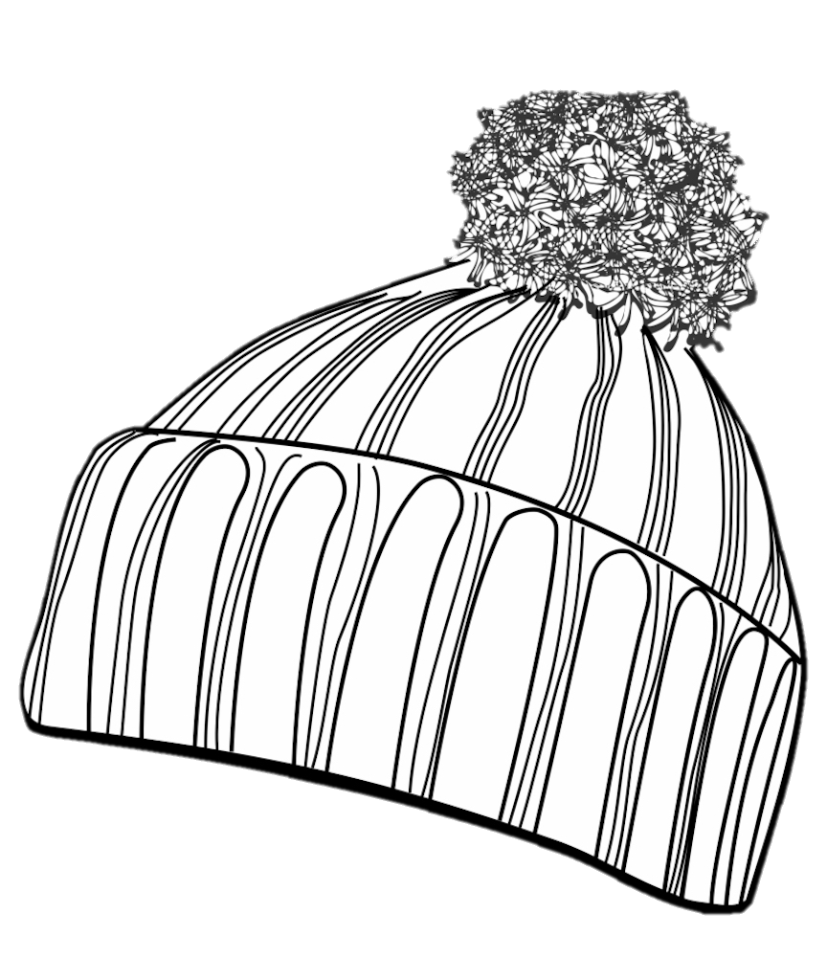
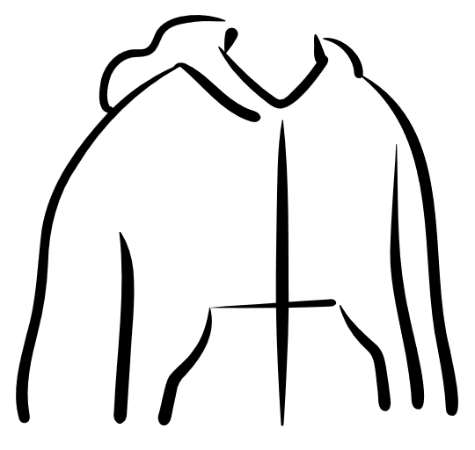
Winter
Fall
Spring
Summer

Slide 4
Wind
Snow
Rain
Cold
Winter
Spring
Fall
Heat
Dust
Summer

Slide 5
What weather conditions are the biggest concern in your territory when installing outdoor equipment?
ⓘ Start presenting to display the poll results on this slide.

Slide 6
Outdoor Products

Slide 7
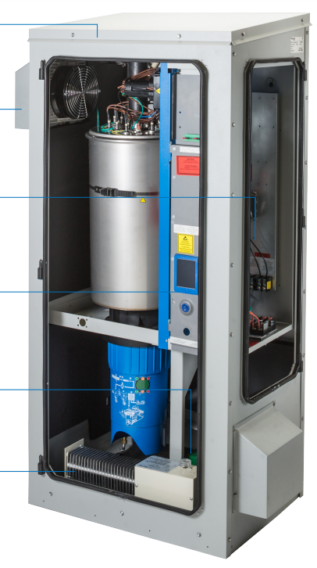
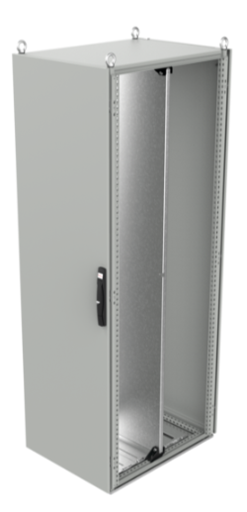
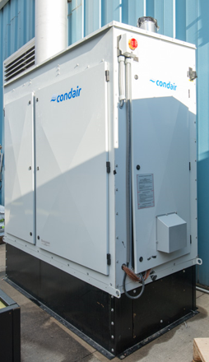
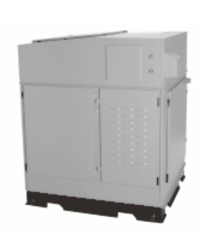
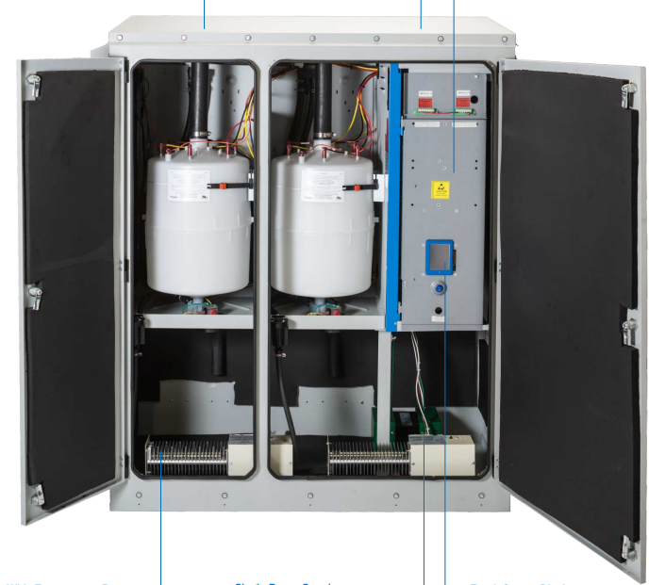
Outdoor products
Overview
Isothermal |  |  |  | Adiabatic
RS OC | EL OC | GS OC | SETC Outdoor | DL Outdoor Enclosure

Slide 8
RS OC
Precision Option

Slide 9
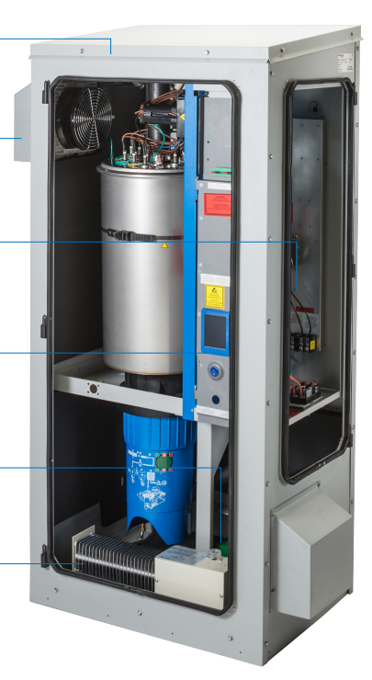
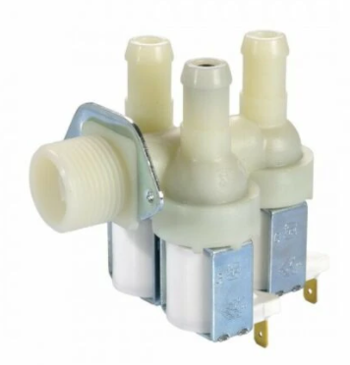
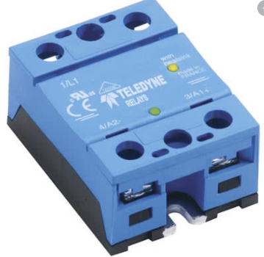
RS OC
Precision Option
Precision Option (SSR’s, Turbo Fill)
What does the precision option give me? | When can I get this?
MODULATING CONTROLS! | June 13, 2022
See the latest newsletter!

Slide 10
GS OC
Condensing Outdoor

Slide 11
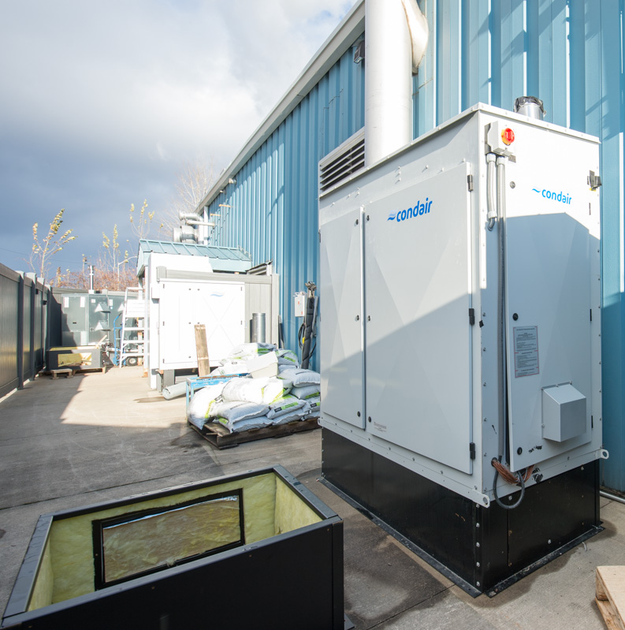
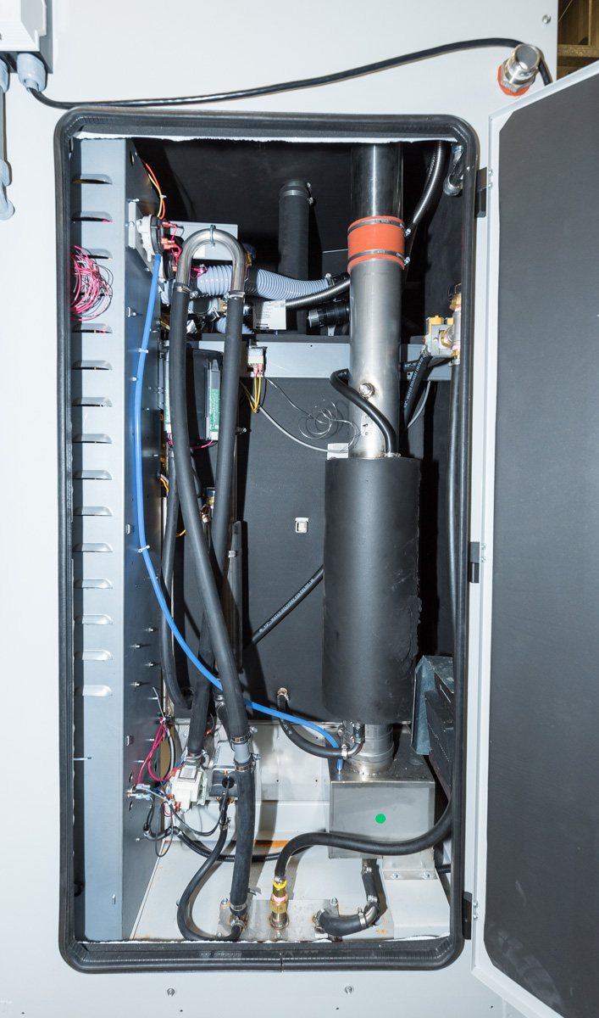
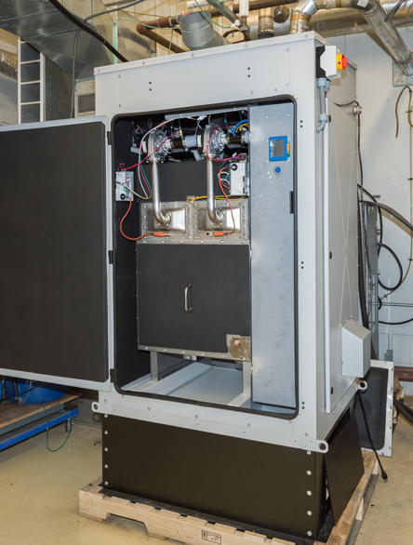
GS OC
Product Overview
Plumbing Access
Ottawa Lab
Tank Access
Roof Curb

Slide 12
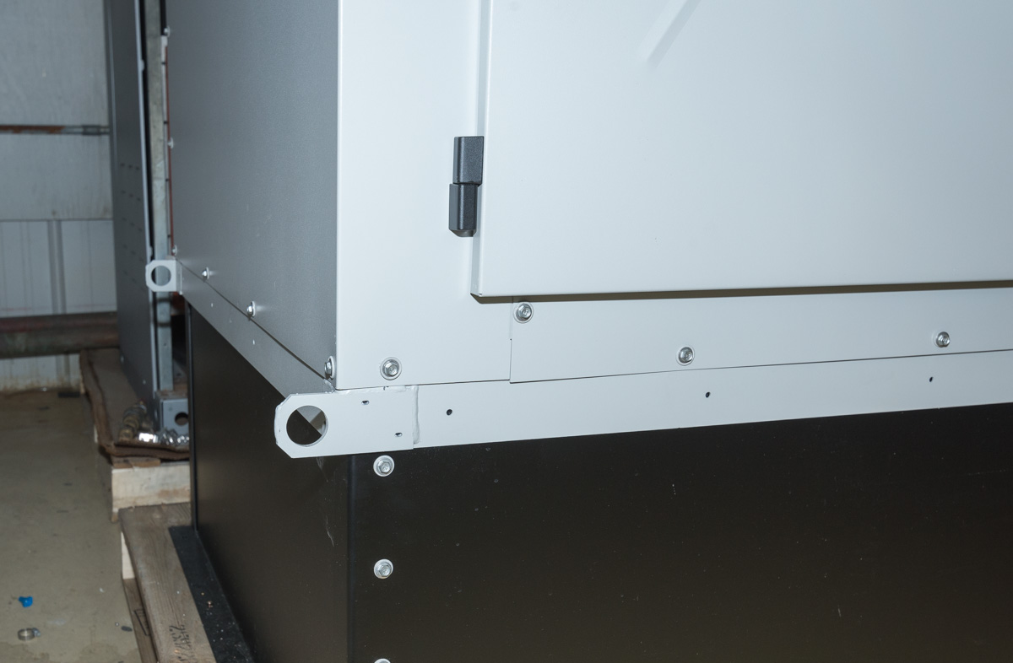
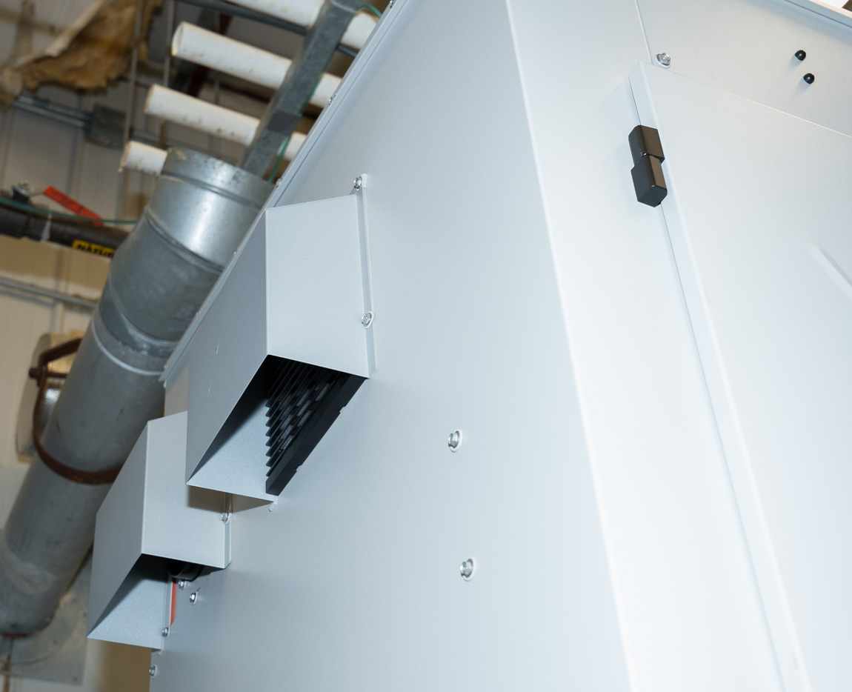
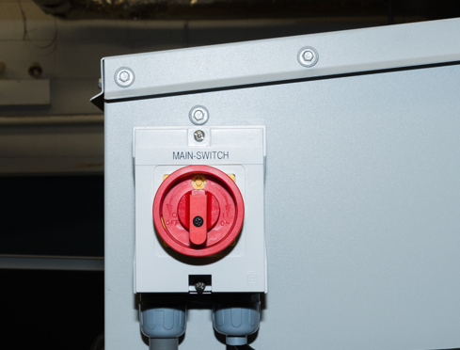
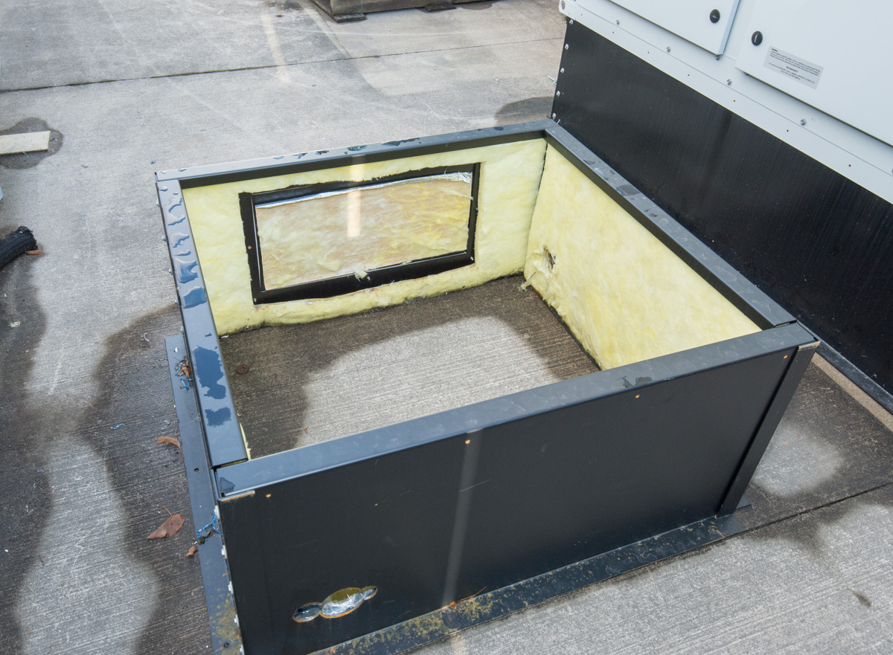
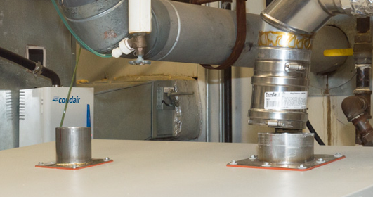
GS OC
Product Overview
Lifting Points
Main Power
Cooling Fan
Roof Curb
Steam Line/ Exhaust
Electrical Cabinet

Slide 13
GS OC
Product Features
Roof Curb
Steam outlet location
Top or Rear
Inlet water drain protection kit
Drains inlet water on power loss to prevent freezing
Drain freeze protection valve
Optional valve only opens when water is cooled to meet plumbing code

Slide 14
GS OC
Temperature Rating
Wind
Rain
Dust
Snow
Heat
COLD CLIMATE
-40°F to +122°F
-40°C to +50°C*
STANDARD
5°F to +122°F*
-15°C To +50°C*
Cold
Ice
* Temp limits are being validated

Slide 15
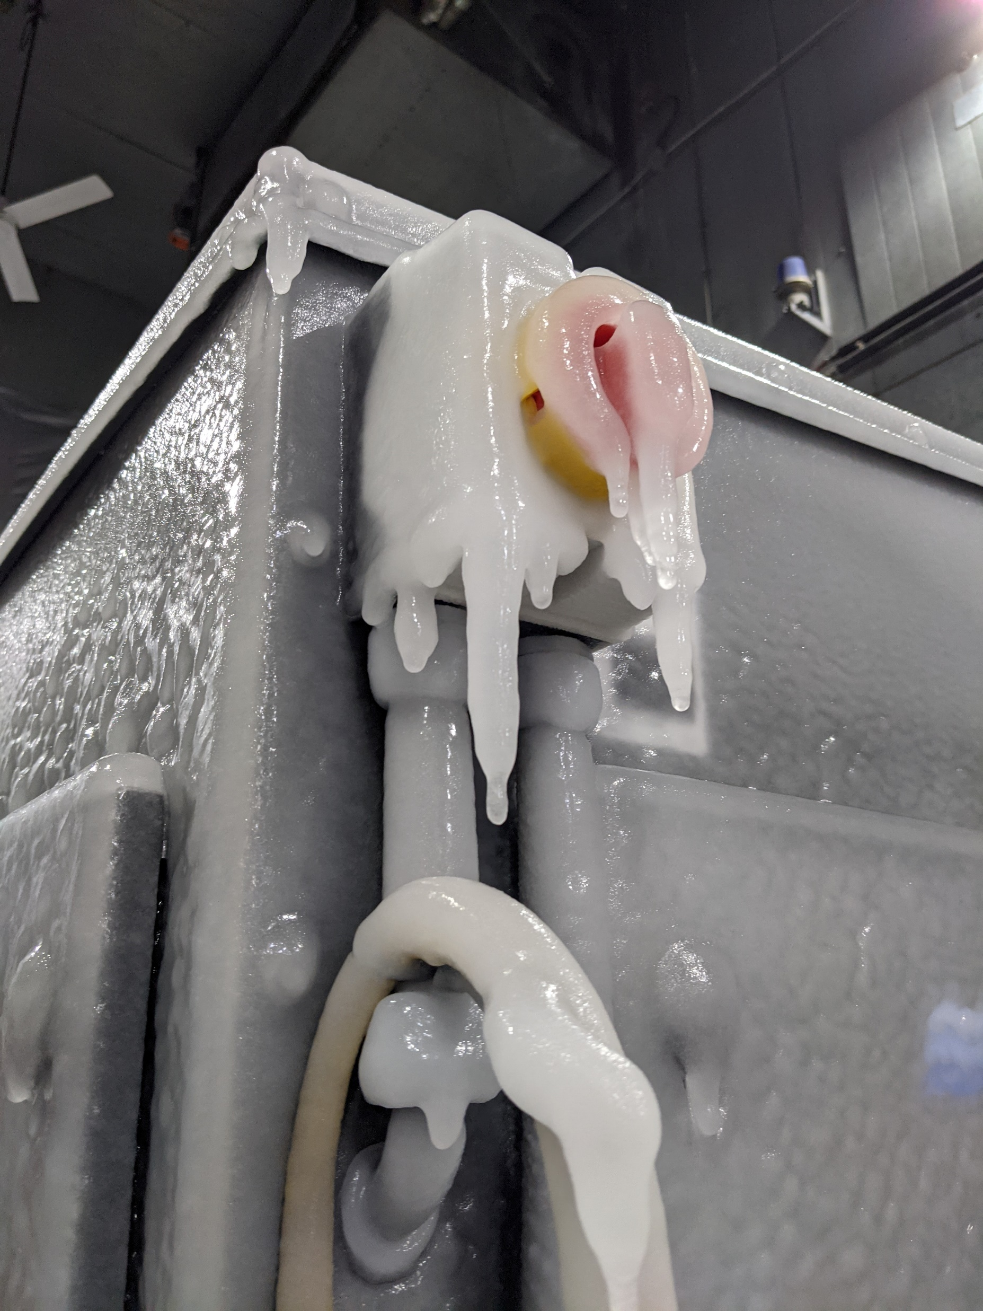
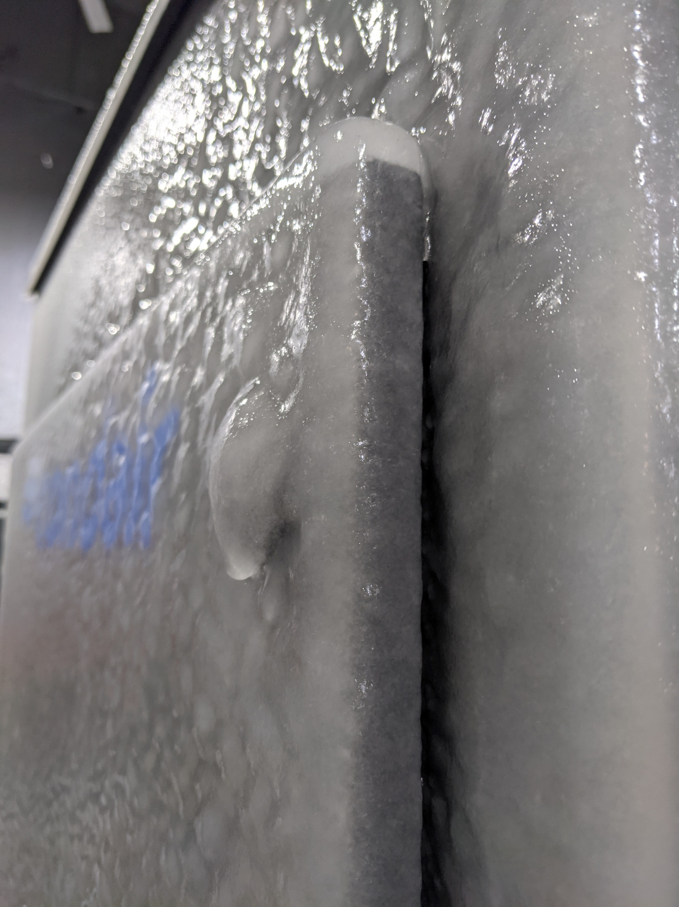
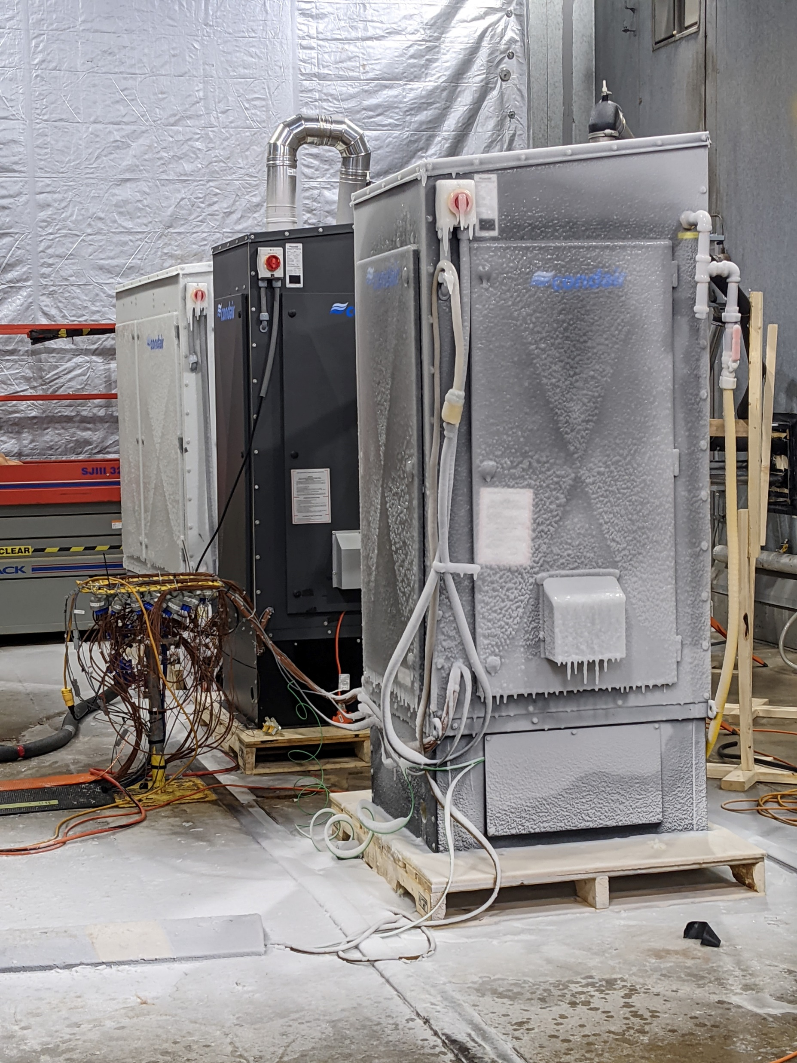
GS OC
Temperature Rating
COLD CLIMATE
-40°F to +122°F
-40°C to +40°C
Ice
Cold
Environmental chamber testing

Slide 16
GS OC
Models
 |  | Temperature Rating
 |  | COLD CLIMATE -40°F to +122°F -40°C to +50°C | STANDARD 14°F to +122°F -10°C To +50°C
CS, NX, MT | GS 50-OC | 120V / 1 208V / 3 | 120V / 1
 | GS 100-OC | 120V/1ph/25A
 | GS 150-OC
 | GS 200-OC | 120V/1ph/40A 208V/3ph/20A | 120V/1ph/25A
 | GS 300-OC | 120V/1ph/45A 208V/3ph/20A | 120V/1ph/30A
 | GS 450-OC | 120V/1ph/50A 208V/3ph/20A
 | GS 600-OC | 120V/1ph/60A 208V/3ph/20A | 120V/1ph/35A
CS – Condensing
NX – Low NOx
MT – Non-Condensing

Slide 17
GS OC
Launch Timeline
All parts on order
Parts in House
Agent Training
Design Reviews
NSM Intro
Zero series build
Launch!

Slide 18
Thank you!

