Slide 1
Mythbusting DRS
Direct Room Systems

Slide 2
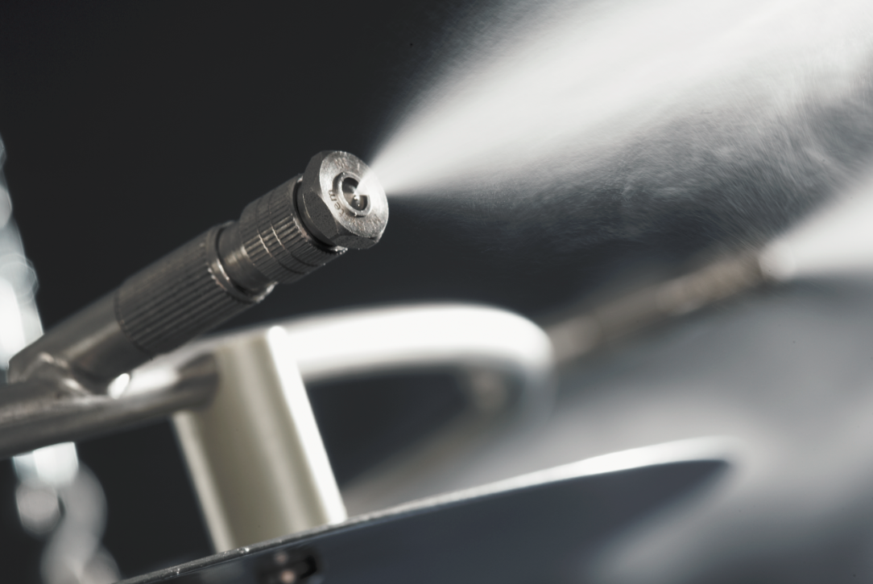
Agenda
Overview of ML system
Why Direct Room Systems (DRS)
Mythbusting DRS
The Condair Advantage
The Opportunity

Slide 3
ML System Overview

Slide 4
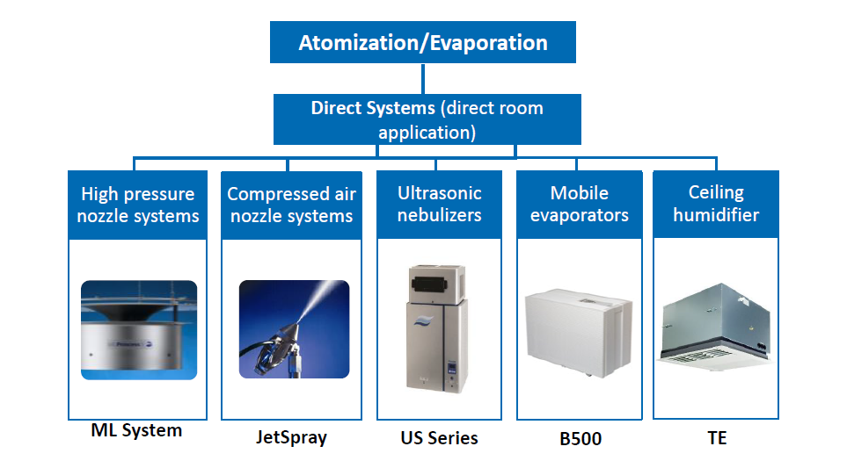
ML System - Overview

Slide 5
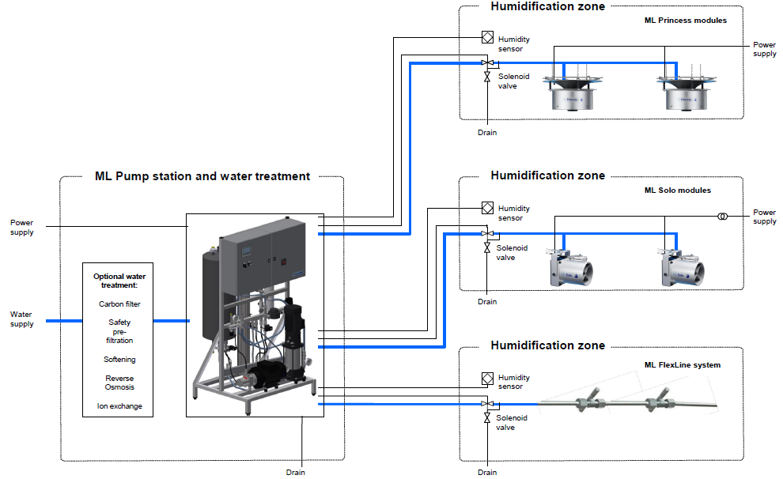
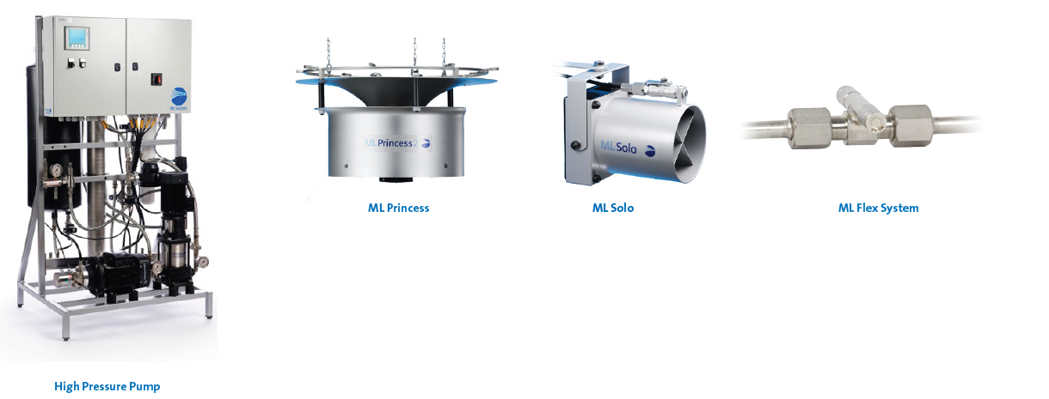
ML System - Overview
Pump Station and Atomizers
264 – 7,000 lbs/hr pump capacities
Water lubricated stainless-steel high-pressure pump
Pre-programed hygiene sequences
Ceiling and wall mounted atomizers
Steel-braided high-pressure hose

Slide 6
Why DRS
7

Slide 7
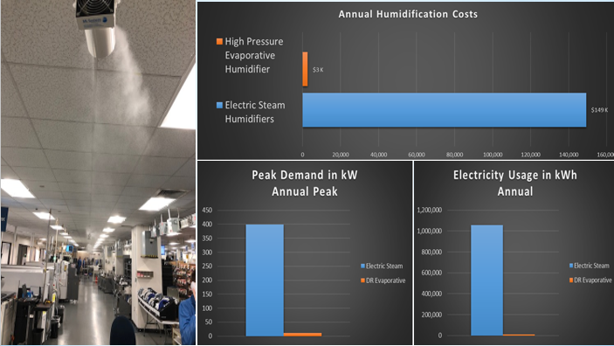
Why DRS
Energy Savings
Benchmark, New York
Benchmark, NY
Challenge: High electrical operating costs, 850 lb/hr of EL units
Solution: 1,200 lb/hr ML system
$140,000 annual electric costs savings
Payback less than 2 years
$140,000 dollars of savings with 2 years pay back

Slide 8
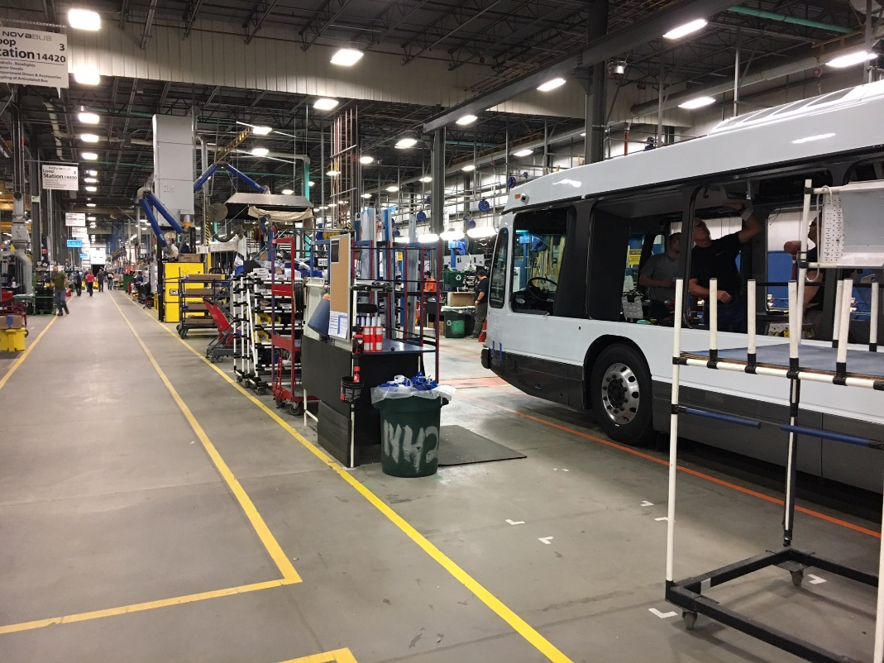
Why DRS
Energy Incentive Rebates
Novabus, New York
Novabus, NY
Challenge: Improper curing of adhesives delayed assembly
Solution: 1,800 lbs/hr ML system
22 Princess 2’s split in 2 zones
Increased manufacturing productivity from 3 to 4 buses/day
$111,000 energy incentive rebate
*Research local rebates at dsireusa.org*
$111,000 energy incentive rebate by NYSERDA
7

Slide 9
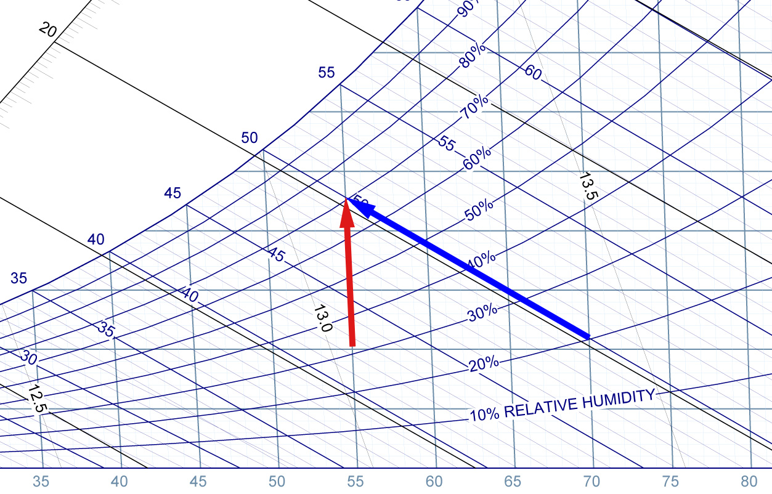
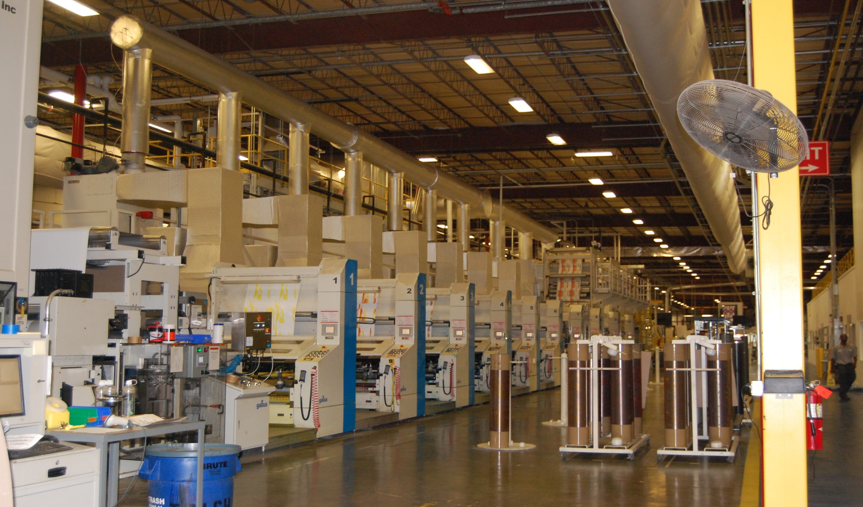
Why DRS
Free Cooling
Specialized Packaging, NY
Specialized Packaging, NY
Challenge: paper curl and roll breaks and year-round cooling load
Solution: 1,800 lb/hr ML system
~170 tons of free cooling
Improve print quality
evaporative
isothermal
1,800 lbs/hr ≈170 tons of cooling
7

Slide 10
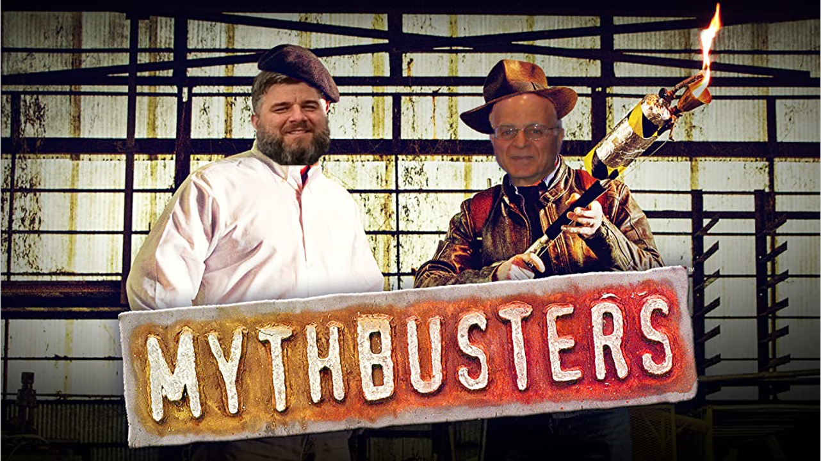

Slide 11
The Condair Advantage

Slide 12
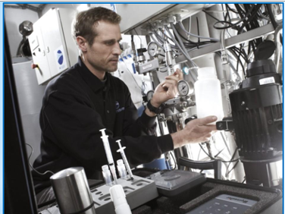
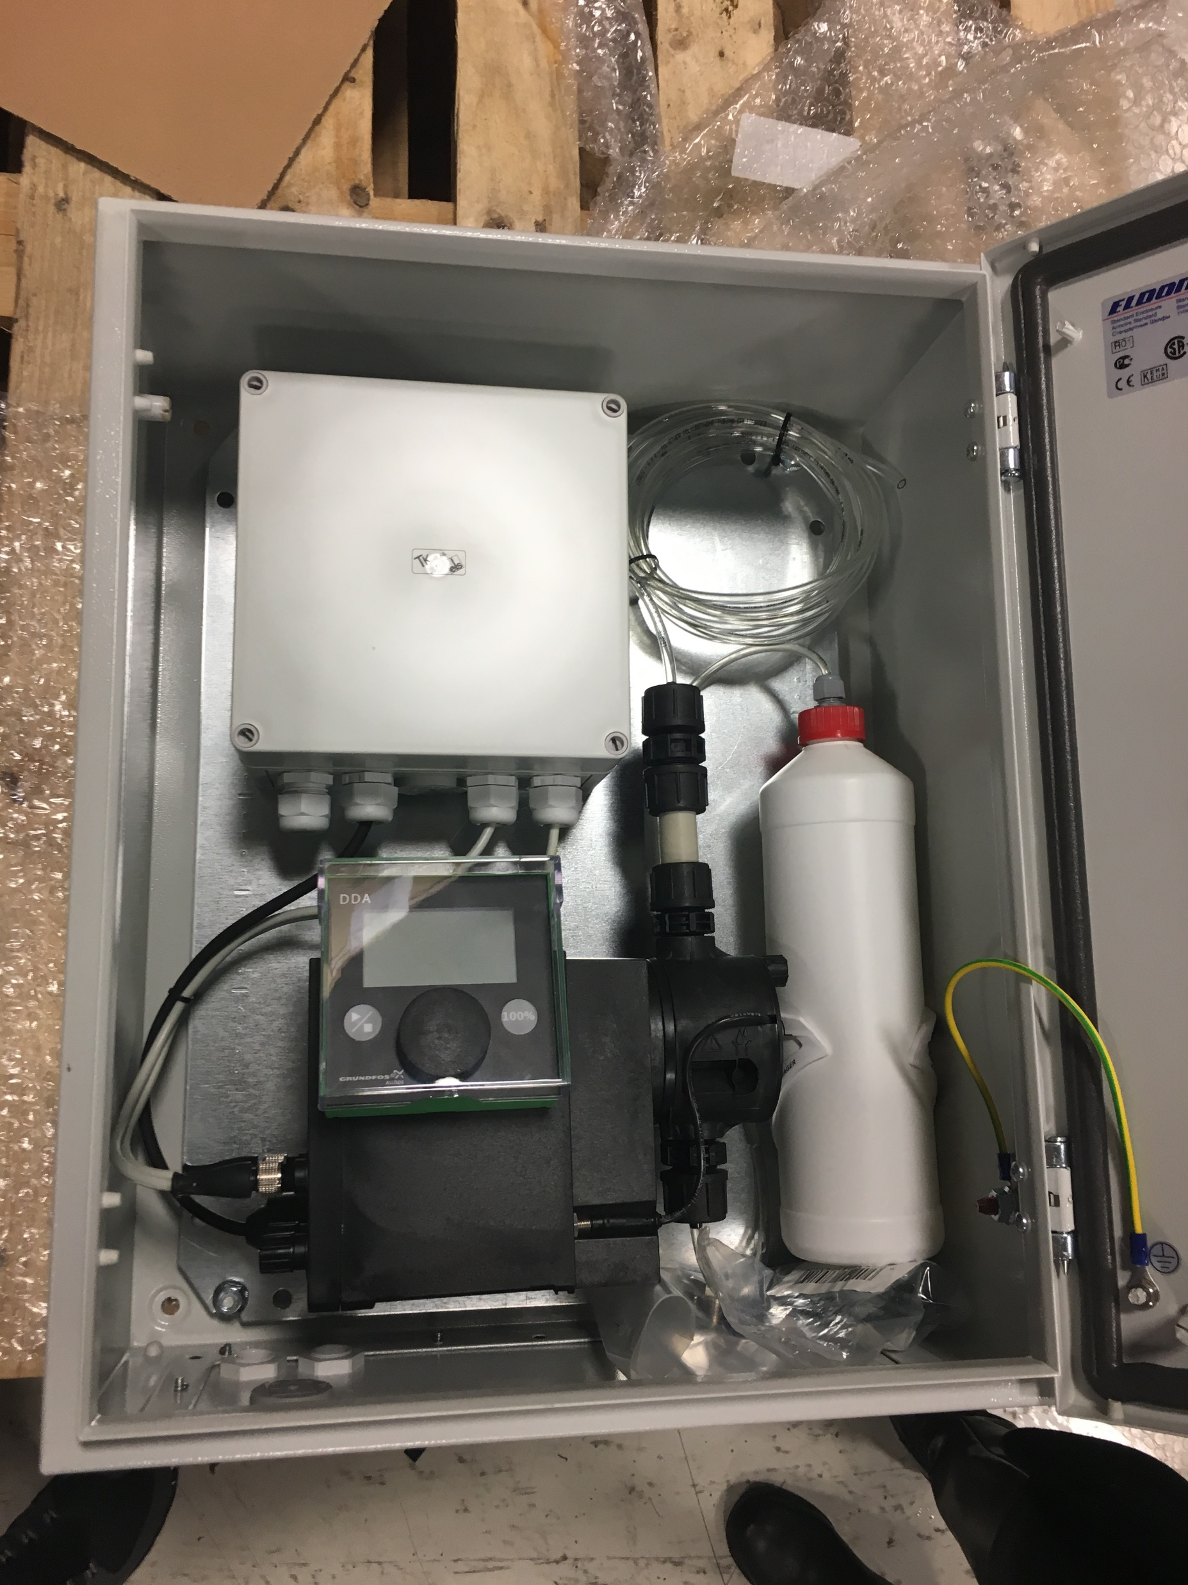
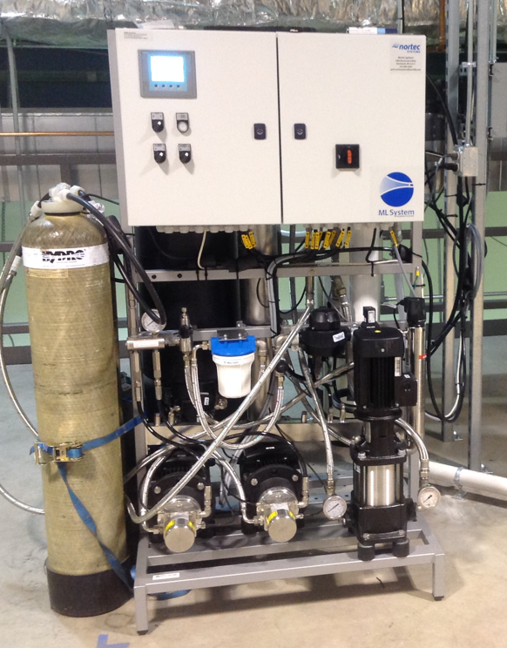
The Condair Advantage
Proprietary Technologies
BQ Testing – Bacteria count
Clean-in-place sanitization
CO2 Dosing with DI water
Rapid Bacteria testing in 30 minutes
Automatic full-system disinfection
Clean room applications

Slide 13
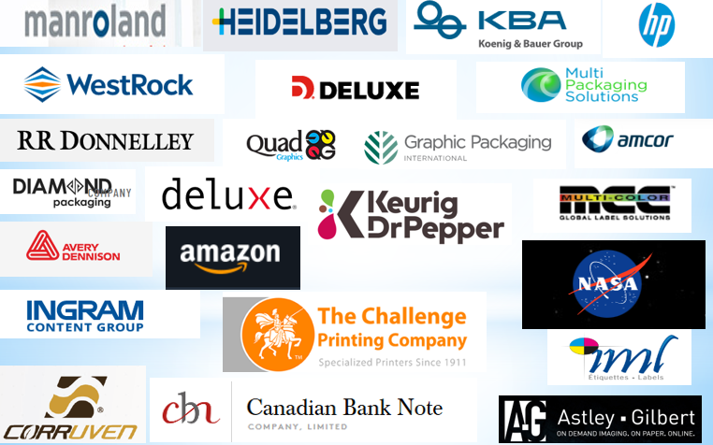
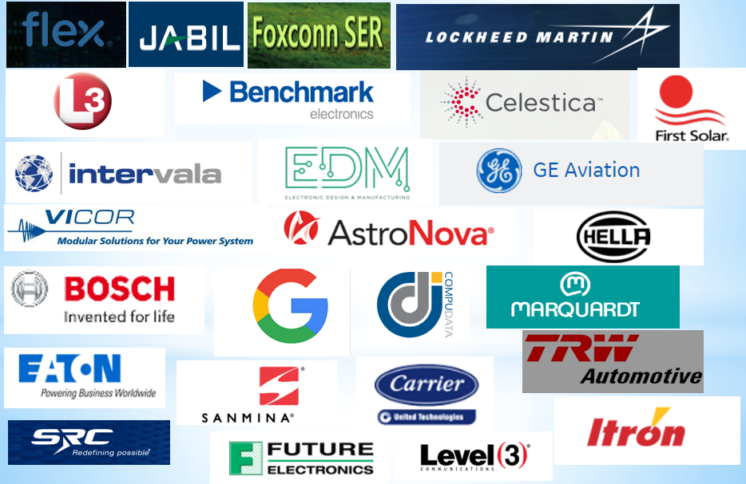
The Condair Advantage
Strong Experience and Name Recognition
Printing & Packaging
Electronics

Slide 14
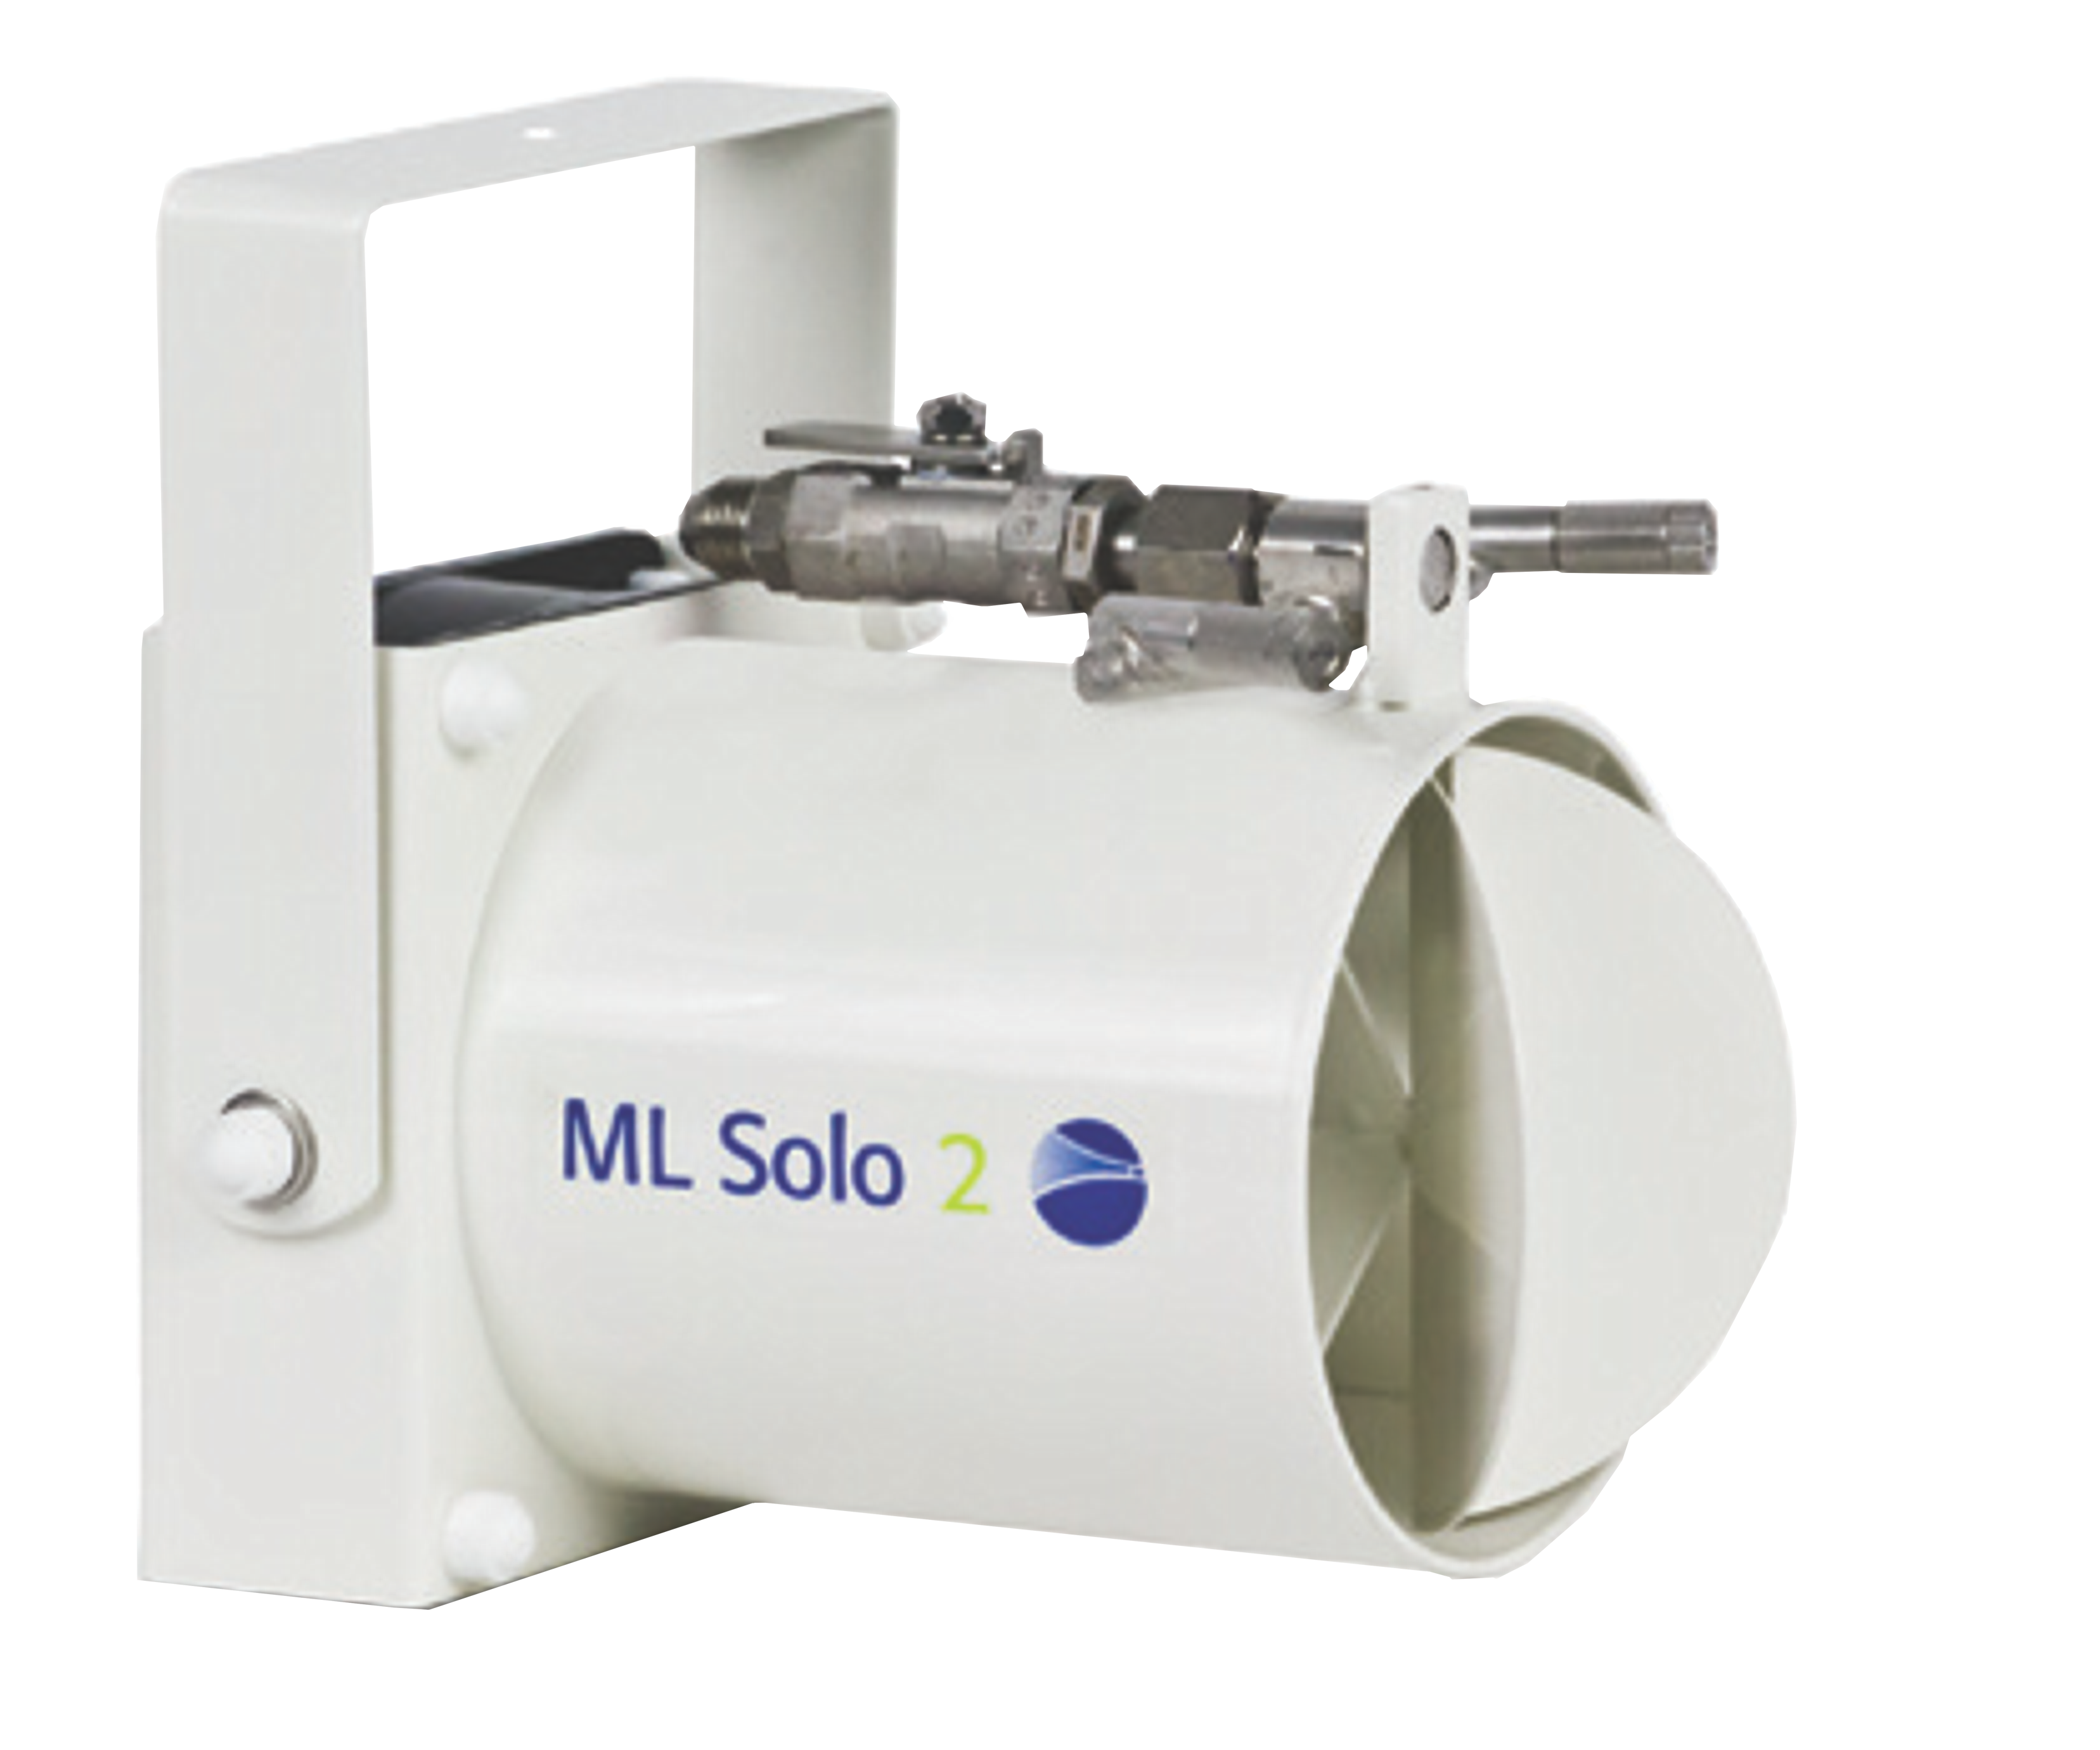
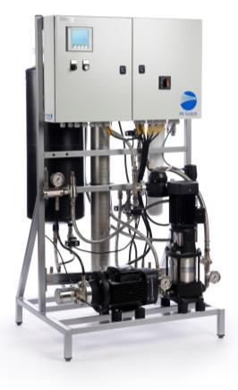
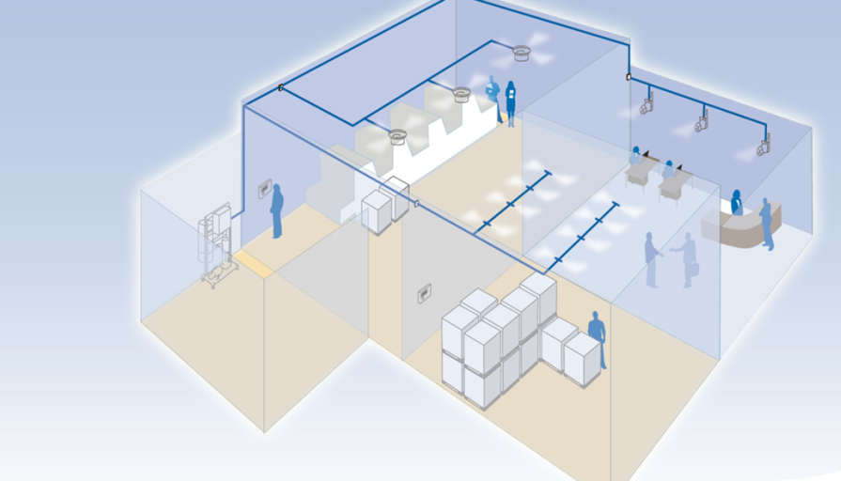
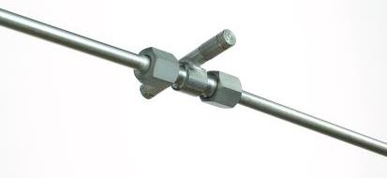
The Condair Advantage
System Flexibility
Princess
Nozzle Capacities 3.3, 5.5, 10, and 14.5 lbs/hr
Atomizers
Princess 2
Princess 2 Max
Solo 1
Solo 2
Flex
Wall or ceiling mounts
Solo
MLP RO 300
Flex

Slide 15
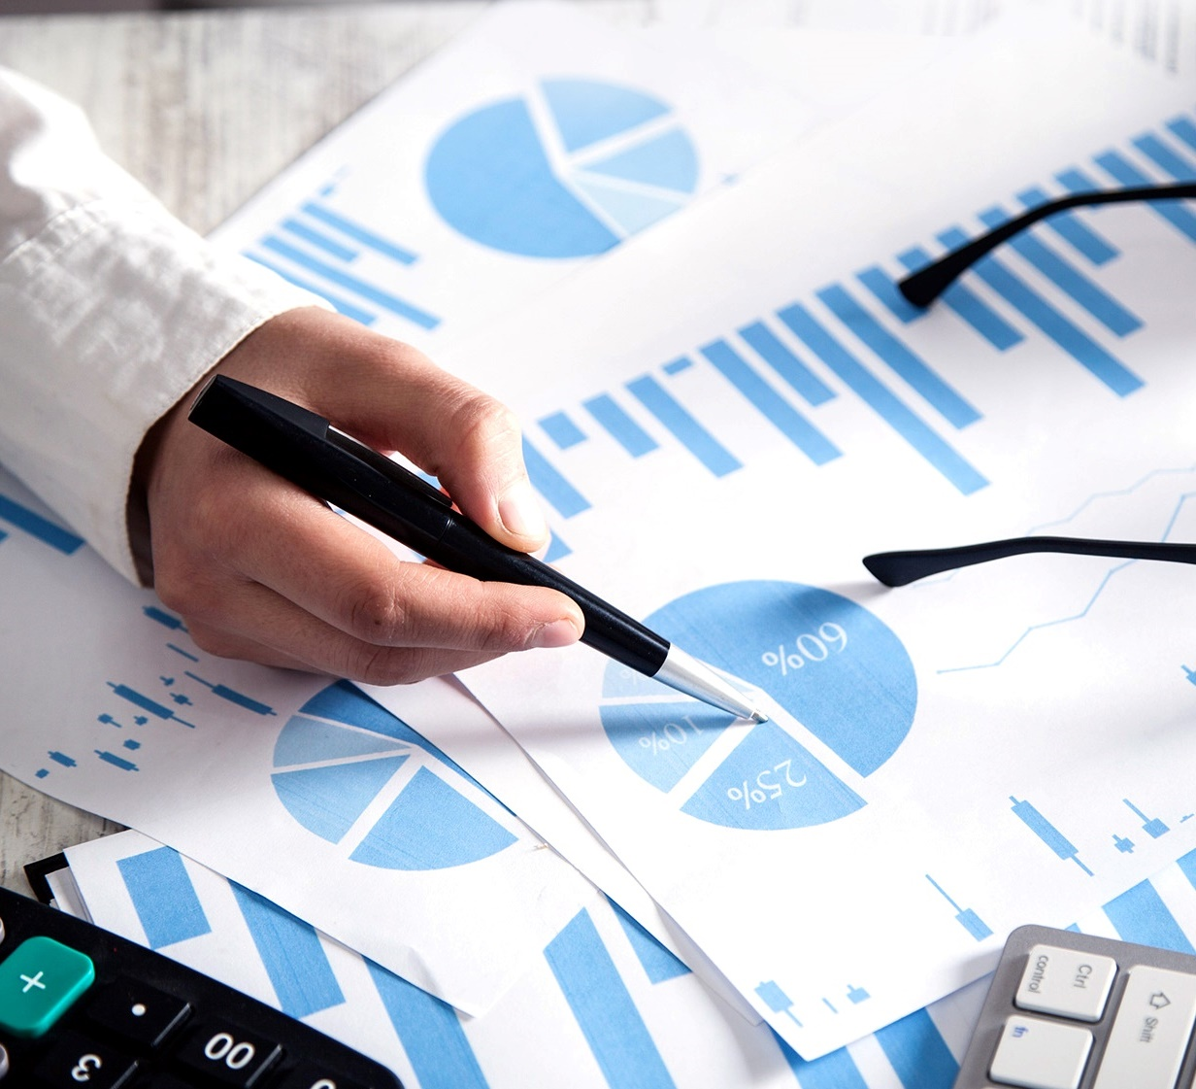
The Opportunity
Low hanging fruit
Condair offers the most flexible solution for any application
Examine old files for large electric loads to replace with DRS
Research your territory for available energy rebates (dsireusa.org)
Influence specifications to include a Condair proprietary technology
For you it is clean, easy money
We’re available to help you sell!

Slide 16
Thank you!
Wafik Kouchouk
Regional Sales Manager
Rob Warneke
Application Manager

