Slide 1
2017 Harvard Medical School Healthcare Symposium
May, 2017
Derek Feeley
President and CEO
@DerekFeeleyIHI

Slide 3
Notes:
A similar incident occurred in Hanoi, Vietnam, under French colonial rule. The colonial regime created a bounty program that paid a reward for each rat killed. To obtain the bounty, people would provide the severed rat tail. Colonial officials, however, began noticing rats in Hanoi with no tails. The Vietnamese rat catchers would capture rats, lop off their tails, and then release them back into the sewers so that they could procreate and produce more rats, thereby increasing the rat catchers' revenue.

Slide 4
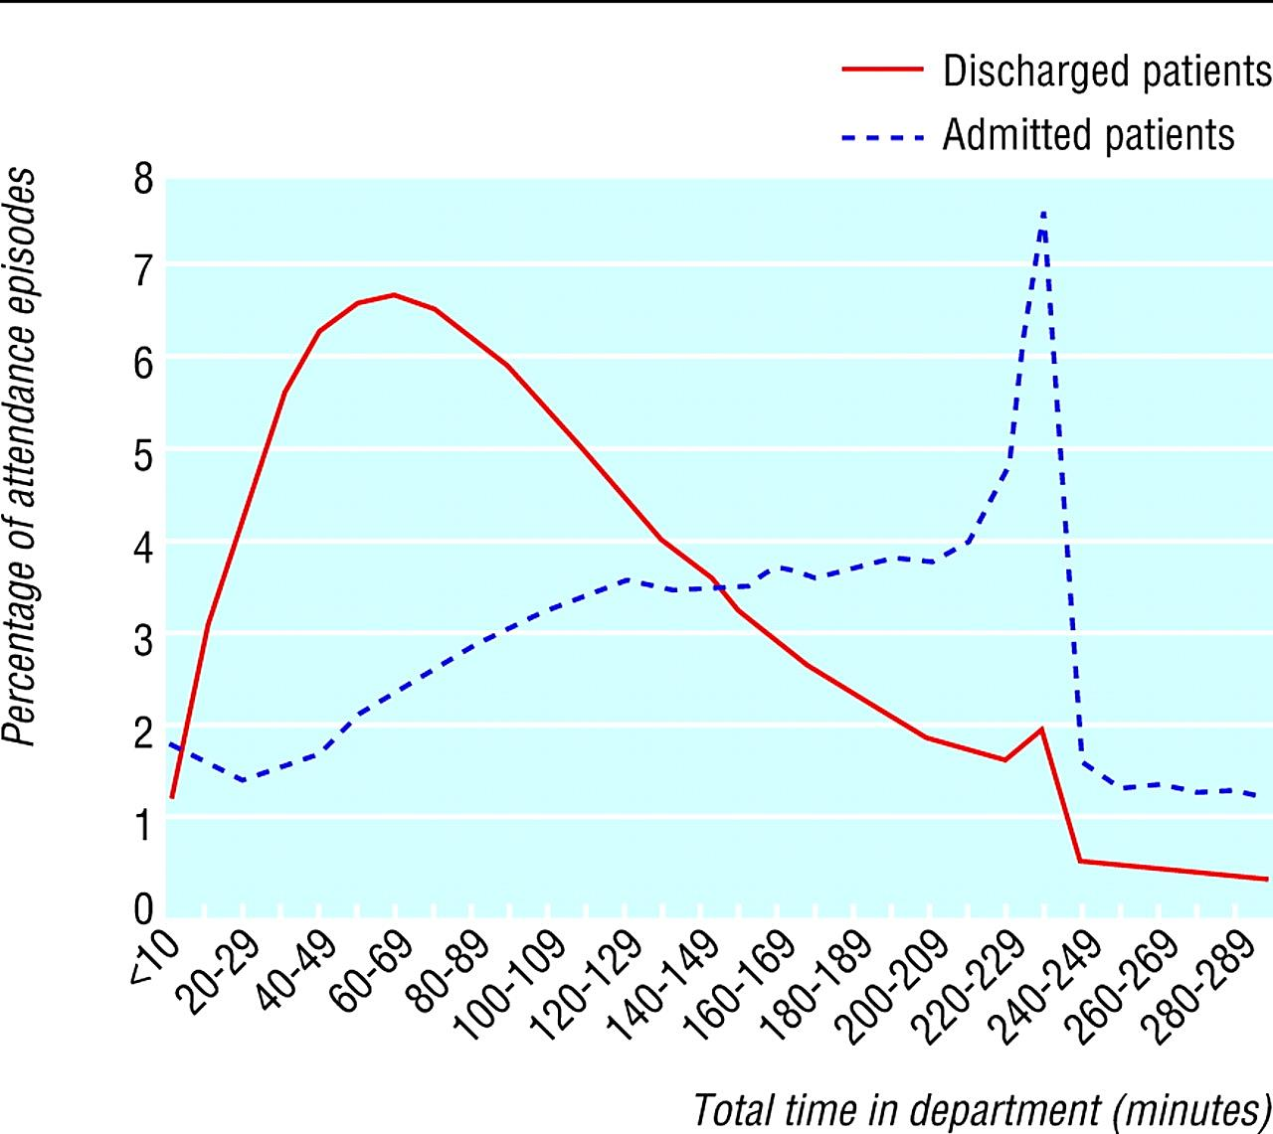

Slide 5
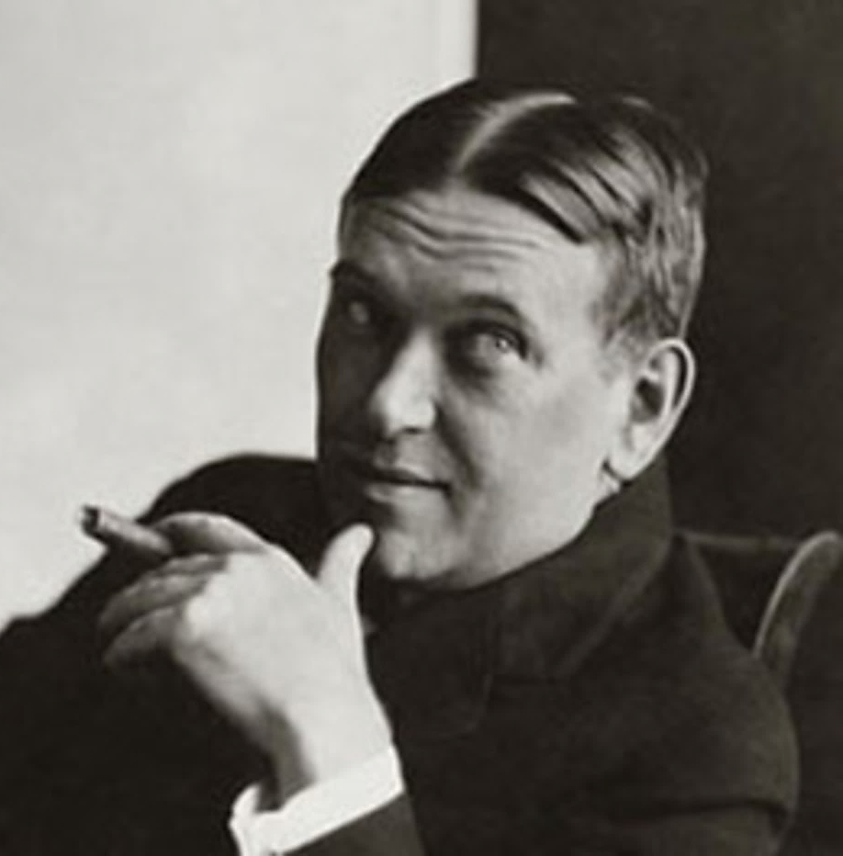
“For every complex problem there is
an answer that is
clear, simple,
and wrong."
H. L. Mencken
Notes:
Our existing model:
A problematic group/condition/outcome is identified, we then apply a methodology to help us make the necessary changes within that group, which leads us to provide new/improved interventions based on evidence of previous success, which we expect to result in desired outcomes.
However, what seems to mostly happen is that our response to (particularly social) problems lags behind the rapidly-changing reality of those problems. We almost inevitably start with looking at the evidence-based interventions that we have available to deliver our desired outcomes. And so often the problem we seek to solve is shaped by the solutions that we offer, not the other way round.
(Our approach to drug misuse and mental ill health is shaped by the diagnostic techniques and treatments we have available, the way we define and view offenders is shaped by our prison estate etc etc)
The new model we’re all working towards:
Seems to me that when people say ‘we need to change the system’, it’s always met by that heart sinking feeling that we’ve got to talk about structures and processes, but hardly ever do we start the conversation with the people who live in the system.
If we’re trying to improve the long-term health of a community, it goes without saying that the main actors in this system will be the community/ the people themselves/ service users together with the frontline, the workers and volunteers. Seems to me that his is where the scale is, not the service providers.
But actually it’s all about the people. What we’re after is sustainable change in the lives of people – each and every PERSON… Jim Mather talks about helping people to be the ‘best versions of themselves’ or ‘the best they can be’.
And how can we support our (health)care worker to deliver this?
Just about every leadership manual in existence agrees that you need to delegate complex problem solving as close to the problem as you can. Leaders like you two cannot see the fine grain of the situation, its context, its unique dynamics. Solutions designed from a distance can’t help but fail…so how can we support our frontline staff to support people to be the best they can be?
We often relate to the frontline as a workforce that needs to be trained, managed and monitored. We tightly prescribe roles – what decisions they are expected to make and what decisions are outwith their responsibility. But somehow, in amongst this staff governance and structure and performance measurement, we need to support our staff to do the moment-by-moment creative problem solving that will allow our system to produce sustainable results for individual people.
So how can we look at shifting the balance of power of decision-making towards citizens and communities and frontline workers. It’s a really uncomfortable proposal for a generation of leaders who have grown up in command and control organisations, and whilst everyone can understand the intellectual argument, I think there is a potential for this keynote to help people to “give it a go” test small, fail quickly etc when they get home.

Slide 6
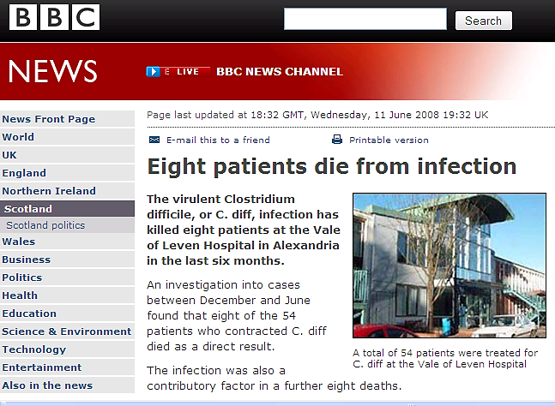
A Burning Platform

Slide 7
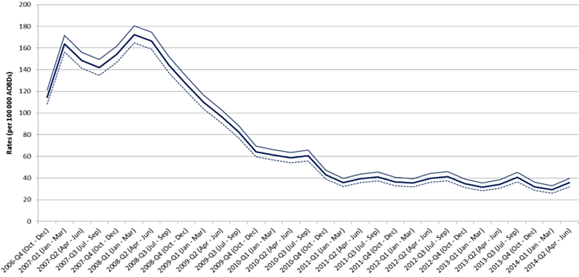
Quarterly rates of Clostridium difficile per 100,000 bed days (65+, 15-64 and 15+)
82% reduction in c-diff cases in the over-65s since 2007
Source: Health Protection Scotland

Slide 8
The SPSP Journey….
Collaboration
Model for
Improvement
Knowledge & skills
Common goal
- aim high
Evidence-based
interventions
Compelling vision

Slide 9
Previously…
Conference Room
APPROVE
DESIGN
DESIGN
DESIGN
DESIGN
Real World
IMPLEMENT
Notes:
Traditionally we have not been good at making change for improvement reliable – because we have not tested whether it will be delivered appropriately in various conditions and environments before we expect all to implement and make part of every day business.
e.g. previous experience of launching new protocols/guidelines – as of Mon am….. expect all to comply fully without really knowing that it’s practical for every system – then we wonder why people don’t comply and the system is unreliable.

Slide 10
The Quality Improvement Way
Conference Room
DESIGN
APPROVE
IF NECESSARY
Real World
START TO IMPLEMENT
TEST & MODIFY
TEST & MODIFY
TEST & MODIFY
Notes:
Traditionally we have not been good at making change for improvement reliable – because we have not tested whether it will be delivered appropriately in various conditions and environments before we expect all to implement and make part of every day business.
e.g. previous experience of launching new protocols/guidelines – as of Mon am….. expect all to comply fully without really knowing that it’s practical for every system – then we wonder why people don’t comply and the system is unreliable.

Slide 11
Collaboration Across Disciplines

Slide 12
The New Normal
Thought you all may like to know that we have eradicated CLABSI within our ICU & deem it to be like polio or smallpox, namely a disease of the past (see the photo). VAP still a challenge where we hit the 300 day target but we always get one as a rare event. Whole team at the RAH quite proud & rightfully so in my eyes.
Kevin Rooney

Slide 13
Kevin’s ICU: ALOS
Cost saving of £990,000
6.2 days
5.1 days
18% reduction
(1.1 days)

Slide 14
Reducing Waste, Overuse, and Costs

Slide 15
Reduce Waste
“50% of all resource expenditure in hospitals is quality-associated waste”
- recovering from preventable foul-ups
- building unused or unusable products
- providing unnecessary treatment
- simple inefficiency
Brent James and Lucy Savitz – Intermountain Healthcare

Slide 16
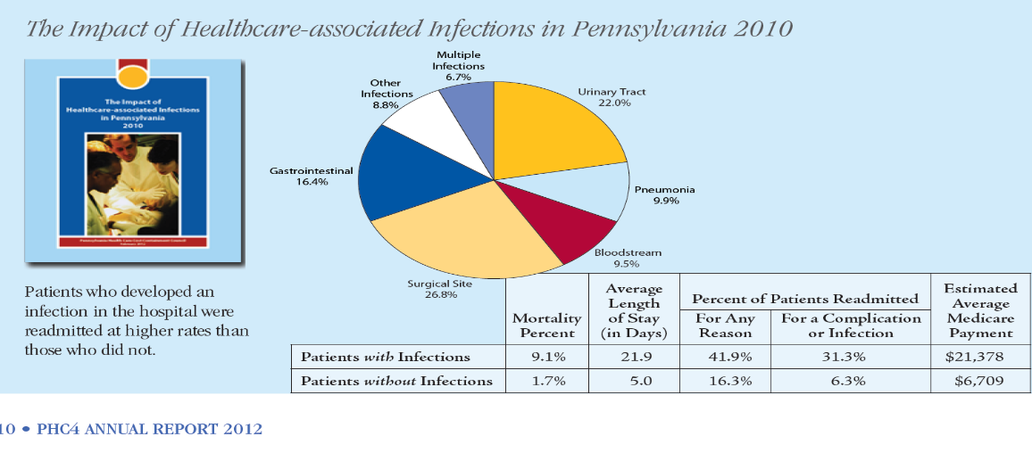
Impact on Costs

Slide 17
Incidence; Global Trigger Tool Reviews
 | 3 Exemplar Hospitals (900 notes) | 40 Bed rural Hospital (300 notes) | 10 Hospital Research Project (240 notes) | 7 Hospital System (3000 notes) | Multi-state Tertiary System (2000 notes)
Events/1000 Days | 83 | 90 | NA | 119 | 86
Events/100 admissions | 45 | 40 | 37 | 41 | 38
Admissions with adverse events | 32% | 30% | 30% | 29% | 30%

Slide 18
Why So Difficult
Needs culture change
Needs learning system
Change is hard
Needs barrier removal

Slide 19
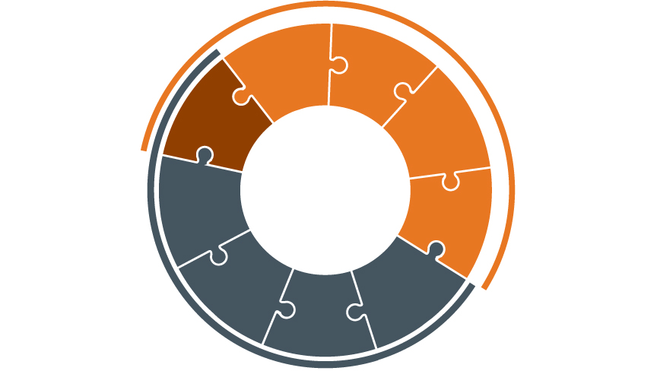
Framework for Safe, Reliable, and Effective Care
Creating an environment where people feel comfortable and have opportunities to raise concerns or ask questions.
Being held to act in a safe and respectful manner given the training and support to do so.
Psychological Safety
Accountability
Facilitating and mentoring teamwork, improvement, respect and psychological safety.
Developing a shared understanding, anticipation of needs and problems, agreed methods to manage these as well as conflict situations
Leadership
Teamwork &
Communication
Engagement of Patients & Family
Openly sharing data and other information concerning safe, respectful and reliable care with staff and partners and families.
Transparency
Gaining genuine agreement on matters of importance to team members, patients and families.
Negotiation
Reliability
Continuous Learning
Improvement
&
Measurement
Applying best evidence and minimizing non-patient specific variation with the goal of failure free operation over time.
Regularly collecting and learning from defects and successes.
Improving work processes and patient outcomes using standard improvement tools including measurements over time.
© IHI and Allan Frankel

Slide 20
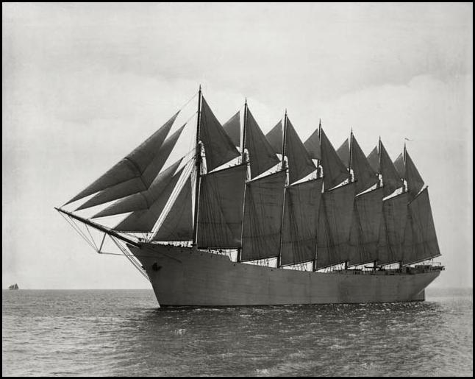
Change
Notes:
1993 5:1 -- “Everyone has a plan until they get punched in the mouth.” Mike Tyson or John Shirley.
The Thomas W. Lawson was the only seven-masted, steel-hulled schooner originally planned for the Pacific trade, but then used primarily to haul coal and oil along the East Coast of the United States. Built in 1902, the ship holds the distinction of being the largest schooner and the largest pure sailing ship (without an auxiliary engine) ever built.
100 years ago: The Thomas W. Lawson was destroyed near the Scilly Isles Hellweather's Reef, in a storm on December 14, 1907, killing all but two of her 18 crew including the pilot who was already aboard ship. All seven masts broke off and fell into the sea with all seamen who had climbed up the rigging for safety on their captain's command.
The lesson: Most of healthcare is dealing with the imperative to Our reliability will not increase by adding more masts, by trying harder, by studying harder – we must find a new approach of we want the headline, if we watnt to reach escape velocity.
At a cost of approximately $250,000, the Thomas W. Lawson holds the record of being the only seven-masted schooner.
Her design and purpose was an ultimately unsuccessful bid to keep sailing ships competitive with the steam ships that were becoming more common for freight transport purposes.
The schooner was smashed starboard side on against Shag Rock near Annet, England by tremendously heavy seas after having grounded the dangerous underwater rocks.

Slide 21
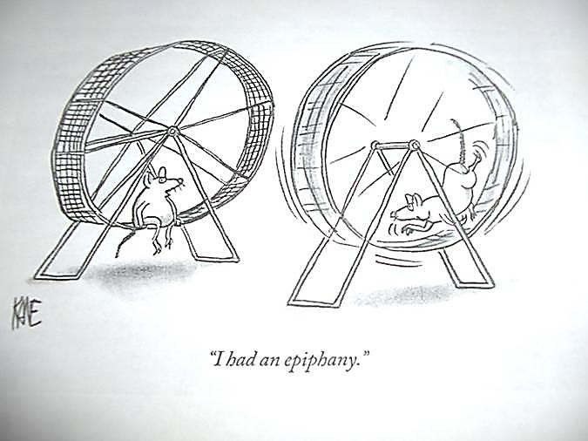
“I had an epiphany…”

Slide 22
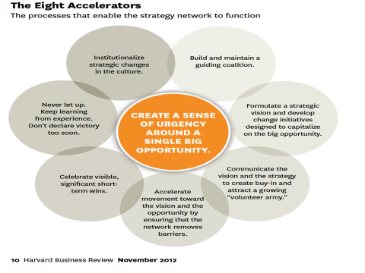
Removing Barriers (Kotter)

Slide 23
Removing Barriers

Slide 24
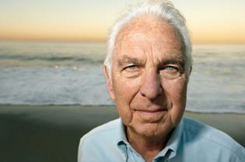
Change is a Team Sport
“Leadership is about getting people to want to do the right thing.”
“Good leaders make people feel that they’re at the very heart of things, not at the periphery. Everyone feels that he or she makes a difference to the success of the organization. When that happens, people feel centered and that gives their work meaning.”
Warren Bennis

Slide 25
Culture Eats Strategy for Breakfast
Culture is a result of what an organization has learned from dealing with problems and organizing itself internally.
Your culture always helps and hinders problem solving
Solve problems by identifying and resolving associated discrepancies between values and behavior
Do not oversimplify culture. It’s far more than “how we do things around here.”
Leaders should not focus on culture change. Focus on a business problem.
Culture is a group phenomenon. Engage focus groups to define how the culture is helping and hindering work on a problem.
Edgar Schein

Slide 26
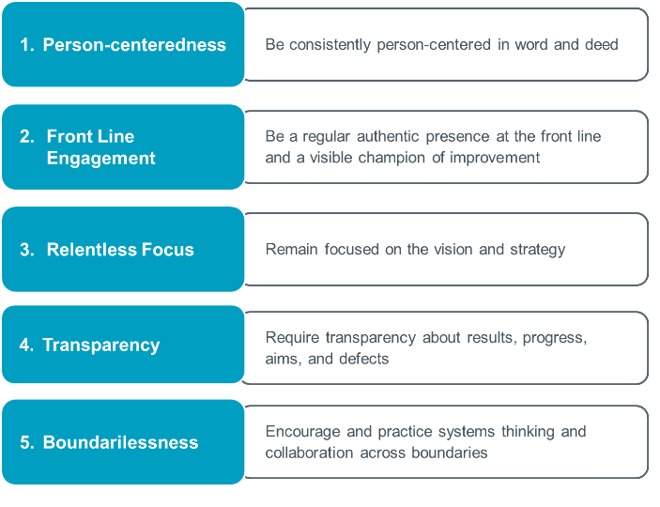
High-Impact Leadership Behaviors
Swensen S, Pugh M, McMullan C, Kabcenell A. High-Impact Leadership: Improve Care, Improve the Health of Populations, and Reduce Costs. Cambridge, MA: Institute for Healthcare Improvement; 2013. Available on www.ihi.org.

Slide 27
