Slide 1
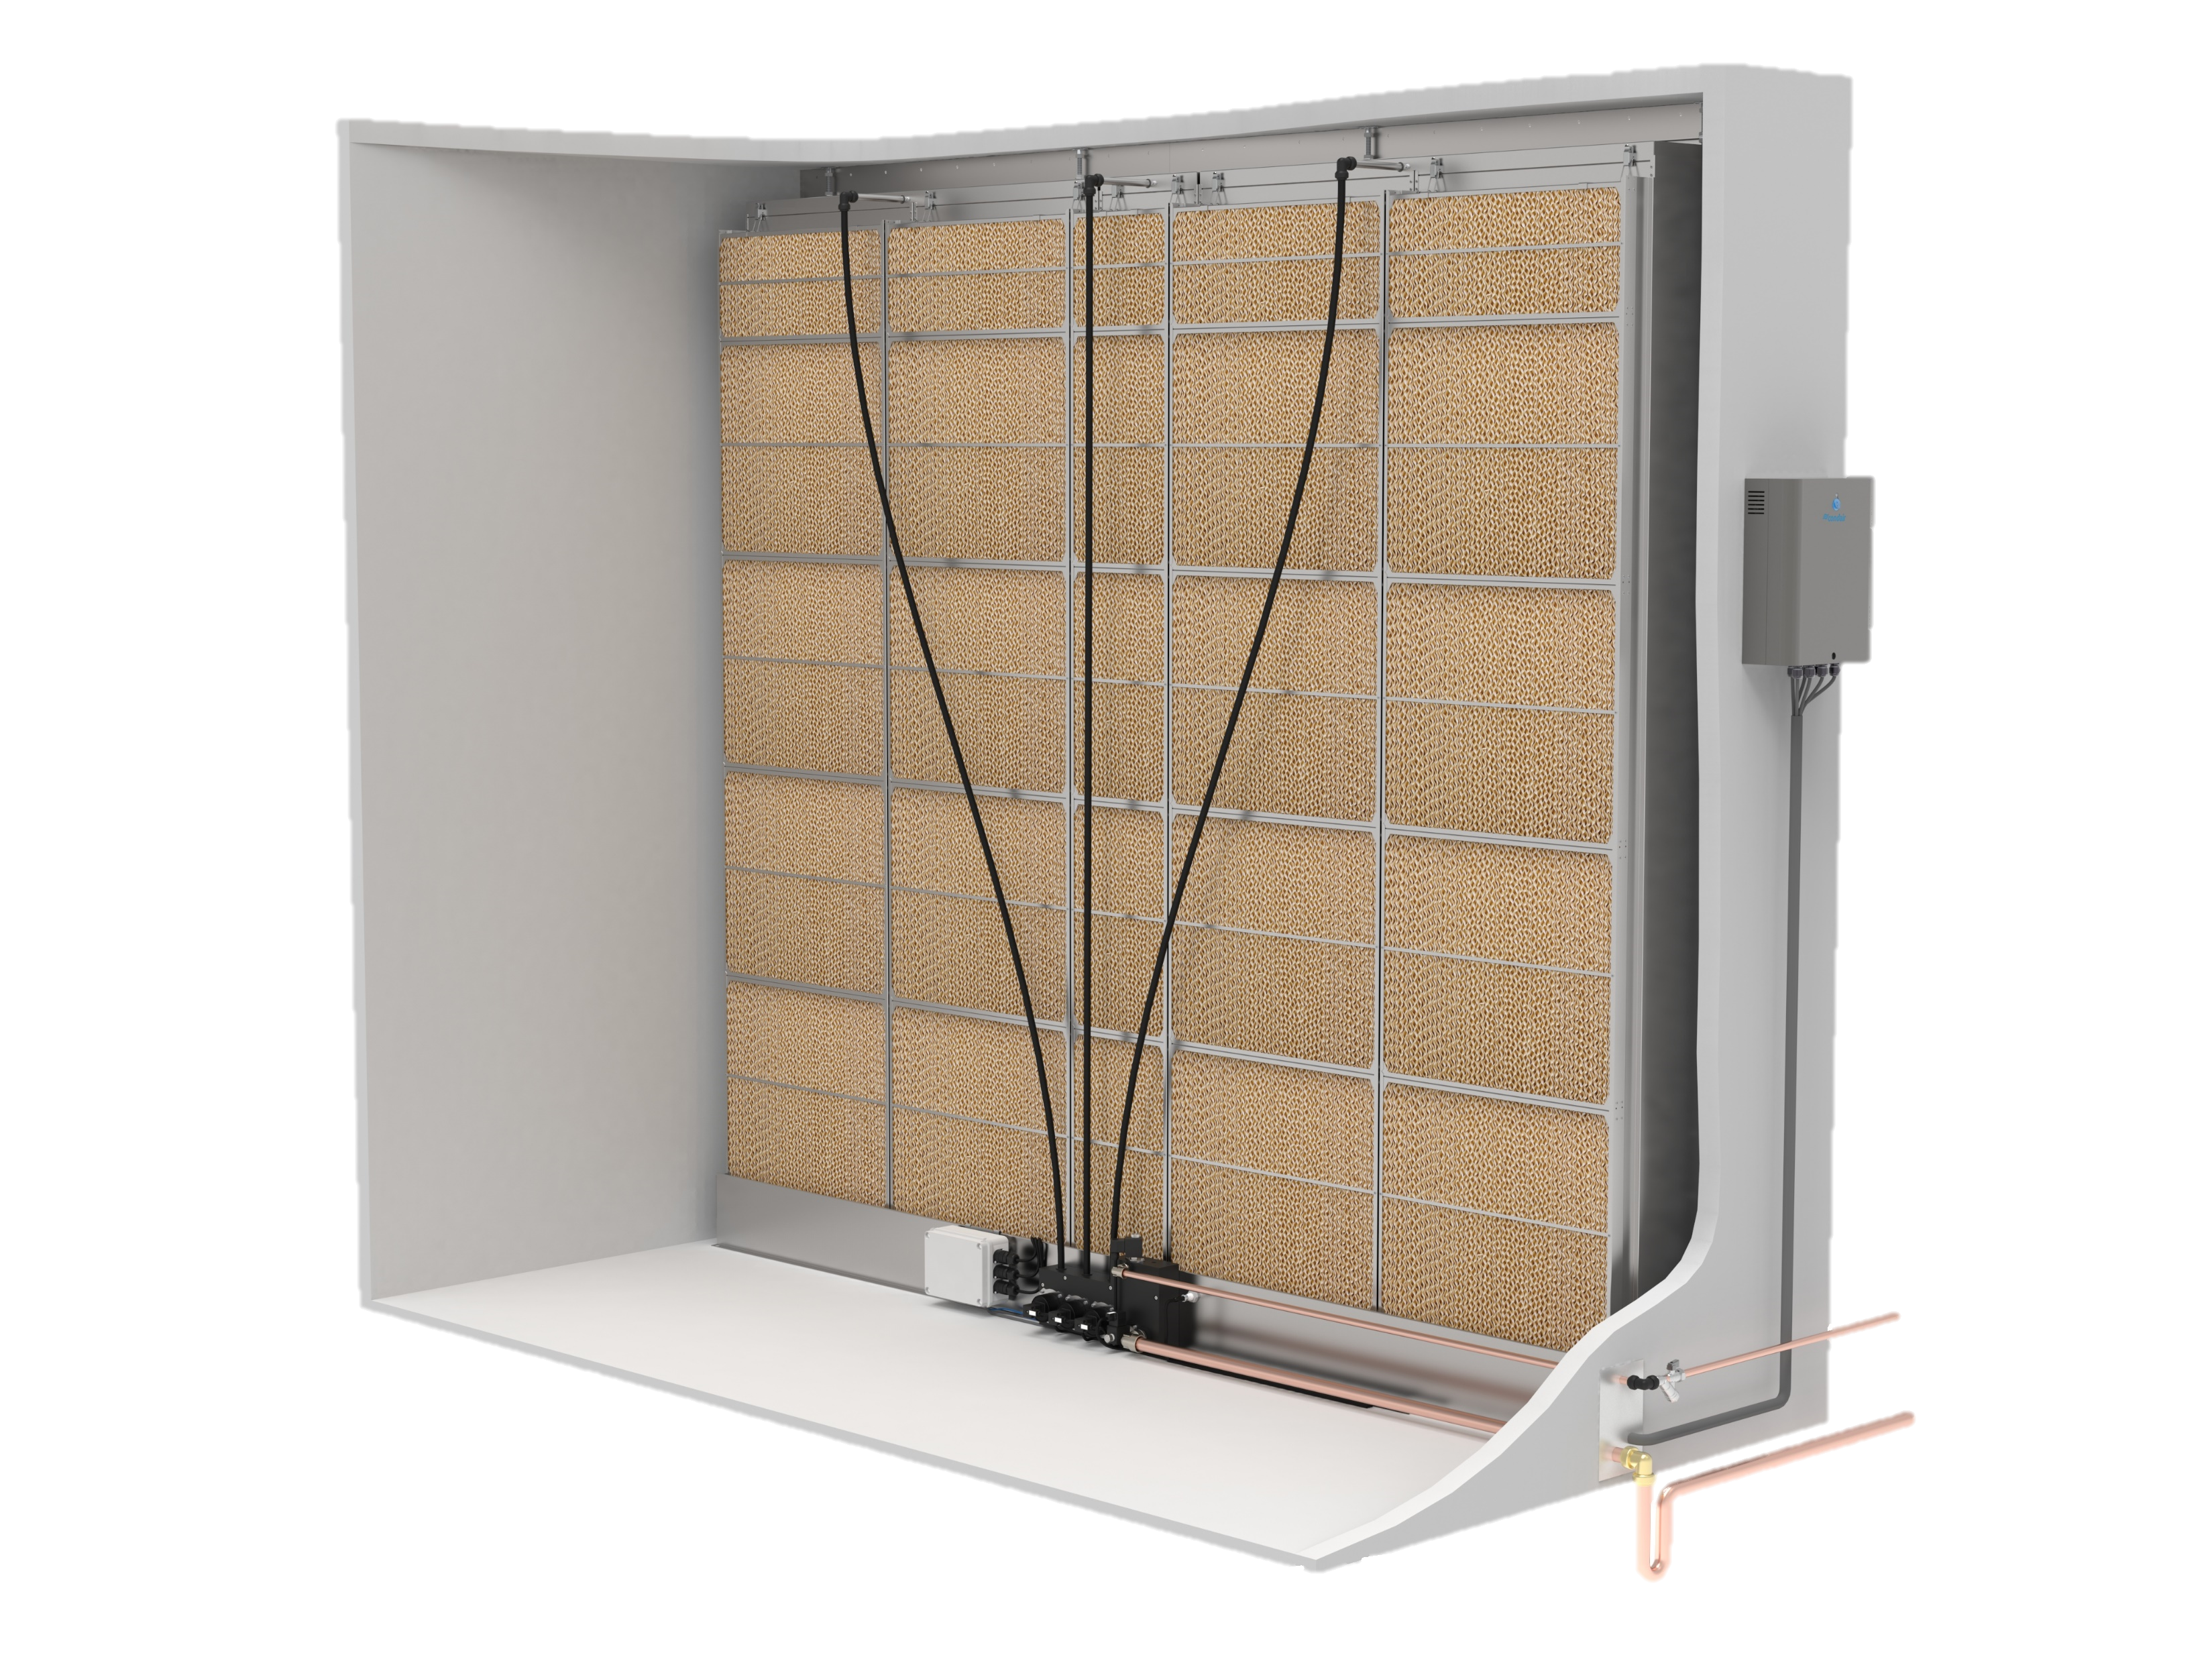

Stay Cool with the Condair MC
Evaporative Humidification & Cooling
Karly Treleaven, Technical Product Manager

Slide 2

Agenda
Stay Cool with the Condair MC
Overview
MC/ME Comparison
Applications
Key Takeaways

Slide 3



Condair MC
The cost-effective evaporative cooling solution!
Optimized Design
Minimizes energy & water consumption
Reduced system footprint
Simplified Features
Increased cost-effectiveness
Quick installation, reliable operation, intrinsic hygiene
Efficient Operation
793 lbs/hr of humidity & 245 kW of adiabatic cooling
< 0.15 kW of electrical energy
Notes:
What was the purpose of designing the MC (cheaper evaporative cooling solution)
Main purpose is evaporative cooling - not high accuracy (+/- %)
USPs

Slide 4
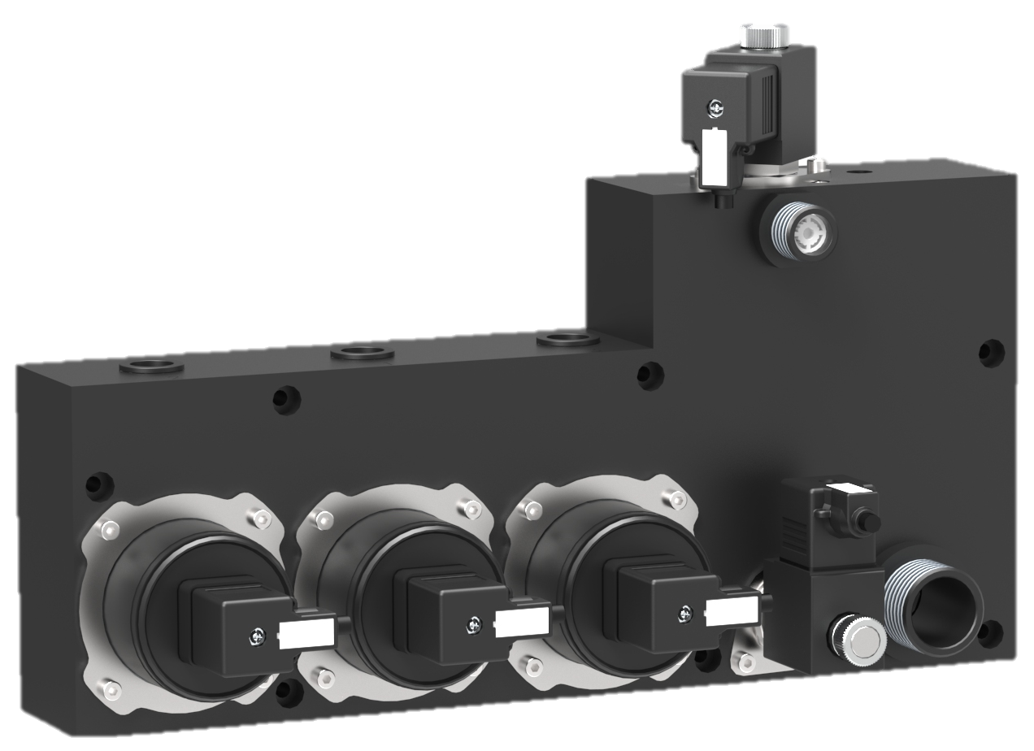
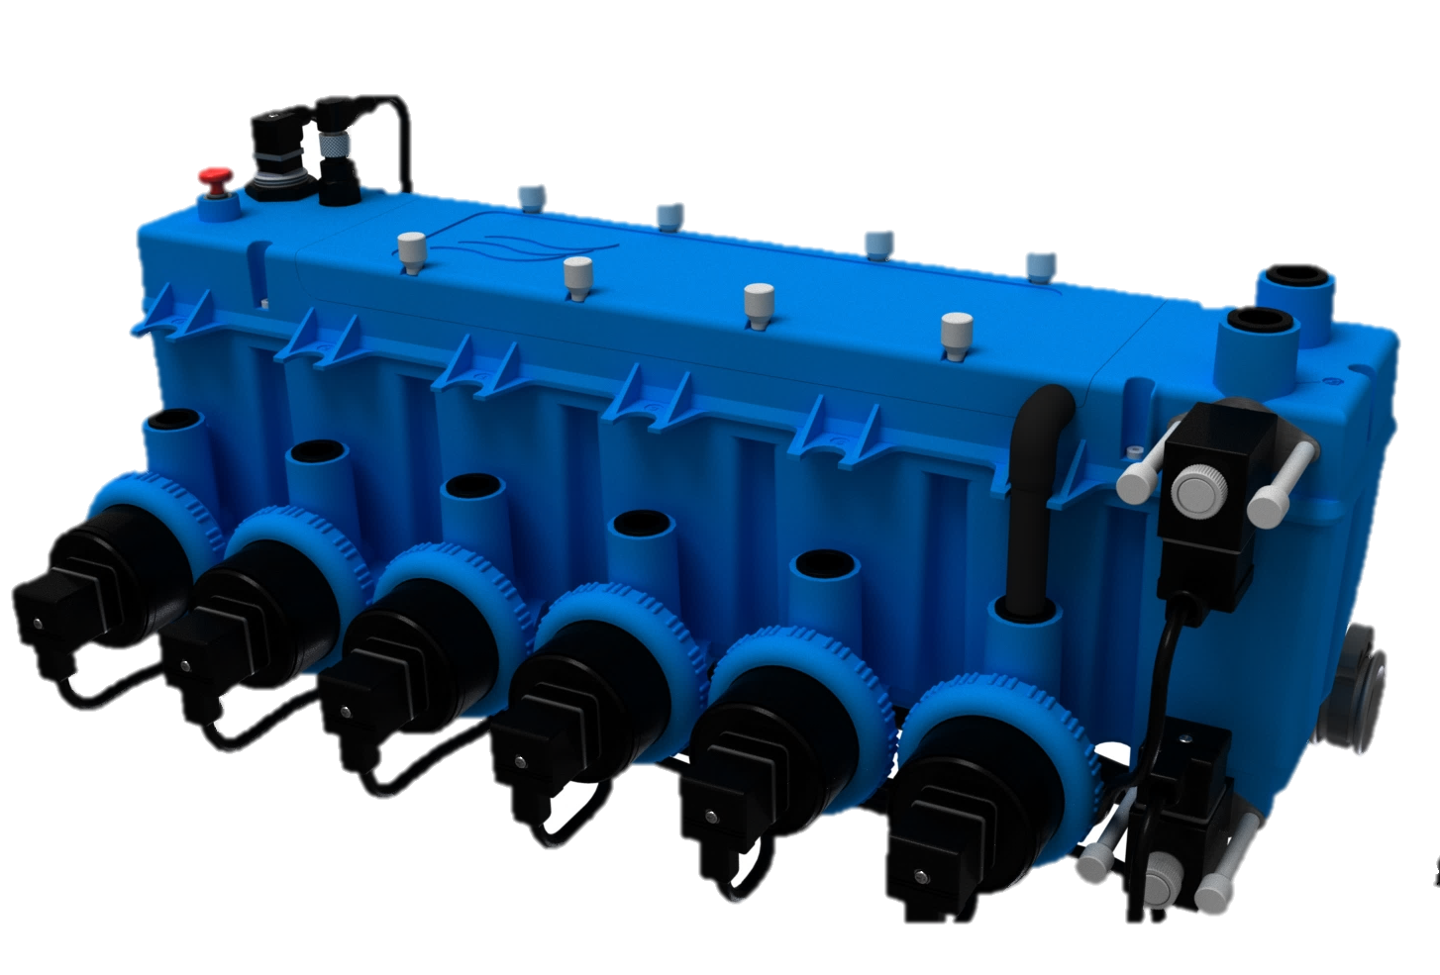
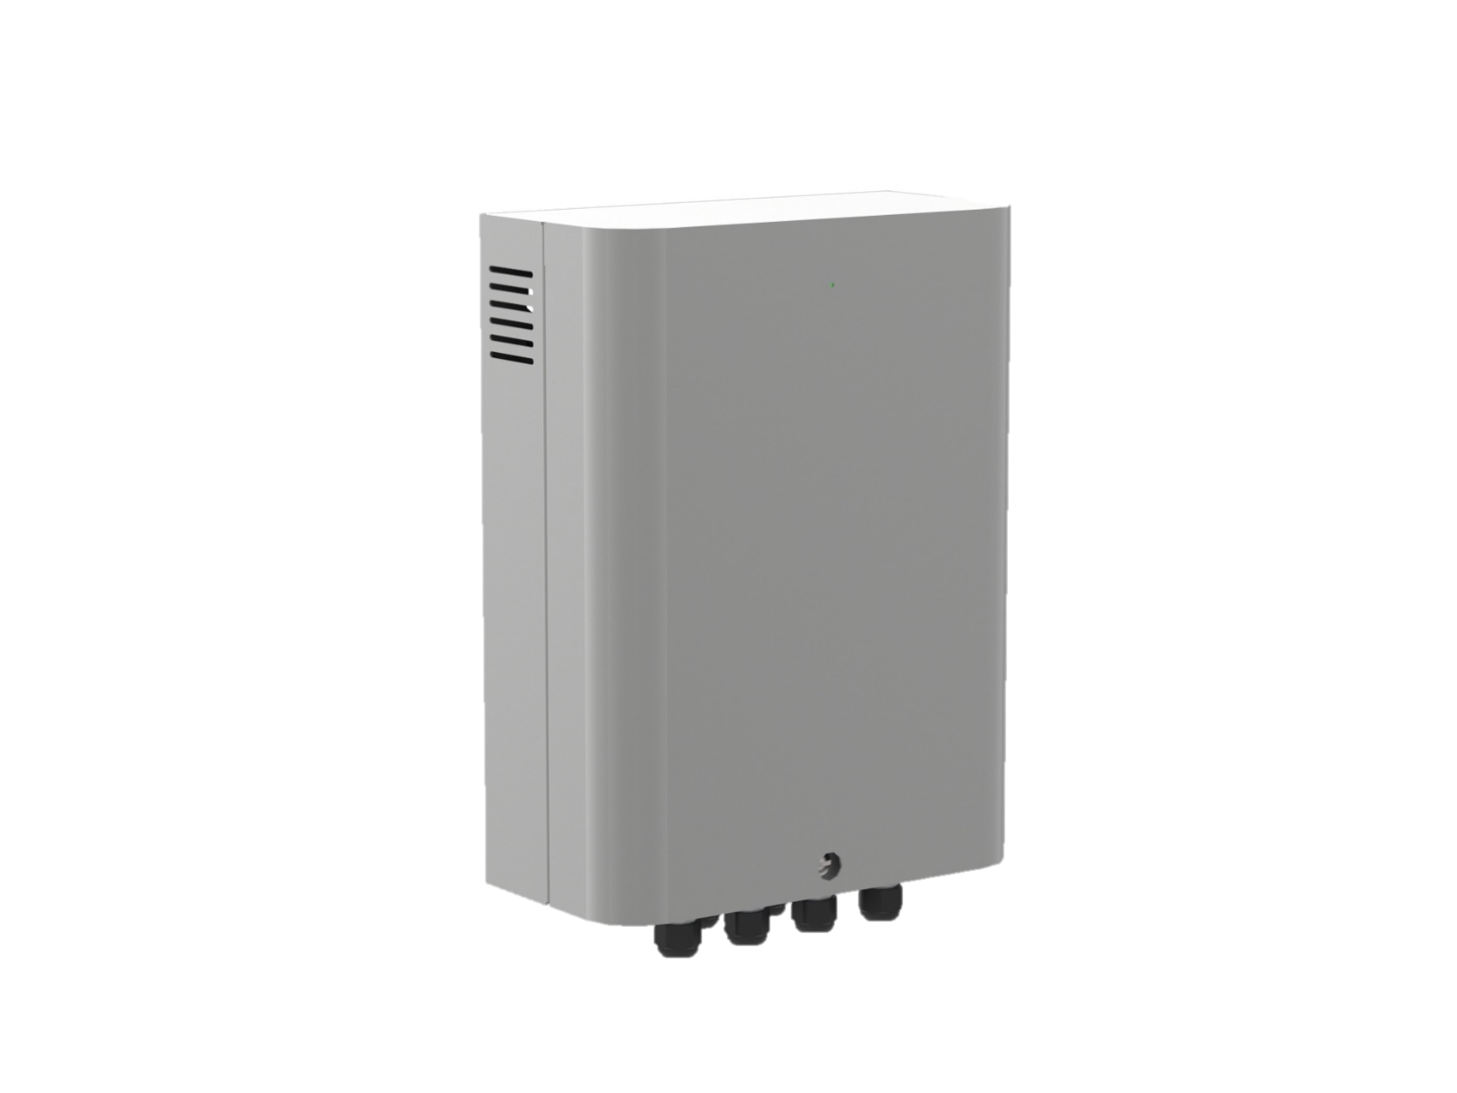
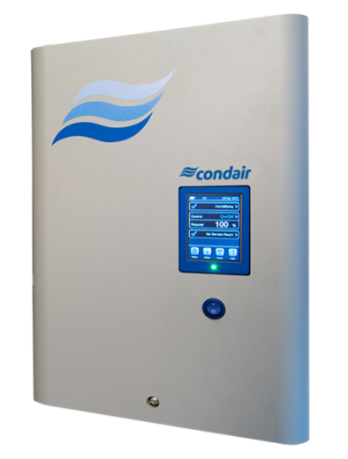
Condair MC vs. ME
What’s Different?
 | MC Series | ME Series
Size Range
Width (in.) Height (in.) | 25.5 – 118 (12” increments) 29.5 – 118 (10” increments) | 25.5 – 165 (6” increments) 24.5 – 157 (5” increments)
Hydraulic Module
Capacity (lbs/hr) Stages System Drain Pump Fault Detection Location | 793 Maximum 3 per system Gravity drain Standard Internal | 2200 Maximum 7 per system Pump assistance Option Internal or External
Media
Types Depths (in.) Efficiencies | Fiberglass 6” | 8” 85% | 95% |  | Fiberglass 4” | 6” | 8” 75% | 85% | 95% | Polyester 8”| 12” 85% | 95% | Polyester 8”| 12” 85% | 95%
Controls
Controller BMS Connectivity Power Consumption | Basic control with status LED Modbus 74 – 145 W | Condair Integrated Controller BACnet / Modbus / Lonworks 85 – 536 W
Notes:
Stages -
Summarize comparison – what’s included, what’s not
Reduced size range
Hydraulic module (no conductivity sensor)
Simplified controls (no IC, modbus only)
Options offering
Hygiene
Water quality / usage

Slide 5
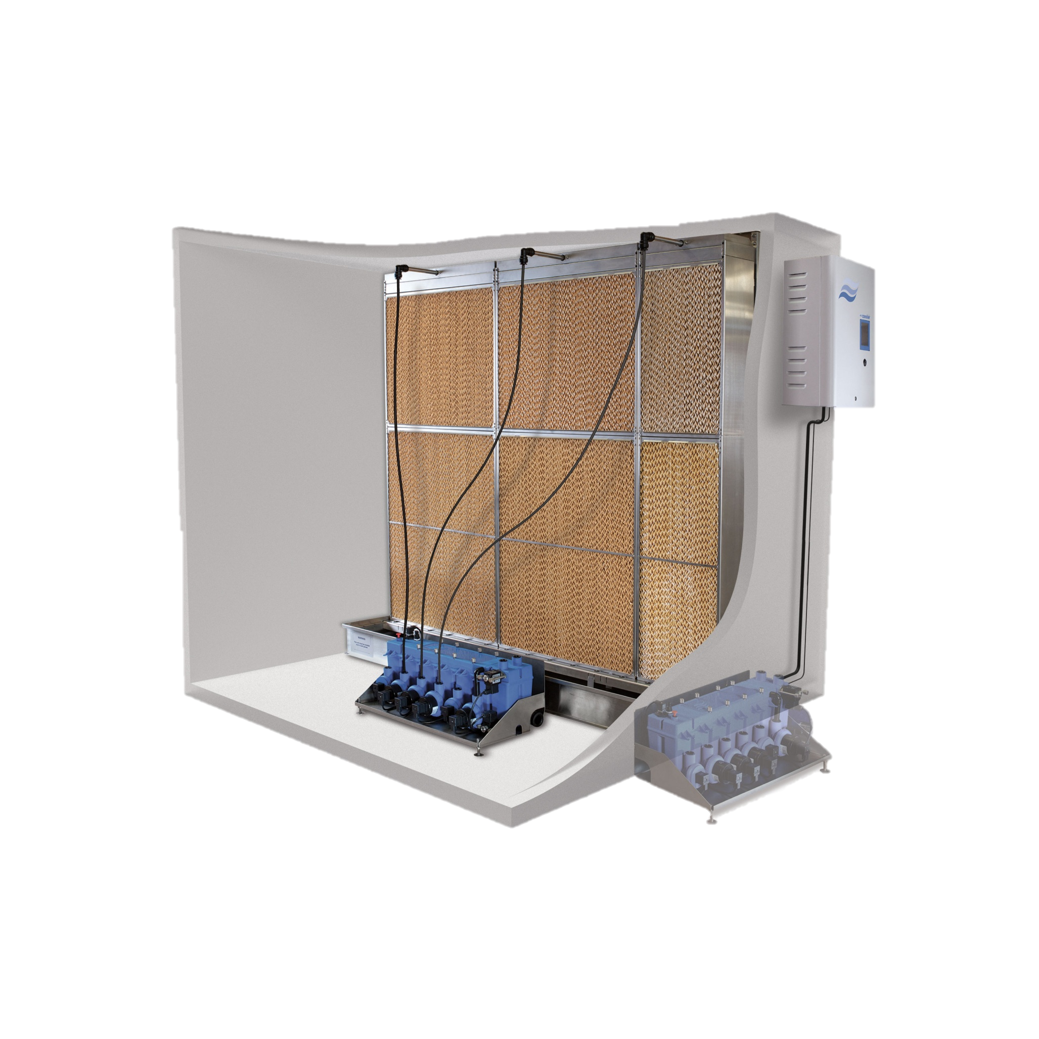
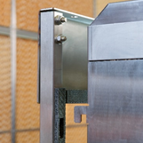
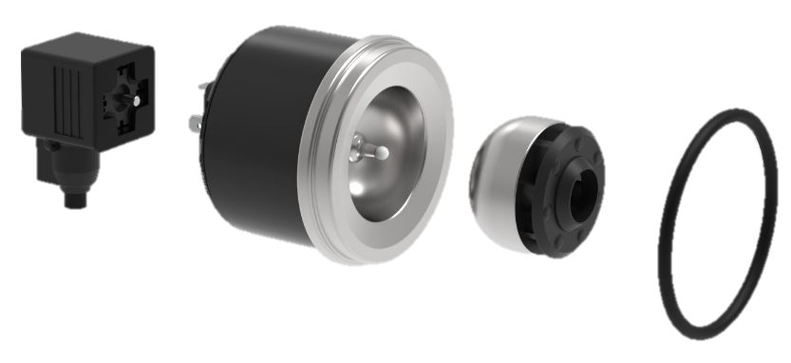
Condair MC vs. ME
What’s the Same?
Clearances:
24” up and downstream
Water Compatibility:
Potable or RO
UL 998 Approved!
Fiberglass media
& hook-in cassette design
Magnetic field
Spherical motor
Hygiene Features:
No stagnant water! Automatic flush & drain cycles, complete drain on power outage
Antimicrobial impregnated glass fibre media
Optional submerged UV to disinfect water and drain tray
Magnetically driven pumps Condair exclusive!

Slide 6
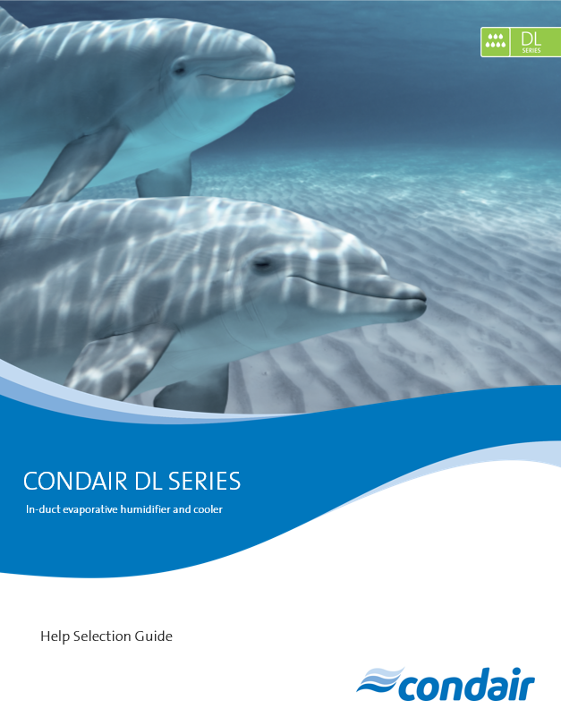
MC Series
Key Takeaways
Why the MC? | Applications
 | Data centers Industrial plants Greenhouses Commercial kitchens | Garages Factories Dairy & poultry farming Warehouses Etc…
Competitive price point!
Selecting in Help is simple!
Notes:
Maximized cost effectiveness – skip the bells & whistles
Competitive price point – The MC offers a lower price point than the ME, while still maintaining that Condair-quality system our customers are after. Perfect for customers who are looking for a more basic evaporative media system, but don’t want to settle for the lower-quality systems the other guys are offering.
Same high-quality components: fiberglass media, stainless steel metalwork
The MC also offers the customer everything they’d need in one conveniently packaged system: controls, hygiene functions, and a simple installation process.
Incredibly energy efficient – operates on <0.15 kW (less than ME due to maximized staging, less pumps)

Slide 7
Thank you!
Karly Treleaven
Karly.Treleaven@Condair.com

