Slide 1


Notes on the Presentation
This presentation is for internal Condair use only
Recommended use:
  Screens in Condair offices
  Internal presentations and training
We have not received permission from all the projects included to share externally. Images also do not have permissions for use other than internally.
For more information on DL in Hospital Applications, contact:
Marlee.Spiegelberg@condair.com
Vithursha.Pasupathy@condair.com

Slide 2
SPOTLIGHT
DL Hybrid Humidifier
in Hospitals

Slide 3
HOSPITAL HUMIDIFICATION
Common Challenges
Hygienic Requirements
Energy Efficiency
High-Accuracy Humidification

Slide 4
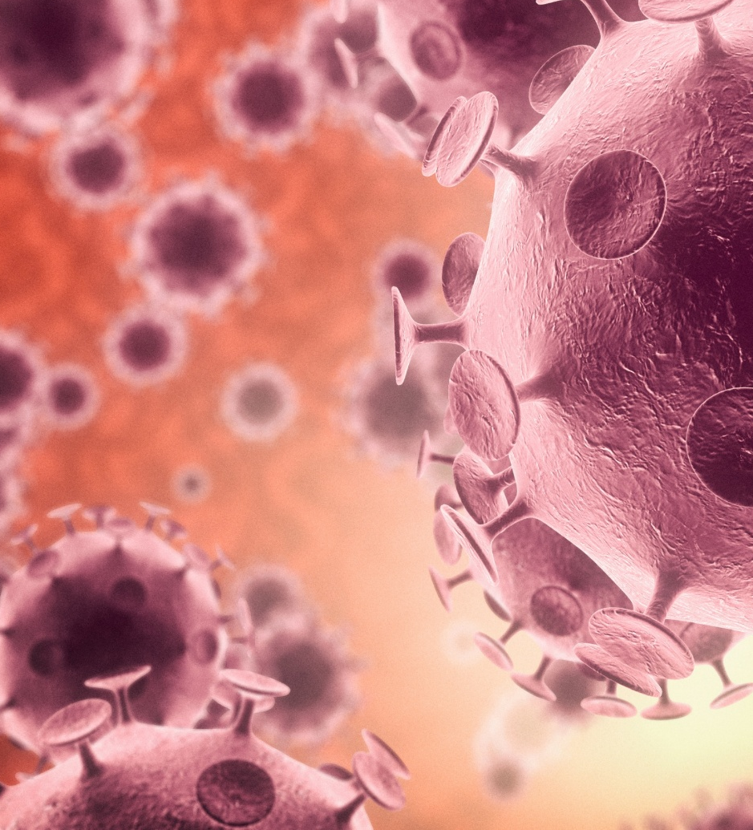


Common Challenges
Hygienic
Requirements
Energy
Efficiency
High-Accuracy
Humidification
The Problem
Hospitals require humidification systems that meet the highest hygiene standards — equivalent to or exceeding those of traditional steam — to prevent infections, protect sensitive laboratory samples, and safeguard both patients and equipment from contamination.
The Problem
A key driver across multiple projects was reducing energy consumption by moving away from traditional isothermal steam humidification toward adiabatic alternatives, while balancing this with indoor air quality standards such as ASHRAE 62.1 and 90.1, including achieving low pressure drops across systems.
The Problem
Specialized environments such as cancer research laboratories and patient recovery rooms demand precise, stable humidity control — typically within a defined range such as 40–60% RH — supported by durable, reliable systems with minimal downtime.
We have a solution for this… the Condair DL Hybrid Humidifier

Slide 5

Hygienic
Requirements
The Problem
Hospitals require humidification systems that meet the highest hygiene standards — equivalent to or exceeding those of traditional steam — to prevent infections, protect sensitive laboratory samples, and safeguard both patients and equipment from contamination.
The Solution
The Condair DL was repeatedly selected for healthcare environments due to its SGS Fresenius Hygiene Certificate and compliance with ASHRAE 170, providing hospitals with the assurance of a hygienic adiabatic solution that meets the stringent standards previously associated only with steam humidification — including in critical applications where infection control is non-negotiable.

Slide 6

^{Memorial Sloan Kettering}
^{New York, NY, US}
Memorial Sloan Kettering Cancer Centre is the largest and longest-established private cancer centre in the world and its origins date back to 1884.
Located in New York‘s Manhattan borough on the Upper East Side, the building has 22 floors totalling 72,000 m² of floor space.

Slide 7
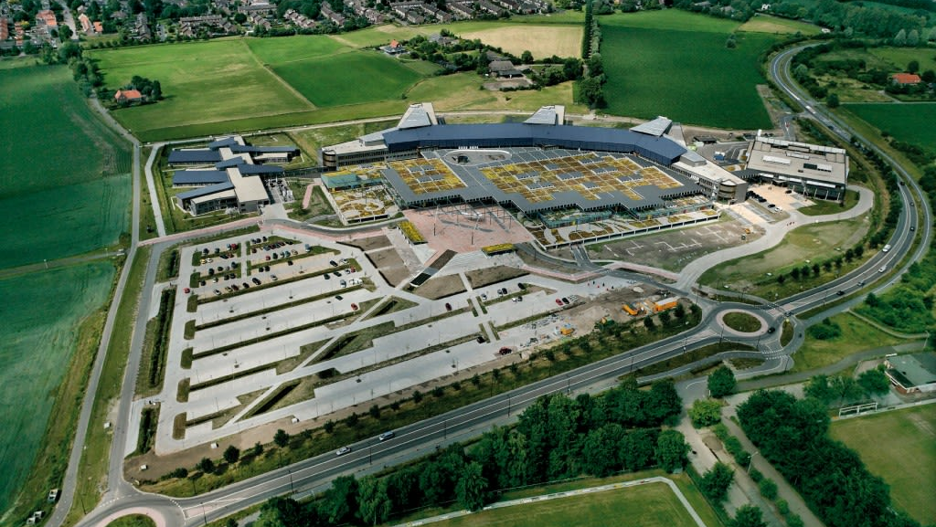
^{Deventer Hospital}
^{Deventer, NL}
The hospital has a large focus on innovation and continuous improvement in healthcare services, offering a wide range of medical specialties, including surgery, internal medicine and emergency care.
Humidification loads were between 44-176 lb/hr (20-80 kg/hr) and could take advantage of waste heat from heat pump systems.

Slide 8
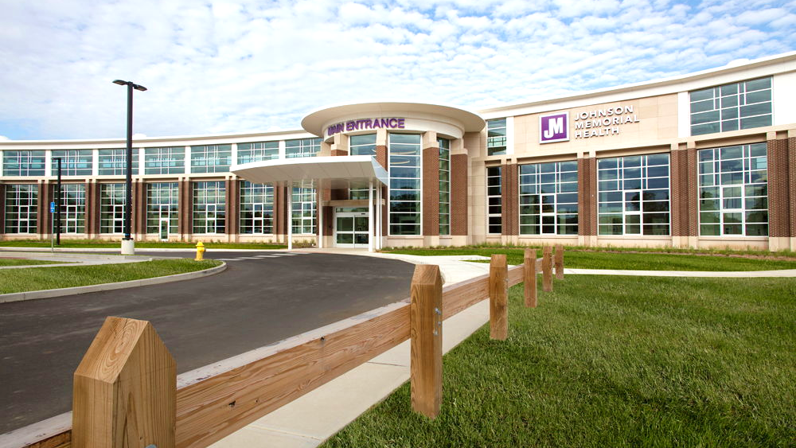
Johnson Memorial Hospital, Behavioral Health Center
^{Franklin, IN, US}
The hospital is a new behavioral health care center on the west side of the main hospital campus featuring 29 in-patient beds and providing mental health services to adults.
This will be only the second nonprofit inpatient behavioral health facility in the United States.
The customer wanted to move away from steam humidification and explore Condair’s adiabatic technology.

Slide 9
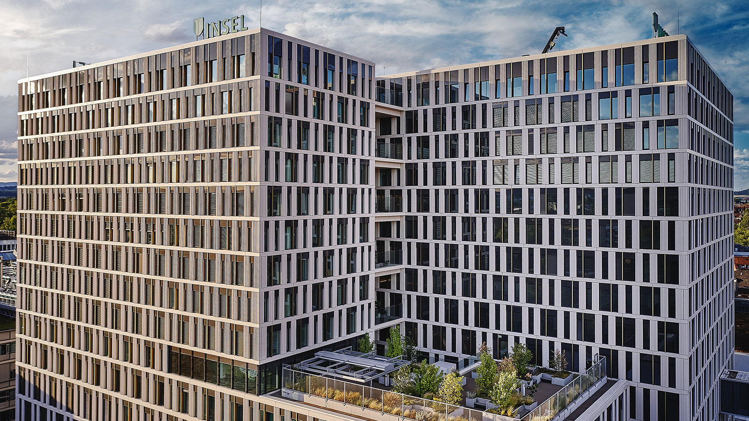
^{Inselspital}
^{Bern, Switzerland}
University Hospital in the capital city of Switzerland.
As a university hospital, the Inselspital occupies an important position in the Swiss healthcare system.
DL systems: 6
Total load sizing: 1’651 kg/h

Slide 10
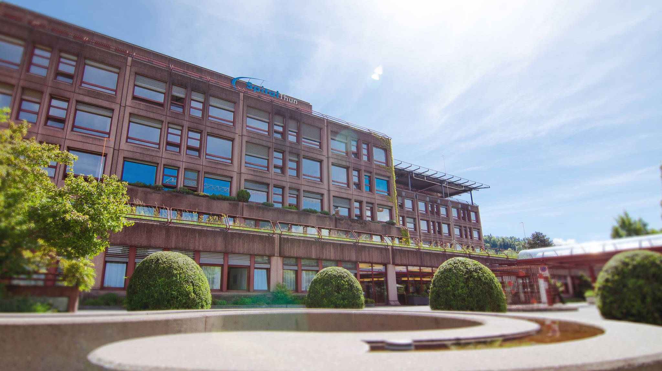
^{Spital STS Thun AG}
^{Thun, Switzerland}
A modern hospital center featuring advanced equipment with complete digitization including centralized digital control, 3D and 4K imaging, automated documentation, and video conferencing capabilities.
DL systems: 3
Total load sizing: 54 kg/h

Slide 11
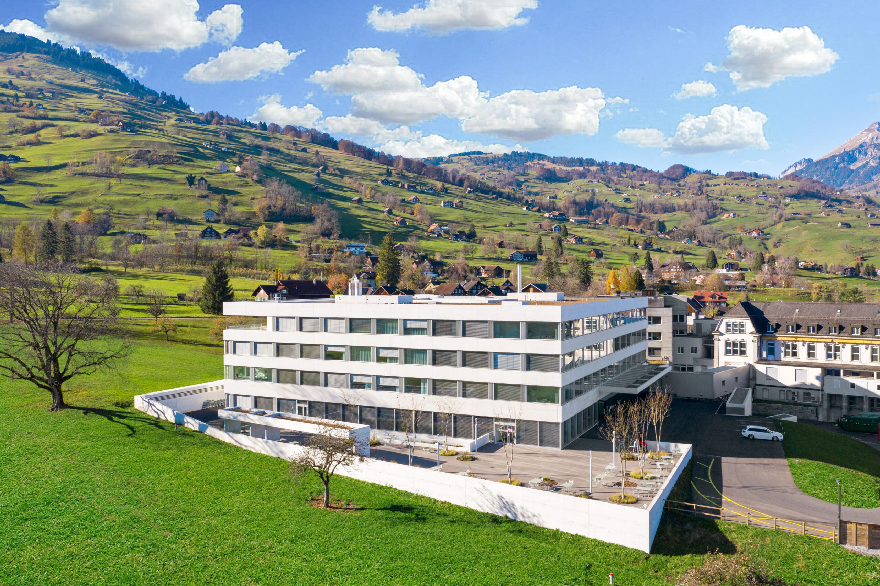
HOCH Health Ostschweiz – Spital Grabs
^{Grabs, Switzerland}
A modern acute-care facility featuring contemporary room infrastructure with advanced imaging and diagnostic capabilities.
As part of the HOCH Health network, the facility provides specialized services supported by direct access to the Kantonsspital St. Gallen's academic resources and interdisciplinary expertise for complex patient cases.
DL systems: 1
Total load sizing: 21 kg/h

Slide 12

Energy
Efficiency
The Problem
Hospitals require humidification systems that meet the highest hygiene standards — equivalent to or exceeding those of traditional steam — to prevent infections, protect sensitive laboratory samples, and safeguard both patients and equipment from contamination.
The Solution
The Condair DL was repeatedly selected for healthcare environments due to its SGS Fresenius Hygiene Certificate and compliance with ASHRAE 170, providing hospitals with the assurance of a hygienic adiabatic solution that meets the stringent standards previously associated only with steam humidification — including in critical applications where infection control is non-negotiable.

Slide 13
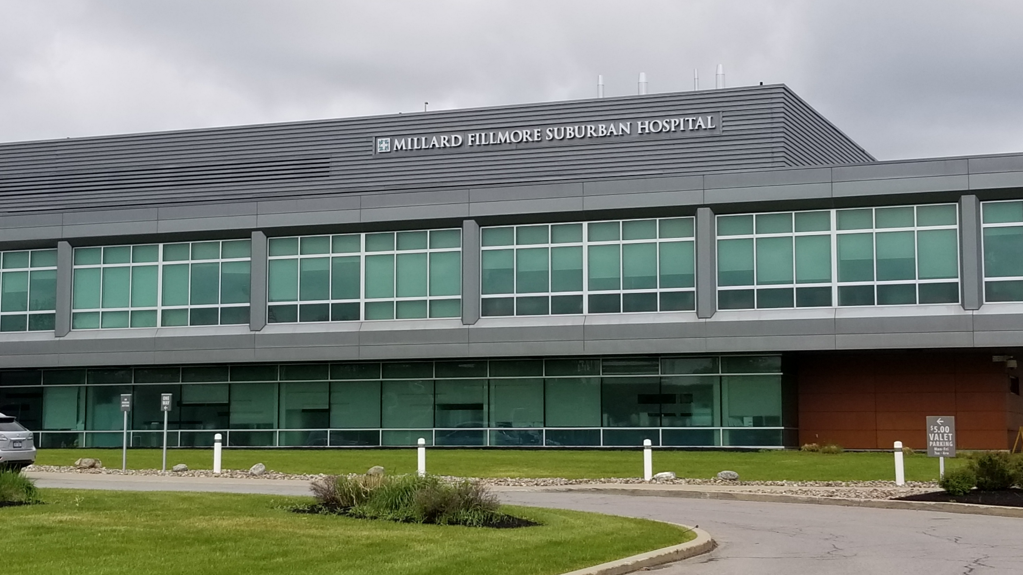
Millard Fillmore Suburban Hospital
^{Buffalo, NY, US}
The hospital is a 265-bed, acute care hospital offering services in cardiology, emergency medicine, gynecology and obstetrics, GI, neonatology, oncology, orthopedics, urology and vascular procedures.

Slide 14
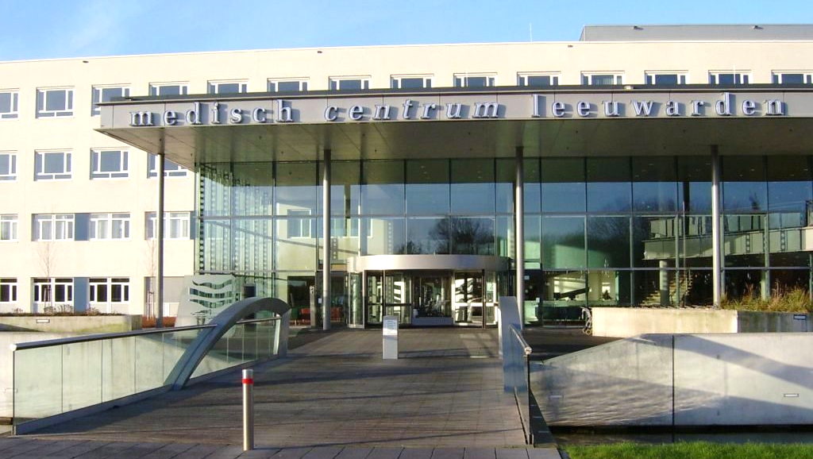
^{Medical Center Leeuwarden}
^{Leeuwarden, NL}
Medical Center Leeuwarden (MCL) is a top-clinical hospital for acute, complex and basic healthcare.
Neonatal suites are in the maternity ward and available for when a newborn requires additional observation, treatment, and/or care.
DL systems: 1
Total load sizing: 33 kg/h

Slide 15
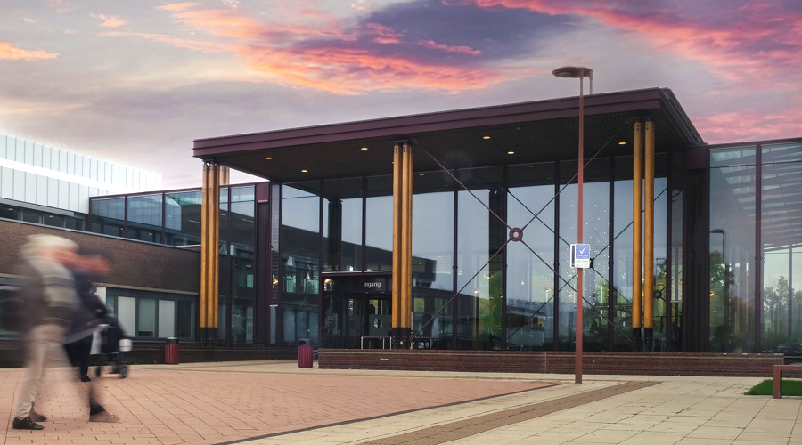
^{VieCuri Medical Center}
^{Venlo, NL}
VieCuri Medical Center is a top clinical hospital, affiliated with the Collaborating Top Clinical Hospitals, and provides both basic and complex care.
They also play a role in both training and scientific research.
DL systems: 3
Total load sizing: 89 kg/h

Slide 16
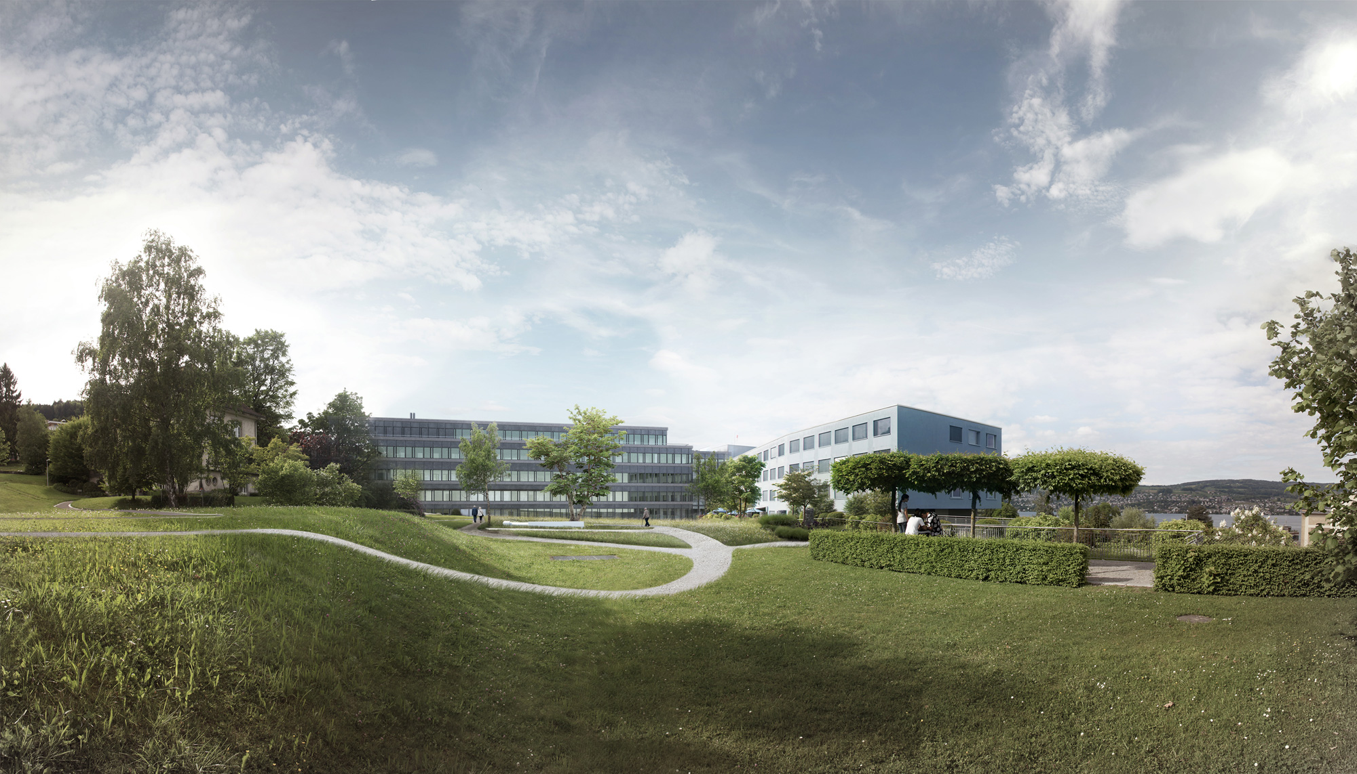
^{See-Spital Neo}
^{Horgen, Switzerland}
An advanced facility featuring the robot-assisted Da Vinci operative system alongside modern intensive care units and state-of-the-art anesthesiology services.
This cutting-edge hospital center enhances See-Spital's capacity for complex procedures across multiple specialties.
DL systems: 3
Total load sizing: 37 kg/h

Slide 17
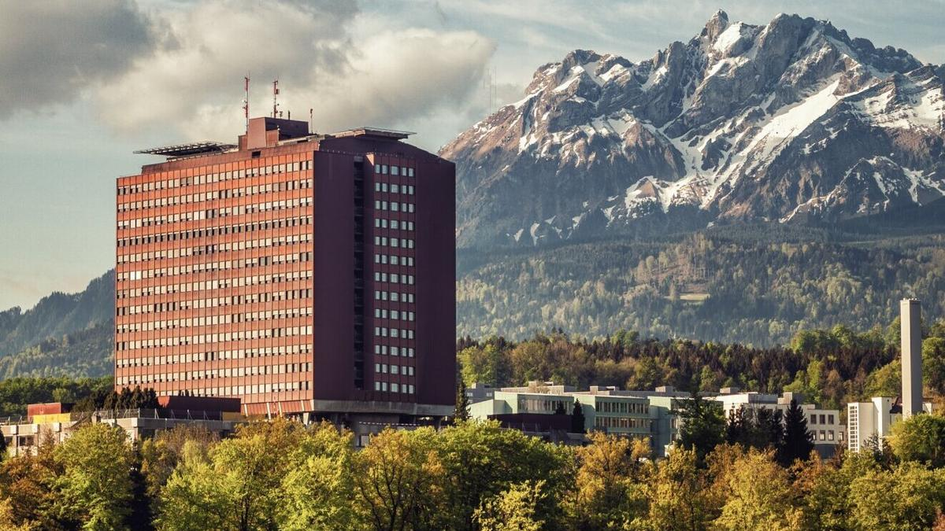
^{Kantonsspital LUKS}
^{Lucerne, Switzerland}
One of Switzerland's largest academic hospital centers combining state-of-the-art imaging technology with modern anesthesiology and intensive care infrastructure.
DL systems: 1
Total load sizing: 43 kg/h

Slide 18

High-Accuracy
Humidification
The Problem
Hospitals require humidification systems that meet the highest hygiene standards — equivalent to or exceeding those of traditional steam — to prevent infections, protect sensitive laboratory samples, and safeguard both patients and equipment from contamination.
The Solution
The Condair DL was repeatedly selected for healthcare environments due to its SGS Fresenius Hygiene Certificate and compliance with ASHRAE 170, providing hospitals with the assurance of a hygienic adiabatic solution that meets the stringent standards previously associated only with steam humidification — including in critical applications where infection control is non-negotiable.

Slide 19
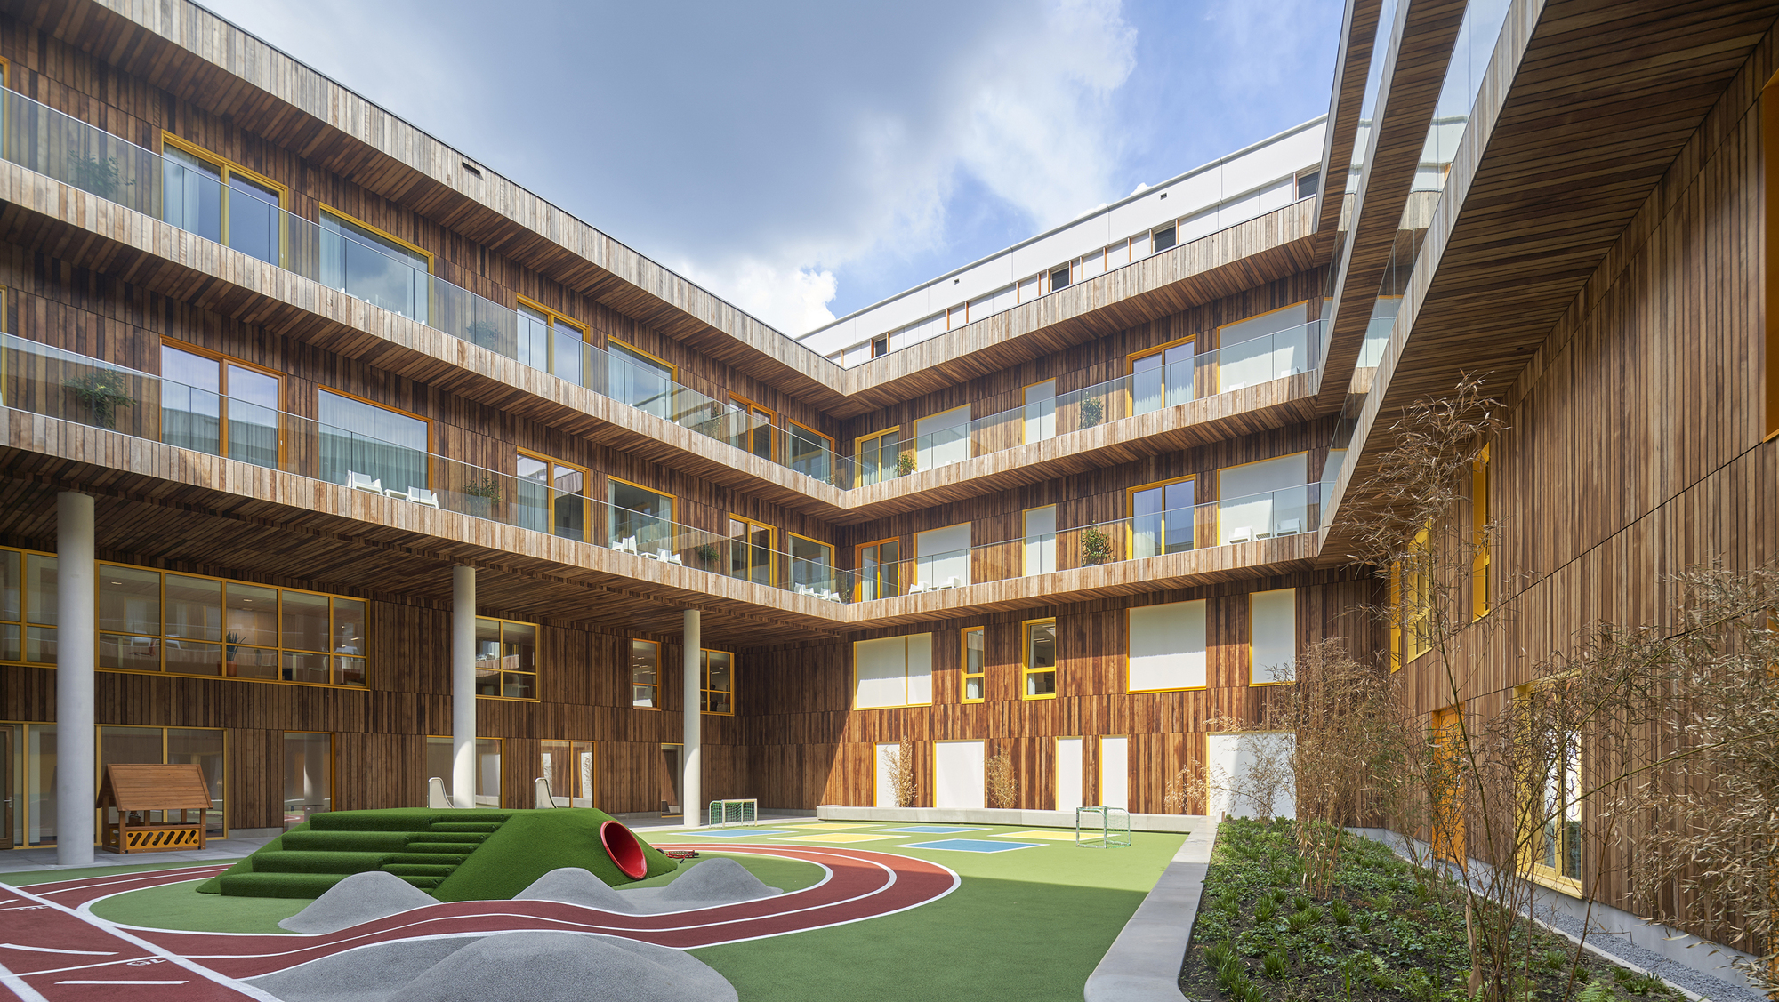
Princess Máxima Center for Pediatric Oncology
^{Utrecht, NL}
The center is a unique hospital that brings together complex care, innovative research, as well as a learning academy.
There are more than 30 independent research groups working within the science division; performing pre-clinical and clinical research on childhood cancer.
DL systems: 1
Total load sizing: 77 kg/h

Slide 20
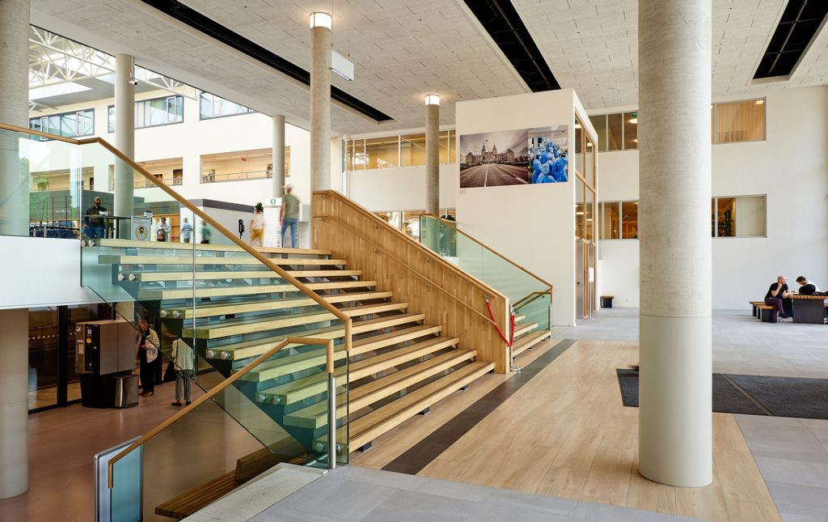
^{OLVG}
^{Amsterdam, NL}
Founded in 1898, OLVG is a major clinical city hospital that also functions as an educational hospital.
Load Sizing: 2 AHUs at 188 kg/h (AHU: 45000 m3/h, 2448 x 2448 mm)
DL systems: 2
Total load sizing: 188 kg/h

Slide 21
SPOTLIGHT
DL Hybrid Humidifier
in Hospitals
Thank you to all the contributors!
For more information on DL in Hospital Applications, contact:
Marlee.Spiegelberg@condair.com
Vithursha.Pasupathy@condair.com

